Slide 1
Lifetime estimation from RHIC Au+Au data
arXiv:1811.09990
T. Csörgő and G. Kasza
XIV. WPCF and Balaton Workshop
June 2019, Dubna and Tihany

Slide 2
Outline
New, exact solution of relativistic perfect fluid hydro (Csörgő-Kasza-Csanád-Jiang: CKCJ)
Observables – dN/dη, dN/dy, R_{L}
Beauty of hydro: useful formulae
Fit results
Observables Inverse slope fits
dN/dη fits
R_{L} fits
Power of analytic hydro: initial energy densities (ε₀)

Slide 3
Perfect fluid hydrodynamics
Conservation of four-momentum:
Energy-momentum tensor (perfect fluid):
Continuity equation:
Equation of state (EoS): closes the equation system
Typically: ε = κ(T) p, T dependent speed of sound
In this work κ = const(T): the speed of sound (c_{s}) is replaced by its average value

Slide 4
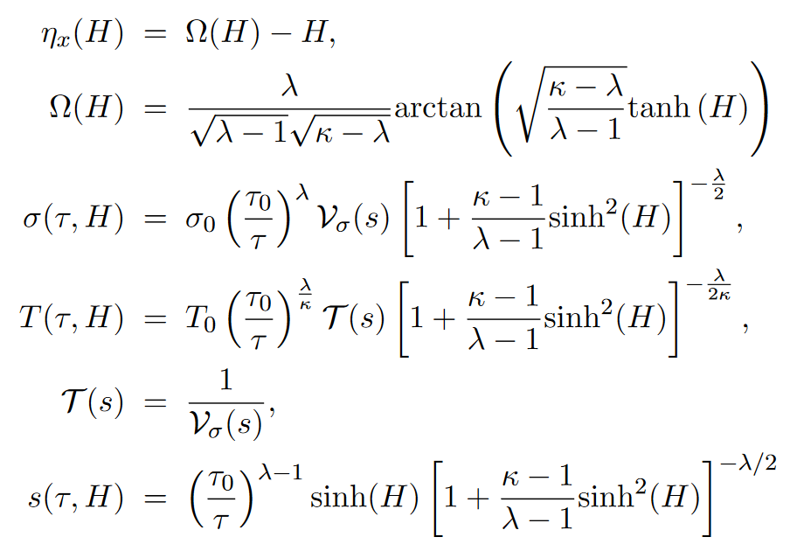
New, exact solutions of perfect fluid
Rindler coordinates
Velocity field:
1+1d, parametric exact solution
If κ→1 limit: CNC):
Csörgő, Kasza, Csanád, Jiang: arXiv:1805.01427
arXiv:1806.06794
Csörgő, Nagy, Csanád solution
arXiv:0709.3677
λ: acceleration parameter
accelerating solution
arXiv:1805.01427
arXiv:1806.06794

Slide 5
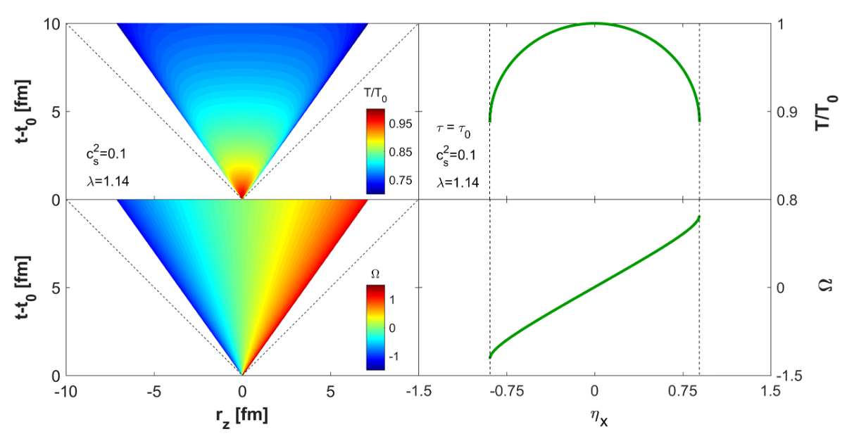
New, exact solutions of perfect fluid
Rindler coordinates
Velocity field:
1+1d, parametric exact solution
If κ→1 limit: CNC):
Csörgő, Kasza, Csanád, Jiang: arXiv:1805.01427
arXiv:1806.06794
Csörgő, Nagy, Csanád solution
arXiv:0709.3677
λ: acceleration parameter
accelerating solution
arXiv:1805.01427
arXiv:1806.06794

Slide 6
Pseudorapidity density
Rapidity density (embedded to 1+3 d space):
Lorentzian average p_{T} as a function of y:
Pseudorapidity density: parametric curve
Four fit parameters: κ, λ, T_{eff} , dN/dy|_{y=0}
T_{eff}: effective temperature
arXiv:1805.01427
arXiv:1806.06794

Slide 7
Rapidity density
Rapidity density: depends on 4 hydro parameters (κ, λ, T_{eff} , dN/dy|_{y=0})
Near midrapidity, in leading order: a Gaussian
From 4 hydro parameters (κ, λ, <N>, T_{eff})
→ only 2 fit parameters (<N>, Δy)
Beautiful example of hydrodynamical scaling behaviour!
Gaussian width:
Midrapidity density:

Slide 8
Pseudorapidity density
Pseudorapidity density: parametric curve (κ, λ, T_{eff} , dN/dy|_{y=0})
Near midrapidity, up to leading order
Midrapidity density:
From 4 hydro parameters (κ, λ, <N>, T_{eff})
→ 3 fit parameters (D, <N>, Δy)
Beautiful example of hydrodynamical scaling behaviour!
Depression parameter:
Gaussian width:

Slide 9
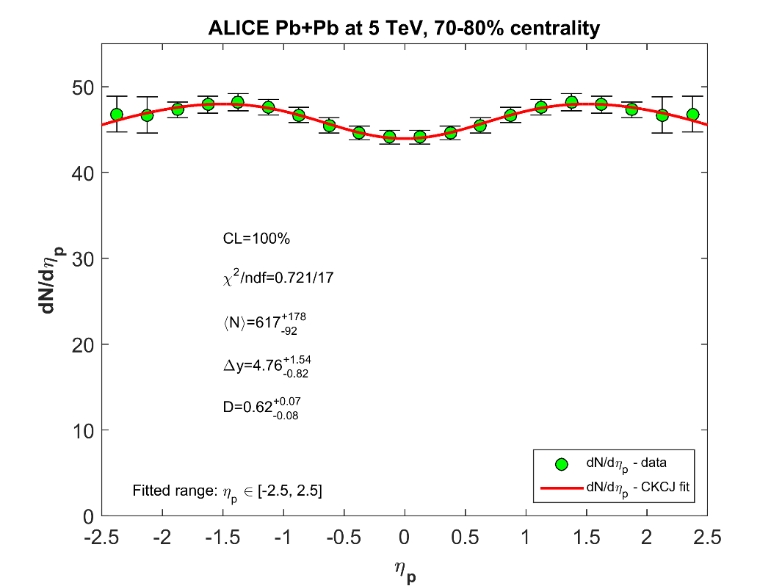
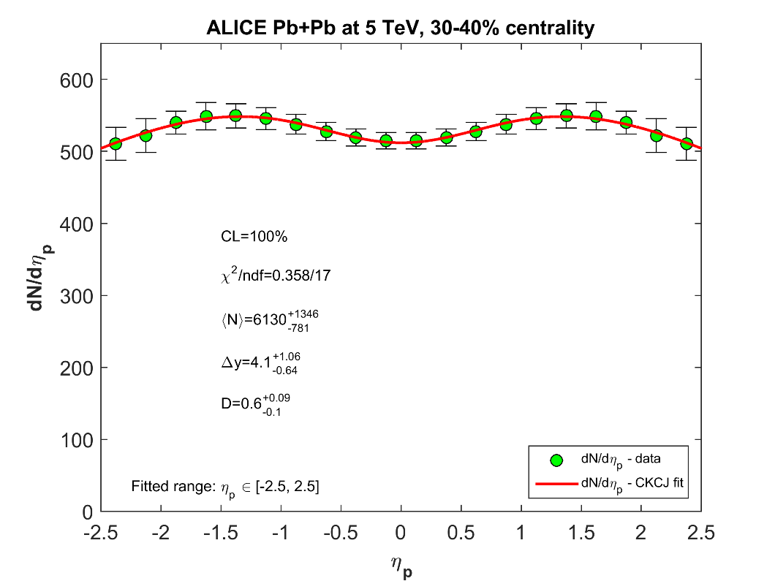
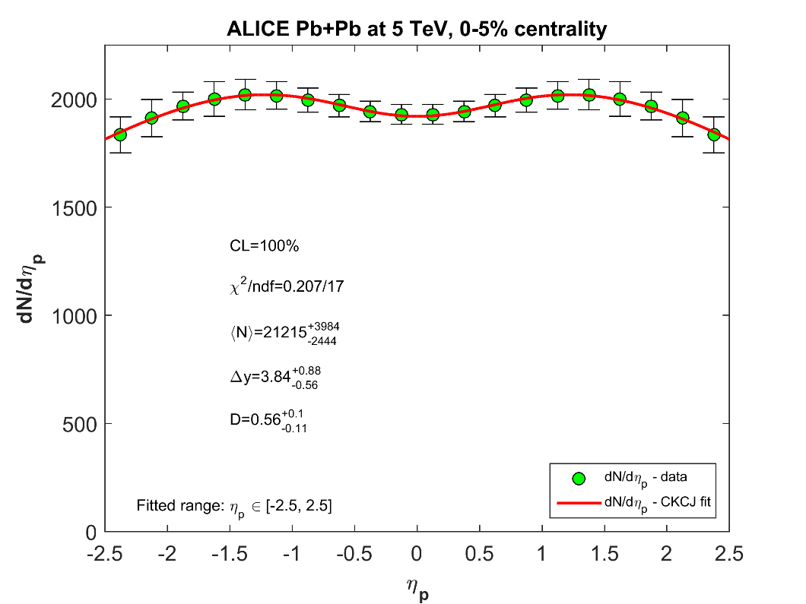
ALICE Pb+Pb data at 5 TeV

Slide 10
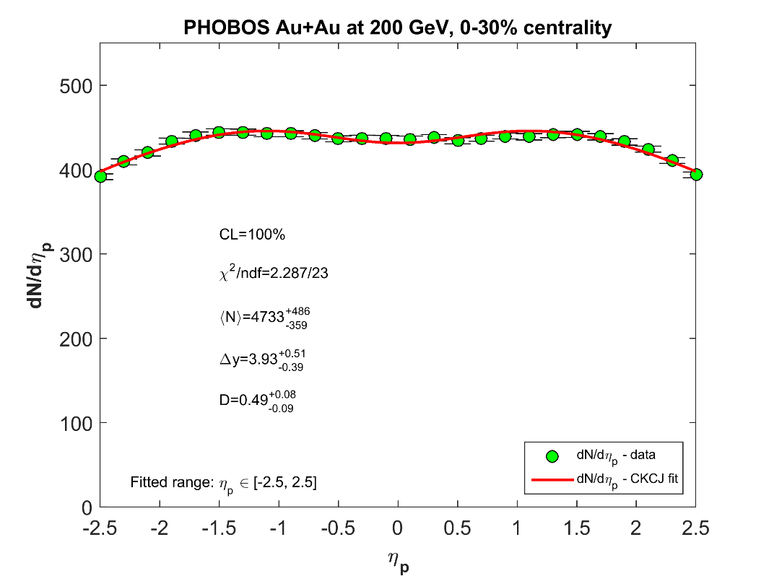
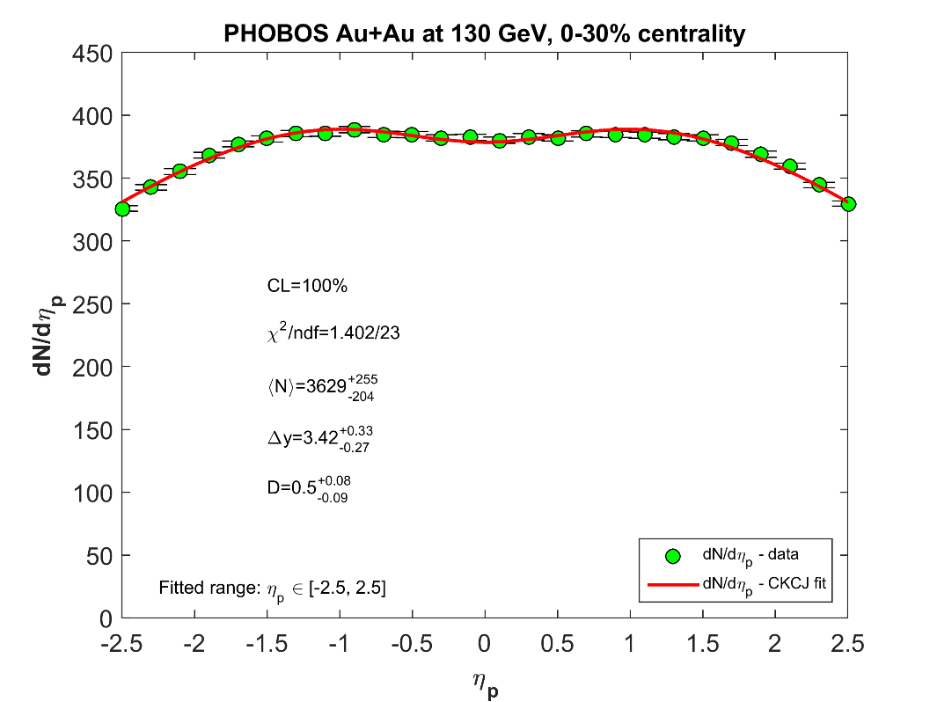
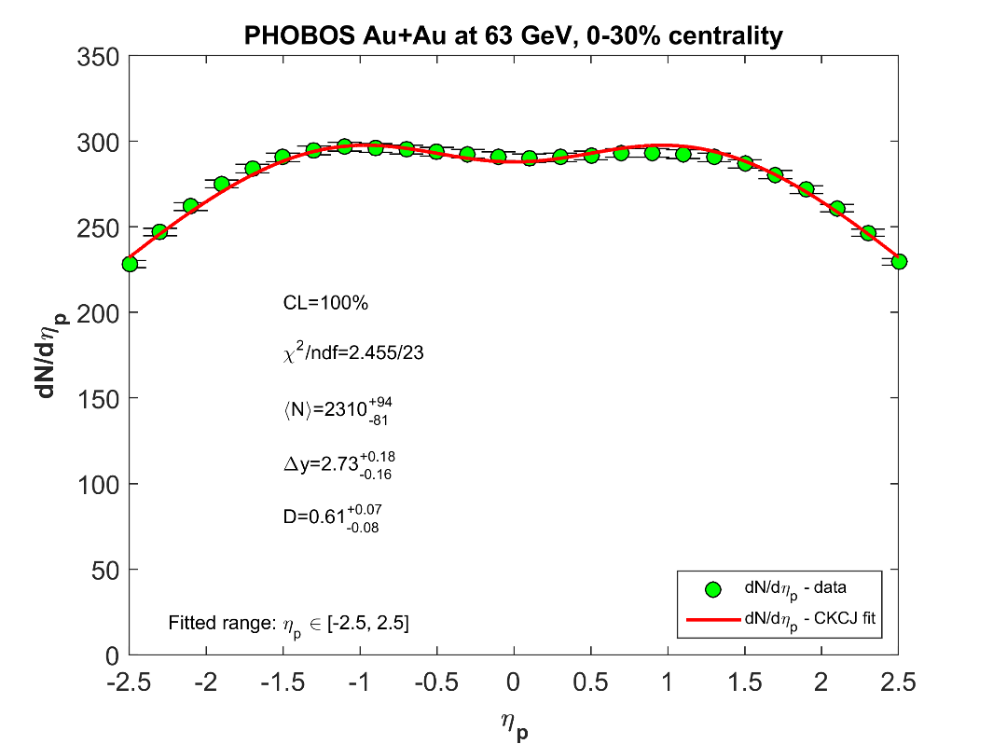
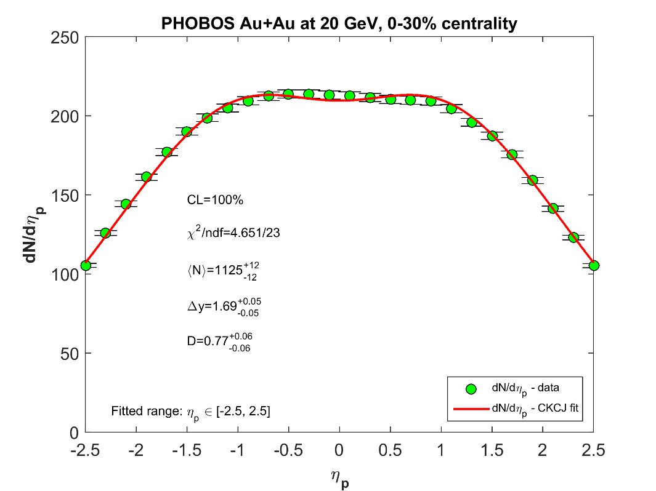
Fits at RHIC, √s_{NN}= 20-200 GeV
Powerful 3-parameter hydro formula. CL „too good”

Slide 11
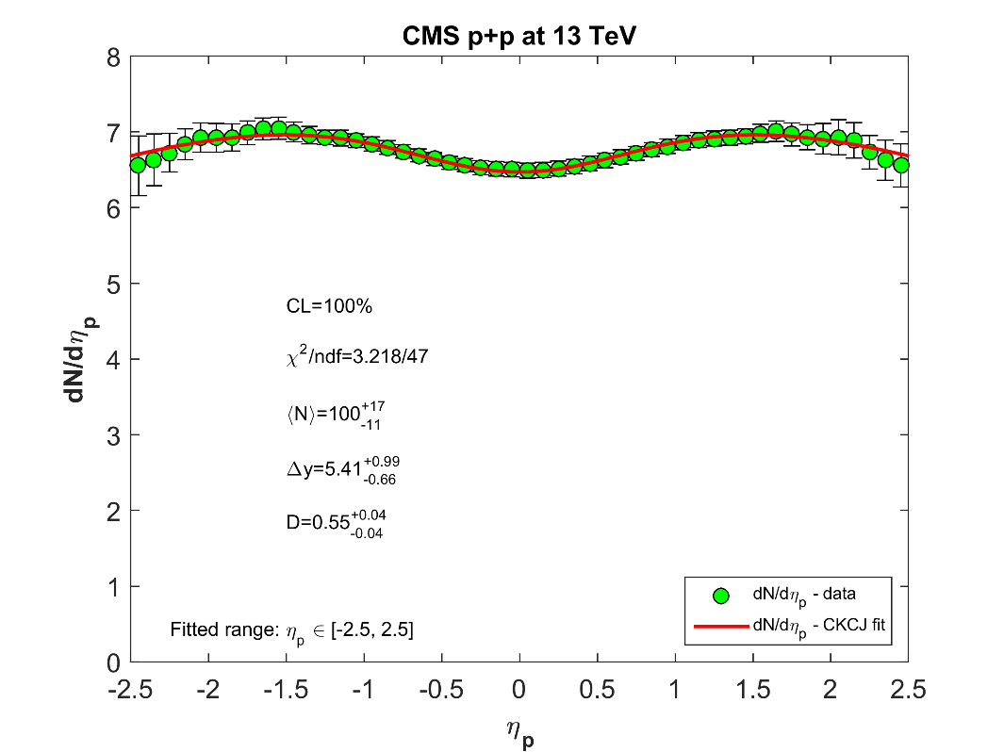
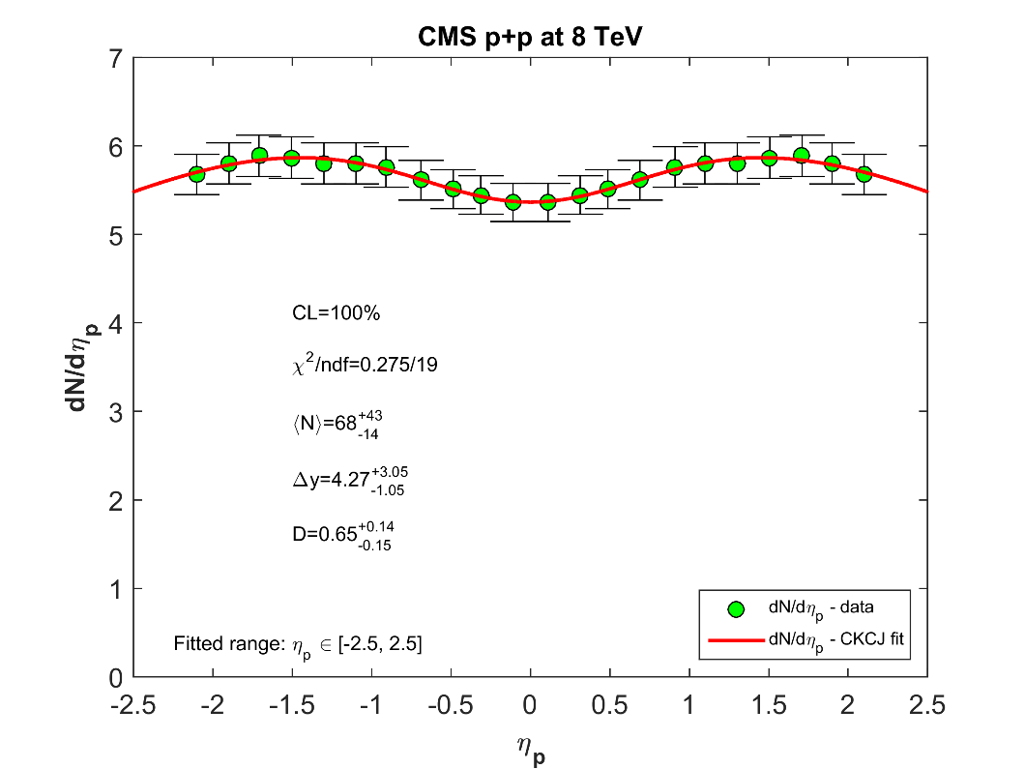
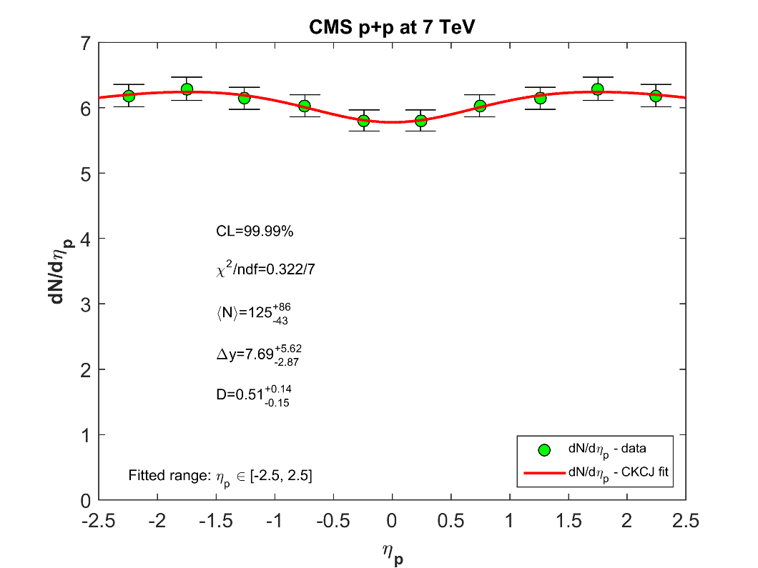
CMS p+p dn/dη fits, 7, 8, 13 TeV

Slide 12
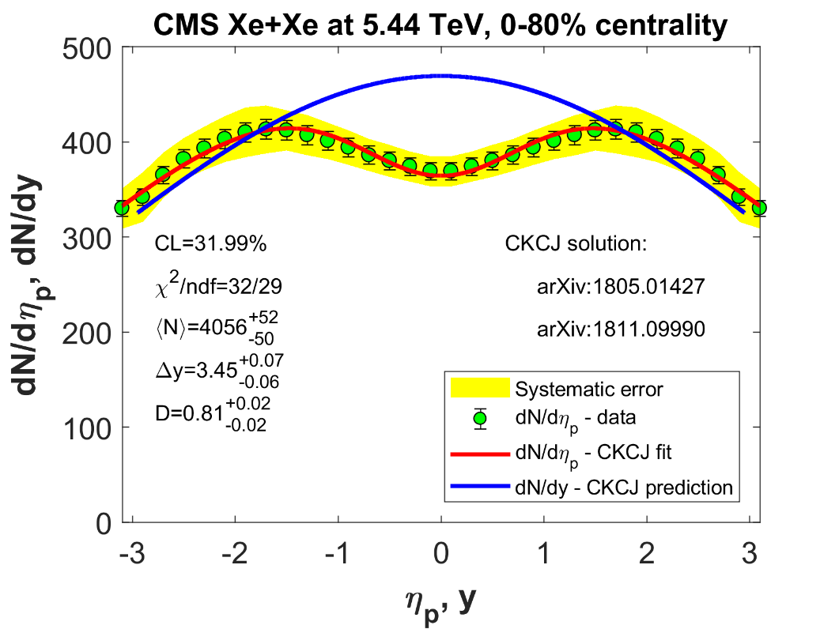
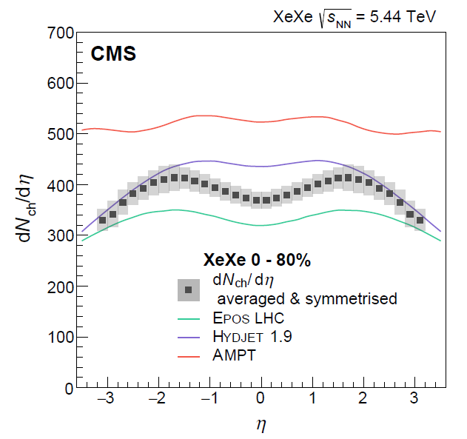
CMS Xe+Xe data, 5.44 TeV
arXiv:1902.03603

Slide 13
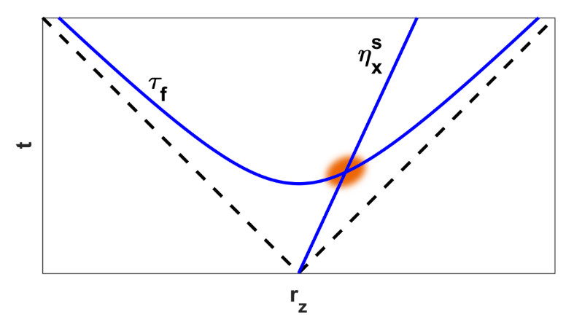
Observables – HBT R_{L}
For a 1+1 d relativistic source (LCMS):
(η_{x}^{s}, τ_{f}) saddle point:
hep-ph/9411307

Slide 14
Observables – HBT R_{L}
For a 1+1 d relativistic source (LCMS):
(η_{x}^{s}, τ_{f}) saddle point
CKCJ solutions are limited to a narrow rapidity interval around η_{x}≈0
At midrapidity:
Δη_{x}: gaussian width of rapidity distribution
hep-ph/9411307

Slide 15
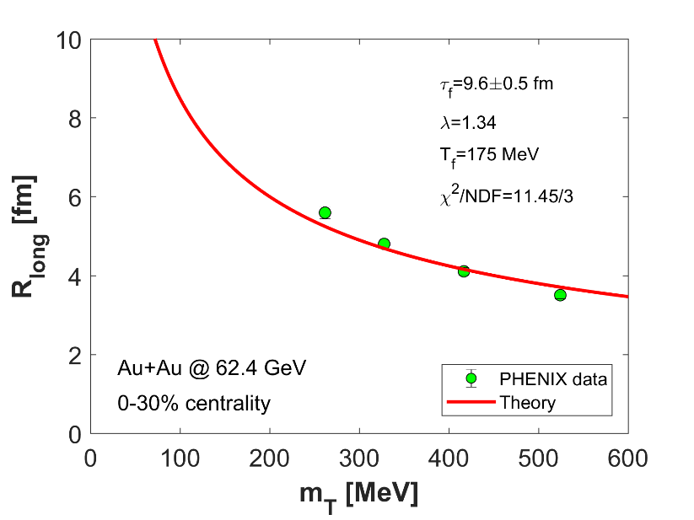
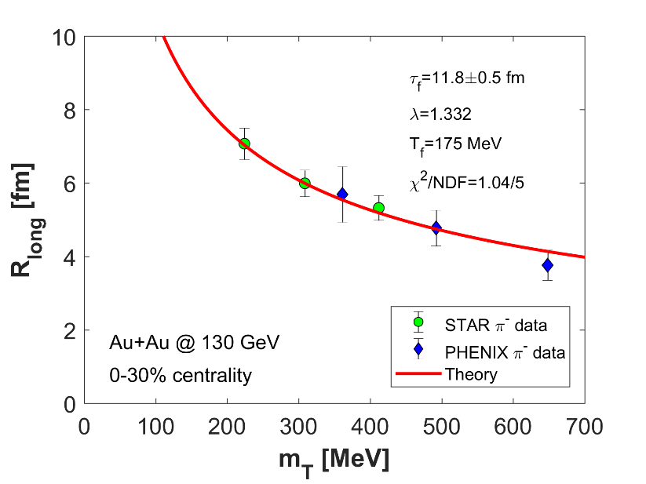
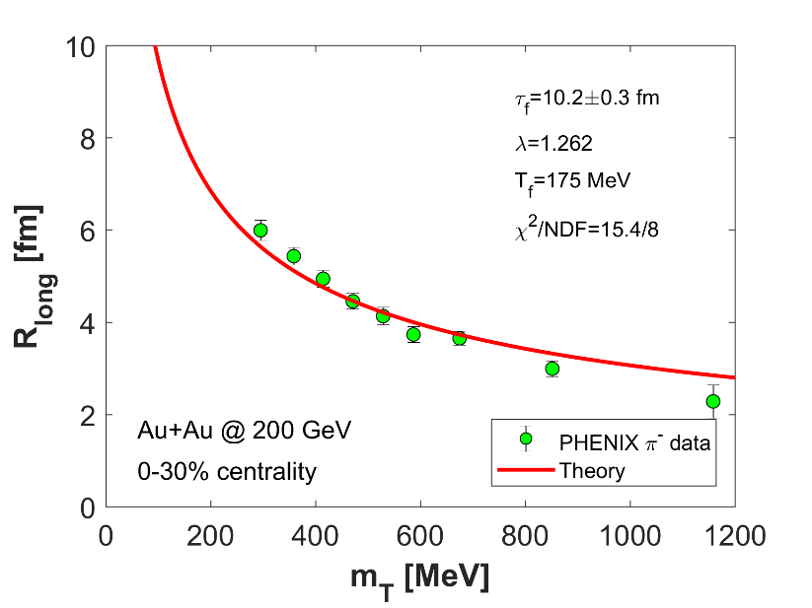
HBT R_{L} fits
Fitted to PHENIX and STAR R_{L} data
From fits to dN/dη: λ, T_{eff} are known
τ_{f} is the only fit parameter
arXiv:1811.09990
arXiv:1403.4972
arXiv:nucl-ex/0201008
arXiv:nucl-ex/0401003

Slide 16
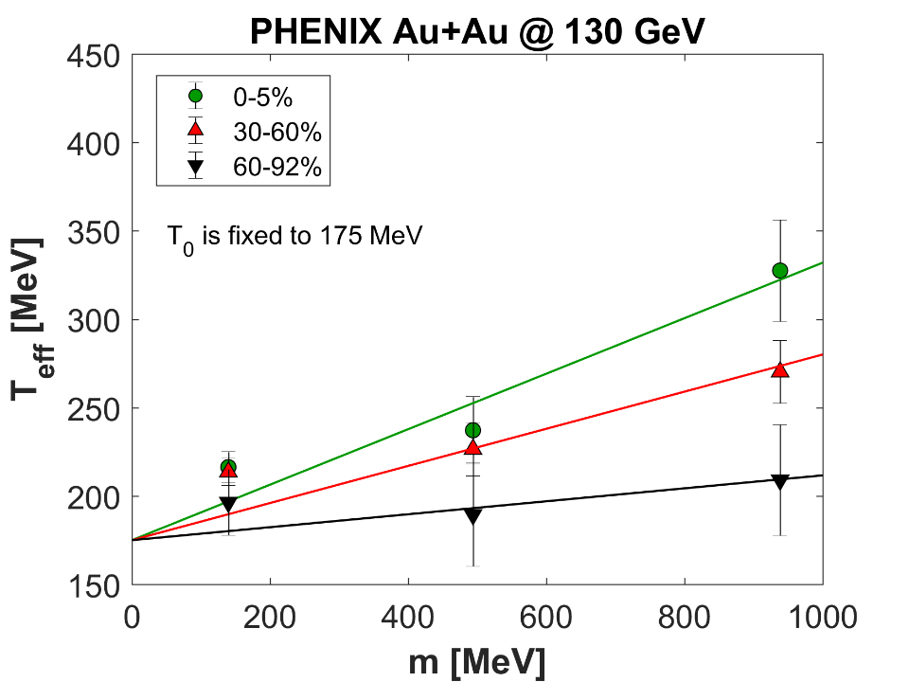
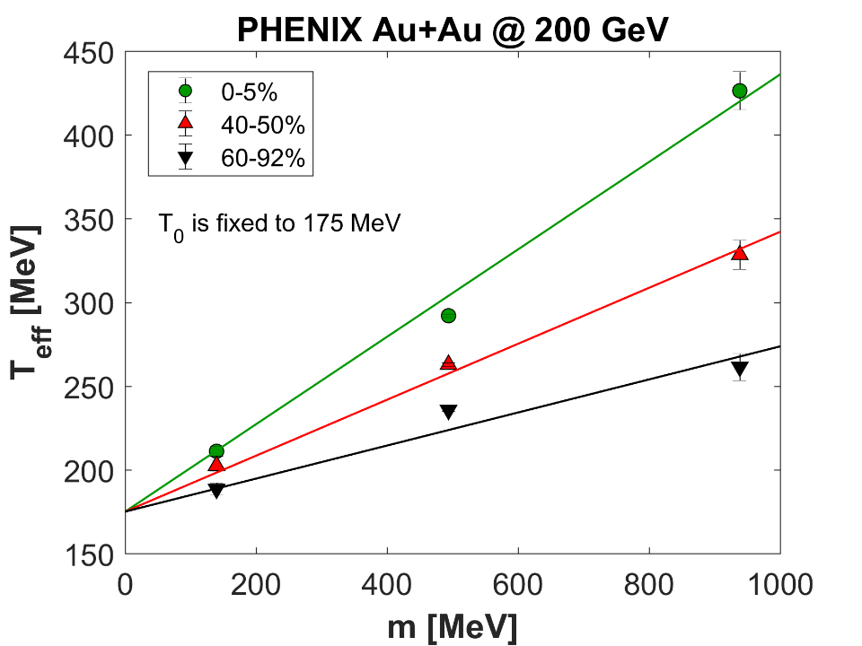
Inverse slope fits
Effective temperature: need centrality dependence
Linear model is fitted to m₀ vs T_{eff} PHENIX data (130 and 200 GeV)
T_{f} is fixed, independent from centrality
arXiv:1801.05716
arXiv:1811.09990

Slide 17
Inverse slope fits
Effective temperature: need centrality dependence
Linear model is fitted to m₀ vs T_{eff} PHENIX data (130 and 200 GeV)
If m₀ vs T_{eff} data is not available (62.4 GeV):
fit to p_{T} spectra or…
T_{eff} can be obtained by dN/dη fits
we chose this

Slide 18
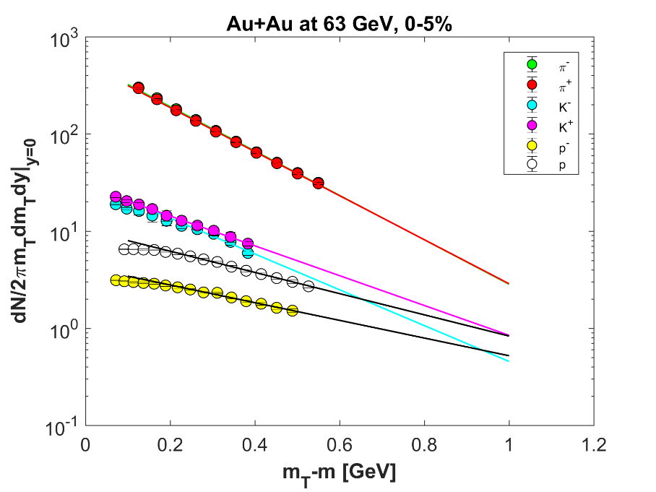
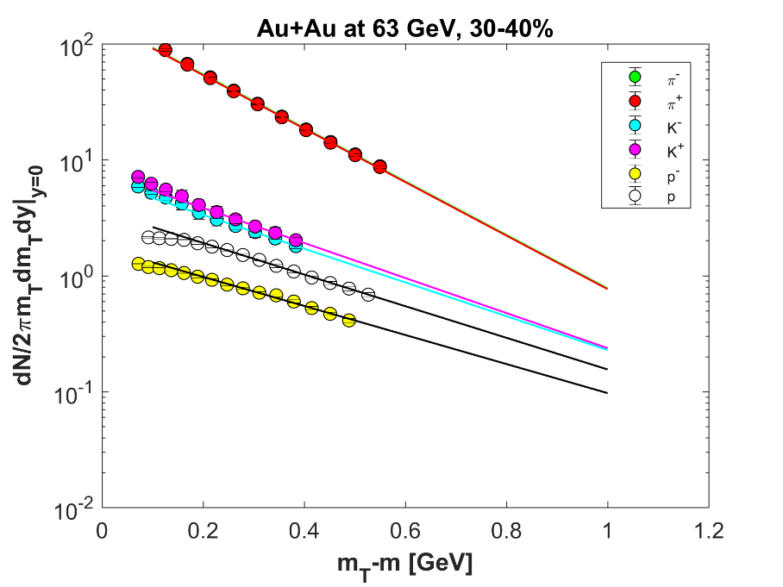
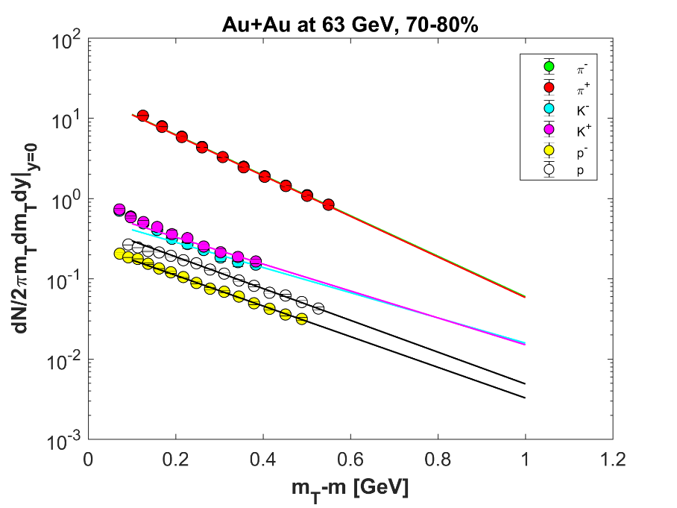
Inverse slope fits
Effective temperature: need centrality dependence
Linear model is fitted to m₀ vs T_{eff} PHENIX data (130 and 200 GeV)
If m₀ vs T_{eff} data is not available (62.4 GeV):
Fit function was from:
arXiv:nucl-ex/0307022
arXiv:0808.2041

Slide 19
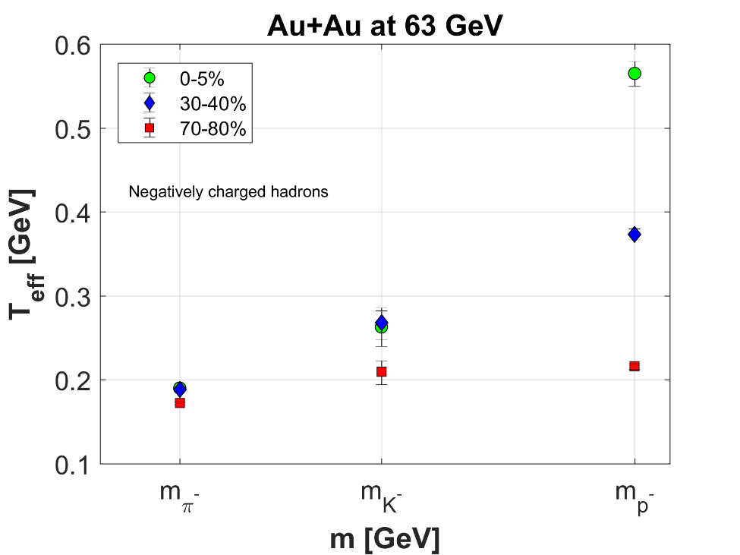
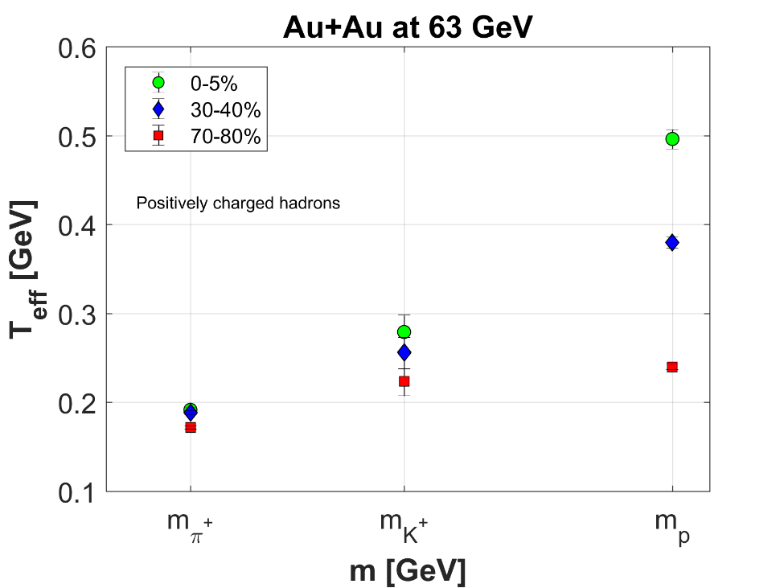
Inverse slope fits
Effective temperature: need centrality dependence
Linear model is fitted to m₀ vs T_{eff} PHENIX data (130 and 200 GeV)
If m₀ vs T_{eff} data is not available (62.4 GeV):

Slide 20
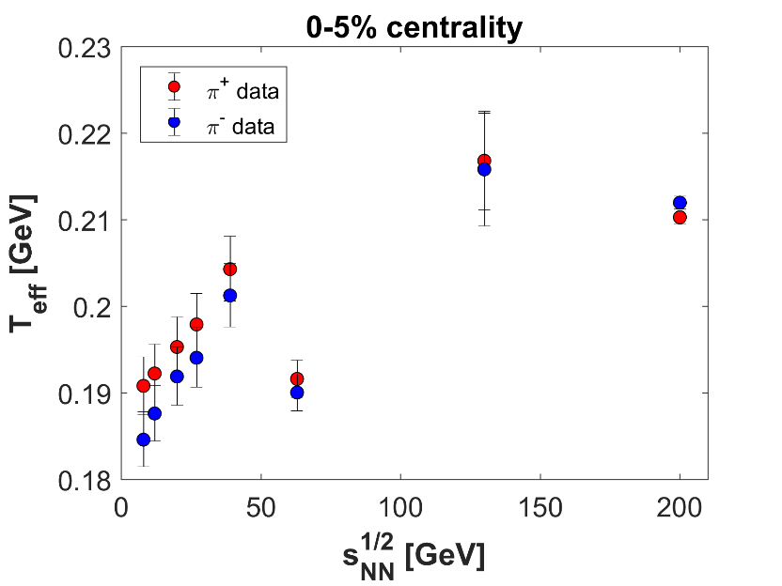
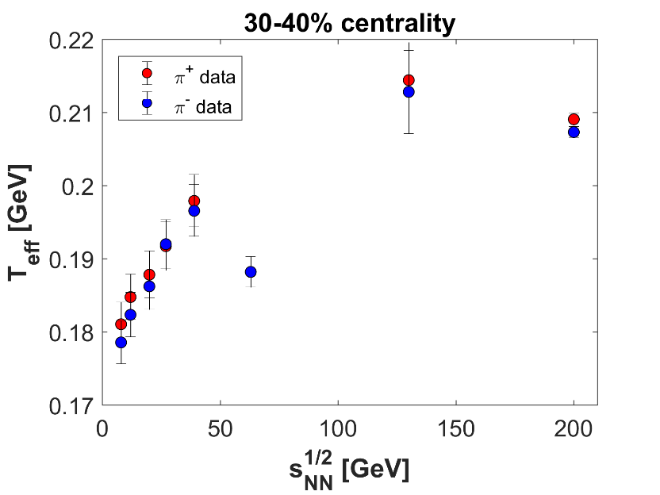
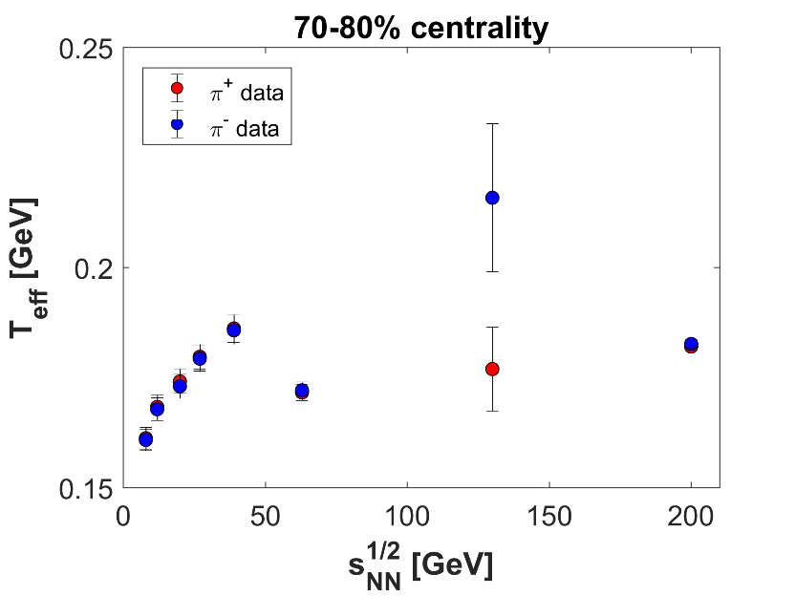
A new feature of STAR p_{T} spectras
The p_{T} spectras of pions are fitted at
7.7, 11.5, 19.6, 27, 39, 62.4, 130 and 200 GeV
Three different centrality class: 0-5%, 30-40%, 70-80%
Interesting behaviour of T_{eff}: local minimum at 62.4 GeV

Slide 21
Initial energy density
From the CKCJ solution ε₀ is exactly calculated:
λ→1 limit: EoS dependence is not vanishing, Bjorken’s formula can be reobtained only in the case of dust
The EoS dependent correction takes into account the work of the pressure
In λ=1 case, the EoS dependence was found first by Gorenstein, Sinyukov and Zhdanov (before Bjorken!)
Now, the fundamental correction to ε₀^{Bj} is also known
λ and τ_{f} are obtained by fits → τ₀ dependence
arXiv:1806.11309
Phys.Lett. 71B (1977) 199-202

Slide 22
Exact result of initial energy density
From the CKCJ solution ε₀ is exactly calculated:
λ→1 limit: EoS dependence is not vanishing, Bjorken’s formula can be reobtained only in the case of dust
The EoS dependent correction takes into account the work of the pressure
In λ=1 case, the EoS dependence was found first by Gorenstein, Sinyukov and Zhdanov (before Bjorken!)
Now, the fundamental correction to ε₀^{Bj} is also known
λ and τ_{f} are obtained by fits → τ₀ dependence
arXiv:1806.11309
Phys.Lett. 71B (1977) 199-202

Slide 23
Exact result of initial energy density
From the CKCJ solution ε₀ is exactly calculated:
λ→1 limit: EoS dependence is not vanishing, Bjorken’s formula can be reobtained only in the case of dust
The EoS dependent correction takes into account the work of the pressure
In λ=1 case, the EoS dependence was found first by Gorenstein, Sinyukov and Zhdanov (before Bjorken!)
Now, the fundamental correction to ε₀^{Bj} is also known
λ and τ_{f} are obtained by fits → τ₀ dependence
arXiv:1806.11309
Phys.Lett. 71B (1977) 199-202
Bjorken’s formula can be applied only for order of magnitude estimations!

Slide 24
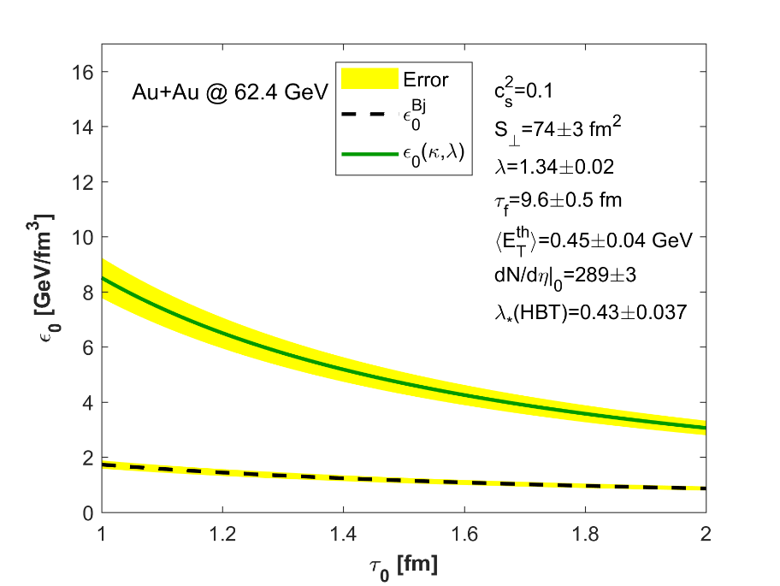
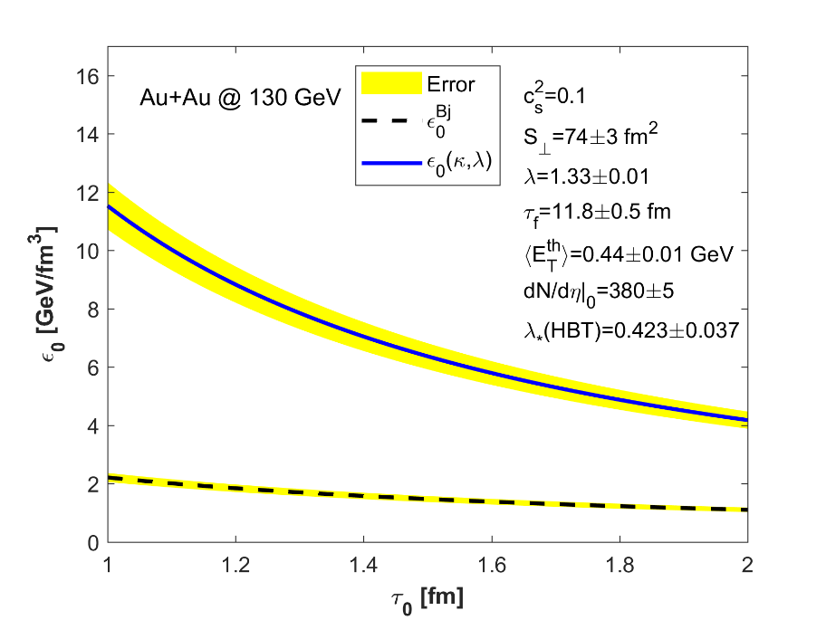
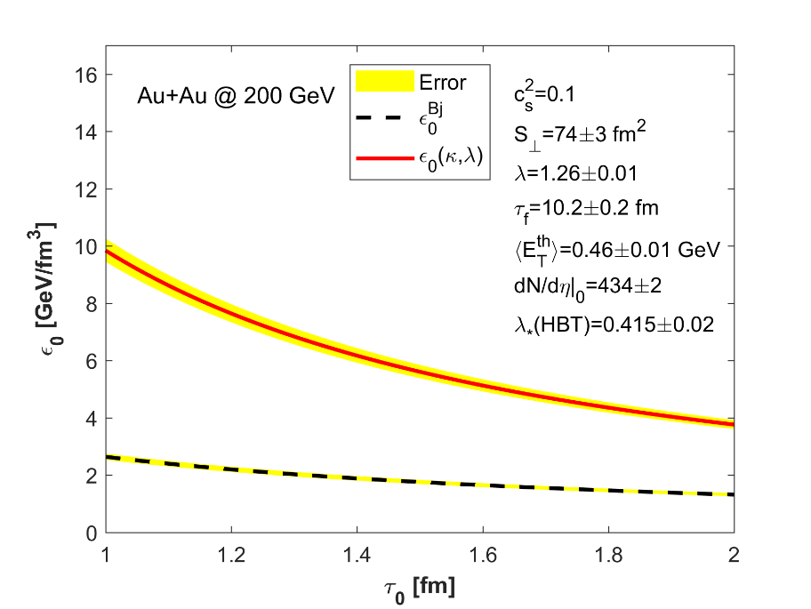
Initial energy densities
Only the thermalized energy is included
Indication for an increasing initial energy density with decreasing colliding energy?
Suggest a non-monotonic behaviour of the initial energy density with $\sqrt{s}$
arXiv:1811.09990

Slide 25
Exact result of initial energy density
Only the thermalized energy is included
Indication for an increasing initial energy density with decreasing colliding energy?
Suggest a non-monotonic behaviour of the initial energy density with $\sqrt{s}$
arXiv:1811.09990

Slide 26
Exact result of initial energy density
Only the thermalized energy is included
Indication for an increasing initial energy density with decreasing colliding energy?
Suggest a non-monotonic behaviour of the initial energy density with $\sqrt{s}$
arXiv:1811.09990

Slide 27
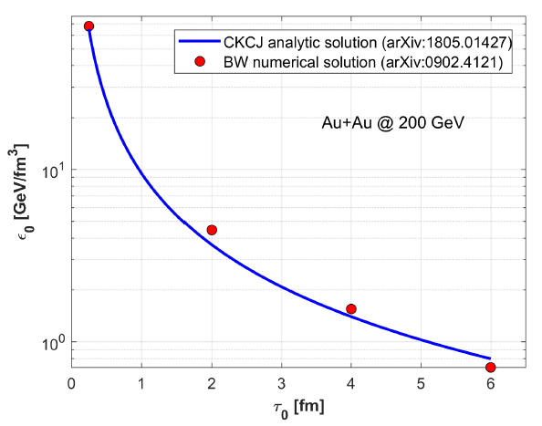
Cross-checks, initial energy density
Only the thermalized energy is included
Indication for an increasing initial energy density with decreasing colliding energy?
Suggest a non-monotonic behaviour of the initial energy density with $\sqrt{s}$
At LHC energies, our method predicts greater ε₀
Cross-check with 1+3 d numerical hydro, lQCD EoS:
Surprisingly good agreement in Au+Au 200 GeV!

Slide 28
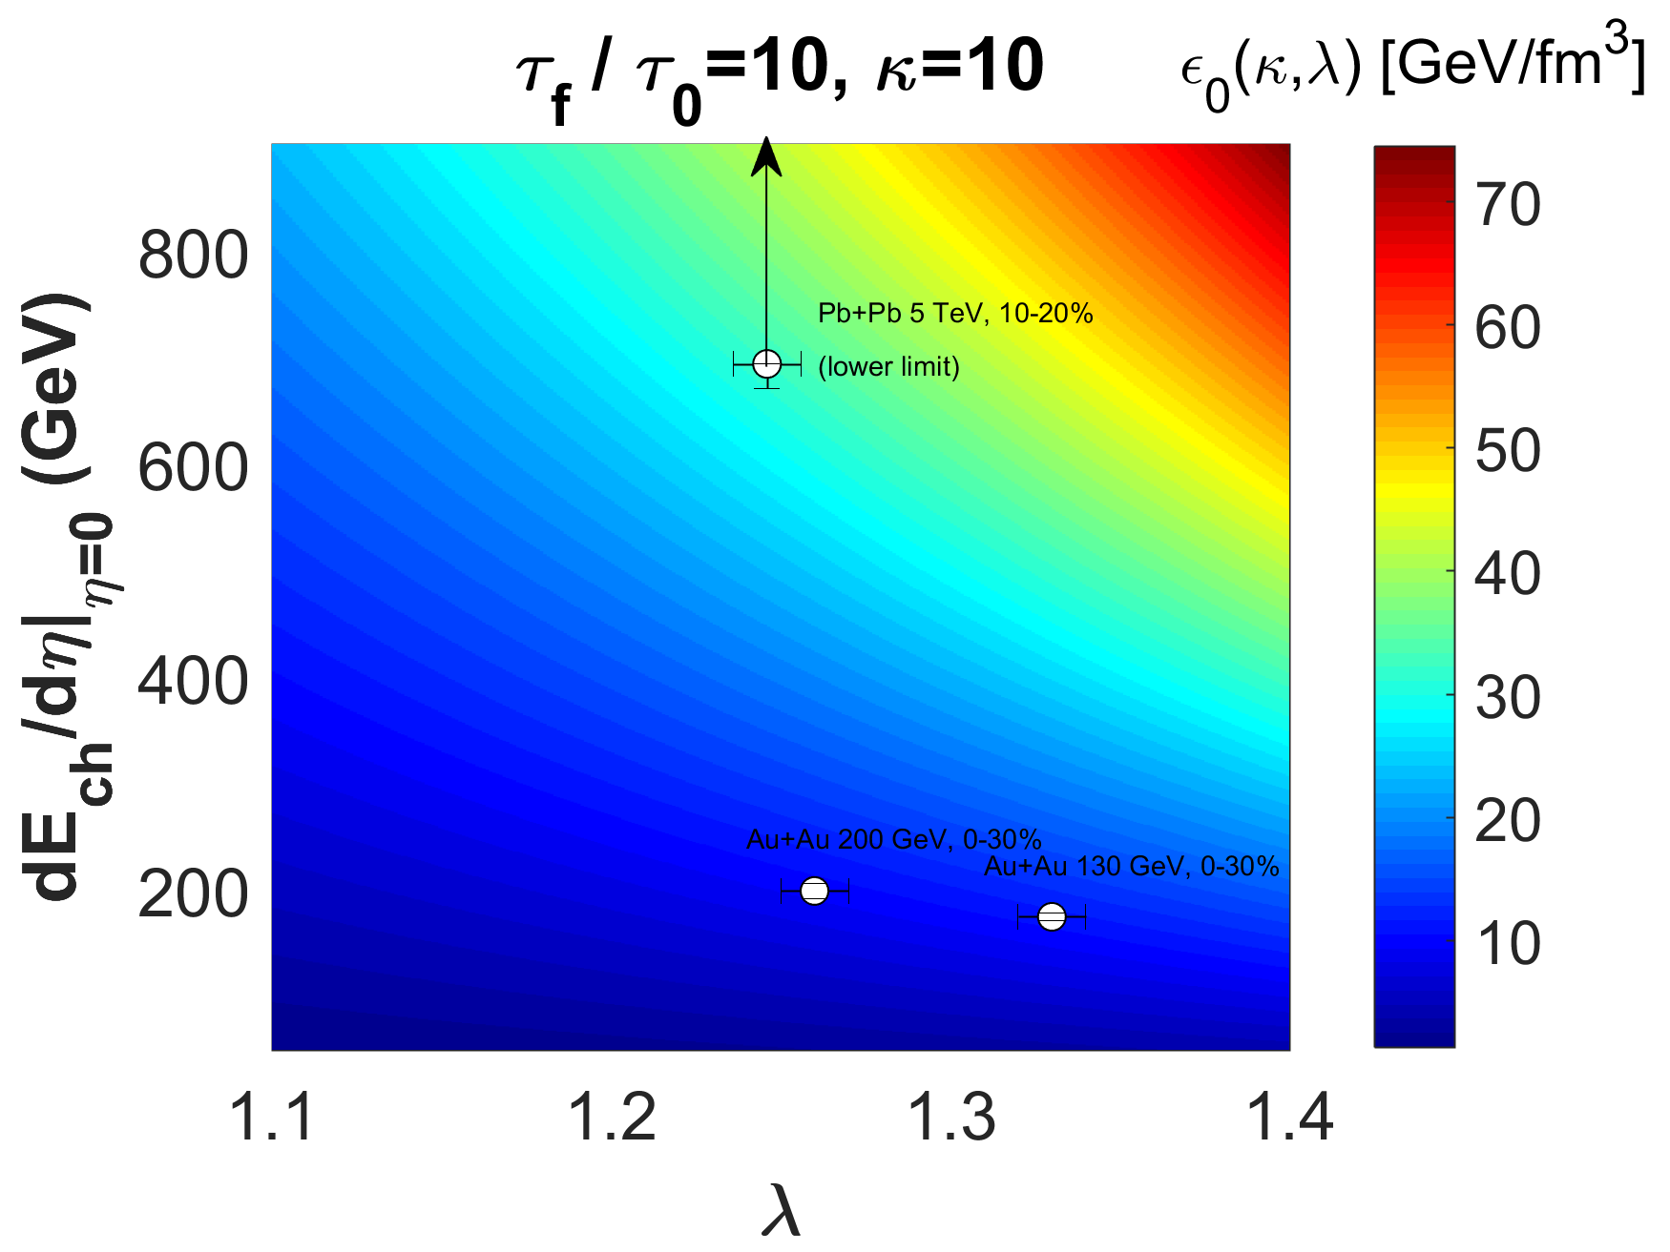
Bivariate function: non-monotonic, with monotonic projections
Initial energy density

Slide 29
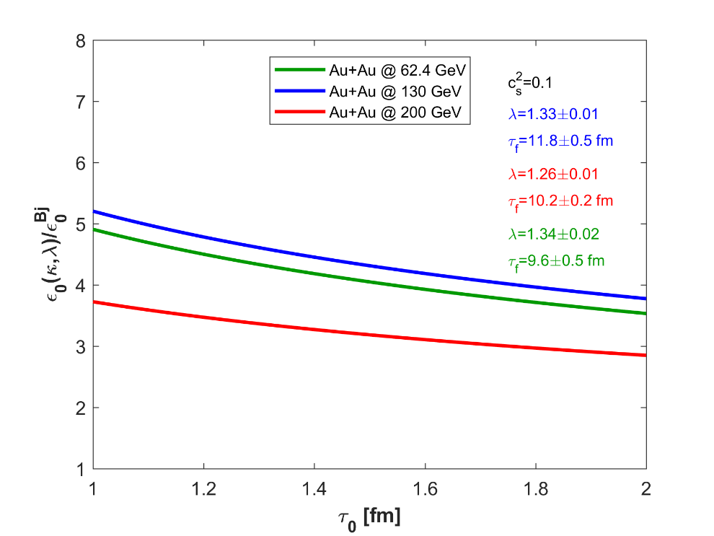
Exact result of initial energy density
Only the thermalized energy is included
Indication for an increasing initial energy density with decreasing colliding energy?
Suggest a non-monotonic behaviour of the initial energy density with $\sqrt{s}$
Need to extend the studies to lower energies (RHIC BES I, BES II, SPS and LHC data)
Need to investigate the possibilities of shock waves
Need to extend the CKCJ solution to 1+3 dimensions
Need to investigate the fit range iteration
the corrections to Bjorken’s initial energy estimate

Slide 30
Summary
New, exact solutions of hydrodynamics: CKCJ solutions
Powerful Gaussian formula for dN/dη (more general than we think?)
Initial energy density is calculated exactly Bjorken’s estimate ignores the first law of thermodynamics
Novel method to obtain the lifetime-parameter τ_{f} evaluation of T_{eff}, dN/dη fits, R_{L} fits
τ₀ dependence of ε₀ can be calculated: surprising result: non-monotonic behaviour of ε₀(s_{NN})?
Further investigations are needed: lower energies, extensions of CKCJ model, fit range iteration
viscous hydro?

Slide 31
Amazing power of analytic hydro
Thank you for your attention!

Slide 32
Backup slide

