Slide 1
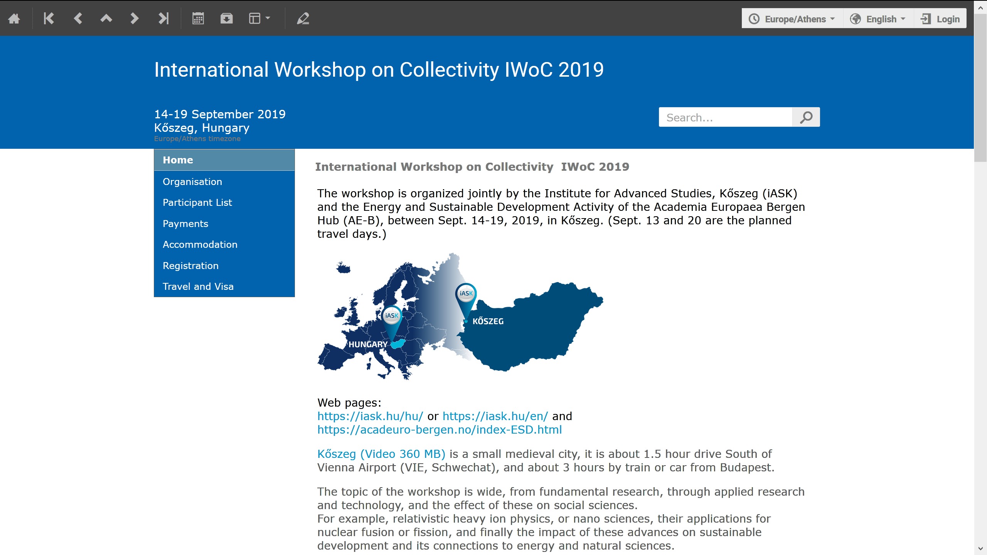
https://indico.cern.ch/event/800723/

Slide 2
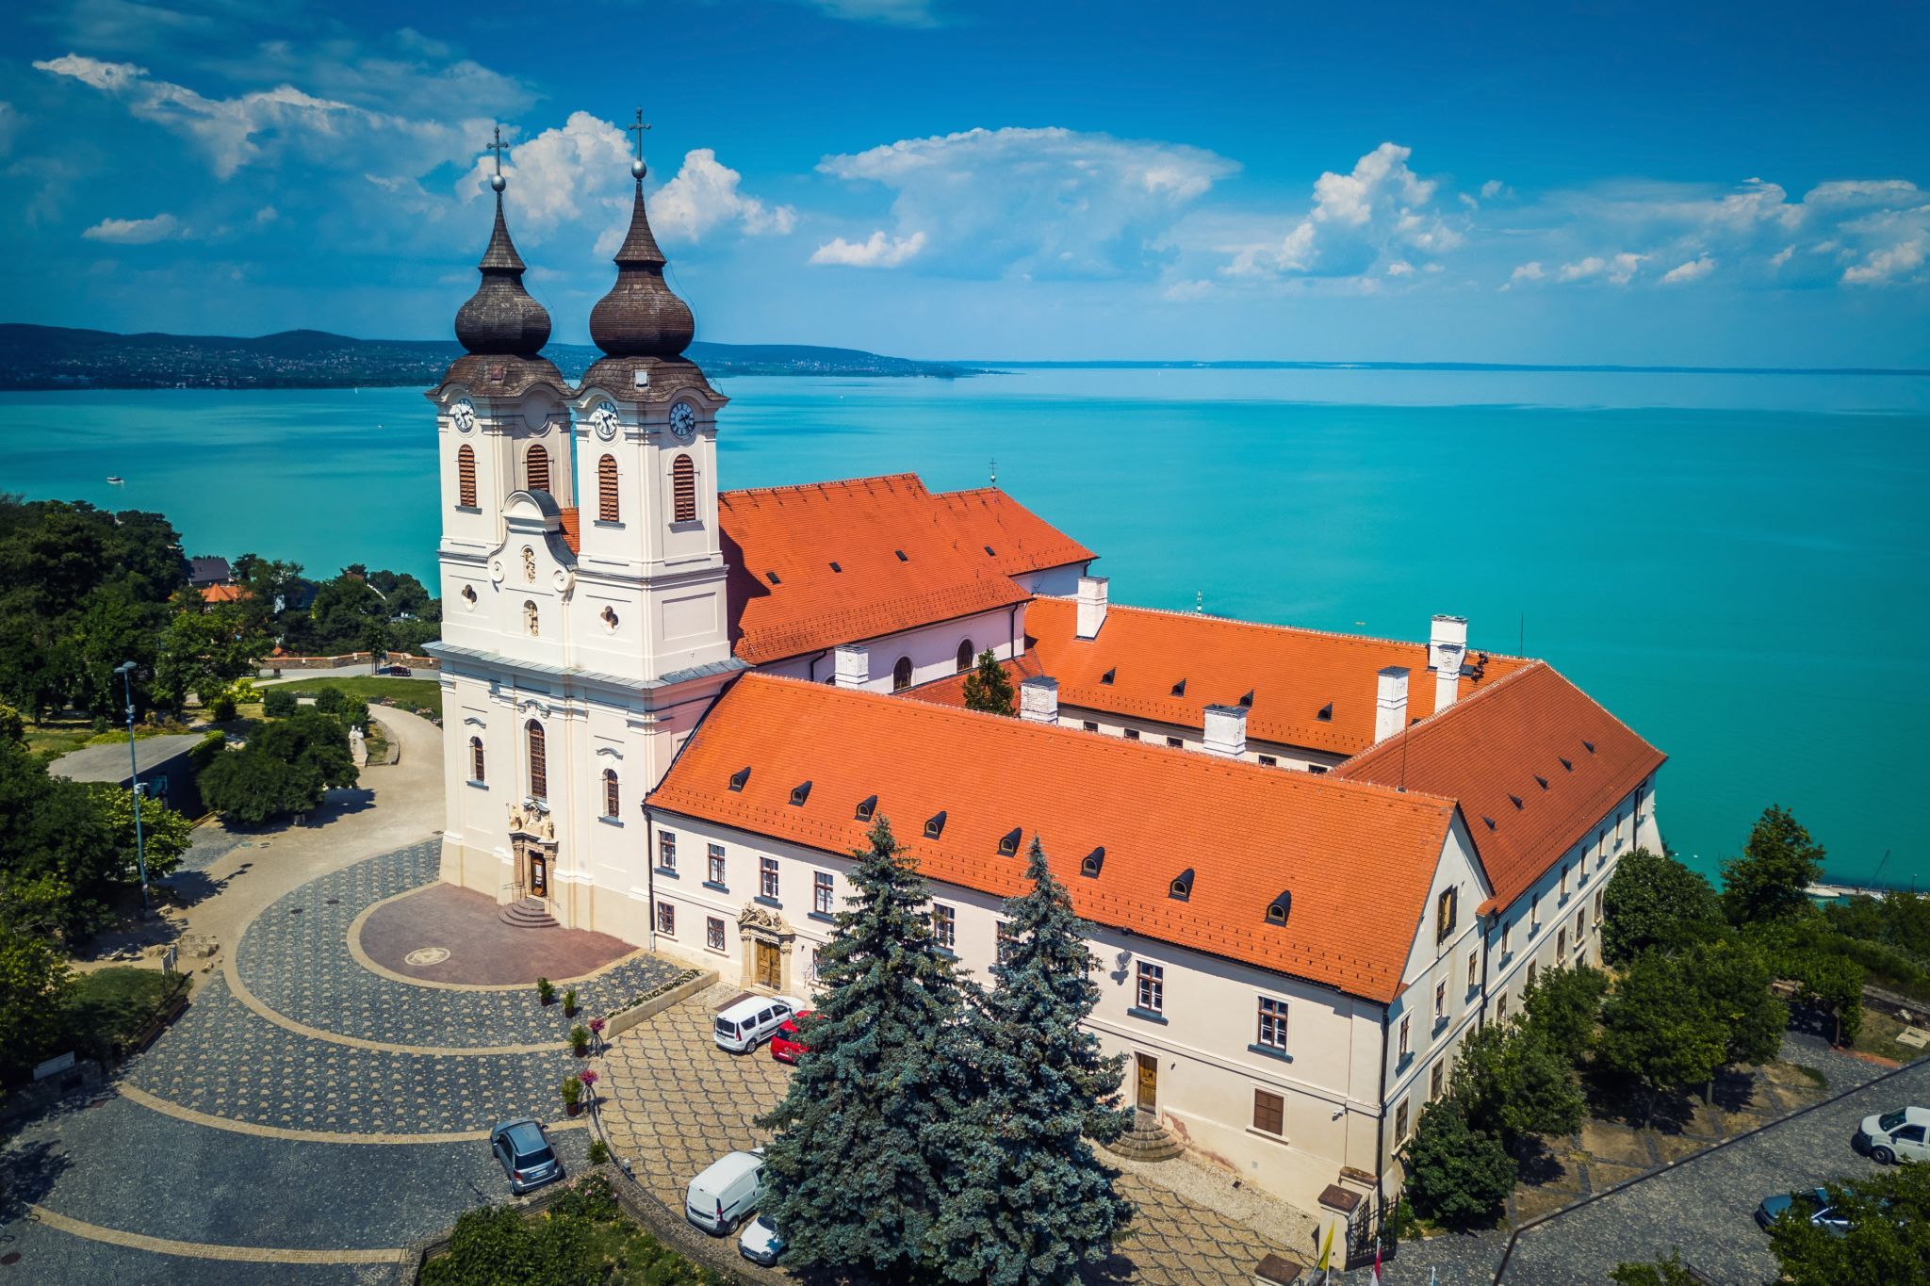
Laser driven rapid
volume ignition
Laszlo P. Csernai,
Univ. of Bergen, Norway &
Wuhan University of Technology, China
Balaton Workshop 2019, Tihany, June 17-21, 2019

Slide 3
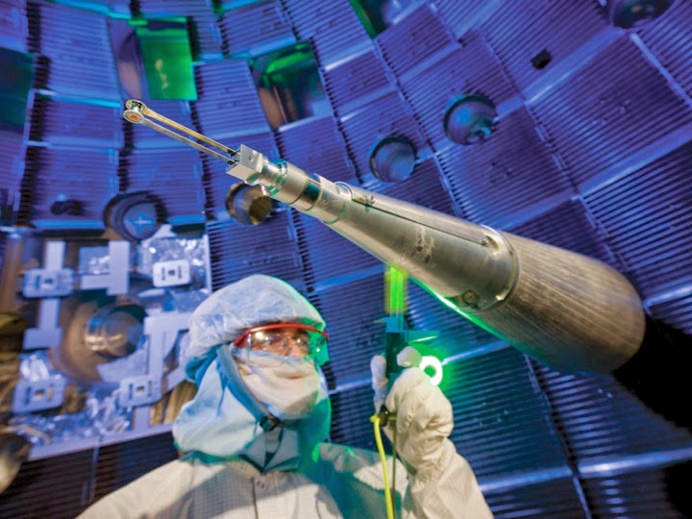
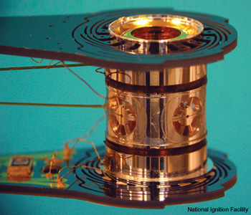
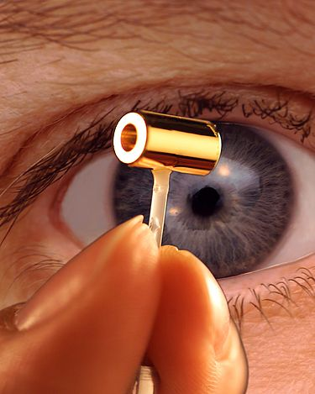
Indirectly Driven,
ICF target for NIF
at LLNL

Slide 4
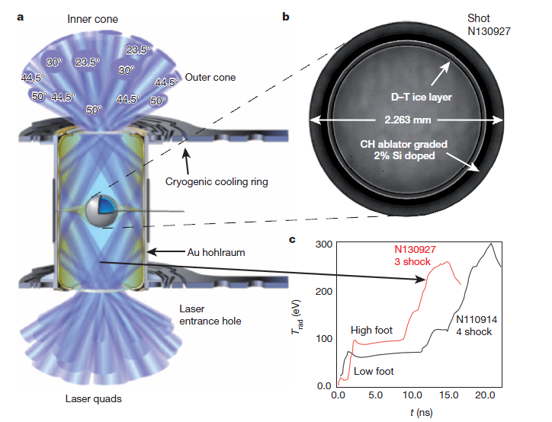
Indirectly Driven, ICF target for NIF
Time profile of the laser beam:
Initial pre- compression of ~ 10 ns,
Stable compression
Then final “shocks” of
~ 15 ns
to ignite
[O.A. Hurricane et al., Nature, 506, 343 (2014), doi:10.1038/nature13008 ]

Slide 5
[Clark et al., Phys. Plasmas,
22, 022703 (2015).]
Snapshots of 3D simulation
22.53ns: peak impl. Velocity
23.83ns: bang, max compr.
22.96ns: jet out, up left
Green surface: Ablator/DT-f.
Peaks: Ablator defects
Colours:
Left: fluid speed
Right: matter density
~adiabatic compression
➔ 80 μm
& heating

Slide 6
Phys. Rev. Lett. 120, 245003 – 14 June 2018:= Q’ > 2

Slide 7
S. Le Pape et al., (LLNL - NIF)
Depleted
Uranium
Notice: The last energetic part of the pulse is less than 4ns!
(It was ~ 15ns earlier.)
published 14 June 2018

Slide 8
Notice: The ignition peak is now in the centre of the compressed target pellet!
80 μm - 2018

Slide 9
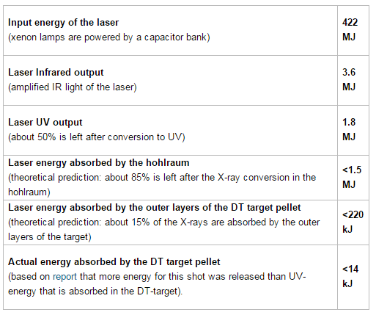
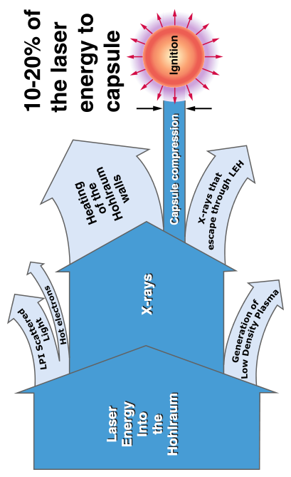

Approximate energy efficiency of diff. process steps of NIF:
2.1
MJ
Energy out
14 kJ
2014:= 0.003318% !
2018:= fusion energy of 54 kJ.

Slide 10
Burning of Quark Gluon Plasma in Relativistic,
Radiation Dominated Systems according to
Relativistic Fluid Dynamics
-
Applications to Pellet Fusion
Classical Fluid Dynamics (CFD) does assumes that all dynamical processes, including shocks and detonations, are having speeds slower than the speed of light, c.
Initial Relativistic FD (RFD) maintained this assumption based on the requirement of causality [A.Taub, 1948].→
Engineering books keep this assumption even today!
Relativistic Heavy Ion Physics proved the opposite!

Slide 11
[ A.H. Taub (1948) ]
Taub assumed that (physically) only slow
space-like shocks or discontinuities may occur (with space-like normal, λ₄=0).
This was then taken as standard, since then (e.g. LL 1954-)

Slide 12
[ L. P. Csernai, Zh. Eksp. Teor. Fiz. 92, 379-386 (1987) &
Sov. Phys. JETP 65, 216-220 (1987) ]
corrected the work of
[ A. Taub, Phys. Rev. 74, 328 (1948) ]
λ_{α} λ^{α} = ± 1
+1
-1

Slide 13
[ L.P. Csernai:
Introduction to Relativistic Heavy Ion Collisions, (1994, John Wiley & Sons, Cichester, England) ]

Slide 14
Discovery of QGP:
CERN
BNL
[U.W. Heinz and P.F. Kolb, Phys. Lett. B 542, 216 (2002)]

Slide 15
[ R. Chatterjee, et al., Phys. Rev. Lett. 96, 202302 (2006) ]

Slide 16
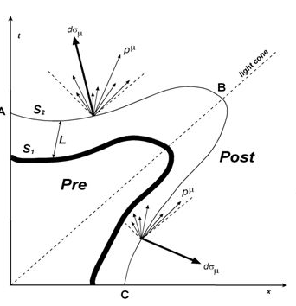
Light cone
[ E. Molnar, et al., J. Phys. G 34 (2007) 1901 ]

Slide 17
[ E. Frodemann, et al., J.Phys. G 34, 2249-2254 (2007) ]

Slide 19
[ Stefan Floerchinger, and Urs Achim Wiedemann,
Phys. Rev. C 89, 034914 (2014) ]
Light cone

Slide 20
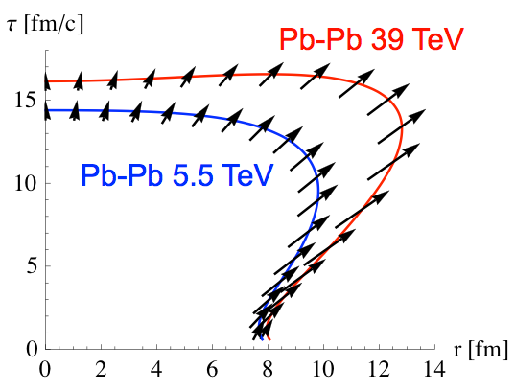
Light cone
Size and time extent of hadronization is measured by two particle correlations,
via Hanbury-Brown & Twiss effect.
[ N. Armesto, et al., Nucl.Phys. A931 (2014) 1163 ]

Slide 21
Applications to Pellet Fusion (I-st)
Relativistic Heavy Ion Physics proves that simultaneous ignition and burning is possible, both theoretically and experimentally!
Up to now all theoretical studies of Internal Confinement fusion are based on Classical Fluid Dynamics (CFD)
[HYDRA, LASNEX]
Still the aim is to
achieve Volume Ignition
achieve Rapid Ignition
but within CFD ?! →

Slide 22
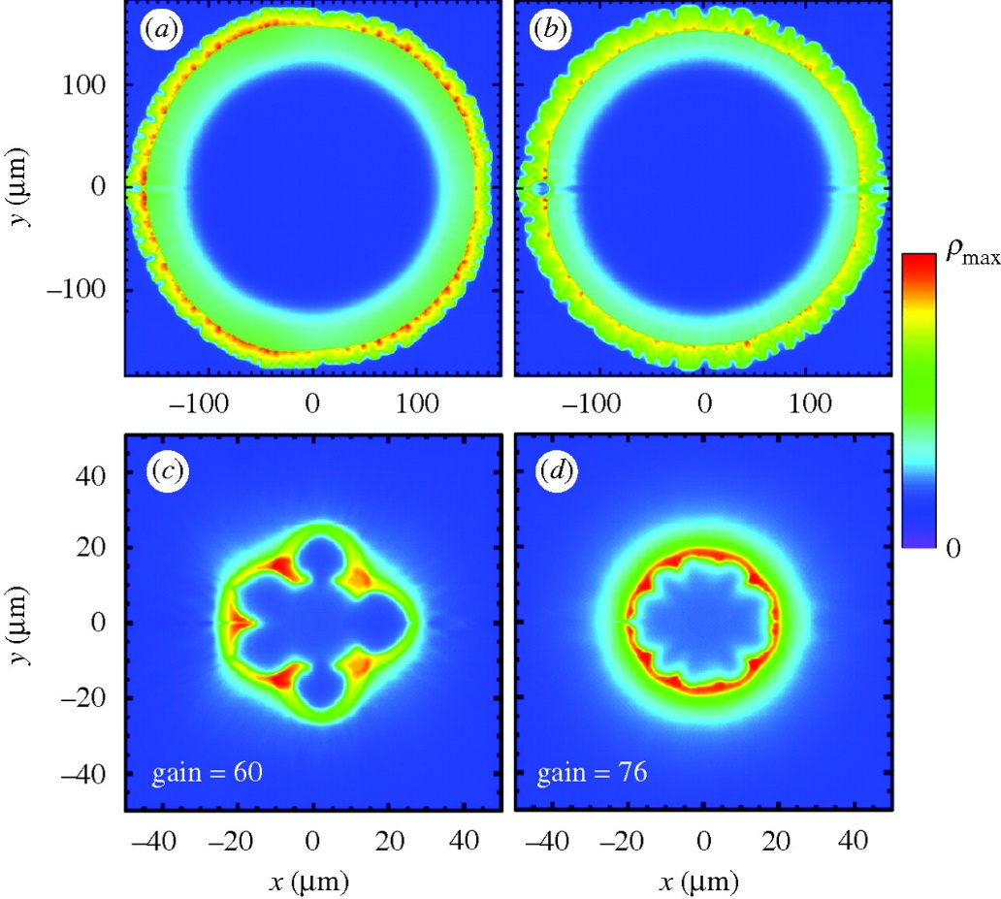
Fusion reaction:
D + T ➔ n(14.1 MeV) + 4He (3.5 MeV)
Constant absorptivity,
Spherical irradiation
Ignition temperature = T1 ➔
Simultaneous, volume ignition up to
0.5 R (i.e. 12% of the volume).
Not too good, but better than:
[ L.P. Csernai & D.D. Strottman,
Laser and Particle Beams 33, 279 (2015).]

Slide 23
Can we achieve larger volume ignition (II-nd)
Two ideas are combined by
L.P. Csernai, N. Kroo, I. Papp [ Patent # P1700278/3 ](*)
Heat the system uniformly by radiation with RFD
Achieve uniform heating by Nano-Technology
Mechanical compression and adiabatic heating should be reduced, because it is slow and leads to Rayleigh-Taylor instabilities. Similarly outside ablator surface should be reduced also.
Uniform, 4π radiation should heat the target to ignition within the light penetration time (i.e. ~ 10-20 ps). This follows from RFD!
[ L.P. Csernai, N. Kroo, I. Papp, Laser and Particle Beams,
LPB, 36(2), (2018) 171-178. . https://doi.org/10.1017/S0263034618000149 ]

Slide 24
LPB, 36(2), (2018) 171-178.
… and 35th Hirschegg Int. Workshop on High Energy Density Physics, Jan. 25‐30, 2015

Slide 25
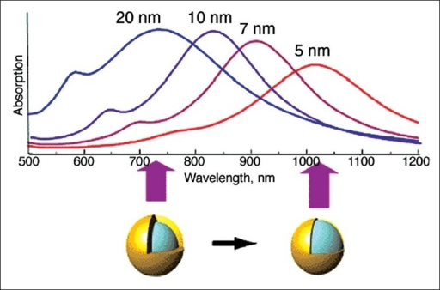
Golden Nano-Shells – Resonant Light Absorption

Slide 26
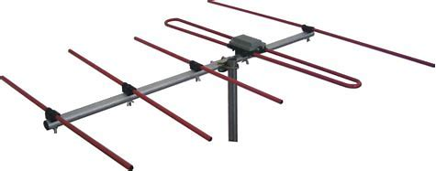
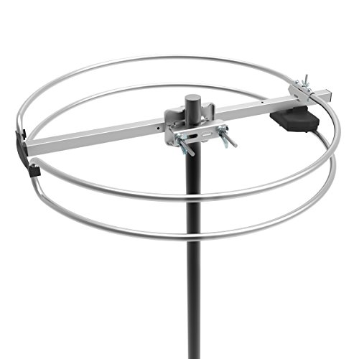
[ Martin Greve, IFT Seminar, Fall (2017) for PV Solar panels]
Omnidirectional TV antenna

Slide 27
LPB, 36(2), (2018) 171-178.
Variation of absorptivity by Nanotechnology
Doping INF pellets with golden nano-shells enables us to achieve the desired variable absorptivity (Tanabe, 2016).
L.P. Csernai, N. Kroo, I. Papp [ Patent # P1700278/3 ](*)

Slide 28
L.P. Csernai, N. Kroo, I. Papp [ Patent # P1700278/3 ]
The absorption coefficient is linearly changing with the radius: In the center, r = 0, α_{K} = 30 cm⁻¹ while at the outside edge α_{K} = 8 cm⁻¹.
The temperature is measured in units of T₁ = 272 keV, and T_{n} = n T₁.
Simultaneous, volume ignition is up to 0.9 R, so 73% of the fuel target!
T (MeV)

Slide 29
Problem:
Not easy to realize, 4π irradiation geometry ➔ 80-192 laser beams
In the earlier estimates we did establish that:
- The principle of simultaneous volume ignition is theoretically possible
with nano-shells
- We did not estimate the necessary laser energy need, and assuming
extremely large laser input energy we neglected the losses.
However the basic principle, the simultaneous all volume ignition can be achieved in 3D, 2D and 1D geometry also !!!
(Einstein’s synchronization of watches.)
We did calculate the realistic energy balance
➔ So, we repeated realistic estimates in 1D with a flat (coin like)
target.

Slide 30
Thick Coin like target - New Developments
L.P. Csernai, N. Kroo, I. Papp
X
Thickness of the target is: h
h depends on pulse energy, ignition energy, target mass, …

Slide 31
Without nano
antennas
The deposited energy from laser irradiation from one side only. The absorption is constant, this leads to an exponentially decreasing energy deposition, and only a negligibly small energy reaches the opposite end of the target.

Slide 32
Without nano
antennas
Irradiation from both sides.
Exponential decrease of deposited energy. Due to the already deposited energy, less energy reaches the middle ➔
The front and back surface is heated up but the middle is not!
Pulse length is: t_{P} = h/c

Slide 33
With nano
antennas
The absorptivity is increased towards the center, due to the implanted nano antennas.
The deposited energy from laser irradiation from one side only. The absorption is modified by nano antennas so that the absorptivity is increasing towards the middle, so that the deposited energy is constant up to the middle. Then the absorptivity is decreasing, but hardly any energy is left in the irradiation front. Thus again only a negligibly small energy reaches the opposite end of the target.

Slide 34
With nano
antennas
Irradiation from both sides.
Ignition energy is: Q_{i} /m
e.g. for DT target: Q_{i} /m = 27 kJ/g
➔ if we have Q = 100 J , then
we can have a target mass:
m_{DT} = Q / Q_{i} g = 3.703 mg.
Then with m_{DT} and ρ_{DT} given
we get the DT-target’s volume, V_{DT} and h_{DT} = 2.67 mm .

Slide 35
With nano
antennas
Ignition is reached at contour line Q = 1.
[ L. P. Csernai, M. Csete, I. N. Mishustin, A. Motornenko, I. Papp, L. M. Satarov, H. Stöcker, N. Kroo, arXiv:1903.10896, Submitted to MRE]

Slide 36
Test of principles with
smaller pulse energy
1 Relativistic time-like (simultaneous) ignition
2 Using nano antennas to reach whole volume uniform ignition or transition
3 Using 1D geometry, with two beams from opposite direction for realizability
Let us take
a P = 30 mJ , 1 ps laser,
a polilactic acid (PLA) target with T = 150 C melting temperature, Q_{i} /m = 28 J/g
this leads to m_{i} = 0.32 mg target mass, and h_{i} = 683 μm target thickness.
The melting transition profile can be checked by simple and affordable analysis by microscope.
The distribution, and absorption properties of implanted nano antennas can be well optimized.

Slide 37
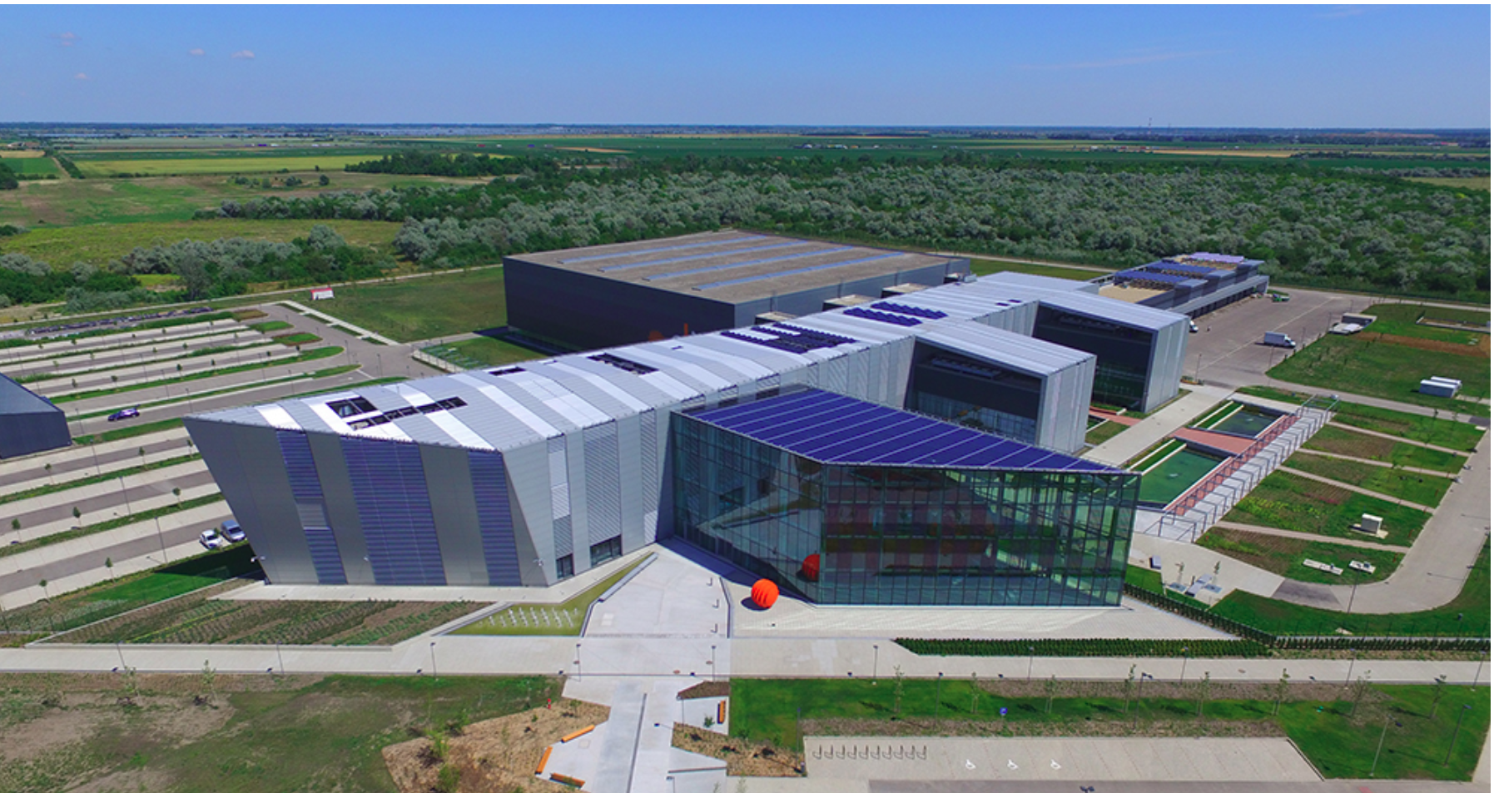
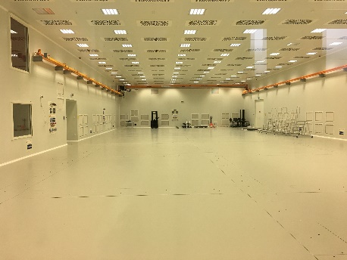
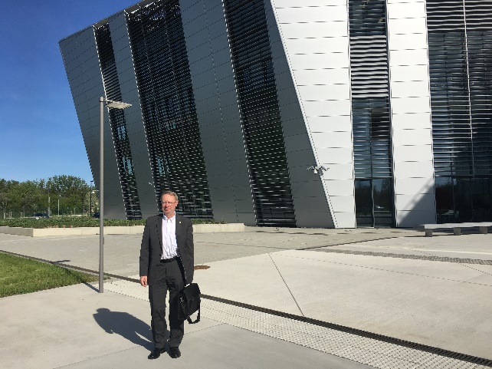
European Laser Infrastructure – Szeged, HU
ELI-ALPS Szeged:
EU Extr. Light Infrastructure
Attosec. Light Pulse Source
2PW High Field laser
10 Hz, <10fs, 20 J

Slide 38
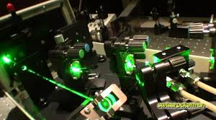
HAS Wigner RCP, Budapest
Gagik P. Dzsotjan, József Bakos, Gábor Demeter,
Dávid Dzsotjan, Miklós Kedves, Béla Ráczkevi,
Zsuzsanna Sörlei, Péter Lévai
Ti-Si Hidra L. 30mJ 10Hz 40fs
Laser wake acceleration of protons for radiation therapy
- proton beam energy is deposited at a location of a certain depth [Bragg peak]
- tumor treatment with minimal side damage (compared to other radiation therapies)
- target is low density (~ like water or more)
- Collaboration with Peking University, China
These features are similar to the needs of laser induced ICF with nano-plasmonics!
Deposition at a depth via the Bragg peak is an alternative way to get volume ignition
Gábor Veres, István B. Földes, Márk Aladi, Imre Ferenc Barna, Róbert Bolla,
Zsolt Kovács, Mihály Pocsai, Dániel Dunai, Gábor Anda et al.
Fusion plasma diagnostics, ITER, JET etc.
Péter Dombi, Péter Rácz, Norbert Kroo et al.
Laser induced nano-plasmonics

Slide 39
HAS Centre for Energy Research, Budapest
Inst. for Technical Physics and Materials Science
András Deák, S. Pothorsky, D. Zámbó, D. Szekrényes, Z. Hajnal, Béla Pácz et al.
Nano-particle assembly at the single particle level
- manufacturing of Au nano-shells and nano-rods
- imbedded in different concentrations in carriers
- polarized target constructions with nano-rods (for polarized laser irradiation)
- testing resonant light absorption
[Detecting patchy nanoparticle assembly at the single-particle level, S.Pothorszky et al., Nanoscale 9(2017)10344]

Slide 40
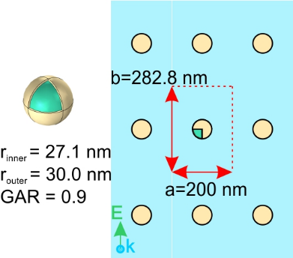
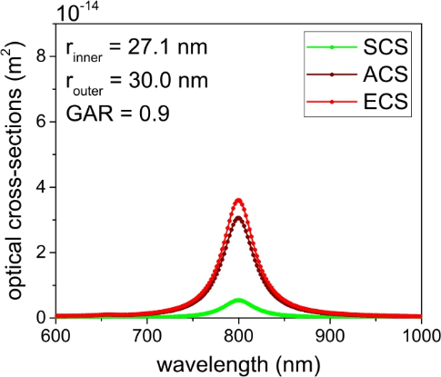
Nano-particle absorption
The target absorptivity is increased via core-shell type plasmonic nano-shells. Calculations via solving the Maxwell equations, and evaluating the ohmic heating were performed.
1 ps laser pulse length, λ = 800 nm, One-sided & two-sided irradiation tested,
85-100 % absorption in the target length h. Nano-antenna shapes, layer configurations, layer distribution varied & analyzed.
[M. Csete, et al., University of Szeged, HU]

Slide 42
Available resources:
Pulse Pulse Pulse
energy frequency length
LLNL NIF 192 laser 3D (1 laser: 11.2 kJ 1/day ~ 10-30 ns
ELI-APLS 2PW High field laser 20 J 10 Hz < 10 fs
(34 J)
BELLA, L. Berkeley Nat. Lab. 34 J 1 Hz < 30 fs
GSI/FAIR PHELIX laser 200 J 1/90min > 0.5 ps
Wigner - Coherent Ti-Si Hidra L. 30 mJ 10 Hz 40 fs
(upto 100 mJ)
Optimal for laser induced ICF with
nano-plasmonics tests ~ 100 J 1 Hz 1-10 ps !

Slide 43
Experimental test of similar configuration @ ShenGuang-II Up, Shanghai :
4 (up) + 4(down) lasers
Target thickness, h (3.6μm-1mm)
& radius, R, (150-400μm) were
varied.
Total pulse energy 1.2kJ (2ns) for 8 beams.
Shortest (250ps) pulses -> 100s MeV ions >
non-thermal distr. = directed ion acceleration
Typical fusion neutron energies were measured & used to extract the target density.

Slide 44
Experimental test of similar configuration @ ShenGuang-II Up, Shanghai :

Slide 45
LLNL – NIF April 2019
Hot-spot, 3μm, burning spreads by α-heating: boundary is approached.
[O.A. Hurricane et al., Phys. Plasmas 26, 052704 (2019) April.]

Slide 46
Thus, ultra-relativistic heavy ion physics lead to discovery Quark Gluon Plasma (QGP), but also
to advances in
(i) relativistic fluid dynamics (RFD).
With (ii) nano technology this may revolutionize in a simple, and (iii) affordable 1D geometry the technological development of
(➔ iv) Inertial Confinement Fusion.
This methodology may be used to study other dynamical, radiation dominated processes.
*

Slide 47
https://indico.cern.ch/event/800723/

Slide 49
Target size ➔ required ignition pulse length
for simultaneous (time-like) ignition

Slide 50
Another Option to Reach Volume Ignition
Heavy-Ion Beams – FAIR & NICA
Energy deposition by heavy ion beams – Bragg peak!
Absorption depth can be tuned! ➔
Beam bunch energy distribution could be achieved
Present Bunch length is ~ 70 ns
Bunch length of 10 ps may be reached [B. Sharkov]
➔ Proposal(s), Patent(s), Laser wake acc. ?

Slide 51
Today !

