Slide 1
Advanced statistical and computational methods in astronomical research
I. Csabai, L. Dobos, R. Beck, T. Budavari, C. Yip, A. Szalay

Slide 2
Age of Big Data

Slide 3
Evolution of the data intensive scientist: early times
theory
observation
reality

Slide 4
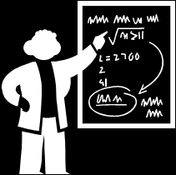
Evolution of the data intensive scientist: past
instruments
theory
observation
reality
experiment
models
test
predictions

Slide 5
Evolution of the data intensive scientist: present
instruments
theory
observation
reality
experiment
models
test
virtual reality
predictions

Slide 6

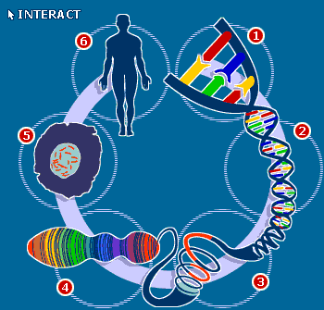
Other disciplines are similar: whole genomes, satellite maps, sensor networks, etc.
instruments
theory
observation
reality
experiment
models
test
virtual reality
predictions

Slide 7
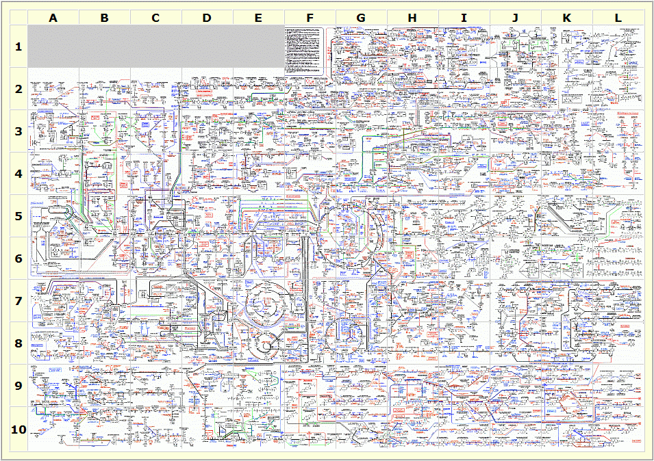
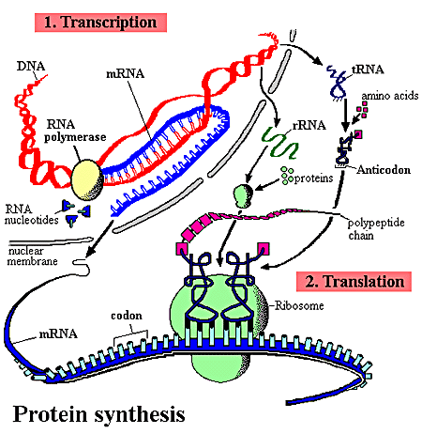
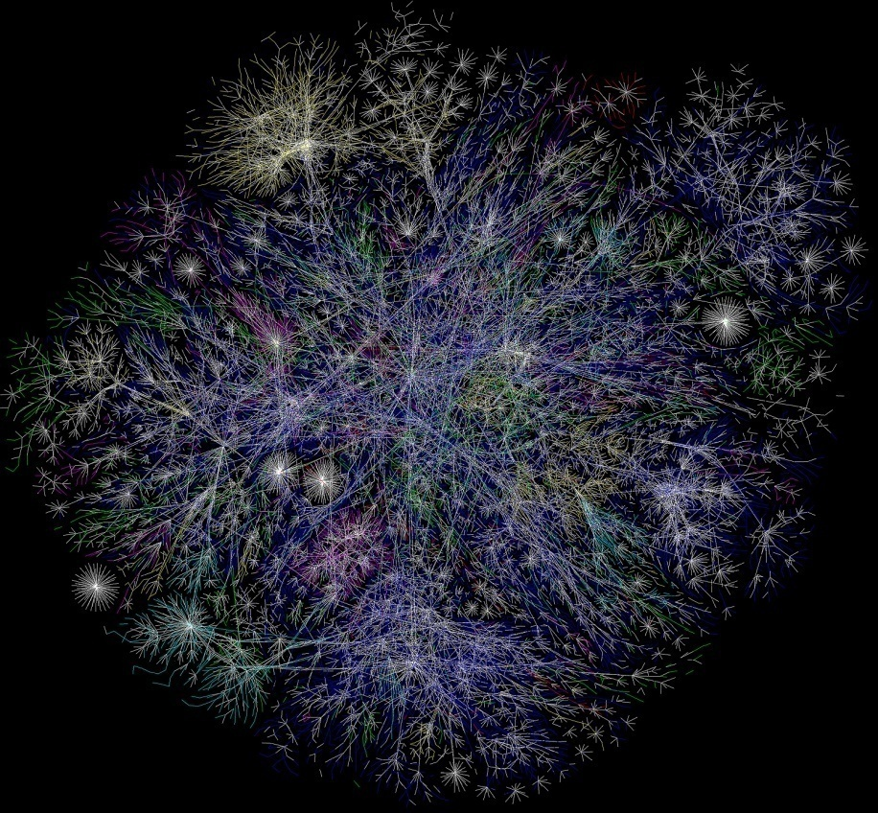
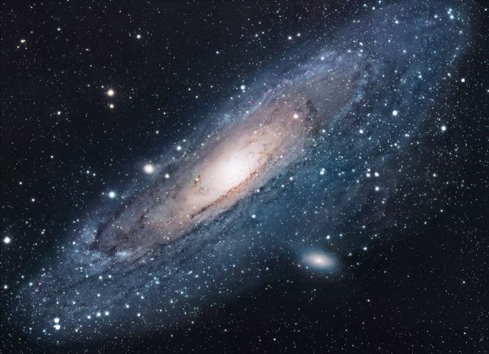
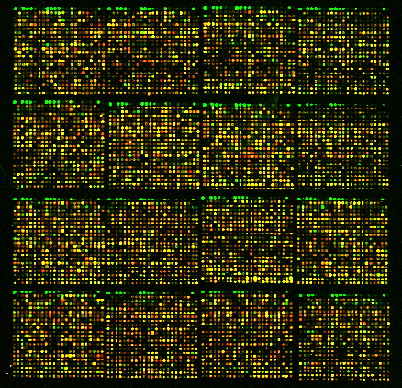
To understand the complex reality, we need complex models
To verify complex models we need a lot of data (large statistical sample -> statistical databases)

Slide 8
The Nature of (most of the) Science Data

Slide 9
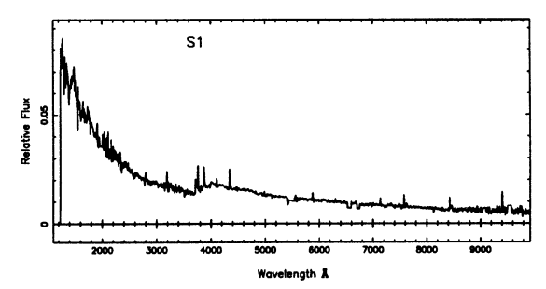
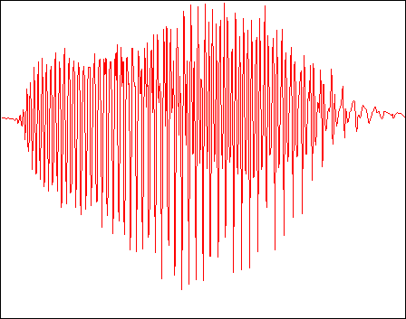

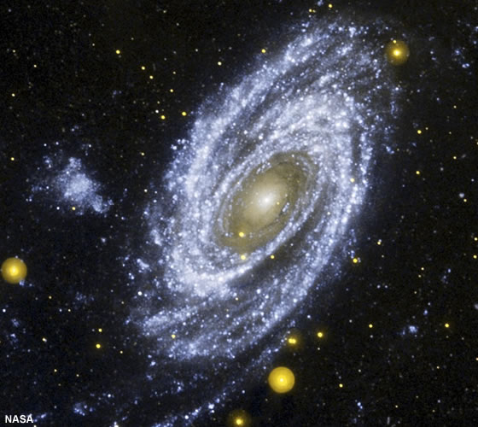
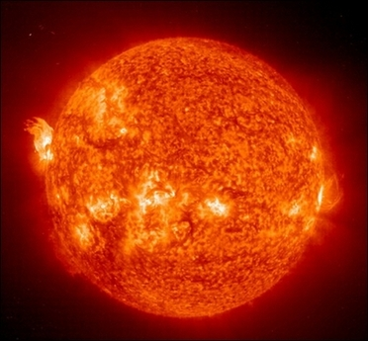
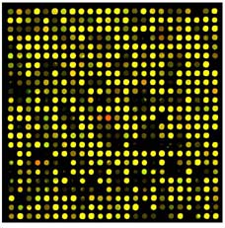
Raw data usually come as high dimensional data vectors

Slide 10
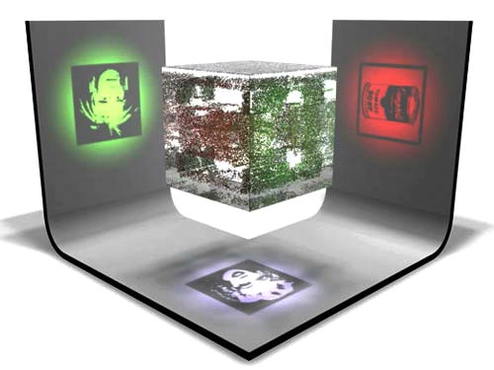
Due to the underlying physical laws, data vectors does not fill the whole space, rather lie on lower dimensional surface/subspace
(this is why we can understand the word!)
Projection ~ compression ~ model

Slide 11
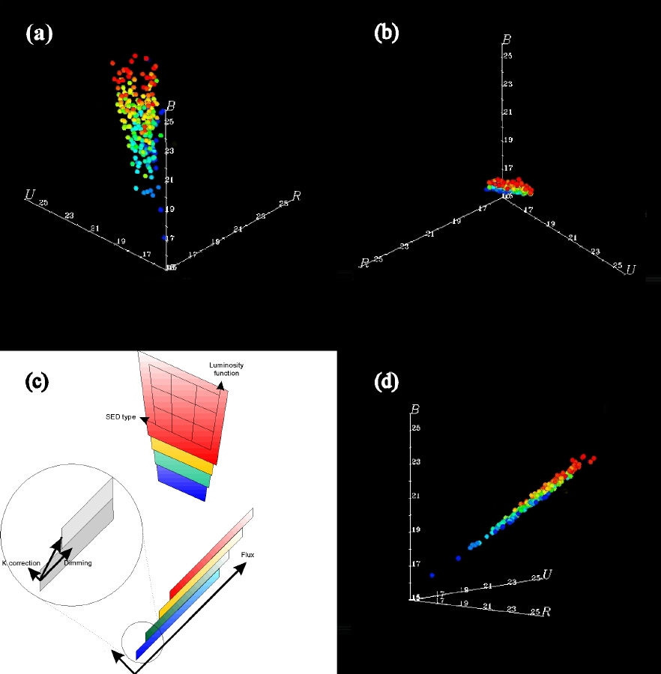
Example: color space vs. „true” physical space
Magnitude systems (UJFN, UBRI, ugriz …) are arbitrary
Galaxies have „important” physical parameters (age, metallicity, redshift, luminosity, …)
Connolly et al. AJ, 1995

Slide 12
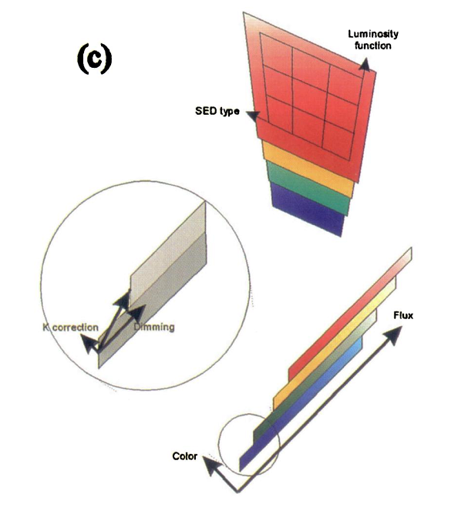
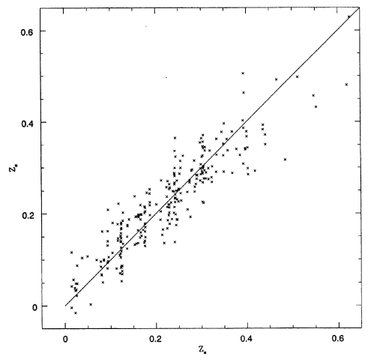

Photometric redshifts
„slabs”: redshift

Slide 13
How to find the underlying subspace in many dimensions: PCA/SVD
X = UΣV^{T}
X
U
x⁽¹⁾
x⁽²⁾
x^{(M)}
u₁
u₂
u_{k}
Σ
V^{T}
σ₁
v₁
.
σ₂
.
v₂
=
σ_{k}
v_{k}
singular values
input data
left singular
vectors

Slide 14
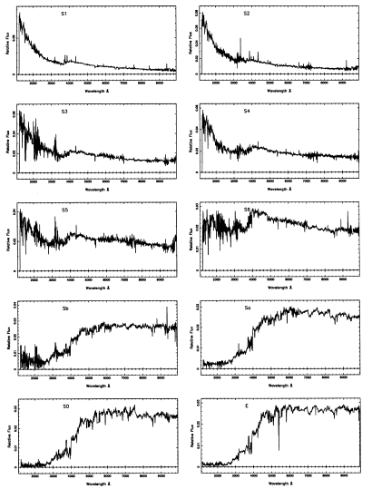
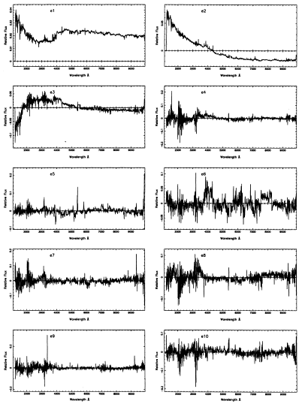
Spectrum PCA – dimension reduction
Connolly et al. AJ, 1995

Slide 15
Some additional difficulties
Missing data – „gappy”
Noise – „robust”
Millions of galaxies– „streaming”
Use databases – SQL array library
Streaming robust gappy PCA integrated with databases:
  Budavari et al. MNRAS 2009
  Dobos et al. EDBT/ICDT Workshop, 2011

Slide 16
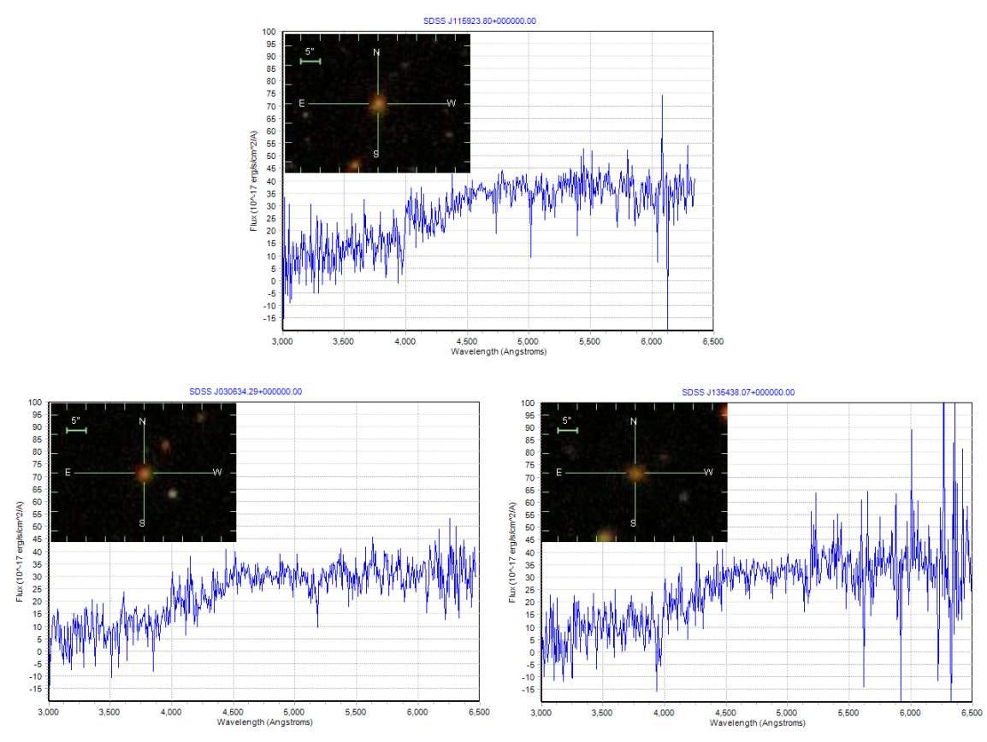
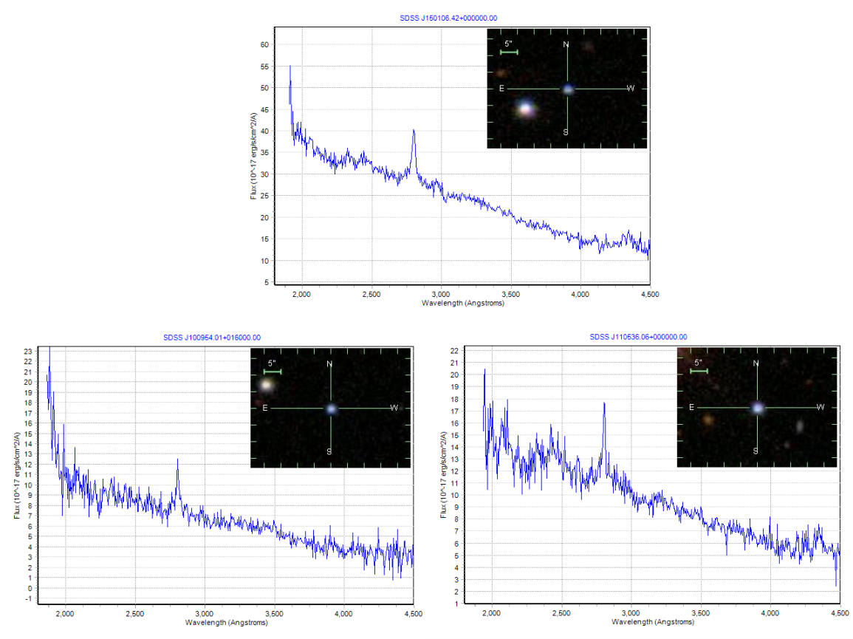
Application: Search for similar spectra
PCA:
AMD optimized LAPACK routines
called from SQL Server
Dimension reduced from 3000 to 5
Kd-tree based nearest neighbor search
Matching with simulated spectra,
where all the physical parameters
are known would estimate age,
chemical composition, etc. of galaxies.

Slide 17
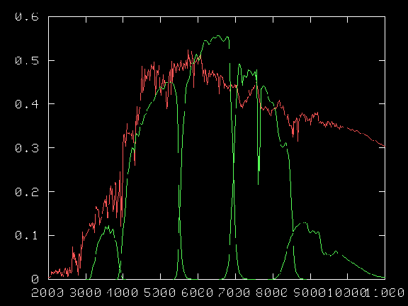
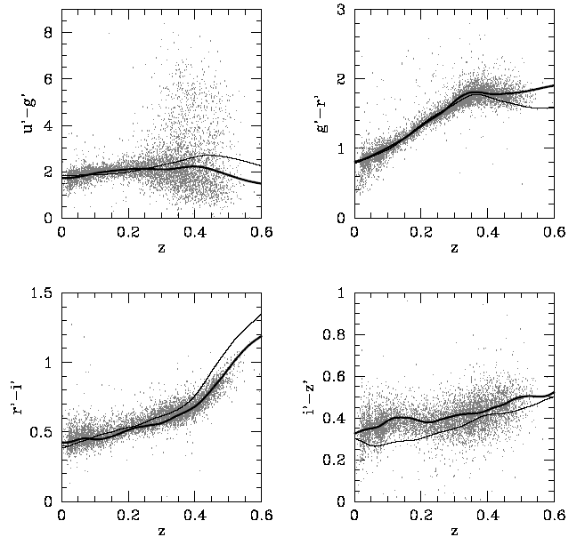
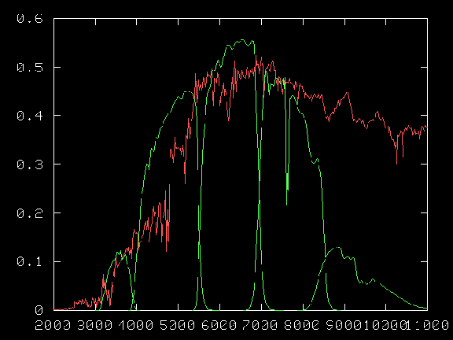
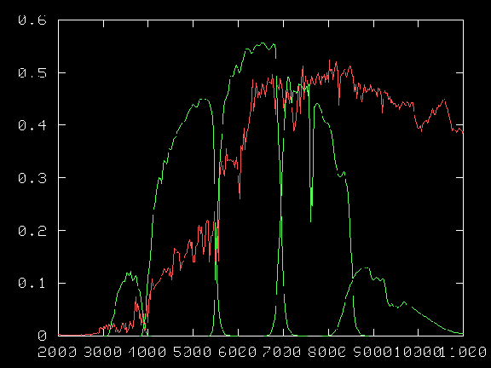
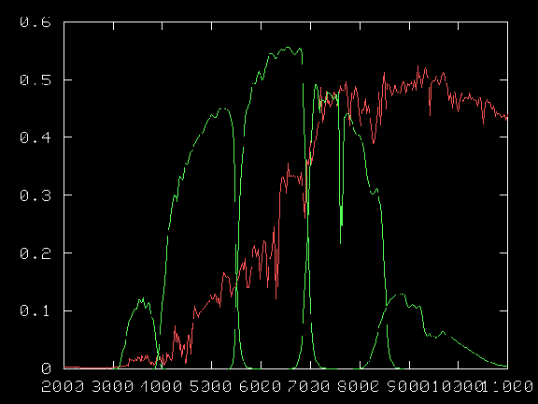
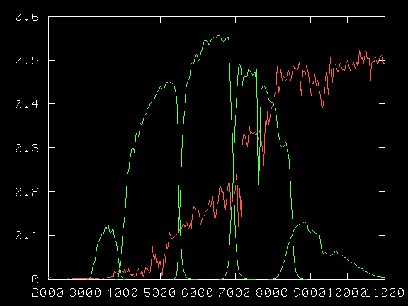
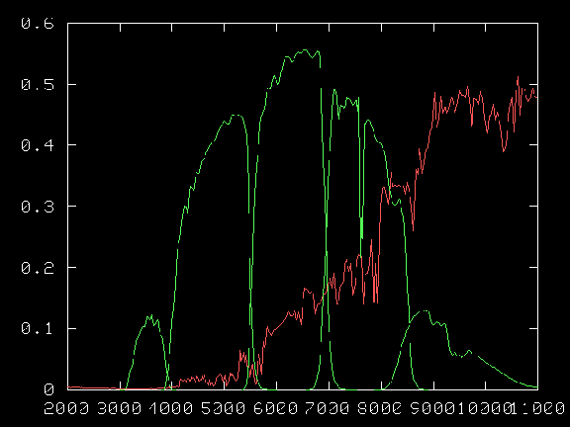
Projection of the spectral space to color space
LIGHT;
SED
MAGNITUDES, COLORS
BROADBAND FILTERS
REDSHIFT

Slide 18
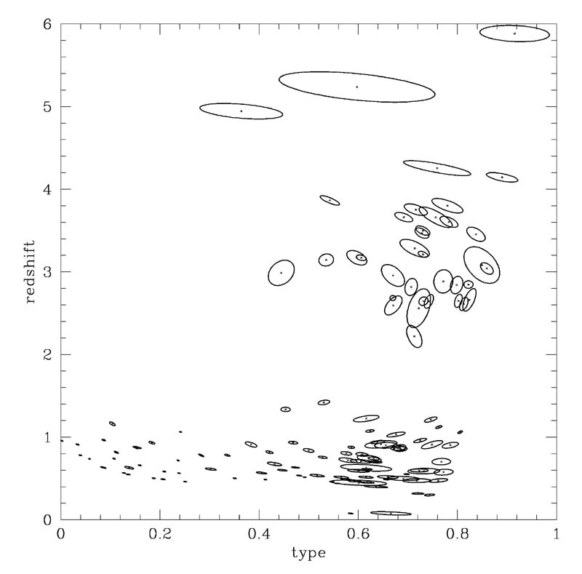
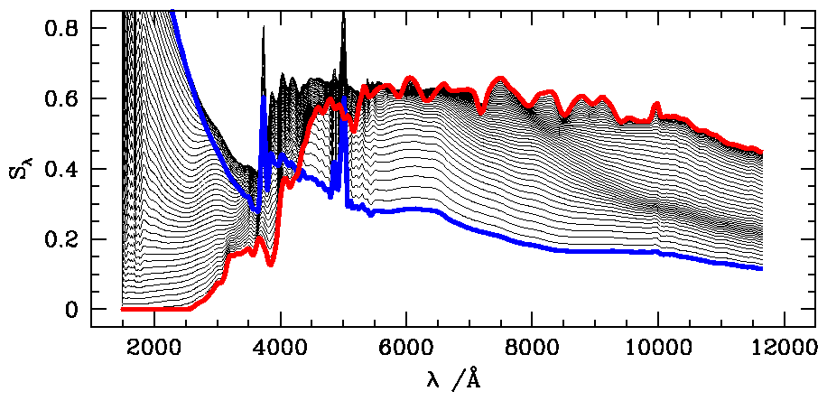
Inversion: from low dimensional observations to low dimensional physical parameters
PARAMETRS
age, dust, ...
GALAXY
early type, late type
LIGHT;
SED
MODEL
OBSERVATIONS
MAGNITUDES, COLORS
BROADBAND FILTERS
REDSHIFT

Slide 19
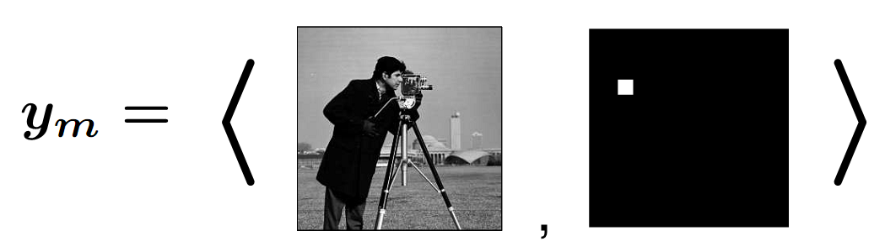
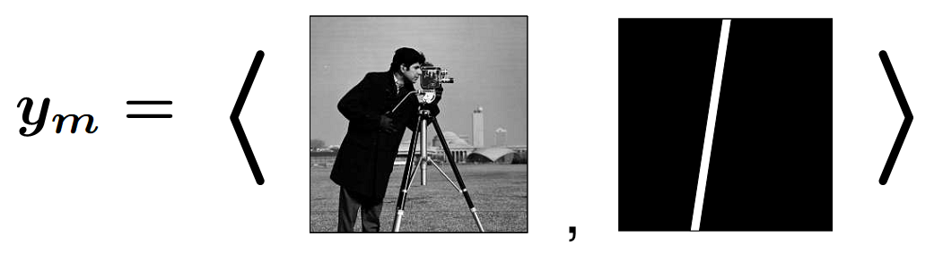
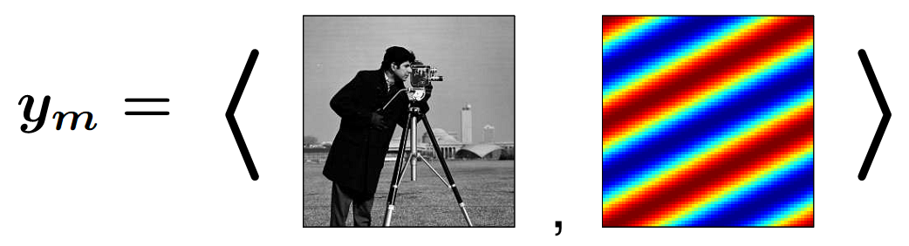
Observing basis (color space)
Dirac deltas: pixels (“natural basis”)
Line integrals (tomography)
Fourier coefficients (“frequency space”)

Slide 20
Representation basis (PCA)
Even if we observe in trivial (pixel) basis, the signal can be expanded in any orthonormal basis without loss of information
The basis can be e.g. Fourier-basis …

Slide 21
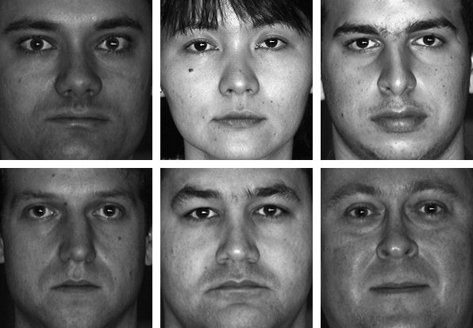

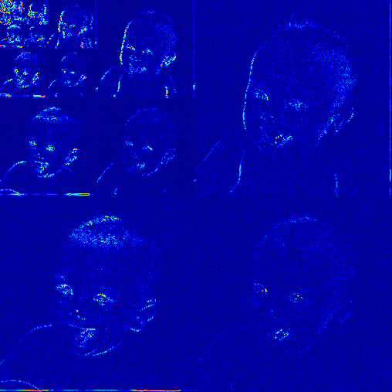
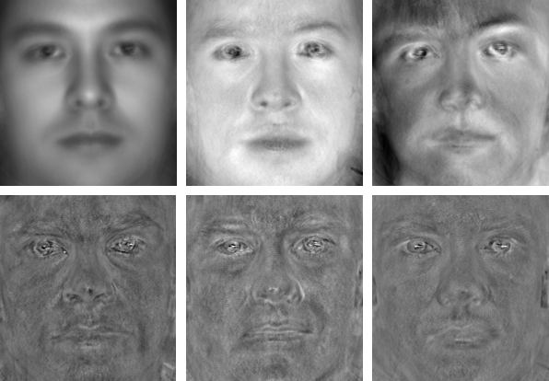
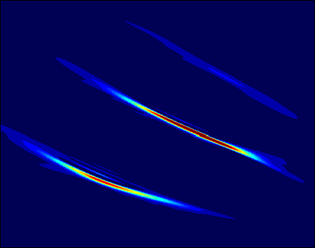
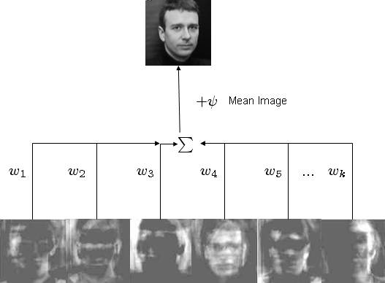
PCA
Raw data
Orthogonal bases
Orthogonal basis
Wavelets
Reconstruction
Fourier
frequency
time
Basis is independent of the data

Slide 22
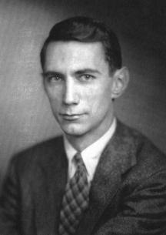
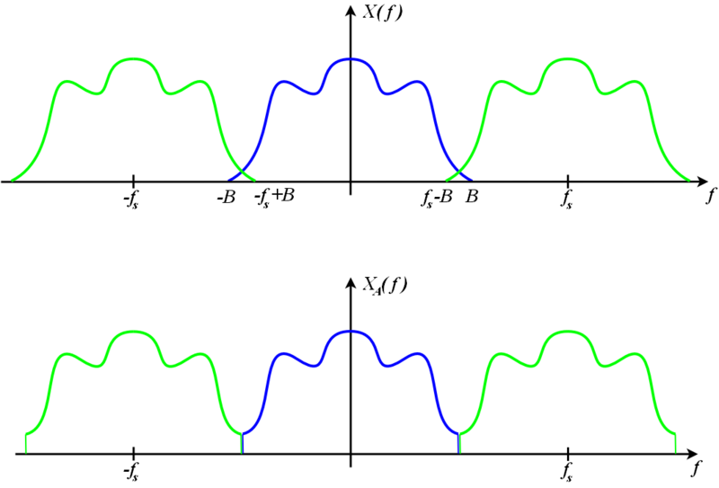
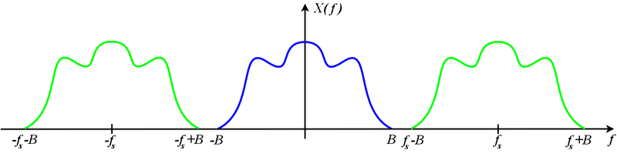
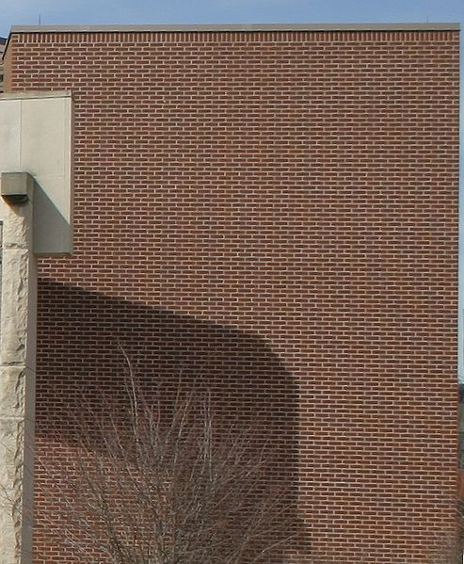

Nyquist-Shannon sampling theorem: how many measurements do we need?
If a function x(t) contains no frequencies higher than B hertz, it is completely determined by giving its ordinates at a series of points spaced 1/(2B) seconds apart.
GOOD
UNDERSAMPLED: ALIASING

Slide 23
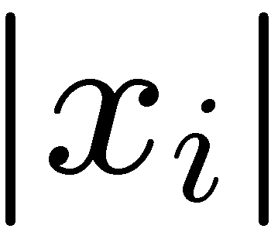
Sparsity / compressibility
In a proper concise basis most of the coefficients are 0 (small)
sorted index
frequency
time
Not true for arbitrary orthogonal basis! The basis often should be „adapted” to the data.

Slide 24
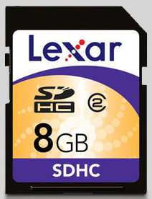

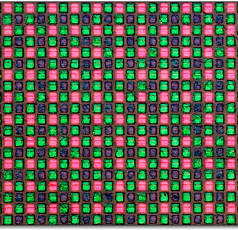

Conventional scenario (e.g. JPEG2000)
sample
compress
decompress

Slide 25
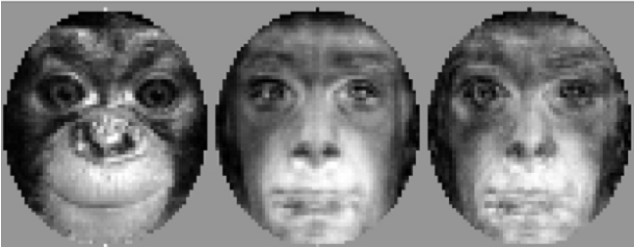
What’s wrong with this picture?
Data is sampled at Nyquist rate
  Waste of sensors/time/bandwitdh/computational resources
  (think of satellites with low computational power and bandwith!)
The basis used for compression can be (PCA, wavelet) signal dependent (“adaptive”)
sample
compress
decompress

Slide 26
Compressive sensing
Shannon was a pessimist!
Why measure all the detailed
signal if we will throw away most of it?
compressive sensing
decompress
Surprising discovery: signals can be recovered from sparse (non-adaptive) randomly sampled measurements!

Slide 27
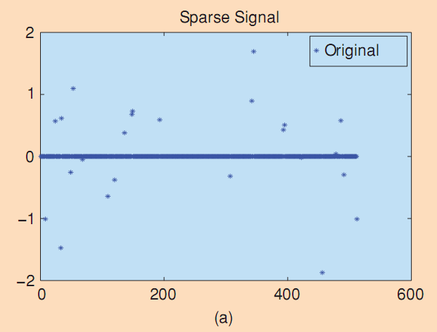
Example
Recovery of spikes
n=512, S=24, m=60
The signal is ultra-wideband in Shannon-Nyquist sense

Slide 28
Compressive sensing: basic principles
Sparsity
  Information rate of a signal may be much smaller, than suggested by its bandwidth. Many natural signals have concise representation when expressed in proper basis:
Incoherence (“uncertainity principle”)
  Extends the time-frequency duality: objects having sparse representation in must be spread out in the domain in which they are acquired (Dirac vs. frequency). OR: Unlike the signal, the observing waveforms have extremely dense representation in
Combinatorial optimization (linear/semi-definite programming)

Slide 29
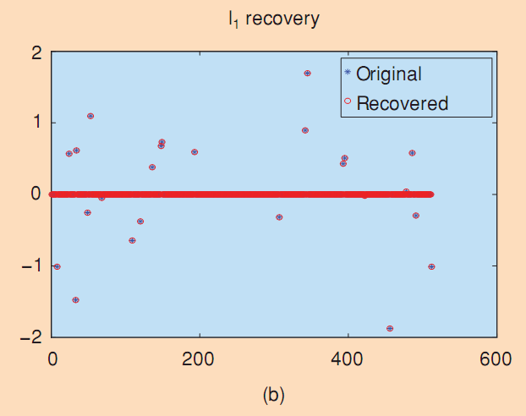
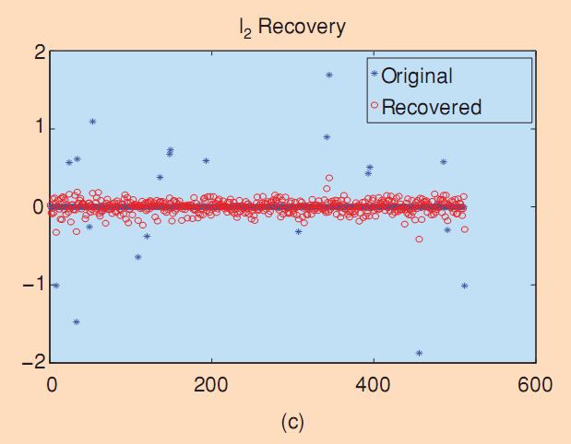
Example
Recovery of spikes from random Fourier coefficients.
n=512, S=24, m=60
The signal is ultra-wideband in Shannon-Nyquist sense

Slide 30

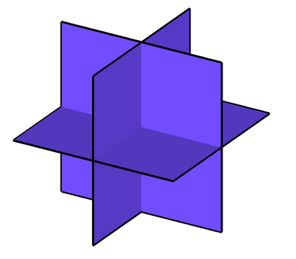

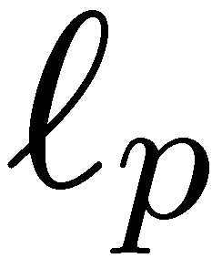



Geometric interpretation
Sparse signal: only K out of N coordinates nonzero
  Random projection model:
  union of K-dimensional subspaces
Compressible signal: sorted coordinates decay rapidly with power-law
  model: ball:
power-law
decay
sorted index

Slide 31
The key: L₁ minimization

Slide 32








Geometric interpretation
Random projection
not full rank
Recovery problem:
given
find
Null space
Search in null space
for the “best”
according to some
criterion
  ex: least squares
(N-M)-dim hyperplane
at random angle

Slide 33







Signal Recovery
Recovery: given
(ill-posed inverse problem) find (sparse)
Optimization:
Closed-form solution:
Wrong answer!
Notes:
33

Slide 34


Signal Recovery
Recovery: given
(ill-posed inverse problem) find (sparse)
Optimization:
Correct!
But NP-Complete alg
“find sparsest vector
in translated nullspace”
Notes:
34

Slide 35


Signal Recovery
Recovery: given
(ill-posed inverse problem) find (sparse)
Optimization:
Convexify the optimization
Correct!
Polynomial time alg
(linear programming)
Notes:
35

Slide 36







“point-like sources”
N=16384
original
M=800 (N)
M=3000 (N)
M=2000 (3000G)
L1-norm,
noiselets /
Gaussian
Discrete
cosine
transform,
lowpass

Slide 37






“point-like sources”
pixel values
N=16384
original
M=800 (N)
M=3000 (N)
M=2000 (3000G)
reconstructed
L1-norm,
noiselets /
Gaussian
L1-norm,
noiselets
original
Discrete
cosine
transform,
lowpass

Slide 38




Applications: single pixel camera
scene
single photon
detector
image
reconstruction
or
processing
DMD
DMD
random
pattern on
DMD array

Slide 39




target
65536 pixels
11000 measurements (16%)
1300 measurements
(2%)

Slide 40



CS Low-Light Imaging with PMT
true color low-light imaging
256 x 256 image with 10:1 compression
[Nature Photonics, April 2007]

Slide 41

Hyperspectral Imaging / Integral Field Spectroscopy
spectrometer
blue
red
near IR

Slide 42
Matrix completion
Similar problem:
Can one guess all the elements of an n x n matrix M if only m<n² values are known? In generally not, but if we know, that the rank of the matrix is low, r=rank(M)<n; and m>r(2n-r), then yes.
Correspondence between matrix-vector, l₁ vector norm – nuclear matrix norm, …
Parallel development of the two fields
If we (as a natural choice) chose to minimize for the rank (similar to the l₀ norm for vectors) while varying all the unknown elements, the problem is NP-hard, double exponential in n.
Key observation: the nuclear norm (≈ l₁ vector norm) is the best convex approximation of the rank function of (certain…) matrices (Fazel 2002).
Minimizing for the nuclear norm is convex, and the problem can be solved in polynomial time.

Slide 43

Van Gogh – Nincs Gogh*
* Sorry this joke works in Hungarian only: “van”= “there is”, “nincs” = “there is no”

Slide 44


Inpainting
Many transformations, like power spectrum
calculation has problems with gaps
Inpainting: statistically correct interpolation
in the gaps
S. Pires et al. MNRAS 2009

Slide 45
References
Emmanuel Candès and Michael Wakin, An introduction to compressive sampling. (IEEE Signal Processing Magazine, 25(2), pp. 21 - 30, March 2008)
Richard Baraniuk, Justin Romberg, and Michael Wakin, Tutorial on compressive sensing (2008 Information Theory and Applications Workshop)
Compressive Sensing Resources: http://dsp.rice.edu/cs ; http://sites.google.com/site/igorcarron2/cs (links+codes); http://www.acm.caltech.edu/l1magic/
Richard Baraniuk, Compressive sensing. (IEEE Signal Processing Magazine, 24(4), pp. 118-121, July 2007)
Guaranteed Minimum Rank Solutions to Linear Matrix Equations via Nuclear Norm Minimization. Benjamin Recht, Maryam Fazel, and Pablo A. Parrilo. To appear in SIAM Review. 2007
A Simpler Approach to Matrix Completion. Benjamin Recht. 2009. To appear in Journal of Machine Learning Research.
Online Identification and Tracking of Subspaces from Highly Incomplete Information. Laura Balzano, Robert Nowak, and Benjamin Recht. 2010 June.
Compressive Sensing DNA MicroarraysWei Dai ,Mona A. Sheikhyy ,Olgica Milenkovicy ,and Richard G. Baraniuk
E. J. Candès, J. Romberg and T. Tao. Robust uncertainty principles: exact signal reconstruction from highly incomplete frequency information. IEEE Trans. Inform. Theory, 52 489-509. (2004)
David L. Donoho and Philip B. Stark: Uncertainty Principles and Signal Recovery, SIAM J. Appl. Math. Volume 49, Issue 3, pp. 906-931 (June 1989)
J.Bobin, J-L Starck, R. Ottensamer: Compressed sensing in astronomy, IEEE Journal on Selected Topics in Signal Processing, 2008

Slide 46
Principal component pursuit

Slide 47
Principal component pursuit*
Low rank approximation of data matrix: X
Standard PCA:
  works well if the noise distribution is Gaussian
  outliers can cause bias
Principal component pursuit
  “sparse” spiky noise/outliers: try to minimize the number of outliers while keeping the rank low
  NP-hard
The L1 trick:
  numerically feasible convex problem (Augmented Lagrange Multiplier)
* E. Candes, et al. “Robust Principal Component Analysis”. preprint, 2009.
Abdelkefi et al. ACM CoNEXT Workshop (traffic anomaly detection)

Slide 48

Slowly varying continuum+absorption lines
Highly variable “sparse” emission lines
This is the simple version of PCP: the position of the lines are known
  but there are many of them, automatic detection can be useful
  spiky noise can bias standard PCA
DATA:
Streaming robust PCA implementation for
galaxy spectrum catalog (L. Dobos et al.)
  SDSS 1M galaxy spectra
  Morphological subclasses
  Robust averages + first few PCA directions

Slide 49

Example: where are the emission lines?

Slide 50
Example: where are the emission lines?

Slide 51

Principal component pursuit (λ=0.6/sqrt(n),ε=0.03)
Low rank
Sparse

Slide 52

Principal component pursuit (λ=0.6/sqrt(n),ε=0.03)
Low rank
Sparse
Noise

Slide 53

PCA
PCA reconstruction
Residual

Slide 54

L1 vs.PCA

Slide 55
CUR matrix decomposition

Slide 56

The problem with PCA
Singular vectors are dense
Hard to interpret for the domain scientist and use in applications

Slide 57



CUR
Leverage score:
Actual column
Singular vector

Slide 58
CUR
Pseudo-inverse of
the intersection of C and R

Slide 59
Use case: avoid overfitting in classification
U
Unsupervised phase
PCA:
Calculate the first k PCA components
LevScore:
Calculate the sum of square weight of each data colomn in the PCA components (leverage score)
ColSel:
In a loop, select c columns wich have the largest leverage scores and most orthogonal to the already selected columns
Valid:
Make a (linear) regression with the selected variables and/or with their combinations on subsets of the training set
Prune:
Validate the prediction capability of the regressions, select the best variables/combination
Model:
Use the best variables and calculate the parameters of the model on the whole training set
Supervised phase

Slide 60

Automatic identification of „important” spectral regions – Lick indices
Ching-Wa Yip et al. in preparation

Slide 61
References
Michael W. Mahoney and Petros Drineas: CUR matrix decompositions for improved data analysis, PNAS January 20, 2009 vol. 106 no. 3 697-702 (and several other papers of the authors)
Bodor A, Csabai I, Mahoney MW, Solymosi N.: rCUR: an R package for CUR matrix decomposition, BMC Bioinformatics, 2012

