Slide 1
The SNe and their host galaxies in SDSS: Characterization of the unconfirmed SNe
Levon Aramyan,
YOURESASTRO 2012, September 5, 2012

Slide 2
Outline
SNe classification
Progenitors
SNe distribution in host galaxies
SNe and their hosts in SDSS DR8 (results)
SDSS DR9
Method of study
Results

Slide 3
SNe classification
SNe
I
II
Ia
Ib
Ic
IIb
IIL
IIP
IIn
H
no
yes
Si
yes
$\left\{\begin{aligned}Ib \\ Ic \\ II\end{aligned}\right.→Core collapse SNe$
$Ia → Thermonuclear SNe$
no
He
yes
no

Slide 4
Progenitors
CC SNe are considered to be the final stage in the stellar evolution of stars with initial masses > 8 - 10 M☉. The progenitors of SNe Ib/c (Ib and Ic) are thought to be massive O type stars that have lost most or all of their hydrogen (and helium in the case of SN Ic progenitors) envelopes by:
strong winds as in Wolf-Rayet (WR) stars (e.g., Eldridge & Tout 2004)
massive binaries produce SNe Ib/c where the outer H or He shells are lost by transfer of material to a companion star via Roche lobe overflow (e.g., Heger et al. 2003)
The SNe Ia are thought to originate from the thermonuclear explosion of a C/O white dwarfs (WDs) (e.g., Turatto 2003; Turatto et al. 2007).

Slide 5
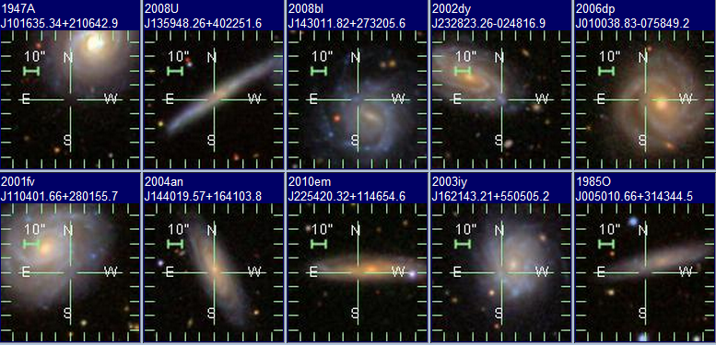
SNe distribution in host galaxies
Because the progenitors of CC SNe are massive young stars, they are expected to occur in the disks of spirals and in Irregular galaxies (e.g., van den Bergh et al. 2005). Particularly in spiral galaxies the distribution of CC SNe is concentrated in spiral arms and HII regions.

Slide 6
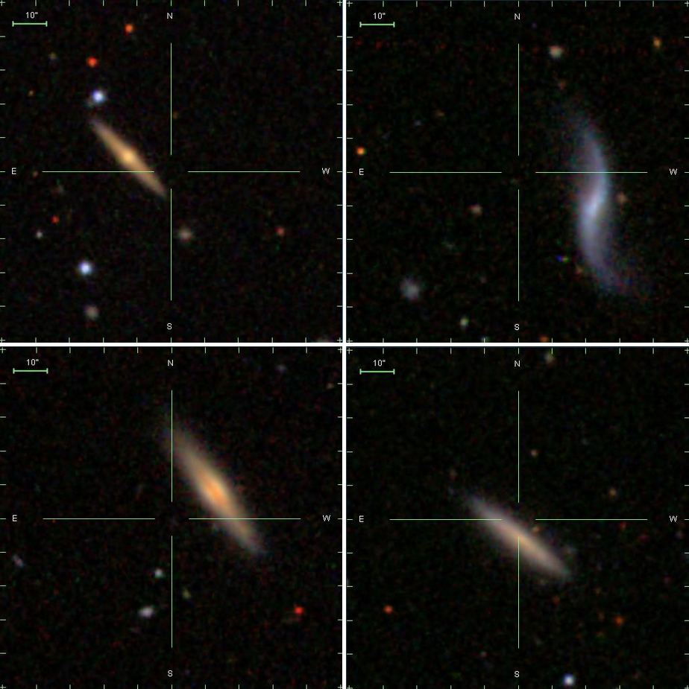
SNe distribution in host galaxies
Because of their long-lived progenitors, only SNe Ia have been observed in E or S0 galaxies, which are, practically, gas and dust free. In contrast to CC events, they are also observed far from the disc of their host galaxies.
1993aj
1999gr
2002ct
1955O

Slide 7
SNe and their hosts in SDSS DR8 (results)
What was the SDSS contribution on measurements of the parameters of the SNe hosts?
We identified 91% of the host galaxy sample (3340 hosts with 3536 SNe) among which the SDSS identification of ∼1100 hosts have been done for the first time.
We provided accurate coordinates, heliocentric redshifts, morphologi cal types, nuclear activity classes (RP, SF, C, LINER, and Sy), apparent g-band magnitudes, major axes (D25), axial ratios (b/a), and position angles (PA) of the host galaxies.

Slide 8
ASC vs SAI SC
We updated spectroscopic types for 67 SNe.
We corrected offsets of 43 SNe and calculated (relatively uncertain) coordinates for 332 SNe with unavailable astrometry via offsets and accurate coordinates of the identified nuclei of their host galaxies.

Slide 9
SDSS DR9
Photometric data is still the same, as in DR8, but with corrected astrometry.
Spectroscopy: Baryon Oscillation Spectroscopic Survey (BOSS) (Dawson et al. 2012) increased the data with additional 539,995 new galaxy spectra, 102,100 new quasar spectra, and 90,897 new stellar spectra.
The 2.5 m telescope

Slide 10
Method of study
There are 39 unconfirmed SNe from SDSS coverage.
Study of the SNe positions in all available images. What could it give us?
If we detect the object in another image (which was taken near the detection epoch of the SN), and see nothing in the SN position in all other images, we can give a confirmation that the object was a real SN.
If we detect an object in the SN position in other images (which were taken far from detection epoch of the SN), we can exclude the event from the catalog as wrongly selected SN.

Slide 11
Method of study
Because of absence of spectroscopic data for these SNe, their types are also unknown.
Study of the SNe positions in SDSS images. What could it give us?
If the host of the SN is early type (E, E/S0, S0) galaxy, or it was exploded far from the disc of its spiral host we suggest a type Ia to be the most possible type for the SN.
If the SN was exploded near the spiral arm, or HII region, we suggest that with high probability the object was CC event.

Slide 12
Method of study
During the morphological classification of the SNe host galaxies we have marked 19 compact (like a star) hosts to analyze their spectra and understand if these events are galactic variables, which were wrongly selected as a SN, or QSO hosts.
For the characterization of these Sne, the spectra from SDSS DR9 were used.

Slide 13
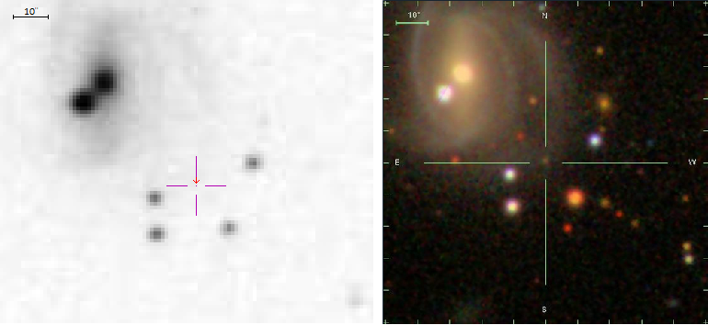
Results
In 3 cases we have found that the object was wrongly selected as SN:
SN 1973O
Star: g=22.33
Is Galactic star!!!
POSS II, J
SDSS

Slide 14
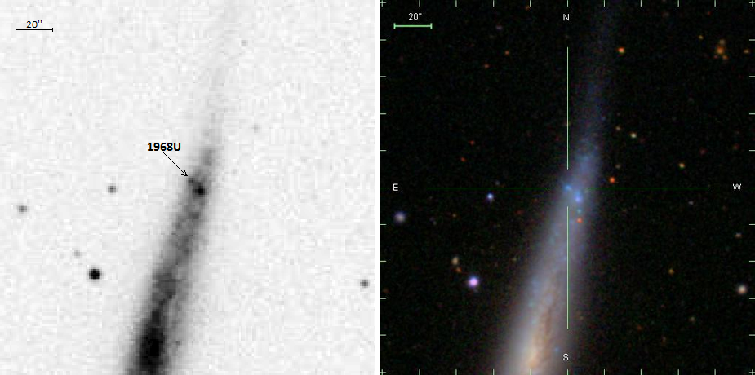
Results
1968U
19868U → HII region!!!
POSS II, J
SDSS

Slide 15
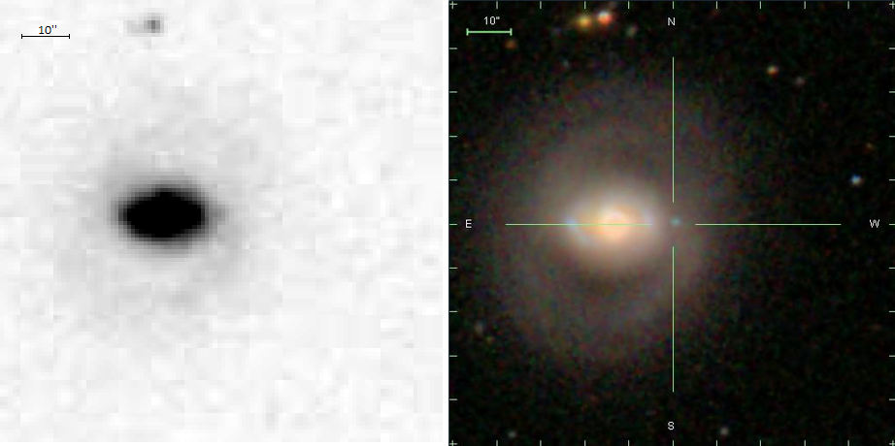
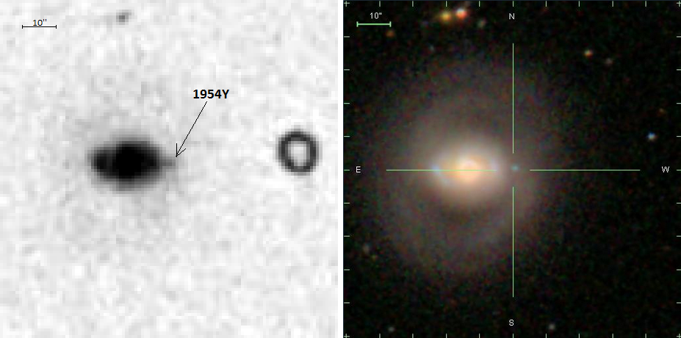
Results
1954Y
What is it?
1954Y → HII region!!!
POSS II, J
SDSS

Slide 16
Results
In addition, via mentioned method we give confirmation for 2 events (1954ad, 1953H), as a real SNe.
For 23 SNe it was possible to suggest a possible type, from which:
11 were SNe type Ia,
and 12 were CC SNe.

Slide 17
Results
The SDSS spectra was available only for 6 (from 19) compact hosts of the SNe. These spectra show that:
4 of them are Galactic stars: 2001ap, 2001at, 2001aw, and 2001am. All these SNe were detected by the QUasar Equatorial Survey Team.
Only 2 of them were QSOs: 2001ca, 2001cc.

Slide 18
Thank you for attention!

