Slide 1

Surface tomography of the
RS Cvn-type double-lined binary V824 Ara (HD 155555)
Levente Kriskovics
Konkoly Observatory,
Budapest, Hungary
kriskovics.levente@csfk.mta.hu

Slide 2
The TempMap Doppler Imaging code
Fris version is written by John Rice (1989.)
This code performs single-line inversion by solving the radiative transfer equation and minimizing this expression:
The initial image is calculated by integrating over the surface
With iterating, the above expression is minimized → this will produce the result image
Regularization is necessary!
    E = ∑∑ [Rcalc(,)–Robs(,)]²+f(M)
Notes:
The used DI code in this study was a newer version of the TempMap code ported to Unix. The original version was written by John Rice.
Basically, the code calculates the local line profiles (R-s) through solving the radiative transfer equation for each section (“pixel”) of the stellar surface. In our case, these segments are 5x5 degs.
After that, thought iterations, the code minimizes the E, and this will produce the result image.
The f notes a regularisation function. Since the S/N is not infinite, there are an infinite number of possible solutions fit to the observations. With the regularisation, we chose the “simplest”.
The inversion is carried out on one line at a time.

Slide 3
Double-lined → extremely difficult target for Doppler Imaging due to line blending
  Simultaneous inversion for the two profiles → two many free parameters (double as usual + vr-shift)
Notes:
Only a few studies have been submitted in the last decades on Doppler Imaging of close, double-lined binaries, because these systems are more difficult to handle than the single stars.
There are DI codes with the ability to carry out the inversions for both profiles simoultaneously, but the number of the free parameters are high even in the single cases... In these cases, double.

Slide 4
Double-lined → extremely difficult target for Doppler Imaging due to line blending
  Simultaneous inversion for the two profiles → two many free parameters (double as usual + vr-shift)
New iterative approach:
  1. Average-profile extraction
  2. Applying Doppler Imaging on the disentangled spectra
  3. Using the map as a template to calculate disturbed profile for the component
  4. Extract the calculated profile from the original spectra
  5. Apply DI on the remaining (the other) component
  6. Repeating
Notes:
Other disentangling methods (as Fourier-disentangling) are not useful in these cases due to the distorions on the profiles therefore we applied a new approach.
First we extracted a template (average profile) of the secondary component and applied DI on the primary profile. With this Doppler map, we calculated the the primary profile corresponding to that map with TempMapForward and extracted that from the original spectra. Then we applied DI on the secondary profiles, and this map could be used to calculate the profiles of the secondary component and extract that from the original spectra, etc. This way we could minimize the possibilty that distortions caused by spots on one profile appear on the other after extraction

Slide 5
V824 Ara (HD 155555): double-lined RS CVn type binary system with two (G5 IV and K0 IV-V) active components
Notes:
V824 Ara is a well-known, pre-main sequence, double-lined active binary star system with a G5 and a K0 compontent.

Slide 6
V824 Ara (HD 155555): double-lined RS CVn type binary system with two (G5 IV and K0 IV-V) active components
Orbital parameters (Strassmeier et al 2000)
Epoch | 2446998.4102
Orbital Period | 1.681646d
Inclination | 52 deg
Eccentricity | 0
Notes:
The orbital parameters can be seen in the table. As you can see the orbital (and rotational) period Is 1.68 days, which makes impossible to cover the whole surface within one rotational period.

Slide 7
V824 Ara (HD 155555): double-lined RS CVn type binary system with two active components
Orbital parameters (Strassmeier et al 2000)
Astrophysical parameters (Strassmeier et al 2000)
Epoch | 2446998.4102
Orbital Period | 1.681646d
Inclination | 52 deg
Eccentricity | 0
 | Primary | Secondary
Teff | 5400±100 K | 5050±100 K
logg | 4.0±0.5 | 4.5±0.5
vsini | 36.8±1 km/s | 33.7±1.5 km/s
m | 1.101±0.013 | 1.001±0.011
Spectral type | G5 IV | K0 IV-V
Notes:
In the second table the astrophysical parameters are summarized. As you can see, the primary component is quite similar to the Sun (of course it is much younger).
These parameters were used during the Doppler Imaging process.

Slide 8
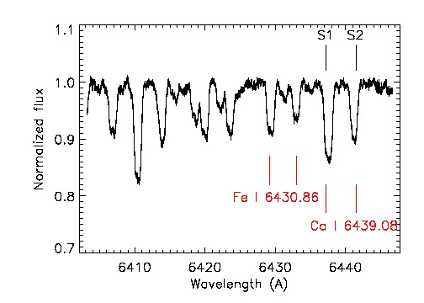
Dataset:
  11 spectra taken between 19. 09. 2002 and 23. 09. 2002 with 3P6-CES (La Silla, Chile) in single order mode covering one orbital period
CES single-order
spectrum from 2002
Notes:
The used spectra were taken with the Coude-Echelle Spectrograph installed on the 3P6 Telescope in La Silla, Chile (this instrument had already been replaced with HARPS). We used 11 spectra covering the 6400-6450 A region of the spectral range. This time-series covers one period adequately and uniformly.
On the panel a typical spectrum can be seen. S1 marks the primary, S2 marks the secondary components. The lower marks indicate the Ca I 6439 an Fe I 6430 lines which were used in the Doppler Imaging process.

Slide 9
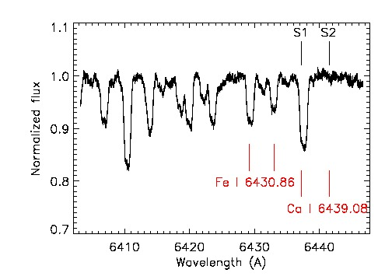
Dataset:
  11 spectra taken between 19. 09. 2002 and 23. 09. 2002 with 3P6-CES (La Silla, Chile) in single order mode covering one orbital period
Example of an
extracted spectrum
Notes:
Here we can see an example of an extracted spectrum. Since the inversion was carried out on one profile, not on all simultaneously, only the disturbing profile was extracted.

Slide 10
Ca I 6439
  The most obvious choice for DI since there are only a few blends in the vicinity of the line
Notes:
Lets see the Doppler Images taken on the Ca line first. As I said this is the most simple case.

Slide 11
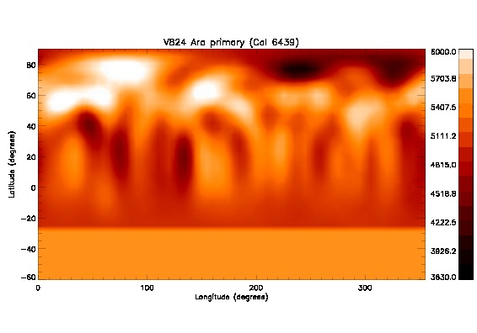
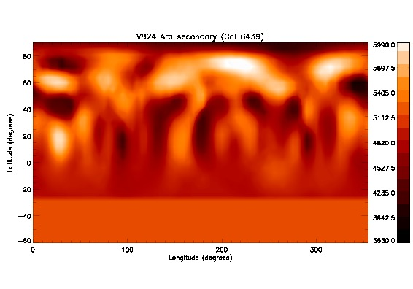
Notes:
The upper figure shows the primary, the lower shows the secondary component's Dopples map in Mercator projection with bars indicating the temperatures corresponding to the colors.

Slide 12
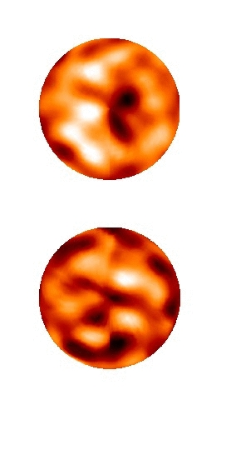
Ca I 6439
  The most obvious choice for DI since there are only a few blends in the vicinity of the line and has a high log(gf)
Notes:
On the right panel the same Doppler maps are seen plotted to a sphere, in pole-on view. The 0 phase is downwards.
On both maps, polar active regions can be found (on a Mercator map, the pole is projected on a line), and mostly on the the secondary, a lot of low latitude nests can be seen.

Slide 13
Ca I 6439
  The most obvious choice for DI since there are only a few blends in the vicinity of the line and has a high log(gf)
Notes:
An other interesting detail on the maps is the hotter regions can be found on both. As it can be seen on the pole-on view, these are mostly concentrated on the opposing hemispheres. The bright features are marked with the ellipses
.

Slide 14
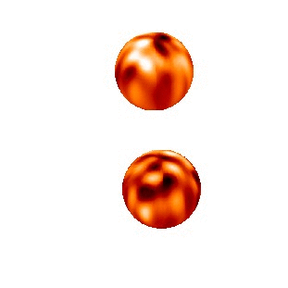
Ca I 6439
Notes:
This gif animation shows the stars moving on a circular orbit with the proper inclination and with the mass-center in the center of the orbit. The size of the stars are similar on the image, which is clearly not the case, but the phases are plotted correcltly,

Slide 15
Fe I 6430
The blending problem (the Fe II 6432 of the primary blends with the Fe I 6430 of the secondary) can be handled by calculating and extracting the Fe II 6432 profile as well
Notes:
The other used mappling line is the Fe I 6430. As I mentioned before, at some phases, the Fe II 6432 line ot the primary component blends with the Fe I 6430 line of the secondary. With calculating and extracting that line profile with the given spot configuration, this problem can be handled.

Slide 16
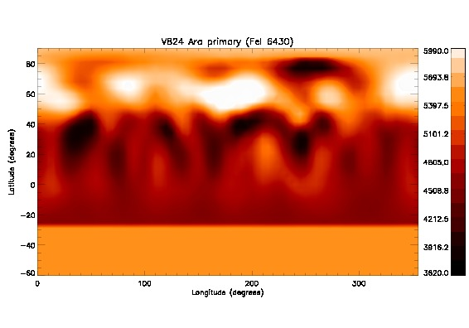
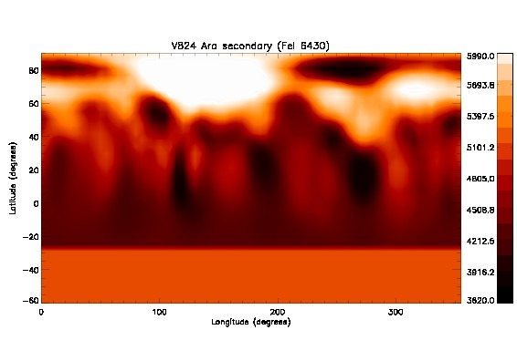
Notes:
Here we can see the primary and secondary components mapped on the Fe I 6430 line. Note that the bright regions are there as well, as the lower latitude active nests, mostly on the secondary components.

Slide 17
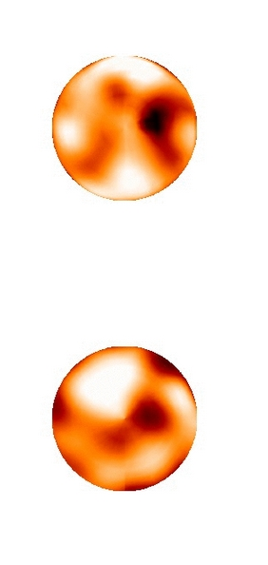
Fe I 6430
The blending problem (the Fe II 6432 of the primary blends with the Fe I 6430 of the secondary) can be handled by calculating and extracting the Fe II 6432 profile as well
Notes:
The same maps plotted on spheres from pole on view, as in the case of the Ca maps.

Slide 18
Fe I 6430
The blending problem (the Fe II 6432 of the primary blends with the Fe I 6430 of the secondary) can be handled by calculating and extracting the Fe II 6432 profile as well
Notes:
The hot regions can be observed on these maps too, which rules out that these are only artifacts. The positions of the spots are similar as well (an note the fact that they are on the opposing hemispheres as expected). There are some differences in the intensities, but this is expected since the two lines are generated in other depths in the stellar atmosphere.

Slide 19
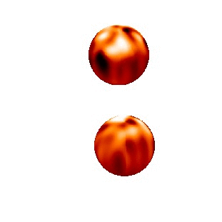
Fe I 6430
Notes:
Here you can see the Fe maps plotted as in the case of the Ca. The bright spots on the opposing hemispheres and the spottedness of the other side of the secondary components can be observerd.

Slide 20
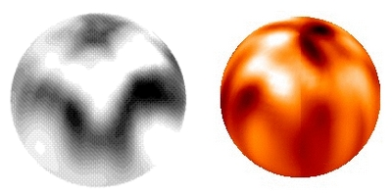
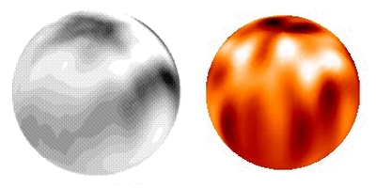
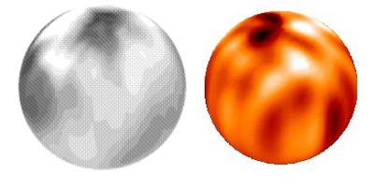
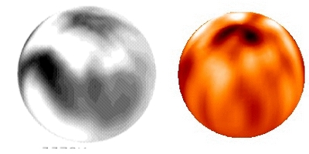
In comparison with Strassmeier et al 2000...
Primary component (Ca I 6439):
  Polar active region seems to be persistent
  Hot spot around ~0 phase is present on both maps
  Low latitude features at ~270
Notes:
With the previously mentioned paper from Strassmeier et al 2000, this study gives us an opportunity to investigate how stable is the magnetic configuration.
The greyscale images are from the mentioned paper, and showing the spot configuration of the primary at the phases of 0, 90, 180 and 270 degrees from left to right and from up to down, respectively.
As you can see, the polar active nest can be found on both maps and therefore may be persistent. The hotter regions are seems to be somewhat persistent as well, with some shift in the longitudes. The active regions on lower latitudes seems to be changing.

Slide 21
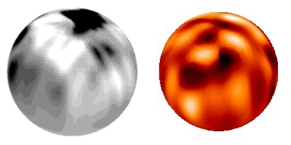
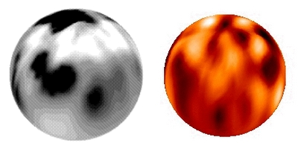
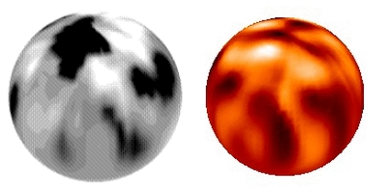
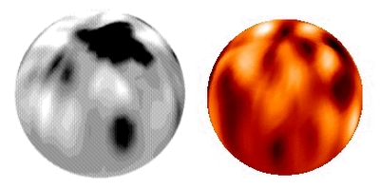
In comparison with Strassmeier et al 2000...
Secondary component (Ca I 6439):
  Polar nest is present, but somewhat weaker on the recent map
  Hot spot at ~0 and 180, but weaker as well
Notes:
On the secondary component, a somewhat constant polar region can be found as well. In comparison with the primary component, the secondary is far more spotted on both maps. The bright regions can be found as well, but with less intensity and area.

Slide 22
Conclusions
The magnetic configuration is not completely unchanged, but there are persistent nests on both components (in comparison with Strassmeier et al 2000, A&A 360, 1019)
  Primary component: lower latitude active regions at ~45 and ~300 degs phase, polar features
  Secondary: weaker polar spot, low latitude active region at ~130 degs
The hotter spots on the opposing hemispheres require further investigation
Notes:
In summary, we can conclude that the new disentangling method works in practice.
We have seen that on both components of the V824 Ara system, there are a few persistent active regions, but on the lower latitudes, the configuration is changing.
The hot spots observed on both components may be a sign of the interacting magnetic fields, and definitely requires more detailed investigation.

Slide 23
Thank you for your attention!
In collaboration with:
Zsolt Kővári
Katalin Oláh
Krisztián Vida
David Garcia

