Slide 1
Panta Rhei
Raimond Snellings

Slide 2
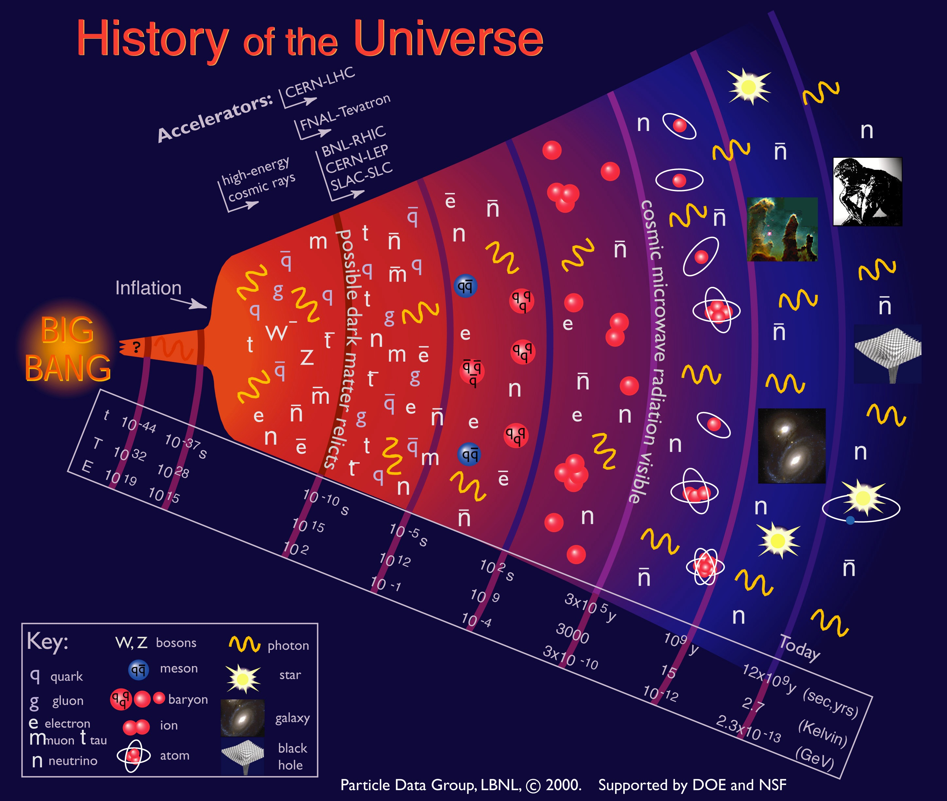
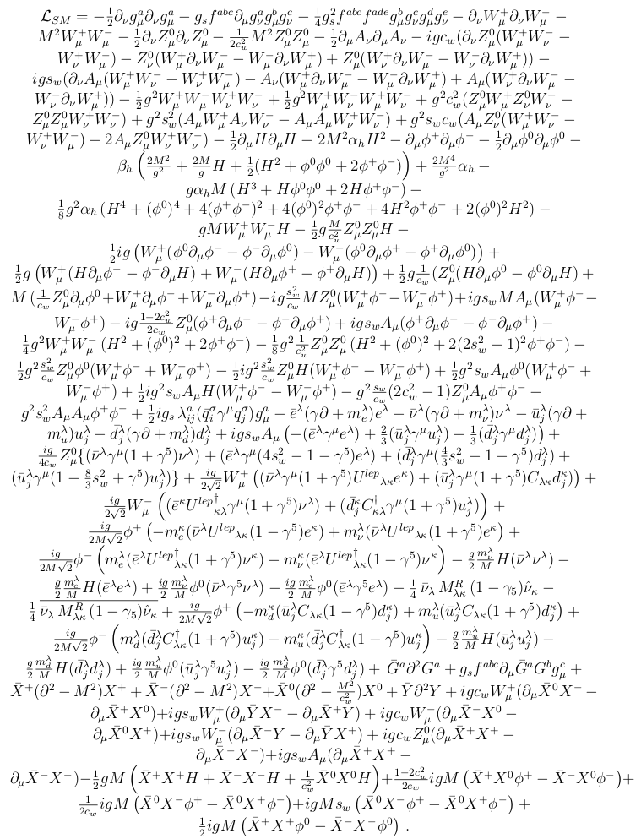
What happens when matter is heated and compressed to very high temperatures and densities?
Quark Gluon Plasma (QGP)
Electroweak phase transition
QCD phase transition
100,000 x T_{core sun}
Do we understand what QCD tells us?

Slide 3
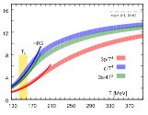
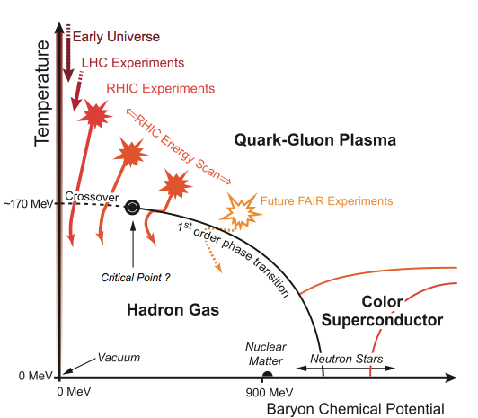
QCD and the Phase Diagram
Lattice QCD predicts a phase transition to a quark gluon plasma at an energy density of about 1 GeV/fm³ and at a temperature of about ~10¹² K
Our current understanding of this new state of matter is very limited!

Slide 4
QCD and the Phase Diagram

Slide 5
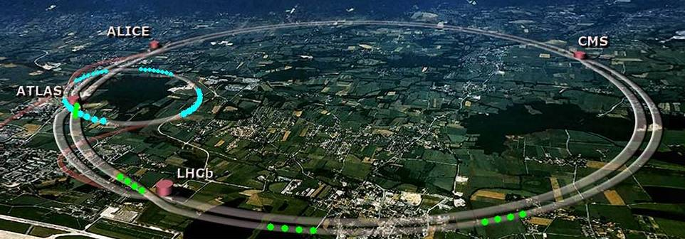
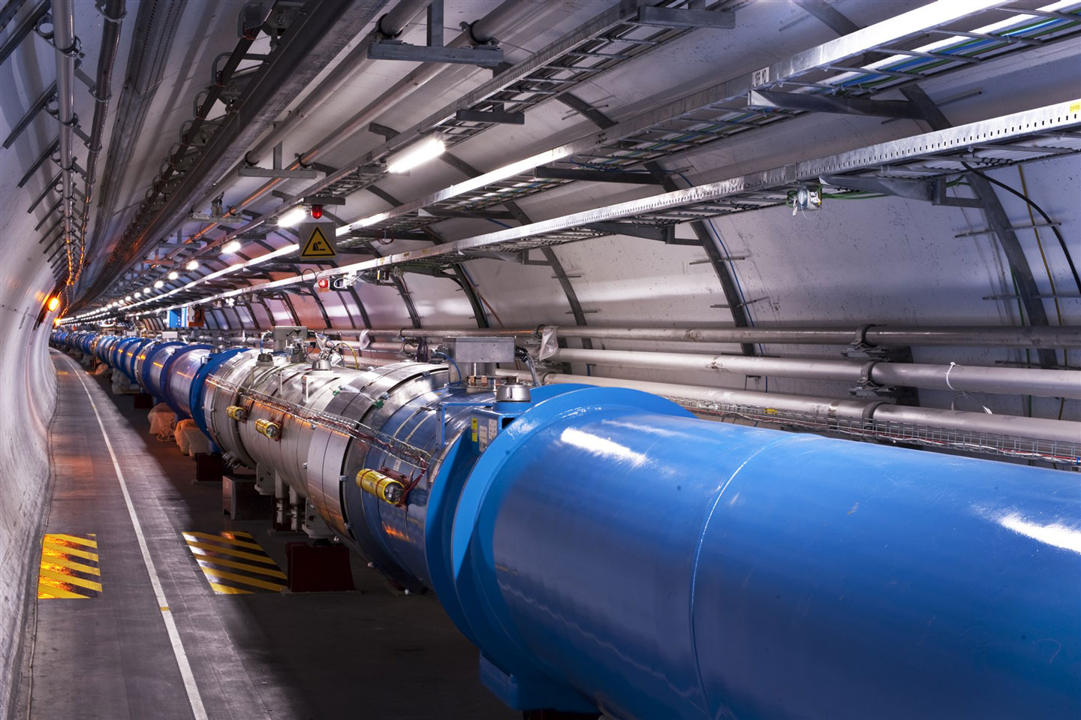
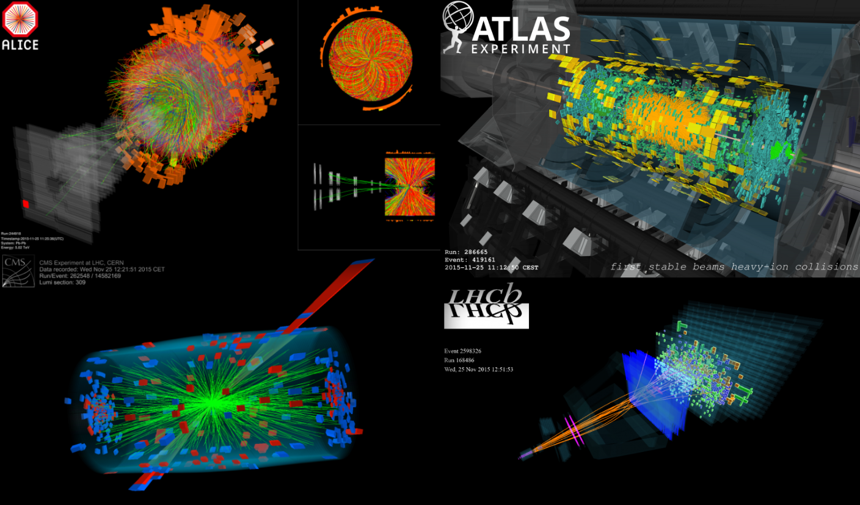
Experimental input needed to understand the phase-diagram
Create a hot and dense system for which hydrodynamics/thermodynamics applies
Collide heavy-ions at the highest possible energies
Measure what happens with state of the art experimental setups

Slide 6
How to connect experimental observables to QCD predictions?
Many of the properties of interest, some which are already calculable in QCD, are difficult or impossible to constrain directly from experimental observables
Created system and its evolution is too complicated to fully describe from first principles
Need well understood control parameters
The spatial geometry of the created system turns out to be one of the best control parameters

Slide 7
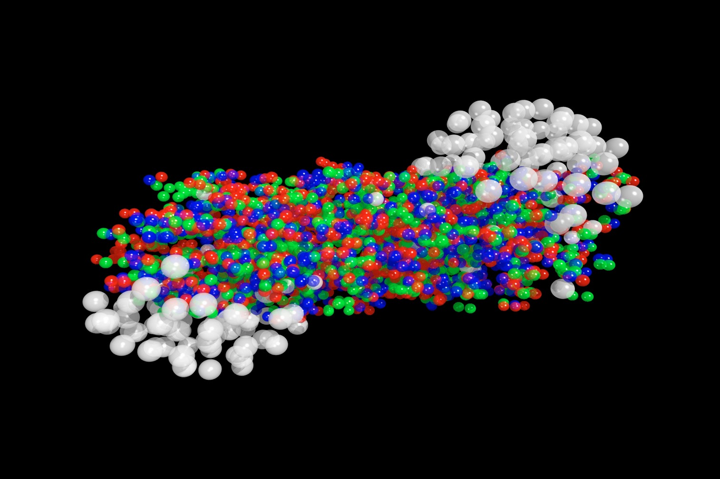
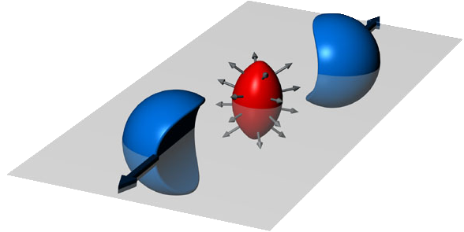
cartoon of a heavy-ion collision
spectators
b
participants
Spatial geometry in transverse plane

Slide 8
Spatial Geometry and Collective Flow
Ollitrault 1992
1) superposition of independent p+p:
2) evolution as a bulk system
high
density / pressure
at center
momenta pointed at random
relative to symmetry plane
pressure gradients (larger in-plane) push bulk “out” → “flow”
more, faster particles seen in-plane
“zero” pressure
in surrounding vacuum
b
b
N
0
π/4
π/2
3π/4
π
φ-Ψ_{RP} (rad)

Slide 9
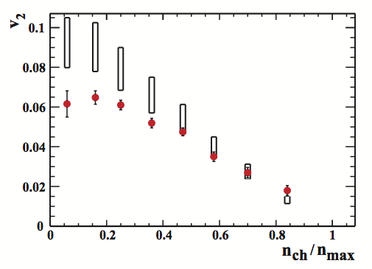
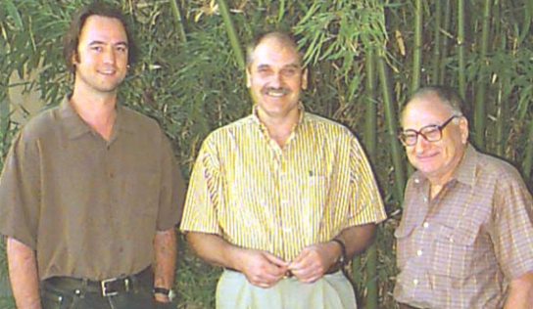
First measurements of Elliptic Flow at the LHC and the succes of a hydrodynamic description
ideal hydrodynamics
R.S., S. Voloshin, A. Poskanzer (Berkeley 2001)
STAR Phys. Rev. Lett. 86, 402–407 (2001)
for more central collisions magnitude of v2 described by ideal hydro

Slide 10
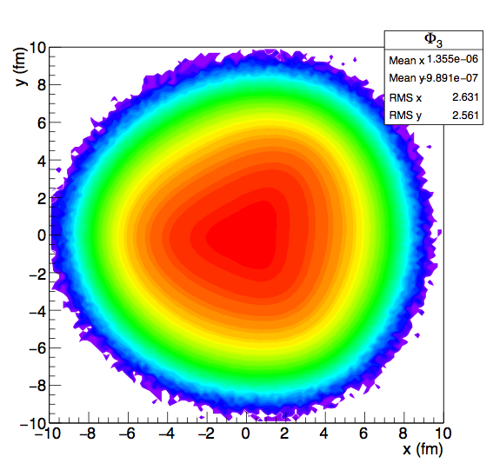
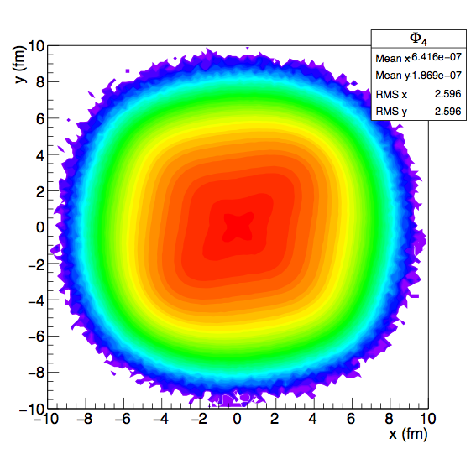
Spatial geometry in the transverse plane
rotated to the planes of symmetry we clearly see the different harmonics

Slide 11
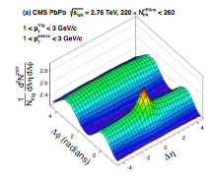
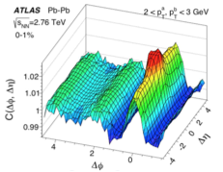
Collective Flow

Slide 12
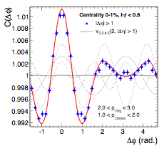
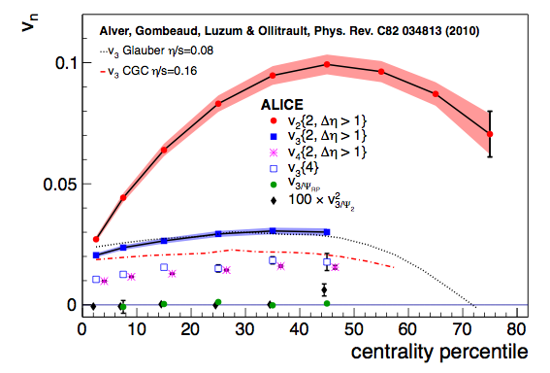
Collective Flow
ALICE arXiv:1105.3865 (2011)
ALICE arXiv:1105.3865 (2011)
Described very well in a viscous hydrodynamic framework

Slide 13
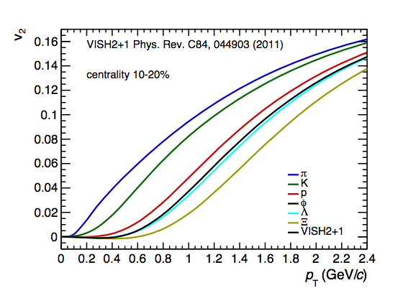
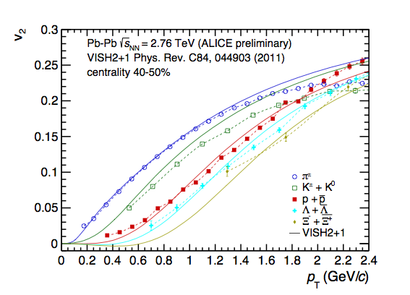
Collective Flow
ALICE arXiv:1405.4632
Described very well in a viscous hydrodynamic framework

Slide 14
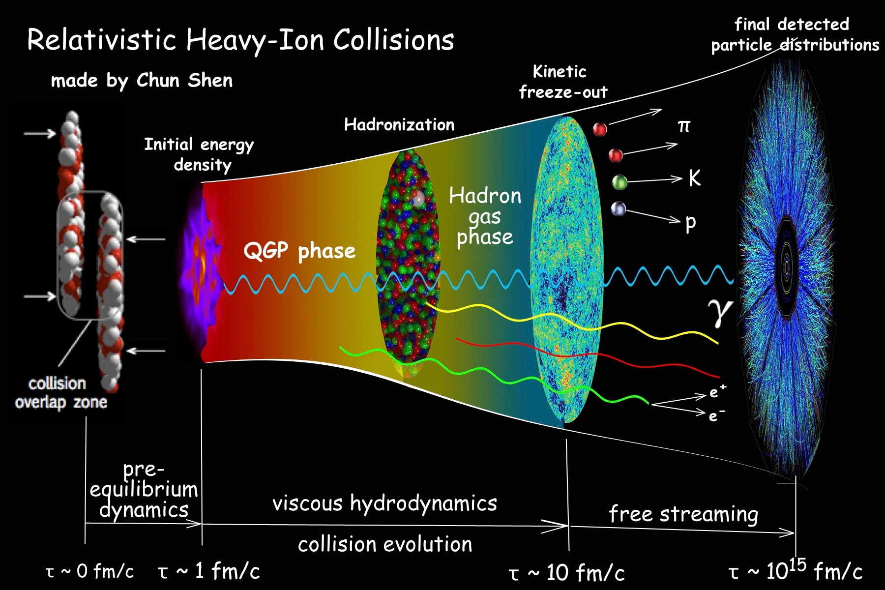
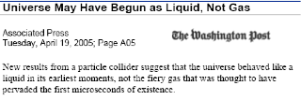
Our current understanding

Slide 15
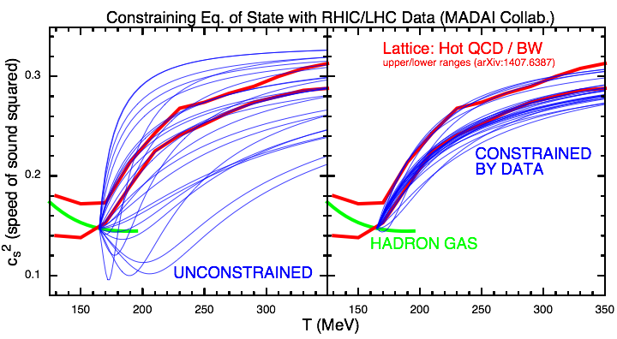
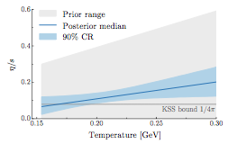
Constraining the QCD EoS and the transport parameters
Analogy: Superconductivity
experimentally discovered 1911:
Heike Kamerlingh Onnes
macroscopic theory 1950:
Ginzburg-Landau
microscopic theory 1957:
Bardeen, Cooper and Schrieffer

Slide 16
Summary
Making use of the spatial anisotropy we can study in detail the strong collective motion in the hot and dense system created in collisions of heavy-ions
allows us to test the QCD EoS and strongly constrain some of the key transport parameters
New insight in the properties of matter around the QCD phase transition
Panta Rhei

