Slide 1

AE Budapest 2017
Boris Sharkov
JINR, Dubna

Slide 2
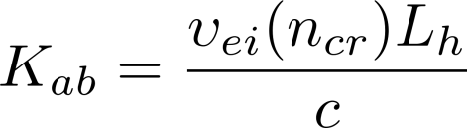
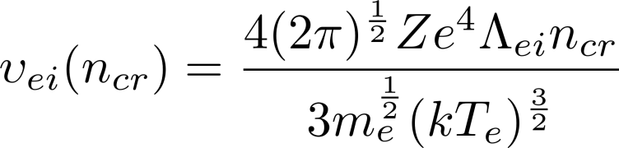



Laser – plasma interaction
J (W/cm2) = 10E12 – 10E14 W/cm2
The inverse Bremsstralung absorption coefficient is given by
where
is the electron-ion collision frequency , T_{e} is the temperature
of the plasma electrons, Z is the ion charge state, e and m_{e}
are the charge and mass of the electron, respectively. Λ_{ei} is the
Coulomb logarithm (Λ_{ei} ≈ 8 - 10), is the
critical electron density, c is the speed of light, is the
scale length of the underdense plasma region, is the plasma
velocity, and is the laser pulse duration.

Slide 3
Charge state distribution
In the case of thermal equilibrium the Saha eqaution determines the relative abundance of charge states.
Notes:
The abundance of a specific charge state depends on temperature as shown in this figure.

Slide 4
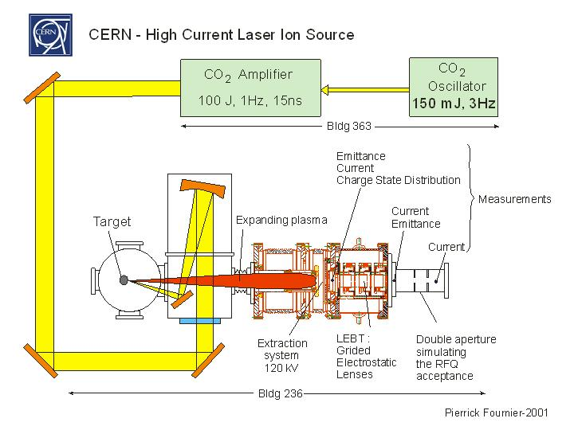
Laser Plasma Ion Source –at ITEP and at CERN
Capable of delivering Pb, In, Nb… ions with rep-rate 1 Hz
For Pb 25+ : 7,7 mA / 3.5 mks , 0.6 10 E10 ions measured
emittance – 0.2 mm mrad (normalized)
Notes:
Heavy Ion accelerators usually ask for high charge state ions for cost effectiveness of the acceleration process.
Intense laser radiation above 10**12 W/cm**2 is the most effective tool to heat matter to very high temperature. However the technical realization of a laser ion source requires some experimental skill also during the long time operation of such a source. We developed a LIS based on a CO2 for the CERN heavy ion program. It was successfully developed and tested and was later operated for many years at ITEP

Slide 5
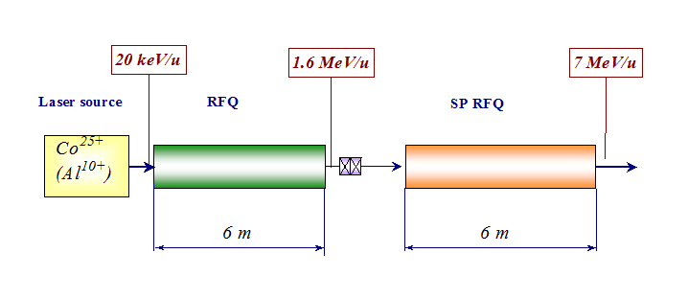
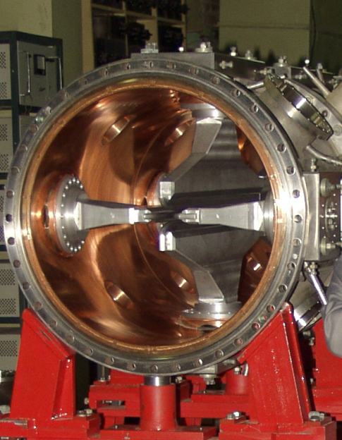
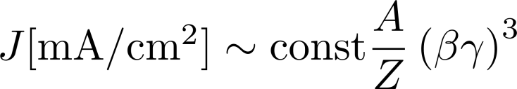
Current limitation in linear accelerators
Alfred Maschke (BNL 1979) : ion current space charge limit for any quadrupole-focusing system

Slide 6


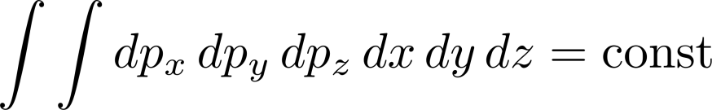
Liouville’s Theorem
A large number of particles in a beam can be described by one point in 6D phase space per particle given by its coordinates and momenta (qi, pi).
The system of ensemble of particles can be described as a density which is a function of the position in phase space :
Liouville's theorem states that the density of particles in phase space is a constant :
Liouvielle’s theorem for an ensemble of non-interacting particles states that the 6D volume occupied by a given number of particles remains invariant:
i.e. in an ideal accelerator system (only linear fields) the normalized emittance remains constant from the source to the target

Slide 7
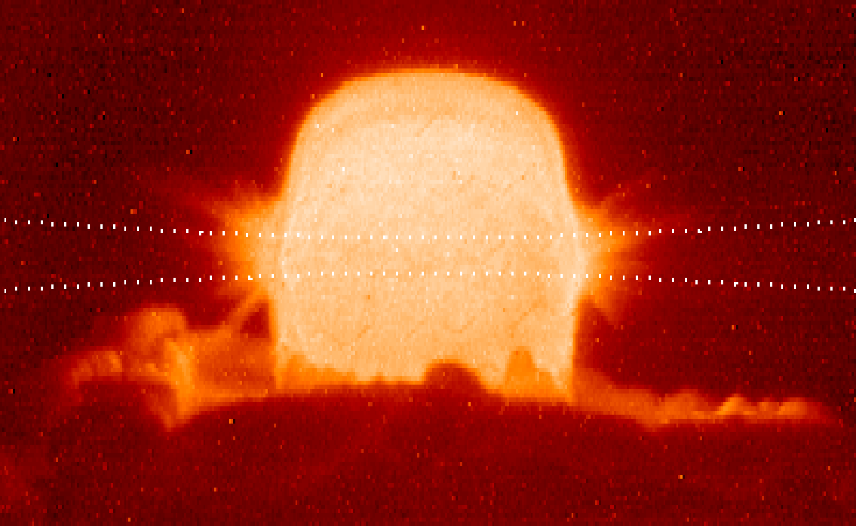
Intense beams of energetic heavy ions are an excellent tool to create and investigate extreme states of matter in reproducible experimental conditions
Intense Heavy Ion Beams
large volume of sample (N mm3)
fairly uniform physical conditions
high entropy @ high densities
extended life time
HI : high entropy states of matter - without shocks !

Slide 8
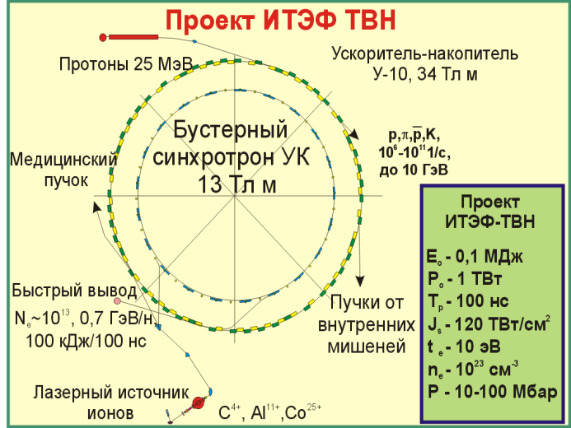
Accumulation of an intense heavy-ion beam
non-Liouvillian atomic or molecular processes could be
used to enhance dramatically the final beam quality for driving a target.
The first possibility is the stacking of a beam from a LINAC into a ring
(either a storage ring or a synchrotron).
Use of photoionization of Bi1+ at this stage was suggested by Carlo Rubbia,
but would require high-power far-UV lasers.
The second possibility is stacking of many pulses accelerated in a synchrotron
into a storage ring.
C. Rubbia, Nucl. Instr. and Meth. A 278 (1989) 253.
D.G. Koshkarev, B.Yu. Sharkov, R.C. Arnold - Nucl.Instr and Meth. in Physics Res. A 415 (1998) 296-304.

Slide 9
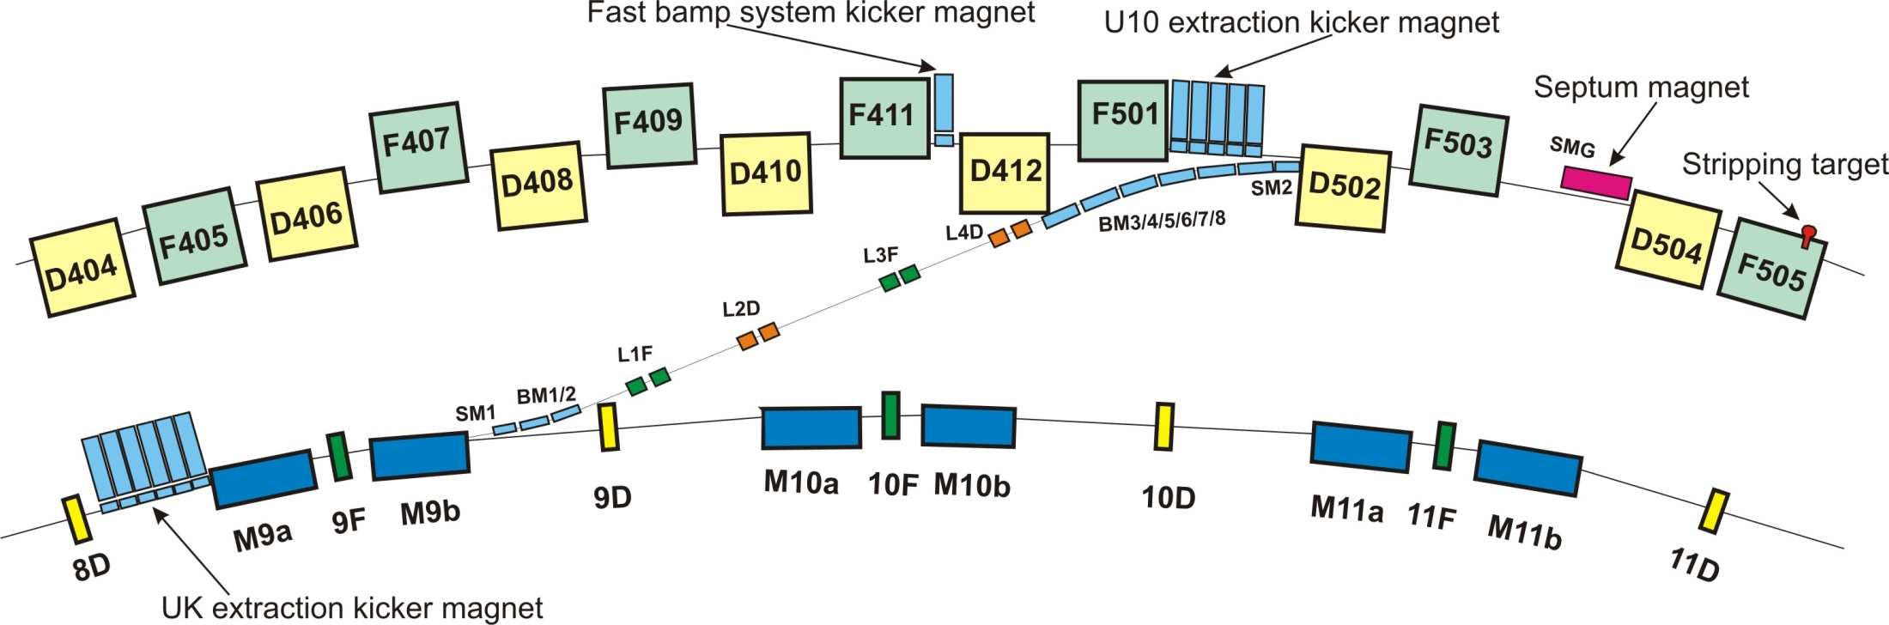
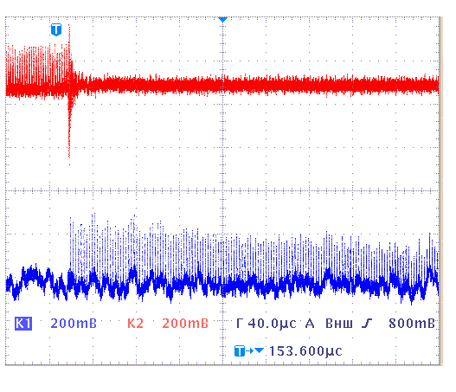
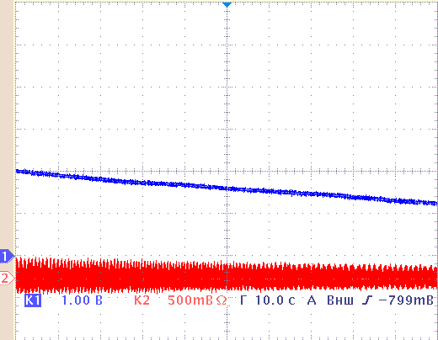
Non-Liouvillian Injection into the storage ring @ ITEP
Accumulator ring U-10
Booster ring UK
C⁴⁺
τ ∼ 7,5 min
C⁶⁺
Notes:
Non-Liouvillian carbon nucleus accumulation at the ITEP storage accelerator facility
N. N. Alekseev, D. G. Koshkarev and B. Yu. Sharkov
Eingefügt aus <http://www.springerlink.com/content/71x538rj226066tx/>
Physical start-up of the new heavy-ion storage accelerator facility has been successfully performed at the Institute of Theoretical and Experimental Physics. Carbon nuclei with an energy of 200 MeV/n are accumulated in the storage ring of the 10-GeV U-10 proton synchrotron, which is converted into an ion accumulator. The accumulation is accomplished using solid-target charge exchange of C⁴⁺ ions that are accelerated in the UK booster synchrotron. Thus, non-Liouvillian carbon nucleus accumulation is accomplished experimentally. Our immediate goal is to raise the amount of accumulated nuclei to 2 × 10¹², which corresponds to the possibilities of the available facility configuration.

Slide 10
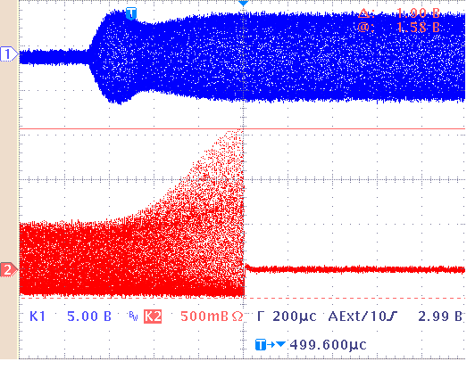
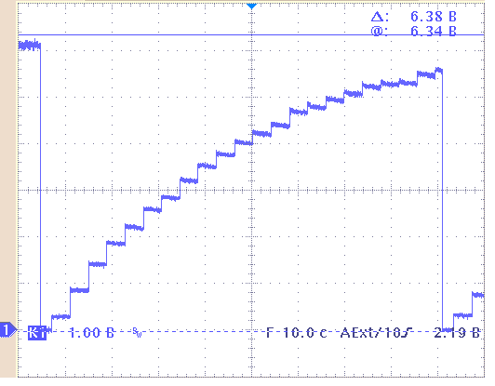
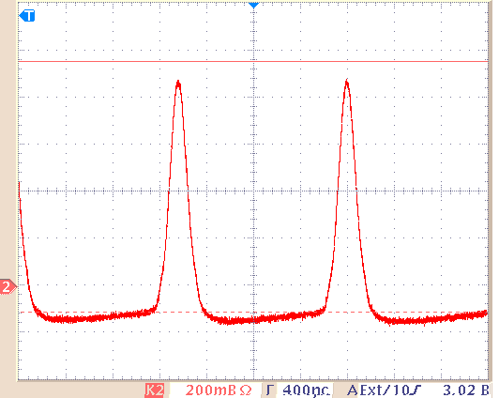
Non-Liouvillian stacking process
RF bunch compression
Stacking process for 213 MeV/u C6+
RF : fo = 695 кHz, 10 кV
Ni > 10^10
170 нс

Slide 11
HI IFE Concept
Ground plan for HIF power plant
B.Y. Sharkov BY, N.N. Alexeev, M.M. Basko et al., Nuclear Fusion 45(2005) S291-S297.
Slide № 3 Medin S.A. et al

Slide 12
Fast ignition with heavy ions: assembled configuration
With a heavy ion energy ≥ 0.5 GeV/u, we are compelled to use cylindrical targets because of relatively long ( ≥ 6 g/cm² ) ranges of such ions in matter.
The 400 kJ ion pulse duration of 200 ps is still about a factor 4 longer than the envisioned laser ignitor pulse. For compensation, it is proposed to use a massive tamper of heavy metal around the compressed fuel:
Assembled configuration
Ignition and burn propagation
t = 0
t = 0.2 ns
Fuel parameters in the assembled state: ρ_{DT} = 100 g/cc, R_{DT} = 50 μm, (ρR)_{DT} = 0.5 g/cm².
2-D hydro simulations (ITEP + VNIIEF) have demonstrated that the above fuel configuration is ignited by the proposed ion pulse, and the burn wave does propagate along the DT cylinder.
Notes:
Slide 10: EPS2003, July 7-11.

Slide 13

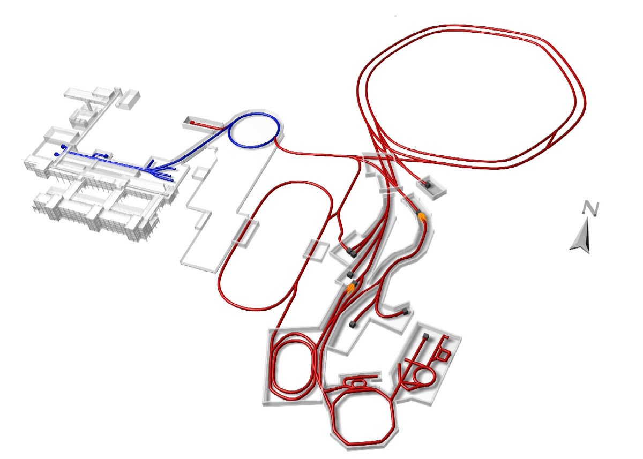
Facility for Antiproton and Ions Research –
the light tower of the ESFRI Roadmap
New accelerator systems entered the construction phase in Darmstadt
Synchrotrons
SIS100 SIS300
p - LINAC
300m
Rare Isotope
Production Target
Antiproton
Production Target
High-Energy Storage Ring
HESR
Superconducting
large-acceptance Fragment Separator
Super-FRS
Collector Ring
CR
Recycled Exp. Storage Ring RESR
New Experimental Storage Ring
NESR

Slide 14
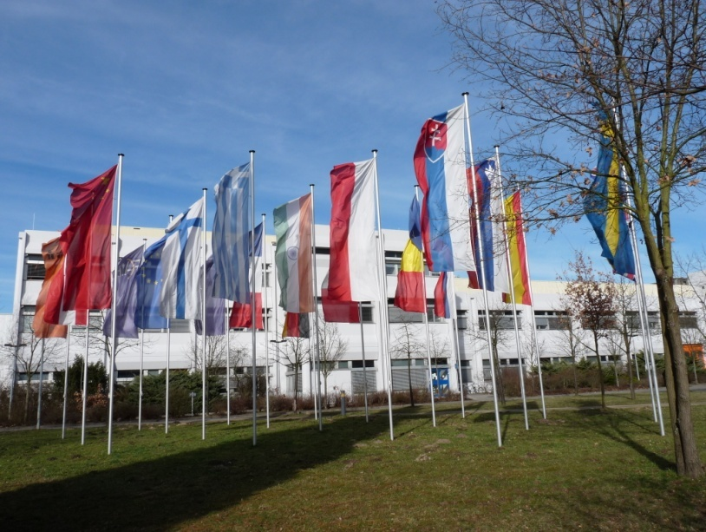
The 4 Scientific Pillars of FAIR
APPA: Atomic, Plasma Physics and Applications
CBM: Compressed Baryonic Matter
NUSTAR: Nuclear Structure, Astrophysics and Reactions
PANDA: Antiproton Annihilations at Darmstadt
In total: 2500 – 3000 Users
from 49 countries
  Scientific program is competitive and world class

Slide 15
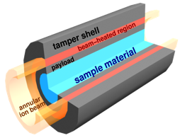

High Energy Density experiments of HEDgeHOB collaboration
HIHEX
Heavy Ion Heating and Expansion
LAPLAS
Laboratory Planetary Sciences
uniform quasi-isochoric heating of a large-volume dense target, isentropic expansion in 1D plane or cylindrical geometry
hollow (ring-shaped) beam heats a heavy tamper shell cylindrical implosion and low-entropy compression
Numerous high-entropy HED states:
EOS and transport properties of e.g., non-ideal plasmas, WDM and critical point regions for various materials
Mbar pressures @ moderate temperatures:
high-density HED states, e.g. hydrogen metallization problem, interior of Jupiter and Saturn
Vladimir Fortov

Slide 16


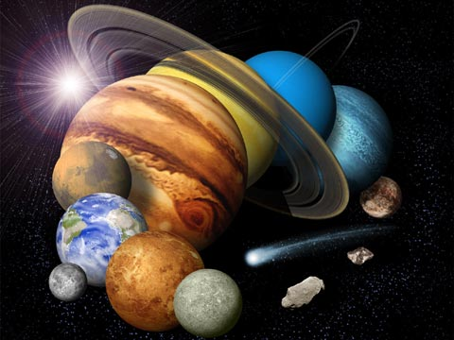
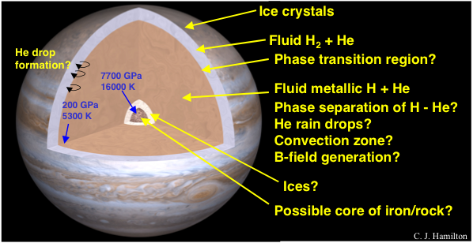
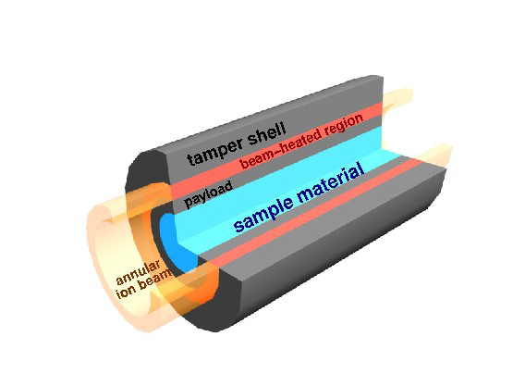
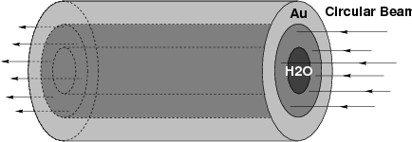
LAPLAS [LAboratory PLAnetary Sciences]
Experimental Scheme: Low entropy compression of a test material like H, D2 or H2O, in a multilayered cylindrical target
[Hydrogen Metallization , Planetary Interiors]
N.A. Tahir et al., PRE 64 (2001) 016202; High Energy Density Phsics 2 (2006) 21;
A.R. Piriz et al, PRE 66 (2002) 056403.
Hollow Beam Au or Pb Circular beam
Shock reverberates between the cylinder axis Very high densities, high
and the hydrogen-outer shell interface. pressure, higher temperature
Very high ƥ (23 g/cc), ultra high P (30Mbar) , ƥ= 1.2 g/cc, P = 11 Mbar,
low T (of the order of 10 kK). T = 5 ev

Slide 17
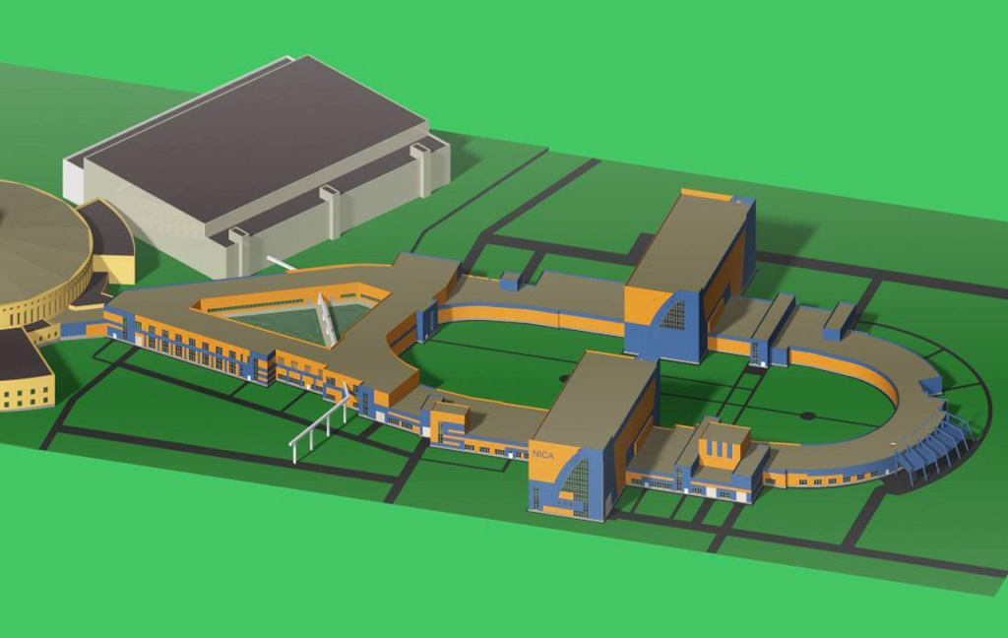
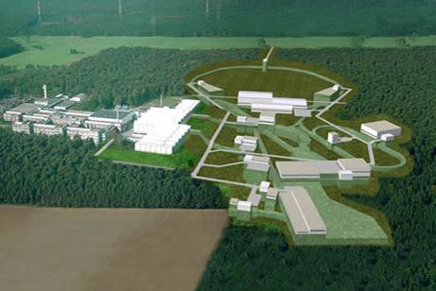
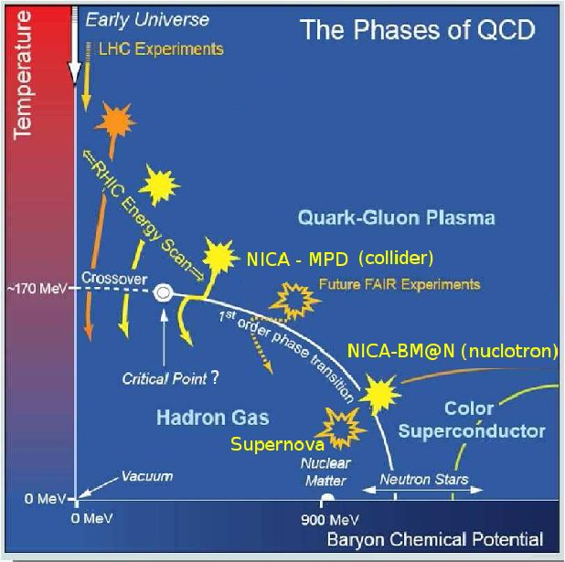
FAIR + NICA : extreme state of nuclear matter
JINR NICA/MPD
Nuclotron-based Ion Collider fAcility
FAIR/CBM
E_{lab} < 60 GeV/n
√sNN = 4 ÷ 11.0 GeV/n
Average luminosity
10²⁷sm⁻²s⁻¹ Au x Au
E_{lab} ~ 34 GeV/n
√sNN = 8.5 GeV
Particle intensity
(for U) up to 10¹¹ ppp
Complimentary research program FAIR - NICA

Slide 18

Thank you for attention !

