Slide 1
FROM ION BEAM TECHNIQUES TO NANOSTRUCTURES
József Gyulai
Professor Emeritus
Energy Res. Centre, Inst. Tech. Phys.& Matl. Sci., MFA
Chair Electronic Devices, BME-BUTE,

Slide 2
At the dawn of integrating transistors on a single chip
– as Gordon Moore predicted and to fortune of academics – there was an open chance to apply ideas from solid state physics and chemistry.
At next development stage, atomic scale precision of preparation techniques became critical – more engineering, less academics.
Today, again physics is coming, but at level of quantum physics, atomic magnetism.

Slide 3
My encounter with ion beam techniques
Being ’best time and best place’ occurred at Caltech as post-doc in the group of Prof. J.W. Mayer from 1969 on, for more than a decade.
My first contribution was finding out how depth-dependent chemical composition can be extracted from Rutherford Backscattering and Channeling spectra (RBS+C).

Slide 4
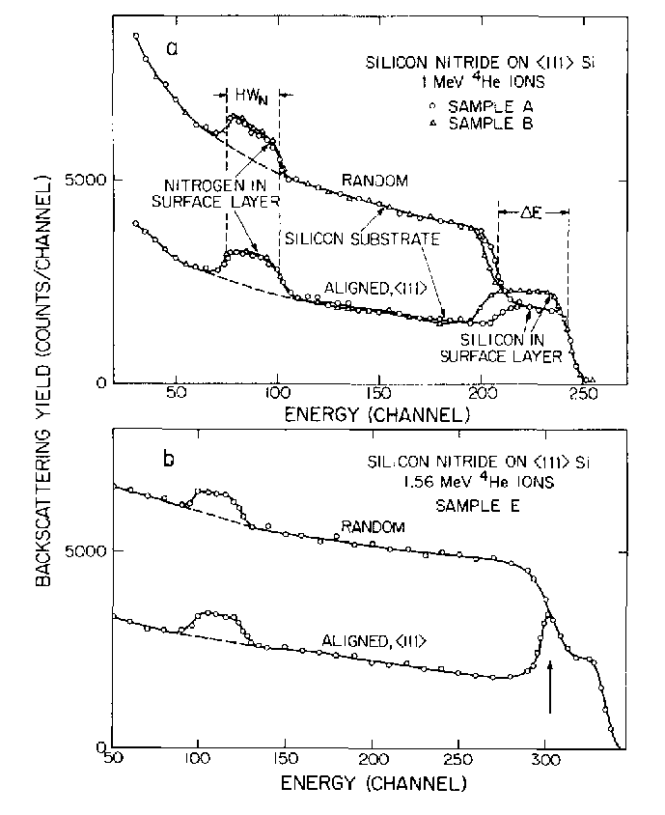
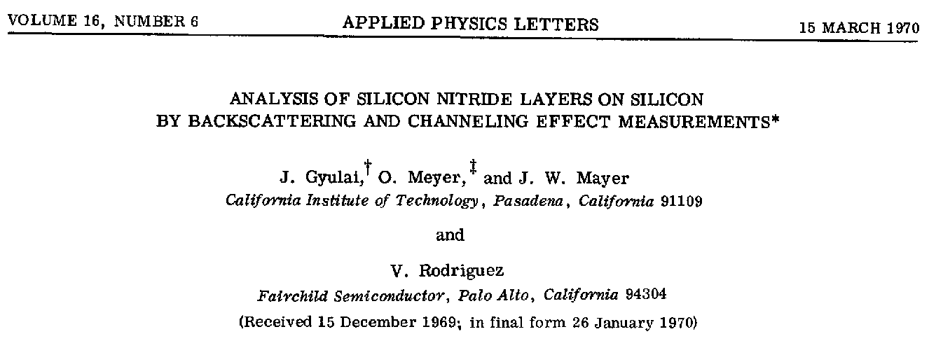
This earned my acceptance in Mayer’s group

Slide 5
Why ”best place”?
Co-author, Val Rodriguez, of Fairchild Development, an earlier Caltech PhD, came to visit us in fall 1969, and I got the task to explain him what we can measure and think on RBS and future of ion implantation, a too early patent of W. Shockley.
It was just one year after Intel left the ’mother company’ and Fairchild was not yet aware of loosing all positions to Intel in the field of semiconductors,
so it was Val who supported my work with up-to-date problems of industry and ’world’s first’ samples (11 papers in one year!)
Intel, in its start-up phase, has not valued usefulness of implantation at all (personal discussions, 1970); this slowly changed from 1975, when R.D. Pashley, our fresh Caltech PhD, later inventor of flash memory, got a job at Intel; today
over 20 implantation steps in production of a processor

Slide 6
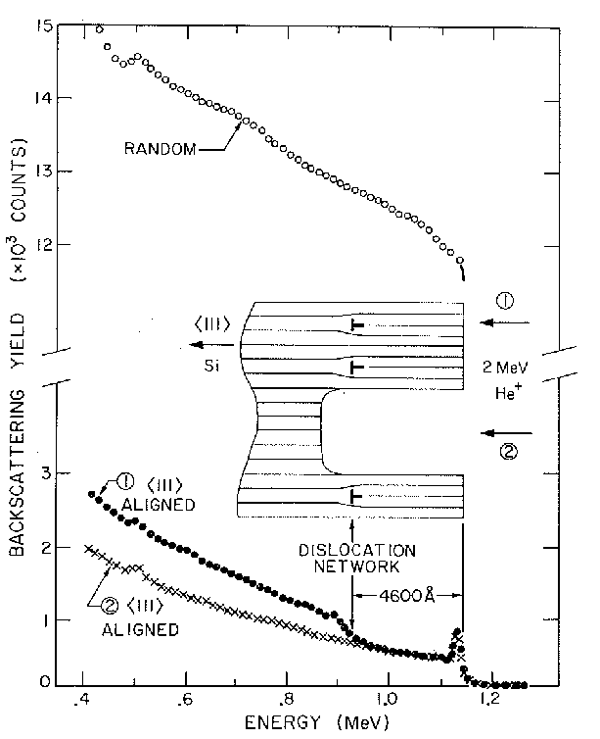
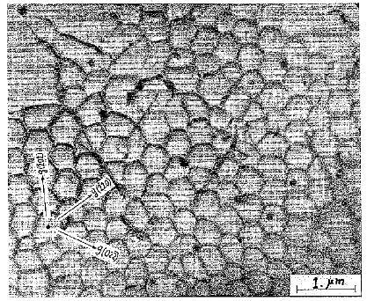
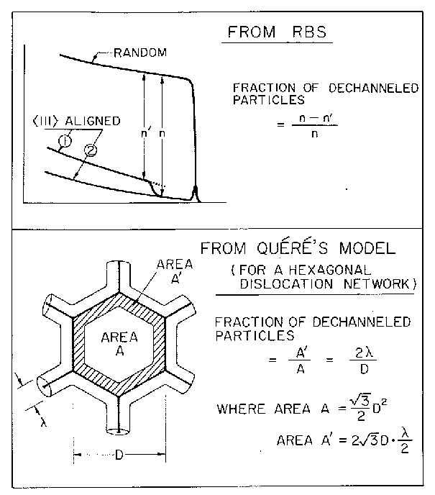
We were adding tricks to RBS: based on that dechanneling being very sensitive to defects, e.g., with etching – area of a dislocation network was deduced
[
110]
W.F. Tseng, J. Gyulai, S.S. Lau, J. Roth, T. Koji, J.W. Mayer: Nucl. Instr. Meth. 149, 615 (1978)

Slide 7
My life after joining my family
Back to Hungary in 1970, organization of a new facility on ion implantation in semi-conductors and on nuclear analytical techniques was the task of a new group at the ‘that-time’ Central Res. Inst. of Phys., KFKI, where I’ve been invited to join.
From 1974 on, an NSF-supported Caltech-KFKI exchange program, maybe the first with an Eastern bloc country, involving Mayer’s and Gyulai’s group made the Budapest group accepted in international community

Slide 8
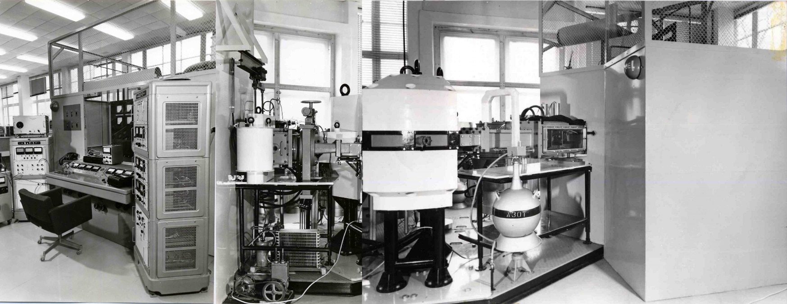
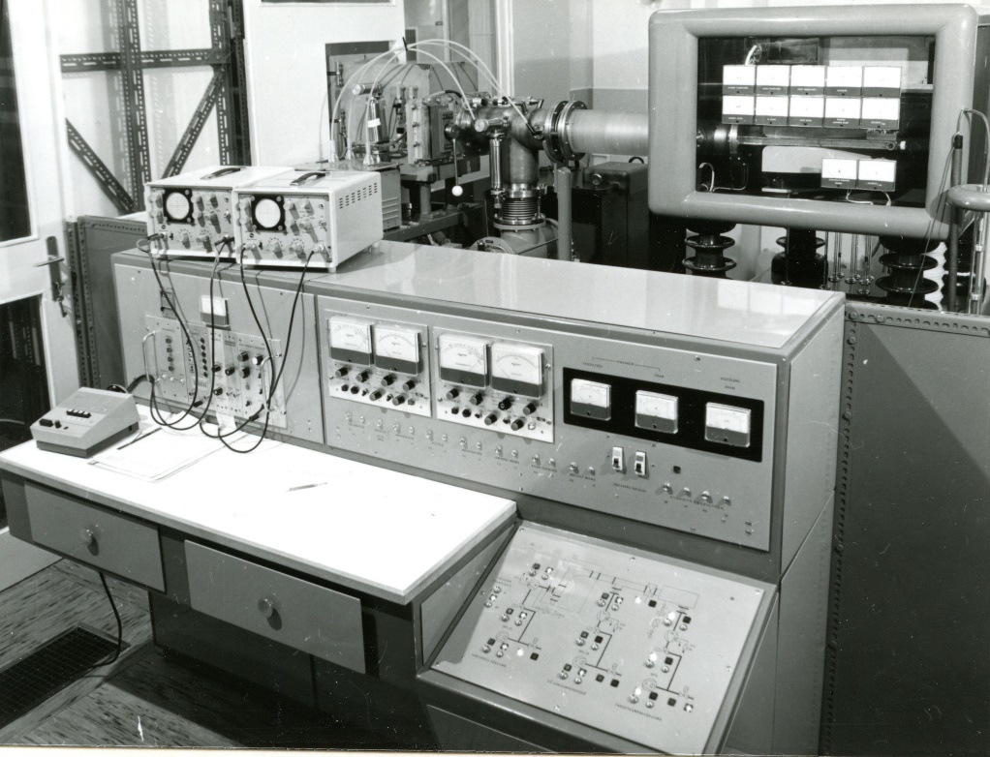
Our first two equipment for implantation
The Kurchatov mass separator ILU-2 at KFKI (above);
High current ion source was designed by M. von Ardenne (as a ’POW’ in the Soviet Union)
Our home made 150 kV implanter, SAFI, E. Pasztor’s group (right)

Slide 9
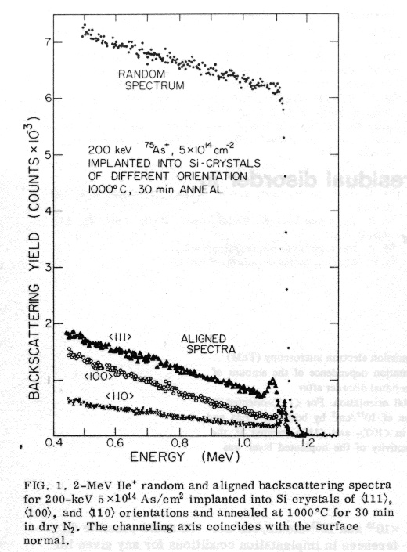
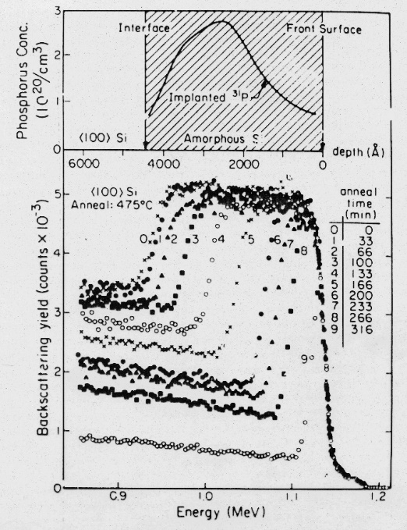
Main contributions of the NSF-supported “Mayer-Gyulai” group
Proving that as substrate (100)-oriented silicon is preferential not only for oxide quality, but also for better reordering of implantation defects – contribution to paradigm change of silicon crystal industry (H. Müller, W.K. Chu, J. Gyulai, J.W. Mayer, T.W. Sigmon, T.R.Cass: APL 26, 292 (1975))
The “Pre-amorphization” technique, curing most negative effects of implantation, proved to be crucial for implantation to become industrial practice;1) amorphization with Si/Ge ions, 2) implantation of dopant, 3) proper anneal; main contributor our L. Csepregi, e.g., JAP 48, 4234, 1978

Slide 10
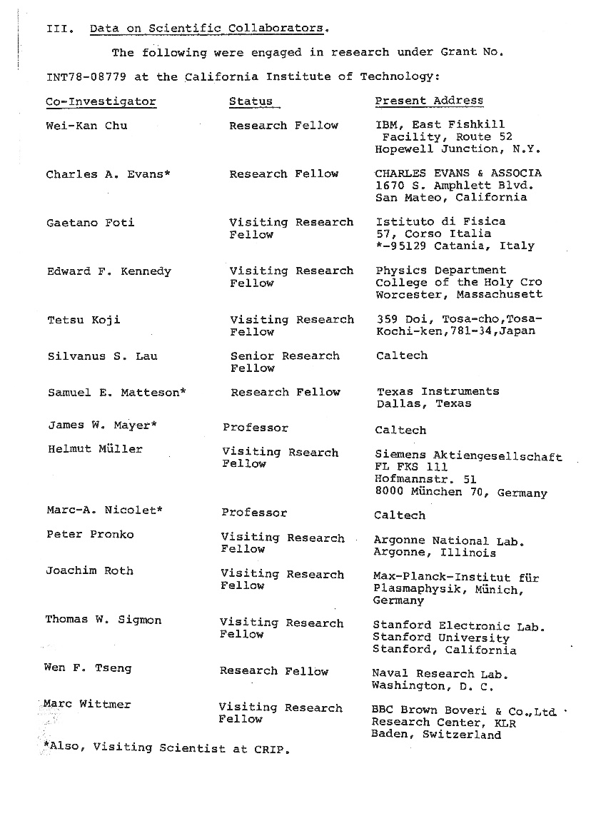
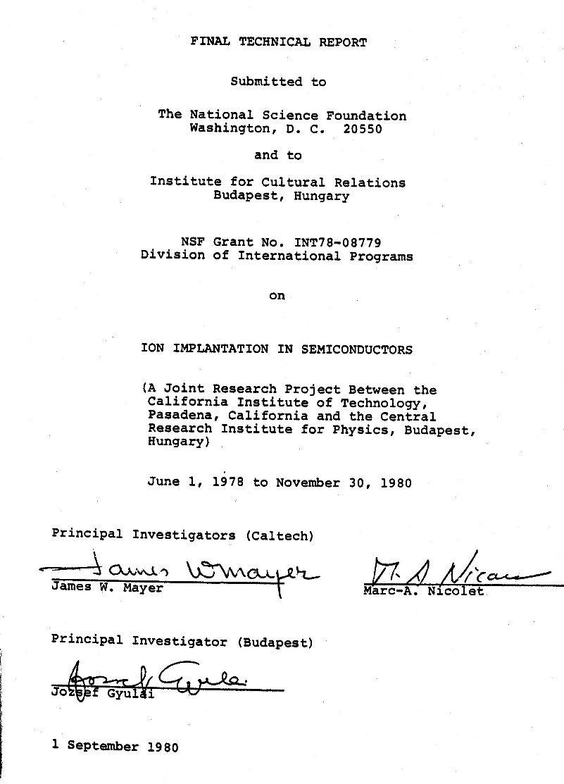
The NSF-CRIP (KFKI) program resulting in 32 joint papers in first years. Right: Westerners involved

Slide 11
My years, 1988-2000, with Prof. H. Ryssel, at and with FhG-Inst. für Integrierte Schaltungen-B, Erlangen
Being ”Zweitgutachter” of seven students there
One example: To success of implantation “Defect engineering” developed as science on verge of solid state physics and engineering
Because of forward peaking character of implantation, type of damage closer to surface is vacancy rich, deeper interstitial rich
Using multiple energy non-doping implantation, a layer can be produced, where relations are more balanced and conditions for defect reordering are favourable (JG at FhG IIS-B: C. Dehm, J. Gyulai, and H. Ryssel, Appl. Phys. Lett. 60 (1992) 1214)

Slide 12
The KFKI, now the MFA semiconductor group
Already from the late eighties we’ve switched to sensorics as a field, where our full, though limited capability semiconductor line allowed us to reach noticeable and applicable results.
Today, especially, in the field of Micro- and Electromechanical Systems, MEMS, e.g., lab-on-chip type novelties (I. Barsony, P. Fürjes, Cs. Dücsö, M. Serényi, et al.).
A strong electron microscopy group with long tradition is partner in numerous EU projects and also supporter of local research (P. Barna, A. Barna, G. Radnoczi, J. Labar, B. Pecz, et al.).

Slide 13
The Budapest RBS – IBA Group
Working on its own, numerous methods, SW solutions were developed by the group improving capabilities of Ion Beam Analysis, IBA – RBS simulation, PIXE simulation, influence of multiple scattering, etc. (E. Kotai, †F. Pászti, G. Vizkelethy, E. Szilágyi, G. Battistig, et al.), (longest supported) cooperation with CNRS Groupe des Phys. des Solides, Paris VII, G. Amsel, I. Vickridge, et al. (JG, E. Szilágyi, G. Vizkelethy, G.Battistig, †É. Vázsonyi, et al.)
Cooperation with Sevilla, Lisbon, with M. Takai, Osaka University (T. Lohner, †F. Pászti, JG), also contributed to gain reputation in IBA community.

Slide 14
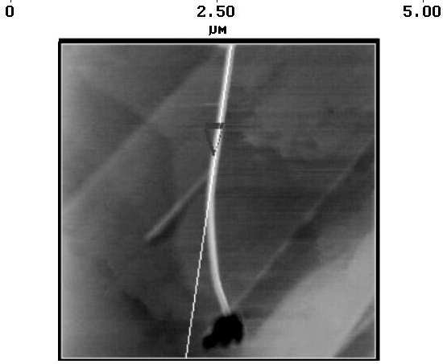
Toward nanoscience in Budapest
Scanning probe measurement of last jumps at swift ion damage (L.P. Biró, J. Gyulai, and K. Havancsák, A.Yu. Didyk, S.Bogen, and L.Frey: Use of atomic-force microscopy and of a parallel irradiation geometry for in-depth characterization of damage produced by swift Kr ions in silicon. Phys. Rev.B, 54(1996)11853-11856),
Discovery of carbon nanotube (CNT) condensation from plasma of swift (>200 MeV) ion impact crater (with L.P. Biró and K. Havancsak, PR B, 52 (1995) 2047)
With heavy ions (Xe) single wall (SW), light ion (Ne) multiwall MWCNT forms – showing influence of plasma density and of cooling rate

Slide 15
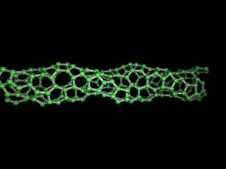
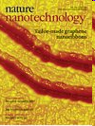
Forms of nanostructures
Forms of nanostructures by incorporating 5- and 7-atom rings
P. Nagy, R. Ehlich, L.P. Biró, and J. Gyulai: Y-branching of single walled nanotubes,
Appl. Phys. A 70(2000)481-483
The Biró-Tapasztó group today focuses on 2D-materials (graphene, Mo-disulphide, bionanostructures, structuring, lithography), etc., visit www.nanotechnology.hu,
E.g., L.Tapasztó, G. Dobrik, P. Lambin, L.P. Biró: Nature Nanotechnology 3, 397(2008)
This conference: Burgen Scholar talk of P. Vancso

Slide 16
Let me truly appreciate those colleagues, who helped and proposed me to become member of this prestigious Academy – the honour is shared among members of groups to whom my long career was bound.

