Slide 1






The next Heavy Ion Jet INteraction Generator
HIJING++
^{1,6}Sz. M. Harangozó, ^{2,3}G. Y. Ma
Supervisors:
¹G. G. Barnaföldi, ⁶G. Papp , ^{2,3}B. W. Zhang
Founders:
^{2,3,4}X-N. Wang, ⁵M. Gyulassy
Contributors:
⁷W. T. Deng, ⁶O. Nieberl
1、Wigner Research Centre for Physics, Hungarian Academy of Sciences
2、Institute of Partical Physics, Central China Normal University
3、Key Laboratory of Quark & Lepton Physics, China
4、Lawrence Berkeley National Laboratory
5、Columbia University in the City of New York.
6、Department of Theroretical Physics, Eötvös Loránd University
7、Huazhong University of Science and Technology.

Slide 2
Outline
Introduction
Work preparation
Turning point
Research progress
Plans and Outlook

Slide 3
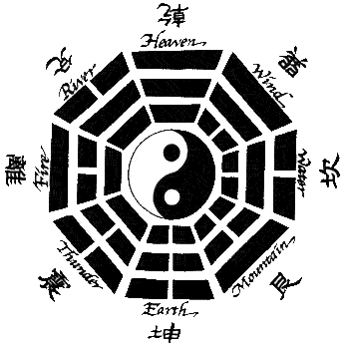
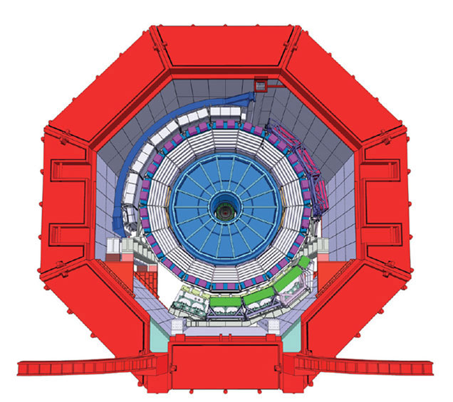
Introduction
HIJING(Heavy-Ion Jet INteraction Generator)
易經
Bagua (eight simbols)
fundamental principles of reality
adjoint representation 8 of SU(3)
Notes:
This slide introduces HIJING and our motivation

Slide 4
Introduction
HIJING(Heavy-Ion Jet INteraction Generator)
HIJING++ But why C++?
Pythia8 is written in C++
Object oriented language: Hierarchy, Modularity
C++11/14 has thread support and compatibility with OpenCL
Notes:
This slide introduces HIJING and our motivation

Slide 5
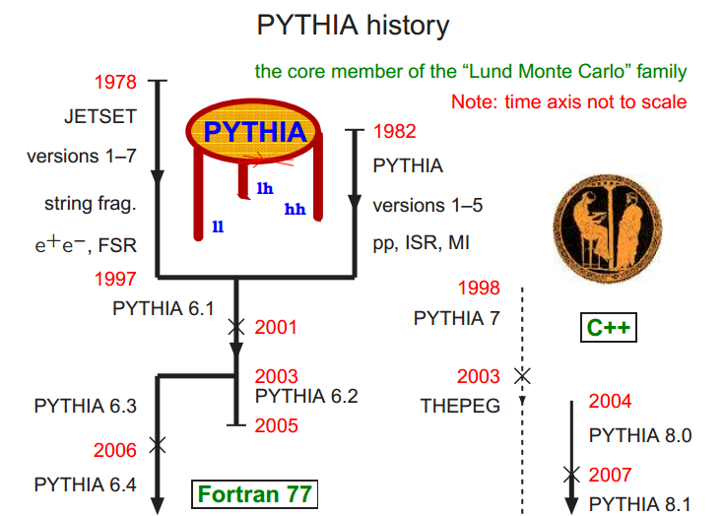
Introduction
Notes:
This silde introduce the evolution of pythia and jetset

Slide 6
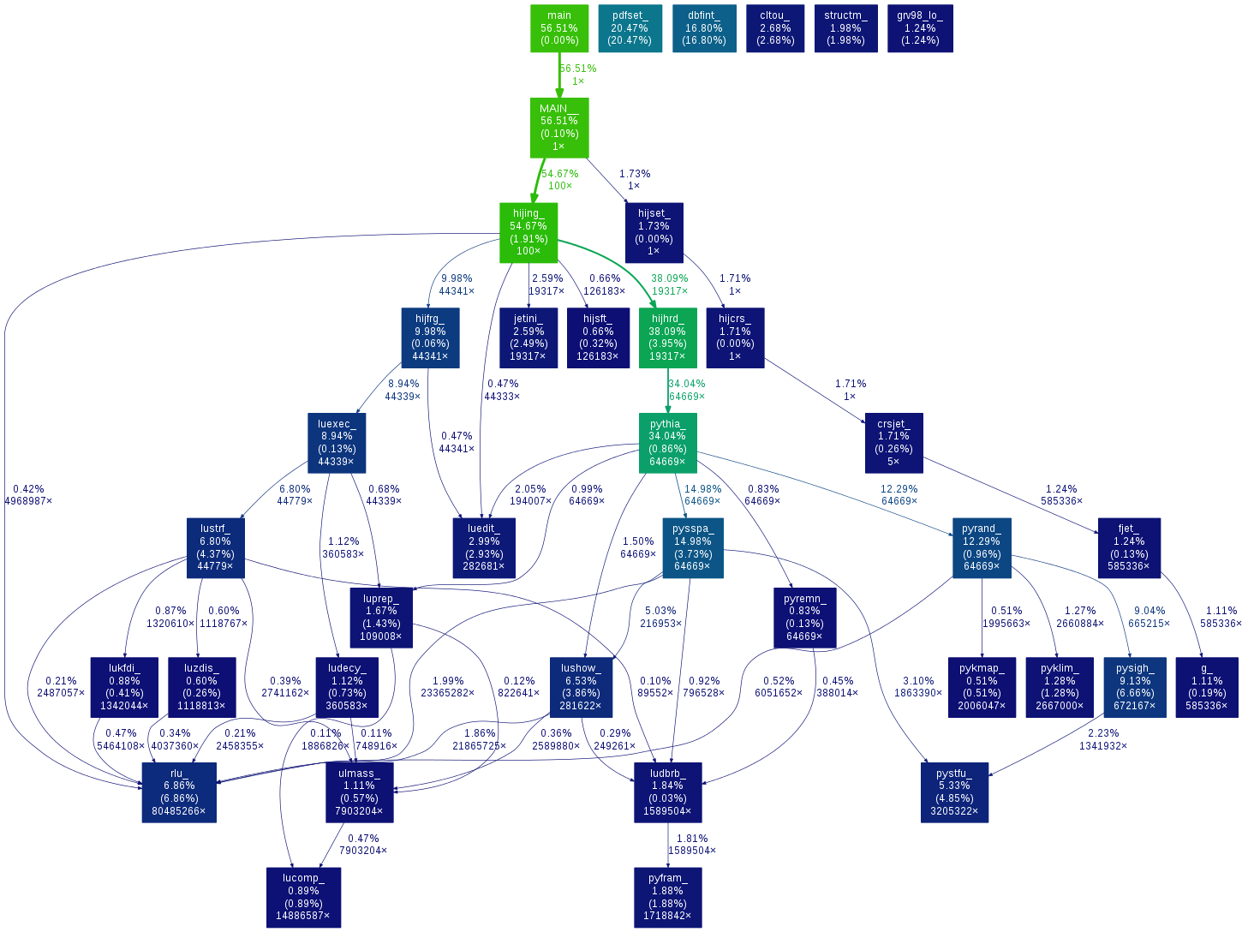
Early stages and preparation
Program analysis:
  HIJING
    deprecated PDF library → LHAPDF6
    optimized PDF initialization
    typos
  Pythia
    analogues between version 5/6 and 8
    finding connetion points
    workflow analysis
Initial idea: change only the Pythia parts in the program
Notes:
This silde introduce the prepararion work we have done so far.

Slide 7
Early stages and preparation

Slide 8
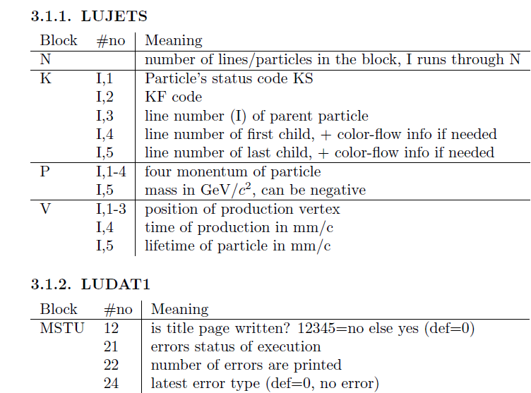
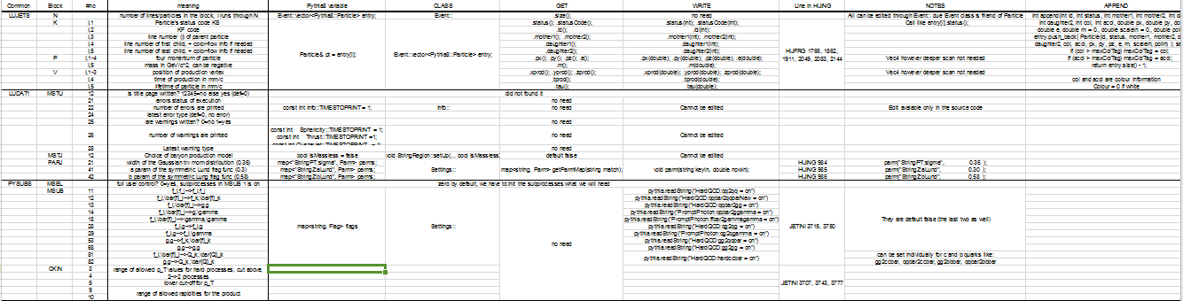
Early stages and preparation
Creating the dictionary:
  HIJING and Pythia connections
  Pythia5/6 and Pythia8 analogues
  Operation on variables
Problem encountered…

Slide 9
To Pythia8
Pythia8 does not support HIJING in it’s current form
Possible solutions:
write an interface between Pythia and HIJING
Modify the Pythia8 at some points
Recreate the HIJING

Slide 10
To Pythia8
Pythia8 does not support HIJING in it’s current form
Possible solutions:
write an interface between Pythia and HIJING
Modify the Pythia8 at some points
Recreate the HIJING
HIJING++ is the ultimate goal…
class Hijing
Following:
Structure
Hierarchy
Guidelines
HIJING only part
Pythia8
Pythia8-modified part

Slide 11
Function validation
cross validation required
results should match
prevent speed loss
Notes:
This silde introduce the tools we are using

Slide 12
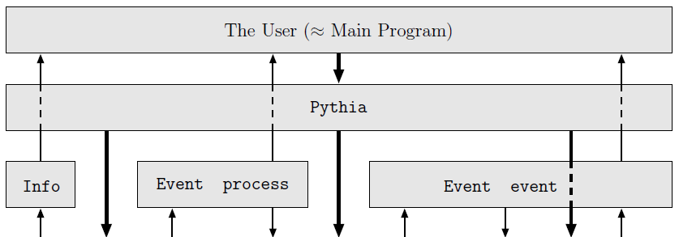
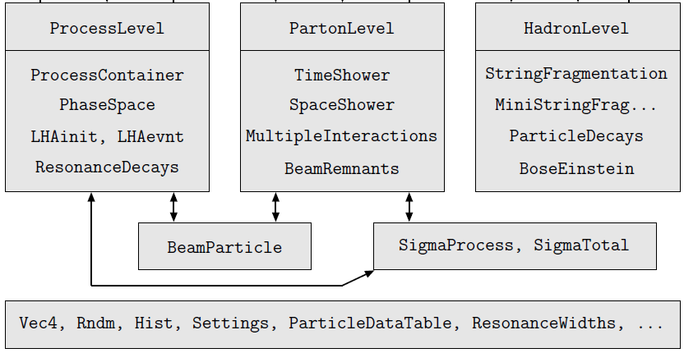
Work Progress
HIJING
Event collector
PYTIHA
Info
Event process
Event event
NucleusLevel

Slide 13
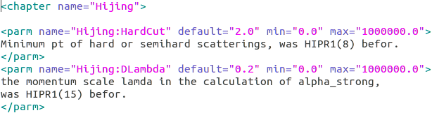
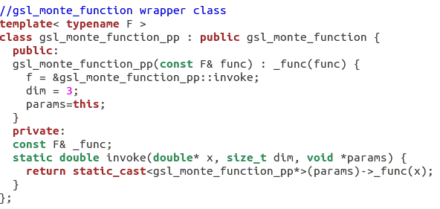
Work Progress
Tools and depencies:
Storing Parameters
XML library
GSL
LHAPDF6
CERNLIB
HOPPET
VEGAS Monte-Carlo integration
DGLAP Toolkit, interpolation
Notes:
This silde introduce the tools we are using

Slide 14
Model improvements
Shadowing
Jet quenching
ARIADNE
Upgrading HIJING shadowing with QCD evolution
Implementing various models
Notes:
A Program for Simulation of QCD-Cascades
Implementing the Colour Dipole Model

Slide 15
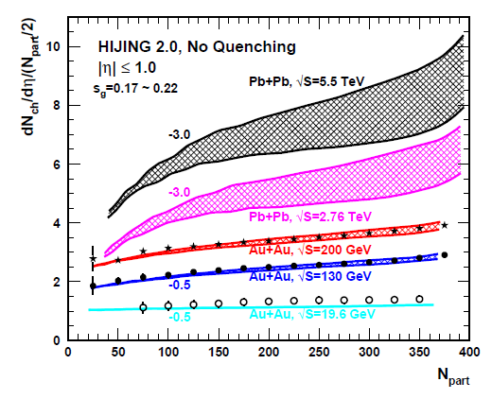
Results from HIJING 2.0
HIJING 2.0 fits RHIC data well;
Improvements are needed in LHC energy;
Solution:
Update the shadowing implementation
in HIJING.
Original parameterization in HIJING
only has x, b-dependence ---- R(x,b).
We want to involve QCD evolution
for the shadowing factor ---- R(x,Q,b).
arXiv:1008.1841

Slide 16
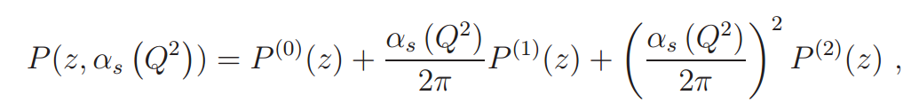
HOPPET: Higher Order Perturbative Parton Evolution Toolkit
It's a Fortran 95 package for carrying out DGLAP evolution and other common manipulations of parton distribution functions(PDFs).
Unpolarised evolution is provided to NNLO, including heavy-quark thresholds in the MS scheme, and longitudinally polarised evolution to NLO.
It uses Runge-Kutta techniques to accomplish the Q-evolution.

Slide 17


Shadowing QCD-evolution
HOPPET
Notes:
原来就有x,b依赖；现在我们再加入Q依赖。

Slide 18


Shadowing QCD-evolution
sq=0.1 is fixed by the data on DIS
sg is the main parameter to adjust
the shadowing effect in HIJING
The shadowing is enhanced in central
collision; but is weakened in peripheral
collision
Notes:
原来就有x,b依赖；现在我们再加入Q依赖。

Slide 19
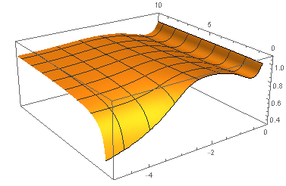
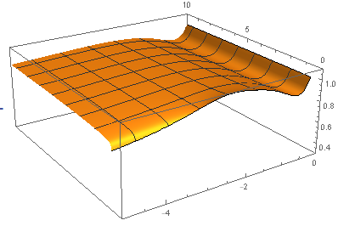
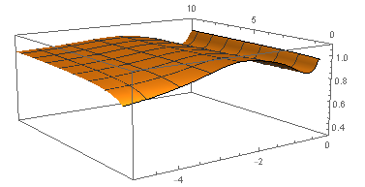
AuAu 200GeV^{(sg=0.3,sq=0.1)}

Slide 20
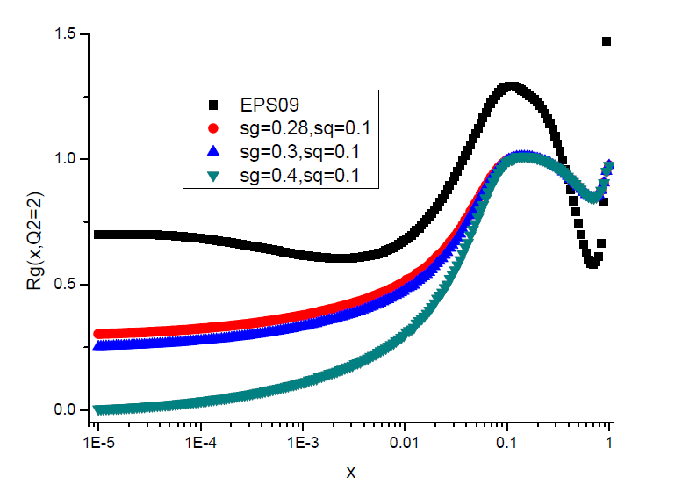
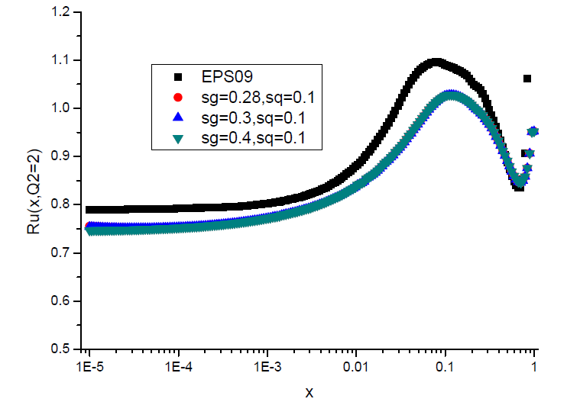
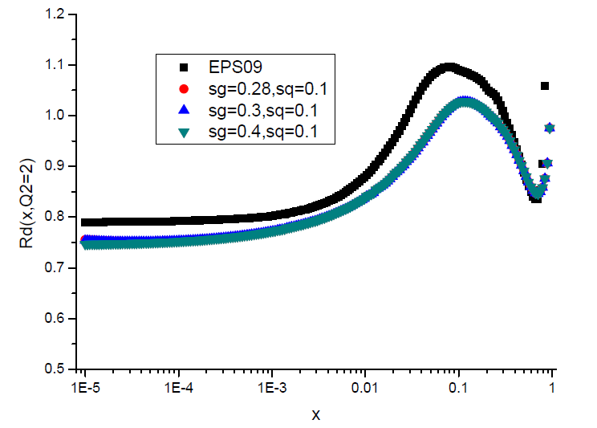
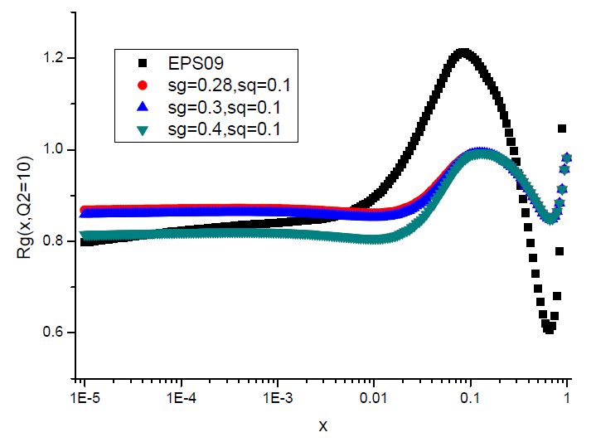
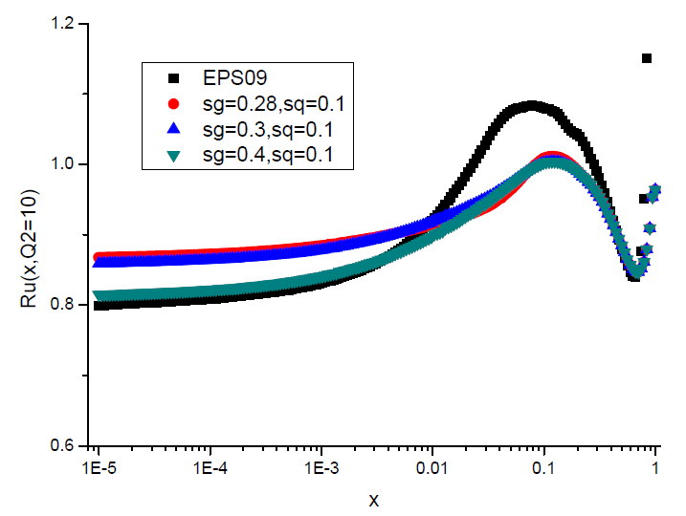
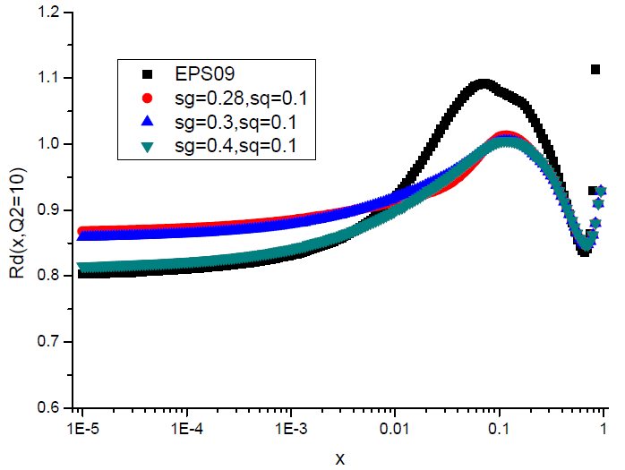
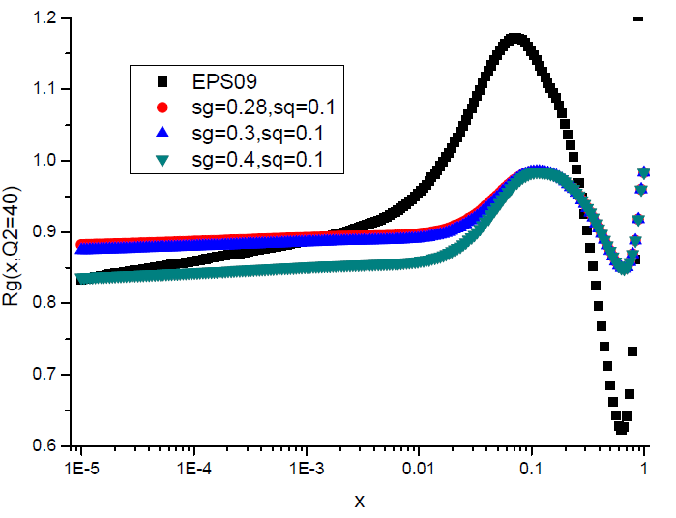
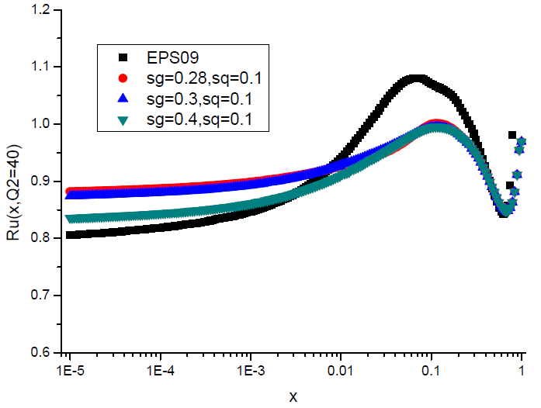

AuAu 200GeV

Slide 21
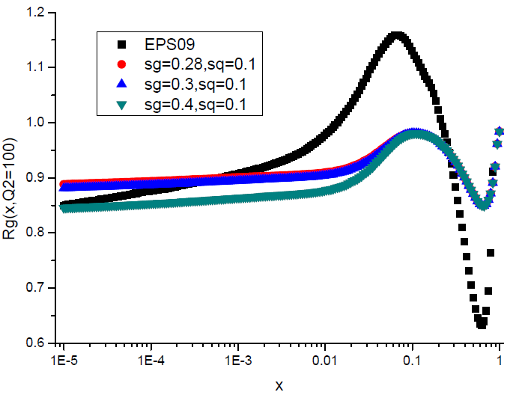
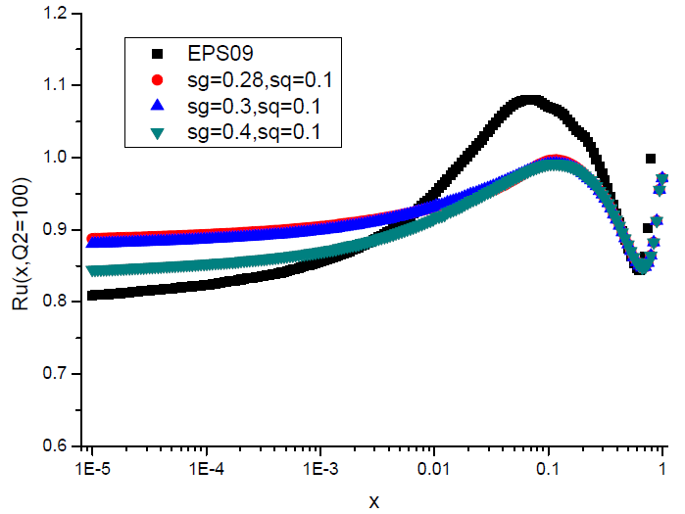
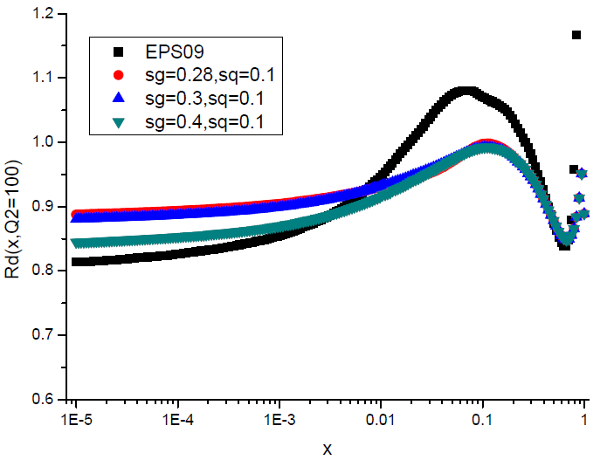
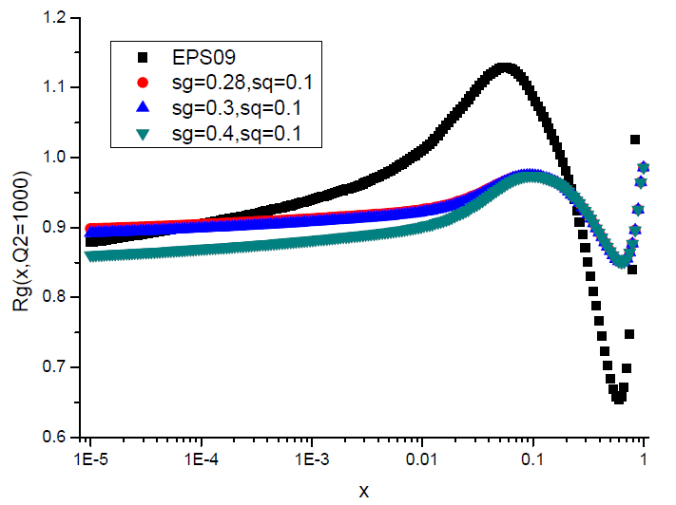
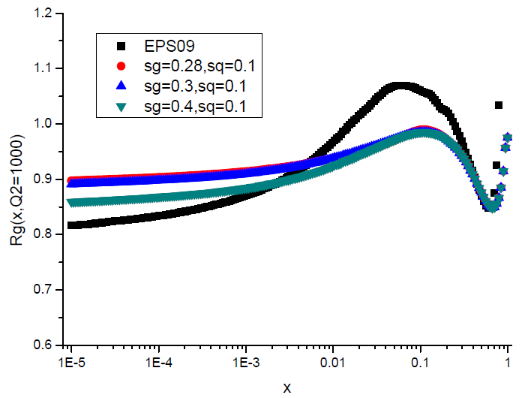
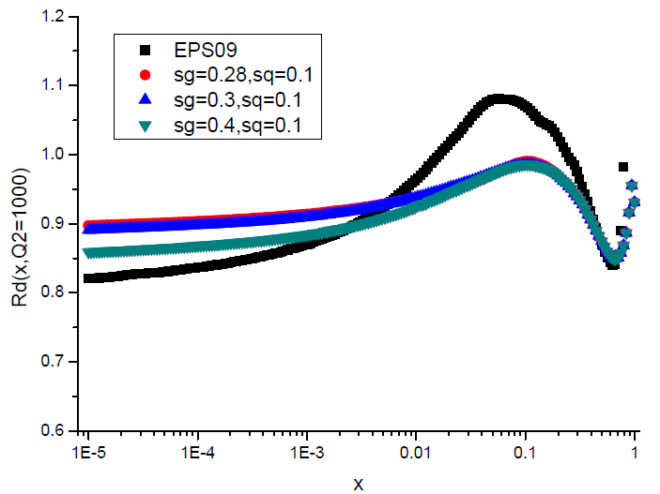
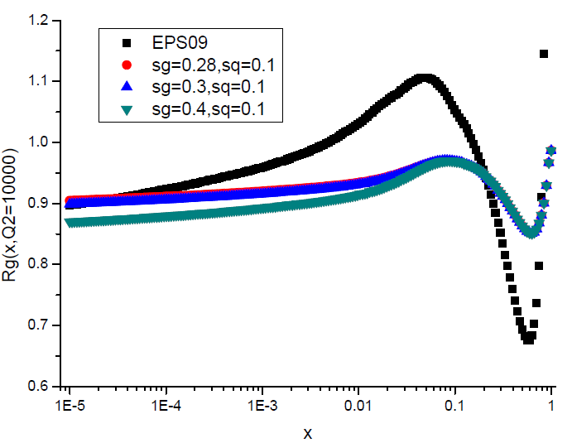
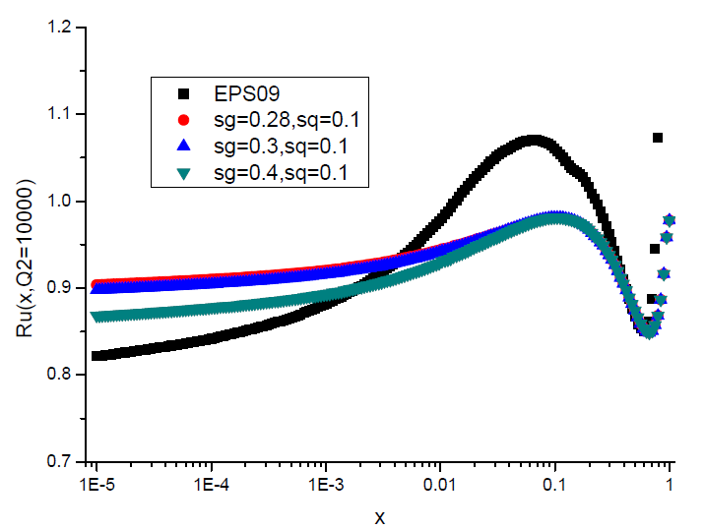
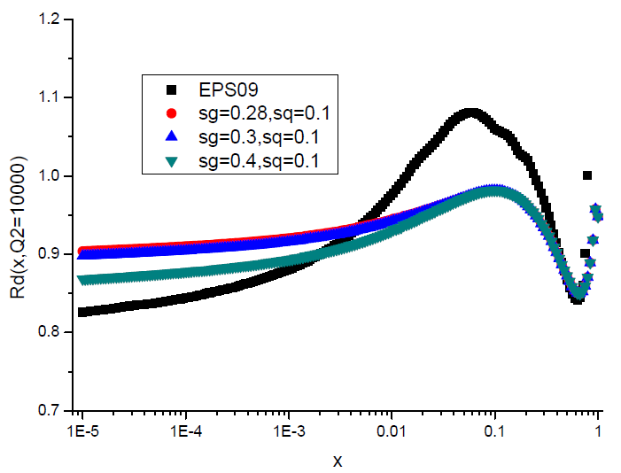
AuAu 200GeV

Slide 22
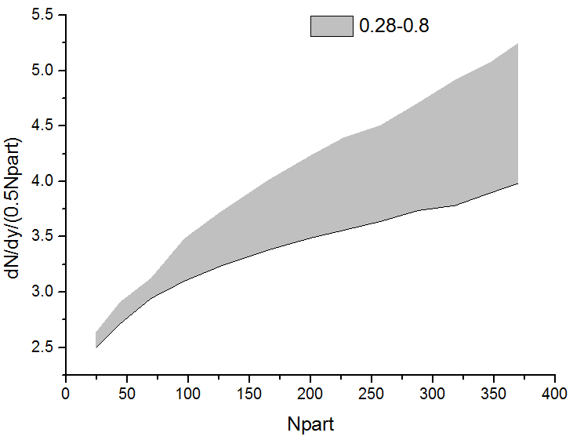
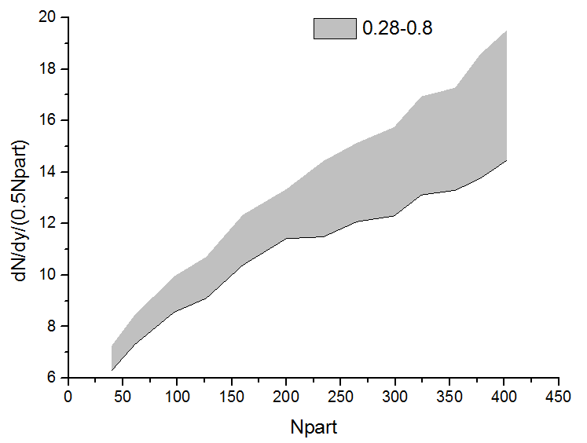
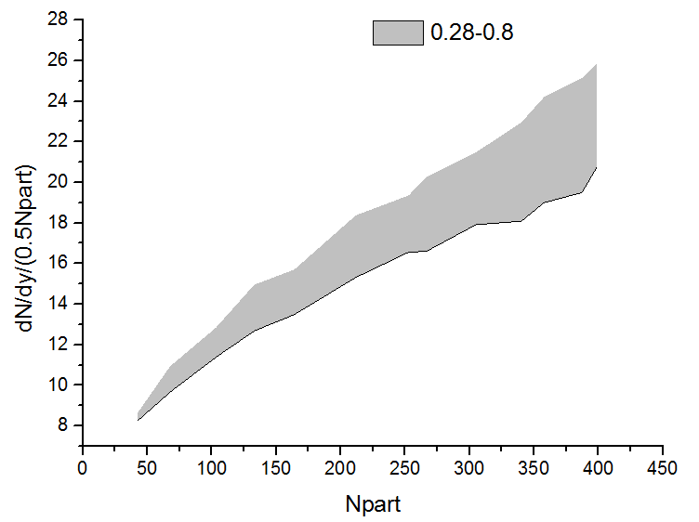
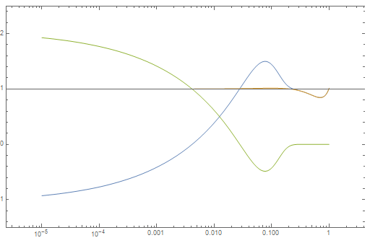
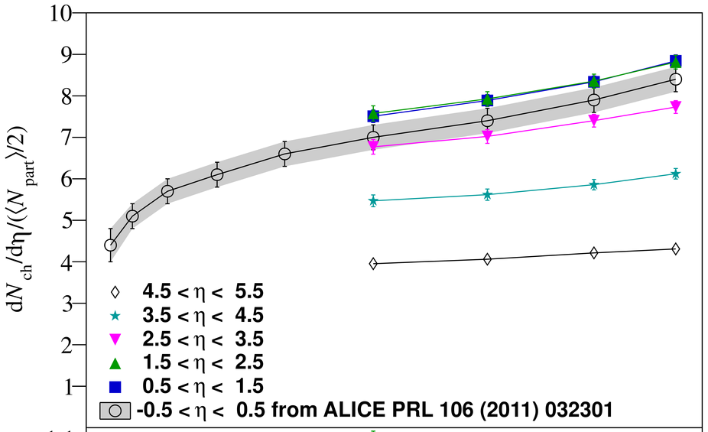
Pseudorapidity density per paticipant
Notes:
加一些实验的结果进去。

Slide 23
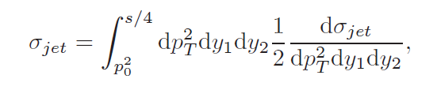
Jet cross section
Collision type | Shadowing case | Geometry dependence | sg | cross section(mb)
AuAu 200GeV | Original | with/without | 0.23 | 8.0134449
AuAu 200GeV | Original | with/without | 0.28 | 7.17908525
AuAu 200GeV | EPS09 LO | without |  | 63.9484787
AuAu 200GeV | EPS09 NLO | without |  | 68.2587433
PbPb 2760GeV | Original | with/without | 0.23 | 15.9231224
PbPb 2760GeV | Original | with/without | 0.28 | 12.0944786
PbPb 2760GeV | EPS09 LO | without |  | 21.7407627
PbPb 2760GeV | EPS09 NLO | without |  | 22.2922268
PbPb 5500GeV | Original | with/without | 0.23 | 18.2494297
PbPb 5500GeV | Original | with/without | 0.28 | 13.2579966
PbPb 5500GeV | EPS09 LO | without |  | 15.5598707
PbPb 5500GeV | EPS09 NLO | without |  | 15.9766397

Slide 24
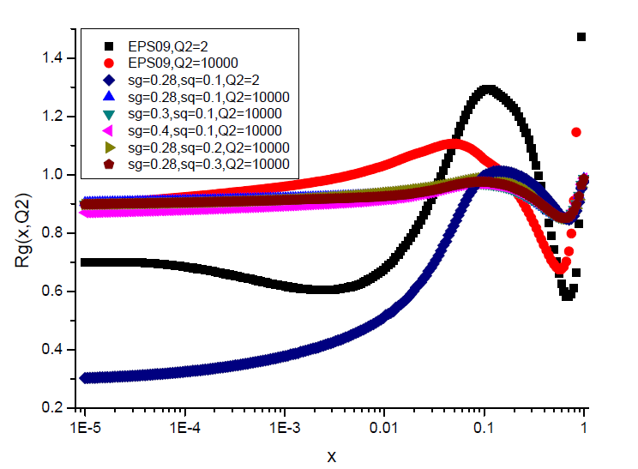
AuAu 200GeV
1.sq-dependence is weak;
2.softer shadowing after
QCD evolution gives rise to enhancement of ;
3.HIJING's shadowing QCD
evolution by HOPPET is similar to EPS09's evolution;
4.EPS09's anti-shadowing factor
does contribute a lot to the jet cross section calculation.

Slide 25
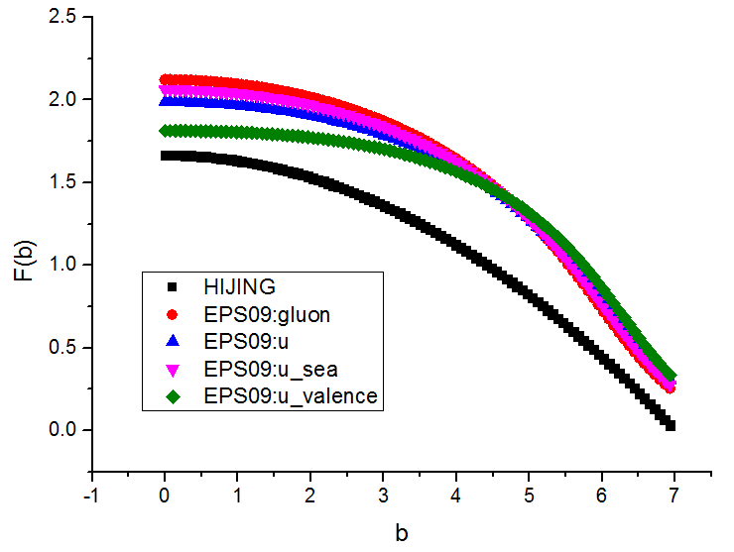
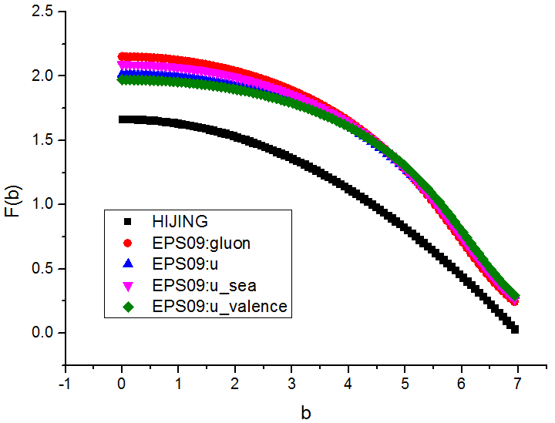
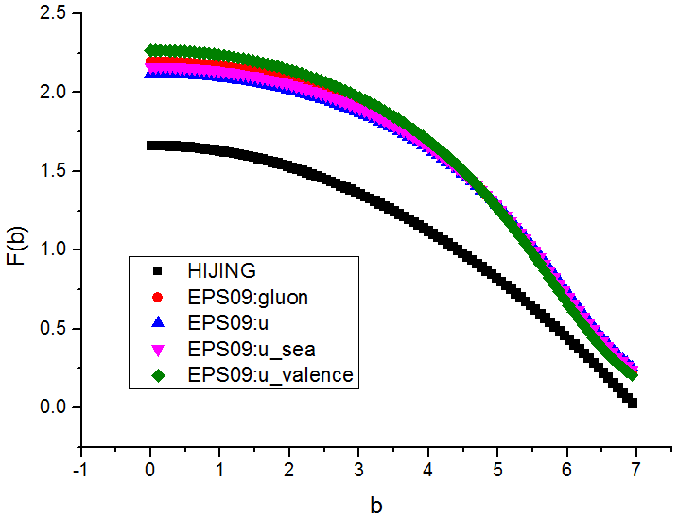
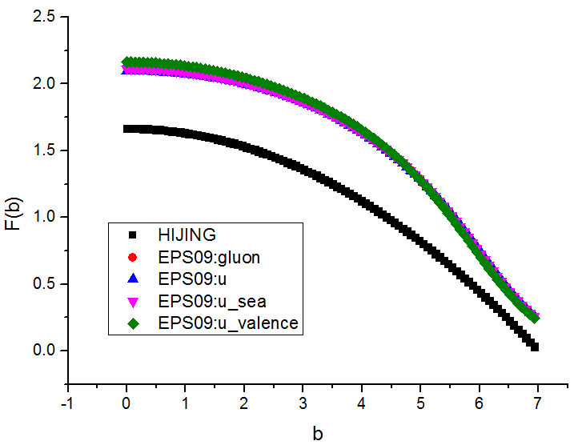
Solution plan

Slide 26

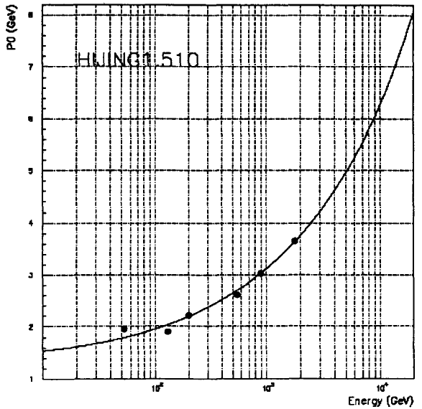
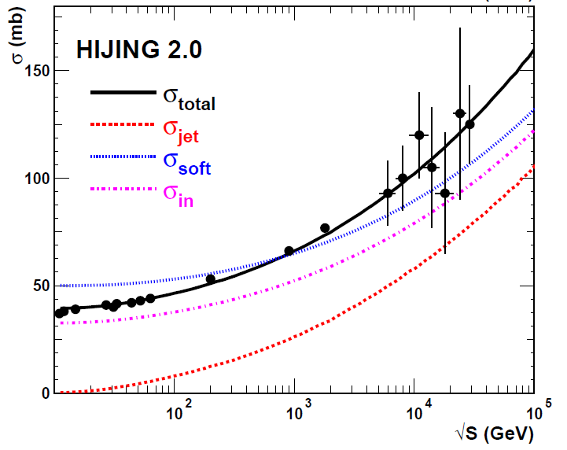
Solution plan

Slide 27
Time schedule & Outlook
Creating core/alpha version before QM2015
Cross check with original HIJING till the end of 2015
Creating functioning beta version in 2016
Multi thread and GPU support
GUI in 2017
……
Notes:
This silde introduce our time table and outlook

Slide 28
Thank you for your attention

Slide 29
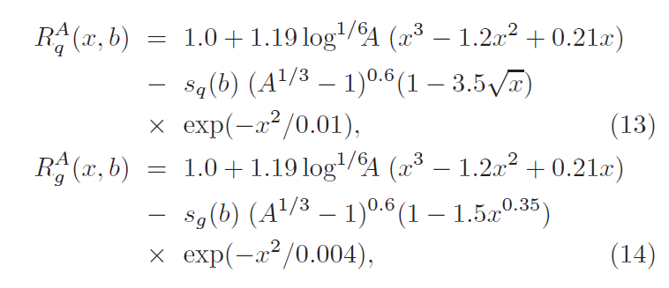
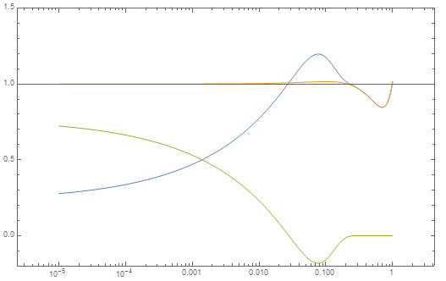
Solution plan

Slide 30
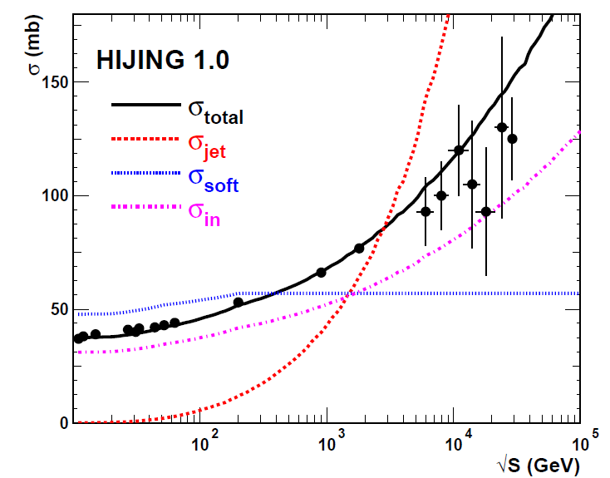
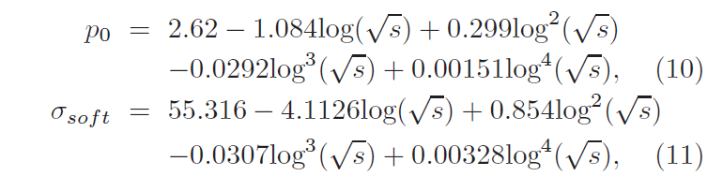
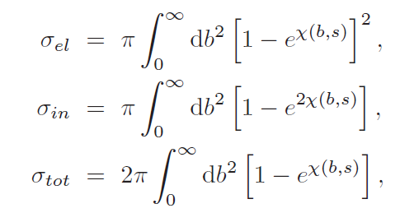

BACK UP:Two-component model

Slide 31


BACK UP(AuAu)

Slide 32



BACK UP:(PbPb)Rg(x,Q)

Slide 33

BUCK UP: LHC_5500

