Slide 1
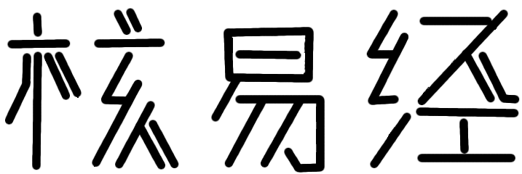
HIJING++
G.G. Barnaföldi, Sz. Harangozó, P. Lévai, G. Ma, G. Papp, X.-N. Wang, B.-W. Zhang

Slide 2
Motivation
Typical application is running simulations for experiments: ALIROOT has a C++ structure;
The underlying event generator is PYTHIA, from version 7 is rewritten to C++;
New PDF sets are appearing, support is mainly in C++ (LHAPDF);
New physics nowadays is mainly coded in C++;
Modularity is supported a lot in C++ (changing main part of the code).

Slide 3
Dilemma
The older generation has a practice in FORTRAN
We can even get the youngsters to code in FORTRAN …
BUT: we cannot admit the were are not smart enough to understand C++
Can we combine C++ and FORTRAN: how much the C++ structure determines the coding?
The Dark Side is easier and welcomes FORTRAN
The proper way is not FORTRAN friendly

Slide 4
Development steps
Combine FORTRAN HIJING with C++ PYTHIA 8 to test the coupling and the ”baseline”
Due to the PYTHIA structure step 1. failed -> convert minimal HIJING code to C++ to proceed: 4 routines should be converted
However, the whole particle information storage structure, PYTHIA control structure should be converted too.
PYTHIA 8 is more “rigid”, it is not possible to switch off some steps -> feedback to PYTHIA project

Slide 5
(Effort) minimization
PYTHIA 8 is written in genuine C++ with classes (structure+functions) in it.
The main code should be written in C++ !
The function called from a C++ program may be written in FORTRAN
However, the passing of variables needs reformatting which slows down the program.

Slide 6
Add ons
Going through the whole code nice possibility for
Removing bugs
Get rid of dead code (software archeology)
Introduce new physics
DGLAP evolved shadowing
New PDFs / parton etc. showers (Lund, Ariadne 4)
Different jet quenching
Etc
With C++ it is easy to change to GPU

