Slide 1
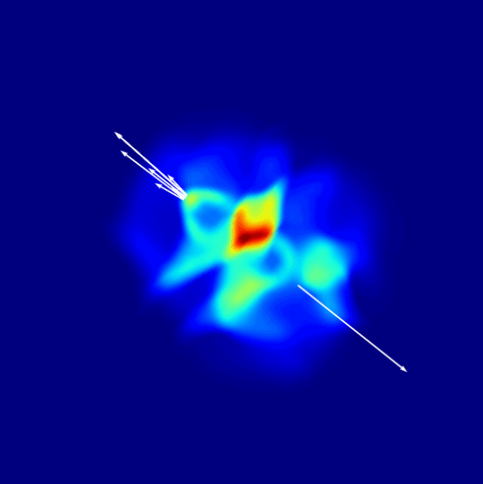

July 13-17, 2015, Balaton, Hungary
CoLBT-hydro
Coupled Linear Boltzmann Jet Transport and Hydrodynamics
Xin-Nian Wang
Central China Normal University / Lawrence Berkeley National Lab
with Wei Chen, Yayun He, Tan Luo, Longgang Pang, Yan Zhu

Slide 2
Jets in heavy-ion collisions
Multiple scattering
Transverse momentum broadening
Jet 1
q
q
Parton energy loss
Jet suppression
Jet 2
A-A collision
Notes:
Jet quenching originally was proposed as a signal of the the formation and high density matter in heavy-ion collisions.

Slide 3
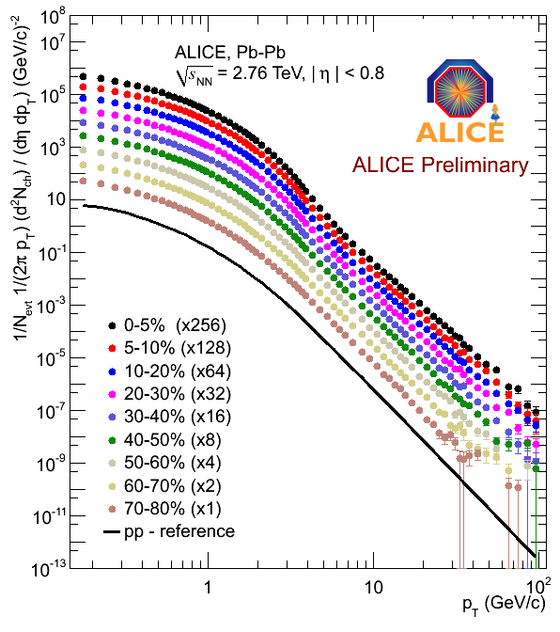
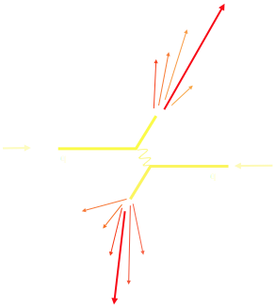
Hard and soft probes
Pb-Pb
pp reference
soft probes
hard probes
Notes:
The medium is transient and the probes are often part of the medium that we want to study. Evolution of the bulk will affect the jet quenching at high pt, and vice versus, jet-induced medium excitation can also affect the bulk evolution. One has to have a comprehensive framework to have both bulk evolution and jet shower propagation in medium.

Slide 4
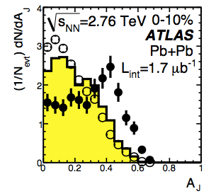
Jet Quenching at RHIC & LHC
Notes:
As we continue our collective efforts, it is time to change the dialog between theorists and experiments. We have long crossed the point that we have to move from the discovery phase of jet quenching to more precision studies and employ it as a tool for quantitative study of the detailed properties and the dense matter in heavy-ion collisions. This needs the collaboration between theorists and experimenters.

Slide 5
Jet-induced shock waves
Re-distribution of lost jet energy
Soft-parton –medium interaction non-perturbative in nature
Closely related to bulk transport properties in medium and EoS
LBT simulations
Jet-induced medium excitation in turn will influence the jet structure (both frag. func. and jet profile)

Slide 6


Linear Boltzmann Jet Transport
from hydro evolution
Induced radiation
Li, Liu, Ma, XNW and Zhu, PRL 106 （2010） 012301
XNW and Zhu, PRL 111 (2013) 062301
He, Luo, XNW & Zhu, arXive: 1503.03313
Notes:
f_i(p_i)=\frac{1}{e^{p_i\cdot u/T}\pm 1} (i=2,4)
f_i(p)=(2\pi)^3\delta^3(\vec p_i-\vec p_0)\delta^3(\vec x-\vec x_0-t\vec v_i) [i=1,3]
\frac{dN_g}{dzd^2k_\perp dt}=\frac{2\alpha_s N_c}{\pi k_\perp^4} P(z)
(\hat p\cdot u) \hat q \sin^2(\frac{t-t_0}{2\tau_f})

Slide 7
Distributions of thermal recoil partons
Recoil partons are mostly soft partons

Slide 8
Distributions of thermal recoil partons
… and small and large angles

Slide 9
Recoil parton and medium excitation
Elastic scattering only
He, Luo, XNW & Zhu, arXive: 1503.03313
Recoil partons: thermal partons after scattering with jet parton
Back-reaction – “negative” partons (diffusion wake)

Slide 10
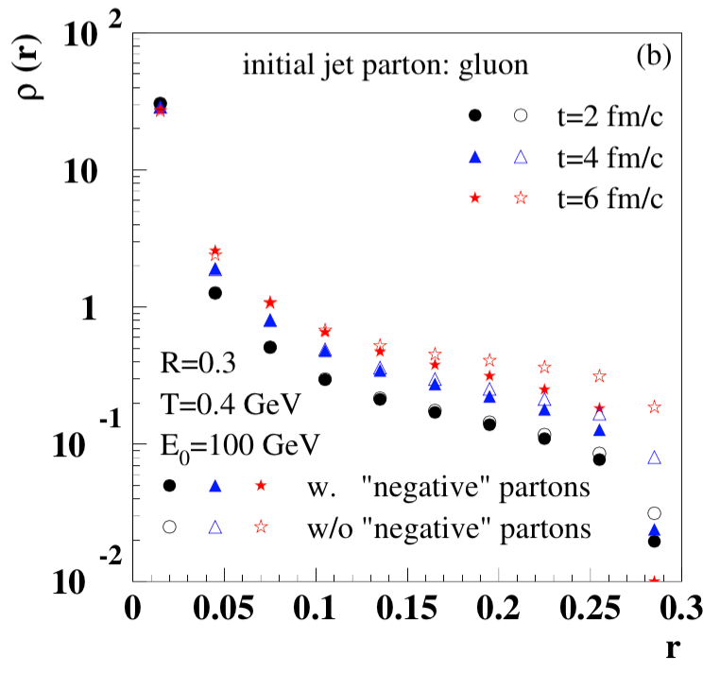
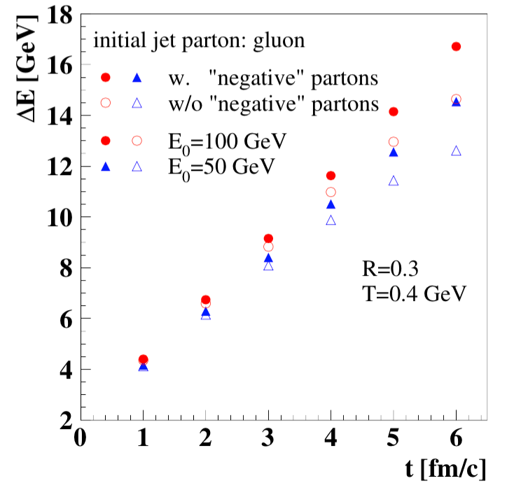

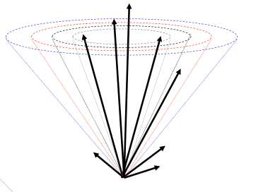
Recoil partons inside jets
Modified FASTJET – for jet reconstructions
He, Luo, XNW & Zhu, arXive: 1503.03313

Slide 11
gamma-jet in Pb+Pb collisions at LHHC
CMS +ATLAS → α_{s} = 0.15 – 0.27
Recoil partons reduce energy
loss by 15%
Accurate data needed to see
Gamma-jet broadening
XNW and Zhu, PRL 111 (2013) 062301

Slide 12
Modification of FF in gamma-jet
XNW and Zhu, PRL 111 (2013) 062301
Softening of fragmentation functions
Suppression of large z^{γ}=p/E^{γ} hadrons (partons)

Slide 13
Jet broadening

Slide 14
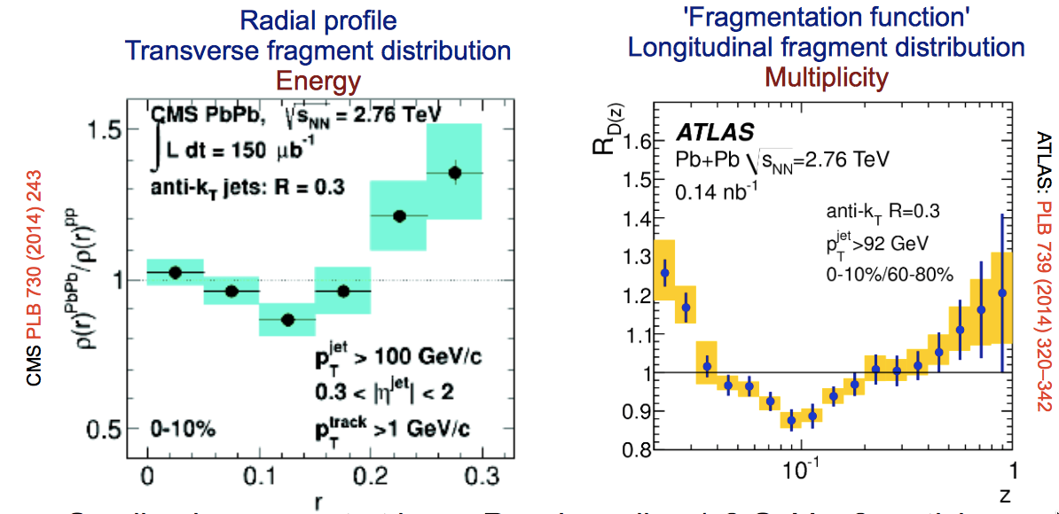
Jet structure

Slide 15
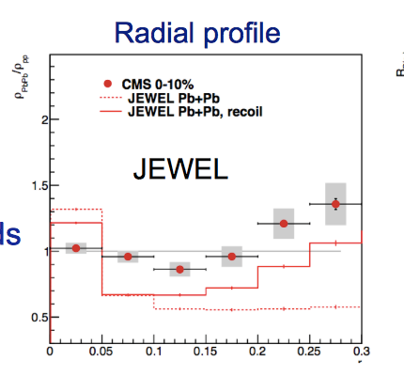
Effect of recoil on jet strcuture
Marco van Leeuwen, HP2015

Slide 16
Jet transport + hydro fluid
Linear Boltzmann jet transport: no interaction among recoil partons
3+1D Hydrodynamic evolution with a source term:
from LBT at any given time t
Carry out LBT simulation at the next time step with an updated
Medium profile from the 3+1D hydro with a source term from LBT
Notes:
\partial_\mu T^{\mu\nu}(x) = j^\nu (x)
\delta f(p,x) \ll f(p,x)
j^\nu(x) = \sum_i (p^\nu_i/p^0_i)\delta^{(3)} (x-x_i) \theta(p^0_i - p^0_{cut})

Slide 17
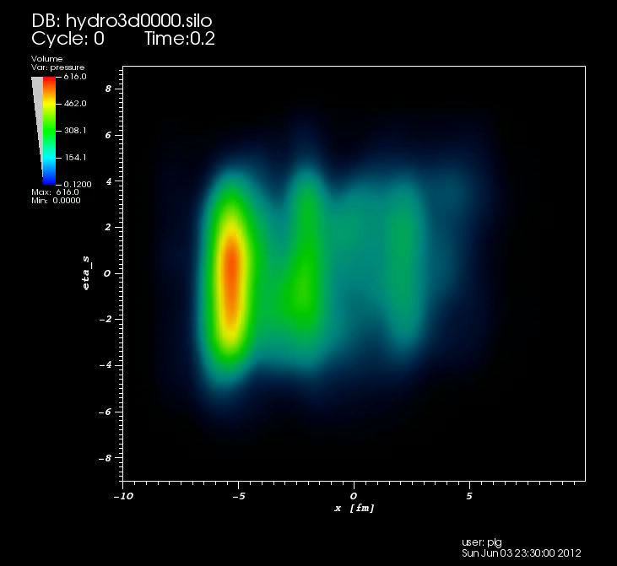
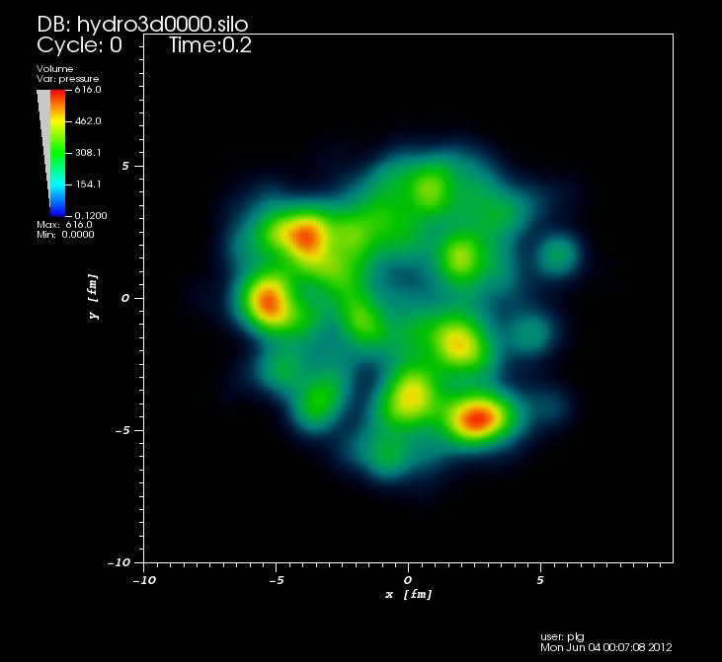
3+1D hydro with fluctuating initial conditions
2D fluctuating initial states: MC- Glauber, MC-KLN, IP-Glasma
3D fluctuating initial states: HIJING+AMPT, NeXus MC
(3+1)D ideal hydro with AMPT initial condition (Pang & XNW 2012)
η
y
x
x

Slide 18
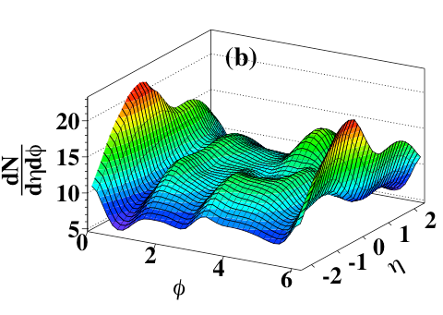
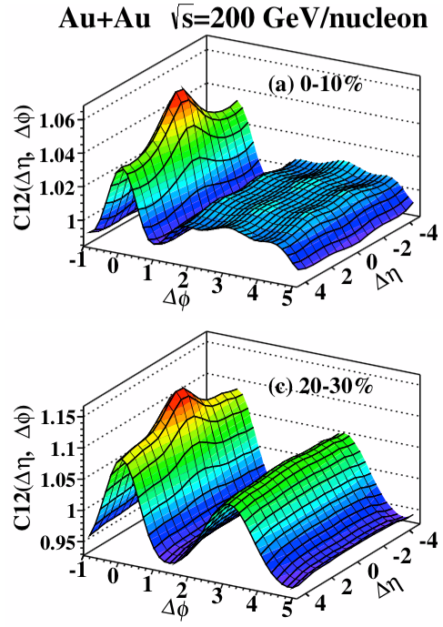
Dihadron correlation from 3+1D hydro
Pang, Wang & XNW PRC 89(2014)064910
Ridges arise from long-range longitudinal correlation in IS
Short range mini-jet-like correlation survives hydro evolution

Slide 19
Longitudinal twist & de-correlation
Pang, Qin, Roy, XNW & Ma, arXive:1410.8690
Notes:
\mathbf{Q}_n \equiv Q_n e^{in\Phi_n}= \frac { 1 }{ N } \sum _{j=1}^{N}{ e^{i n \phi_j}}
C_n(A, B) = \frac{\langle Q_n(A) Q_n(B) e^{i n[\Phi_n(A) - \Phi_n(B)]}\rangle } {\sqrt{\langle Q_n^2(A) \rangle}\sqrt{ \langle Q_n^2(B) \rangle}}

Slide 20
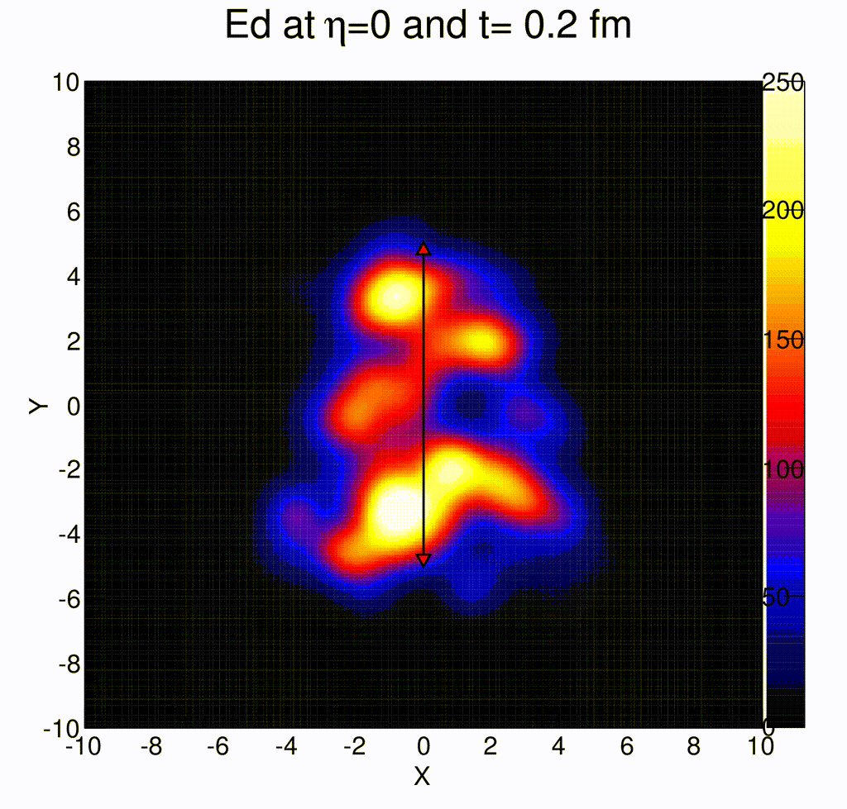
Jet propagation in anisotropic fluid

Slide 21
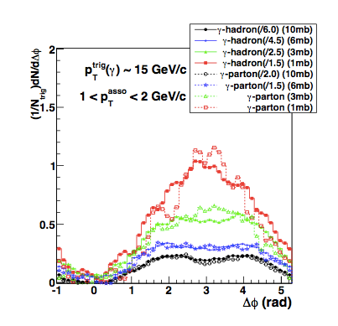
Broadening of γ-hadron correlation
γ-hadron from AMPT calculation
Li, Liu, Ma, XNW and Zhu, PRL 106 （2010） 012301
Ma and XNW, PRL 106 (2011) 162301

Slide 22
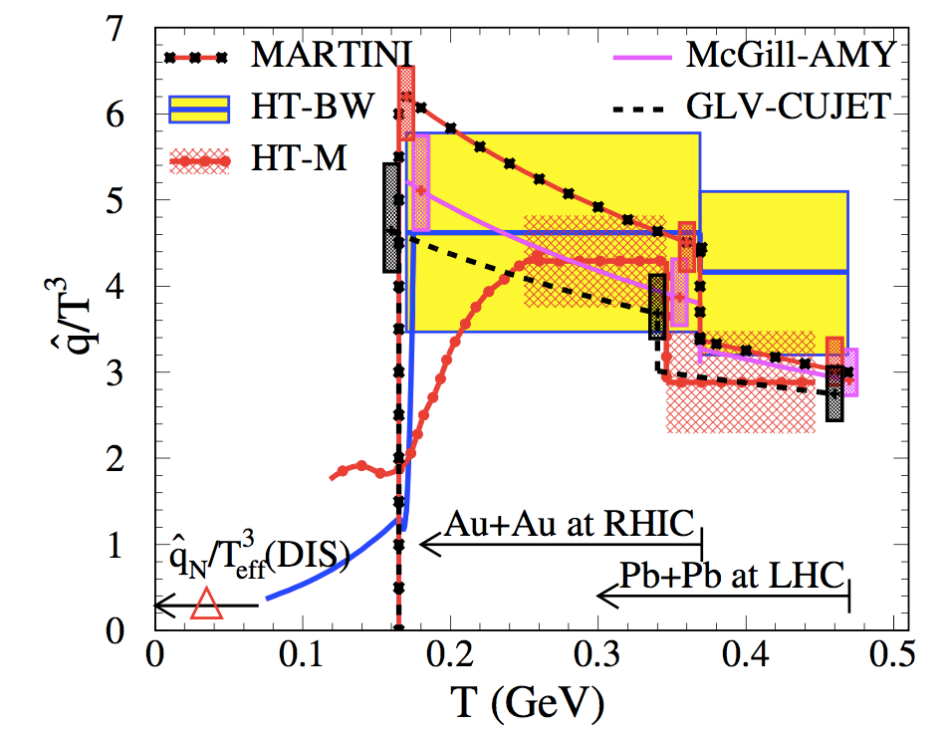
Jet transport coefficient
JET Collaboration: PRC 90 (2014) 014909 arXiv:1312.5003
RHIC
LHC
Notes:
LHC: T_0=473 MeV qhat/T^3=3.14
RHIC: T_0=373 MeV qhat/T^3=3.47
\hat q \approx \left\{
\begin{array}{l}
1.2 \pm 0.3 \\
1.9 \pm 0.7
\end{array}
\;\; {\rm GeV}^2/{\rm fm} \;\; \text{at} \;\;
\begin{array}{l}
\text{T=370 MeV},\\
\text{T=470 MeV},
\end{array}
\right.

Slide 23
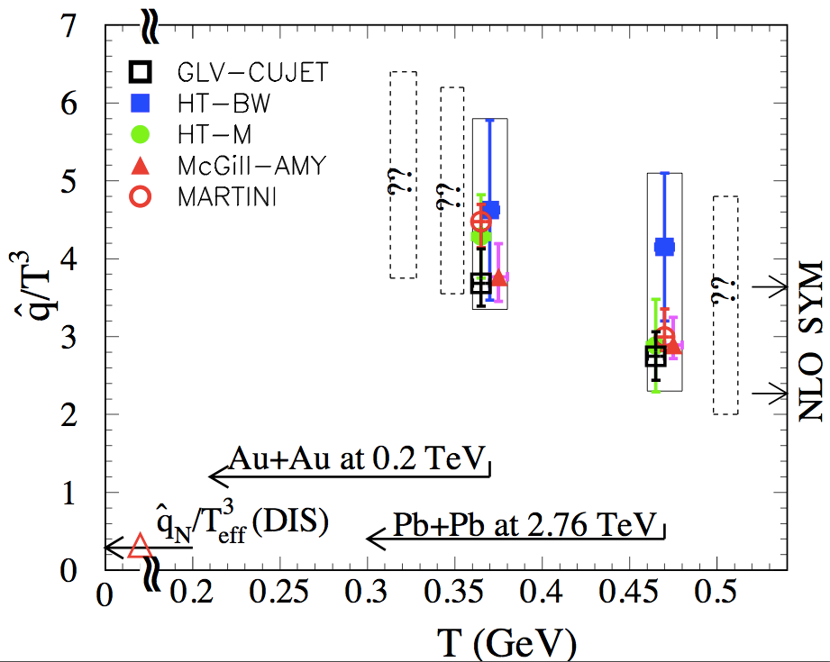
Jet transport coefficient
JET Collaboration: PRC 90 (2014) 014909 arXiv:1312.5003
Future: dihadron, gamma-hadron, flavor dependence, jet observables
RHIC BES and LHC higher energy
Notes:
LHC: T_0=473 MeV qhat/T^3=3.14
RHIC: T_0=373 MeV qhat/T^3=3.47
\hat q_{\rm SYM}^{\rm NLO}=\hat q_{\rm SYM}^{\rm LO}\left( 1-\frac{1.97}{\sqrt{\lambda}}\right)

Slide 24
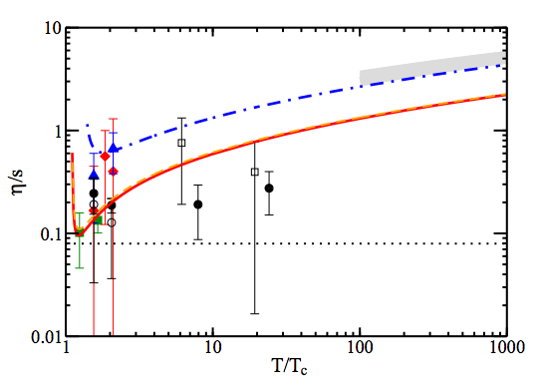
Summary
First step towards quantitative extraction of qhat from combined jet quenching at RHIC and LHC, extending to other jet observables
Jet transport & medium excitations via LBT + (3+1)D hydro
Bluhm, Kampfer & Redlich 2010
AdS/CFT
Majumder, Muller & XNW (2007)
Notes:
\frac{\eta}{s} \ge \frac{3T^3}{2\hat q}

Slide 26
Backup

Slide 28
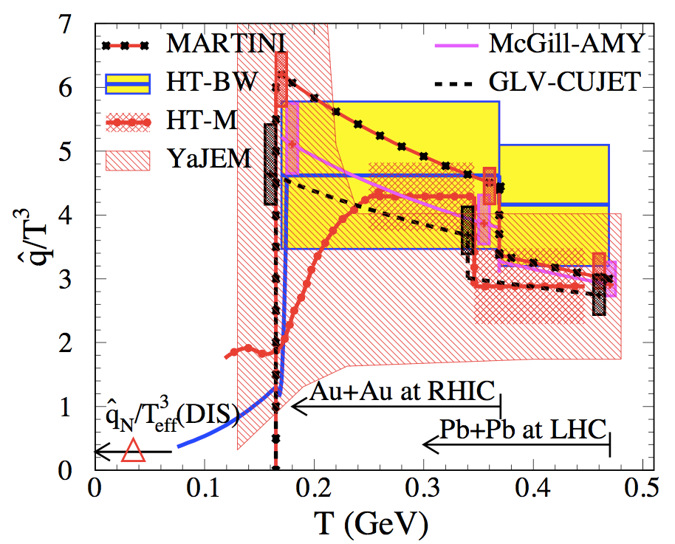
Jet transport coefficient
JET Collaboration: arXiv:1312.5003
Notes:
LHC: T_0=473 MeV qhat/T^3=3.14
RHIC: T_0=373 MeV qhat/T^3=3.47

Slide 29
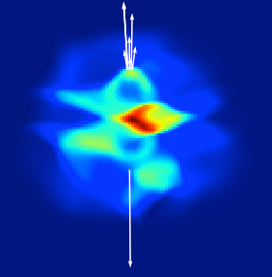
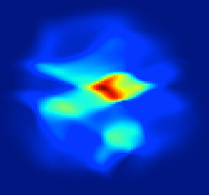
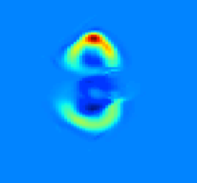
Jet transport in fluctuating hydro BG
LBT + 3+1D hydro with AMPT IS

Slide 30
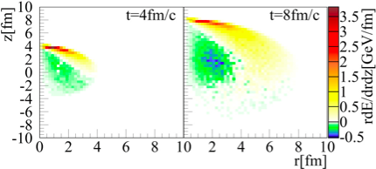
Jet-induced medium excitation
Jet propagation in a uniform medium

Slide 31
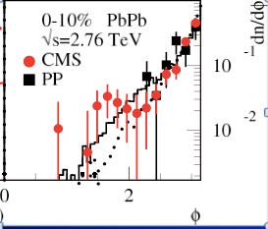
Effect of recoils and jet broadening
XNW and Zhu, PRL 111 (2014) 062301
Li, Liu, Ma, XNW and Zhu （2010）
Ma and XNW (2011)
Talk by: Tan Luo (Wed.),

Slide 32

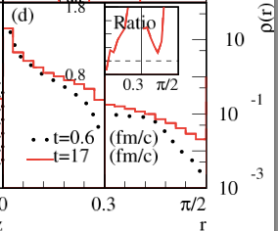
Broadening of jet transv. profile
R=0.3

Slide 33
Medium mod. of frag function
Seen in CMS & ATLAS single jets
XNW and Zhu, PRL 111(2013)062301
XNW, Huang & Sarcevic (1996)
Energy of reconstructed jet dominated by leading particle
Suppression of fragmentation functions relative to initial energy

Slide 34
Factorization at twist-4
Transverse momentum square weighted
cross section
T-4 LO
T-4 NLO
Finite contribution from asymmetric-cut diagrams

Slide 35
Evolution equation for T4 - NEW
soft-soft
hard-hard & soft-hard & hard-soft
When , there is no phase space for the gluon radiation from the initial gluon.

Slide 36
Running coupling in jet quenching
2013

Slide 37
Jet quenching phenomenology
McGill-AMY
HT-BW
HT-M
Notes:
As a first step to extract jet transport parameters from experimental data, we use this JET package to look at the single hadron suppression at both RHIC and LHC

