Slide 1
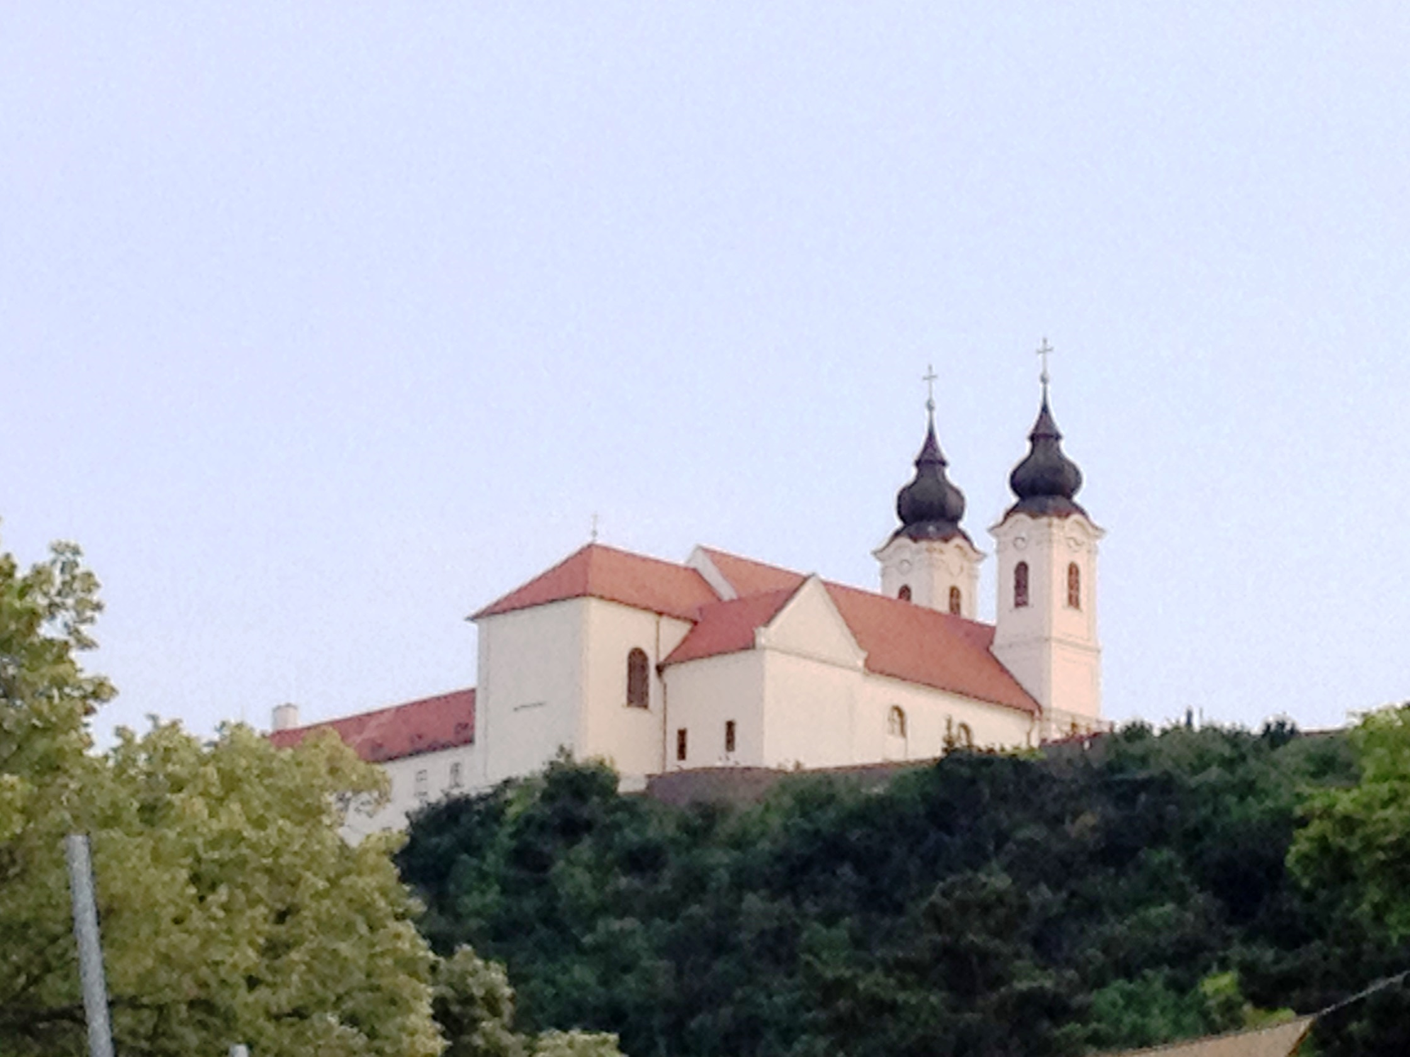
Separating Collective Flow and
Fluctuations in Peripheral Relativistic
Heavy Ion Collisions
Laszlo P. Csernai, University of Bergen
Based on: Csernai, Stöcker, J Phys G 41 (2014) 124001
Balaton Workshop 2015,
Tihany, HU, July 12-17, 2015

Slide 2
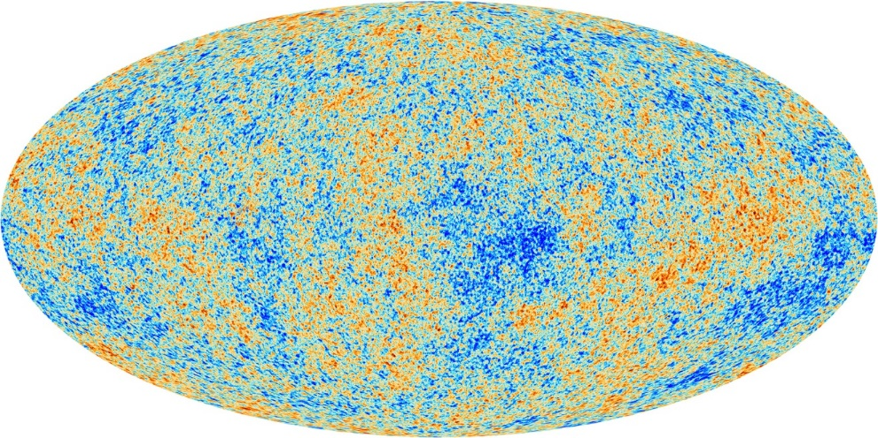
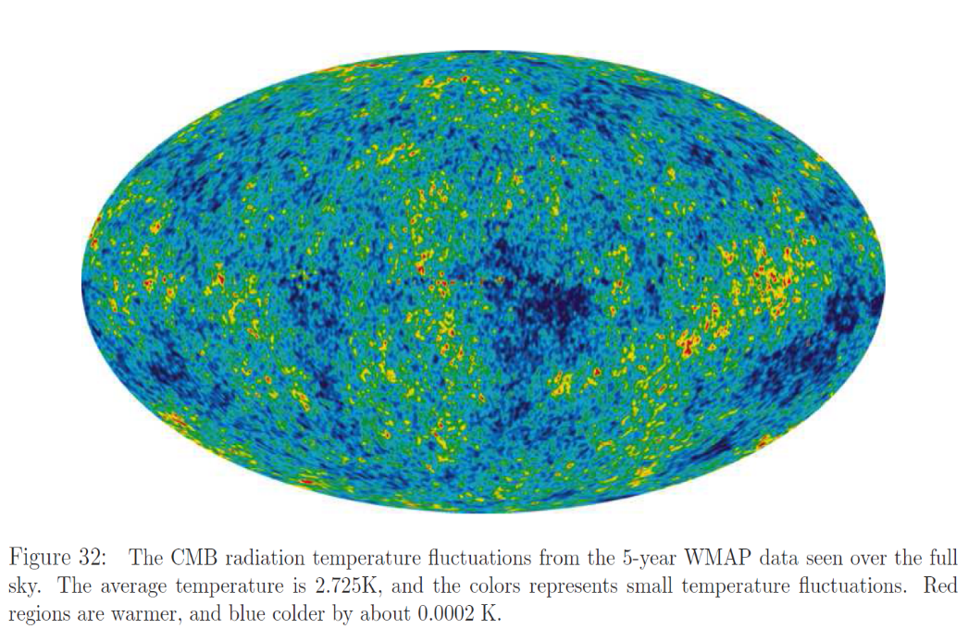
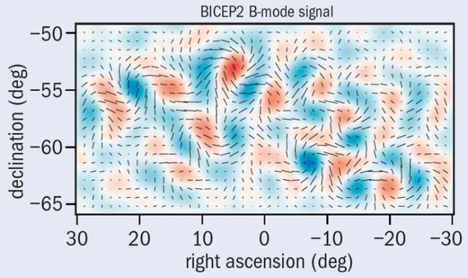
Fluctuations and
polarization
Planc

Slide 3
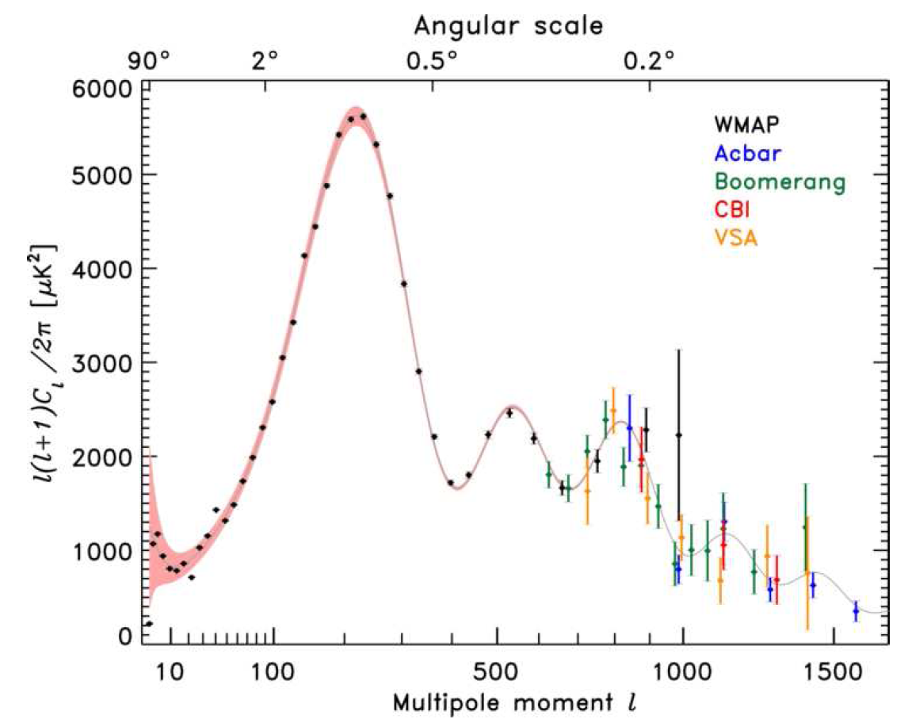
Longer tail on the negative ( low l ) side ! (see discussion of “Skewness” later)

Slide 4
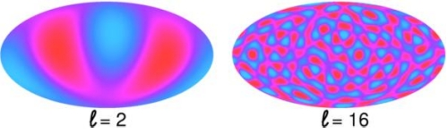
In Central Heavy Ion Collisions
~ spherical with many (16) nearly equal perturbations
~ like Elliptic flow, v₂

Slide 5
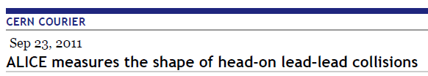
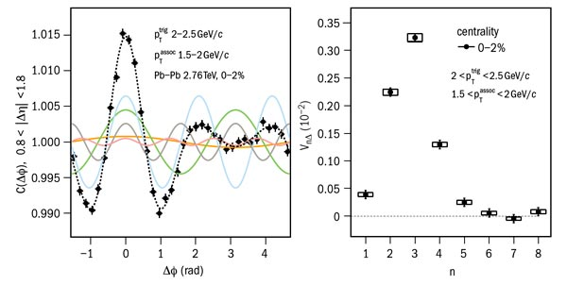
Flow originating from initial state fluctuations is significant and dominant in
central and semi-central collisions (where from global symmetry no azimuthal
asymmetry could occur, all Collective v_{n} = 0 ) !

Slide 6
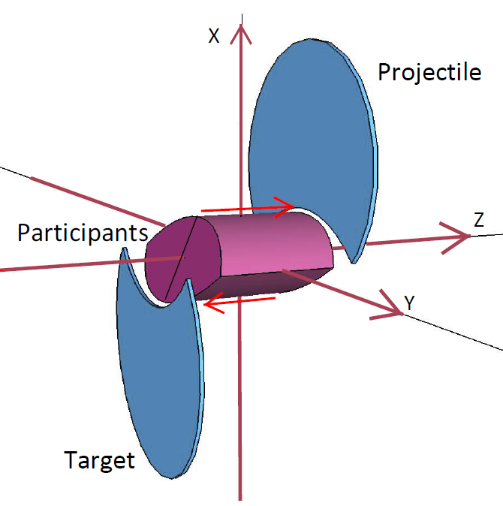
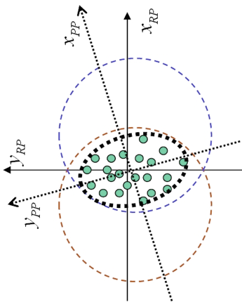
Peripheral Collisions (A+A)
Csernai & Stöcker, arXiv: 1406.1153v2 [nucl-th]
Global Symmetries
Symmetry axes in the global CM-frame:
  ( y ←→ -y)
  ( x,z ←→ -x,-z)
  Azimuthal symmetry: φ-even (cos nφ)
  Longitudinal z-odd, (rap.-odd) for v_{odd}
  Spherical or ellipsoidal flow, expansion
Theory:
Experiment:
Fluctuations
Global flow and Fluctuations are simultaneously present → Ǝ interference
  Azimuth - Global: even harmonics - Fluctuations : odd & even harmonics
  Longitudinal – Global: v1, v3 y-odd - Fluctuations : odd & even harmonics
  The separation of Global & Fluctuating flow is a must !! (not done yet)

Slide 7
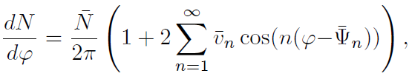




Used by most experimental groups today.
[R Snellings, J Phys G 41 (2014) 24007]
[LP Csernai & H Stoecker J Phys G 41 124001]
Anisotropic Flow

Slide 8

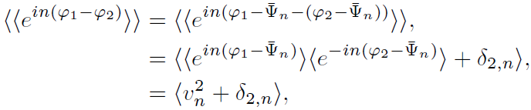

Anisotropic Flow
Used by most experimental groups today.
[R Snellings, J Phys G 41 (2014) 24007]
[LP Csernai & H Stoecker J Phys G 41 124001]
( for evaluating v_{n})
e.g. with 4 particle cumulant method:
Reaction plane (RP) is lost, P/T side of RP is also lost, CM is not known

Slide 9
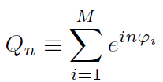
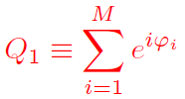


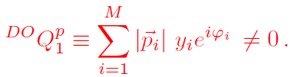




We need an EbE reference angle (e.g. the RP).
Can we find it?
→ Separate forward & backward pt. → c.m.
Or one can approximate this as:
Weighting with y → dominates large rapidities→ Use a segmented ZDC to find the RP!
In addition we should find the participant c.m. Separate out longitudinal fluctuations.

Slide 10
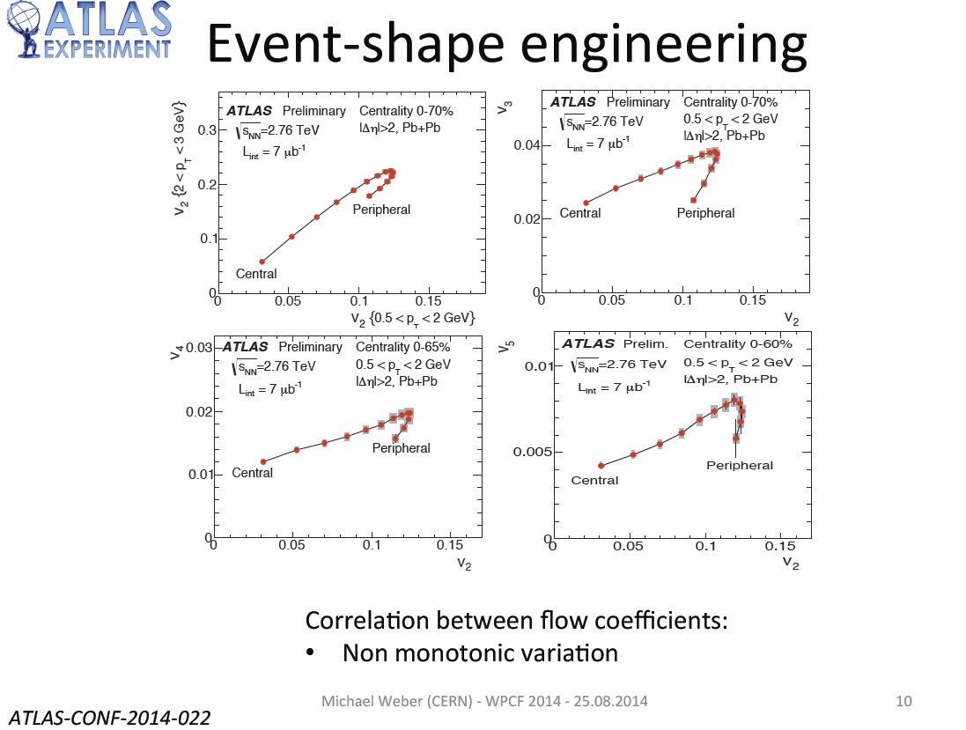
Fluctuations
Global flow

Slide 11
Two types of flow processes from:
Fluctuations and/or Global Collective Flow
How to split these two:
In theoretical models
  Mode-by-mode hydrodynamics,
  [S. Floerchinger, U.A. Wiedemann, Phys. Rev. C 88, 044906 (2013), Phys. Rev. C 89, 034914 (2014), Phys. Lett. B 728, 407 (2014)]
In experiments it is more involved
    Average many events
    But keeping the symmetries

Slide 12



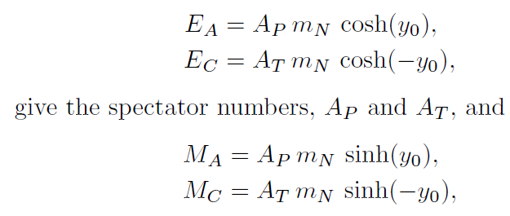
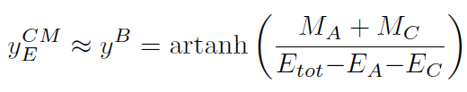

Method to compensate for C.M. rapidity fluctuations
Determining experimentally EbE the C.M. rapidity
Shifting each event to its own C.M. and evaluate flow-harmonics there
Determining the C.M. rapidity:
The rapidity acceptance of a central TPC is usually constrained (e.g for ALICE
|η| < η_{lim} = 0.8, and so: |η_{C.M.}| << η_{lim} , so it is not adequate for determining
the C.M. rapidity of participants.
Participant rapidity from spectators
A
B
C

Slide 13
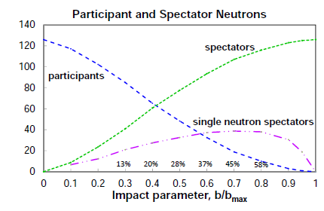
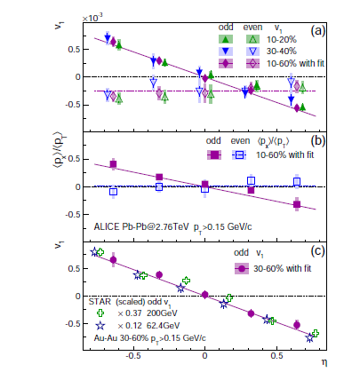
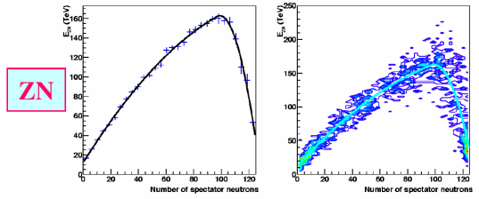
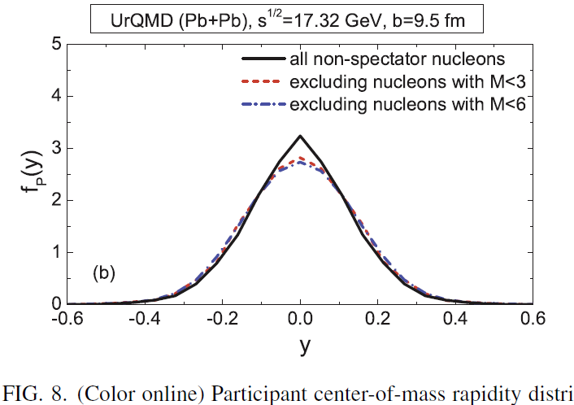

ALICE: Phys. Rev. Lett. 11, 232302 (2013)
Correction, EbE
Single neutron spectators are based on
nuclear multi fragmentation studies →
in experiment should be taken from data [ ALICE estimate from 1984 → ]
Results from preliminary ALICE data:
Results from preliminary ALICE data show
the average and EbE fluctuations →
v₁^{odd} = ~ -0.0025 v₁^{even} = ~ 0
ALICE PRL 2013:
v₁^{odd} = ~ -0.0005 v₁^{even} = ~ -0.00025
et al.

Slide 14
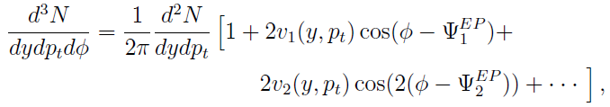

[LP Csernai & H Stoecker J Phys G 41 124001]
Azimuthal Flow analysis with Fluctuations today
Is this a complete ortho-normal series? Yes, if the values are defined …..
We can see this by using: →

Slide 15





[LP Csernai & H Stoecker J Phys G 41 124001]
Azimuthal Flow analysis with Fluctuations today
Is this a complete ortho-norml series? Yes, if the values are defined …..
We can see this by using: →
Reaction Plane (EbE)
And the two coefficients:
→
In Collider
In EbE: CM,RP
In EbE: CM,RP

Slide 16
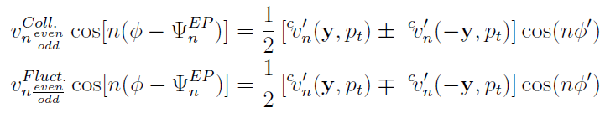

Now: Separating Global Collective Flow & Fluctuations
and let us construct even and odd combinations from the data:
&
[Csernai L P, Eyyubova G and Magas V K, Phys. Rev. C 86 (2012) 024912.]
[Csernai L P and Stoecker H, (2014) arXiv: 1406.1153v2 .]

Slide 17
x 0.37
x 0.12

Slide 18
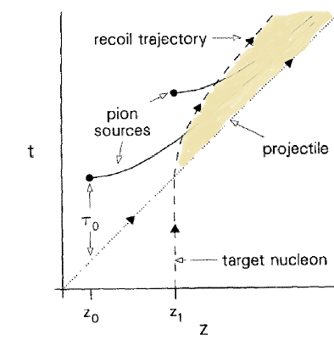
Hot-Gluon Field → Compact IS, shear & vorticity
[Gyulassy & Csernai, NPA460 (1986) 723]: Flux tube dominance →
Flux tube, w/ large string tension →
Longitudinal extension is limited:
Energy & momentum conservation
Shear flow, vorticity, rotation
IS: 3-4 fm/c
[ Magas et al., NPA 712 (2002)167]

Slide 19
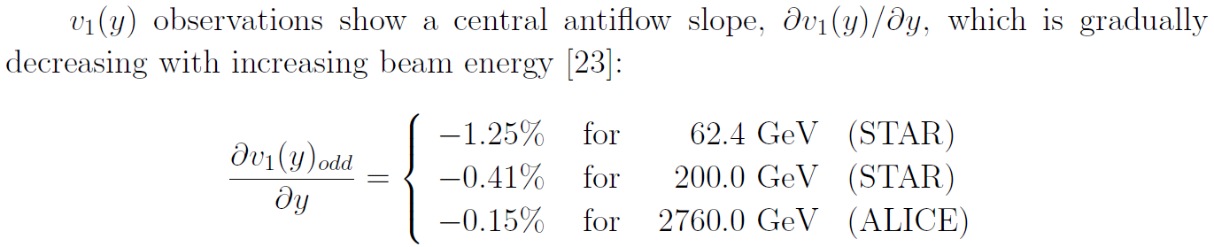

Development of v₁(y) at increasing beam energies
This can be attributed to smaller increase of p_{t} and the pressure, and the shorter
interaction time, and also to increasing rotation.
In [Cs., Magas, Stöcker, Strottman, PRC84 (2011)] we predicted this rotation,
but the turnover depends on the balance between rotation, expansion and freeze out.
Apparently expansion is still faster and freeze out is earlier, so the turn over to the
Positive side is not reached yet.
Interesting collective
flow phenomena in
low viscosity QGP →

Slide 20
Detection of Global Collective Flow
We are will now discuss rotation (eventually enhanced by KHI).
For these, the separation of Global flow and Fluctuating flow is
important. (See ALICE v1 PRL (2013) Dec.)
One method is polarization of emitted particles
  This is based equilibrium between local thermal vorticity (orbital motion) and
  particle polarization (spin).
  Turned out to be more sensitive at RHIC than at LHC
  (although L is larger at LHC)
  [Becattini F, Csernai LP and Wang DJ, Phys. Rev. C 88 (2013) 034905.]
  At FAIR and NICA the thermal vorticity is still significant (!)
  so it might be measurable.
The other method is the Differential HBT method to analyze rotation:
  [LP. Csernai, S. Velle, DJ. Wang, Phys. Rev. C 89 (2014) 034916]

Slide 21
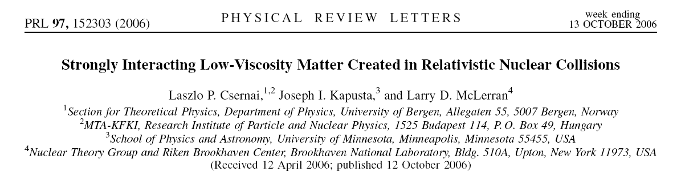
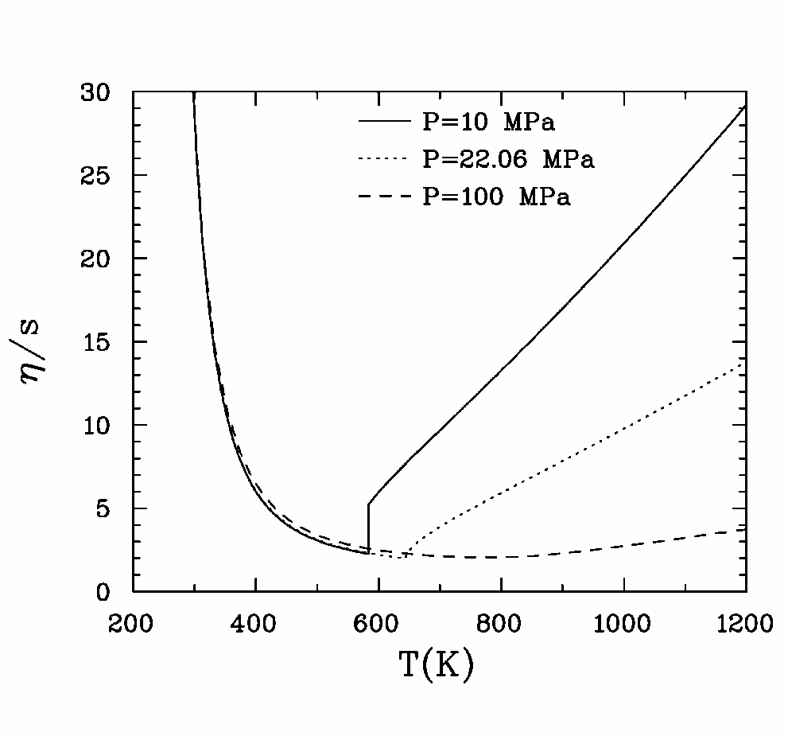
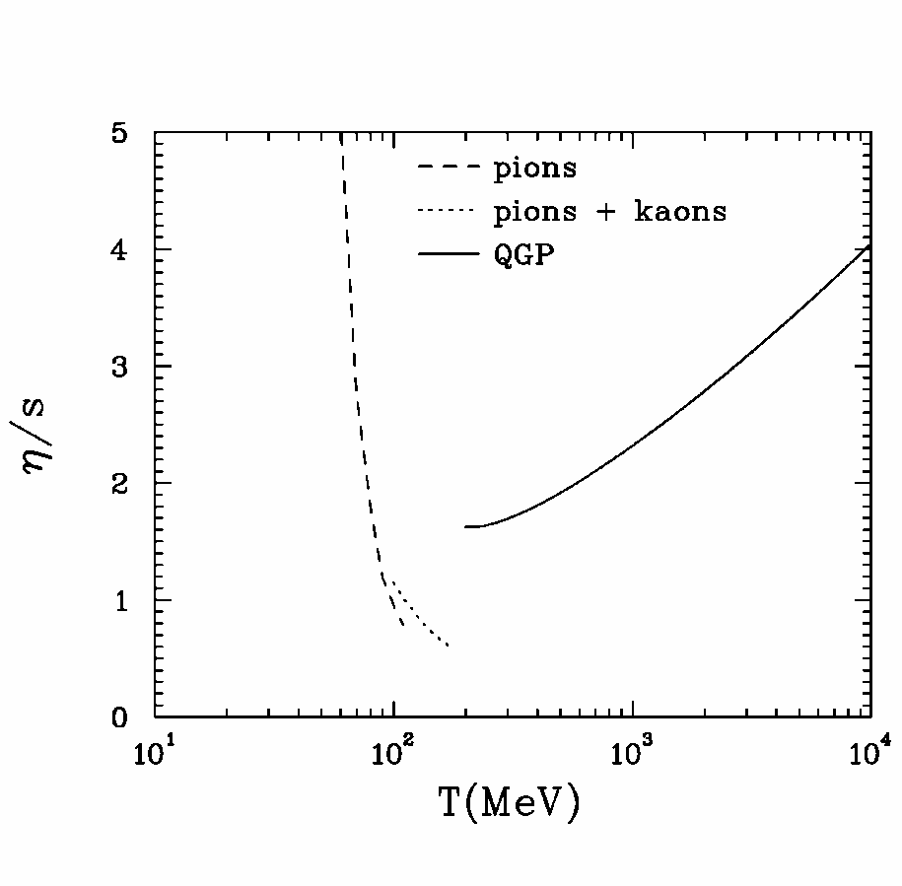
Viscosity vs. T has a minimum at the 1st order phase transition. This might signal the phase transition if viscosity is measured. At lower energies this was done.
Water
QGP
Notes:
Suggested for the 1st time to use the minimal viscosity to find the phase transition threshold.

Slide 22
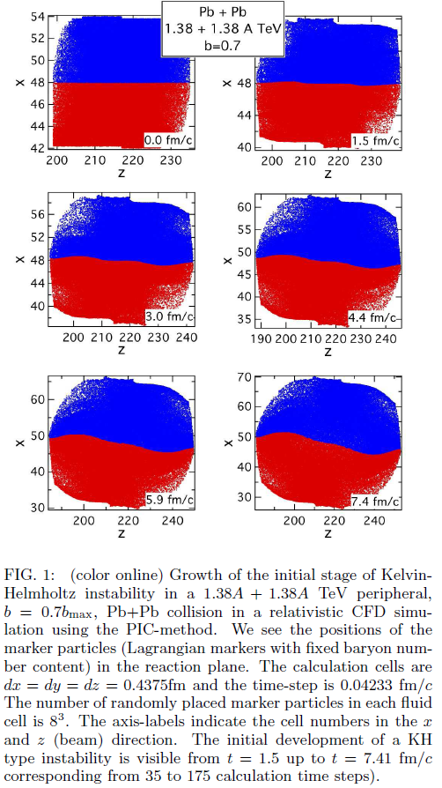
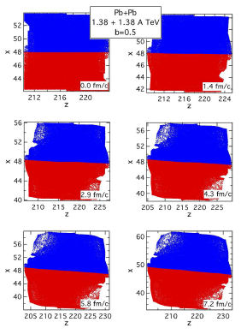

KHI →
ROTATION
KHI
2.4 fm

Slide 23
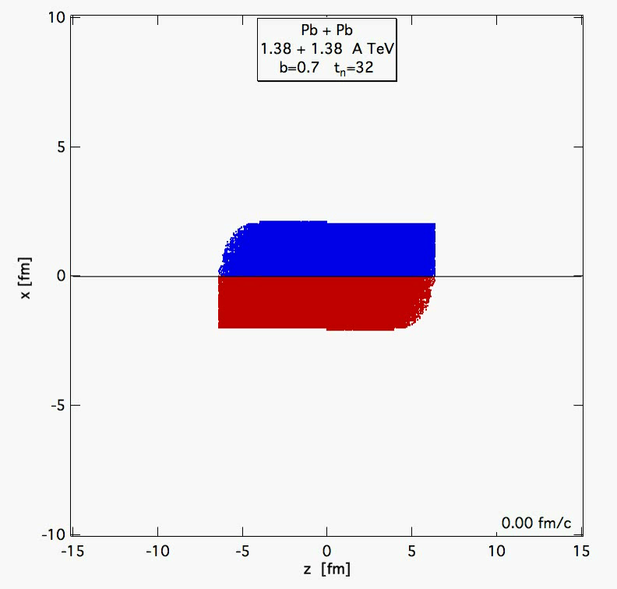
KHI →
ROTATION
KHI
2.4 fm

Slide 24

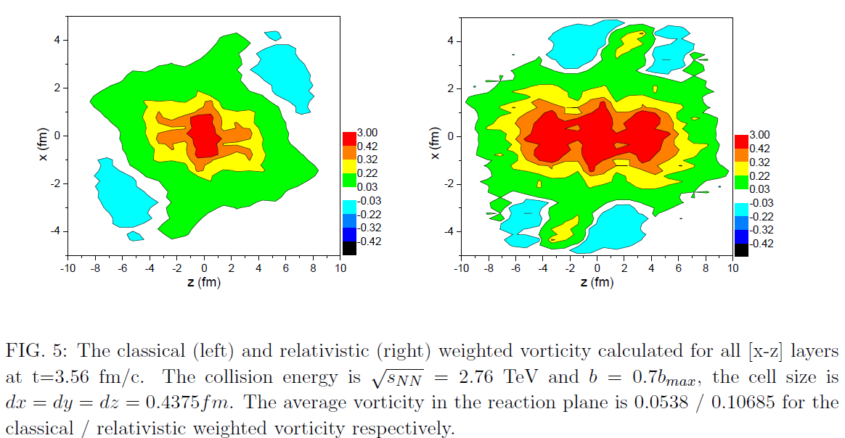
Weighted Vorticity
Relativistic
Classical
3 c/fm !
c/fm
c/fm
[Csernai, Magas,Wang, Phys. Rev. C 87 (2013) 034906]

Slide 25
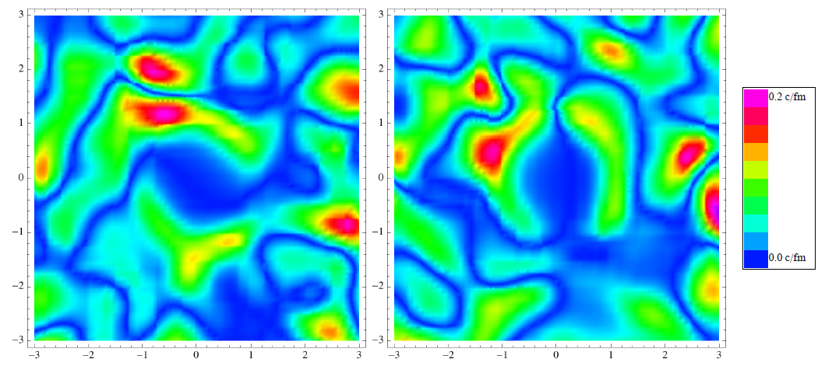



Onset of turbulence around the Bjorken flow
S. Floerchinger, U.A. Wiedemann, JHEP 100,1111 (2011); J. Phys. G 38, 124171 (2011)
y
0.2 c/fm !
Initial state Event by Event vorticity and divergence fluctuations.
Amplitude of random vorticity and divergence fluctuations are the same
In dynamical development viscous corrections are negligible (→ no damping)
Initial transverse expansion in the middle (±3fm) is neglected (→ no damping)
High frequency, high wave number fluctuations may feed lower wave numbers

Slide 26
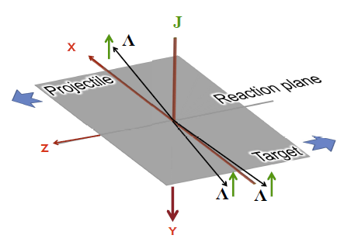



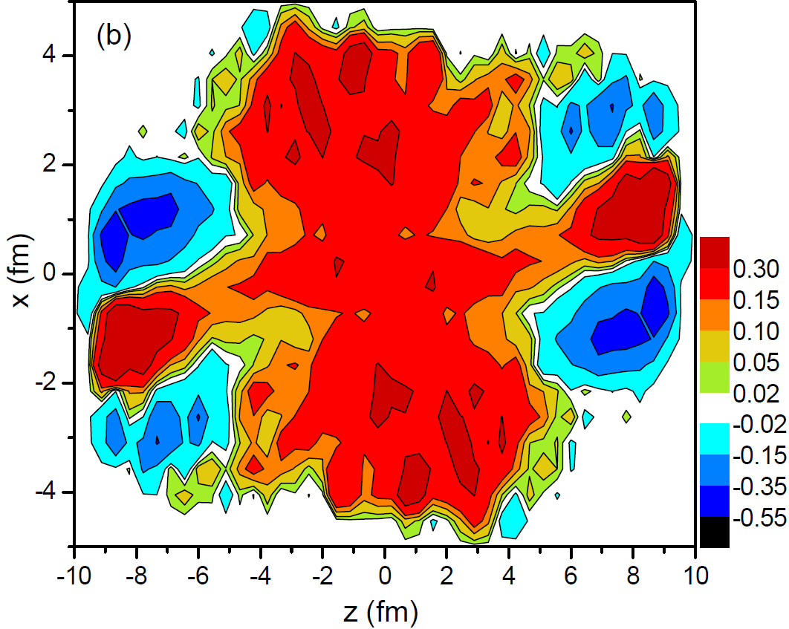
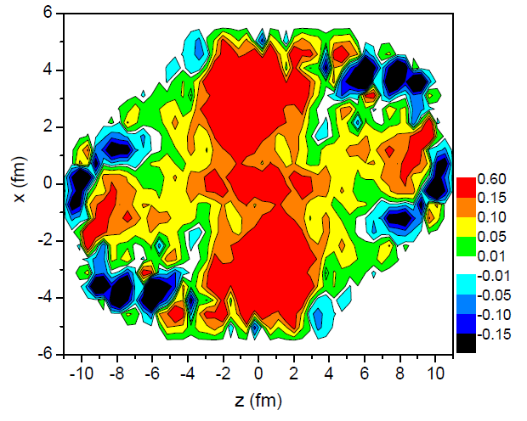
Detecting rotation:
Lambda polarization
← From hydro
[ F. Becattini, L.P. Csernai, D.J. Wang,
Phys. Rev. C 88, 034905 (2013)]
LHC
RHIC
3.56fm/c
4.75fm/c

Slide 27
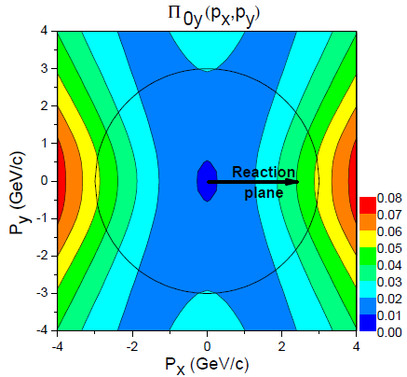
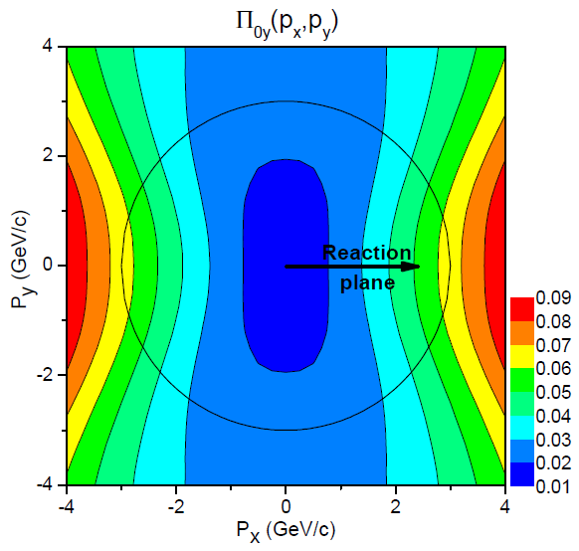
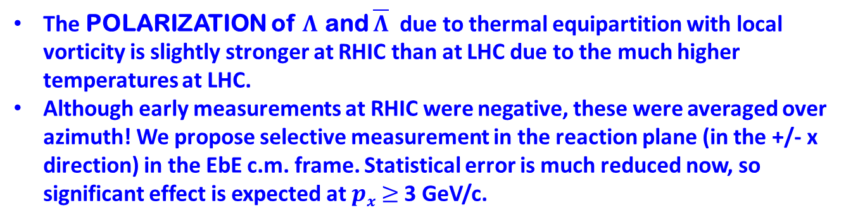
Lambda polarization
[ F. Becattini, L.P. Csernai, D.J. Wang,
Phys. Rev. C 88, 034905 (2013)]
LHC
RHIC

Slide 28
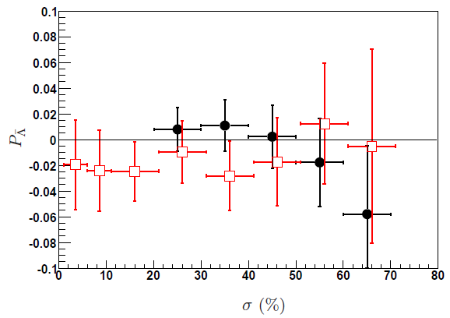
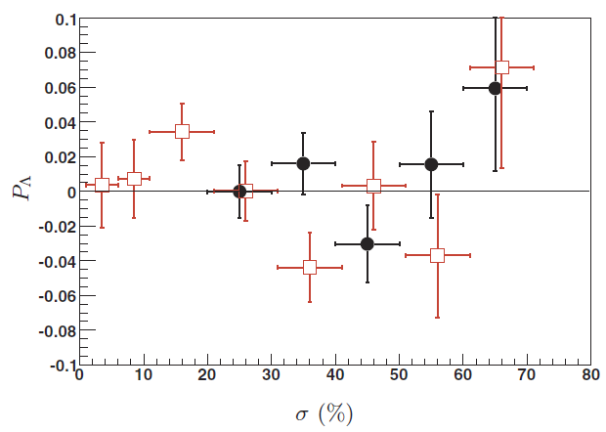
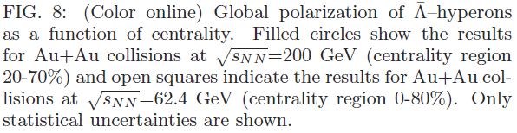
Measurements: Inconclusive (2007)
62.4 GeV
62.4 GeV
200 GeV
200 GeV
* Azimuth averaged ↓
* C.M. & RP_{(P/T)} should be
precisely determined,
& only at large p_{x} !
B.I. Abelev et al., (STAR)

Slide 29
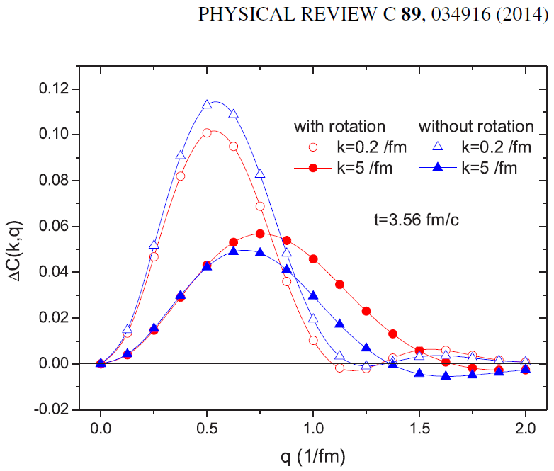

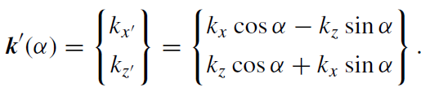

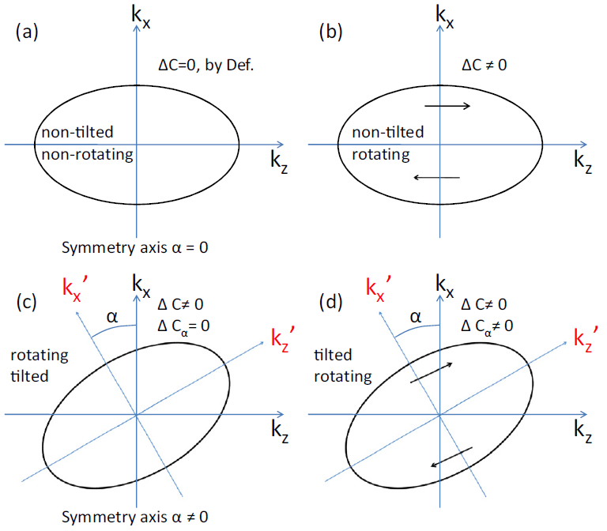
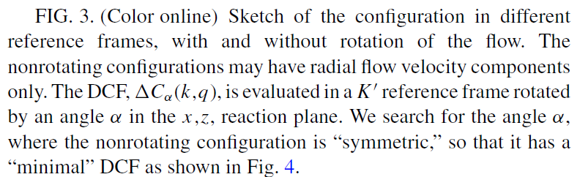
Differential HBT method
We can rotate the frame of reference:
→
Measure k,q (p₁,p₂,p₃,p₄) in the
out & long directions, in the R.P.

Slide 30
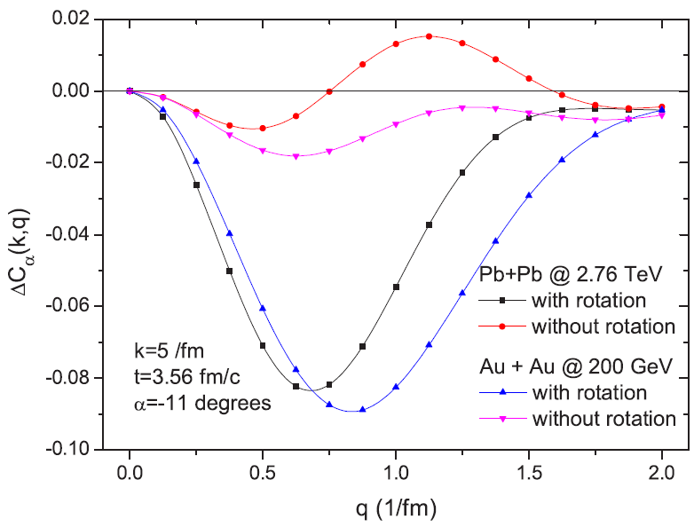
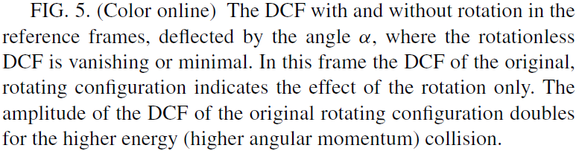
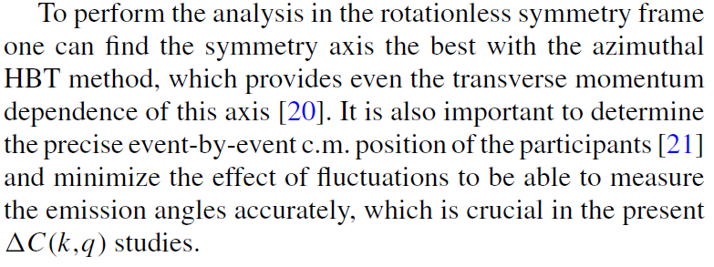
Signs of rotation
  [LP. Csernai, S. Velle, DJ. Wang, Phys. Rev. C 89 (2014) 034916]
  [LP. Csernai, S. Velle, Int. J. Mod. Phys. E 23 (2014) 1450043]

Slide 31
Exact, expanding and rotating hydro solution (E.M.)
Exact model: T. Csörgő, M.I. Nagy, Phys. Rev. C 89, 044901 (2014).
Hydro: L.P. Csernai, D.J. Wang, and T. Csörgő, Phys. Rev. C 90, 024901 (2014). Vor.: L.P. Csernai, J.H. Inderhaug, Int. J. Modern Physics E 24, 1550013 (2015).

Slide 32
Vorticity in E.M. & in ECHO-QGP hydro
EM: YL Xie, RC Glastad, LP Csernai, arXiv: 1505.07221v1 [nucl-th]
ECHO-QGP hydro: F Becattini et al., arXiv: 1501.04468v2 [nucl-th]
Vorticity components: -y directed from rotation, [x,z] or [r,φ] directed fr. Expansion
: rot β or ∂_{t} β
Different initial conditions (!): with vs. without shear ➔
In E.M. rot β = - 0.132 … -0.106, decreasing with time | HwSh.: 0.3—0.6
. ∂_{t} β_{r} = 0.029 – 0 x y/fm, ∂_{t} β_{φ} = 0.009 - 0 x r/fm, ∂_{t} β_{y} ≈ 0.0
In ECHO-QGP: (no initial shear !) mean values:
. rot β = 0.0 … - 0.007, increasing, with viscosity
Matter is put beyond ± \η_{m}, parameter to secure angular momentum without shear!
➔
No vorticity in the middle zone of the collision, just at high rapidities, i.e. high z
~[x,z]-component

Slide 33
Vorticity in ECHO-QGP hydro cont.
In the [x,z] ~ [x,η] plane y-directed vorticity, changes btwn: -0.05 – 0.03
Net FO vorticity is negative up to
-0.007 with “large” viscosity.
No initial vorticity
No vorticity in central domains
Both due to lack of initial
shear flow

Slide 34
Polarization in E.M. & in ECHO-QGP hydro
Y-directed polarization, Π_{y}, is very different. In E.M. max polarization is -11%, >> in ECHO-QGP it is -0.2%,
due to lack of initial shear flow

Slide 35
Polarization in E.M. & in ECHO-QGP hydro cont.
In the Π_{x}-direction the initial shear flow has no effect.
The structure is similar, the amplitude is different and the sign is
opposite. There may be different conventions (?)

Slide 36
Summary
We have shown how to split Collective flow & Fluctuations
When Collective Flow is identified: New patterns
Small viscosity (→ fluctuations & instabilities)
Kelvin-Helmholtz Instability (KHI) ~ turbulence
These are observable in polarizations and in HBT

