Slide 1
evopro group Selected references

Slide 2
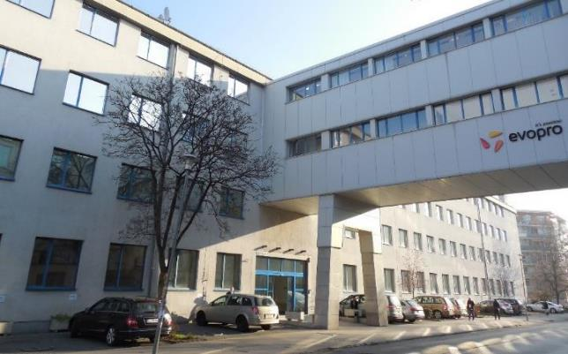
Group introduction - facts & figures
As an engineering services provider, evopro delivers worldwide into various industrial domains.
Established in 2001
Main offices:
Germany (Regensburg)
Hungary (Budapest) – HQ
Romania (Cluj)
Further foreign entities: Austria, Norway, UAE
Revenue in 2014: 20M €
90% of projects are international
Employees: 260 (Q1, 2015)
200 engineers
Electronics (instrumentation & control)
App. SW, IT
Mechatronics

Slide 3
Areas of activity Group competences
evopro Holding
evopro systems engineering
evopro Innovation
Industrial Automation
Control systems engineering
Embedded/FPGA Systems
Control system research for IoT/CPS/Industrie 4.0
Cloud Computing HW acceleration
Measurement and Test
10 Engs
40 Engs
Cabinet Manufacturing
Field Installation
40 Engs
Vehicle development:
Composite body
e-/Hybrid powertrains
40 Techn
110 Engineers

Slide 4
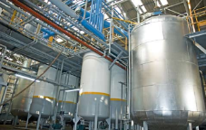
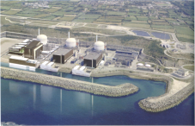
Company introduction - competences
Instrumentation & Control Systems engineering
Industry competences
Factory-/Process automation
Nuclear/Energy/Big Physics
Base competences
PLC / Embedded Control Systems HMI / SCADA / DCS
Motion Control,
Servo Drive Systems,
Robotics
Simulation
Virtual commissioning
Cloud Computing
HW Acceleration
Service orchestration
Embedded instrumentation,
Signal processing
Analog- and Digital- Hardware design,
HDL design
Real-time Software,
Kernel level development
Database and Application SW development

Slide 5
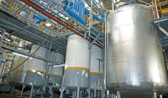
Control Systems Technologies
Electrical and mechanical design
EPlan, Autocad, Engineering Base, Dialux, Rittal Power Engineering, Simaris, Alpha Select, Rapsody, Comos,
Autocad, Catia, Engineering Base, Inventor, NX, ProEngineer, Solid Edge, Solid Works
Drives, Motion control
Siemens: Masterdrive, Micromaster, Movidrive, Simodrive, Sinamics, Sinumerik, Simotion, Robicon Other: Beckhoff, Lenze, SEW, Sumitomo,…
Robotics
KUKA, ABB, Fanuc, …
PLC controls Siemens Simatic Other: ABB, Allen Bradley, Beckhoff, Bosch Rexroth, Fanuc, Phoenix Contact, Schneider, Mitsubishi, Modicon, Omron, …
HMI/SCADA/DCS
Siemens: PCS7, WinCC, WinCC Flexible, WinCC OA Other: LabView, InTouch, Factory-Link, Infilink, Citect, 4Mation
Industrial bus- and communication systems
Industrial Ethernet, Profibus, Profinet, Modbus, EtherCAT, EIB, ASI, Canbus, BACnet, IO-Link

Slide 6
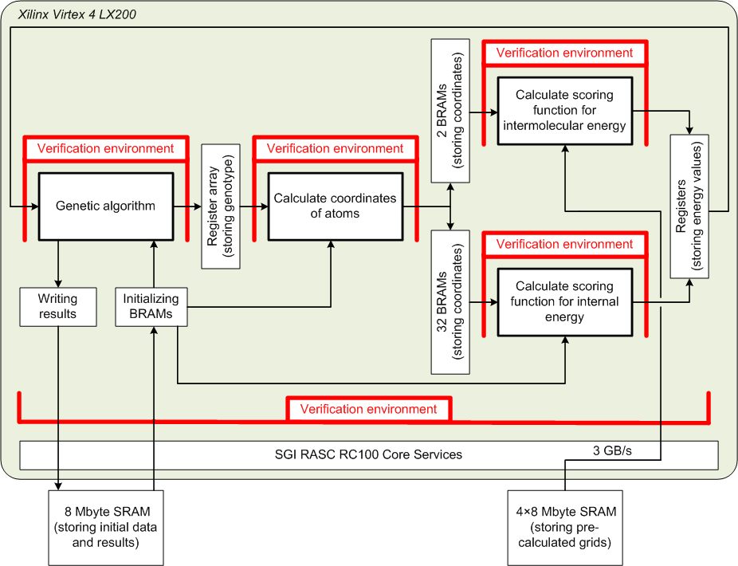
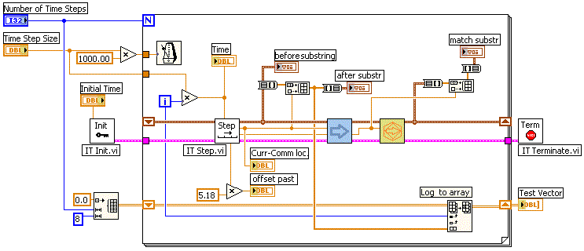
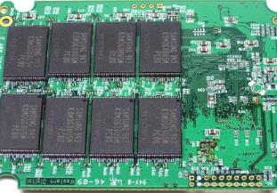
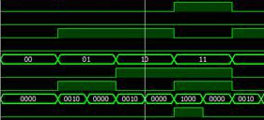
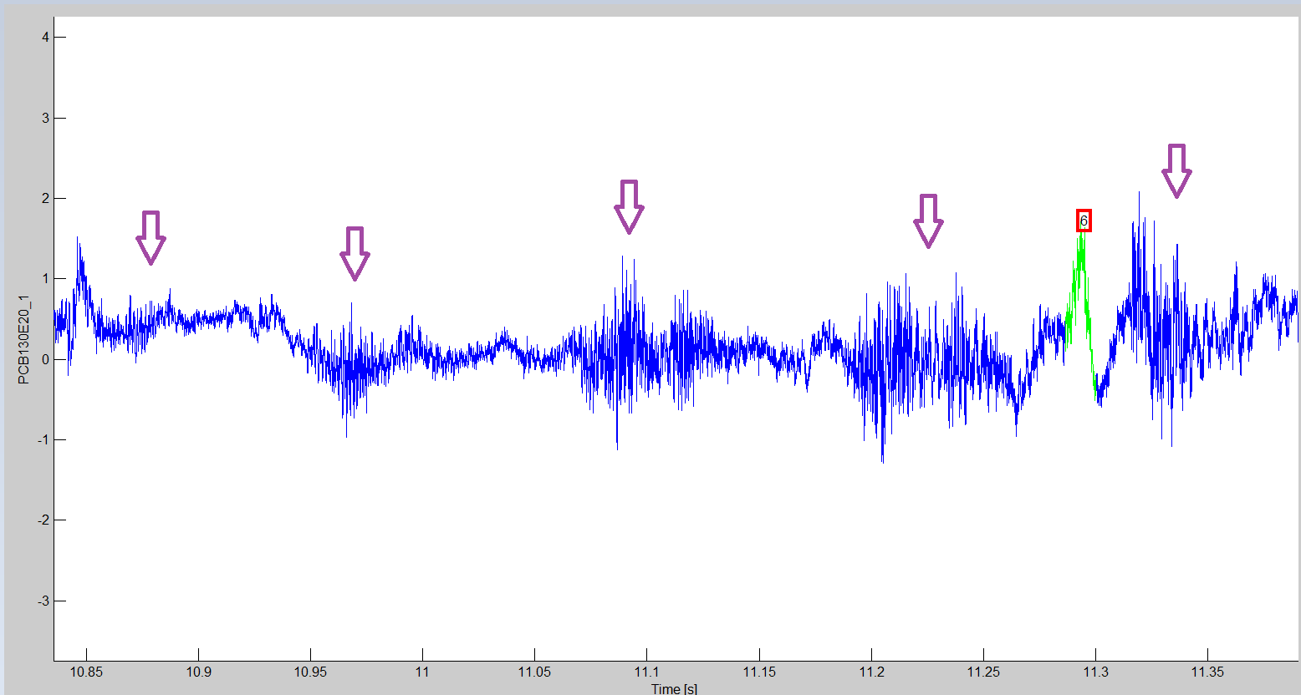
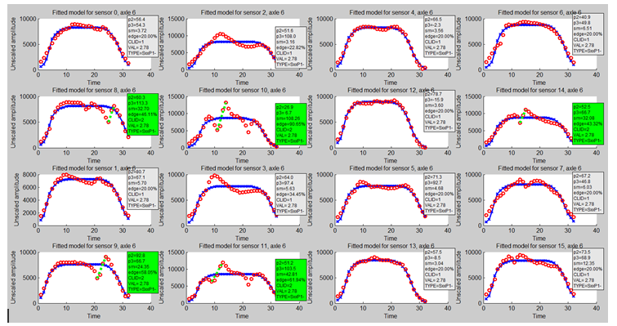
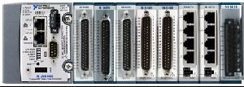
Embedded Systems Technologies
Systems engineering According to IEC 15288
Hardware
Up to layer number of 8 PCBs
Flex-rigid technology
Typical density: 325 components, 100 nets on (3” x 1.25” x 1.25”) area
Top component: chip scale BGA of 0.5 mm pitch
Software
embedded software development: C, C++
Core: ARM, AVR, PIC, TI
Heterogeneous computing
FPGA: vhdl, verilog
GPGPU: CUDA, OPENCL
DSP: Analog Devices, TI
multicore: OpenMP, C++11, FastFlow
RTOS micrium, ucOS-II, eCOS, Linux RTAI, VxWorks
LabView
Hardware in the loop simulation and test
Notes:
- Ide lehetne „Kiegészítő modulként betenni az eRTM-et is? Lehetne azt végig úgy pozícionálni, mit egy kiegészítő funkció/modul???

Slide 7
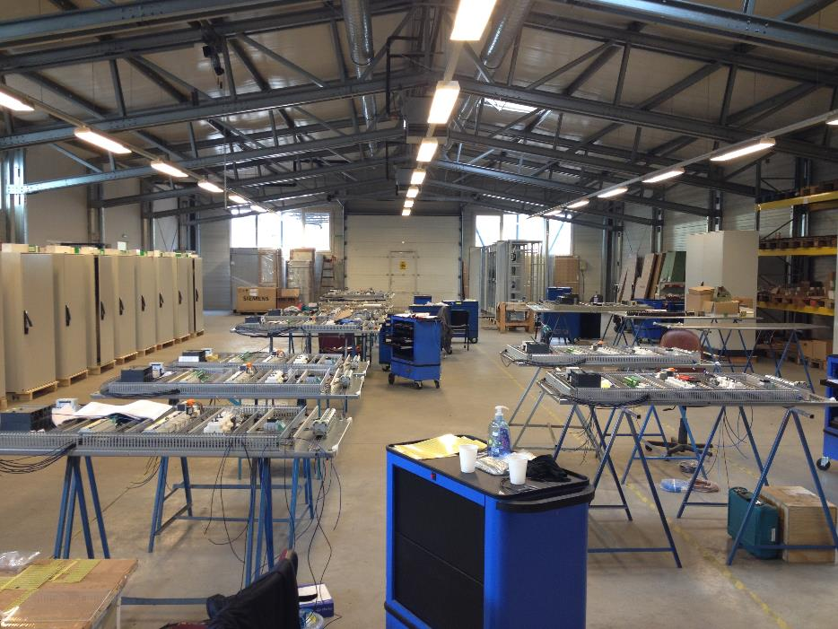
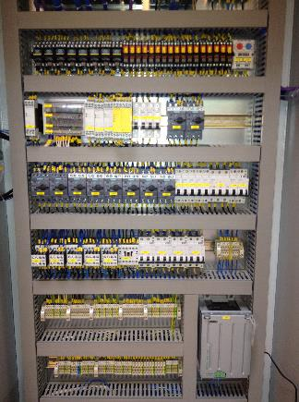
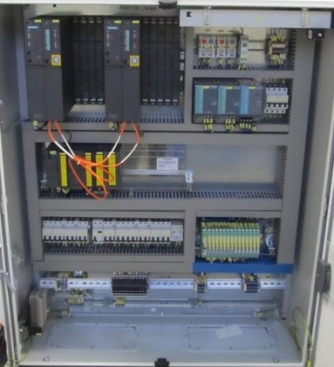
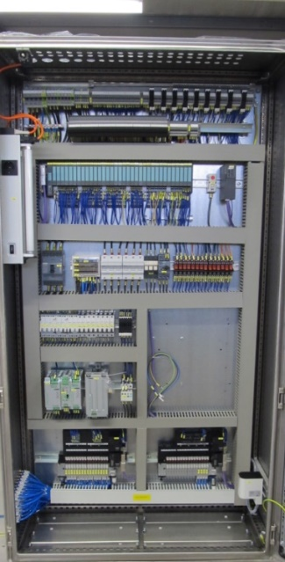
Cabinet design and assembly
Electrical design and fabrication of Control and Electrical cabinets:
Control panels/switchboards
Control Cabinets
MCC cabinets
VSD and Soft Starter Enclosures
Custom Motor Control Centers and protection cabinets
Marshalling & Termination Enclosures
Local Control Stations
Pump Control Panels
Metering Enclosures
Control Distribution Enclosures
Custom Designed Boards
UPS Cabinets
Power distribution switchboards (up to 4000A)
Electrical panels for power factor correction
Secondary circuits cabinets for medium and high voltage switchboards

Slide 8
References
Selected references

Slide 9
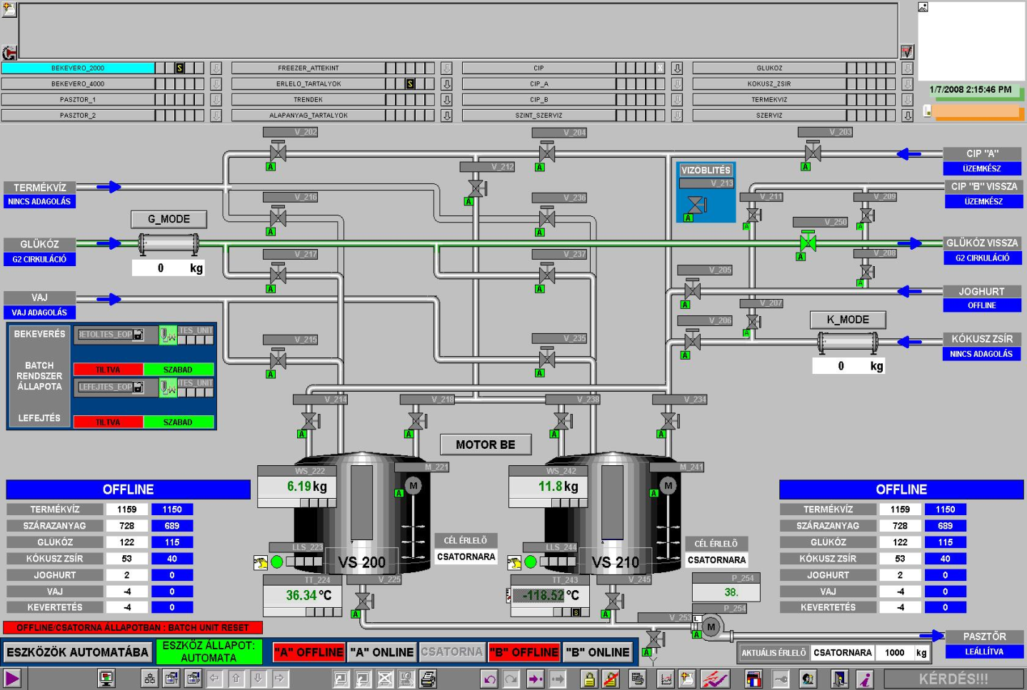
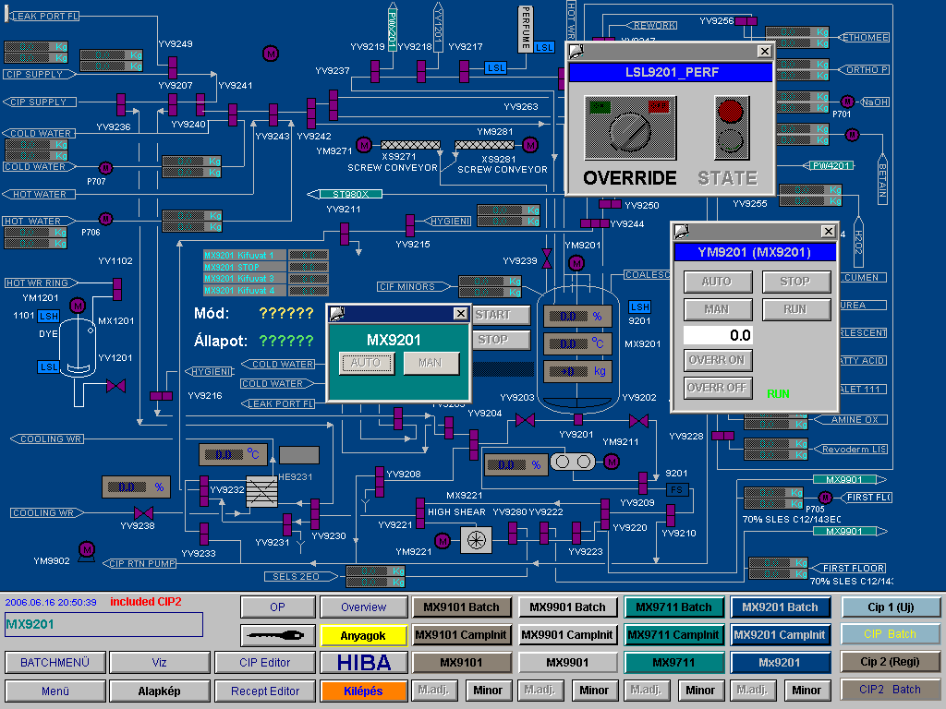
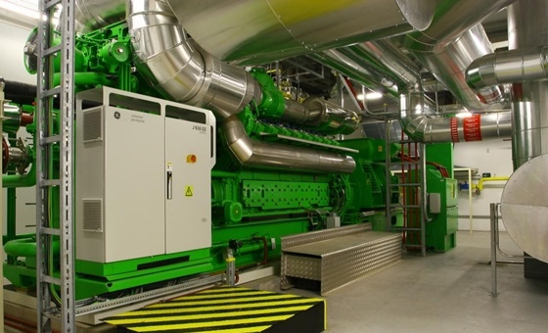
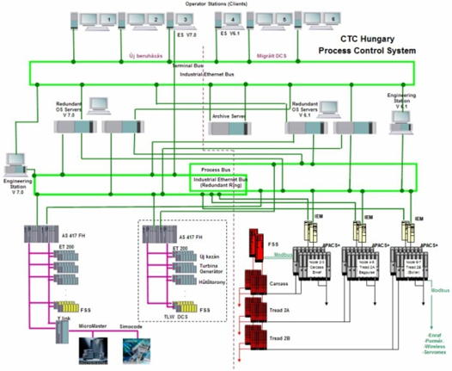
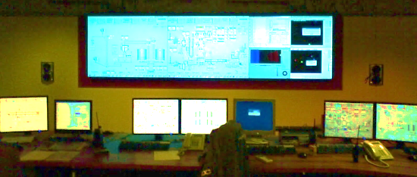
Control Engineering Services Process Industry
Chemical-, Food&Bevarage, Oil&Gas-, Waste Water Treatment plants
Process Control, DCS and HVAC systems
Systems design (also Redundant and Failsafe systems)
Electrical design
Cabinet Manufacturing, installation and commissioning
SW programming
Instrumentation
Industrial IT
Overall Commissioning

Slide 10
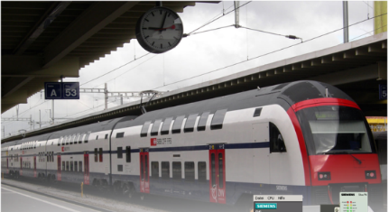
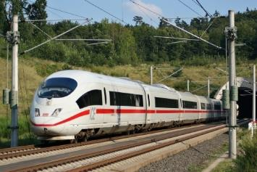
Control Engineering Services Energy / Marine / Transportation
Energy
Control system design and commissioning of Industrial turbines
Miskolc (Hungary)
Lockerbie (Scotland)
Gunsan (South-Korea)
Marrakesh (Morocco)
Biowanze (Belgium)
Donawitz (Austria)
Pfaffenau (Austria)
Kauvo (Finnland)
Salzgitter (Germany)
Marine
Control-, Drives- and Power management systems design and commissioning (SIL 2)
Platform support ships
Rolling stock
Control system design and commissioning (SIL 4)
Suburban trains
ICE trains
Locomotives
Rail-side signaling

Slide 11
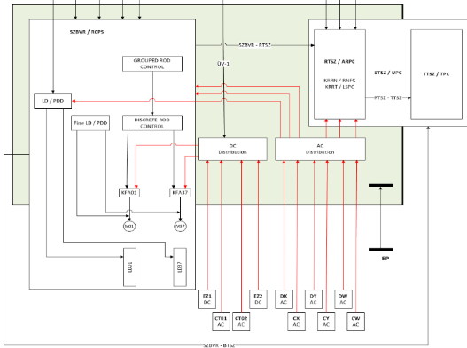
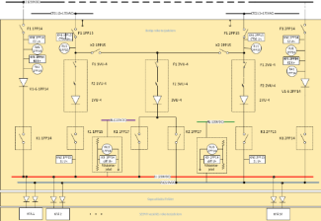
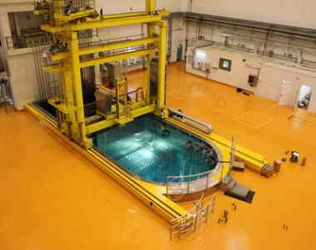
Control Engineering Services Nuclear
Nuclear power plant: Flamanville (Fr)
Automation system development in non critical areas
Software controls support of power plant automation system
Specification of EDF requirements
Increasing effectiveness of individual function blocks
Managing development from planning to testing
Nuclear power plant: PAKS (Hu)
Control System Refurbishment, Requirements specifications for:
Control Rod Control System [RCS]
Reactor’s Power Control System [RPC]
China Advanced Research Reactor (CARR) Beijing
(Sophisticated light-water tank reactor with 60 MW power)
Protection, Control and Monitoring System for Cold Neutron Source
Redundant control system engineering
Electrical design, cabinet assembly
SW design for data acquisition, protection and control
SCADA programming and LT archive
Commissioning and Tests

Slide 12
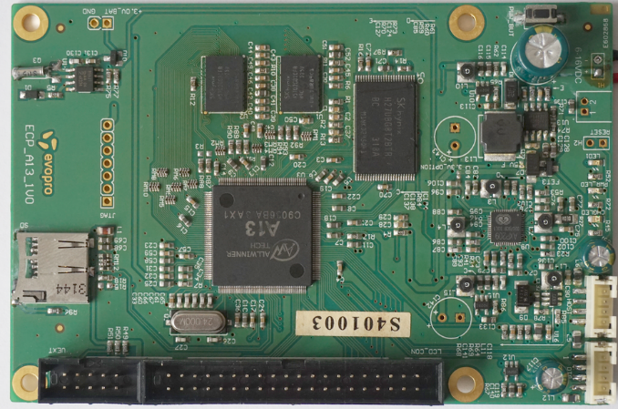
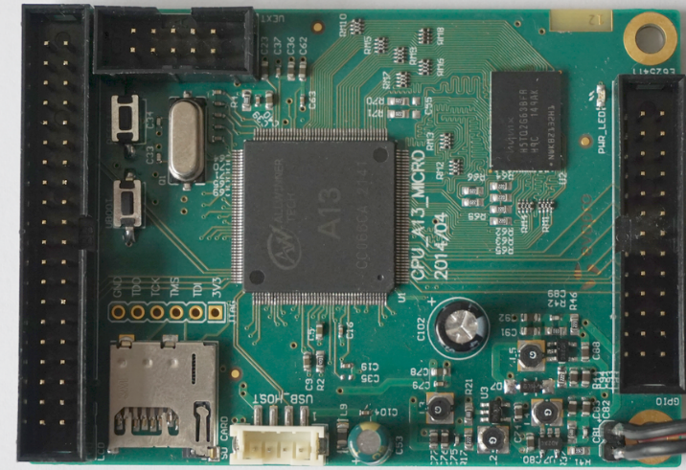
evopro computing platforms: Cortex A8 ARM CPU Boards
A13 Cortex A8 processor at 1GHz, 3D Mali400 GPU
512 MB DDR3 RAM (2 x 256Mbit)
4GB NAND Flash (for Android OS, etc.)
6-16VDC input power supply
1 x USB Host, 1x USB OTG
SD-card connector for booting optional Linux images
LCD interface for 7" touchscreen LCDs
RTC PCF8563 on board for real time clock
Battery option and connector
UART and SPI interfaces
JTAG
Dimensions: 80mm x 120mm
A13 Cortex A8 processor at 1GHz, 3D Mali400 GPU
256 MB DDR3 RAM
5VDC input power supply
1 x USB Host
SD-card connector for booting optional Linux images
LCD interface for 7" touchscreen LCDs
GPIO, UART and SPI interfaces
JTAG
Dimensions: 60mm x 85mm

Slide 13
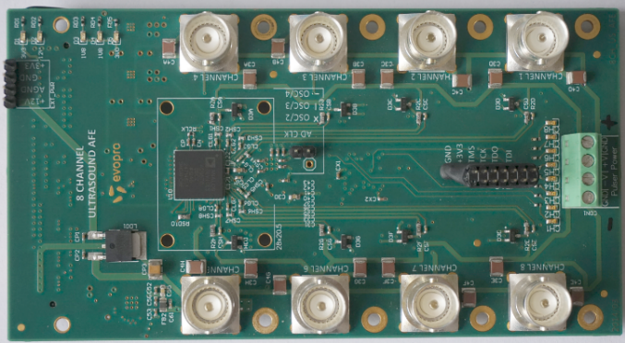
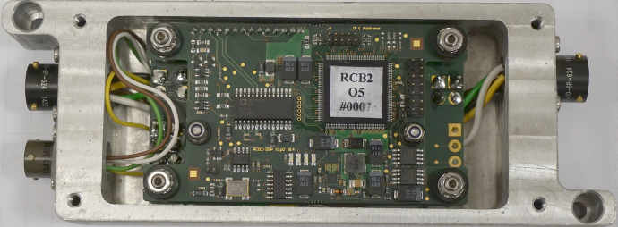
Analog front-end Load measurement module
Analog Devices AD9670 Ultrasound AFE for high-end medical ultrasound applications
8 independent channels with integrated RX/TX switch
0 to ±100V, 2.5A, up to 35MHz pulse drivers for high speed ultrasound transducers
8 channels of integrated and register configurable LNA, VGA, AAF, ADC, digital demodulator/decimator and FIR filter.
Flexible active input impedance matching
ADC: 14bits, up to 125MSPS / channel
On-board CPLD for independent, user configurable beamforming of each channel
160pin FMC-LPC connector to interface with Xilinx FPGA demo board (SP605)
Dimensions: 70mm x 130mm
Analog Devices SHARC DSP
Strain gauge bridge interface
24 bit ADC 44 kHz
RS485 communication

Slide 14
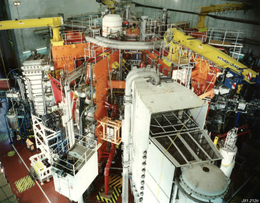
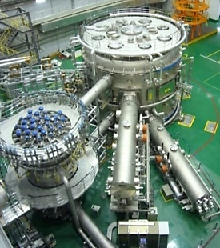
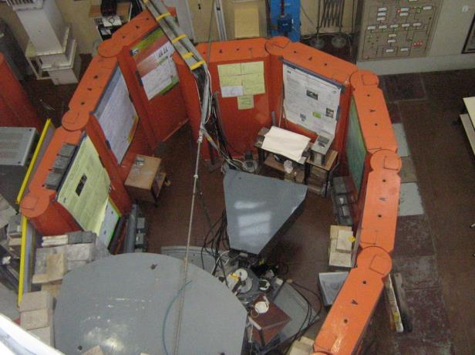
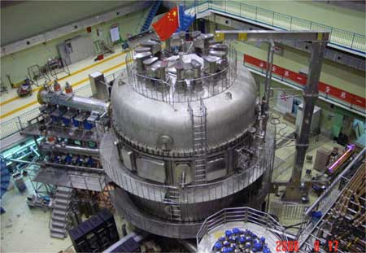
evopro Innovation’s Physics Control Projects
BES control at tokamaks
KSTAR (South Korea)
JET (UK)
EAST (China)
Neutron diffractometer at BNC

Slide 15
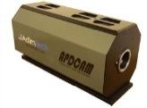
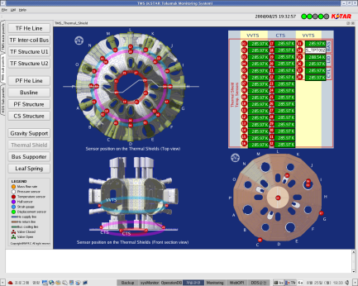
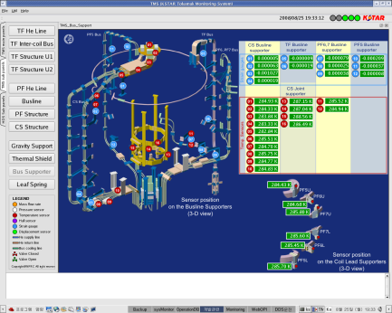
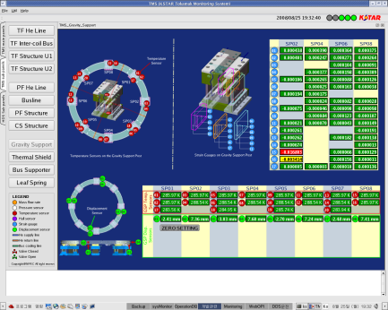
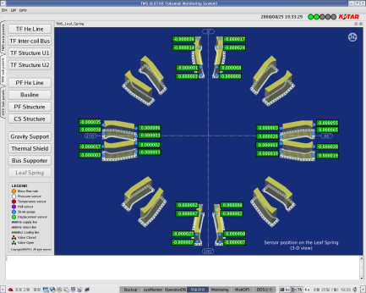
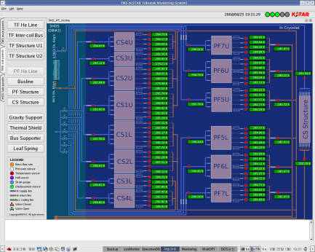
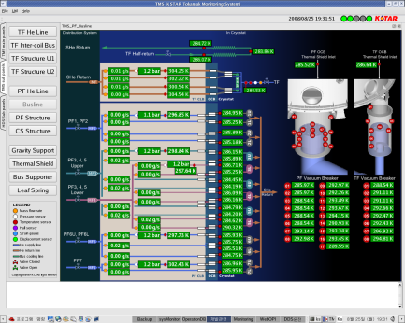
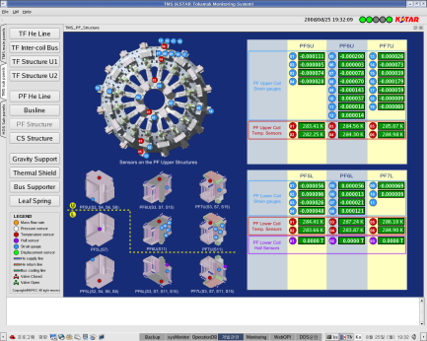
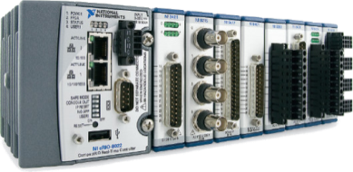
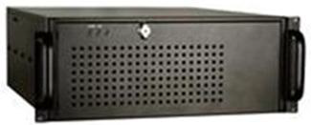
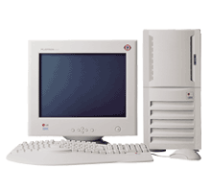
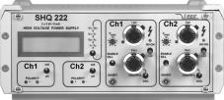
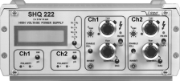
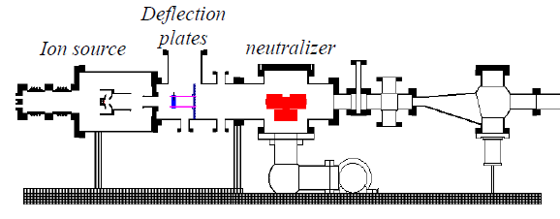
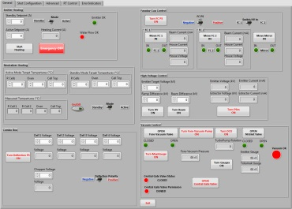
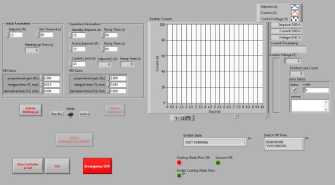
BES Integration into KSTAR’s Control System
APD camera
Remote Operation
NI cRIO module with I/O cards
LabView Host
and
EPICS IOC
Gbit Ethernet
HV PSs
Local Console
Turbo Pumps
Analog signals
Li-beam gun
Faraday Cups
LabView Front Panels

Slide 16
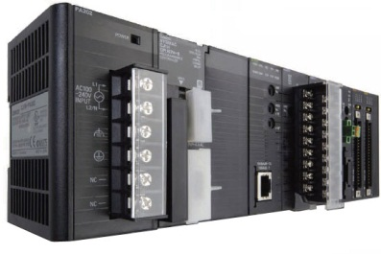
Control System Architecture of PSD Diffractometer
Linux based EPICS Input/Output Controller
Remote Operation
Omron PLC
TCP/IP
TCP/IP
TCP/IP or USB
TDC Unit
Temperature and Pressure Control
Local Console
Mechanical Control
Detector
Signal
PSD
Diffracto-
meter
HTP Cell
He-3 Detector

Slide 17
International projects

Slide 18
Summary
Extensive industrial background in control systems engineering
Solid base for delivering high value (xM €), long-term (several yrs.) projects - both, financial and procedural
In-house competence to deliver turn-key measurement, data acquisition and controls solutions based on commercial of-the-shelf as well as custom designed components
International delivery and support capabilities
High motivation to grow in Scientific Research and Big Physics

Slide 19
Thank You for Your Attention !
Contacts:
Tamas Winkler
+36 304 888 323
tamas.winkler@evopro-group.com
Janos Vamosi
+36 304 535 084
janos.vamosi@evopro.hu
The evopro group
Hauszmann A. u. 2.
H-1116 Budapest www.evopro-group.com

