Slide 1
Recent projects and possible cooperation topics with QERI
Dr. Bálint Hartmann
Renewable Energy Research group
Dr. Attila Talamon
Thermal Energy Research group

Slide 2
Recent projects
Possibilities of the utilisation of renewable and fossil energy sources at the site of Tisza II power plant
Four-step evaluation (assessment of initial conditions, evaluation of energy sources, risk assessment, boundary conditions of national energy policies)
Both conventional and renewable sources
Recommendation prepared for the site owner
Feasibility and environmental economic evaluation of electricity and heat generation technologies
MCDA (Multi-Criteria Decision Analysis) focusing on arbitrarily selected aspects
Both conventional and renewable
LCOE calculations
Revision of the Hungarian Renewable Energy Action Plan for the Ministry of National Development

Slide 3
Recent projects
Development of highly energy-efficient data centre infrastructure (ongoing)
Low PUE (Power Usage Effectiveness), decrease of AC and DC losses
Utilisation of locally available renewable energy sources
Integration of energy storage (kinetical, electrochemical, etc.)
Waste heat reutilisation
Smart power from bioenergy by underground heat storage hybrid system (BUHS)
Access to the electricity grid and also to traditional district heating systems
Interseasonal energy management with underground heat storage
New approach of energy producers and consumers
Renewable energy hybrid system; integration of bio- and geoenergy technologies

Slide 4
Possible cooperation topics with QERI
#1: Building integrated renewable energy utilisation and energy management system, using energy storage
#2: Utilisation of energy storage to facilitate the integration of intermittent renewable energy sources into a power system, operating in islanded mode
#3: Implementing multifunctional building energy typology as a basis of future national/regional/district renewable energy research strategies and action plans
#4: Highlighting renewable energy potential at national and urban level using GIS mapping technology as an online DSS (Decision Support System)
#5: Facing Qatar 2022 FIFA World Cup residential energy challenges. District Cooling System (based on renewable energy) potential of Doha

Slide 5
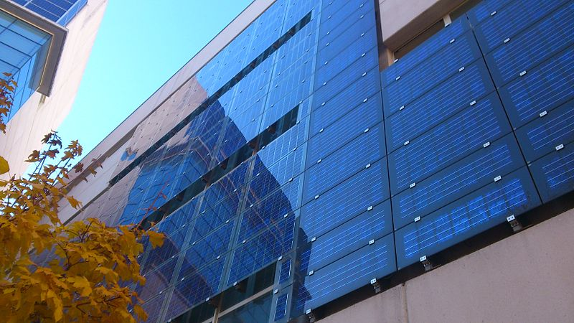
Topic #1
Building integrated renewable energy utilisation and energy management system, using energy storage
Small-to-medium scale generation units
Solar and wind energy

Slide 6
Topic #1
Advantages
Decreasing power losses of urban distribution networks
5-10%
„Prosumer concept”
Better MW/space ratio than conventional deployment
Low cost local production
Challenges
Generation potential estimation
Energy Management System control algorithms
New building designs (could be an advantage)

Slide 7
Topic #1 – selected publications
Talamon A, Hartmann B, Szoó D, Csoknyai T: Photovoltaic Cells vs. Solar Collectors: Primary Energy Generation Based Assessment Report 37th World Energy Engineering Congress, Washington DC, USA, 2014
Hartmann B, Török Sz, Börcsök E, Oláhné Groma V: Multi-objective method for energy purpose redevelopment of brownfield sites JOURNAL OF CLEANER PRODUCTION 82: pp. 202-212., 2014
Papp Sz, Hartmann B: Examination of the impacts of solar panels on low-voltage distribution grid depending on the placement. IEEE 4th IYCE, Siófok, Hungary, 2013
Vokony I, Hartmann B: Proposal of a Novel Operation and Control System for a Micro Renewable Energy Farm IEEE 4th IYCE, Siófok, Hungary, 2013

Slide 8
Topic #2
Utilisation of energy storage to facilitate the integration of intermittent renewable energy sources into a power system, operating in islanded mode
Integration of intermittent renewable sources
Distributed but centrally controlled units
Capable of providing reserves and ancillary services

Slide 9
Topic #2
Advantages
„Two birds with one stone”
Increased renewable penetration
Decreased reserve capacities, different allocation mechanisms
High quality of supply in load centres with high power density
Possibility to postpone strengthening and upgrading of network elements
Challenges
Requirements of islanded operation
Integration of electric vehicles
Distributed storage units
Control and management system (software)
Necessity, feasibility

Slide 10
Topic #2 – selected publications
Hartmann B, Dán A: Methodologies for Storage Size Determination for the Integration of Wind Power IEEE TRANSACTIONS ON SUSTAINABLE ENERGY 5:(1) pp. 182-189., 2014
Hartmann B, Dán A: Cooperation of a Grid-Connected Wind Farm and an Energy Storage Unit—Demonstration of a Simulation Tool IEEE TRANSACTIONS ON SUSTAINABLE ENERGY 3:(1) pp. 49-56., 2012

Slide 11
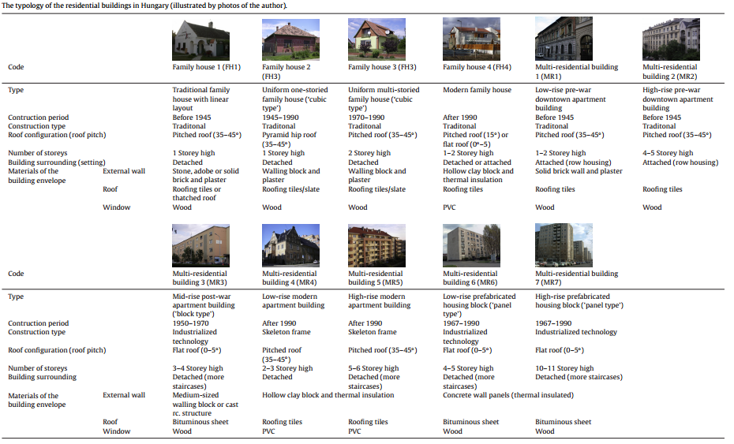
Topic #3
Implementing multifunctional building energy typology as a basis of future national/ regional/ district renewable energy research strategies and action plans
Setting up national building cadastre
Energy efficiency and renewable energy utilization potential analysis
Evaluation of possible hybrid energy systems
GHG emission reduction

Slide 12
Topic #3
Advantages
Multilateral usability
Energy & Environmental potentials
Useful in Decision Support Systems
High quality of statistic data
Possibility of developing GIS tools
Challenges
Synchronizing existing statistical databases
Architectural and engineering field surveys
Adapting building sector to climate change

Slide 13
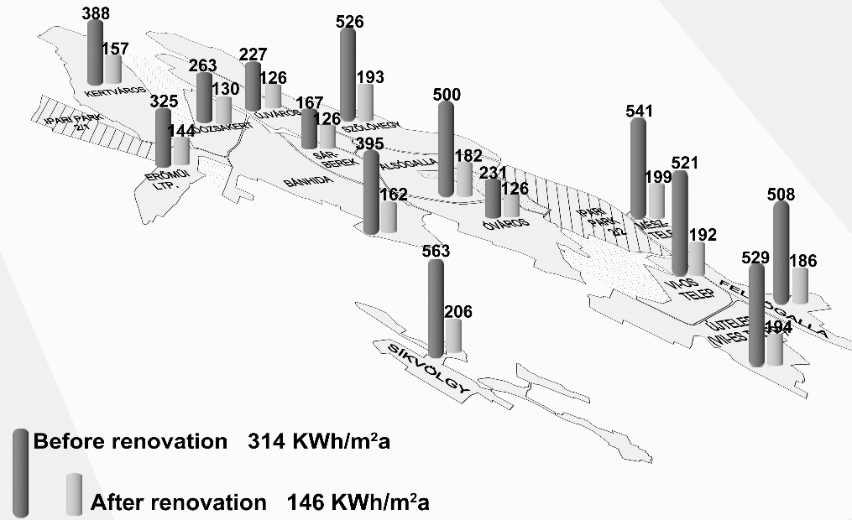
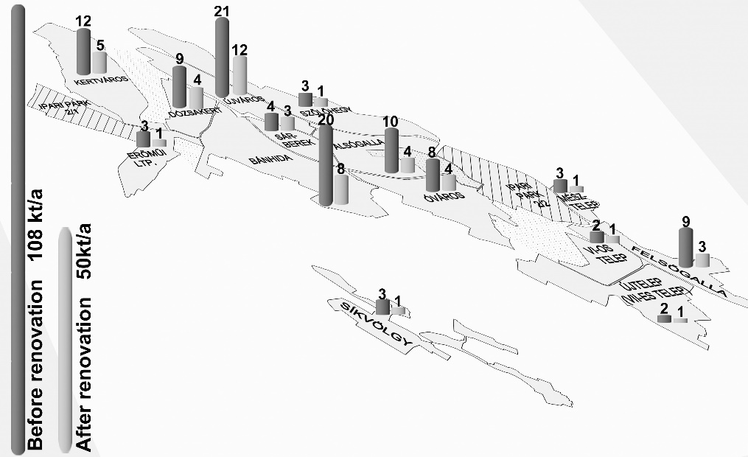
Topic #3
Implementing multifunctional building energy typology as a basis of future national/ regional/ district renewable energy research strategies and action plans:
Hrabovszky-Horváth, S., Pálvölgyi, T., Csoknyai, T., Talamon, A.,, Generalized Residential Building Typology for Urban Climate Change Mitigation and Adaptation Atrategies: The Case of Hungary, Energy and Buildings Journal, Vol. 62/2013, pp: 475-485, Impact Factor: 2,809

Slide 14
Topic #3 – selected publications
Hrabovszky-Horváth S, Pálvölgyi T, Csoknyai T, Talamon A: Generalized Residential Building Typology for Urban Climate Change Mitigation and Adaptation Atrategies: The Case of Hungary Energy and Buildings Journal, Vol. 62/2013, pp: 475-485
Talamon A, Hartmann B, Vokony I: Towards Zero Energy Buildings in Central Europe 34th World Energy Engineering Congress, Chicago, USA, 2011
Talamon A: Energy Efficiency Opportunities of the Public Buildings in Central Europe 33th World Energy Engineering Congress, Washington DC, USA, 2010

Slide 15
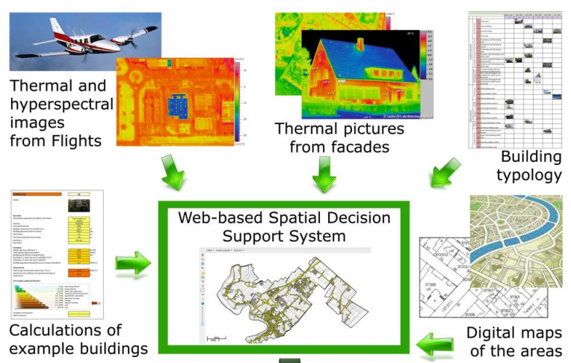
Topic #4
Highlighting renewable energy potential at national and urban level using GIS mapping technology as an online DSS (Decision Support System)
Analysing renewable energy potential on national level
Nearly zero energy solutions for building sector
Limitations of renewable energy solutions, particularly in case of densely built urban areas

Slide 16
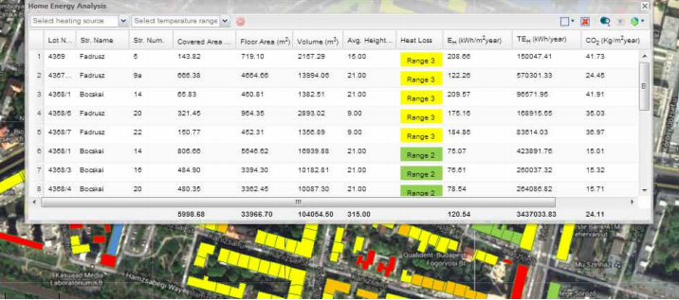
Topic #4
Advantages
Multilateral usability
Energy & Environmental potentials
Useful in Decision Support Systems
High quality of statistic data
Possibility of developing GIS tools
Challenges
Synchronizing existing statistical databases
Architectural and engineering field surveys
Adapting building sector to climate change

Slide 17
Topic #4 – selected publications
Talamon A, Csoknyai T, Szendrő G: Towards Zero Energy Buildings in Central Europe - GIS-based Mapping Tool of Urban Energy Potential Book: Fuelling the Future - Advances in Science and Technologies for Energy Generation, Transmission and Storage, pp. 544-550, BrownWalker Press, Florida, USA, 2013
Pálvölgyi T, Csoknyai T, Hess N, Szendrő G, Talamon A: Remote sensing for energy saving,18th Building Services Mechanical and Building Industry Days International Conference, Urban Energy Conference, Debrecen, Hungary, 2012

Slide 18
Topic #5
Facing Qatar 2022 FIFA World Cup residential energy challenges. District Cooling System (based on renewable energy) potential of Doha
High potential of district cooling technology
Newly-built World Cup residental and other-function buildings
Existing densily-built urban area
Possible impact of the climate change in the framework of World Cup Schedule (Heating or Cooling?)

Slide 19
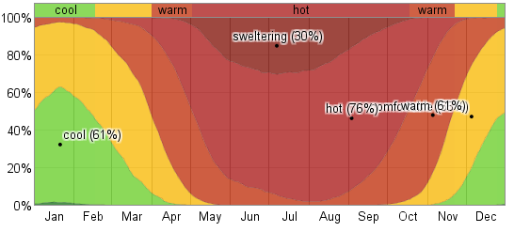
Topic #5
Challenges
Performance of urban-level vulnerability assessments are strongly interlinked by the structure and composition of building stock
Adapting the building sector to climate change
Advantages
Multilateral usability
Useful in Decision Support Systems
Vulnerability evaluation
https://weatherspark.com

Slide 20
Topic #5 – selected publications
Talamon A, Csoknyai T: Monitoring of a Performance-oriented Policy Model for Retrofitting ’Panel Buildings’ Environmental Engineering and Management Journal, Vol. 10/2011, No. 9.
Talamon A: Building sector and climate change: The case of Hungary Advanced Materials Research Journal, Volume 899, 2014, pp 99-104.
Talamon A: Climate Parameters in Built Environment from Energetic Point of View – Towards Climate Severity Index in Hungary Ybl Journal of Built Environment, I., 2013/2, Versita, De Gruyter, London

Slide 21
Thank you for your attention!
hartmann.balint@energia.mta.hu
talamon.attila@energia.mta.hu

