Slide 1
Hungarian Academy of Sciences Gergely Böhm Head of International Relations

Slide 2
The Academy has a unique status in Hungary
Tradition
Founded in 1825, the Academy owes its inception to public will, assisted by public donations rather than the will of a monarch or a government decision.
Legal status
Self-governing public body (Academy Law defines its legal status )
Dual mission
learned society
runs the largest research network in Hungary, (the only research network in Hungary dedicated to discovery research)
Responsibility
The Hungarian Academy of Sciences enjoys by far the greatest level of public trust among public institutions in Hungary (TÁRKI, 2013.)

Slide 3
Structure
MTA Public Body
(„learned society”)
365 members of the Academy in 11 sections
~ 13000 members of the Public Body
MTA Research Network
research institutions
research groups at universities (and other public institutions)
MTA Secretariat governed by the General Assembly and the Presidium

Slide 4
The MTA research network in 2015 The only research network dedicated to discovery research in Hungary
RESEARCH INSTITUTE Network
10 RESEARCH CENTRES
5 RESEARCH INSTITUTES
RESEARCH group NETWORK
89 „ACADEMY” RESEARCH GROUPS AT UNIVERSITIES AND OTHER PUBLIC INSTITUTIONS
97 LENDÜLET „MOMENTUM” RESEARCH GROUPS
56 AT MTA RESEARCH INSTITUTIONS
41 AT UNIVERSITIES (IN ADDITION)

Slide 5
II. Research centres and research institutes of the Hungarian Academy of Sciences since 2012
blue: main office; red: enabled research staff
New research centres
ECOLOGY
Tihany
91
ENERGY SCIENCE
Budapest
92
HUMANITIES AND ARTS
Budapest
312
NATURAL SCIENCES
Budapest
411
AGRICULTURAL SCIENCES
Budapest
204
SOCIAL SCIENCES
Budapest
156
ASTRONOMY AND EARTH SCIENCE
Sopron
123
„WIGNER” PHYSICS
Budapest
250
ECONOMY AND REGIONAL STUDIES
Budapest
144
Unchanged research institutes
MEDICAL SCIENCE
Budapest
81
MATHEMATICS
Budapest
81
LINGUISTICS
Budapest
94
BIOLOGY
Szeged
225
NUCLEAR RESEARCH
Debrecen
105
INFORMATICS
Budapest
140

Slide 6
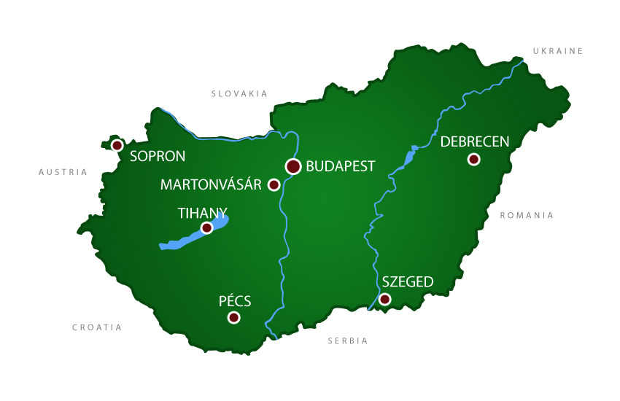
Main offices of the HAS Research Institute Network Budapest 9, outside Budapest: 6

Slide 7
The Momentum (Lendület) programme from Brain Drain to Brain Gain
Continuous growth in the number of research groups and financing: by 2014 97 research groups and over 11 million euros
yearly budget in million euros
number of research groups

Slide 8
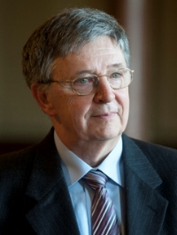
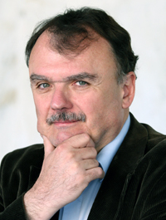
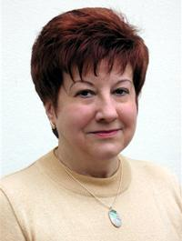
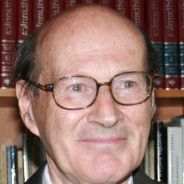
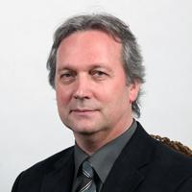
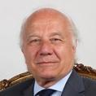
New Chief Officers (2014-2017)
At its 185th General Assembly held on 5-6 May 2014 the Hungarian Academy of Sciences elected new chief officers for the period 2014-2017
László Lovász
President
Ádám Török
Secretary General
Beáta Barnabás
Deputy General Secretary
Domokos Szász
Vice President for Natural Sciences
Tamás Freund
Vice President for Life Sciences
Lajos Vékás
Vice President for Social Sciences

Slide 9
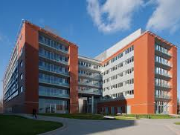
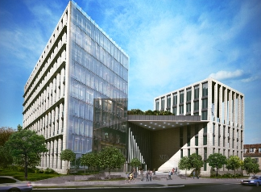
New buildings improved infrastructure
Research Centre for Natural Sciences was inaugurated in 2013
CERN@Wigner Data Centre (2013)
New building for Humanities and Social Sciences (2015)
Improved research infrastructure
targeted, competitive funding for infrastructure development since 2011 in a yearly amount of EUR 7 million

Slide 10
New Initiatives
Flagship programmes including the Lendület (Momentum) Grants and infrastructure developments will continue uninterrupted in the recently renewed research network
New initiatives: Enhanced cooperation with universities
Excellence Cooperation Programme: first pilot project (MEDinPROT) launched in 2014
Call announced on new methodologies in public education
extension of the Lendület (Momentum) Grants with additional research groups co-financed by industry

Slide 11
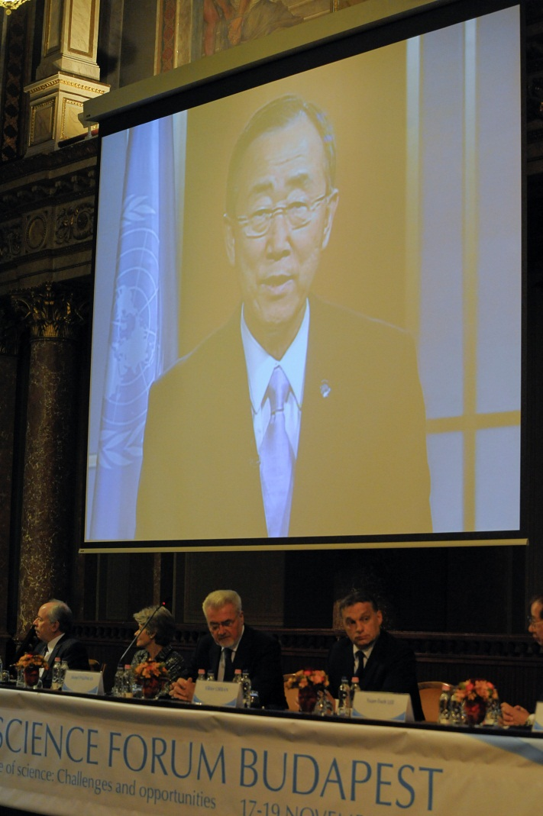
Contribution to European and international science policy and evidence-based policy advisory
Europe
European Academies Science Advisory Council (EASAC) – policy advisory
Science Europe – interest representation
a special attention to Central Europe (V4)
Horizon 2020
Global
World Science Forum in co-operation with UNESCO, ICSU, AAAS, EASAC and TWAS
Special attention to
Open Access,
research integrity
policy advisory
science to society

Slide 12
World Science Forum 4-7 November 2015 Budapest
Biennial event organised by the Hungarian Academy of Sciences since 2003 in co-operation with UNESCO, ICSU, AAAS, EASAC and TWAS
High-level forum for outstanding scientists and decision-makers in the fields of science, policy-making, and industry
2013: Rio de Janeiro, 2015: Budapest, 2017: Jordan Main theme: „The Enabling Power of Science” 2 narratives: Sustainability (UN Agenda, SDG, COP21) + Communication (public engagement, science into policy making)
Themes: science communication, confidence in science, review of the development of SDGs, science in innovation, integrative global efforts in science, science in policy-making, disaster risk reduction, science governance, science carrers,

Slide 13
Thank you for your attention

