Slide 1
Glitches, Neutron Star Structure and External Torques: New Developments, New Perspectives NewCompStar Budapest, 19.06.2015 M. Ali Alpar ongoing work with Onur Akbal and Erbil Gügercinoğlu

Slide 2
*Overview on glitches: External torque, starquakes, superfluidity, pinning and creep in the crust superfluid. *Entrainment: How to meet the requirements. Flux line-vortex line pinning and creep in the core superfluid. *PSR J1119 Unusual glitch signatures & change in external pulsar torque: → Inward vortex motion? → Crust breaking ? Scale? → Scale in number of unpinned vortices? *Minimum glitch size in the Crab pulsar → Scale in crust breaking? → Scale in number of unpinned vortices?

Slide 3
Sudden change in rotation rate and spindown rate with no correlated change in pulsar’s electromagnetic signature (until recently→ PSR J 1119) → changes internal to the neutron star: either structural (starquakes) or regarding angular momentum exchange between star’s components (vortex unpinning : superfluid)

Slide 4
Pure quake:

Slide 5
Superfluid: *Slow postglitch relaxation *Size and frequency of large glitches (Vela PSR) → IF due to starquakes, rate of (elastic) energy dissipation too large cf observational bounds on thermal radiation. * Superfluid: only rotational kinetic energy involved with the large events, rate of energy dissipation OK.

Slide 6
Superfluid: Angular momentum conservation: : How many vortices moved outward : Moment of inertia of superfluid regions through which vortices moved. Change in spindown rate (in glitch with no change in external (pulsar) torque):

Slide 7
Glitches are probably not pure superfluid events either. Crustquakes trigger , superfluid amplifies. *Crab: time between glitches does not fit pure superfluid unpinning model. *Vela and other pulsars with large glitches also exhibit Crab like small glitches. *Vela interglitch fits: estimate of time to next glitch improves with inclusion of Crab like “persistent shift” (Akbal, + Sarah Buchner, ongoing)

Slide 8
Crust breaking and vortex unpinning Crust breaking is the likely trigger in both Crab and Vela glitches, amplified to different sizes by an avalanche of unpinned vortices. Same number of vortices involved in Crab and Vela. They travel a small distance in Crab: vortex pinning traps network not developed. In Vela the avalanche travels throughout the crust superfluid: percolating network.

Slide 9
Between glitches – steady state spindown of the superfluid proceeds by thermally activated vortex creep against pinning, driven by the lag ω = Ω_{s} – Ω_{c} . The lag is offset at glitches. The response can be highly nonlinear in the glitch induced offset, has different linear and nonlinear regimes.. Modelling the postglitch response identifies systematic behaviour in Crab, Vela and other pulsars.

Slide 10
Two component equations of motion: I_{c} dΩ_{c} /dt + I_{s} dΩ_{s} /dt = N_{ext} dΩ_{s} /dt = - nκ <v_{r}>/r = - 2Ω_{s} <v_{r}> / r steady state:

Slide 11
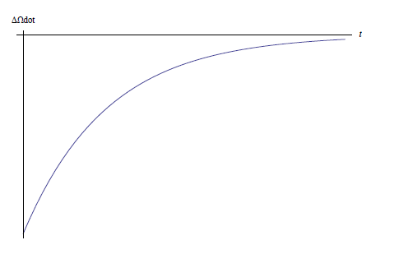
Linear coupling of sf and “crust” and linear response: When dΩ_{s} /dt = = - ( Ω_{s} - Ω_{c}) / τ Perturbations from steady state → response: exponential decay; Amplitude of response is linear in the perturbation (glitch ΔΩ). Postglitch data typically involve several distinct exponential relaxation pieces.

Slide 12
Linear coupling of sf and “crust” & exponential relaxation with: i) bona fide drag forces ii) linear regime of creep. Relaxation time in linear regime: is very sensitively dependent on pinning parameters and temperature → ambiguity in interpreting model fits. iii) nonlinear creep regime but small perturbation: response of sf regions through which no vortices move in glitch. ω = Ω_{s}− Ω_{c} . δΩ_{s}>>ΔΩ_{c} , since I_{s} δΩ_{s} = I_{c} ΔΩ_{c} . So δω = δΩ_{s} in regions through which vortices moved. In regions where no vortex motion occurred δω = ΔΩ_{c} a much smaller peturbation.

Slide 13
Superfluid spindown by vortex flow: V_{r} is the average radial velocity of the vortices:
In vortex creep V_{r} is given by a microscopic vortex velocity V₀ times a highly nonlinear function f(ω) of the lag ω = Ω_{s}− Ω_{c} .

Slide 14
V₀ is the microscopic speed of an unpinned vortex line/segment with respect to pinning sites.
Linear regime obtains if f (ω;pinning,T) = is “small enough”. Bennett Link (2014) has argued that if V₀ = ωR, the macroscopic average relative velocity, then there is no linear regime.
However V₀ is dominated by microscopic contributions to the local superfluid flow due to inhomogeneities (nuclei in the crust lattice).
(Bernoulli effects) make V₀ ~10⁷ cm s⁻¹ >> ωR
(Alpar thesis 1977, Shaham 1980, Epstein & Baym 1988), so the linear regime as well as the nonlinear regime can operate in different parts of the star.
Notes:
My thesis : simple derivation of Bernoulli force and associated V_{o} . Jacob’s paper: uses method of images and cylindrical nucleus. Epstein and Baym: kinetic energy calculation using contour integral and spherical nucleus (actually cylindrical- 2-d cut is a circle). Ginzburg Landau calculation which they fixed (with wrong assignmnt of fudge factor to Δ rather than xi; but that does not effect the kinetic energy calculation where phase gradients, azimuthal velocity is involved rather than the r gradient of the order parameter). All approaches get V_{o} ~K/(2 pi a )* Lambda-1 /Lambda+ (1 or 2) ~ 10⁷ cm / s. Here a is the lattice spacing,
Lambda = rho _{o} / rho _{G .}

Slide 16
For free (unpinned) vortex lines between flux lines in the core superfluid , V₀ ~ 1 cm/s → only the nonlinear regime of creep is possible. (Gügercinoğlu, to be submitted, 2015).
Notes:
V₀ is much smaller in the core superfluid because the distances between the pinning sites, the flux lines, l _{Φ} ~ (Φ₀/B)^{1/2} is much larger than the distances (a ~ 40 fm) between pinning centres, nuclei, in the crust lattice.

Slide 17
Creep response to outward vortex motion: * Lag ω = Ω_{s}− Ω_{c} driving the creep is reduced by the glitch. → Creep rate decreases : * Superfluid spinning down less efficiently, so the observed crust spins down rate increases, after the glitch . * In nonlinear creep regions through which vortices move during the glitch → Creep almost fully stops; resuming after a waiting time when the lag has healed back to steady state. The waiting time t₀ is proportional to the perturbation, the response has a highly nonlinear dependence on the perturbation : Fermi function. A prediction of the model that was later observed ! Stacked waiting times: constant second derivative .

Slide 18
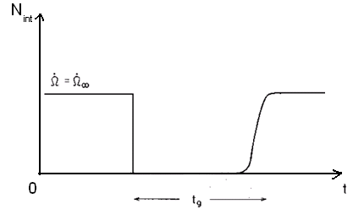
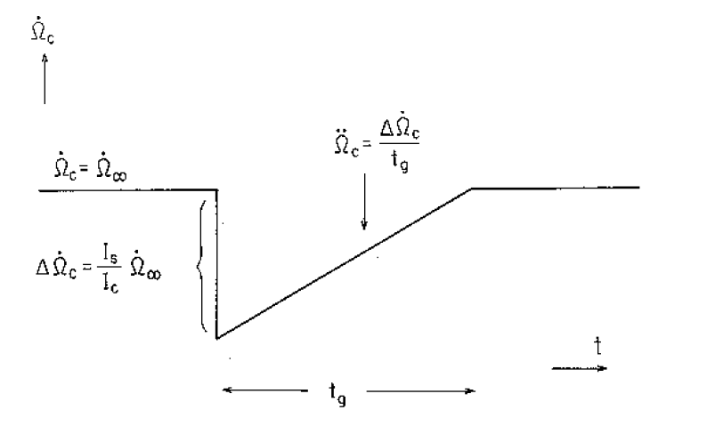

Slide 20
Interplay between creep and unpinning: in nonlinear creep only. (→ talks by Bryn Haskell & Andrew Melatos)

Slide 21
Entrainment : (Chamel) m_{n}*/m_{n} > 1. (but entrainment may be different: Nicolas Chamel’s talk in this conference: dirty mix of nuclei in crust. Coherent scatterring may be due to superfluidity rather than Bragg lattice. ) → The extent of the neutron star regions involved in glitches and postglitch response must be larger than we thought: I_{s,glitch} / I > I_{s,crust} / I ~10⁻² .

Slide 22
A superfluid region that can support pinning and creep and provide the extra moment of inertia needed: Flux line vortex line pinning ; Creep of vortex lines against flux lines: Sidery & Alpar The outer core neutron superfluid-proton superconductor region with toroidal flux lines – importance in creep? Sidery & Alpar

Slide 23
Gügercinoğlu – talk at this conference: application to Vela pulsar and all pulsar glitches with observed exponential relaxation.

Slide 24
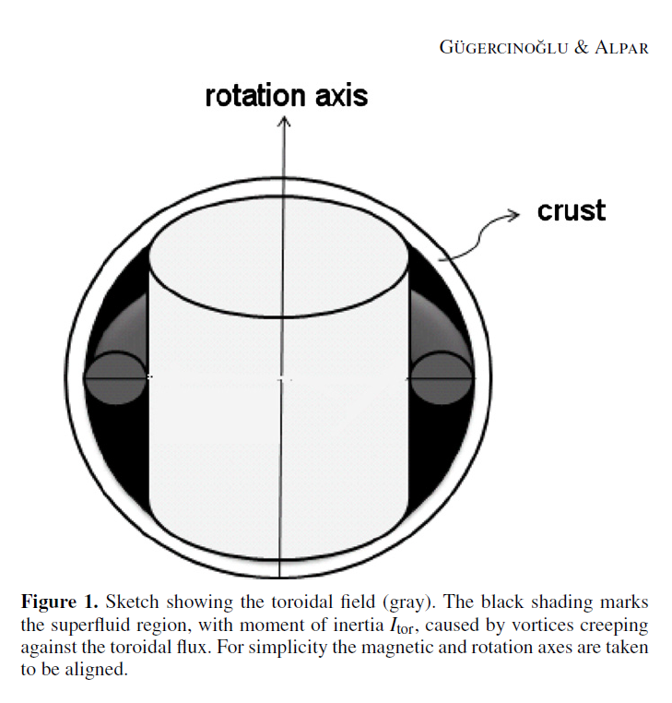

Slide 25
A toroidal flux line arrangement in the core? Electromagnetic stresses for poloidal + toroidal arrangement → “stable”? So that toroidal flux lines are at rest w.r. to crust while neutron vortex lines pin, unpin, creep through the toroidal region?

Slide 26
Vortex lines magnetized, electron scattering (Alpar, Langer & Sauls 84) Flux lines effected by buoyancy, tension; electron scattering (Harvey, Ruderman, Shaham 1986) Flux line vortex line interaction (Sauls 1988, Srinivasan, Bhattacharya, Muslimov & Tsygan 1990) Flux lines’ radial velocity cf vortex lines’ radial velocity: cut through or move with vortex lines ? Ruderman, Zhu & Chen 1998 -unfortunate typo:

Slide 27
PSR J 1119 -6127, 2007 glitch: unusual signatures and change in pulsar torque Weltevrede, Johnston & Espinoza 2011 Antonopoulou et al. 2014 RRAT and intermittent behaviour for 3 months after the glitch. in the long term (permanently?) Wrong sign for creep response. Wrong sign, AND too large, for a crust quake.
Notes:
|Delta Omega dot/Omega dot| ~10 ⁻³

Slide 28
PSR J 1119 -6127 Extension of Vortex Creep Model Akbal, Gügercinoğlu, Şaşmaz Muş & Alpar 2014 Inward vortex motion at glitch, must be induced : → by crust breaking, → which occurred near magnetic pole in this high B pulsar, →changed the angle between Ω and μ, → changed the external torque (permanently) → effected magnetosphere and emission pattern (3 month postglitch transient )

Slide 29
Creep response to inward vortex motion: * Lag ω = Ω_{s}− Ω_{c} driving the creep is increased by the glitch. * → Creep rate increases, and then relaxes exponentially. * after the glitch . Response to inward or outward vortex motion: Response of internal torques to perturbations (glitch) always decay fully, in the long run:

Slide 30
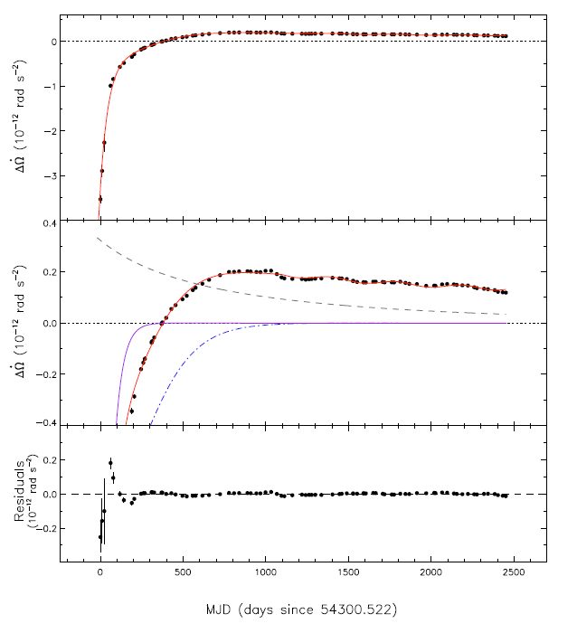
Notes:
t_{o} = 317 d
tau ₂ = 157 d

Slide 31
Results of Akbal, Gügercinoğlu, Şaşmaz-Muş & Alpar (2015) Plates of size D in a ring about the rotation axis are involved in a crustquake. Plates move inward by D towards the rotation axis to decrease moment of inertia (right sign for reducing oblateness, tiny change in I does not give the glitch magnitude). The change Δα ∼D/R in the angle between Ω and μ gives a permanent change in external torque which we measure from the long term data.→ D ~6 m, For a plate thickness h ~100 m, D/h = 6 * 10⁻² ~ θ _{cr} (cf Horowitz & Kadau 2009).

Slide 32
The number of vortices pinned to each plate is: The number of inward and outward moving vortices, from model fits to postglitch timing data: Now these come out as the number of vortices in the broken ring, some moving in and some unpinned and moving outward during the glitch: Nice! And this agrees with the number of outward moving vortices in Crab and Vela pulsars which seemed like a coincidence before: now it all relates to D and θ _{cr} .

Slide 33
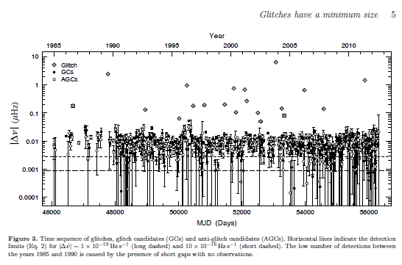
Minimum Glitch Size in Crab

Slide 34
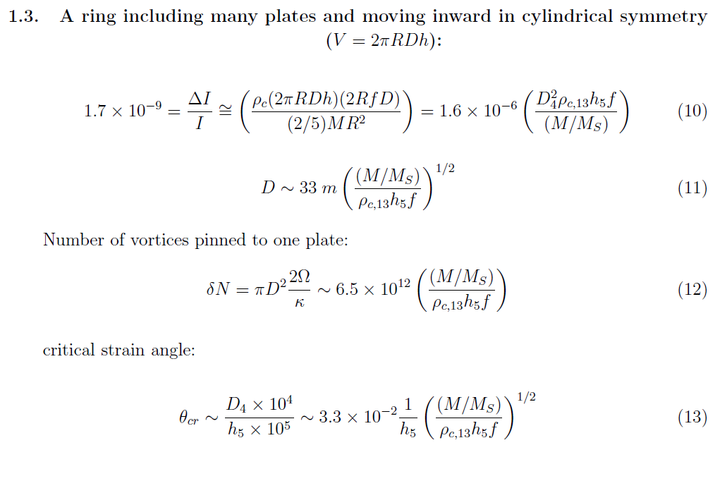
Preliminary results (Akbal, to be submitted, 2015)

Slide 35
Issues: *Entrainment: Is the crust enough? Run of m*/m through the crust. * Toroidal field/flux lines: Stability (long decay times?) Remaining in the core/vs being pushed out to the crust ? * Typical plate size and θ _{cr} ? *Vortex unpinning avalanches – scale free or is there a typical number of unpinned vortices? If so: * Is this scale intrinsic to pinned superfluid hydrodynamics ( local superfluid velocities and unpnning conditions?) OR, * is it imposed by a scale in crust breaking (D, θ _{cr} ) ? Pinning: Pizzochero et al. + microscopic vortex motion… Avalanches: Melatos, Haskell et al. + interplay with equibrium creep… Crust, superfluid, external torque interplay

Slide 36
Extra slides

Slide 37
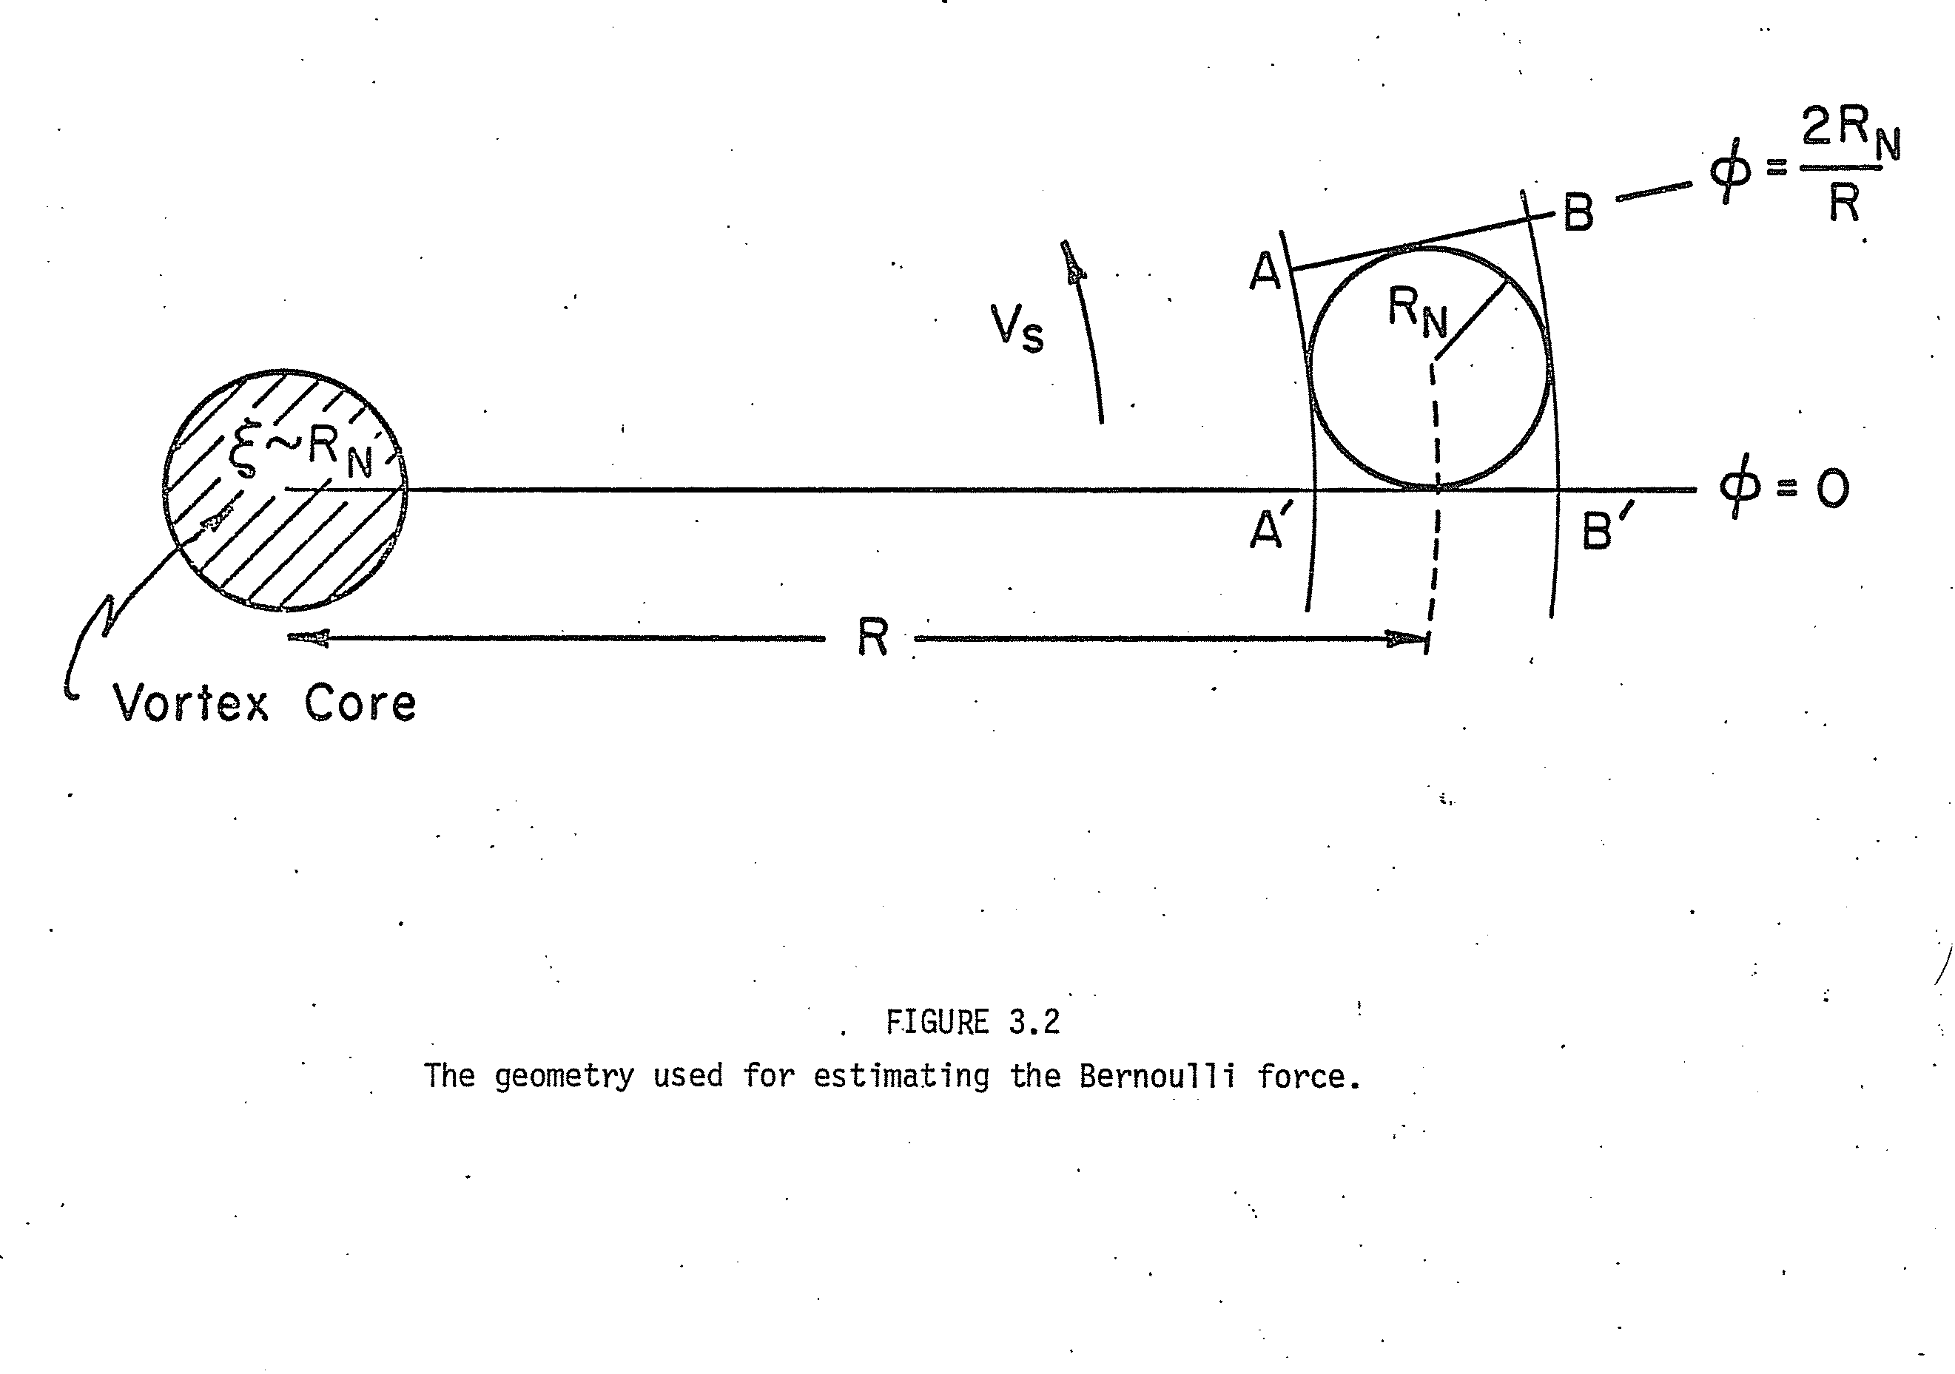

Slide 38
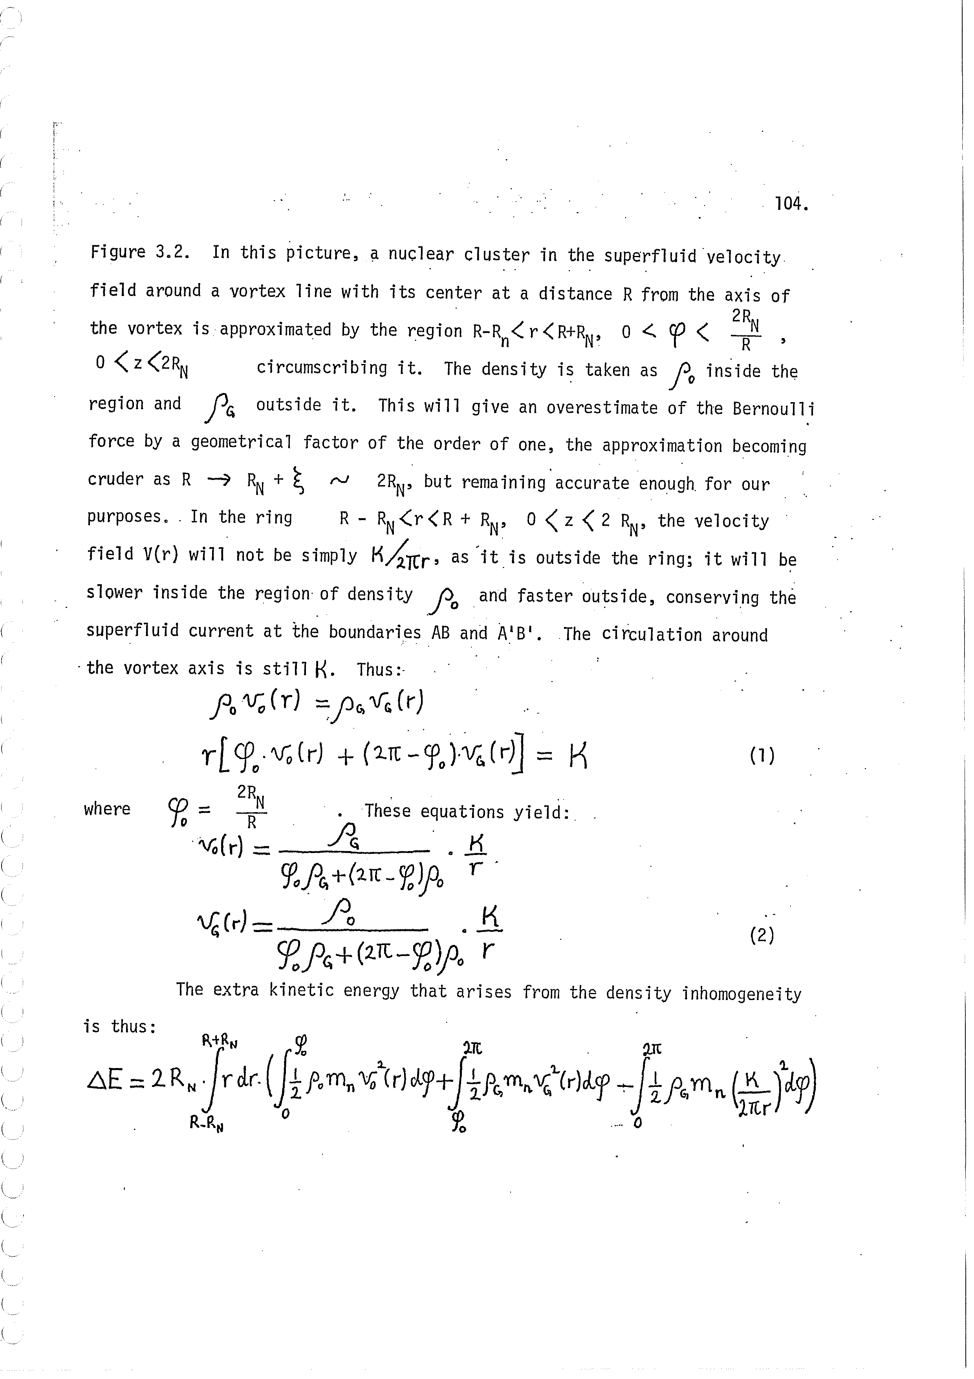

Slide 39
Results of Akbal et al. (2015) Plates of size D in a ring about the rotation axis are involved in a crustquake. Plates moved inward by D towards the rotation axis to decrease moment of inertia (right sign for reducing oblateness, tiny change in I does not give the glitch magnitude). The change Δα ∼D/R in the angle between Ω and μ gives a permanent change in external torque which we measure from the long term data.→ D ~6 m, For a plate thickness h ~100 m, D/h = 6 * 10⁻² ~ θ _{cr} (cf Horowitz & Kadau 2009). The number of vortices pinned to each plate is: The number of inward and outward moving vortices from model fits to postglitch timing data: Nice! And agrees with the number of outward moving vortices in Crab and Vela pulsars which seemed like a coincidence before: now it all relates to D and θ _{cr} .

Slide 40
Flux line vortex line interaction. Mal Ruderman – push through. E_{p} Flux Vortex: Typo. Jones (2006) . Magnus, Buoyancy > Pinning : Driving force: EM stresses of poloidal field. Situation now: v _{(flux)} = 4 X 10⁻⁷ cm s⁻¹. →t = 10⁵⁻⁶ yr i. Crab- Vela are not distinct re: v _{(flux)} ii. Radio pulsar field decay governed by crustal Ohmic diffusion & other crust processes like Hall decay. iii. Older neutron stars – core field is still likely to be stable and flux lines pin vortex lines, because the poloidal-toroidal field config is stable for appropriate volume of toroidal field and amplitude ratio. How does the toroidal-poloidal combination relax? Stability : Braithwaite (2009) stability against Ohmic diffusion. Lander et al (2012), Lander (2014) stability of hydromagnetic equilibrium numerical. Akgün et al (2013), analytical.

