Slide 1
Constraining neutron star properties with perturbative QCD Aleksi Vuorinen University of Helsinki
NewCompStar Conference, Budapest
16.6.2015
Main reference: Kurkela, Fraga, Schaffner-Bielich, AV, ApJ 789 (1402.6618)

Slide 2
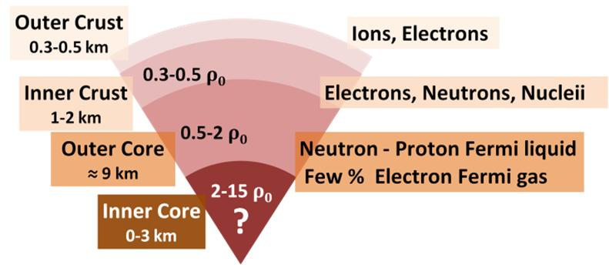
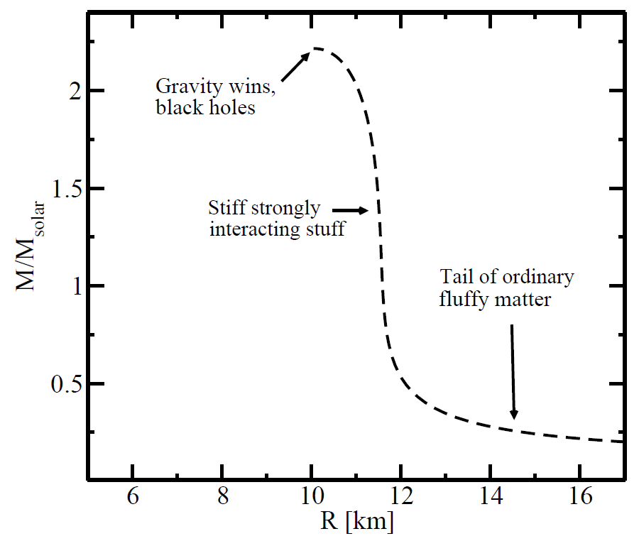
Classic problem in nuclear astrophysics: Predict composition and main properties of neutron stars
Main tool: EoS + TOV-eqs.
Theory challenge: Find EoS of nuclear/quark matter that is
Cold:
Electrically neutral:
In beta equilibrium:

Slide 3
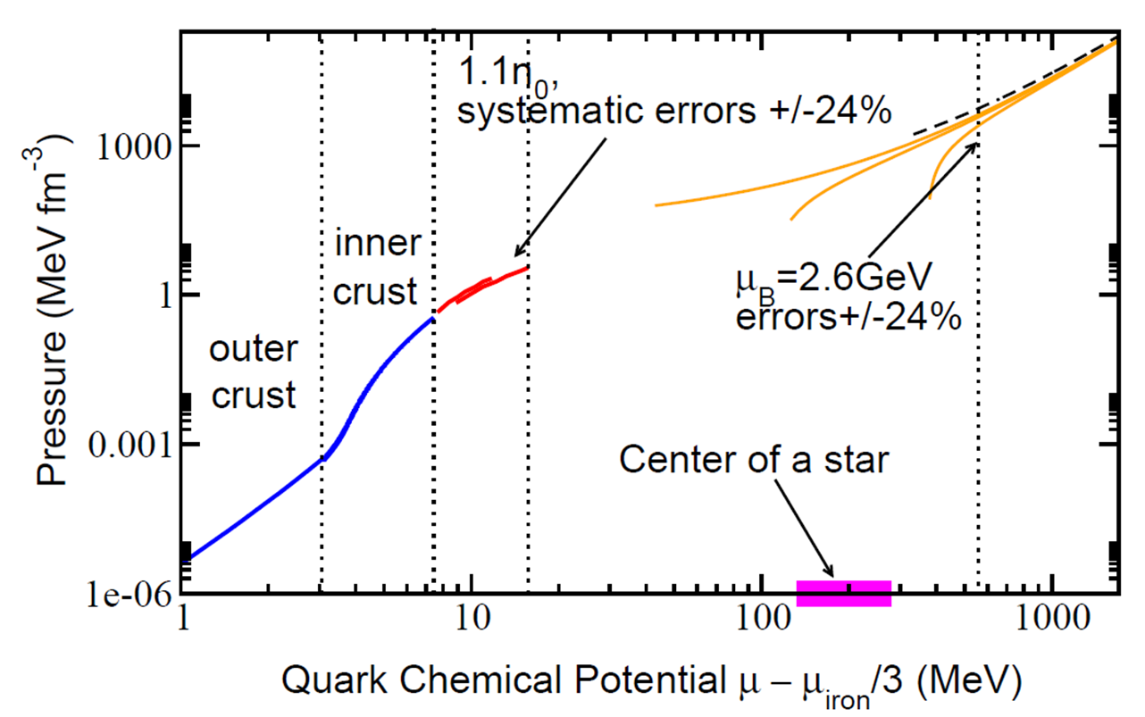
At low density ( ) EoS well constrained by low-energy nuclear physics: Nuclei, neutrons and electrons
Around saturation density, effective field theory methods necessary: At , EoS known at level; Tews et al., PRL 110 (2013)
Problem: Star cores still far away!
Notes:
Star centers at several 100 MeV. What can we do at higher density?

Slide 4
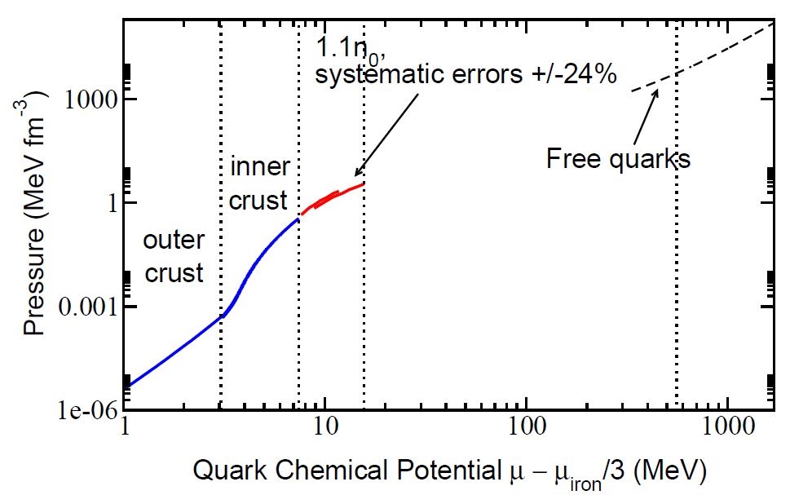
Asymptotic freedom gives behavior at ultrahigh density. However,…
At interesting densities system strongly interacting but no lattice QCD available
Quark pairing important and very nontrivial to account for: Even phase structure unknown

Slide 5
How about building a bridge from the high density side, taking insights from high-T physics?

Slide 6
Perturbative QCD at high density
Entering no man’s land: Interpolating polytropes
Implications for neutron star physics: MR-relations and beyond

Slide 7
Perturbative QCD at high density
Entering no man’s land: Interpolating polytropes
Implications for neutron star physics: MR-relations and beyond

Slide 8
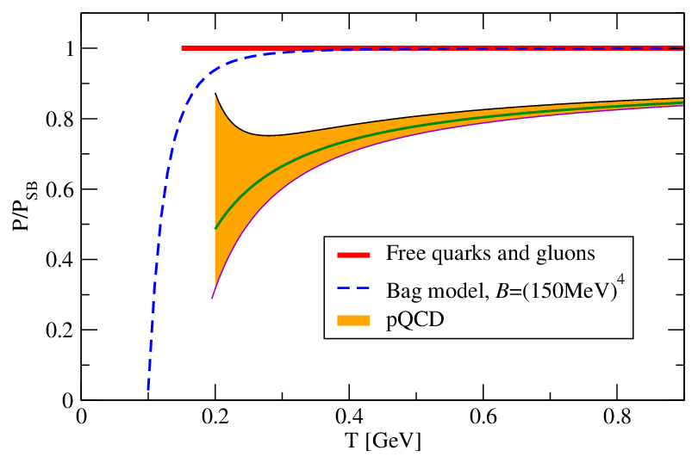
High-T EoS: Active research topic for decades, with resummed perturbation theory pushed to 4-loop order
NB: MIT Bag model predicts rapid (powe-law) approach to free limit – stark contrast with pQCD!

Slide 9
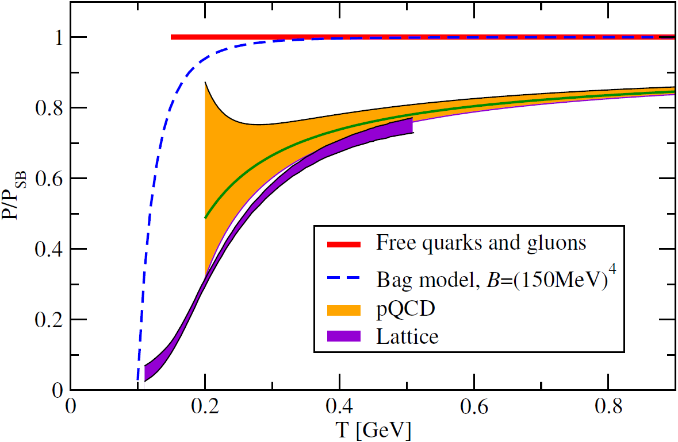
Main difference to high-density: Lattice QCD provides nonperturbative first principles result
Confirms validity of pQCD result from onwards

Slide 10
Quantitative error estimates from renormalization / resolution scale dependence

Slide 12
Leading order at zero temperature: Gas of noninteracting quarks

Slide 13
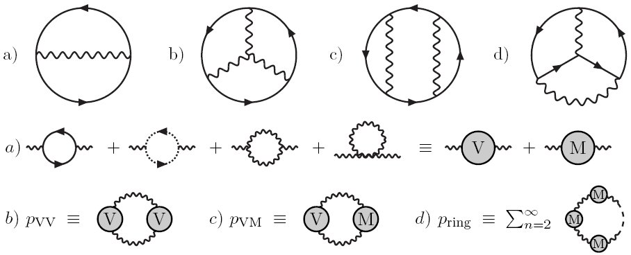
NLO and NNLO: Vacuum diagrams and ring resummation
Kurkela, Romatschke, Vuorinen, PRD 81 (2010)

Slide 14
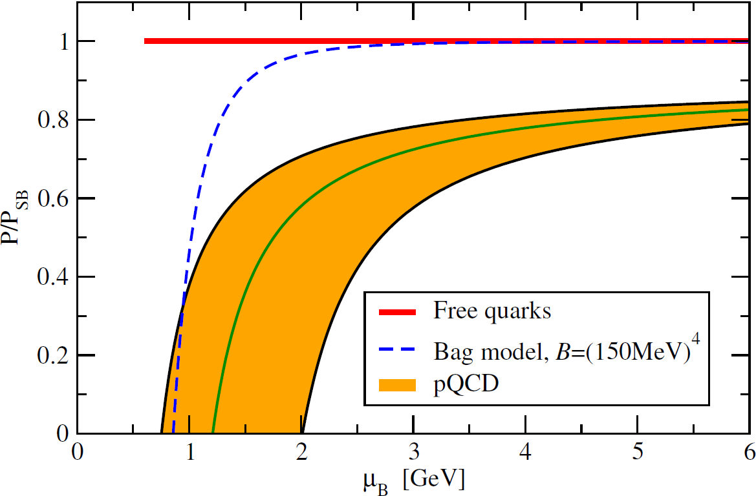
NLO and NNLO: Vacuum diagrams and ring resummation
Main sources of uncertainty:
Renormalization scale dependence
Running of
Value of strange quark mass

Slide 15
NLO and NNLO: Vacuum diagrams and ring resummation

Slide 17
Perturbative QCD at high density
Entering no man’s land: Interpolating polytropes
Implications for neutron star physics: MR-relations and beyond

Slide 18
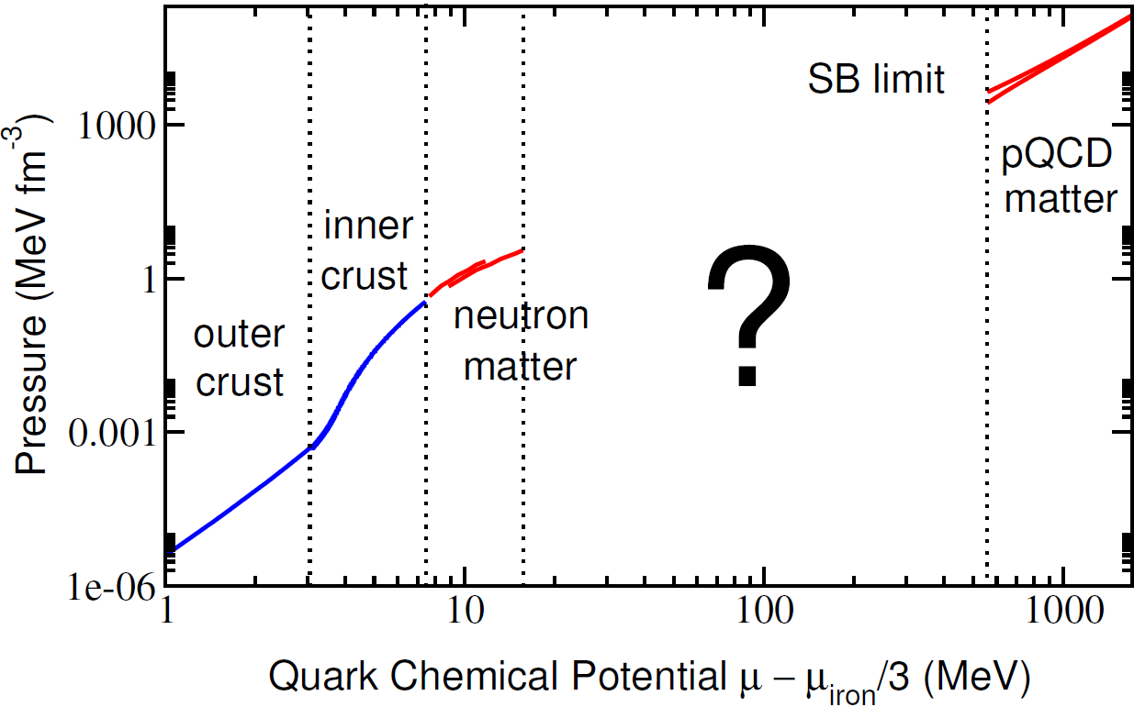
Two choices:
Phenomenological models
Controlled interpolation between known limits

Slide 19
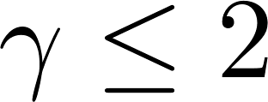
Quantify ignorance using piecewise polytropic EoSs, , and varying all parameters. Do this requiring
Smooth matching to nuclear and quark matter EoSs
Continuity of and when matching monotropes (can be relaxed)
Subluminality - asymptotically equivalent to
Ability to support a two solar mass star
Hebeler, Lattimer, Pethick, Schwenk, APJ 773 (2013)
Kurkela, Fraga, Schaffner-Bielich, Vuorinen, APJ 789 (2014)
Notes:
Typical parametrization when no idea of how function behaves

Slide 20
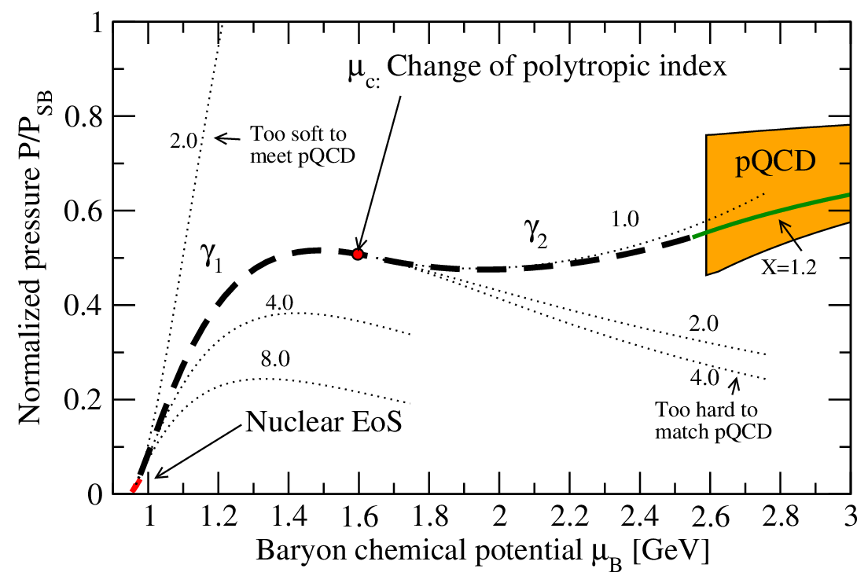
Solutions exist for

Slide 21
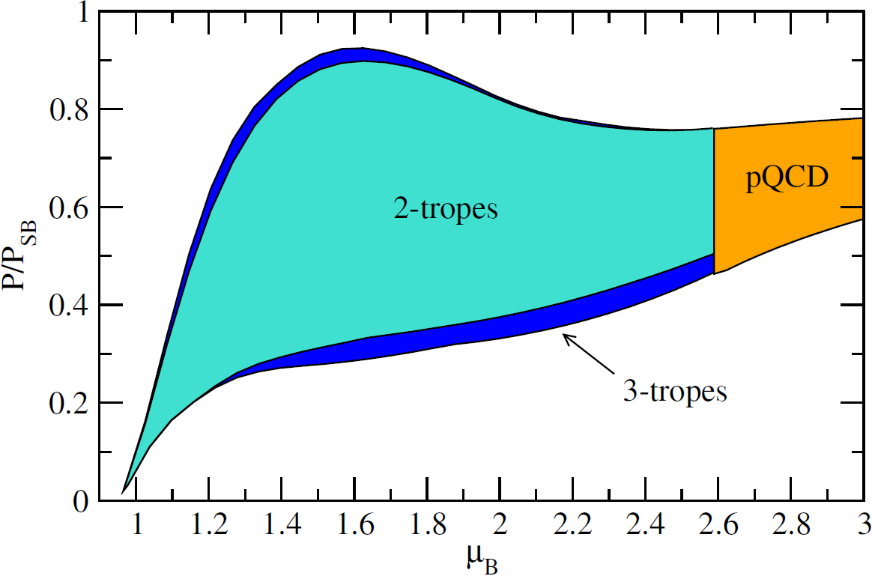
The minimum number of monotropes required for matching – and apparently also sufficient – is 2

Slide 22
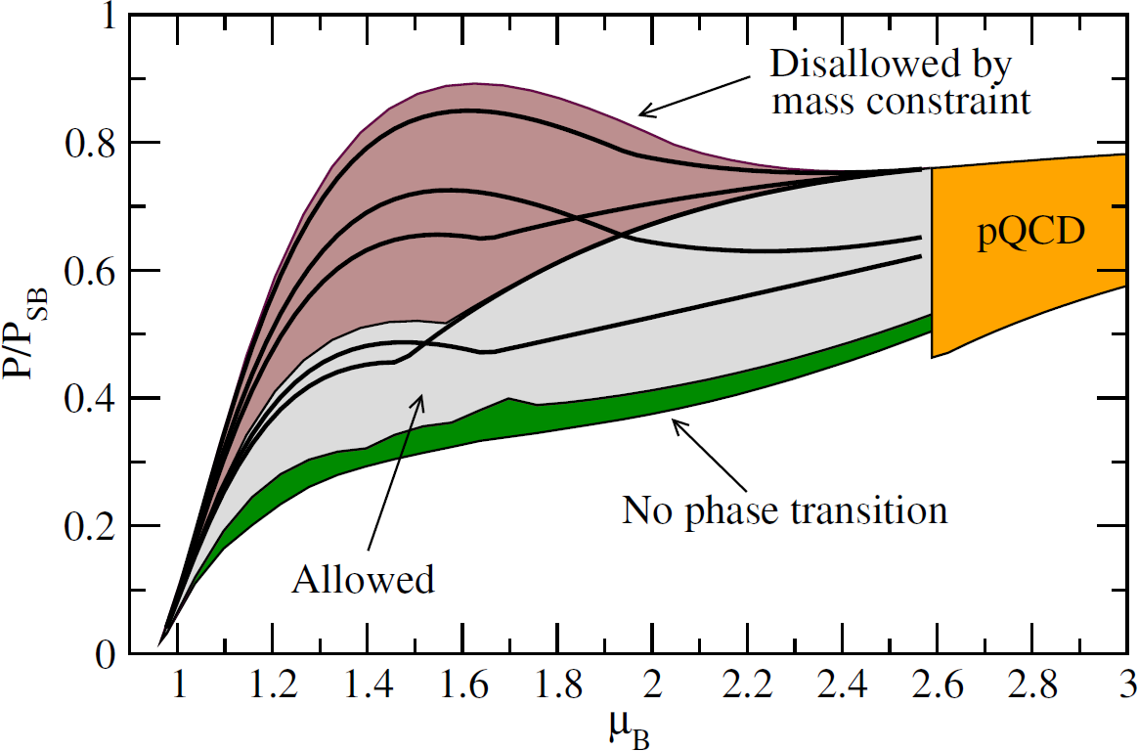
Two solar mass constraint significant. On the other hand, allowing for a 1st order phase transition (nonzero `latent heat’) only leads to a smaller region of allowed EoSs

Slide 23
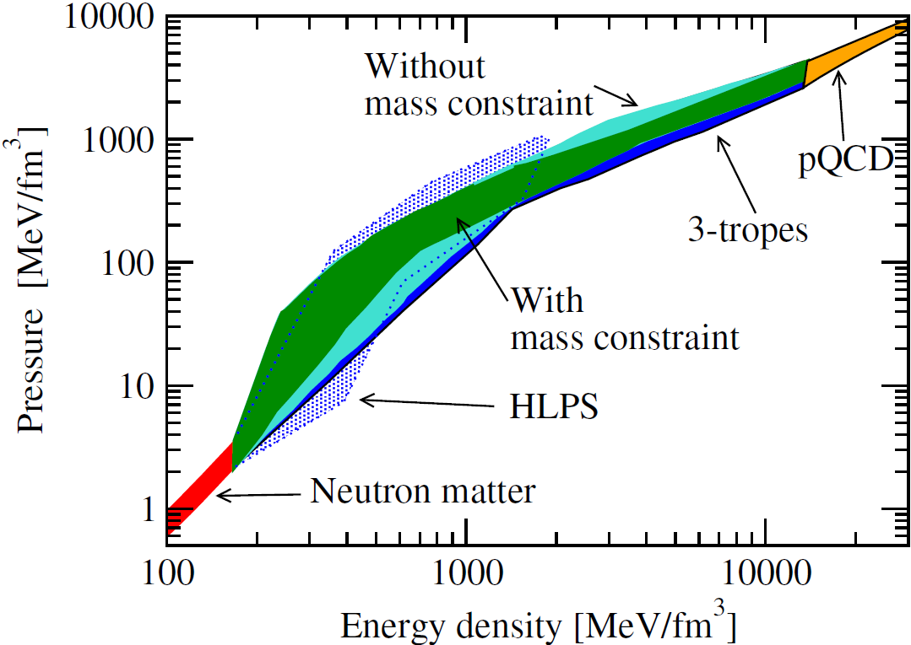
HLPS [Hebeler, Lattimer, Pethick, Schwenk, APJ 773 (2013)] without high-density constraint

Slide 24
Perturbative QCD at high density
Entering no man’s land: Interpolating polytropes
Implications for neutron star physics: MR-relations and beyond

Slide 25
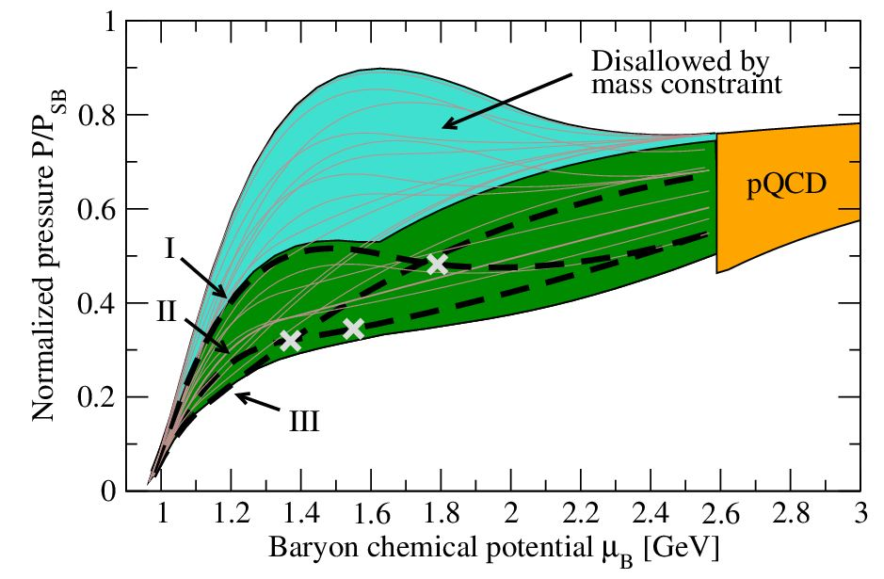

Slide 26
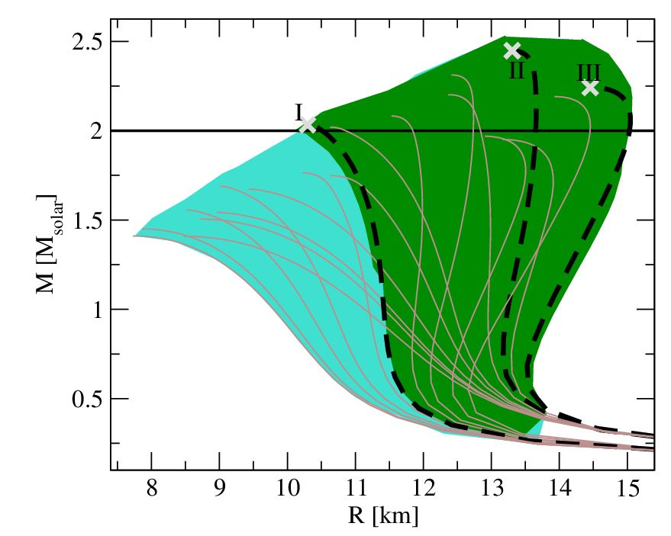
Maximal masses up to ! Central densities
Large reduction in EoS uncertainty due to tension from mass constraint: Large stellar masses require stiff EoS, matching to pQCD soft
EoS uncertainty down to 30% at all densities

Slide 27
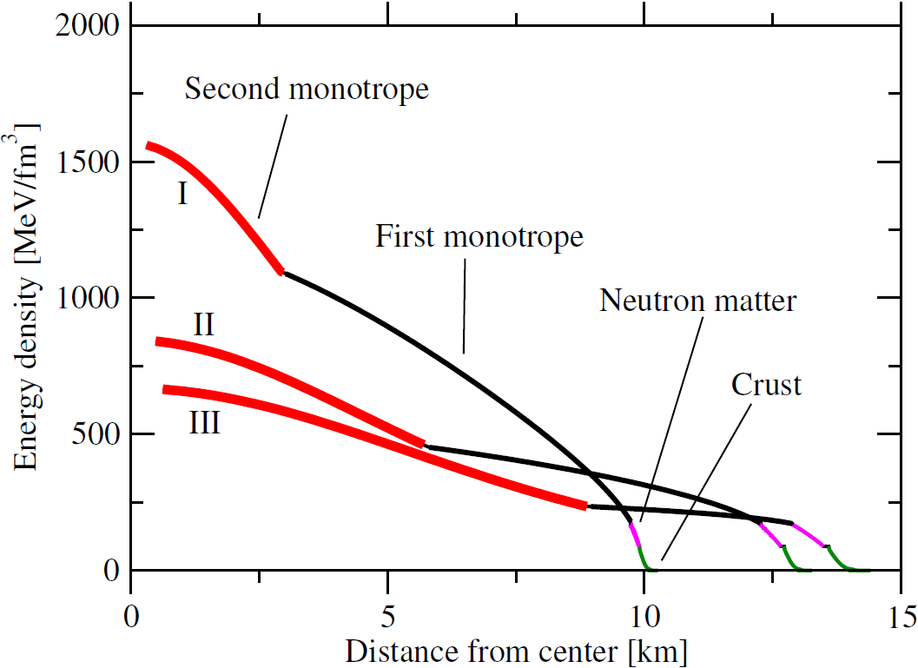
Nuclear matter EoS only used very close to star surface – yet important effects from matching

Slide 28
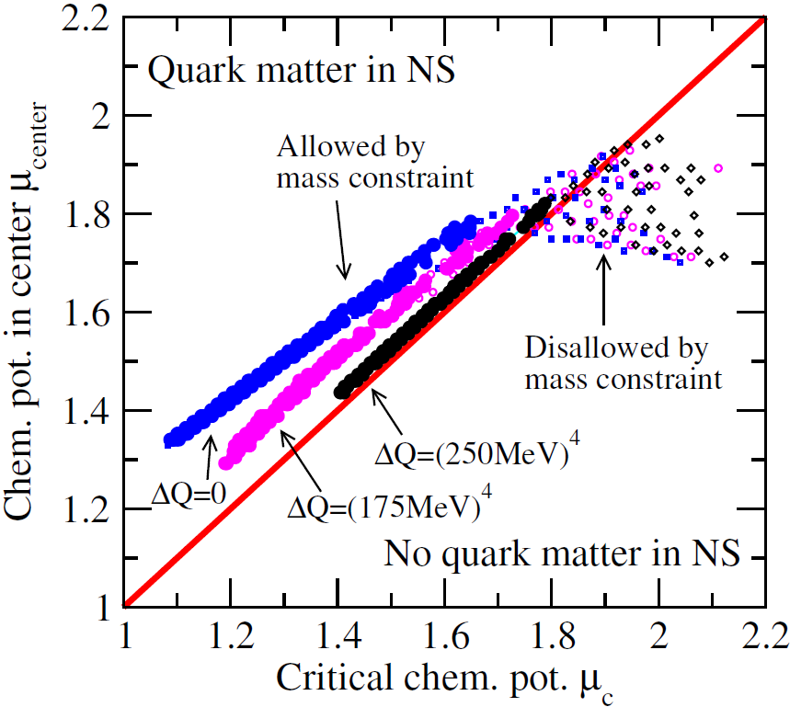
Interpreting polytrope matching point ( ) as phase transition to quark matter, witness strong correlation between and the chemical potential at the center of a maximally massive star.
The stronger the transition, the less room for quark matter. Even then the pQCD result crucial for constraining the EoS!

Slide 29
Final thoughts
Figuring out the properties of neutron star matter from 1st principles is hard…
but not impossible if one systematically uses insights both from low and high density
pQCD constraint highly powerful even if no quark matter present in neutron stars
NB: 3-loop quark matter EoS exists and strongly differs from Bag model prediction – please do not use the latter!

