Slide 1
GPU-based iterative CT reconstruction
Tamás Huszár Zsolt Adam Balogh
Tamas.huszar@mediso.com Zsolt.Balogh@mediso.com
R & D Mediso Ltd.
20-21 May 2015 Budapest, Hungary
5th GPU WORKSHOP - THE FUTURE OF MANY-CORE COMPUTING IN SCIENCE
Notes:
1

Slide 2
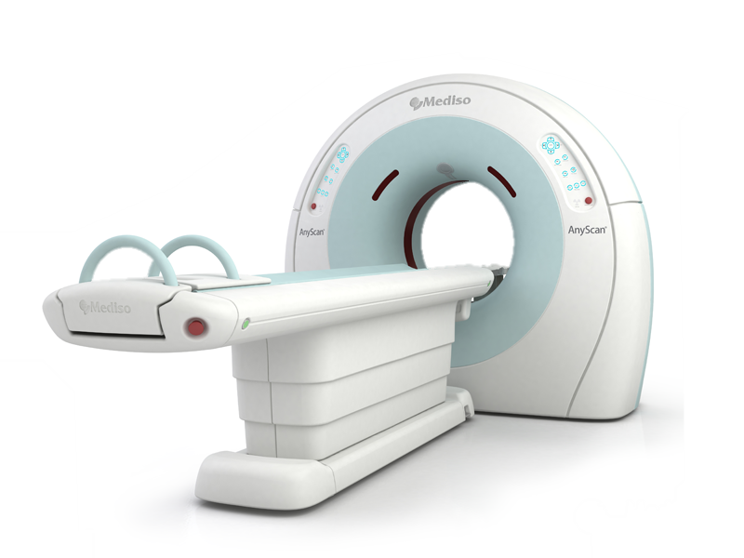
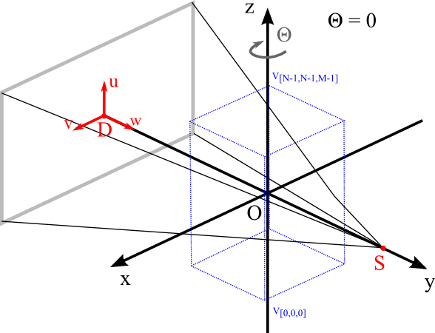
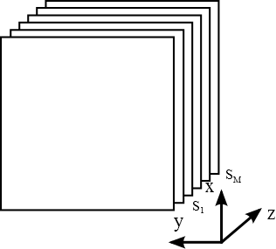
Computed Tomography
2

Slide 3
CUDA
CUDA (Compute Unified Device Architecture)
A parallel computing platform and programming model invented by NVIDIA. It enables increases in computing performance by exploiting the power of the graphics processing unit (GPU).
Hardware
Kepler microarchitecture
GeForce GTX TITAN Z (compute capacity 3.5, memory 12 Gb, CUDA cores 5760)
GeForce GTX TITAN Black (compute capacity 3.5, memory 6 GB, CUDA cores 2688)
Maxwell microarchitecture
GeForce GTX 980 (compute capacity 5.2, memory 4 GB, CUDA cores 2048)
GeForce GTX TITAN X (compute capacity 5.2, memory 12 GB, CUDA cores 3072)
3
Notes:
3

Slide 4
CUDA
CUDA framework
Wraps and hides CUDA functionality
Enables fast development
Features
Smart Device selection
Occupancy calculations
Kernel launch
Memory management
4

Slide 5
CUDA
CUDA framework
Smart device selection
GPU filters (available memory, display cards, …)
Get connected displays with NvAPI
Occupancy calculations and kernel launch
Calculate block size for highest occupancy
Semi-automatic with CUDA 6.5 occupancy API
Kernel launch macros to hide thread micromanagement
5

Slide 6
CUDA
CUDA framework
Kernel configuration macros
Use cudaFuncGetAttributes to find register and shared memory usage
cudaOccupancyMaxPotentialBlockSize
kernel info + data size → blockSize3D, gridSize3D
Kernel launch macros
Sync / Async mode for debug
Profiling / logging
Thread index calculator for the CUDA kernel program
Easy indexing for 2D and 3D image arrays using block and grid configuration
Kernels must avoid over-indexing
6
Notes:
6

Slide 7
CUDA
CUDA framework / Example
Kernel launch:
ADD_CONF(myKernel, 512*512*256);
KERNEL_LAUNCH_ASYNC(
myKernel, config["myKernel"], dataSize, parameters, ...);
myKernel:
uint tid = index();
uint2 pos = getXY( tid, dataSize.width );
data[pos.x, pos.y] = ...;
7
Notes:
7

Slide 8
CUDA
CUDA framework / Device memory allocation
Generalized datastructures for different types
array, layered array, global memory, pitched memory
1D, 2D, 3D
float, double, …
Transparent multi-GPU support
Examples:
template<typename T> DeviceMemoryArray2D<T>
template<typename T> DeviceMemoryLinear3D<T>
template<typename T> DeviceMemoryLayered3D<T>
8
Notes:
8

Slide 9
CUDA
Dynamic memory allocation example
DeviceMemoryLinear3D<float> volume1(gpu1);
DeviceMemoryArray3D<float> volume2(gpu2);
volume2.copy(volume1);
instead of
cudaMemcpy3DParms parms;
memset(&parms, 0, sizeof(cudaMemcpy3DParms));
parms.srcPos = srcPos;
parms.dstPos = dstPos;
parms.srcPtr = make_cudaPitchedPtr(devPtr, pitch, x, y);
parms.dstArray = array;
parms.extent = extent;
parms.kind = cudaMemcpyDeviceToDevice;
cudaMemcpy3DAsync( &parms, 0 );
9
Notes:
9

Slide 10
Iterative CT reconstruction
Iterative CT generations
1st generation | Filtered Back Projection
2nd generation | Image-space Iterative Reconstruction
3rd generation | Statistical Iterative Reconstruction
4th generation | Model-based Reconstruction
10

Slide 11
Iterative CT reconstruction
Forward-projection
Projections
FBP
Start image
Iterated projections
Iterated image
Result
Back-projection
11

Slide 12
Iterative CT reconstruction
Iterative reconstruction types
Algebraic reconstruction techniques (ART, SART, SIRT)
solving y=Ax, where y is sinogram data, A is system model
Statistical reconstruction methods (EM, ML) (I ~ Poisson +
Normal)
Model-based methods (go beyond modeling statistics of the
detected photons as Poisson distributed)
12
Notes:
12

Slide 13
Iterative CT reconstruction
Maximalization of the conditional probability P( μ | y ),
where μ is the distribution of linear attenuation coefficients
y is the vector of transmission measurements.
Backprojection
is the value of pixel j,
is the measured sinogram along line i,
is the intersection length of projection line i with pixel j.
13
Notes:
13

Slide 14
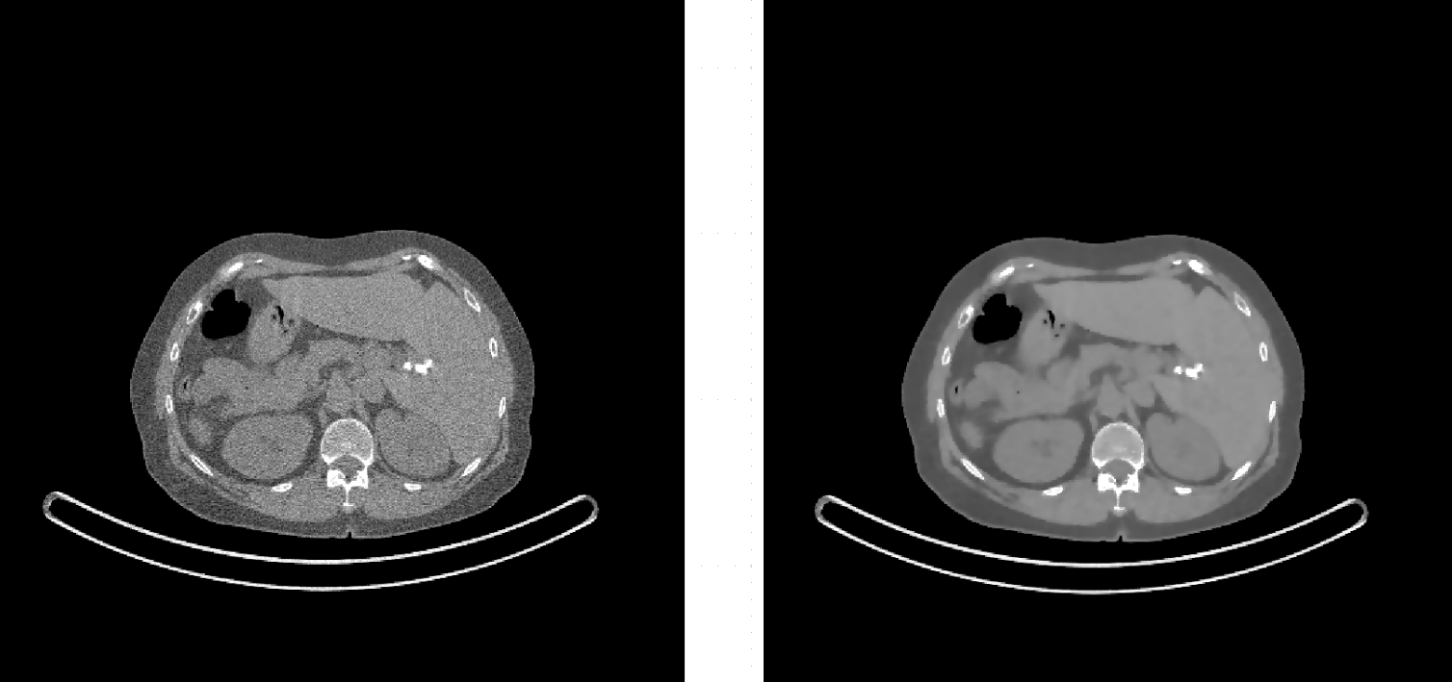
Iterative CT reconstruction
Reconstructed volume (FBP and iterative)
14
Notes:
14

Slide 15
Iterative CT reconstruction
Advantages
image noise reduction
dose reduction
artifact reduction
Disadvantages
computation time (using GPU)
model complexity
software complexity, non-linear algorithms
15
Notes:
15

Slide 16
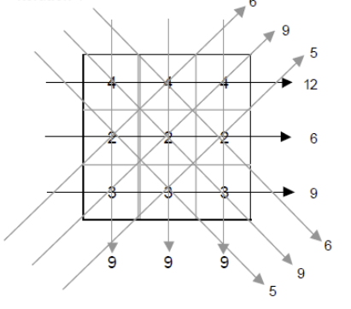
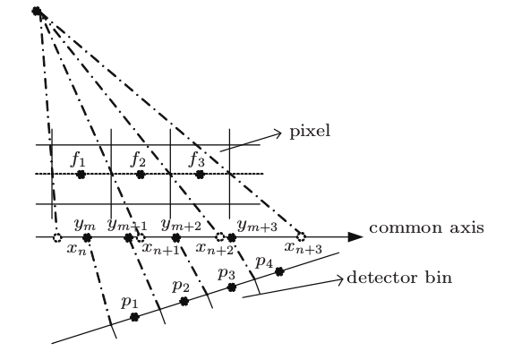
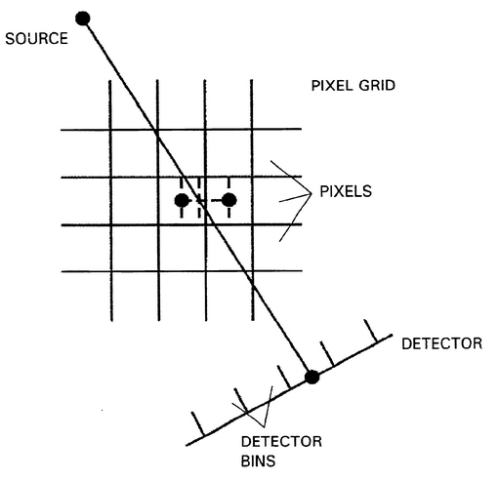
Iterative CT reconstruction
Projector types (parallelization)
pixel-driven (ray-driven)
voxel-driven
distance-driven
16
Notes:
16

Slide 17
Iterative CT reconstruction
Optimizations
CPU vs. GPU
Memory access patterns
Coalesced access
Texture memory vs. global memory
Use float instead of double where possible
Memory size
Multi-GPU
17

Slide 18
Measurements
Reconstruction speed
18

Slide 19
Measurements
Reconstruction speed
19

Slide 20
Measurements
Reconstruction speed
20

Slide 21
Measurements
Reconstruction speed
21

Slide 22
Measurements
Titan X speedup
22

Slide 23
Thank you for your attention!
23
Notes:
23

