Slide 1
Fisher Information based Classification on GPUs
Bálint Daróczy, András A. Benczúr
„Big Data – Momentum” Research Group
Institute for Computer Science and Control
Hungarian Academy of Sciences (MTA SZTAKI)
daroczy.balint, benczur.andras@sztaki.mta.hu
http://datamining.sztaki.hu

Slide 2
Classification of multimodal objects
Examples:
Images with text caption
Time series of multiple physical parameters
Content, hyperlinks, PageRank, # Facebook likes, follower network …
Difficulty:
Need to capture the connection and dependencies of modalities
Need for a multimodal generative model
Computational complexity of scaling multiple modes
Costly wrapper methods

Slide 3
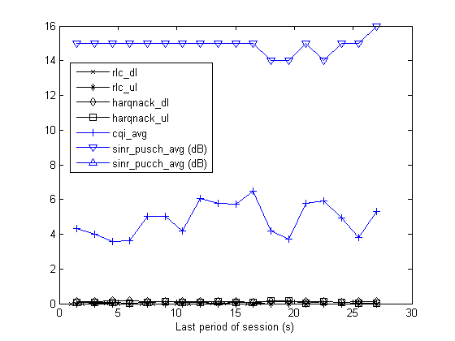
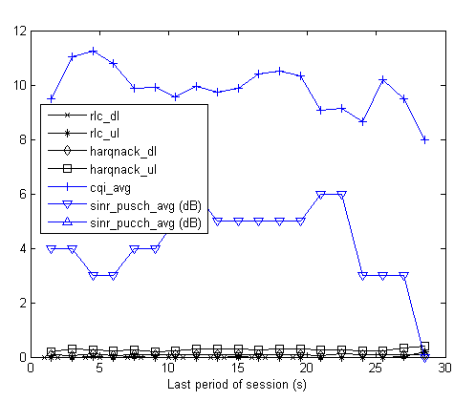
Mobile session drop prediction
LTE Base Station eNodeB CELLTRACE logs
no drop
RRC connection setup / Successful handover into the cell
UE context release/ Successful handover out of the cell
START
END
Per UE traffic report (traffic volumes, protocol events (HARQ, RLC))
Per radio UE measurement (CQI, SINR)
Period: 1.28s
Per UE measurement reports (RSRP, neighbor cell RSRP list)
drop
Daróczy, Vaderna, Benczúr: Machine Learning Based Session Drop Prediction in LTE Networks and its SON Aspects. IWSON workshop at VTC2015-Spring in Glasgow, Scotland.

Slide 4
Time series
Dynamic Time Warping as the best performing distance
i
i
i
i
i+2
time
time
Any distance (Euclidean, Manhattan, …) which aligns the i-th point on one time series with the i-th point on the other will produce a poor similarity score.
A non-linear (elastic) alignment produces a more intuitive similarity measure, allowing similar shapes to match even if they are out of phase in the time axis.

Slide 5
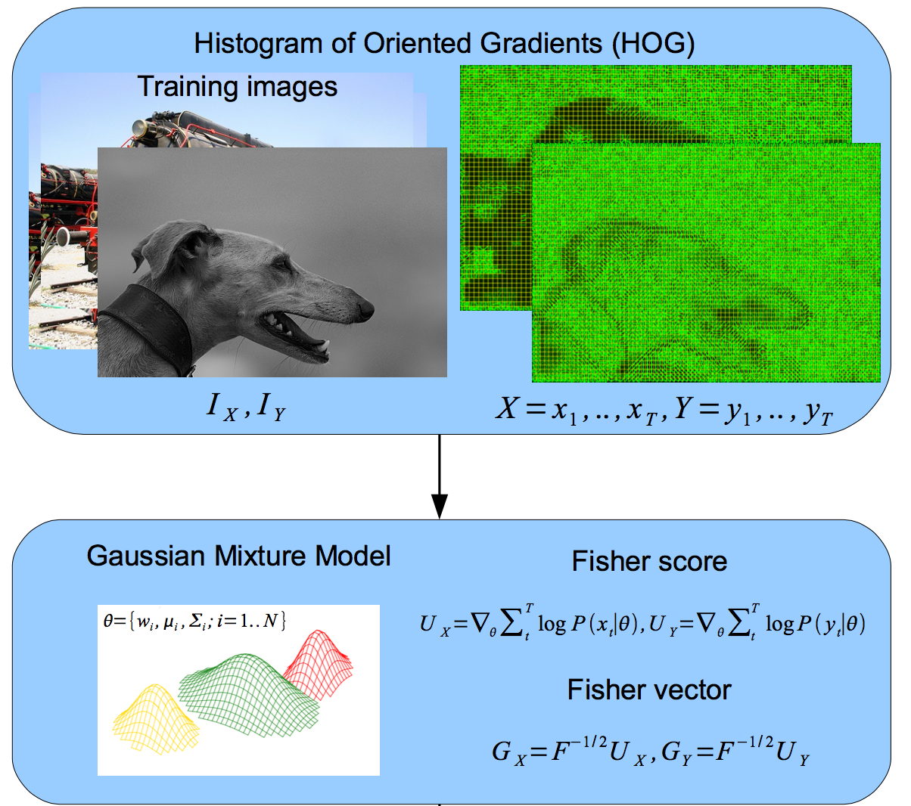
Content based image classification
Daróczy, Benczúr, Rónyai. Fisher kernels for image descriptors: a theoretical overview and experimental results. Annales Univ. Sci. Budapest 2013

Slide 6
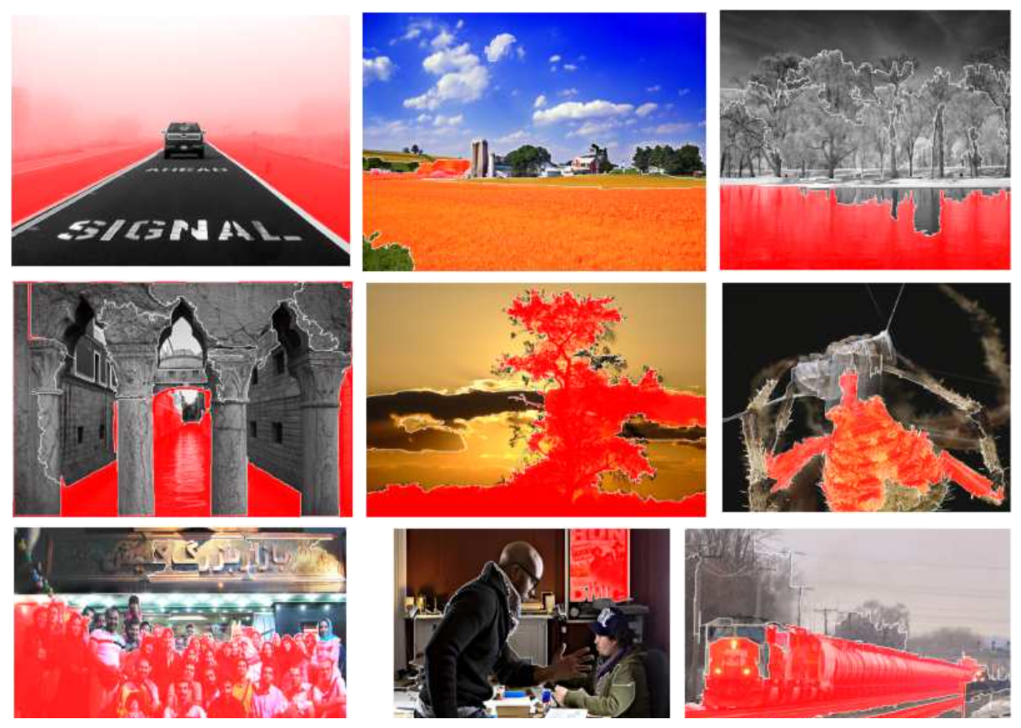
Combination with text
Fog
rural
lake
spider
tree
riverstream
Big group
train
Picture in a picture

Slide 7
Combination with text

Slide 8
Even Web classification is multimodal
user_id | 824143586
tweet_id | 77847926931000
movie_id | 1045658
rating | 8
rating_diff_from_avg | 0,8
user_created_at | 1347659915
user_followers_count | 165
user_friends_count | 258
user_favourites_count | 33
user_statuses_count | 451
tweet_creation_time | 1366097554
tweet_hashtag_num | 1
tweet_url_num | 1
tweet_mention_num | 0
tweet_is_retweet | 0
tweet_has_retweet | 0
movie_avg_rating | 41829
movie_rating_num | 384348
movie_genre | Romance, Comedy
…
engagement | ?
Pálovics et at., RecSys Challenge 2014: an ensemble of binary classifiers and matrix factorization (2nd place)
Erdelyi et al., The classification power of Web features. Internet Mathematics, 2014

Slide 9
Warmup: linear SVM
Maximal margin linear classifier
Kernel trick transforms into a high-dimensional nonlinear space
We want to use pairwise similarities to define the space …
(w,b)
x
f
y
denotes +1
denotes -1
f(x,w,b) = sign(wx+b)
Support Vectors: data points that the margin pushes up against

Slide 10
Warmup: linear SVM
Maximal margin linear classifier
(w,b)
x
f
y
denotes +1
denotes -1
f(x,w,b) = sign(wx+b)
Margin can be NEGATIVE!

Slide 11
Support Vector Machine optimization
Need to minimize
Subject to
But w is a linear combination of the support vectors:
All we need is a way to compute w ● x for a support vector w and another vector x → any two data points
Goal: a mathematically sound notion of w ● x based on the similarity of the document!

Slide 12
Support Vector Machine optimization
In a transformed space (x → φ(x)) we only need the value of the dot product (kernel value):
K(x_{i},x_{j}) = φ(x_{i})^{T}φ(x_{j})

Slide 13
New method: the Similarity Kernel
Represent doc X as Random Field P(X|θ) generated by distances from other docs d₁, d₂, … by energy function
Sample set S can be all training set, a sample, or cluster representatives
Fisher score of X is vector G_{X} = ∇θ log P (x|θ)
Define a mapping x → G_{x}F^{-1/2}
Yields the Kernel K(x, y ) = G_{x}^{T} F⁻¹ G_{y}
Intuitive interpretation: G_{X} is the direction where the parameter vector θ should be changed to fit best to data point X.
For a Gibbs Random Field (with approx. Fisher Information matrix) we get a natural normalization of the distances from the sample set S:
d₁
d₂
d₃
d_{|s|}
…..
The simplest Random Field
x

Slide 14
Use of the GPU
SVM optimizer usually runs fast even single core, IF …
… The pairwise distance computation is solved
Distance measures:
DTW: O(N²) in length of the series, but in practice it is closer to O(N)
In our case: N ~ 15
Kullback-Leibler divergence, Jaccard, …: sparse, not ideal for GPU
O(N), where N>10K, but sparse
Minkowski (L1, L2, …): linear, but for image features it is dense and 100K+
Fisher with Cholesky decomposition:
Linear; fast computation of kernel values
Complexity depends only on the size of the sample set S and the number of representations K: O(S·K)
Same OpenCL code ran on
CPU: Intel 3770K 4 cores / 8 threads all used by OpenCL
GPU: AMD Radeon 7970, 2048 streams

Slide 15
Web Quality and the GPU
Feature extraction
Similarity
computation
Kernel
calculation
SVM
solver
Network
Dense
Low-Dim
High complexity non-linear
multi-kernel
Web classification
baseline
Textual
Sparse
High-Dim
Web classification
with
Similarity kernel
Network
Dense, Low-Dim Sample
Dense
Low-Dim
linear SVM
Even online predictions
Textual
Sparse, High-Dim Sample
Bálint Daróczy, Dávid Siklósi, Róbert Pálovics, András A. Benczúr
Text Classification Kernels for Quality Prediction over the C3 Data Set
WebQuality in conjunction with WWW 2015

Slide 16
Web Quality and the GPU
Feature extraction
Similarity
computation
Kernel
calculation
SVM
solver
Network
Dense
Low-Dim
High complexity non-linear
multi-kernel
Web classification
baseline
Textual
Sparse
High-Dim
CPU: 1.05 + 24.3 ms /page
GPU: 2.06 + 4.29 ms/page
Web classification
with
Similarity kernel
Network
Dense, Low-Dim Sample
Dense
Low-Dim
linear SVM
Even online predictions
Textual
Sparse, High-Dim Sample
CPU: 4.78 ms/page
GPU: 2.72 ms/page

Slide 17
Web Quality running times
Sparse
Bag of Words
ms/document

Slide 18
Image classification and the GPU
Feature extraction
Similarity
computation
Kernel
calculation
SVM
solver
Visual
Dense
Very High-D
High complexity non-linear
multi-kernel
Multimodal Visual
Concept detection
Textual
Sparse
High-Dim
Multimodal Visual
Concept detection
with
Similarity kernel
Visual
Dense Very High-D Sample
Dense
Low-Dim
linear SVM
Even online predictions
Textual
Sparse
High-D Sample
B. Daróczy, D. Siklósi and A.A. Benczúr
SZTAKI @ ImageCLEF 2012 Photo Annotation (2nd place)

Slide 19
Image classification and the GPU
Feature extraction
Similarity
computation
Kernel
calculation
SVM
solver
Visual
Dense
Very High-D
High complexity non-linear
multi-kernel
Multimodal Visual
Concept detection
Textual
Sparse
High-Dim
CPU: 1600 + 11.5 ms/image
GPU: 758 + 3 ms/image
Multimodal Visual
Concept detection
with
Similarity kernel
Visual
Dense Very High-D Sample
Dense
Low-Dim
linear SVM
Even online predictions
Textual
Sparse
High-D Sample
CPU: 661 ms/image
GPU: 274 ms/image
CPU: 4.58 ms/image
GPU: 2.1 ms/image

Slide 20
Image classification running times
Very high density
ms/image

Slide 21
Time Series running times
Session Drop
Prediction
Feature extraction
Kernel
calculation
SVM
solver
High complexity non-linear
multi-kernel
Raw Time Series (6)
Statistics
Dense
Low-Dim
AdaBoost
Session Drop Prediction
with
Similarity kernel
CPU: <1 ms/session
Statistics
CPU: 6.45 ms/seission
GPU: 1.02 ms/session
DTW distance D1
Raw Time Series (6)
Dense
Low-Dim
linear SVM
Even online predictions
DTW distance D6

Slide 22
Runtime dependence on sample size
ms/instance
Session
Text
Image
Session
Text
Image

Slide 23
Sparse vs. Dense representations
2.49x
2.3x
2.1x
1.6x
1.1x

Slide 24
Quality overview
 | Traditional method | Similarity Kernel
Web classification | Linear text kernel | Multimodal kernel
Area Under ROC curve | 0.69 | 0.74
Kernel size | 30K dim, 90MB sparse | 6K dim, 18MB dense
Image Concept Detection | Color HOG descriptors | Color HOG + text similarity (multimodal)
Mean Avg Precision | 0.367 | 0.426
Kernel size | 660K dim, 9.9GB floats | 15K dim, 450MB floats
Session Drop Prediction | AdaBoost over Statistics | DTW
Area Under ROC curve | 0.90 | 0.93

Slide 25
Conclusions
Fisher kernel
Tool to use arbitrary similarity functions in classification
Combine similarities of even completely incompatible attribute sets
Works well for quite a few practical problems
Over the GPU
Computationally costly step is the pairwise distance computation
Embarrassingly parallel task
Easy to implement with dense vectors
Problematic for sparse vectors, e.g. document term frequencies

