Slide 1
Scientific Computing
at ELI-ALPS
Sándor Farkas
Scientific Computing Group
ELI-ALPS

Slide 2
Outline
ELI-ALPS HU
Timing, phases of ELI-ALPS
Short overview of the lasers
Goals from Scientific Computing point of view using the GPUs
Challenges
Strategy
Current status, experiences

Slide 3
ELI-ALPS HU

Slide 4
ELI-ALPS
ELI-ALPS: Extreme Light Infrastructure Attosecond Laser Pulse Source
Mission:
to generate X-UV and X-ray femtosecond and attosecond pulses, for temporal investigation at the attosecond scale of electron dynamics in atoms, molecules, plasmas and solids
to contribute to the technological development towards 200PW

Slide 5
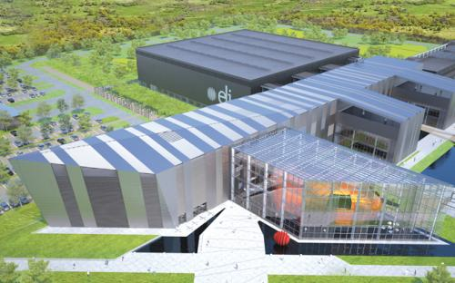
ELI-ALPS HU - Szeged
Plan of the building

Slide 6
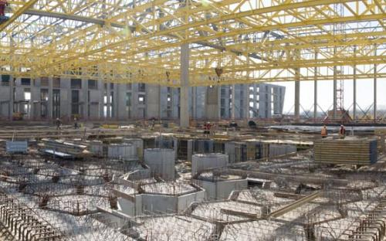
Phases of the implementation, operation
Current phase: construction of the buildings are in progress, end of 2015
2016/Q3 commissioning and testing
From 2018: User facility

Slide 7
The Laser

Slide 8
The LASER – theoretical background
Acronym for: Light Amplification by Stimulated Emission of Radiation
Excited level
E₂
1. External energy source
Ground level
E₁
Atom
The energy levels are discrete, as we learnt from quantum mechanics

Slide 9
The LASER – theoretical background
Acronym for: Light Amplification by Stimulated Emission of Radiation
Excited level
E₂
1. External energy source
2. A photon arrives
Ground level
E₁
Atom
The energy levels are discrete, as we learnt from quantum mechanics

Slide 10
The LASER – theoretical background
Acronym for: Light Amplification by Stimulated Emission of Radiation
Excited level
E₂
1. External energy source
2. A photon arrives
3. The atom goes to the ground energy level and an additional photon is emitted
Ground level
E₁
Atom
The energy levels are discrete, as we learnt from quantum mechanics

Slide 11
The LASER – theoretical background
Acronym for: Light Amplification by Stimulated Emission of Radiation
A better naming is a device emitting light through a process of optical amplification
Excited level
E₂
1. External energy source
2. A photon arrives
3. The atom goes to the ground energy level and an additional photon is emitted
Ground level
E₁
Atom
The attributes (direction, wavelength) of the new photon are the same as the first one causing coherent light
The energy levels are discrete, as we learnt from quantum mechanics

Slide 12
The laser - components
Let’s see how it works
1. We need a tube with the gain medium
2. Laser pumping energy
3. High reflector
4. Output coupler

Slide 13
The laser - components
Let’s see how it works
1. We need a tube with the gain medium
2. Laser pumping energy
3. High reflector
4. Output coupler

Slide 14
The laser - components
Let’s see how it works
1. We need a tube with the gain medium
2. Laser pumping energy
3. High reflector
4. Output coupler

Slide 15
The laser - components
Let’s see how it works
1. We need a tube with the gain medium
2. Laser pumping energy
3. High reflector
4. Output coupler

Slide 16
The laser - components
Let’s see how it works
1. We need a tube with the gain medium
2. Laser pumping energy
3. High reflector
4. Output coupler
5. Laser beam

Slide 17
Category of lasers – modes of operation
Continuous: the power output is continuous over time – continuous wave (CW)
It is feasible for lots of applications.
Limitation can be the amount of energy hitting the target per a specific duration. It may happen the target can cool down and the experiment will fail.

Slide 18
Category of lasers – modes of operation
Pulsed mode: any laser not classified as continuous wave
Optical power appears in pulses of some duration at some repetition rate
Advantages:
larger energy can be transferred during a relatively short time
At some applications the peak power achieved with pulsed lasers is important

Slide 19
Femtosecond, attosecond pulses
Due to limitations of physical laws the simple pulsed operation lasers can achieve “only” femtosecond (10⁻¹⁵s) pulses.
Special medium
Femtosecond laser source
Secondary – attosecond source
For the attosecond pulses so called secondary sources are required. For instance the primary source is a femtosecond laser hitting a special medium and the result is attosecond coherent radiation.

Slide 20
Applications of pulsed lasers
Achieve high energy amount
Observe very short (ultra fast) phenomena to analyze physical, chemical, biological processes
  Analogy: high speed flashes in photography
  With attosecond pulses
  At laser physics special detectors, mirror systems are used to take pictures, like the Mach-Zehnder interferometer

Slide 21
Spectograms, interferograms, …
The input pictures have special formats and usually requires denoising, postprocessing
Due to the high framerate of the detectors (several 10 kHz) not all of the pictures can be stored, so clever filtering may required

Slide 22
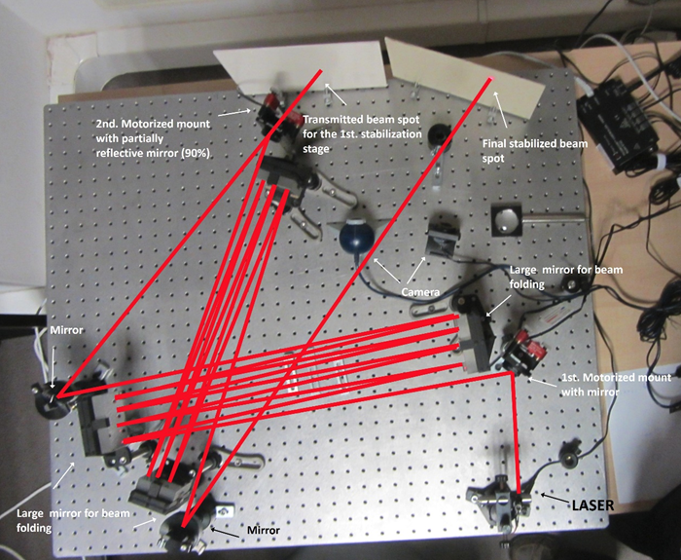
Prototype: Beam alignment with Tango

Slide 23
Application of pulsed laser - spectograph
Sample
Spectograph
Reference
Delay
Broadband
lightsource

Slide 24
The interferogram
y₀
Spatial position (y)
Frequency (ω)
Reference: A. Börzsönyi et.al., Appl. Sci 2013,3,515-544

Slide 25
IT goals in ELI-ALPS HU

Slide 26
Current focus
on data analysis
Limitations:
Bandwidth
Computing capacity
Storage capacity

Slide 27
Primary goal of the High Performance Computing Cluster
Online data-analysis:
  Near to the cameras. 1 detector – 1 PC (with GPU)
  Calculating with more than one data source (Cluster – 1 node with 2-4 GPUs)
  Special hardware is required (FPGAs)
Filtering, storing the input data for further analysis

Slide 28
Secondary, additional goals
Support simulations and other applications than online data processing.
The ELI-ALPS will operate later as a user facility, with offices, meeting rooms, supercomputing capabilities.
Additionally to the resident projects external projects can visit and use the facility. The HPC can be used by them too.

Slide 29
Challenges

Slide 30
Our goals -> GPUs
A natural idea is to solve the challenges with the support of GPUs:
Online data analysis. The data arrives with 2 GB/sec bandwidth. The task is to analyze and store it.
Simulations. Hundreds of millions of particles and their interactions has to be simulated
General supercomputing service for the user facility

Slide 31
GPUs at first sight
Performance: Tflops
Bandwidth: some hundreds GB/sec
Fast memory: DDR5

Slide 32
Details
As we know the Devil is in the detail

Slide 33
Details – the bandwidth
true inside of the GPU
The ”details”:
  The bandwidth between the host RAM and the GPU RAM is much lower limited by the PCIExpress 2.x, somewhere around 8GB/sec
  PCIExpress 3.x will help slightly only
Consequence:
The algorithms has to take care of the bandwidth limitation, the copy operations must be designed carefully

Slide 34
Details – the bandwidth
Counterintuitively some algorithms (with a data size limit) are still faster using the CPU cores with SIMD optimized code than on GPUs
Consequence:
May be it is worth to evaluate, create and use mixed strategies (some algorithms use the CPU cores, some algorithms use the GPUs)

Slide 35
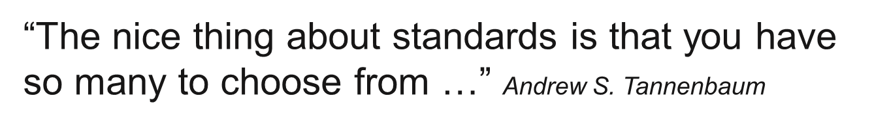
Details – Standards, APIs
CUDA is NVIDIA specific, but several applications are “tight coupled” to it.
  In our case we have to support it
OpenCL is not vendor specific
  We have to support it

Slide 36
Details – the “context” of the GPU card
There are use cases where 1 GPU is feasible and there are others where many GPUs are required and they do not fit in one box
This problem is not rooted of course in the current GPU programing concept, but may increase the initial/maintenance costs, complexity of the hardware/software architectures in a high manner

Slide 37
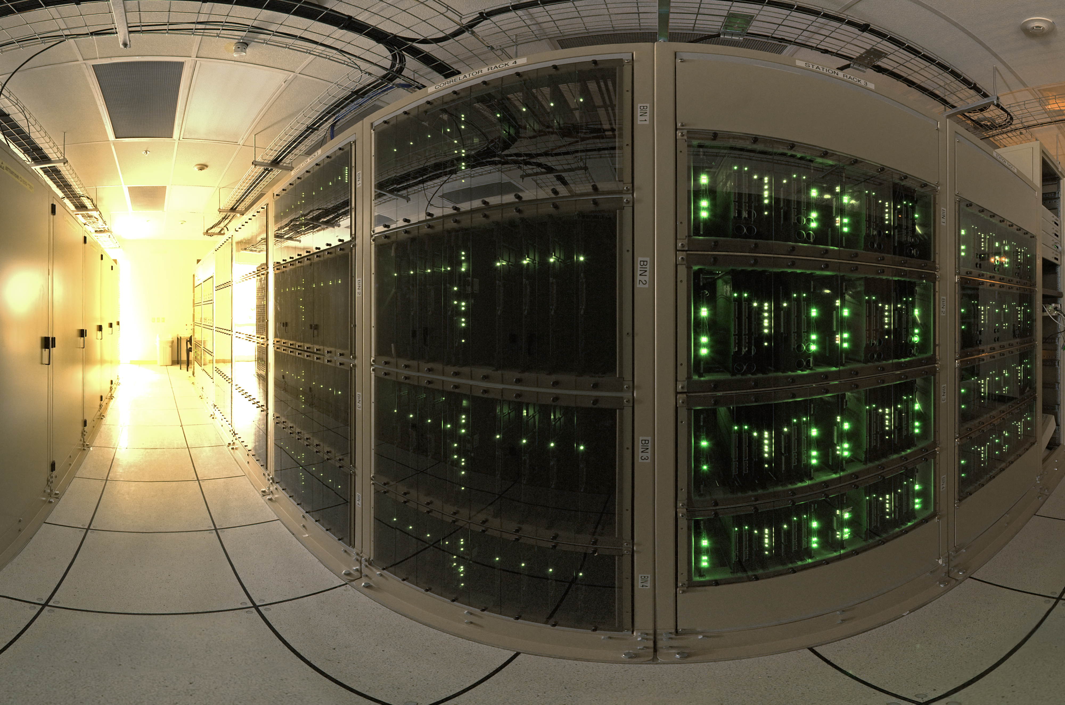
High Performance Computing Cluster
At hardware level it will consist of special servers, storage, network, cooling, building
At software level it may consist of layers, APIs, schedulers, …
And they should work effectively together

Slide 38
Strategy in ELI-ALPS HU

Slide 39
Scientific Computing Strategy in ELI-ALPS HU
Living together with the planned phases and (with the budget of it) we need a realistic and if possible incremental strategy:
Vision according to the high level requirements
Evaluate both the hardware and software stacks as the current phase allows

Slide 40
Strategy – know-how
  Hiring experts with the relevant skills
  Attend courses if necessary
  Consult with in-house scientists to have more fine-grained understanding of their requirements
  Consult with the experts of similar facilities to avoid reinventing the wheel

Slide 41
Current phase
The Scientific Computing group consists of 3 experts
Due to other non-HPC related tasks the resources are limited
At this phase we evaluate technologies with few workstations, NVIDIA Quadro cards and GbE
It means:
time consuming PoC creation, micro-benchmarking (which is not a best practice)

Slide 42
Strategy – Next phase
Plan the next phase to be able to test/check the final hardware/software stack
Test cluster with server category boxes, network and GPUs
Try to evaluate special GPU related solutions which can increase the performance like RDMA

Slide 43
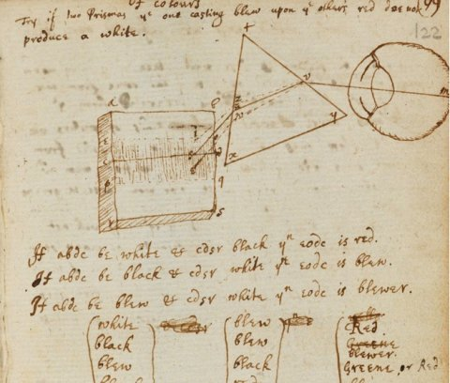
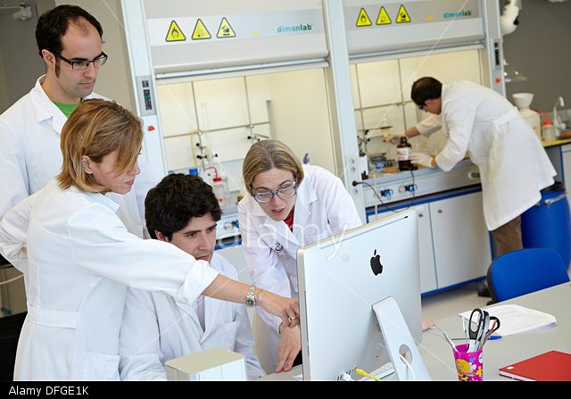
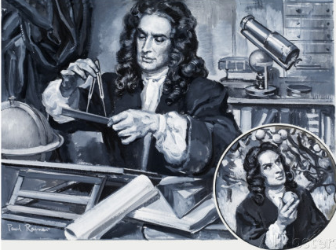
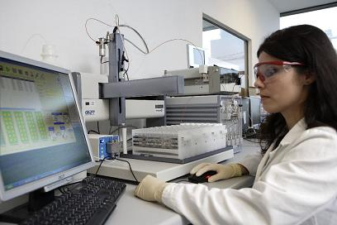
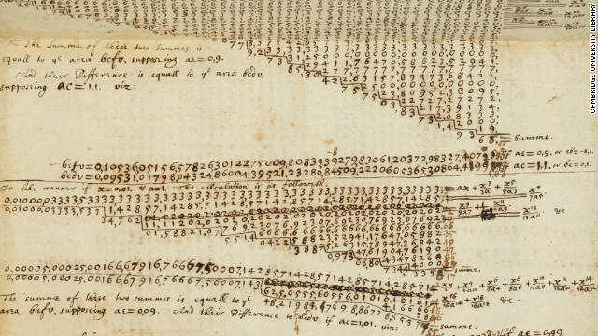
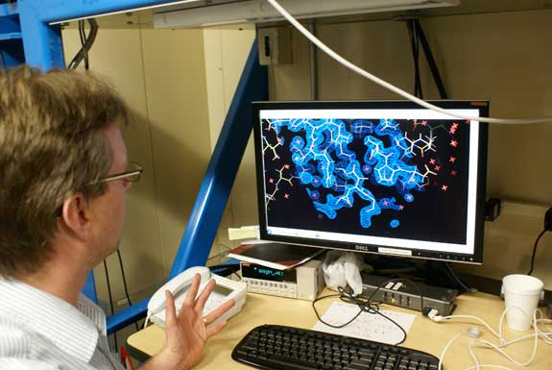
Scientific Software

Slide 44
Achievements
Proprietary GPU related applications are purchased (MatLab, COMSOL)
Evaluation of GPU related Open Source standalone and framework-like applications has been started: PIcOnGPU, UFO-KIT

Slide 45
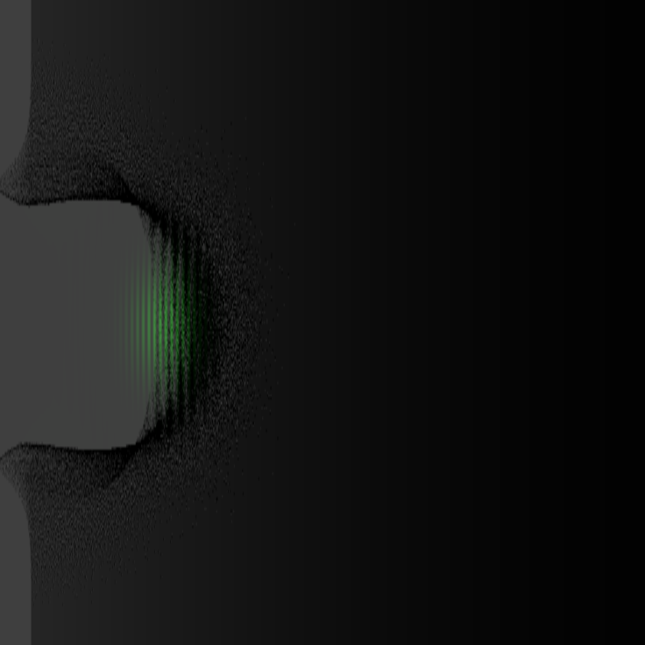


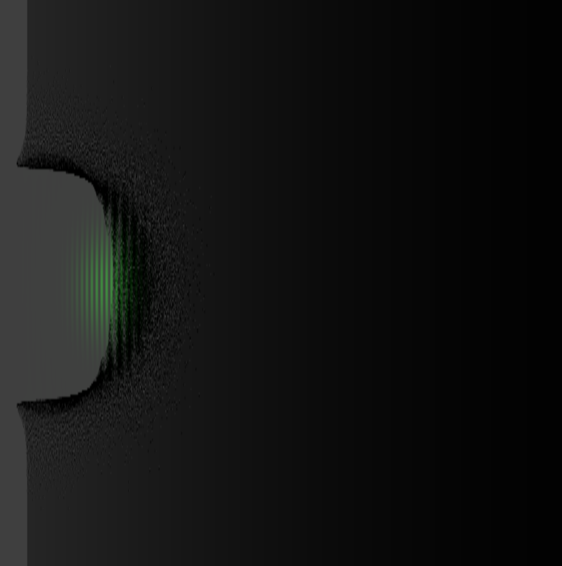








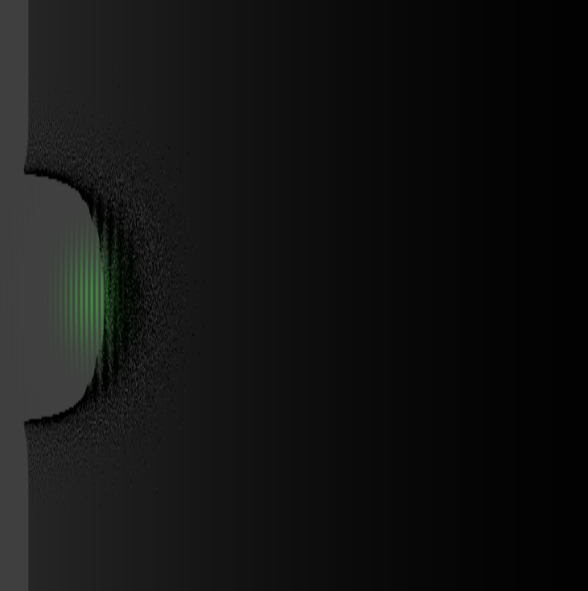
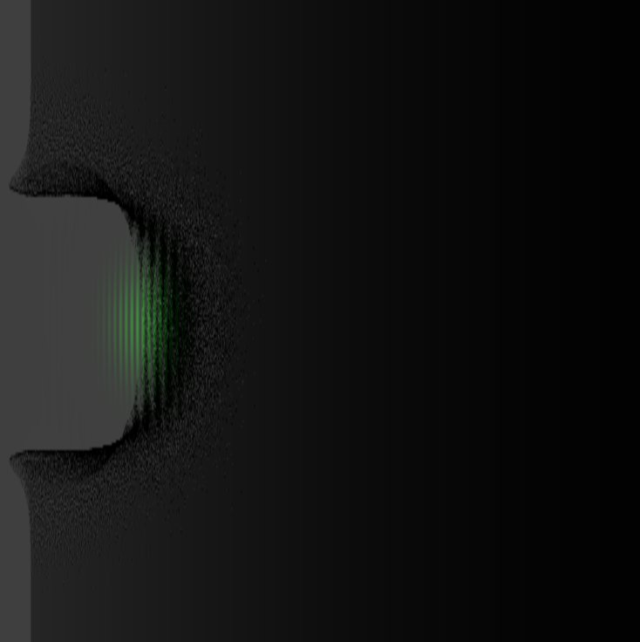
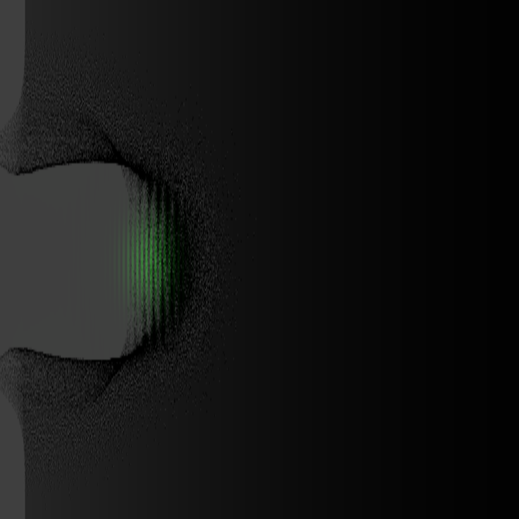
PIcOnGPU
Particle-in-Cell Code
The Laser hits the plasma
The process is simulated using GPU cluster

Slide 46
PIConGPU
Test boxes:
2 x Intel Xeon CPU E5-1650 v3
16 GB RAM
2 x NVIDIA Quadro K4200
1 Gbit Ethernet
Debian 8
CUDA Toolkit 6.5
Torque 4.2.9
LaserWakeField example simulation

Slide 47
PIConGPU
It scaled well:
1 GPU: 172 sec
2 GPUs with double sized problem (same box): 293 sec
2 nodes with 2 GPUs each of them:
2 GPU: 167 sec
4 GPU: 115 sec

Slide 48
PIConGPU in VM using PCIPassthrough
First tests using a VM instantiated by OpenStack
OS: Debian 8
2 GPUs via PCIPassthrough
The same example which were used in native environment and resulted in 167 sec ran for 230 sec
Slower ~20-30%
Note: this is not real benchmark!!!!

Slide 49
UFO-KIT
Ultrafast X-ray Imaging – Karlsruhe Institute of Technology
“ufo framework
Streamed data processing using heterogeneous compute resources
Pipelined and parallelized on multiple levels
Suited for high-volume image processing (e.g. tomography)”
Reference: GPU-based data analysis with the UFO framework
Matthias Vogelgesang
matthias.vogelgesang@kit.edu

Slide 50
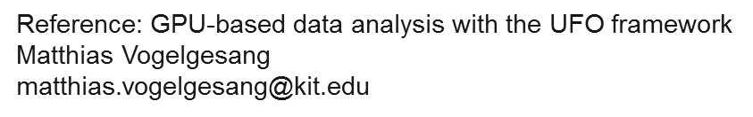
UFO-KIT
Core framework written in C and OpenCL
Large suite of pre-defined filters for high-throughput image processing
User specifies workflow, framework takes care of the rest
Open source (LGPL) and hosted at GitHub github.com/ufo-k

Slide 51

JSON workflow example
{
"nodes": [
{"plugin": "read", "name": "read",
"properties": {"path": "folder/sino*.tif"}},
{"plugin": "rescale", "name": "rescale",
"properties": {"factor": 0.5}},
{"plugin": "write", "name": "write",
"properties": {"filename": "output.h5:/raw"}}
],
"edges": [
{"from": "read", "to": "rescale", "input": 0},
{"from": "rescale", "to": "write", "input": 0}
]
}

Slide 52
UFO – Qt GUI

Slide 53
Achievements
Evaluation of different schedulers has been started: Torque, Slurm
Evaluation of cloud solution software has been started: OpenStack

Slide 54
Achievements
Evaluation of specific object storage/filesystem has been started: Ceph
Comparing different concepts: native hosts, containers, virtualization has been started: Docker, OpenStack with KVM
  Additionally to the complexity increasement there can be performance and/or security impact too at the non-native solutions

Slide 55
Achievements - Communication
Regular communication, visits to the Szeged University (TeWaTi group)
Weekly meetings with the increasing number of scientists in ELI-ALPS HU

Slide 56
Summary

Slide 57
Summary
Data storage and processing
Challenges
Very high data rates from detectors
Online near-real time data analysis and reduction
Online data visualization
  aggregation of detectors
Dynamically changing needs and diversity (by experiments)
  Data rates/volumes
  Computing capacity
  Data analysis software
Growing data volumes expected -> continuously growing IT infrastructure
Design goals
Flexible, scalable solutions (no hard upper limit)
Scaling-out -> cost efficiency
Avoid vendor lock-in
Follow widely accepted standards/solutions
Prefer well supported evolving solutions
Possibility for customization
Control Total-Cost-of-Ownership
Open source state-of-the-art private cloud solution on a reliable, high capacity, high performance scale-out software-defined storage platform.

Slide 58
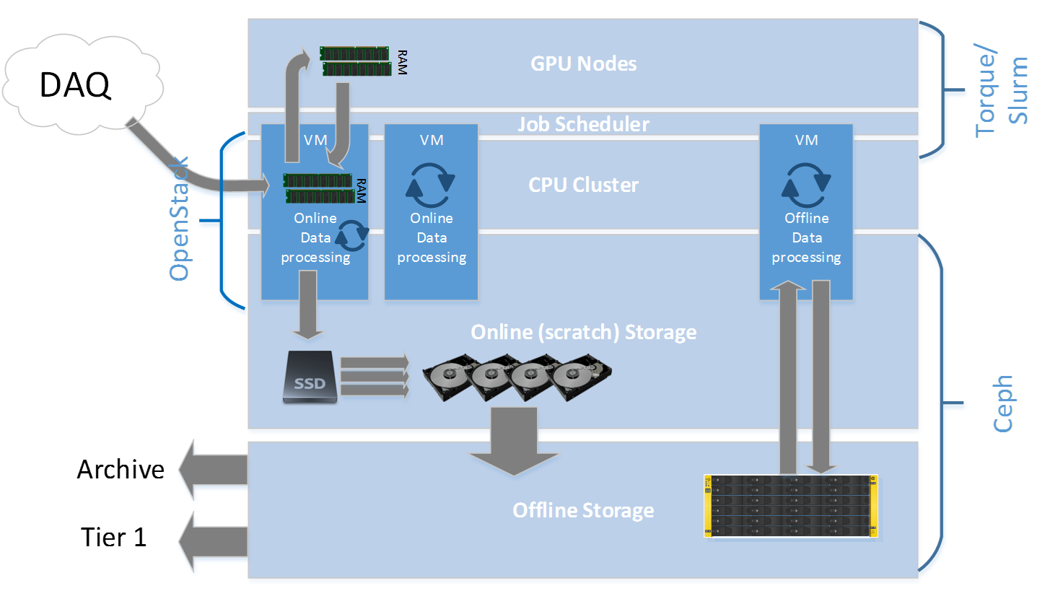
Data Processing
HPC Vision

Slide 59
References, links
ELI-ALPS HU
http://www.eli-hu.hu/
TeWaTi Laser and Research Group
http://titan.physx.u-szeged.hu/~tewati/
The Laser
http://en.wikipedia.org/wiki/Laser
Heterogenous computing
http://en.wikipedia.org/wiki/Heterogeneous_computing
PCIExpress
http://en.wikipedia.org/wiki/PCI_Express

Slide 60
References, links
Interferometry:
http://en.wikipedia.org/wiki/Interferometry
Mach-Zehnder interferometer:
http://en.wikipedia.org/wiki/Mach%E2%80%93Zehnder_interferometer
UFO-KIT
http://ufo.kit.edu/software.html
PiConGPU
https://www.hzdr.de/db/Cms?pNid=3227
Special thanks to Peter Jojart, Adam Borzsonyi for scientific consultations
Special thanks to Sandor Bodo-Merle, Peter Szasz for reviewing the presentation

Slide 61

Questions?

Slide 62
THANK YOU FOR YOUR ATTENTION!

