Slide 1

ONE CAN SIMPLY WALK INTO HETEROGENEOUS PARALLELISM
Alexandru Voicu, Ph.D.
Software Engineer
Visual C++ Libraries

Slide 2
“Where is the meat?”
Programming for heterogeneous parallelism is a convoluted, confusing affair – because we made it one!

Slide 3
reduce

Slide 4
But wait, there’s (literally☹) more! scan

Slide 5
Multum Im Parvo
On today’s menu:
A homogeneous perspective on the modern heterogeneous landscape;
To be or not to be (a fundamental part of a complete heterogeneous programming model);
What if C++ AMP were to go on a diet?
The world is not made of nails – only Thor gets away with using only a hammer!

Slide 6
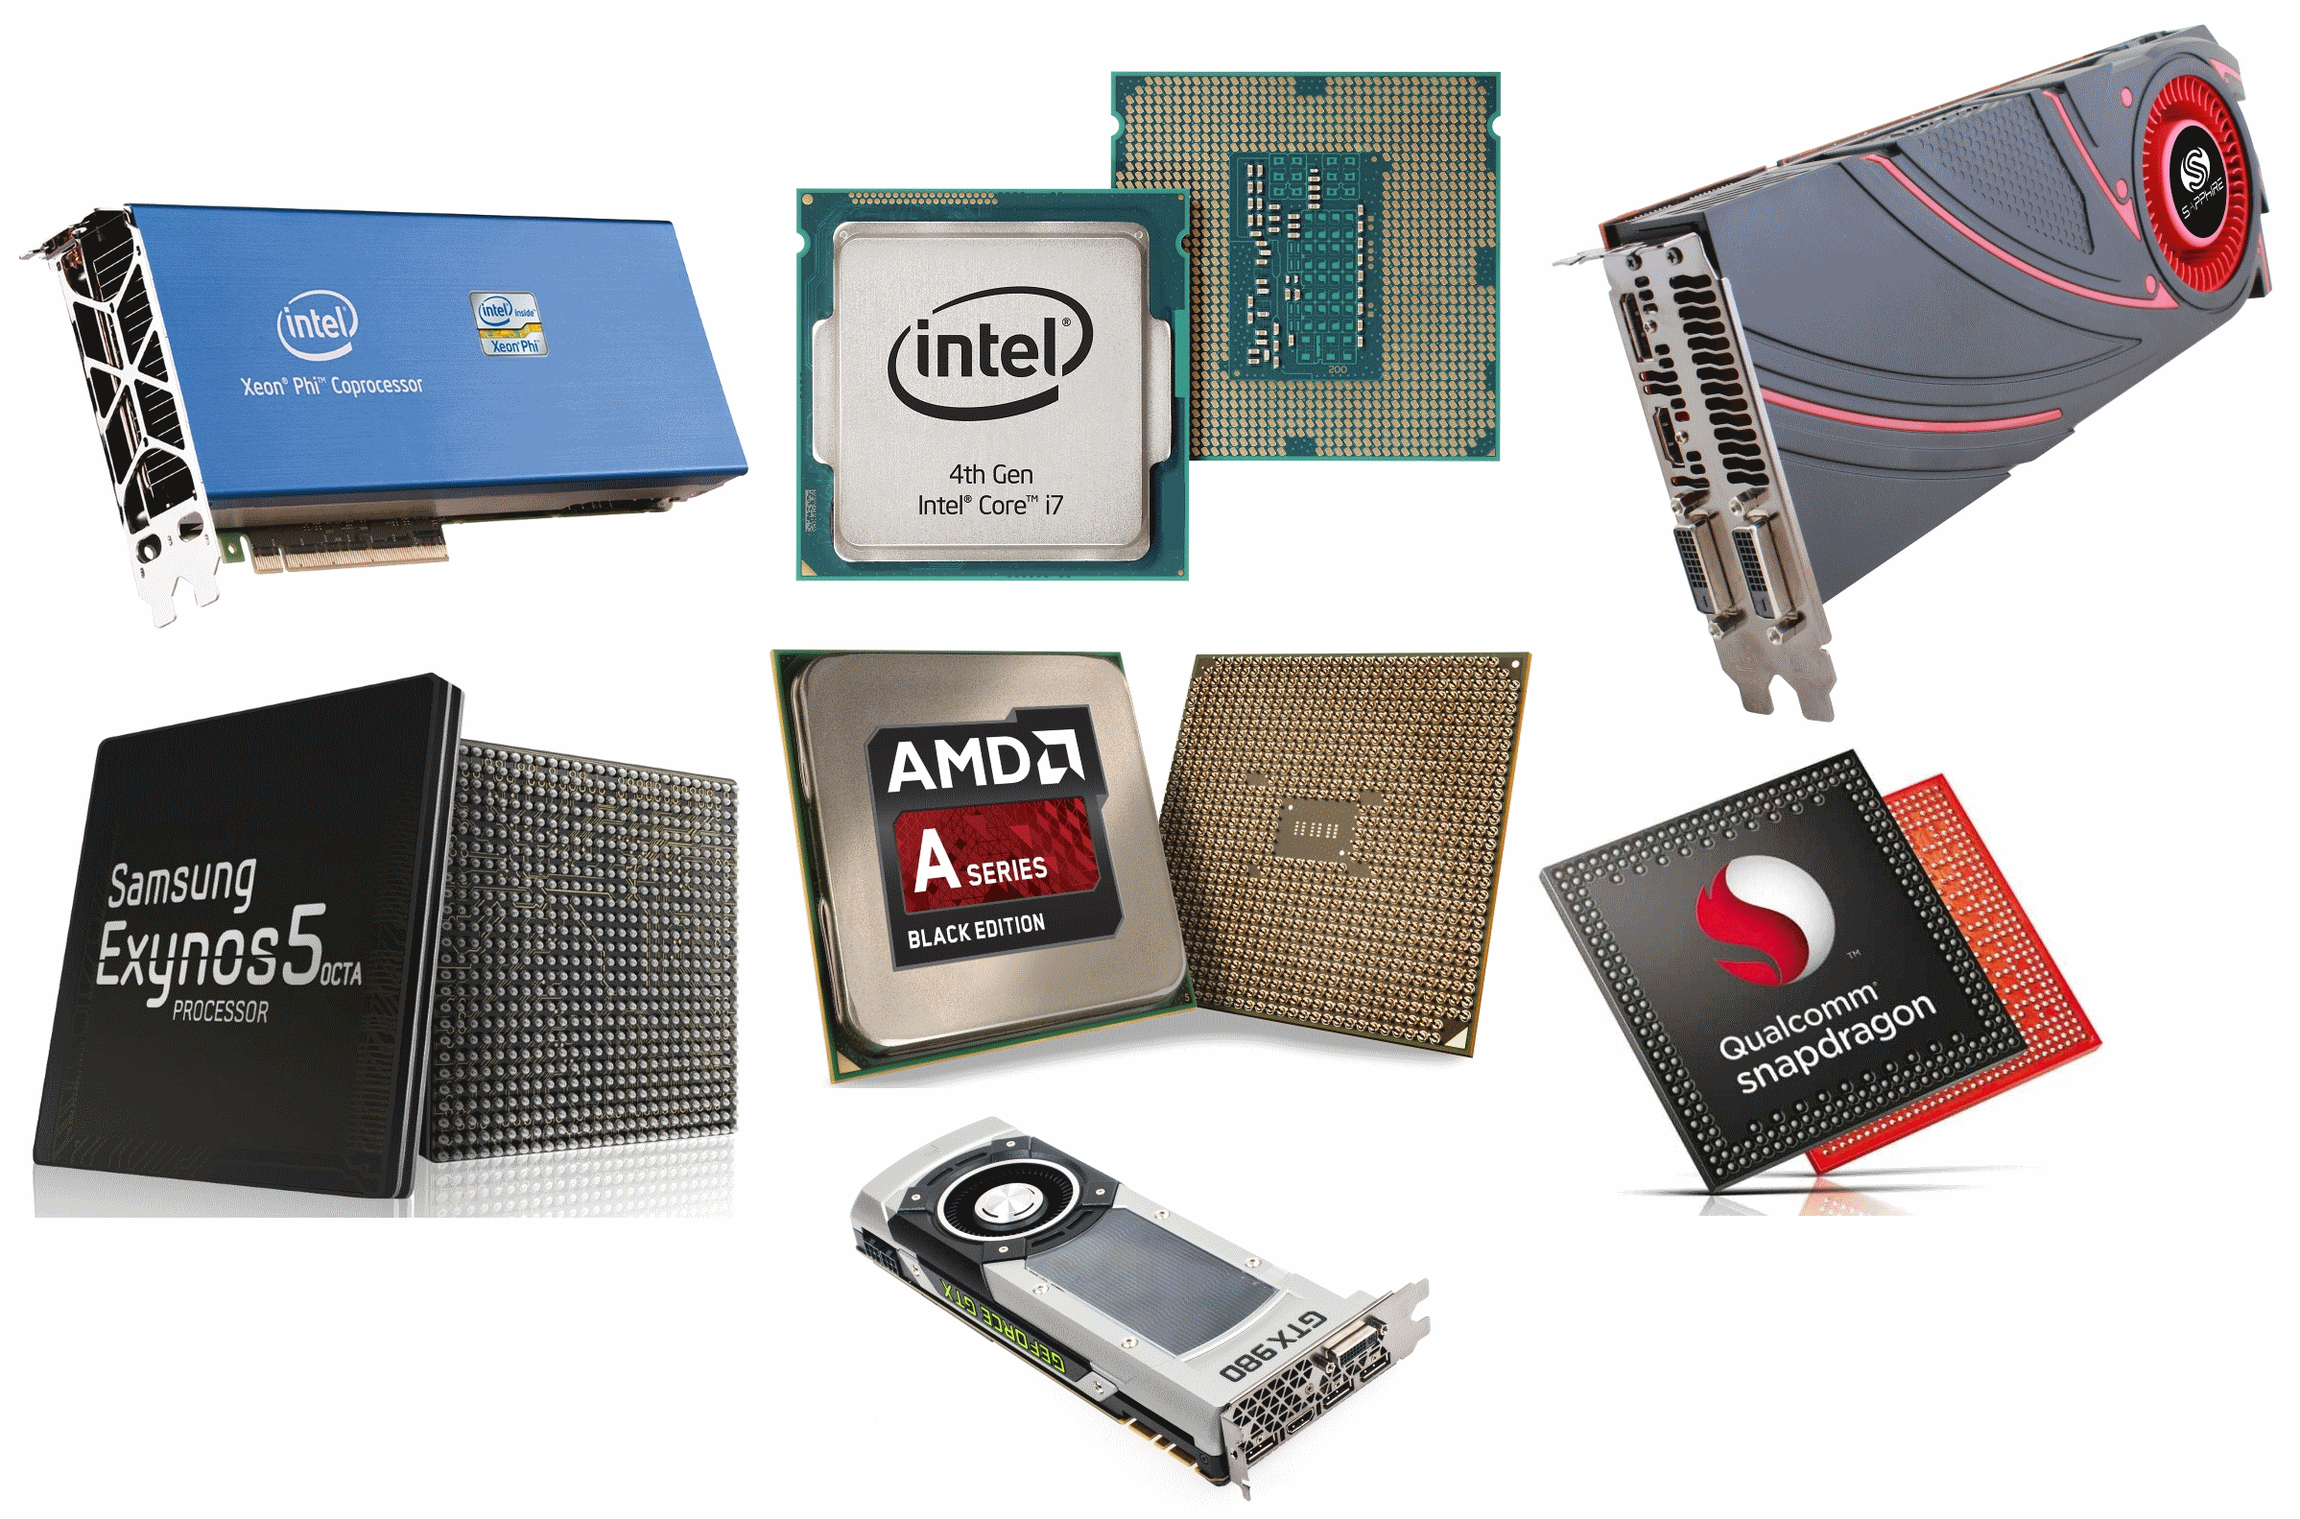
BEWARE REALITY, FOR IT IS DARK AND FULL OF HARDWARE
Once upon a time in Bell Labs..

Slide 7
Once upon a time in Bell Labs…
Dennis Ritchie (Von Neumann?) opted for a great abstract machine model for C:
  1 processor
  1 flat memory pool
  SISD execution
  details

Slide 8
Decades later…
The C and C++ abstract machine models are augmented to:
  1 processor (possibly with multiple homogeneous cores)
  1 flat memory pool
  SISD or MIMD execution
  a formal memory model
  details

Slide 9
Reality
Is a harsh mistress:
  Many, heterogeneous, processors, in the same machine (CPUs, GPUs, DSPs, etc.)
  Processors and their memory pools are distributed (and frequently incoherent)
  MIMD and SIMD (even better if SIMT nee SPMD) execution
  Multi-layered, potentially odd, memory model(s)
  Lots of details

Slide 10
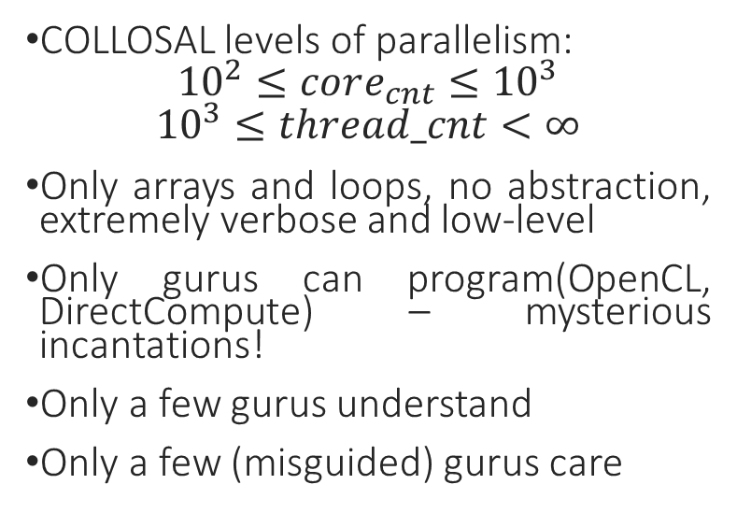
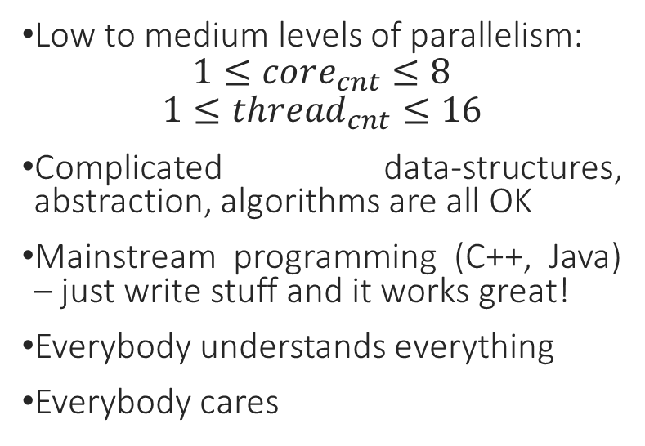
The common wisdom…
CPU
gpu
Low to medium levels of parallelism:
$$1≤core_{cnt}≤8$$
$$1≤{thread}_{cnt}≤16$$
Complicated data-structures, abstraction, algorithms are all OK
Mainstream programming (C++, Java) – just write stuff and it works great!
Everybody understands everything
Everybody cares
COLLOSAL levels of parallelism:
$${10}^{2}≤core_{cnt}≤{10}^{3}$$
$${10}^{3}≤thread_cnt<∞$$
Only arrays and loops, no abstraction, extremely verbose and low-level
Only gurus can program (OpenCL, DirectCompute) – mysterious incantations!
Only a few gurus understand
Only a few (misguided) gurus care

Slide 11
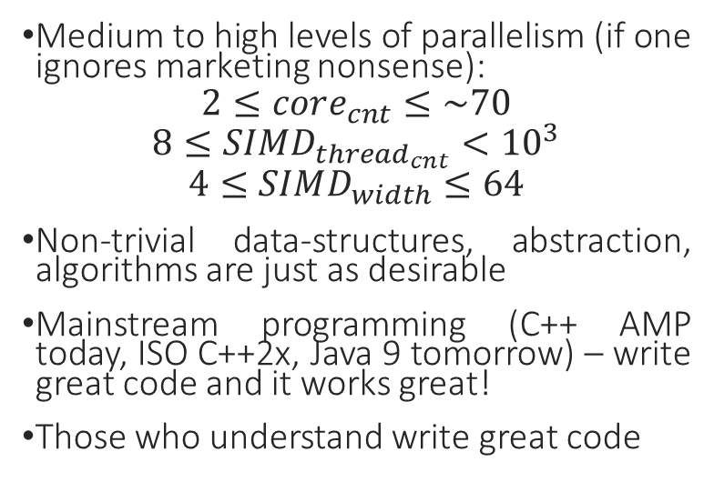
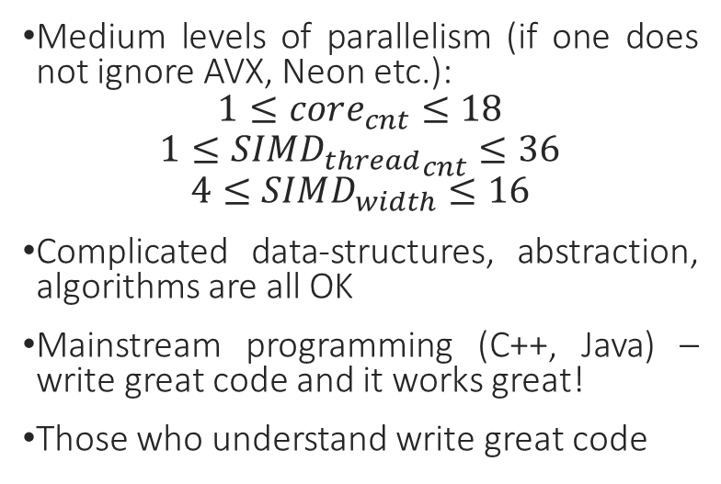
…is wrong (has been wrong for years)
CPU
gpu
Medium levels of parallelism (if one does not ignore AVX, Neon etc.):
$$1≤core_{cnt}≤18$$
$$1≤{SIMD_{thread}}_{cnt}≤36$$
$$4≤SIMD_{width}≤16$$
Complicated data-structures, abstraction, algorithms are all OK
Mainstream programming (C++, Java) – write great code and it works great!
Those who understand write great code
Medium to high levels of parallelism (if one ignores marketing nonsense):
$$2≤core_{cnt}≤\sim 70$$
$$8≤SIMD_{thread_{cnt}}<{10}^{3}$$
$$4≤SIMD_{width}≤64$$
Non-trivial data-structures, abstraction, algorithms are just as desirable
Mainstream programming (C++ AMP today, ISO C++2x, Java 9 tomorrow) – write great code and it works great!
Those who understand write great code

Slide 12
The correct abstract machine model
We program processors:
With a variable number of cores;
Capable of executing SIMD threads;
Which follow the Von Neumann paradigm.
Everything else is business as usual:
The interaction with memory matters for performance– locality, regularity etc.
“It’s all about algorithms and data-structures!” Alexander Stepanov
This is necessary and sufficient understanding for efficiently programming {C, G, A, *}PUs!

Slide 13

ALL YOU NEED IS…

Slide 14
The IHV
“do everything, we are unique from head to toe and nothing that came before applies” :
  CUDA
  OpenCL
  DirectCompute
Verbose, GPU-centric, focused on exposing innards with impunity:
  SIMD execution width under programmer control
  Intra-SIMD thread barrier constructs (needed to maintain the above illusion, they have a FUNDAMENTAL impact on the programming model)
  Liberal exposure of IHV-specific details
  Composability, mainstream appeal, portability – what’s that?
Pretty good for generating vendor lock-in and job security for the enlightened

Slide 15
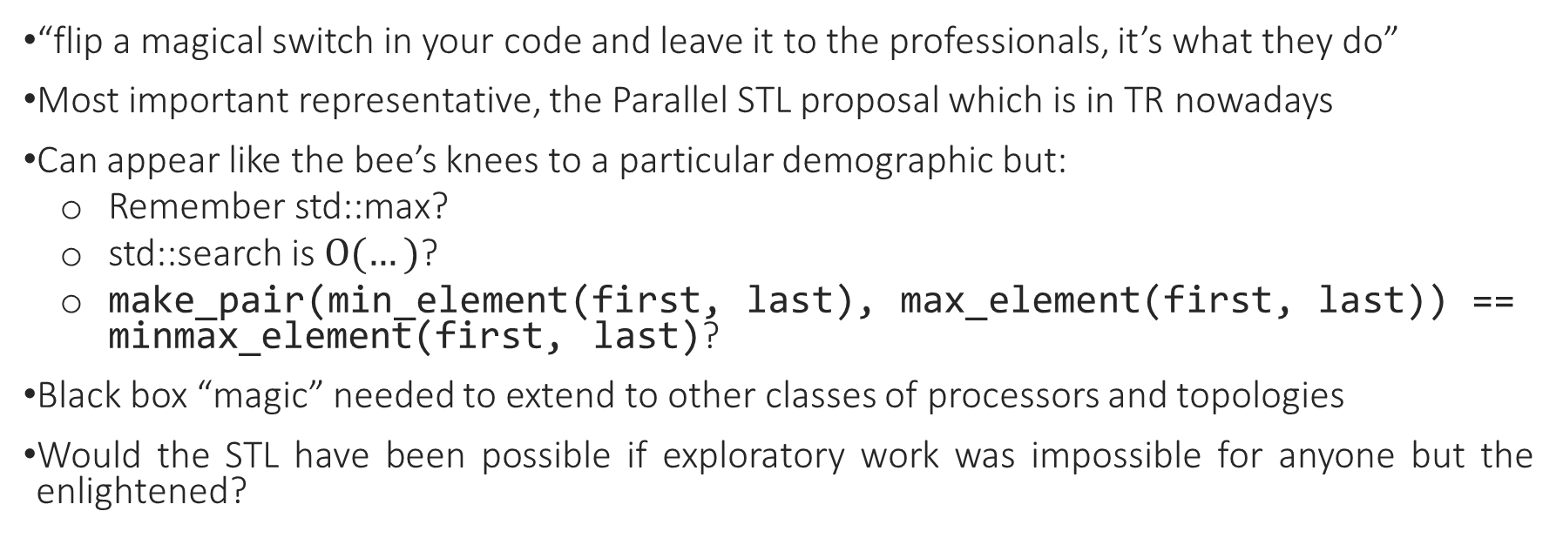
The “good-guy” librarian
“flip a magical switch in your code and leave it to the professionals, it’s what they do”
Most important representative, the Parallel STL proposal which is in TR nowadays
Can appear like the bee’s knees to a particular demographic but:
  Remember std::max?
  std::search is $Ο(…)$?
  make_pair(min_element(first, last), max_element(first, last)) == minmax_element(first, last)?
Black box “magic” needed to extend to other classes of processors and topologies
Would the STL have been possible if exploratory work was impossible for anyone but the enlightened?

Slide 16
The “good-guy” compiler writer
“flip a magical switch at compile-time and be amazed”
What we usually think it means is that foo(…), the 1000 LOC monster, will be parallelized across cores and vectorised across the SIMD lanes within those cores
What it actually means is that:
void foo(const int* A, const int* B, int* C, std::size_t n) {
for (std::size_t i = 0; i != n; ++i) C[i] = A[i] + B[i];
}
might be parallelised and vectorised is it’s aliasing free, the stars align and Khal Drogo returns.
The compiler is more Rincewind than it is Gandalf, don’t throw the guys writing it under a bus
Hilariously (intractably) difficult issues once scope is expanded to account for heterogeneity

Slide 17
A humble programmer’s perspective (no, not Dijkstra’s)
The abstract C++ machine model needs to be extended (within reason):
  Express locus of execution (this CPU, the GPU attached to that NUMA node etc.)
  Express modus of execution (SISD thread, SIMD thread etc.)
  Account for potentially non-uniform memory between loci
Magical libraries should be implementable wholly within the confines of the language and the standard library i.e. it should be possible for an Ada programmer to show up and write, from scratch, the fastest parallelised and vectorised sort function that scales across NUMA nodes, abaci or what have you
The changes and cognitive overload they bring should be minimised

Slide 18
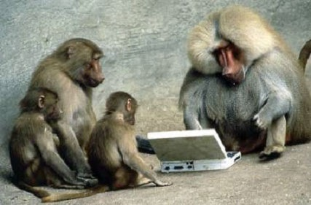
Putting our code where our mouth is
A gedankenexperiment based on what we have discussed up to now

Slide 19
A minimal but sufficient programming model (I)
We cannot get the model that we want (yet)
So we’ll approximate it on top of C++ AMP:
  + we can experiment with CPUs and GPUs
  + on a number of operating systems (Windows, Linux, OS X)
  - we cannot experiment with more exotic hardware (DSPs, clusters)
  - we have to accept some rough edges

Slide 20
A minimal but sufficient programming model (II)
Key ideas:
  Program against the hardware’s native SIMD width – no need for barriers, fundamentally alters the programming model;
  Expose a mechanism for specifying the locus of execution – dispatch work to accelerator of choice;
  Hide data-movement concerns for the base case, retain ability to control it for advanced use cases - C++ AMP array_view is merely a good start here;
  Minimise cognitive overload and friction with existing C++ Standard – seamlessly slot in alongside work such as the Parallel STL.

Slide 21
How? (naming is just for illustration)
3 + 2
ADTs:
  accelerator
  tiled_index
  tile_exclusive_cache
Functions:
  parallel_for_each
  uniform_invoke
LIBRARY ONLY SOLUTION

Slide 22
accelerator
Abstracts a computation capable resource (e.g. CPU, GPU, FPGA, NodeSomewhereOverTheRainbow)
Addresses the issue of heterogeneity

Slide 23
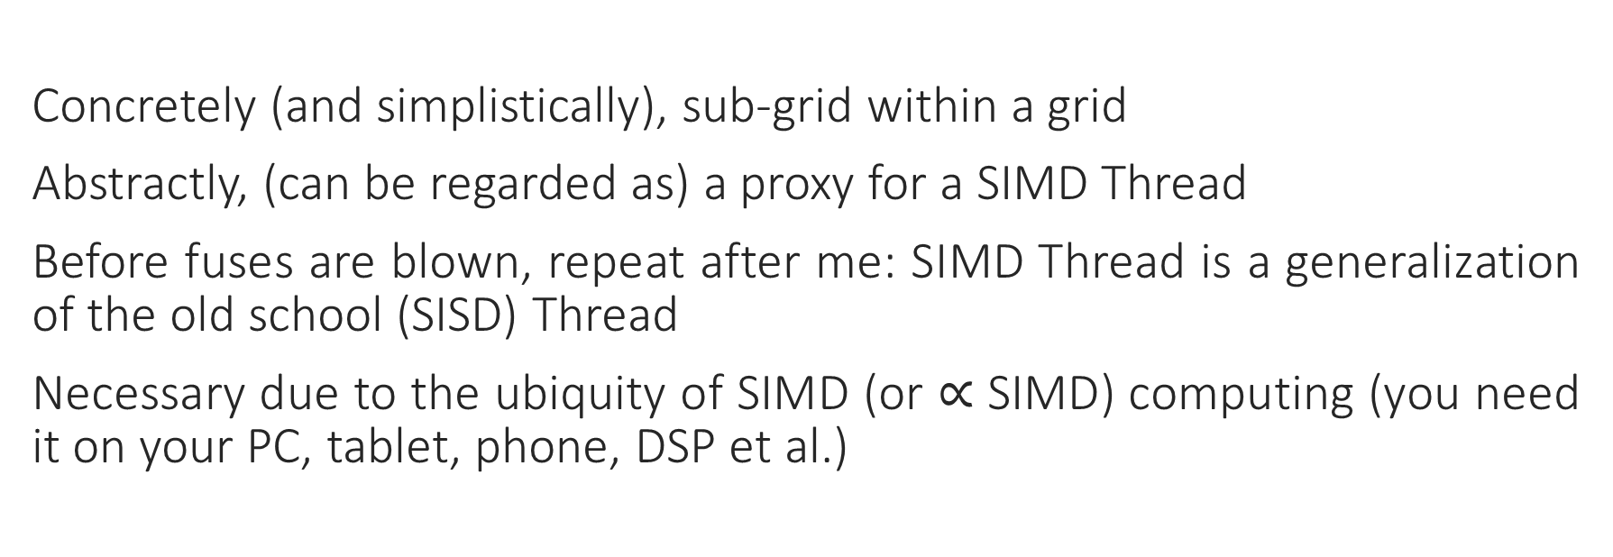
tiled_index
Concretely (and simplistically), sub-grid within a grid
Abstractly, (can be regarded as) a proxy for a SIMD Thread
Before fuses are blown, repeat after me: SIMD Thread is a generalization of the old school (SISD) Thread
Necessary due to the ubiquity of SIMD (or $∝$ SIMD) computing (you need it on your PC, tablet, phone, DSP et al.)

Slide 24
tile_exclusive_cache
Abstracts the idea of memory that is “close” to a (SIMD) Thread, and exclusive to it
Can be backed by a hardware scratchpad, as is the case in Cell or GPUs, but that is not mandatory
SIMD Thread visibility
Wide applicability: think NUMA or even more loosely coupled
Orthogonal to the nature of processing: useful for SISD and SIMD cases

Slide 25
parallel_for_each
Unique entry-point for accelerated execution, similar to the tiled parallel_for_each present in C++ AMP.

Slide 26
uniform_invoke
Signals desire to execute at SIMD Thread frequency i.e. traditional SISD execution
Set flags, grab mutexes or locks etc.
Leaves room for auto-vectorisation, builds upon currently recommended idioms
All memory addresses that are visible across SIMD lanes are in a synchronized state at uniform_invoke boundaries

Slide 27
reduce revisited (I)
const auto d = Execution_parameters::tiled_domain(last - first);
const Difference_type<I> w = Execution_parameters::work_per_tile(last - first);
const auto tmp = Execution_parameters::temporary_buffer<Value_type<I>>(d.size());
parallel_for_each(d, [=](tiled_index tidx) {
const Difference_type<I> t = tidx.tile[0] * w;
const Difference_type<I> n = _min(w, last - first - t);
const T r = _reduce_in_tile_n(first + t, n, identity_element, tidx, op);
uniform_invoke(tidx, [=](auto&& tile) { tmp[tile] = r; });
});
return _inner_reduce_host(cbegin(tmp), cend(tmp), identity_element, op);

Slide 28
reduce revisited (II)
template<typename I, typename T, typename Op>
T _reduce_in_tile_n(I f, Difference_type<I> n, const T& identity, const tiled_index& tidx, Op op)
{
T r = identity_element;
for (Difference_type<I> i = tidx.local[0]; i < n; i += tidx.width) {
r = op(r, first[i]);
}
tile_exclusive_cache<T[tidx.width]> tmp(tidx, [=](auto&& out) {
out[tidx.local[0]] = r;
});
return _inplace_reduce_single_tile_n(tmp.get(), tidx.width, identity, tidx, op);
}

Slide 29
reduce revisited (III)
template<typename I, typename T, typename Op>
T _reduce_in_tile_n(I f, Difference_type<I> n, const T& identity_element, const tiled_index& tidx, Op op)
{
T r = identity_element;
for (Difference_type<I> i = tidx.local[0]; i < n; i += tidx.width) {
r = op(r, first[i]);
}
tile_exclusive_cache<T[tidx.width]> tmp(tidx, [=](auto&& out) {
out[tidx.local[0]] = r;
});
return tmp.reduce(identity_element, op);
}

Slide 30
reduce revisited…
Is but a rough example, intended to wet the appetite!

Slide 31
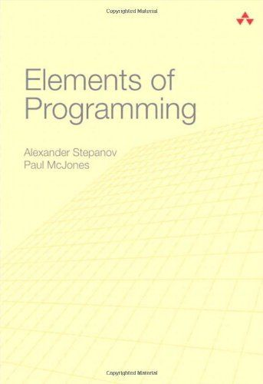

Recommended reading I
Excellent book on programming
EXCELLENT BOOK ON PROGRAMMING

Slide 32
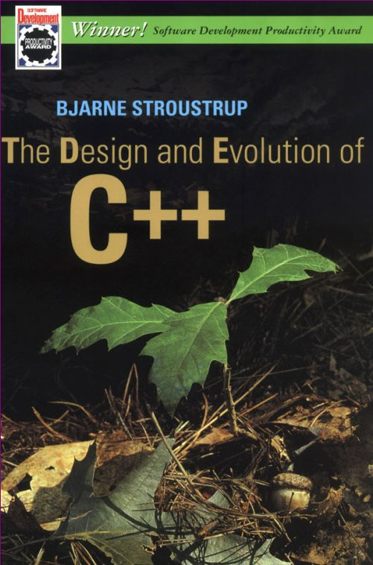
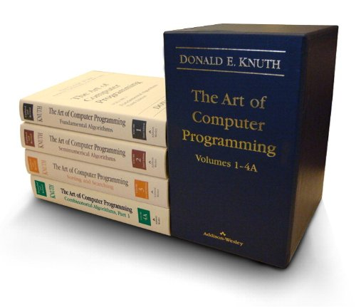
Recommended reading II
GOOD BOOK ON PROGRAMMING MODEL DESIGN
EXCELLENT BOOK ON ALGORITHMS AND DATA STRUCTURES (Yes, even in a heterogeneous world)

Slide 33
Experimental instruments
You can see a further development of the ideas presented herein on (pick the alexv_pre_experimental_vs2015_dysfunctional branch):
https://ampalgorithms.codeplex.com/
Note that it is very rough – pick master (which is handled by Ade Miller) for any non-exploratory work.

Slide 34


Slide 35

“Lasciate ogni speranza, voi ch’entrate!”

