Slide 1
Observables and initial conditions from exact rotational hydro solutions
T. Csörgő ¹ , I. Barna ¹ and M.I. Nagy ^{1,3}
¹ MTA Wigner Research Center for Physics, RMKI
³ ELTE University, Budapest, Hungary
New exact rotating hydro solutions
Two different family of equations of state
Summary: new rotating solutions
Single particle spectra
Elliptic and higher order flows
Oscillations of HBT radii
Summary: effects on observables
arXiv:1309.4390v2 PRC 89, 044901 (2014)
+ manuscript in preparation

Slide 2
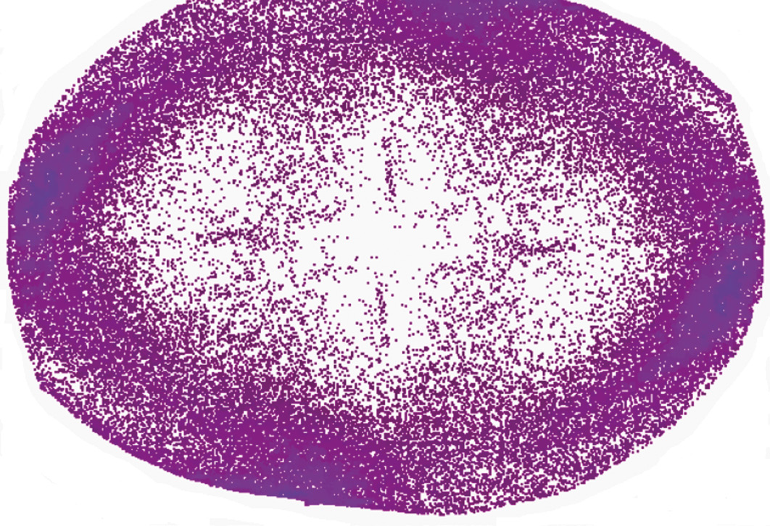
Motivation: initial angular momentum
Observation of conserved quantities: important
Example from L. Cifarelli, L.P. Csernai, H. Stöcker,
EPN 43/22 (2012) p. 91

Slide 3
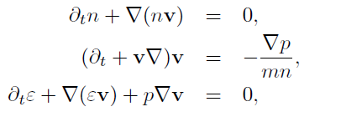
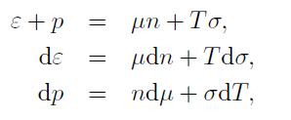
Hydrodynamics: basic equations
Basic equations of non-rel hydrodynamics:
Euler equation needs to be modified for lattice QCD EoS
Use basic thermodynamical relations
for lack of conserved charge (baryon free region)

Slide 4
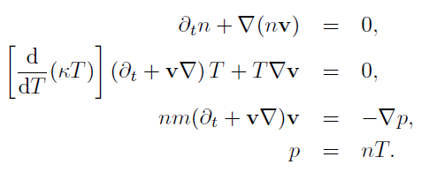
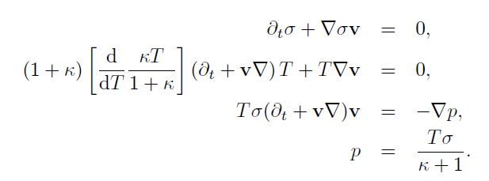
Rewrite for v, T and (n, or σ)
lattice QCD EoS: modification of the dynamical equations:

Slide 5
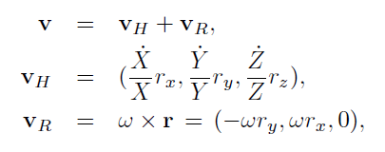
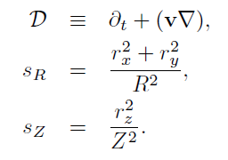
Ansatz for rotation and scaling
The case without rotation:
known self-similar solution
T. Cs, hep-ph/00111139
S. V. Akkelin et al,
hep-ph/0012127, etc.
Let’s try to add rotation!
First good news: scaling variable remains good
→ a hope to find ellipsoidal rotating solutions!

Slide 6
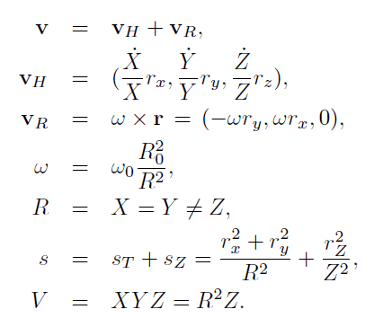
Common properties of solutions
From self-similarity
Ellipsoidal ->spheroidal
time dependence of
R and ω coupled
Conservation law!
For details, see arXiv:1309.4390

Slide 7
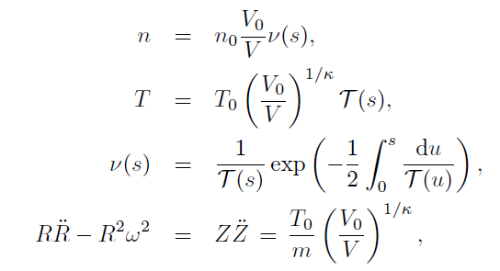
Solutions for conserved particle n
Similar to irrotational case:
Family of self-similar solutions, T profile free
T. Cs, hep-ph/00111139
Rotation leads to increased transverse acceleration!
For details, see arXiv:1309.4390

Slide 8
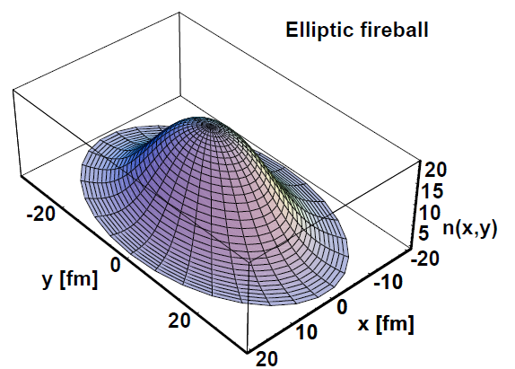
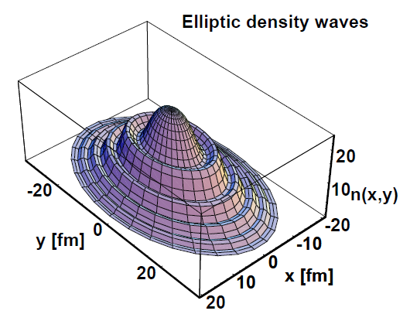
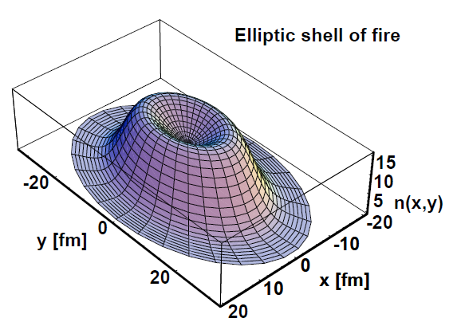
Role of temperature profiles

Slide 9
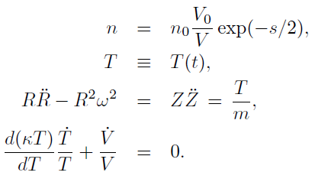
1B: conserved n, T dependent e/p
Works only if T is T(t) only
But more general EoS
Similar to
T. Cs. et al,
hep-ph/0108067
Rotation: increases transverse acceleration

Slide 10
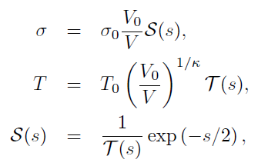
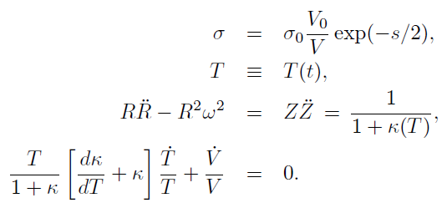
Solutions for lattice QCD type EoS
Two different class of solutions: p/e = const(T) or p/e = f(T)
Notes: increased acceleration (vs conserved n)
Observables calculable if σ ~ n(final) (Landau)

Slide 11
First integrals: Hamiltonian motion
1A: n is conserved
2A: n is not conseerved
Angular momentum conserved
Energy in rotation → 0

Slide 12
Summary so far: rotating solutions
New and rotating
exact solutions of fireball hydro
Also for lattice QCD family of EoS
Now analyzed in detail
(after 53 years)
Important observation:
Rotation leads to stronger radial expansion
lQCD EoS leads to stronger radial expansion
Perhaps connected to large radial flows
in RHIC and LHC data
Observables:
Next slides
arXiv:1309.4390 (v2)

Slide 13
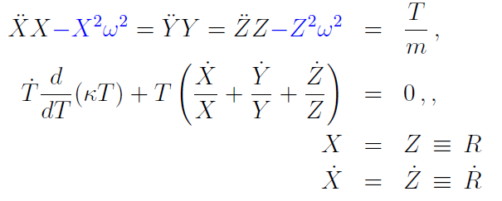
Observables from rotating solutions
Note: (r’, k’) in fireball frame
rotated wrt lab frame (r,k)
Note: in this talk, rotation in the
(X,Z) impact parameter plane !

Slide 14
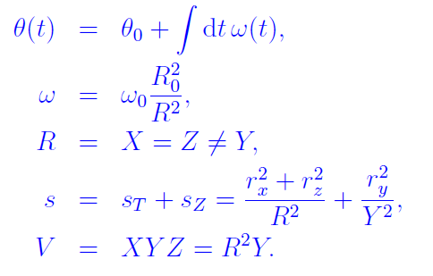
Role of EoS on acceleration
Lattice QCD type Eos is explosive
Tilt angle θ integrates rotation in (X,Z) plane: sensitive to EoS!

Slide 15
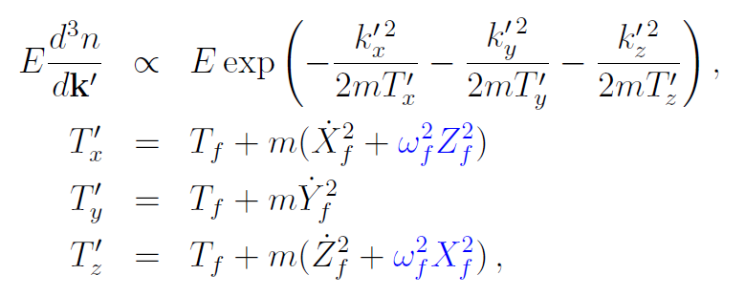
Single particle spectra
In the rest frame of the fireball:
Rotation increases effective temperatures both in the longitudinal and
impact parameter direction
in addition to Hubble flows

Slide 16
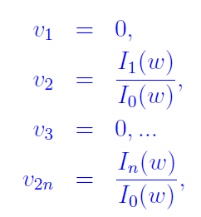
Directed, elliptic and other flows
From the single particle spectra
→ flow coefficents v_{n}
Note:
model is fully analytic
As of now, only X = Z = R(t)
spheroidal solutions are found
→ vanishing odd order flows
See next talk for fluctuations

Slide 17
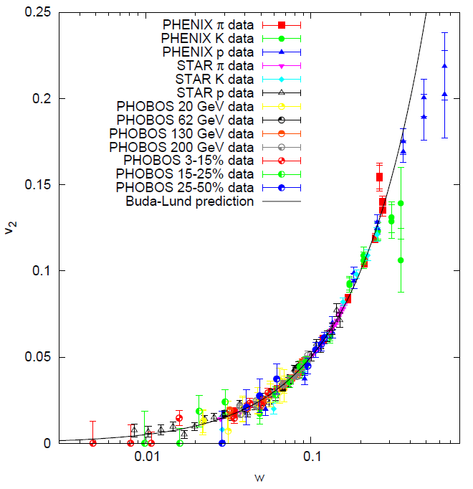
Reminder: Universal w scaling of v₂
Rotation does not change v2 scaling, but it modifies radial flow
Black line: Buda-Lund prediction from 2003
nucl-th/0310040
Comparision with data:
nucl-th/0512078
Note: v2 data depend on particle type, centrality, colliding energy, rapidity, pt

Slide 18
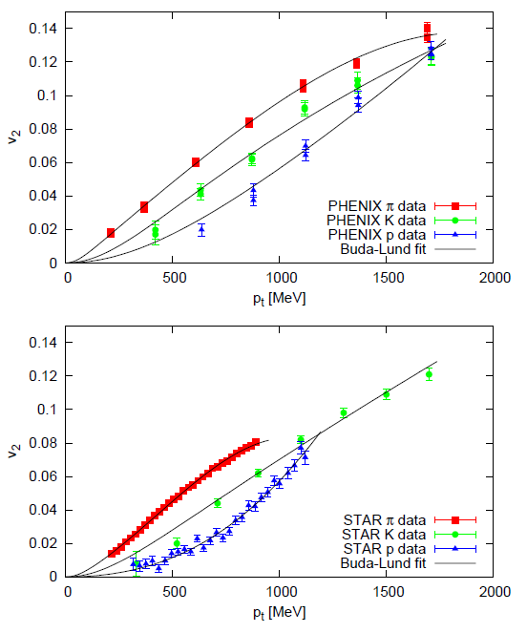
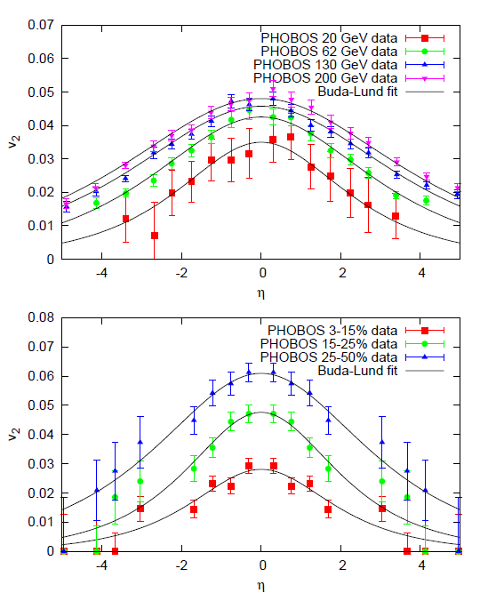
Details of universal w scaling of v₂
nucl-th/0512078

Slide 19
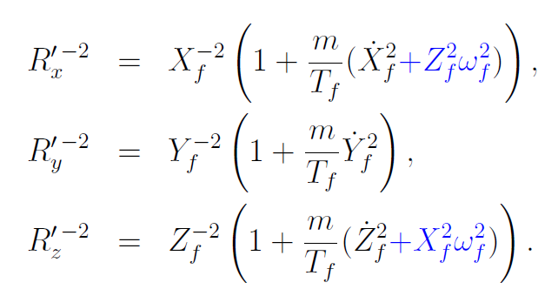
HBT radii for rotating spheroids
Diagonal Gaussians in natural frame
New terms with blue
→ Rotation decreases HBT radii similarly to Hubble flow.

Slide 20
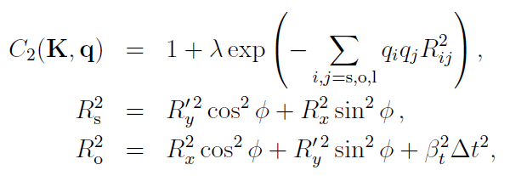
HBT radii in the lab frame
HBT radii without flow
But spheriodal symmetry of the solution
Makes several cross terms vanish → need for ellipsoidal solutions

Slide 21
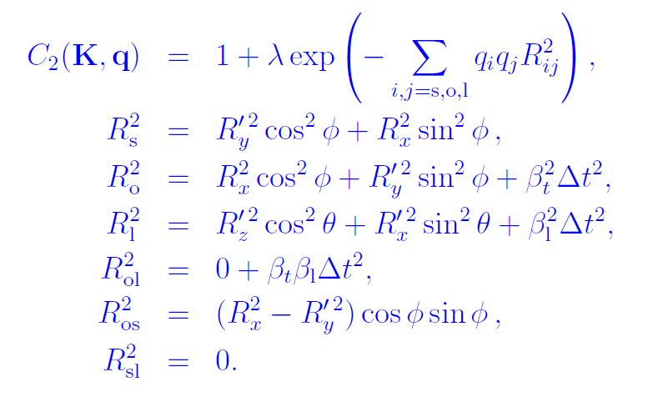
HBT radii in the lab frame
HBT radii without flow
But spheriodal symmetry of the solution
Makes several cross terms vanish → need for ellipsoidal solutions

Slide 22
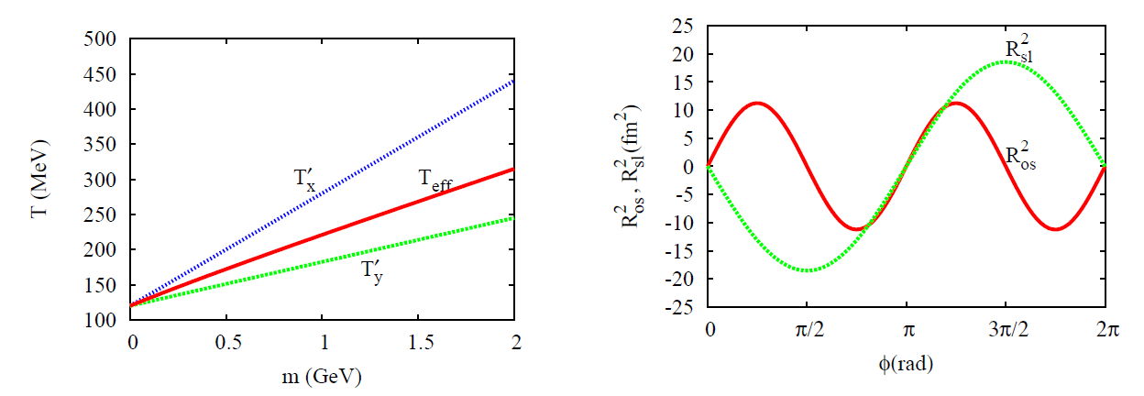
Qualitatively rotation and flow similar
But need more time dependent calculations
and less academic studies
(relativistic solutions)

Slide 23
Summary
Observables calculated
Effects of rotation and flow
Combine and have same mass dependence
Spectra: slope increases
v₂: universal w scaling remains valid
HBT radii:
Decrease with mass intensifies
Even for spherical expansions:
v₂ from rotation.
Picture: vulcano
How to detect the rotation?
Next step: penetrating probes

Slide 24
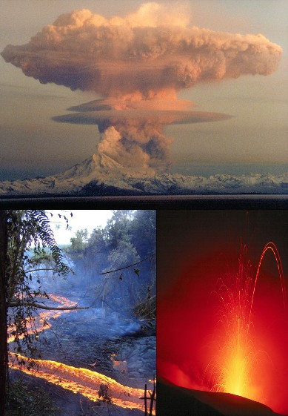
Summary
Observables calculated
Effects of rotation and flow
Combine and have same mass dependence
Spectra: slope increases
v₂: universal w scaling remains valid
HBT radii:
Decrease with mass intensifies
Even for spherical expansions:
v₂ from rotation.
Picture: vulcano
How to detect the rotation?
Next step: penetrating probes

