Slide 1
OPENCL ECOSYSTEM UPDATES
Developer UX at the forefront

Slide 2
TABLE OF CONTENTS

Slide 3
1ST PARTY OPENCL-SDK
Where it all begins

Slide 4
OPENCL 3.0
Re-imagination of the API
Builds on top of the last widely adopted version, 1.2
Adopts the Vulkan-like „slim core API with everything else extensions” approach
Lowers the bar for adoption
Newcomers
Solves issues for existing adopters
1ST PARTY OPENCL-SDK

Slide 5
OPENCL 3.0 ECOSYSTEM REBOOT
New ICD Layers capability allows augmenting/modifying runtime behavior
Add missing features, validate correctness, trace, profile, etc
OpenCL SDK serves as a „one-stop shop” for devs
Initial batch of native samples & utilities awarded to Stream
Coming to a GitHub near you
Defines the semantics of layered implementations to fill in the gaps of platform support
Most notably OpenCLOn12, enabling OpenCL across the entire Windows ecosystem, regardless of vendor support.
1ST PARTY OPENCL-SDK
https://www.microsoft.com/en-us/p/opencl-and-opengl-compatibility-pack/9nqpsl29bfff

Slide 6
OPENCL 3.0 ECOSYSTEM REBOOT
New ICD Layers capability allows augmenting/modifying runtime behavior
Add missing features, validate correctness, trace, profile, etc
OpenCL SDK serves as a „one-stop shop” for devs
Initial batch of native samples & utilities awarded to Stream
Coming to a GitHub near you
Defines the semantics of layered implementations to fill in the gaps of platform support
Most notably OpenCLOn12, enabling OpenCL across the entire Windows ecosystem, regardless of vendor support.
1ST PARTY OPENCL-SDK
https://www.microsoft.com/en-us/p/opencl-and-opengl-compatibility-pack/9nqpsl29bfff

Slide 7
WHAT’S INSIDE THE BOX?
OpenCL-Headers
OpenCL-ICD-Loader
OpenCL-CLHPP
Utility libraries
Sample codes
Documentation
OpenCL-Guide
1ST PARTY OPENCL-SDK

Slide 8
WHAT’S INSIDE THE BOX?
OpenCL-Headers
OpenCL-ICD-Loader
OpenCL-CLHPP
Utility libraries
Sample codes
Documentation
OpenCL-Guide
The definitive C bindings to the OpenCL API
Relatively new helper headers for
Creating your own ICD
Creating your own layer
1ST PARTY OPENCL-SDK

Slide 9
WHAT’S INSIDE THE BOX?
OpenCL-Headers
OpenCL-ICD-Loader
OpenCL-CLHPP
Utility libraries
Sample codes
Documentation
OpenCL-Guide
The canonical Installable Client Driver loader
libOpenCL.so/OpenCL.dll
Responsible for loading vendor runtimes
Shared ownership by vendors and OS
Exposed to
Let users tap into latest features
Help implementers debug
1ST PARTY OPENCL-SDK
clGetPlatformIDs(numPlatforms, platforms, NULL);

Slide 10
WHAT’S INSIDE THE BOX?
OpenCL-Headers
OpenCL-ICD-Loader
OpenCL-CLHPP
Utility libraries
Sample codes
Documentation
OpenCL-Guide
Canonical C++ bindings to the OpenCL API
Reduces verbosity
Adds safety guards
C++11 is the minimum
1ST PARTY OPENCL-SDK

Slide 11
WHAT’S INSIDE THE BOX?
OpenCL-Headers
OpenCL-ICD-Loader
OpenCL-CLHPP
Utility libraries
Sample codes
Documentation
OpenCL-Guide
Utility libraries to help developers with common tasks, for eg.
Give me a context with device N on platform M
Obtain profiling data in std::chrono-friendly format
Contributions are welcome
Convert error code -48 to „CL_INVALID_KERNEL”?
1ST PARTY OPENCL-SDK

Slide 12
WHAT’S INSIDE THE BOX?
OpenCL-Headers
OpenCL-ICD-Loader
OpenCL-CLHPP
Utility libraries
Sample codes
Documentation
OpenCL-Guide
1ST PARTY OPENCL-SDK

Slide 13
WHAT’S INSIDE THE BOX?
OpenCL-Headers
OpenCL-ICD-Loader
OpenCL-CLHPP
Utility libraries
Sample codes
Documentation
OpenCL-Guide
1ST PARTY OPENCL-SDK

Slide 14
WHAT’S INSIDE THE BOX?
OpenCL-Headers
OpenCL-ICD-Loader
OpenCL-CLHPP
Utility libraries
Sample codes
Documentation
OpenCL-Guide
All documentation is written in Markdown
Cross-linking with the OpenCL-Guide
Getting started guides
Linux
Windows
CMake support
More on this later
1ST PARTY OPENCL-SDK

Slide 15
HIGHER STANDARDS
The entire ecosystem is thoroughly tested
Warning free using highest warn levels
3 platforms (Windows, Linux, MacOS)
3 compilers (MSVC, GCC, Clang)
Multiple language C/C++ standards
With/without compiler extensions
Public facing CI scripts
1ST PARTY OPENCL-SDK

Slide 16
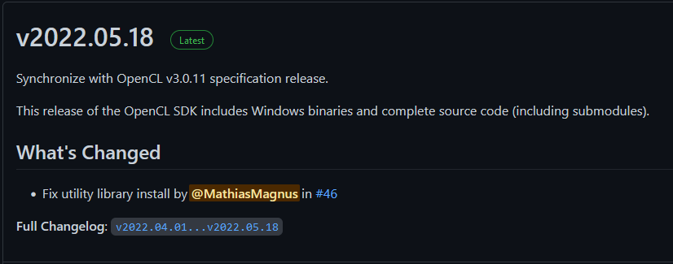
HIGHER STANDARDS
The entire ecosystem is thoroughly tested
Warning free using highest warn levels
3 platforms (Windows, Linux, MacOS)
3 compilers (MSVC, GCC, Clang)
Multiple language C/C++ standards
With/without compiler extensions
Public facing CI scripts
Continuous Deployment in place
Quarterly source & binary releases
1ST PARTY OPENCL-SDK

Slide 17
LAYERS ARE KEY
- Ogres are like onions.
- They smell and turn white if you leave them on the sun?
- No Donkey! They got layers!

Slide 18
OPENCL 3.0 ECOSYSTEM REBOOT
New ICD Layers capability allows augmenting/modifying runtime behavior
Add missing features, validate correctness, trace, profile, etc
OpenCL SDK serves as a „one-stop shop” for devs
Initial batch of native samples & utilities awarded to Stream
Coming to a GitHub near you
Defines the semantics of layered implementations to fill in the gaps of platform support
Most notably OpenCLOn12, enabling OpenCL across the entire Windows ecosystem, regardless of vendor support.
LAYERS ARE KEY
https://www.microsoft.com/en-us/p/opencl-and-opengl-compatibility-pack/9nqpsl29bfff

Slide 19
OPENCL 3.0 ECOSYSTEM REBOOT
New ICD Layers capability allows augmenting/modifying runtime behavior
Add missing features, validate correctness, trace, profile, etc
OpenCL SDK serves as a „one-stop shop” for devs
Initial batch of native samples & utilities awarded to Stream
Coming to a GitHub near you
Defines the semantics of layered implementations to fill in the gaps of platform support
Most notably OpenCLOn12, enabling OpenCL across the entire Windows ecosystem, regardless of vendor support.
LAYERS ARE KEY
https://www.microsoft.com/en-us/p/opencl-and-opengl-compatibility-pack/9nqpsl29bfff

Slide 20
UNDERSTANDING LAYERS
Without layers support enabled, the ICD Loader will
dispatch the call to the correct vendor driver
LAYERS ARE KEY
Application
ICD Loader
Driver 1
Function 1
Function 2
Driver 2
Layers for OpenCL – Brice Videau @ IWOCL 2021
(https://raw.githubusercontent.com/Kerilk/OpenCL-Layers-Tutorial/main/presentation/LayersForOpenCL.pdf)

Slide 21
UNDERSTANDING LAYERS
With layers support enabled, the ICD Loader will
first redirect calls to different active layers
then dispatch the call to the correct vendor driver
LAYERS ARE KEY
Application
ICD Loader
Driver 1
Function 1
Function 2
Driver 2
ICD Loader
ICD Loader
Function 1
Function 2
Function 2

Slide 22
OBJECT LIFETIME TRACKING
Leaking objects
clReleaseEvent(evt[0]);
clReleaseEvent(evt[1]);
clReleaseMemObject(bufferSrc);
clReleaseMemObject(bufferDst);
clReleaseMemObject(bufferRes);
clReleaseKernel(kernel);
clReleaseProgram(program);
clReleaseCommandQueue(queue);
clReleaseContext(context);
clReleaseDevice(device);
LAYERS ARE KEY

Slide 23
OBJECT LIFETIME TRACKING
Leaking objects
cl_ulong total_time = 0;
for (int i = 0 ; i < steps ; ++i)
{
cl_event event;
clEqneueNDRandeKernel(
queue, kernel, 1, NULL,
&global_work_size, &local_work_size,
0, NULL, &event);
clGetEventProfilingInfo(
event, CL_PROFILING_COMMAND_START,
sizeof(cl_ulong), &start, NULL);
clGetEventProfilingInfo(
event, CL_PROFILING_COMMAND_END,
sizeof(cl_ulong), &end, NULL);
total_time += end – start;
}
LAYERS ARE KEY

Slide 24
OBJECT LIFETIME TRACKING
Leaking objects
cl_ulong total_time = 0;
for (int i = 0 ; i < steps ; ++i)
{
cl_event event;
clEqneueNDRandeKernel(
queue, kernel, 1, NULL,
&global_work_size, &local_work_size,
0, NULL, &event);
clGetEventProfilingInfo(
event, CL_PROFILING_COMMAND_START,
sizeof(cl_ulong), &start, NULL);
clGetEventProfilingInfo(
event, CL_PROFILING_COMMAND_END,
sizeof(cl_ulong), &end, NULL);
total_time += end – start;
clReleaseEvent(event);
}
LAYERS ARE KEY

Slide 25
OBJECT LIFETIME TRACKING
Leaking objects
Double free
Shortcircuit an option
cl_context ctx_a = clCreateContext(...);
clReleaseContext(ctx_a);
// Do a whole bunch of other stuff
/*
*
*
*
*
*
*
*
*
*
*
*
*/
clReleaseContext(ctx_a);
LAYERS ARE KEY

Slide 26
OBJECT LIFETIME TRACKING
Leaking objects
Double free
Shortcircuit an option
Use after free
cl_context ctx_a = clCreateContext(...);
clReleaseContext(ctx_a);
// Do a whole bunch of other stuff
/*
*
*
*
*
*
*
*
*
*
*
*
*/
clGetContextInfo(ctx_a, CL_CONTEXT_DEVICES,
0, NULL, &devices_size);
LAYERS ARE KEY

Slide 27
OBJECT LIFETIME TRACKING
Leaking objects
Double free
Shortcircuit an option
Use after free
Use of dangling handle
cl_context ctx_a = clCreateContext(...);
clReleaseContext(ctx_a);
cl_context ctx_b = clCreateContext(...);
clReleaseContext(ctx_a);
LAYERS ARE KEY

Slide 28
OBJECT LIFETIME TRACKING
Leaking objects
Double free
Shortcircuit an option
Use after free
Use of dangling handle
Needs a dictionary between ICD and user code
Translate whenever the user uses a handle
cl_context ctx_a = clCreateContext(...);
clReleaseContext(ctx_a);
cl_context ctx_b = clCreateContext(...);
clReleaseContext(ctx_a);
LAYERS ARE KEY

Slide 29
INPUT ARGUMENT VALIDATION
API entry points have various pre/post-conditions users ought not violate
If conditions are violated, an error is raised
Worst case scenario, the app crashes
There are $124 + 109 = 233$ (core + extension) functions
Writing checks for each is a lot of work
That work has to be done for every language projection
C, C++, C# (OpenCL.Net), Python (PyOpenCL), etc
Can we do better?
LAYERS ARE KEY

Slide 30
INPUT ARGUMENT VALIDATION
cl_int clEnqueueWriteBuffer(cl_command_queue command_queue, cl_mem buffer,
cl_bool blocking_write, size_t offset, size_t size, const void* ptr,
cl_uint num_events_in_wait_list, const cl_event* event_wait_list,
cl_event* event);
command_queue is a valid host command-queue in which the read / write command will be queued. command_queue and buffer must be created with the same OpenCL context.
buffer refers to a valid buffer object.
blocking_read and blocking_write indicate if the read and write operations are blocking or non-blocking (see below).
offset is the offset in bytes in the buffer object to read from or write to.
size is the size in bytes of data being read or written.
ptr is the pointer to buffer in host memory where data is to be read into or to be written from.
event_wait_list and num_events_in_wait_list specify events that need to complete before this particular command can be executed. If event_wait_list is NULL, then this particular command does not wait on any event to complete. If event_wait_list is NULL, num_events_in_wait_list must be 0. If event_wait_list is not NULL, the list of events pointed to by event_wait_list must be valid and num_events_in_wait_list must be greater than 0. The events specified in event_wait_list act as synchronization points. The context associated with events in event_wait_list and command_queue must be the same. The memory associated with event_wait_list can be reused or freed after the function returns.
event returns an event object that identifies this read / write command and can be used to query or queue a wait for this command to complete. If event is NULL or the enqueue is unsuccessful, no event will be created and therefore it will not be possible to query the status of this command or to wait for this command to complete. If event_wait_list and event are not NULL, event must not refer to an element of the event_wait_list array.
LAYERS ARE KEY

Slide 31
INPUT ARGUMENT VALIDATION
cl_int clEnqueueWriteBuffer(cl_command_queue command_queue, cl_mem buffer,
cl_bool blocking_write, size_t offset, size_t size, const void* ptr,
cl_uint num_events_in_wait_list, const cl_event* event_wait_list,
cl_event* event);
CL_INVALID_COMMAND_QUEUE if command_queue is not a valid host command-queue.
CL_INVALID_CONTEXT if the context associated with command_queue and buffer are not the same or if the context associated with command_queue and events in event_wait_list are not the same.
CL_INVALID_MEM_OBJECT if buffer is not a valid buffer object.
CL_INVALID_VALUE if the region being read or written specified by (offset, size) is out of bounds or if ptr is a NULL value.
CL_INVALID_EVENT_WAIT_LIST if event_wait_list is NULL and num_events_in_wait_list > 0, or event_wait_list is not NULL and num_events_in_wait_list is 0, or if event objects in event_wait_list are not valid events.
CL_MISALIGNED_SUB_BUFFER_OFFSET if buffer is a sub-buffer object and offset specified when the sub-buffer object is created is not aligned to CL_DEVICE_MEM_BASE_ADDR_ALIGN value for device associated with queue. This error code is missing before version 1.1.
CL_EXEC_STATUS_ERROR_FOR_EVENTS_IN_WAIT_LIST if the read and write operations are blocking and the execution status of any of the events in event_wait_list is a negative integer value. This error code is missing before version 1.1.
CL_MEM_OBJECT_ALLOCATION_FAILURE if there is a failure to allocate memory for data store associated with buffer.
CL_INVALID_OPERATION if clEnqueueReadBuffer is called on buffer which has been created with CL_MEM_HOST_WRITE_ONLY or CL_MEM_HOST_NO_ACCESS.
CL_INVALID_OPERATION if clEnqueueWriteBuffer is called on buffer which has been created with CL_MEM_HOST_READ_ONLY or CL_MEM_HOST_NO_ACCESS.
CL_OUT_OF_RESOURCES if there is a failure to allocate resources required by the OpenCL implementation on the device.
CL_OUT_OF_HOST_MEMORY if there is a failure to allocate resources required by the OpenCL implementation on the host.
LAYERS ARE KEY

Slide 32
GENERATE CHECKS FROM XML
Before input arg validation
<command suffix="CL_API_SUFFIX__VERSION_1_2">
<proto>
<type>cl_int</type>
<name>clReleaseDevice</name>
</proto>
<param>
<type>cl_device_id</type>
<name>device</name>
</param>
</command>
LAYERS ARE KEY

Slide 33
GENERATE CHECKS FROM XML
Before input arg validation
After input arg validation
<command suffix="CL_API_SUFFIX__VERSION_1_2">
<proto>
<type>cl_int</type>
<name>clReleaseDevice</name>
</proto>
<param>
<type>cl_device_id</type>
<name>device</name>
</param>
</command>
<command suffix="CL_API_SUFFIX__VERSION_1_2">
<proto>
<type>cl_int</type>
<name>clReleaseDevice</name>
</proto>
<param>
<type>cl_device_id</type>
<name>device</name>
</param>
<if>
<object_is_invalid name="device"/>
</if><then>
<log>device is not a valid device
</log>
<name>clReleaseDevice</name>
<value>CL_INVALID_DEVICE</value>
</then>
</command>
LAYERS ARE KEY

Slide 34
IN ACTUAL NEWS
What happens in OpenCL land?

Slide 35
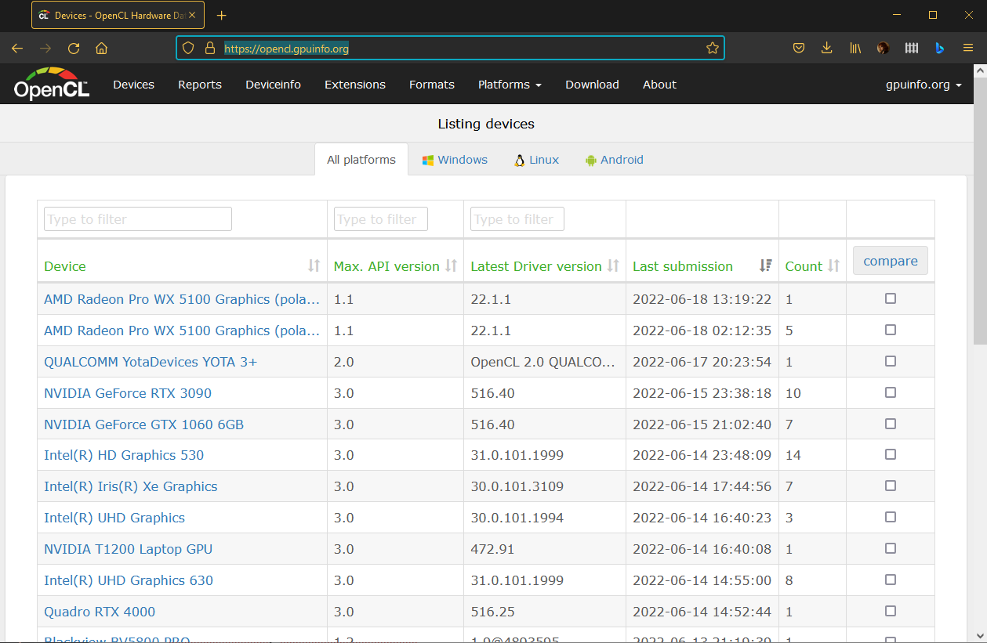
OPENCL ON GPUINFO
Popular database of GPU capabilities
Suports
OpenGL, Vulkan, OpenGL ES and now OpenCL!
Windows, Linux, Android
Invaluable if you wish to
check the capabilities of a device you don’t own
gauge portability when depending on a feature/extension
IN ACTUAL NEWS
https://opencl.gpuinfo.org/

Slide 36
SPIRV2CLC
Kévin Petit has done some awesome work by releasing a SPIR-V to OpenCL C transpiler
Calling it disassembling would be a mild overstatement
„If you squint really, you can see the SPIR-V”
IN ACTUAL NEWS

Slide 37
SPIRV2CLC
Kévin Petit has done some awesome work by releasing a SPIR-V to OpenCL C transpiler
Calling it disassembling would be a mild overstatement
„If you squint really, you can see the SPIR-V”
kernel void saxpy(float v20, float global* v21, float global* v22){
v23:;
float __attribute__((aligned(4))) v5_storage; float * v5 = &v5_storage;
float global* __attribute__((aligned(8))) v6_storage; float global* * v6 = &v6_storage;
float global* __attribute__((aligned(8))) v7_storage; float global* * v7 = &v7_storage;
uint __attribute__((aligned(4))) v8_storage; uint * v8 = &v8_storage;
*v5 = v20;
*v6 = v21;
*v7 = v22;
ulong v25 = get_global_id(0);
uint v26 = convert_uint(v25);
*v8 = v26;
float v27 = *v5;
float global* v28 = *v6;
uint v29 = *v8;
ulong v30 = convert_long(as_int(v29));
float global* v31 = &v28[v30];
float v32 = *v31;
float global* v33 = *v7;
uint v34 = *v8;
ulong v35 = convert_long(as_int(v34));
float global* v36 = &v33[v35];
float v37 = *v36;
float v38 = mad(v27, v32, v37);
float global* v39 = *v7;
uint v40 = *v8;
ulong v41 = convert_long(as_int(v40));
float global* v42 = &v39[v41];
*v42 = v38;
return;
}
IN ACTUAL NEWS
kernel void saxpy(
float a,
global float* x,
global float* y)
{
int gid = get_global_id(0);
y[gid] = a * x[gid] + y[gid];
}

Slide 38
STANDARD PORTABLE IR
It is the PTX of OpenCL
Was born out of necessity of vendors wanting to obfuscate proprietary kernel code
The API at some point needs device code as an unencrypted stream of ASCII char array (easy to hijack)
Also soves some vendor compiler non-conformance issues
SPIR turned out to be possibly the biggest mistake OpenCL has ever made
A mistake to be repeated by Microsoft with DXIL
SPIR-V saves the day („V” stands for Vulkan, not 5)
Vulkan needed an IR badly
New IR is adopted by both OpenCL and OpenGL
IN ACTUAL NEWS

Slide 39
STANDARD PORTABLE IR
It is the PTX of OpenCL
Aspect | SPIR 1.2 | SPIR 2.0 | SPIR-V 1.X
LLVM Interaction | Uses LLVM 3.2 | Uses LLVM 3.4 | 100% Khronos defined Round-trip lossless conversion
Compute Constructs | Metadata/Intrinsics | Metadata/Intrinsics | Native
Graphics Construct | No | No | Native
Supported Language Feature Supported | OpenCL C 1.2 | OpenCL C 1.2 OpenCL C 2.0 | OpenCL C 1.2 / 2.X C++ for OpenCL GLSL
OpenCL Ingestion | OpenCL 1.2 Extension | OpenCL 2.0 Extension | OpenCL 2.1/2.2 Core OpenCL 3.0 Extension
Graphics API Ingestion | - | - | Vulkan 1.X OpenGL 4.6 Core
IN ACTUAL NEWS
Source: https://www.khronos.org/spir/

Slide 40
STANDARD PORTABLE IR
It is the PTX of OpenCL
Aspect | SPIR 1.2 | SPIR 2.0 | SPIR-V 1.X
LLVM Interaction | Uses LLVM 3.2 | Uses LLVM 3.4 | 100% Khronos defined Round-trip lossless conversion
Compute Constructs | Metadata/Intrinsics | Metadata/Intrinsics | Native
Graphics Construct | No | No | Native
Supported Language Feature Supported | OpenCL C 1.2 | OpenCL C 1.2 OpenCL C 2.0 | OpenCL C 1.2 / 2.X C++ for OpenCL GLSL
OpenCL Ingestion | OpenCL 1.2 Extension | OpenCL 2.0 Extension | OpenCL 2.1/2.2 Core OpenCL 3.0 Extension
Graphics API Ingestion | - | - | Vulkan 1.X OpenGL 4.6 Core
IN ACTUAL NEWS
Source: https://www.khronos.org/spir/

Slide 41
STANDARD PORTABLE IR
SPIR-V FOR GRAPHICS
SPIR-V FOR COMPUTE
100% Khronos defined
Bi-directionally translatable to/from LLVM
Can represent any shading language
Rich, open-source tooling
Everything SPIR-V for graphics does and more
Unstructured control-flow
Pointer arithmetic
Optimizer looks very different
Both extensions can be transformed away
Lots of optimizer work
Done in Mesa
OpenCLOn12, clvk
IN ACTUAL NEWS

Slide 42
THE STATE OF SPIR-V
SPIR-V is a crucial, yet notoriously non-portable feature
It’s one of the reasons why Vulkan is such a huge success
Tooling around SPIR-V is thriving
Greatly improves portability of shaders and tooling
On desktop, AMD and Nvidia still don’t ship SPIR-V compilers for OpenCL
Even OpenCLOn12 supports it
cl_khr_il_program is the extension to look for
Can we teach runtimes that don’t support SPIR-V ingestion to somehow… compile them?
I thought you’d never ask
IN ACTUAL NEWS

Slide 43
SPIR-V FOR THE MASSES
Are you thinking what I’m thinking? Layers!
Nothing prevents a layer from calling into a different API function than the one being called.
IN ACTUAL NEWS
Application
ICD Loader
Driver 1
Function 1
Function 2
Driver 2
Layer 1
Layer 2
Function 1
Function 2
Function 2

Slide 44
SPIR-V FOR THE MASSES
Are you thinking what I’m thinking? Layers!
Nothing prevents a layer from calling into a different API function than the one being called.
IN ACTUAL NEWS
Application
ICD Loader
Driver 1
clCreateProgramWithIL
clCreateProgramWithSource
Driver 2
Layer 1
clCreateProgramWithIL

Slide 45
C++ FOR OPENCL
Language built on top of OpenCL C 3.0 unified and C++17 enabling most of regular C++ features in OpenCL kernel code.
List of restricted C++ features are the same as always
Virtual functions, dynamic_cast, refs to func, ptr to member func, RTTI, exceptions, thread_local, non-placement new/delete, STL
Upstream LLVM 14 with experimental support
Need to compile kernels offline
Load IL as binary and feed to clCreateProgramWithIL
cl_ext_cxx_for_opencl allows online compilation
IN ACTUAL NEWS
clang -cl-std=CLC++2021 kernel.clcpp
std::ifstream binary{ location, std::ios::binary };
cl::Program prog{ ctx, std::vector{ std::istreambuf_iterator<char>{ binary },
std::istreambuf_iterator<char>{} } };
prog.build({ device });

Slide 46
C++ FOR OPENCL
Language built on top of OpenCL C 3.0 unified and C++17 enabling most of regular C++ features in OpenCL kernel code.
List of restricted C++ features are the same as always
Virtual functions, dynamic_cast, refs to func, ptr to member func, RTTI, exceptions, thread_local, non-placement new/delete, STL
Upstream LLVM 14 with experimental support
Need to compile kernels offline
Load IL as binary and feed to clCreateProgramWithIL
cl_ext_cxx_for_opencl allows online compilation
IN ACTUAL NEWS
clang -cl-std=CLC++2021 kernel.clcpp
std::ifstream binary{ location, std::ios::binary };
cl::Program prog{ ctx, std::vector{ std::istreambuf_iterator<char>{ binary },
std::istreambuf_iterator<char>{} } };
prog.build({ device });

Slide 47
WE’RE HIRING
https://streamhpc.com/jobs/

