Slide 1
The GUARDYAN code: a full core realistic nuclear power plant simuation
Dr. Légrády Dávid
Budapest University of Technology and Economics
Institute of Nuclear Techniques
GPU Monte Carlo reactor dynamics code: GUARDYAN
Tomographic Image Reconstruction (PET, CT)
Notes:
Kutatási fázis
realisztikus rendszerek
célkitűzés
Teljes Szerkezet:
mit akarunk
ez mekkora truváj
GPU és minden hozadéka
+ technikák: Woodcock, adjungált fésülés, stb.
verifikáció és bencsmárkok
Eredmények: TR + Cd
Paks I

Slide 2
The Team
Budapest University of Technology and Economics (BME)
Team Members:
Former Team Members:
Dr. Dávid Légrády (associate professor, scientific coordinator, Monte Carlo variance reduction, reactorphysics)
Gábor Tolnai (physicist, algorithm and code development, testing,..)
Tamás Hajas (PhD Student, noise analysis of TH coupling)
József Kópházi (associate professor, reactorphysics, deterministic and MC transport methods )
Márton Pukler (MSc student, Monte Carlo variance reduction, sampling)
Gergely Ferenczy (MSc student, variance estimation)
Elod Pazman (MSc student, TH coupling, cross section homogenization)
Mark Margoczi (MSc student, TH coupling, noise propagation)
Boglarka Babcsany (applications, benchmark comparison)
Dr. Balázs Molnár (former PhD student, MC variance reduction)
Máté Halász (adjoint professor, stochastic processes)
Hajna Takács (MSc student, first code version)
Ábel Bartik (BSc student, tallying on GPU’s)

Slide 3
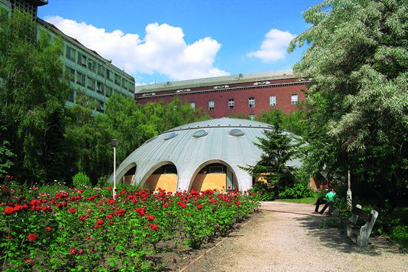
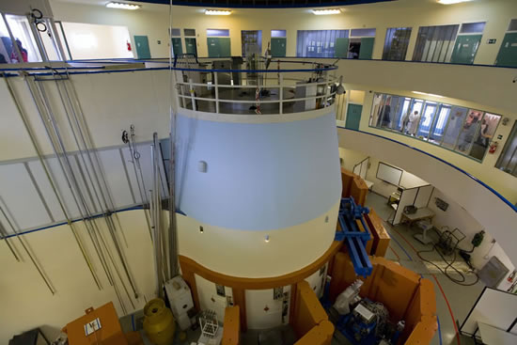
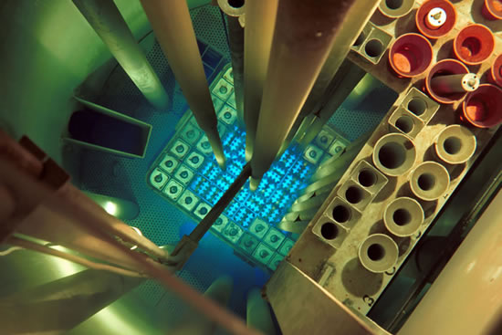
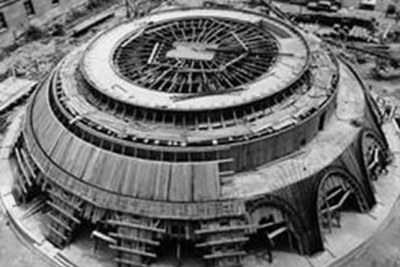
BME NTI
Budapest University of Technology and Economics (BME, since 1782), Hungary; Institute of Nuclear Techniques; www.reak.bme.hu
Nuclear education anda 100kW training reactor since 1971 – 50 year anniversary

Slide 4
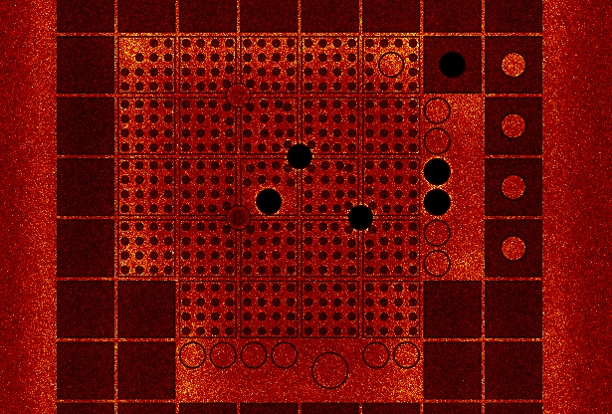
GUARDYAN Overview
GPU Assisted Reactor Dynamic Analysis, http://awing.reak.bme.hu/GUARDYAN
“Ultimate Fidelity” Monte Carlo nuclear reactor code for backing safety analysis
Similar Codes:
dynTRIPOLI – CEA, France (CPU)
dynSERPENT – VTT, Finnland (CPU)
Current competitive advantages:
GPU
Works on Power Plant scale (only us so far!)
Has been verified with Power Plant measurement data (only us so far!)
BME Training Reactor
(50th birthday)
Current competitive disadvantages:
4 NVIDA 1080 ( 5th birthday)
1 NVIDIA RTX 3090, A4000, A6000
Wigner GPU cluster (Tesla’s)
Waiting for Komndor HPC access

Slide 5
Neutron transport MC – GPU vs visual rendering
GUARDYAN - Overview
Visual Monte Carlo GPU Rendering
Neutron Transport Monte Carlo
Physics:
Independent particles (photons)
Free path along a straight line
Direction change at boundary crossing
Simple scatter law(s)
Rarely diffusion-type transport
A few material parameters
Physics:
Independent particles (neutrons)
Free path along a straight line
Free flight follows exponential pdf
Difficult scatter laws (approx. 70 types)
Always interaction within the material
Few Gbyites of nuclear data
Accuracy requirement:
Shold look realistic
Surfaces represented as triangles
Accuracy requirement:
10pcm (10x10⁻⁵) error is already unacceptable
2nd to 3rd order bounding surfaces
0.0015cm (15um) difference may cause 20% power drop
Hardware:
A few registers
Simple precision arithmetics
RTX
Hardware:
Large amount of registers needed
Double precision arithmetics
RTX?

Slide 6
A bit of reactorphysics in laymen’s terms
Maintaing a chain reaction:
Escape
Fission
Absorption
1 neutron to 1.001 neutron / generation, 1000 generations /second = 2.7 x power increase / second
0.001 = 100pcm (percent mille)
700pcm of the population is “delayed neutron precursor”, neutrons emerge later: reactor control
Time dependent system
Immense precision is needed
Notes:
Elég jó-e?
Szakmailag a konkurrenciához képest – erről beszélünk sokat
ahhoz, hogy iparilag alkalmazható legyen – ezért jöttünk, ennek eldöntéséhez hangzanak el részletek
akadémiai környezet vagy céges környezet tud jól szolgáltatni? Cégest finoman felvetni

Slide 7
conventional reactor physics solvers
Boltzmann Equatons: integrodifferntial equation with 6 independent phase space and 1 time dimension
Notes:
Elég jó-e?
Szakmailag a konkurrenciához képest – erről beszélünk sokat
ahhoz, hogy iparilag alkalmazható legyen – ezért jöttünk, ennek eldöntéséhez hangzanak el részletek
akadémiai környezet vagy céges környezet tud jól szolgáltatni? Cégest finoman felvetni

Slide 8
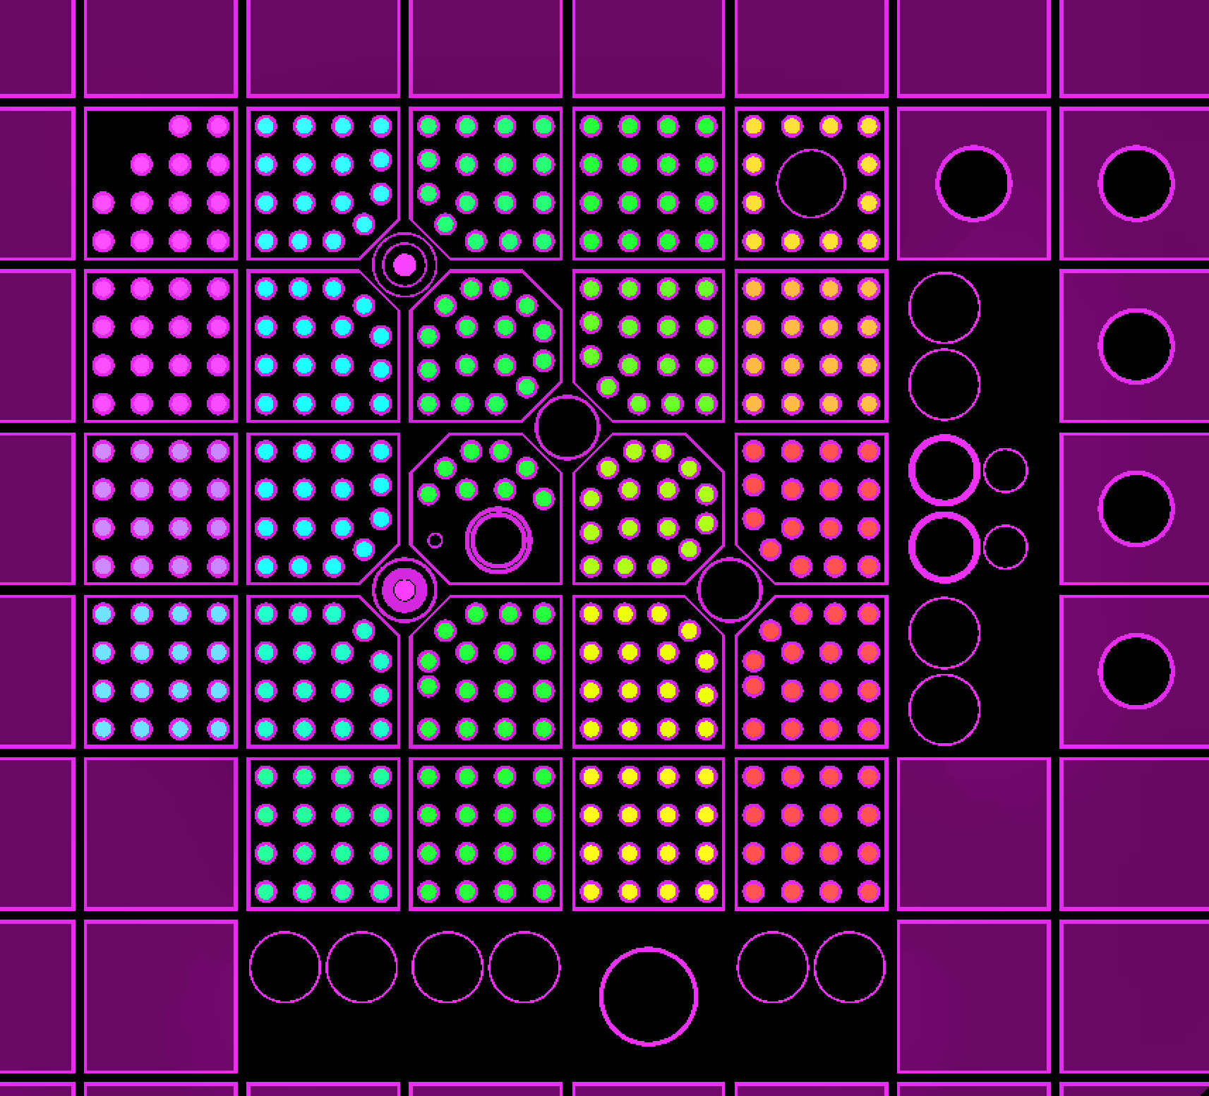
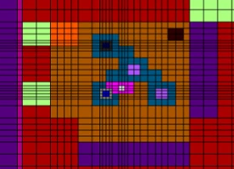
conventional reactor physics solvers
Solvers for time dependent reactor dynamics:
2 energy group diffusion (! Most used! ) – requires heavy data preprocessing by MC
Nodal finite differences /finite elements – requires heavy data preprocessing by MC
Modal finite differences /finite elements (rare)
Stepwise Static Monte Carlo
Dynamic Monte Carlo (new, past few years)
GPU use:
For MC mostly, rare
Notes:
Elég jó-e?
Szakmailag a konkurrenciához képest – erről beszélünk sokat
ahhoz, hogy iparilag alkalmazható legyen – ezért jöttünk, ennek eldöntéséhez hangzanak el részletek
akadémiai környezet vagy céges környezet tud jól szolgáltatni? Cégest finoman felvetni

Slide 9
Path Sampling
Σ varies with
Temperature
Density
Energy
Mean free path = 1/ Σ
GUARDYAN uses the Woodcock-method

Slide 10
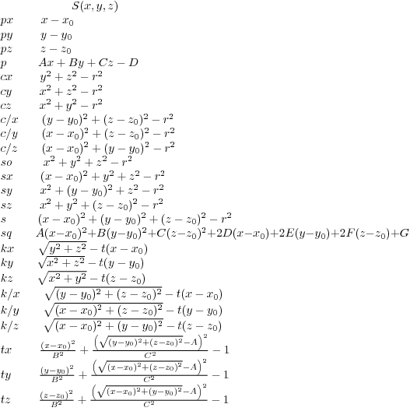
Constrictive Solid Geometry
Cells: Homogeneous material, defined by bounding surfaces and boolean operators
Surfaces: plane, cylinder, sphere, ...
Lattices: rectangular and hexagonal
Transformation: rotation matrices
Materials: by isotope composition
Universes
Input logic similar to MCNP, Serpent, OpenMC
<geometry>
<surface id="1" type="cz" transform="301" coeffs="40.000"/>
<surface id="2" type="c/z" coeffs="5.000 17.32 10.0"/>
<cell id="2" material="13" surfaces="1" universe="53"/>
<cell id="3" material="dead" surfaces="-2 -1" universe="58"/>
<cell id="4" surfaces="-1" fill="58" transform="4"/>
<transformation id="4" displacement="0.2 0.2 0.2"
rotation="300 210 -90 390 300 -90 90 90 0"/>
<transformation id="0" displacement="0 0 0"/>
<lattice id="58" type="hexx" dimension="9 9" pitch="0.1 0.1"
universes ="
58 58 58 58 58 58 58 58 58
58 58 58 58 53 53 53 53 58
58 58 58 53 53 53 53 53 58
58 58 53 53 53 53 53 53 58
58 53 53 53 53 53 53 53 58
58 53 53 53 53 53 53 58 58
58 53 53 53 53 53 58 58 58
58 53 53 53 53 58 58 58 58
58 58 58 58 58 58 58 58 58"
transform ="
0 0 0 0 0 0 0 0 0
0 0 0 0 4 4 0 0 0
0 0 0 4 4 0 0 0 0
0 0 4 4 0 0 0 4 0
0 4 4 0 0 0 4 4 0
0 4 0 0 0 4 4 0 0
0 0 0 0 4 4 0 0 0
0 0 0 4 4 0 0 0 0
0 0 0 0 0 0 0 0 0"
/>
</geometry>

Slide 11
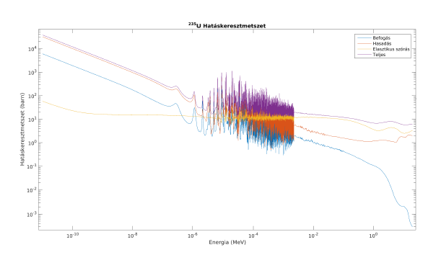
Path Sampling

Slide 12
GUARDYAN Population Control
Population in near critical systems
After the 1st generation 60% dies, off-springs of the 40% stays (no escape, ν=2.5)
After the 2nd generation 88% dies, 12% of original samples’s offsprings stay
After the 3rd generation 90% dies, 10% of original samples’s offsprings stay
…
100th generation: 95% dies, 5% of original samples’s offsprings stay
Analog calculation would result in
Few samples would produce large amount of samples: one GPU thread would launch huge amount calculations
Rest of the threads would be idle
Non-analog calculation devised:
Fission does not split trajectories, only weight change occurs
In time steps the population is “combed” to maintan equal number of parallel running threads
“Forced fission” to avoid large weight fluctuations

Slide 13
Combing
Analog combing
1
2
M-1
M
w₁
w₂
w₃
w₄
...
w_{N-2}
w_{N-1}
w_{N}
New weight: Σ (w_{i})/M
Non-analog combing
1
2
M-1
M
φ⁺₁ w₁
φ⁺₂ w₂
φ⁺₃ w₃
φ⁺₄ w₄
...
φ⁺_{N-2}w_{N-2}
φ⁺_{N-1}w_{N-1}
φ⁺_{N}w_{N}
New weight: Σ (w_{i})/M/φ⁺_{i}
Vissza

Slide 14
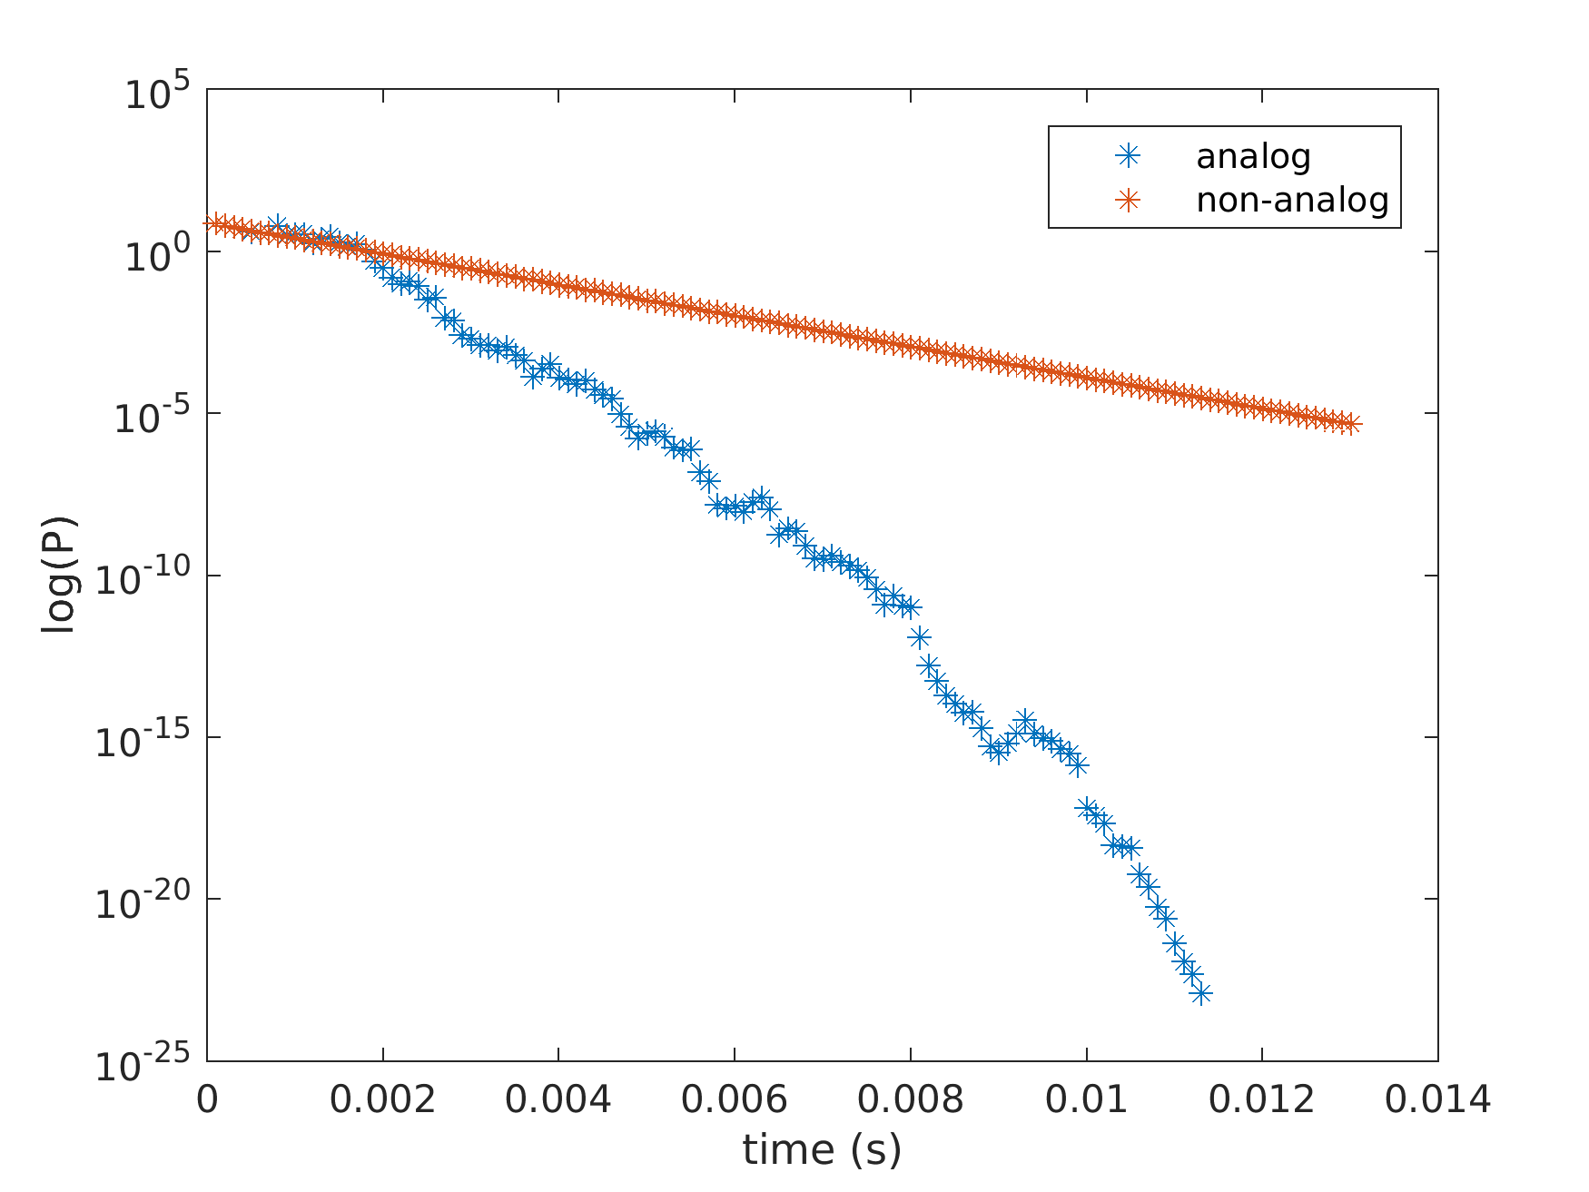
Analog population collapsing
Notes:
Hasadási statisztika

Slide 15
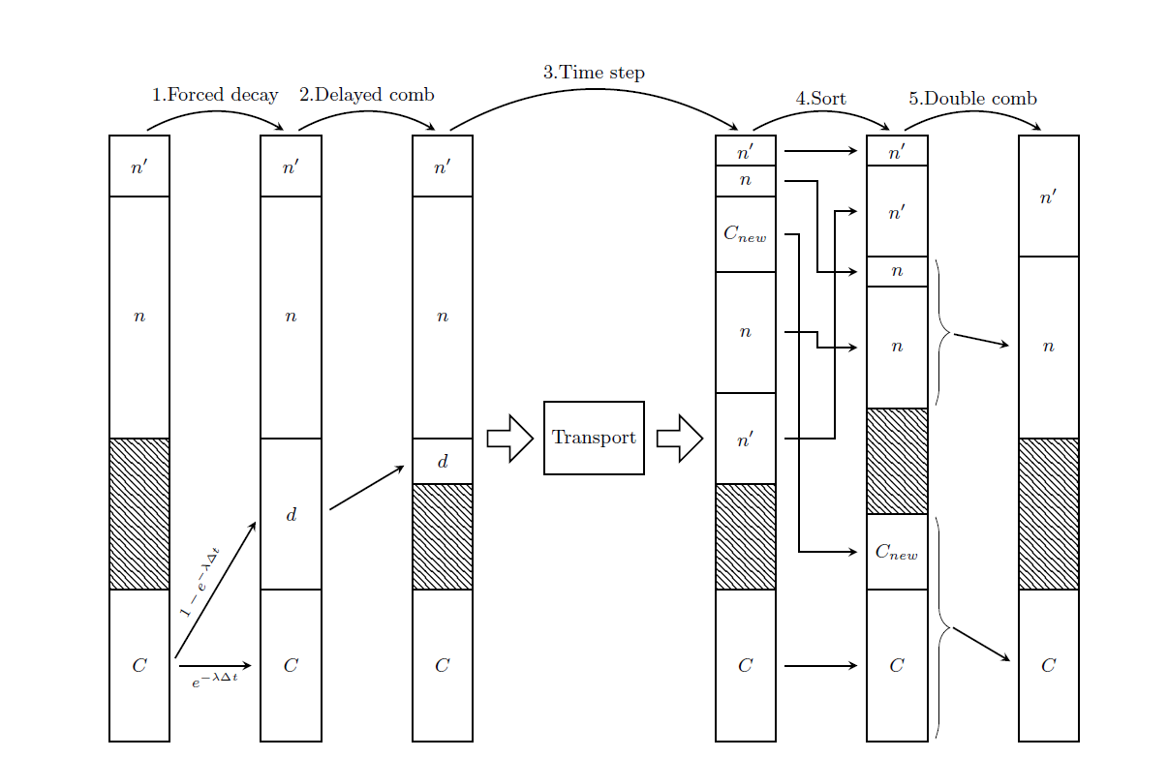
Population Control with delayed neutrons
Delayed neutrons hangling
largely differing time scales of prompt and delayed neutrons
in reality 10 000 x so many precursors as prompt neutrons
after 1000 generations the population becames 99.9% precursors, they maintatin the power
Complicated precursor handling: non-analog treatment is neaded
Notes:
Mit tud a GPU, ebből mi következik, ez mire ad lehetőséget
nem analóg mintavételezés, fontos!

Slide 16
Verification with Power Plant data
Paks Nuclear Power Plant Unit 4, Campaign 32, BOC
vodo-vodyanoi enyergeticheskiy reactor (Sowiet/ Russian type)
Water-cooled water moderated reactor
440/v213
Nominal power 440 MWe
Power uprating to 500 MWe
Rod Drop Experiment (RDE), routinely performed at each campaign start
Asymmetric rod gets stuck (the most important one)
Time dependent ex-core detector readings recorded
Before Wigner 8xA100: 4 weeks – 4 seconds, repeated ?4 times?
After Wigner 8xA100: 2 weeks, 12 seconds, 8 independent replica runs
-> Publication
Legrady, D. ; Tolnai, G. ; Hajas, T. ; Pazman, E. ; Parko, T. ; Pos, I.
Full Core Pin-Level VVER-440 Simulation of a Rod Drop Experiment with the GPU-Based Monte Carlo Code GUARDYAN
ENERGIES 15 : 8 Paper: 2712 , 17 p. (2022)

Slide 17
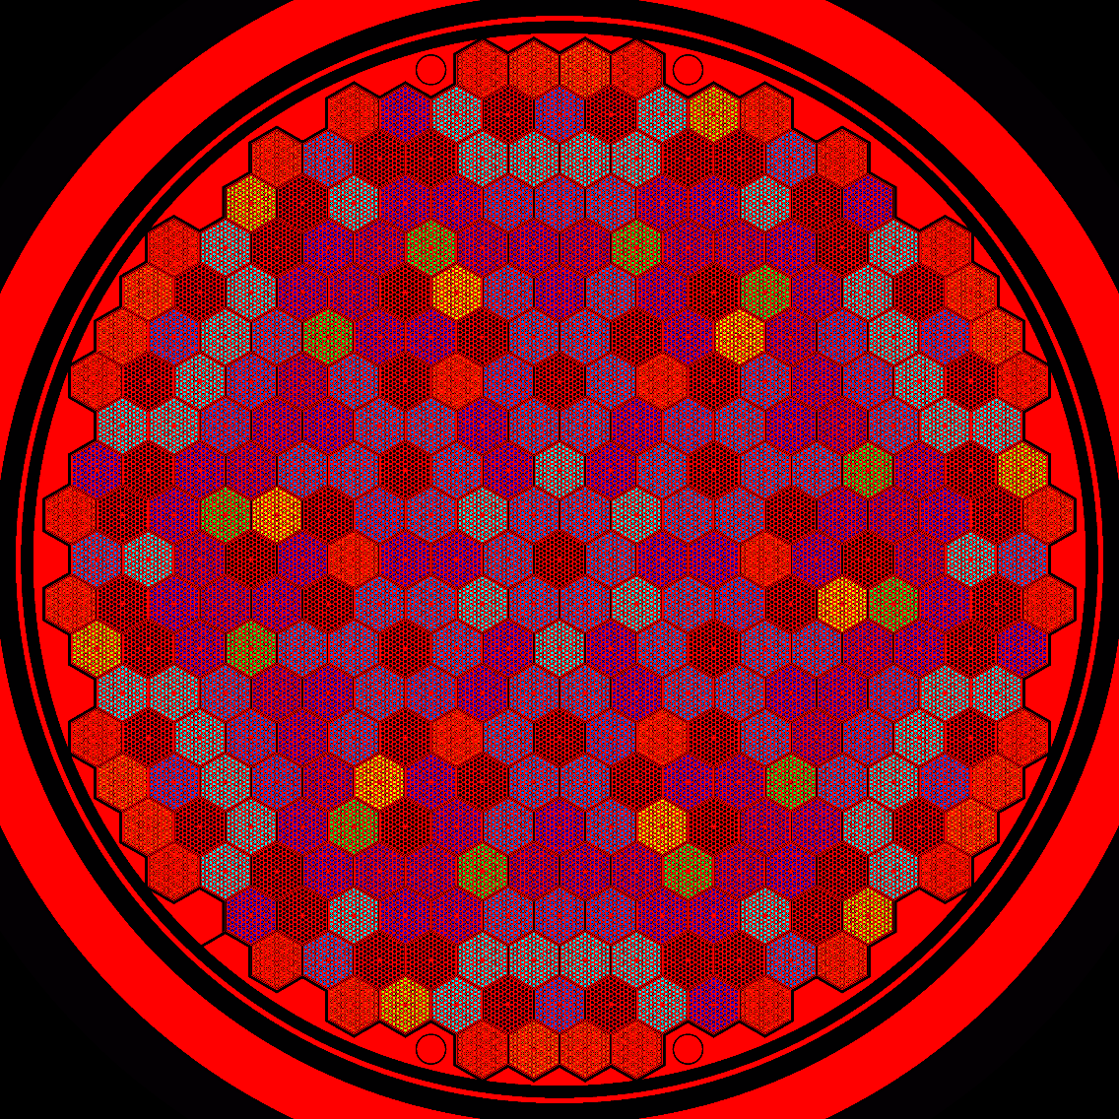
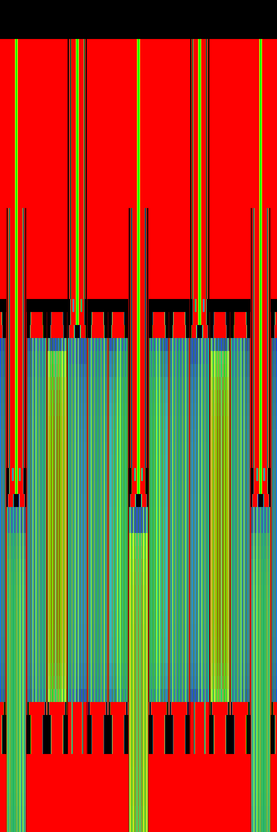
Verification with Power Plant data
193 surfaces
107869 cells
119 lattices
4516 universes
1657 materials
187 isotopes

Slide 18
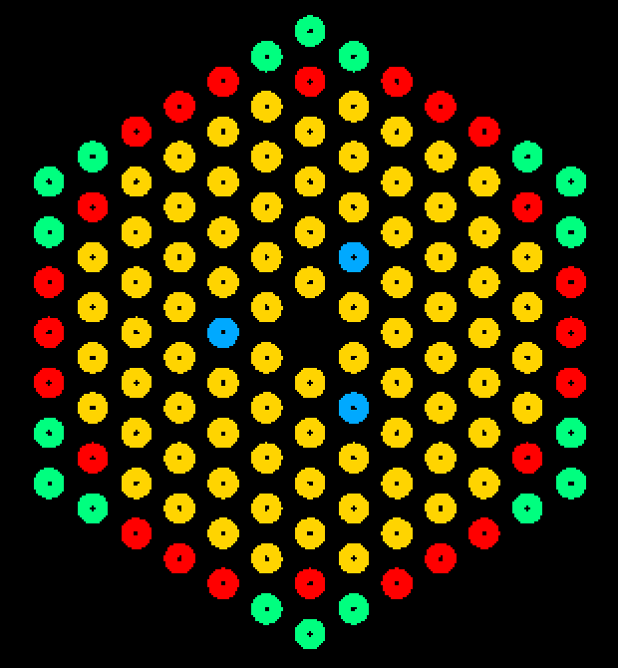
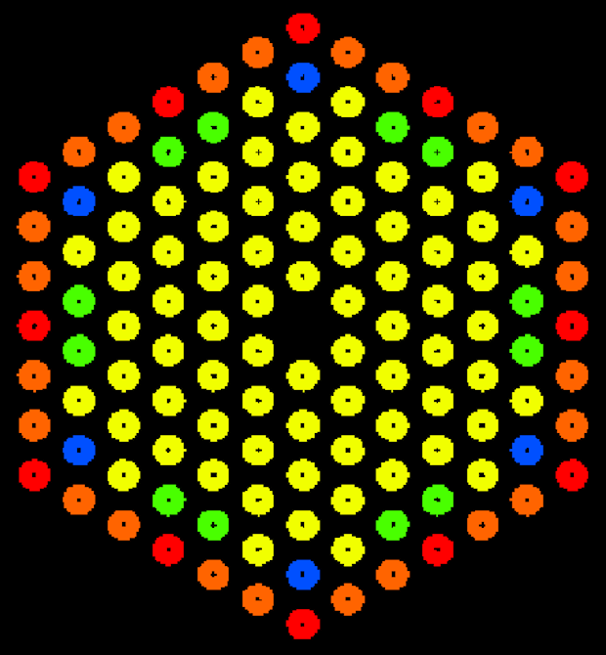
Verification with Power Plant data
Paks NPP, block 4, campaign 32, fully detailed caltulation

Slide 19


Verification with Power Plant data

Slide 20
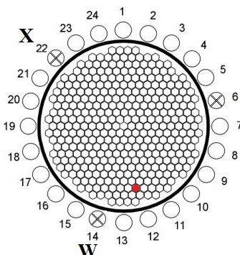
Verification with Power Plant data

Slide 21
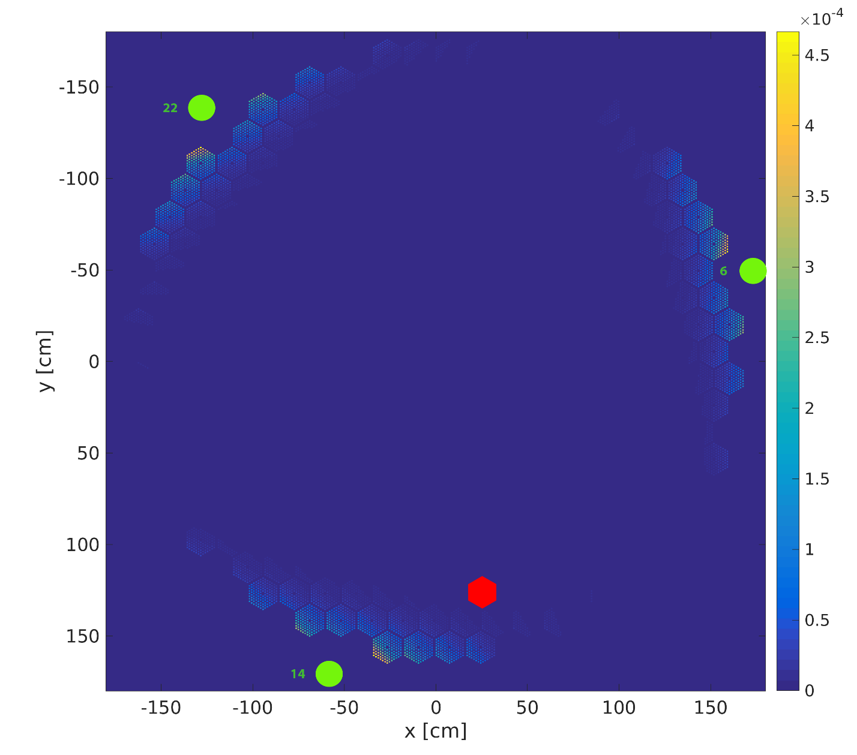

Slide 22


Slide 23
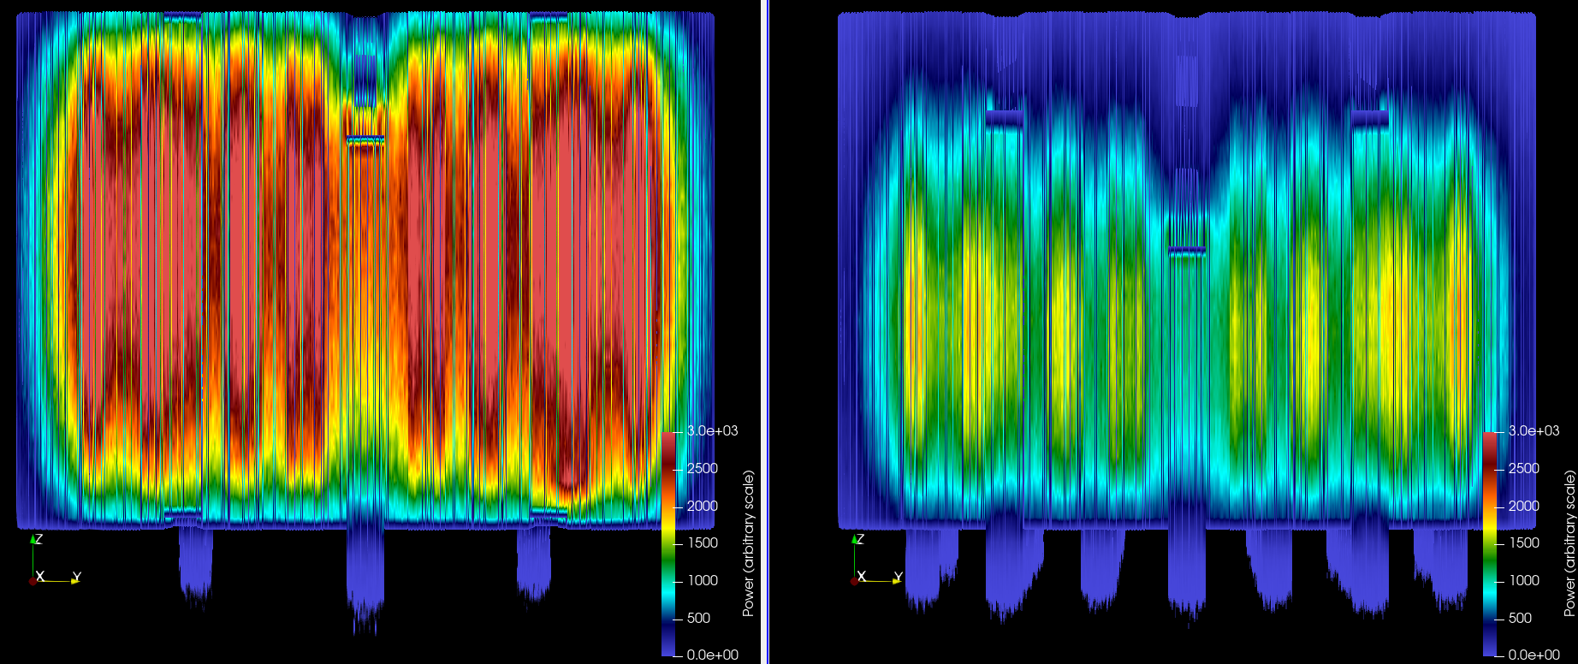
Verification with Power Plant data

Slide 24
Verification with Power Plant data
Videos come

Slide 25
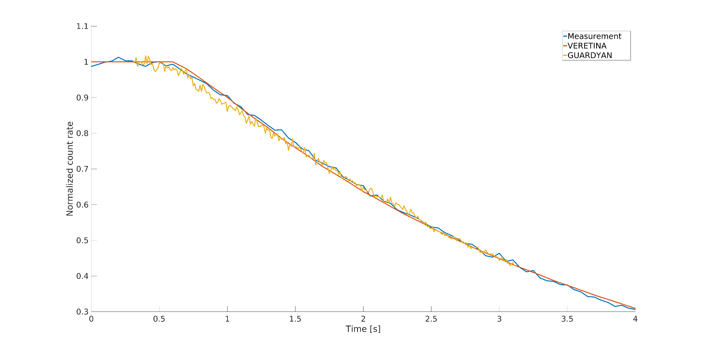
Verification with Power Plant data
BEFORE Wigner 8xA100

Slide 26
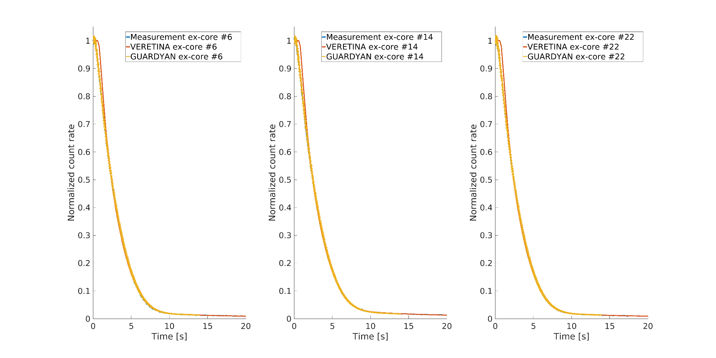
Verification with Power Plant data
AFTER Wigner 8xA100

Slide 27
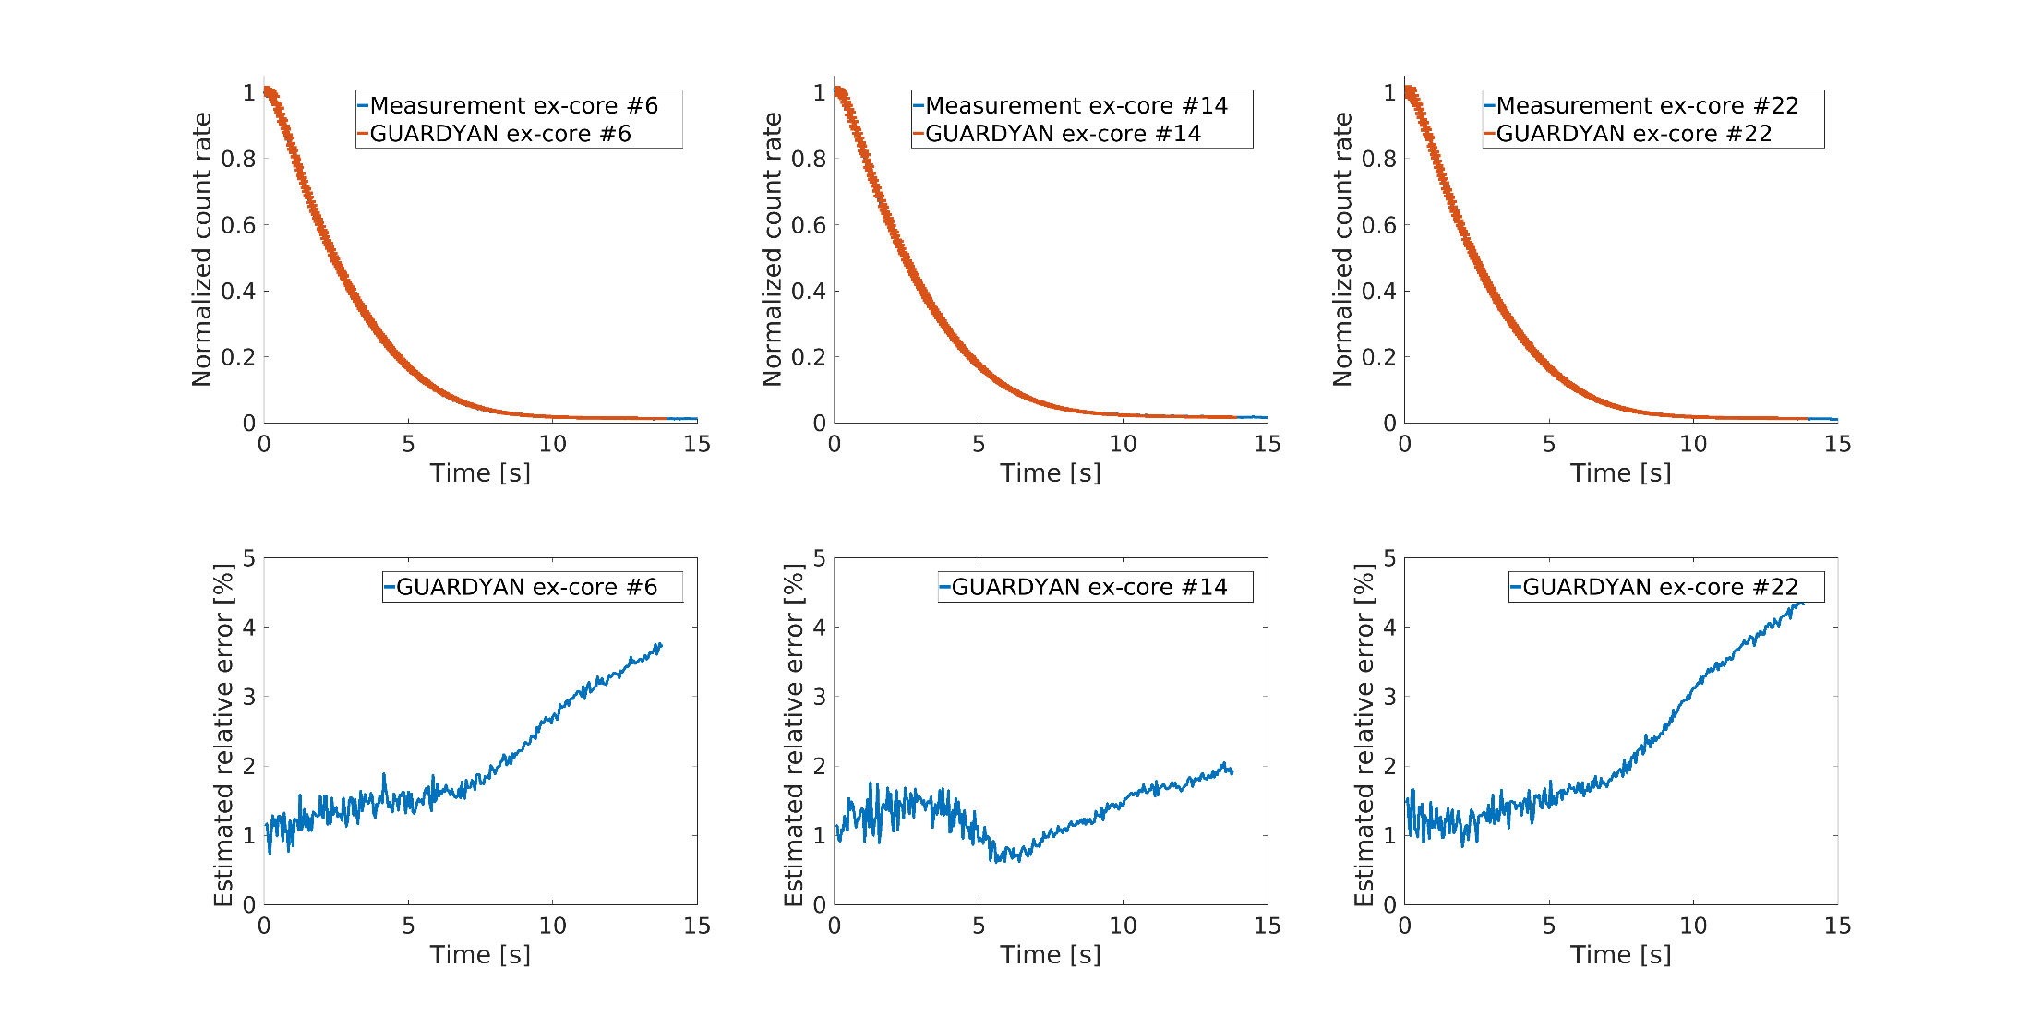
Verification with Power Plant data

Slide 28
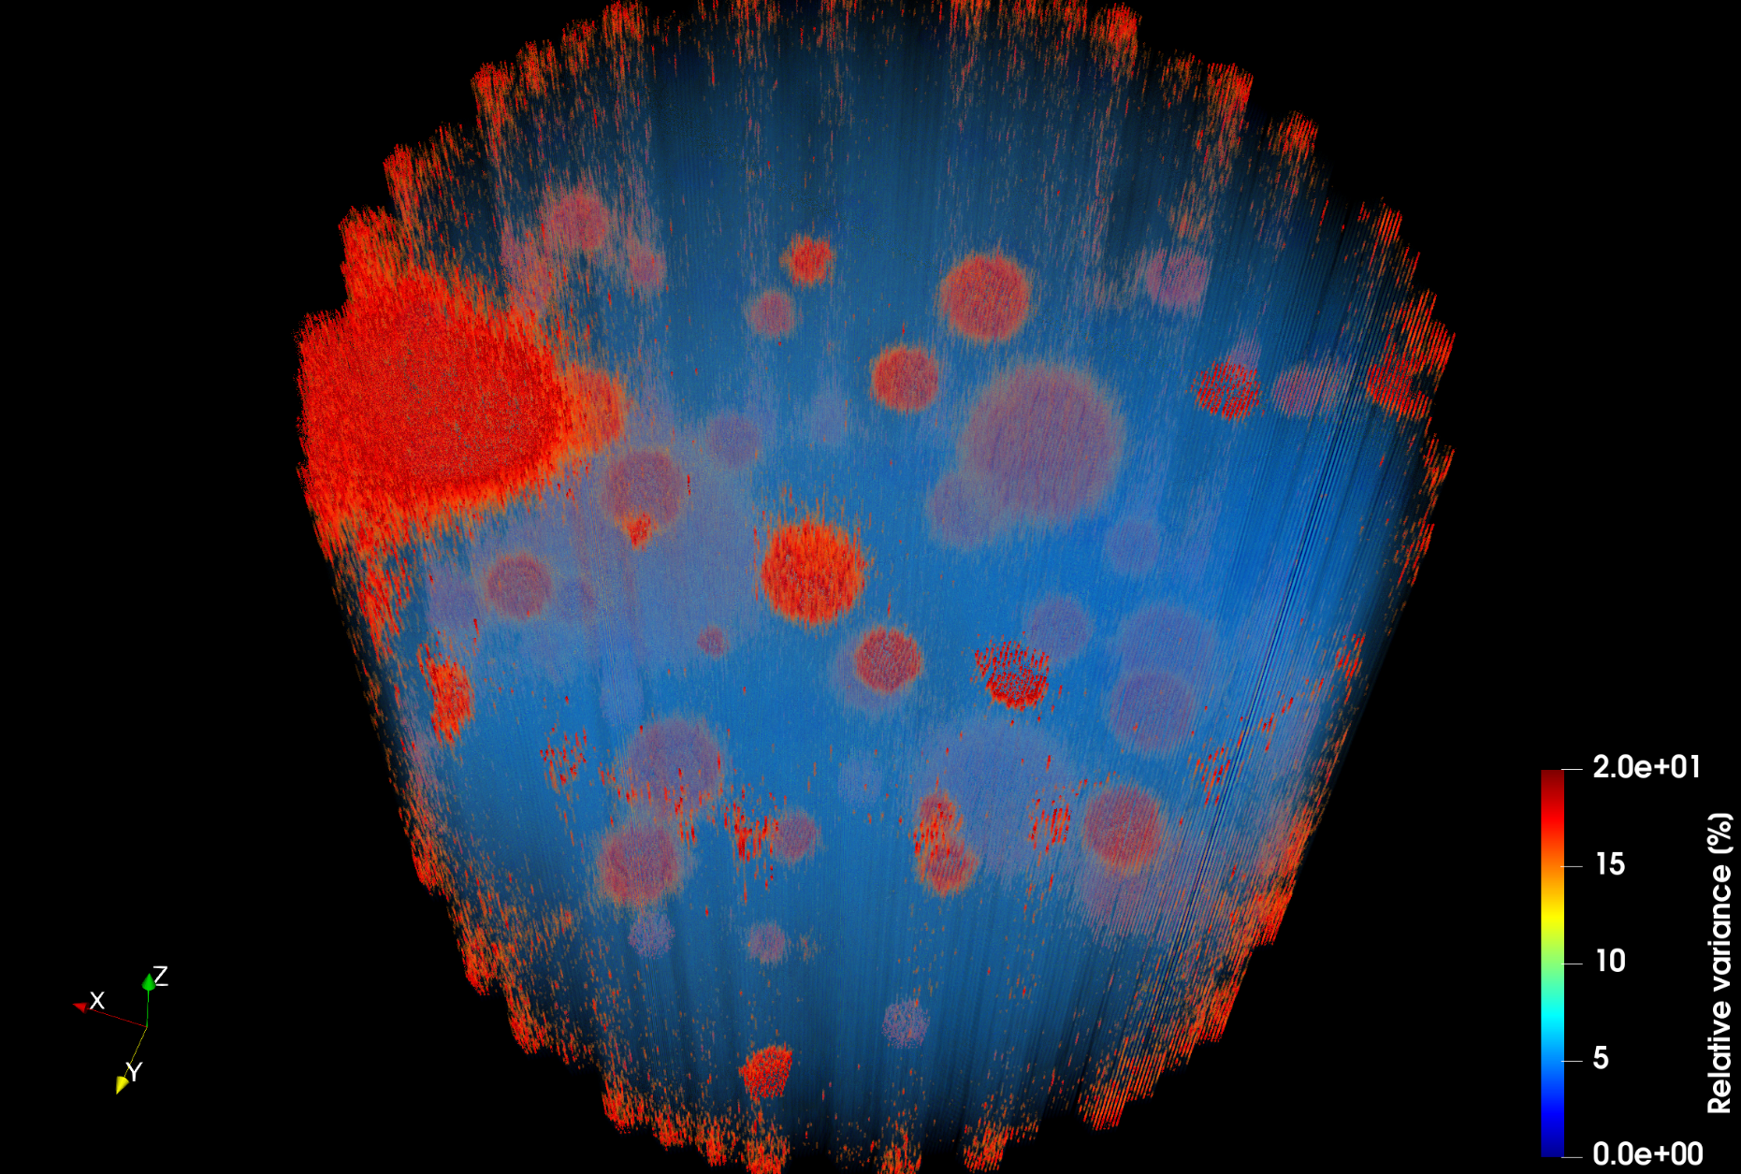
Variance distribution

Slide 29
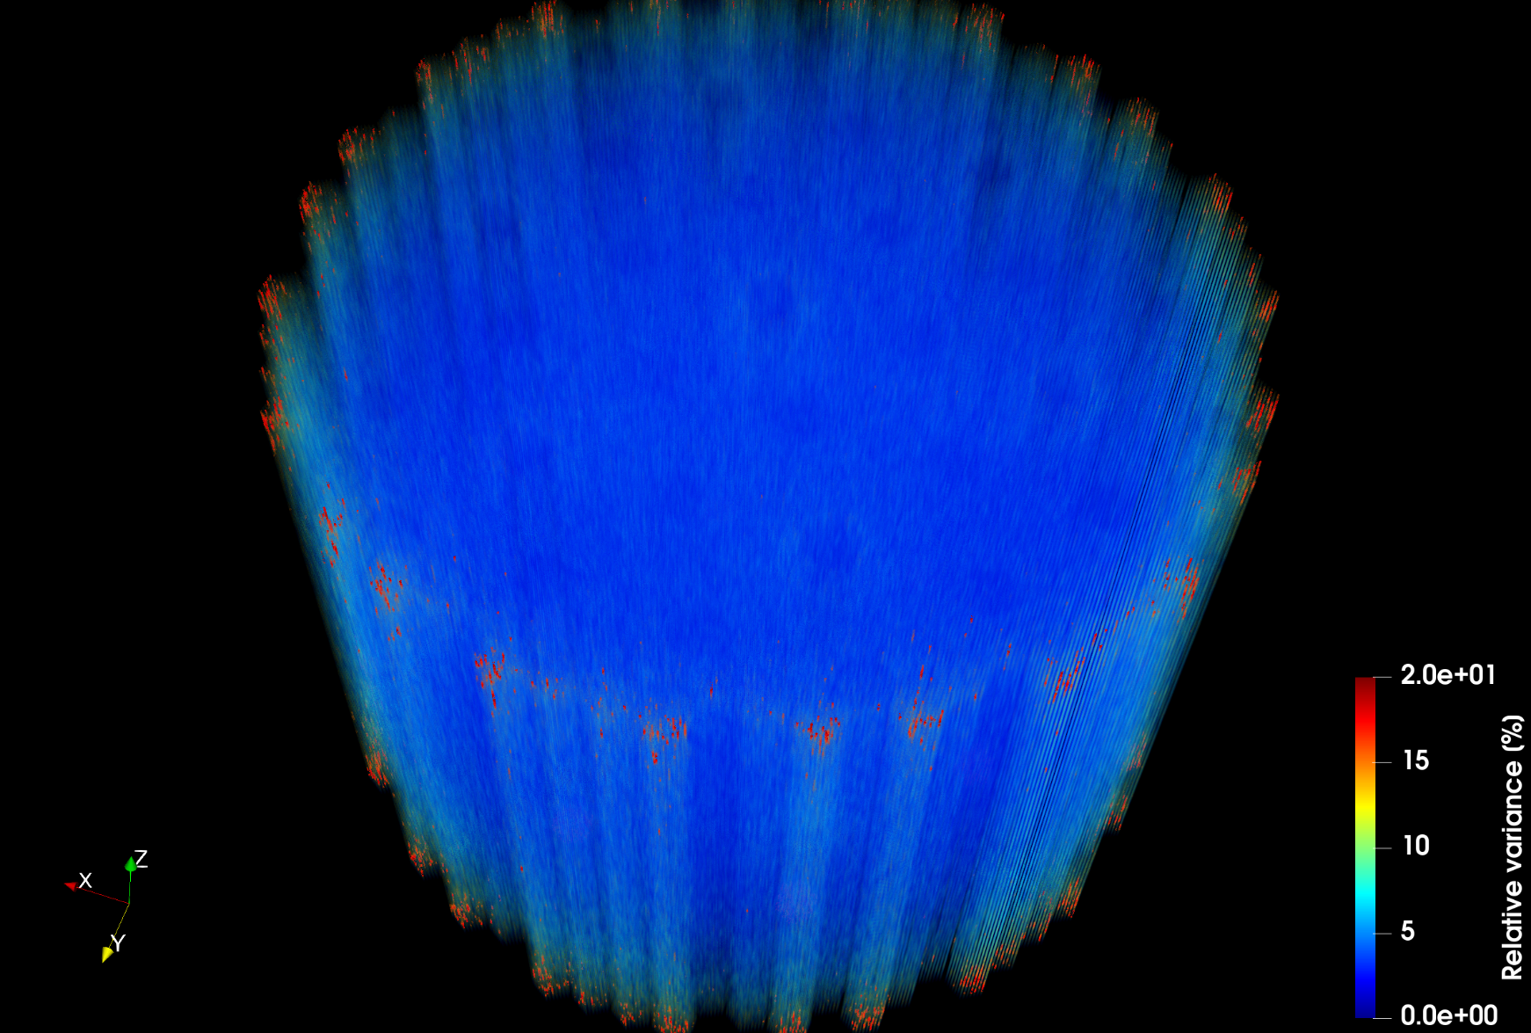
Variance distribution

Slide 30
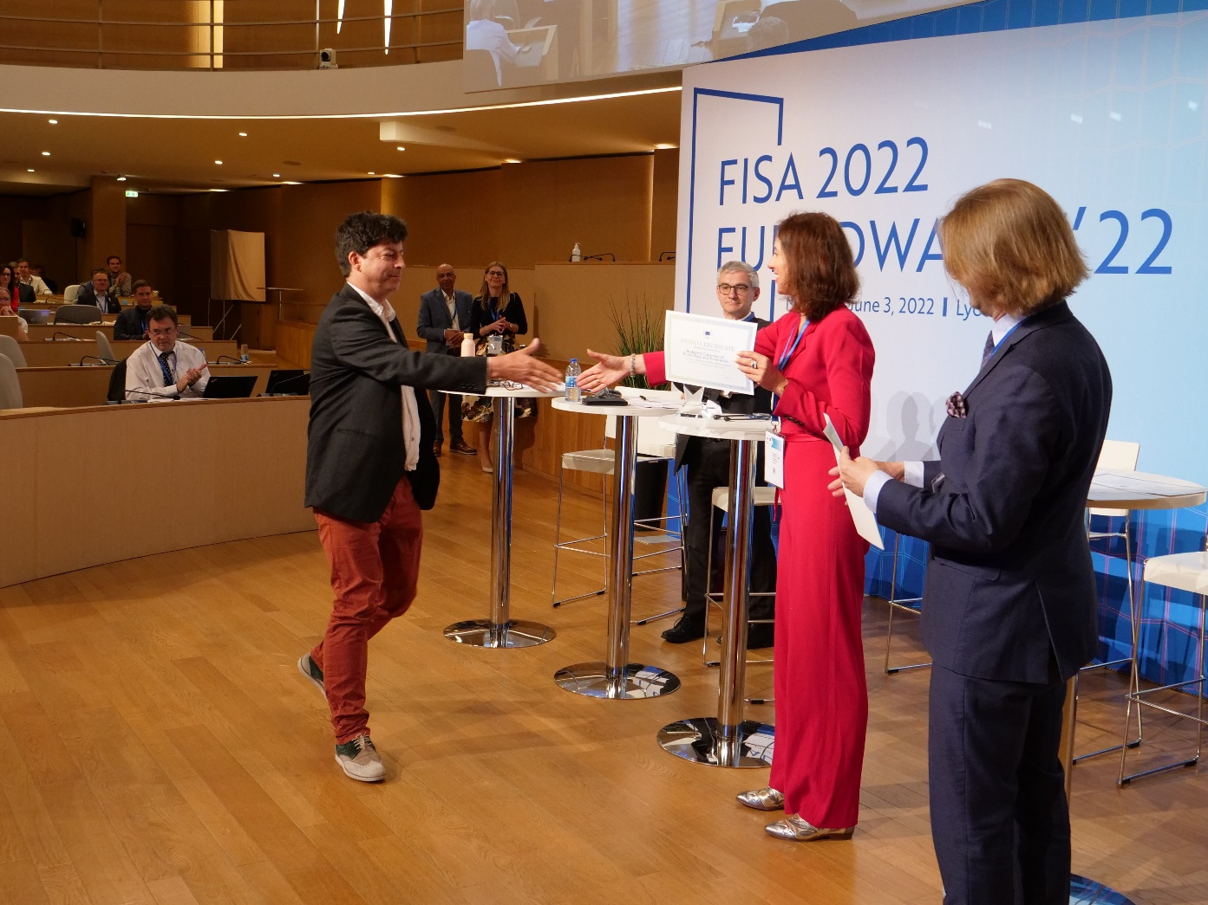
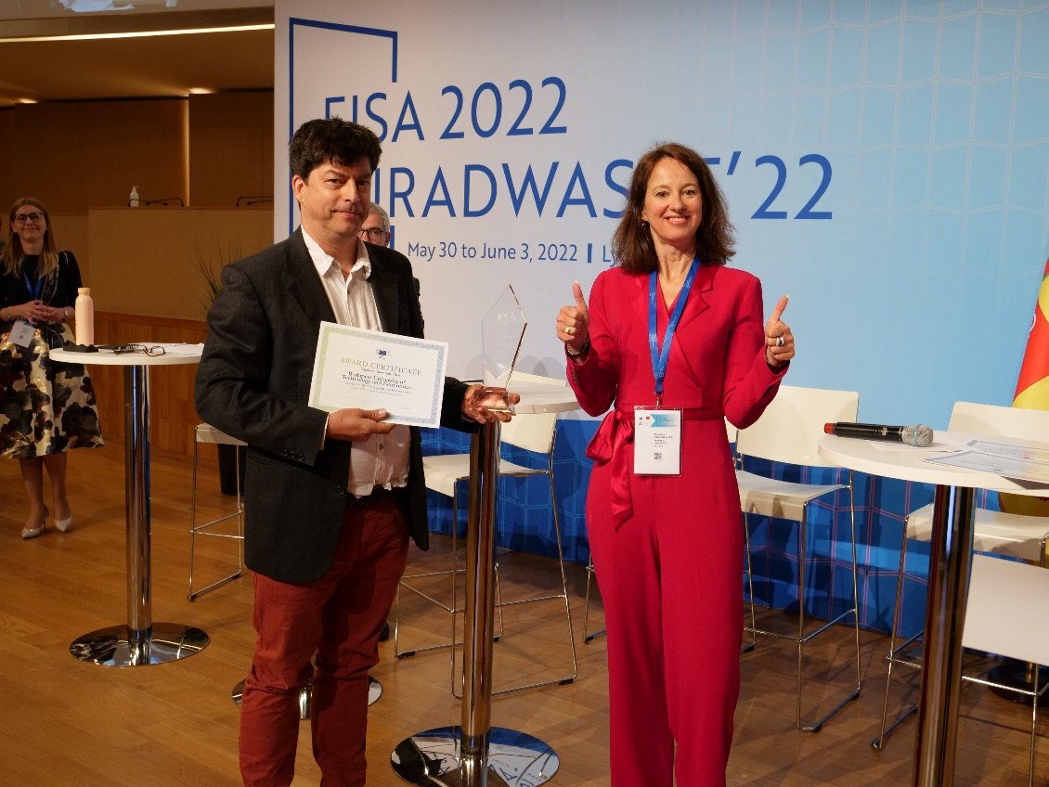
EURTOM Nuclear Innovation Prize

Slide 31
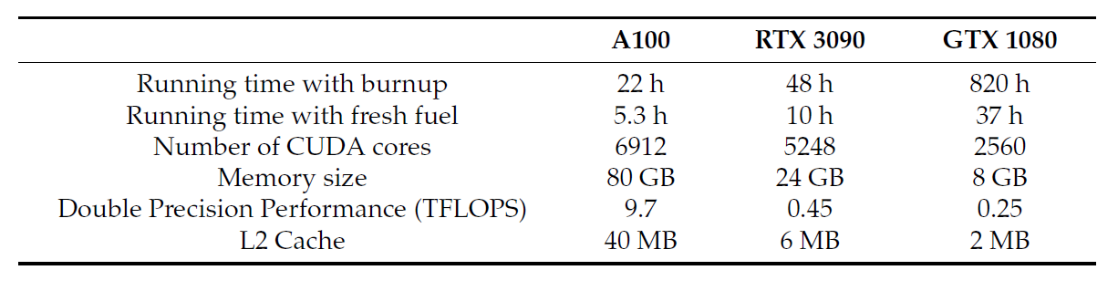
Variance distribution
Efficiency losses:
50% of thread use
Almost NONE of the extra double precision arithmetic capacity utilized

Slide 32
Thank you for listening!

