Slide 1
Parallel Implementation of Multivariate Empirical Mode Decomposition on GPU
June 2022
Zeyu Wang，Zoltan Juhasz
University of Pannonia
Veszprem, Hungary
Notes:
Parallel Implementation of Multivariate Empirical Mode Decomposition on GPU

Slide 2
Content outline
1. Background
1.1 Empirical Mode Decomposition
1.2 Features of EMD and its variants
1.3 Processing pipeline of MEMD
2. Parallel implementation of MEMD
2.1 Numerical steps
2.2 Implementation details
2.3 Data layout in memory
3. Performance analysis
3.1 Performance overview
3.2 Kernel performance comparison
4. Future works
Notes:
The content is grouped into 4 parts.

Slide 3
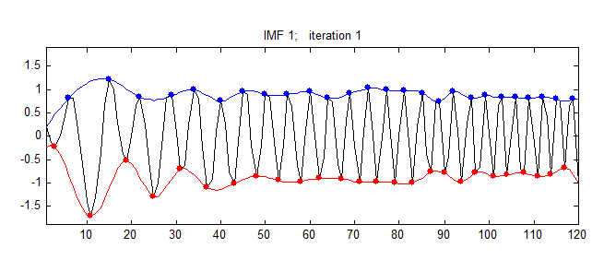
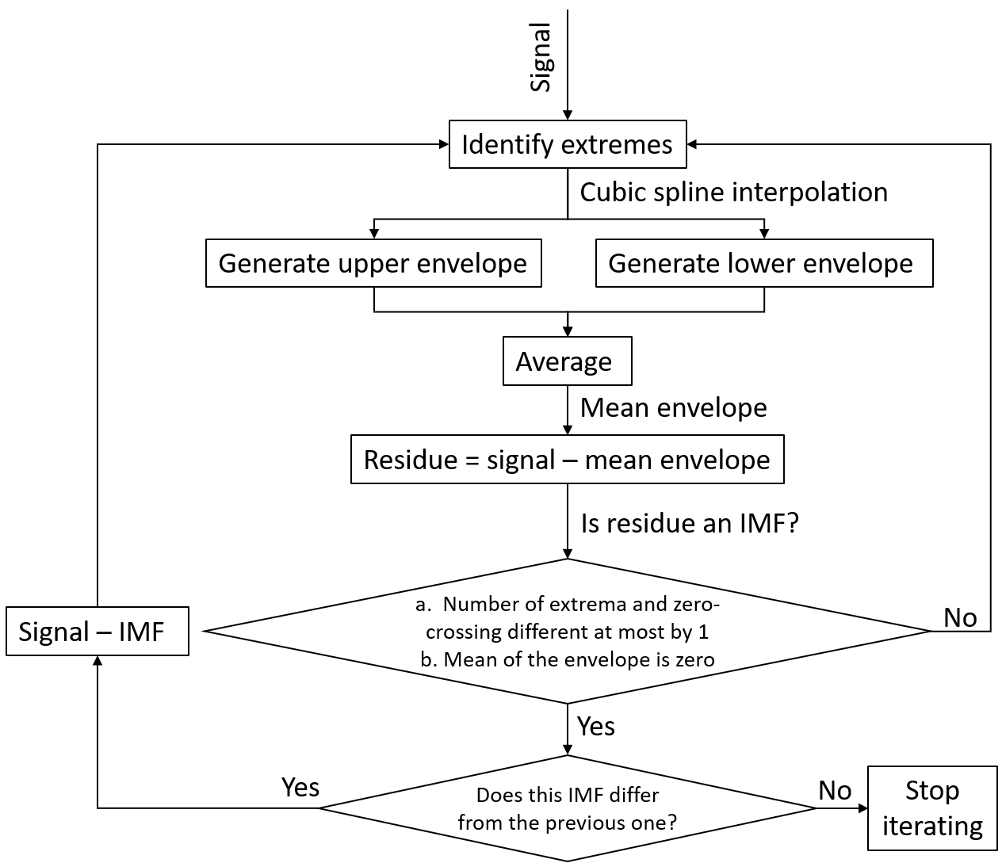
1.1 Empirical Mode Decomposition
EMD process
signal
IMF1
IMF2
Separation of different oscillation modes
EMD process flowchart
N. E. Huang et al., “The empirical mode decomposition and the Hilbert spectrum for nonlinear and non-stationary time series analysis,” Proc. R. Soc. A Math. Phys. Eng. Sci., vol. 454, no. 1971, pp. 903–995, 1998
Notes:
We need some mechanism to convert a non-stationary signal to a stationary signal
Separating mixed instantaneous frequencies into different components, The concept of IMF
BUT the intermittent noise will cause the mode mixing problem: in a certain IMF, it includes different oscillation modes.

Slide 4
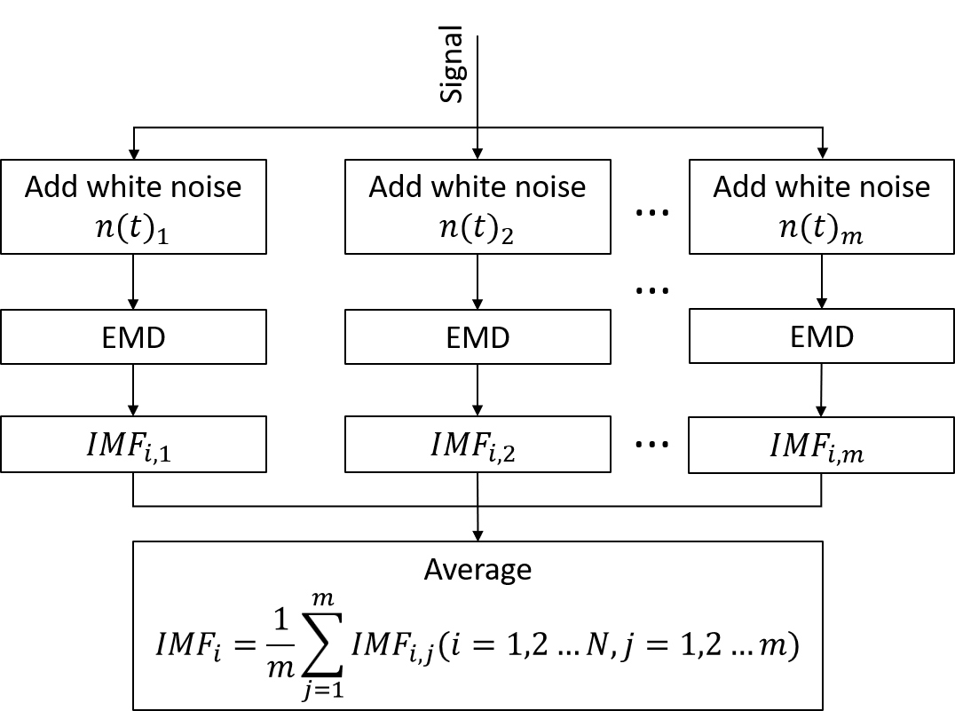
1.2 Features of EMD and its variants
signal
IMF1
IMF2
Handle of intermittent noise
$${IMF}_{1,1}$$
$${IMF}_{1,2}$$
……
$${IMF}_{1,m}$$
$${IMF}_{2,1}$$
$${IMF}_{2,2}$$
……
$${IMF}_{2,m}$$
…
……
$${IMF}_{n,1}$$
……
……
EEMD process
$${IMF}_{j,1}$$
IMFs alignment
$${IMF}_{k,m}$$
Notes:
By adding noise, we can submerge the intermittent noise
IMFs alignment problem (multichannel)

Slide 5
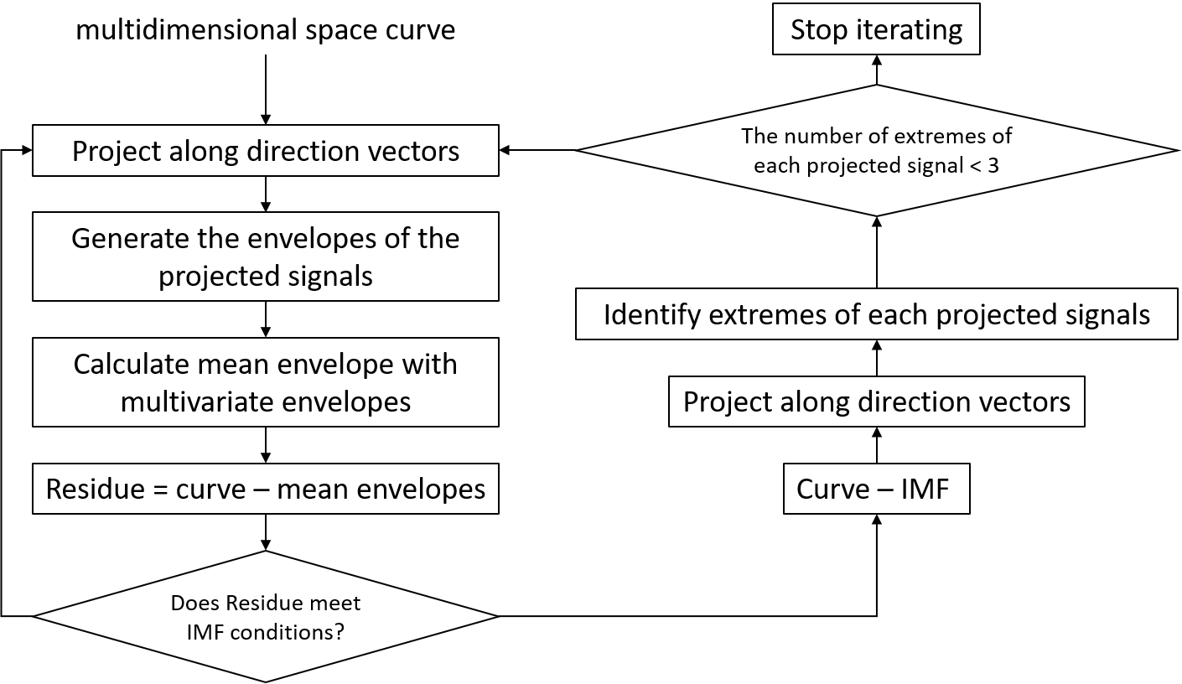
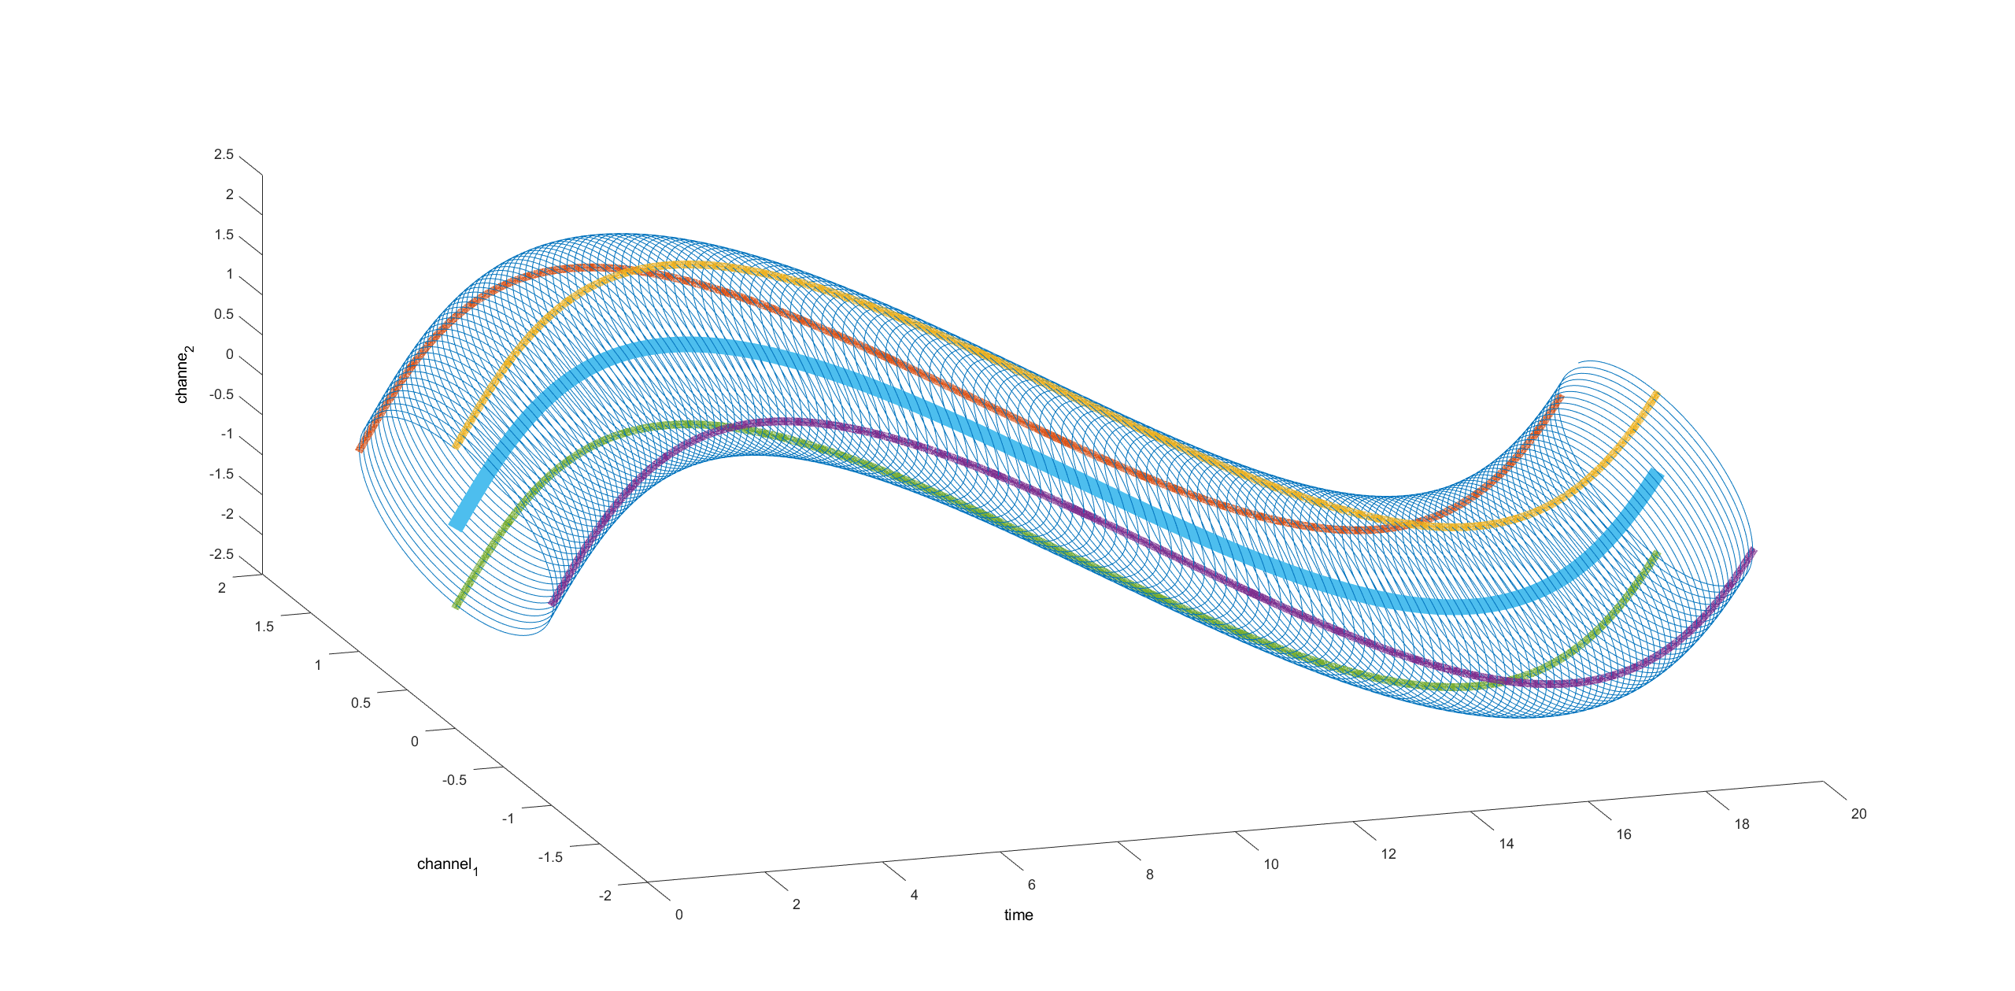
1.3 Processing pipeline of MEMD
Multivariate envelope
Direction vector
Envelopes of projected signals and the multivariate envelope
MEMD process flowchart
Notes:
The advantages and necessity of MEMD should be emphasized here.
EEG is multichannel signal in general
NA-MEMD

Slide 6
2.1 Numerical steps of MEMD
1. Use the data matrix to dot product the direct vector:
2. Detect the extreme points on the projection signal
channels
projection
Maxima
Minima
direction vector_1
p1
p2
p3
p4
p5
p6
p7
p8
p1
p2
p3
p4
p5
p6
p7
p8
p1
p2
p3
p4
p5
p6
p7
p8
d1
d2
d3
$$∙$$
=
time
time

Slide 7
2.1 Numerical steps of MEMD
3. Find the corresponding multivariate extrema
4. Interpolate on the dimensions of multivariate extrema
Maxima
Minima
p1
p2
p3
p4
p5
p6
p7
p8
p1
p2
p3
p4
p5
p6
p7
p8
(Here we need to perform six interpolation operations)

Slide 8
2.1 Numerical steps of MEMD
5. Calculate multivariate mean envelope
Upper envelope
Lower envelop
Mean envelope from direction vector_1
( )
=
6. Calculates the mean envelope from the mean envelopes of all direction vectors.
+
/2

Slide 9
2.2 Implementation details
Use CUDA shuffle operation to detect extrema
overlap
overlap
……
Signal
0 | 1 | 2 | … | … | 29 | 30 | 31 | 32 | … | … | 59 | 60 | 61 | 62 | … | … | 89 | 90 | 91
0 | 1 | 2 | … | … | 29 | 30 | 31
warp 1
30 | 31 | 32 | … | … | 59 | 60 | 61
warp 2
60 | 61 | 62 | … | … | 89 | 90 | 91
warp 3
Notes:
Warp level overlap
One warp include 32 threads
Not strategies, use the implementation details,
Introduce the extrema detection method, read form the global memory and compare, no
Use the shared memory, but it’s only for the block level, we need to use the block level overlap
The shuffle provide a function for the threads in same warp to communicate with neighborhood

Slide 10
2.2 Implementation details
Use prefix sum to get compact extrema vector
Threads
Signal
$$s_{0}$$ | $$s_{1}$$ | $$s_{2}$$ | $$s_{3}$$ | $$s_{4}$$ | $$s_{5}$$ | $$s_{6}$$ | $$s_{7}$$ | $$s_{8}$$ | $$s_{9}$$ | $$s_{10}$$ | $$s_{11}$$
Extrema flag
1 | 0 | 0 | 1 | 0 | 1 | 0 | 1 | 0 | 0 | 1 | 1
Prefix sum
Prefix sum vector
0 | 1 | 1 | 1 | 2 | 2 | 3 | 3 | 4 | 4 | 4 | 5
Compact extrema vector
$$s_{0}$$ | $$s_{3}$$ | $$s_{5}$$ | $$s_{7}$$ | $$s_{10}$$ | $$s_{11}$$
0 1 2 3 4 5
Notes:
The prefix sum to get compact extrema vector
Compact extrema

Slide 11
2.2 Implementation details
Multi tridiagonal systems solver in interpolation
·
$$y_{3}$$
$$f_{2}$$
·
$$f_{3}$$
$$y_{2}$$
·
$$x_{3}$$
$$y_{3}$$ | $$y_{7}$$ | $$y_{11}$$
$$y_{2}$$ | $$y_{6}$$ | $$y_{10}$$
$$y_{1}$$ | $$y_{5}$$ | $$y_{9}$$
$$y_{0}$$ | $$y_{4}$$ | $$y_{8}$$
CH1:
$$y_{1}$$
·
$$f_{1}$$
$$y_{0}$$
$$x_{1}$$
$$x_{2}$$
$$x_{3}$$
$$x_{2}$$
$$y_{7}$$
$$x_{0}$$
·
·
$$y_{6}$$
·
$$y_{5}$$
$$f_{5}$$
CH2:
$$f_{6}$$
Coefficient matrix
$$x_{1}$$
·
$$f_{4}$$
$$y_{4}$$
$$x_{0}$$
$$x_{1}$$
$$x_{2}$$
$$x_{3}$$
·
$$y_{11}$$
Right hand matrix
$$x_{0}$$
$$y_{10}$$
·
$$f_{8}$$
CH3:
·
$$f_{9}$$
$$y_{9}$$
·
CH1
CH2
CH3
$$y_{8}$$
$$f_{7}$$
$$x_{0}$$
$$x_{1}$$
$$x_{2}$$
$$x_{3}$$
CH1
CH2
CH3
Notes:
Introduce the cubic spline interpolation first, in order to get the interpolated signal, we need so solve some tridiagonal matrix problem,
Thomas algorithm, CR and PCR algorithm, the CUsparse library provide a function to solve the multi right hand tridiagonal matrix.
In the multivariate extrema, they share the same index, but different extrema value.
The coefficient matrix A depends only on the position of the extreme points

Slide 12
2.3 Data layout in memory
To store raw signal and multivariate IMF
To store direction vectors
To store projected signals
To store IMFs result
Time
Direction vectors
Time
Time
Direction vectors
IMFs
Channels
Channels
Channels
Channels
X2
Notes:
X2 for upper and lover envelopes on different direction vectors
Introduce the direction vector loop based on the projected signals memory.

Slide 13
3.1 Performance overview
Dataset: EEGLAB sample dataset
Number of channels: 4
Number of direction vectors: 64
Length of signal: 30504
Number of IMFs: 8
Number of iteration: 10
Execution time (milliseconds)
Compared to CPU,
Titan achieved 190X
RTX3070 achieved 55X
speedup
Notes:
No time detail,
Form millisecond to second
Logspace

Slide 14
3.2 Kernel performance compared to literature
Number of channels: 16
Number of direction vectors: 64
Length of signal: 1001
Number of IMFs: 8
Number of iteration: 10
 |  | Execution time (μs)
Kernels | Number of calls | Literature [1] | Our version | Speedup
HammersleySeqGen | 1 | 11 | 3.42 | 3x
DirectionVecGen | 1 | 148 | 64.64 | 2x
Projections | 7 | 802 | 10.21 | 79x
PeaksDetection | 70 | 1232 | 6.61 | 187x
BoundaryCondSet | 140 | 3961 | 84.73 | 47x
EnvelopeMean | 140 | 152 | 28.34 | 5x
[1] Mujahid, T., Rahman, A. U., & Khan, M. M. (2017). GPU-Accelerated Multivariate Empirical Mode Decomposition for Massive Neural Data Processing. IEEE Access, 5, 8691–8701.
Notes:
Use the
Combine the 14 page and the 15 page into one page

Slide 15
4 Future works
There are still limitations in our performance tests, and in the future, we will test more datasets including 128-channel EEG signals under different execution parameters.
The effects of some detailed parameter settings on the decomposition results still need to be further studied, such as the settings of extrema and tridiagonal matrix boundary conditions, and the setting of sifting stop criterion.
Some numerical validations are currently ongoing, and the stream mechanism will be introduced into MEDM computations to further improve the parallelization and performance.
Notes:
Stream improvement
Testing in different configuration
For 128 channels
For parameter setting

