Slide 1
Implementation strategies for Multi-GPU PIC/MCC plasma simulation on pre-exascale systems
Zoltan Juhasz¹, Zoltan Donko² and Peter Hartmann²
¹Dept. of Electrical Engineering and Information Systems, University of Pannonia, Veszprem, Hungary
²Dept. of Complex Fluids, Institute for Solid State Physics and Optics, Wigner Research Centre for Physics, Budapest, Hungary

Slide 2
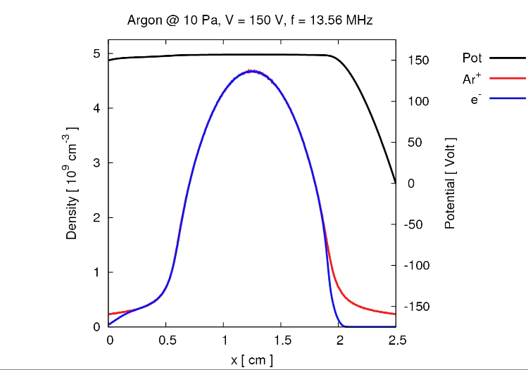
Plasma simulation
Understanding capacitively coupled radiofrequency discharges in plasma
Spatiotemporal changes in electric field
Non-equilibrium transport of particles
Numerical simulation helps to understand the behaviour of particles
Uses kinetic theory for describing particle movement
1D and 2D geometries

Slide 3
Approach: Particle-in-Cell (PIC) simulation
N-body problem
no direct particle interaction, particles interact with the field
place particle charges to grid
solve grid for field – Poisson equation
move particles based on field forces
Particle count: from 100k to 10m particles
Complication: collision!
CPU execution is long: ranging from days to months
parallel solutions: OpenMP and/or MPI code
irregular memory accesses make code difficult to parallelise efficiently

Slide 4
Baseline: single-GPU implementation (1D geometry)
Loop for simulation cycles (1000-3000)
Loop for input samples (800)
1. move electrons -- e_move kernel
2. check boundaries -- e_boundary kernel
3. electron collision -- e_collisions kernel
4. electron density calculation -- e_density kernel
5. move ions -- ion_move kernel
6. check boundaries -- ion_boundary kernel
7. ion collision -- ion_collisions kernel
8. ion density calculation -- ion_density kernel
9. Poisson solver -- CPU seq. solver (Thomas algorithm)
Problems:
too many small kernels with low op. intensity,
memory bound kernels,
kernel launch overhead,
CPU Poisson solver, host-device data transfer

Slide 5
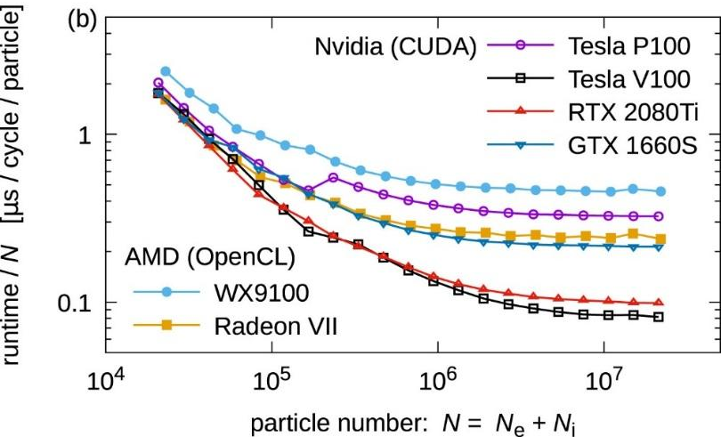
GPU PIC/MCC behaviour
Multi-GPU advantage:
introduce further speedup for a system of given size (strong scaling)
increase particle count without increasing execution time (weak scaling)
Speedup
per-particle execution time

Slide 6
Typical GPU systems (desktops, small clusters)
1 node
1 A100 GPU
6,912 cores
1 node
4 A100 GPUs
27,648 cores
4 nodes
16 A100 GPUs
110,592 cores

Slide 7
Komondor (Hungary, coming soon):
200 GPUs, 4.5 Pflop/s

Slide 8
Marconi 100 (Italy):
256 out of 3920 GPUs
32 Pflop/s

Slide 9
Leonardo (Italy):
14000 GPUs
200+ Pflop/s
by end of 2022
How can we create efficient programs for such systems?

Slide 10
Pre-exascale multi-GPU architecture
At least three different communication fabrics
PCI-e (CPU-GPU)
Nvlink (GPU-GPU)
Slingshot or Infiniband (node- node)
HPE Cray EX
MARCONI 100
LEONARDO

Slide 11
Multi-GPU plasma simulation program strategies
Simulation strategies
domain decomposition: each cell of the grid on one GPU
particle decomposition: particles are distributed over the GPUs
Implementation strategies
single node, single thread
single node, multithread (OpenMP)
multi-node case
MPI
OpenMP/MPI hybrid
OpenMP/CUDA-aware MPI hybrid
NCCL
NVSHMEM

Slide 12
Single node, single thread multi-GPU program
// distributing the workload across multiple devices
for (int i = 0; i < ngpus; i++) {
cudaSetDevice(i);
cudaMemcpyAsync(d_A[i], h_A[i], iBytes,
cudaMemcpyHostToDevice, stream[i]);
cudaMemcpyAsync(d_B[i], h_B[i], iBytes,
cudaMemcpyHostToDevice, stream[i]);
kernel<<<grid, block, 0, stream[i]>>> (d_A[i], d_B[i], d_C[i], iSize);
cudaMemcpyAsync(h_C[i], d_C[i], iBytes,
cudaMemcpyDeviceToHost, stream[i]);
}
cudaDeviceSynchronize();

Slide 13
Data distribution
each GPU moves particles locally and computes new charge densities
Poisson solver on CPU or on each GPU (requires collective communication)

Slide 14
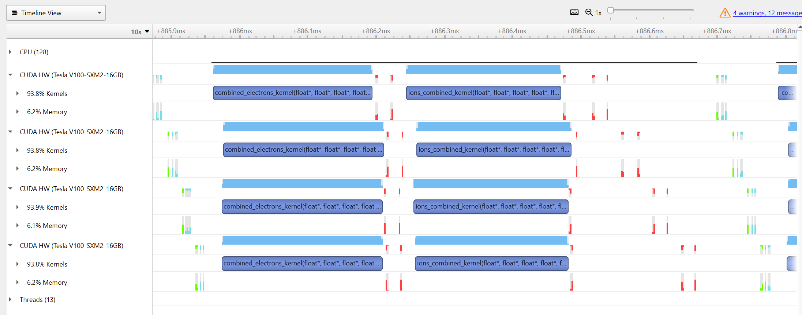
Multi-GPU 1D execution, single node, OpenMP
execution timeline of a single iteration step

Slide 15
Multi-node case, MPI strategy
Node 1
Node 4
Node 2
Node 3

Slide 16
Problems
Requires collective communication operations involving CPU and GPU memory
traditional MPI is not suitable – requires extra copy operations from GPU to CPU
CUDA-aware MPI is OK, can use GPU pointers
Communication initiation is on CPU
difficult to overlap comms. with GPU kernel execution
communication can eventually become a performance bottleneck
scalability limit

Slide 17
Alternative No 1 – NCCL
NVIDIA Collective Communication Library
Provides uniform API for all-gather, all-reduce, broadcast, reduce, reduce-scatter, point-to-point send and receive comm. routines
Optimized to achieve high bandwidth and low latency over PCIe, NVLink and other high-speed interconnects
Automatic topology detection for high bandwidth paths on AMD, ARM, PCI Gen4 and InfiniBand
Supports multi-threaded and multi-process applications
InfiniBand, RoCE and IP Socket internode communication
NCCL 2.4 introduced tree-based all-reduce instead of rings

Slide 18
Mismatch of communication libraries and the CUDA model
MPI and NCCL provide CPU-initiated communication routines
Assumes separate computation and communication steps
Fine for synchronous execution where all processes execute in parallel
CUDA model relies on large number of threads to hide memory and instruction latency: threads >> cores
Internal scheduling of kernels (thread blocks) makes it difficult to hide communication
Need a distributed model more aligned with the CUDA programming model

Slide 19
Alternative No 2 – NVSHMEM
NVIDIA OpenSHMEM Library implementation – development started for and with the SUMMIT supercomputer system
Virtual shared memory system
Collective and point-to-point communication routines called from CPU or from GPU kernel
GPU-initiated communication: much simpler overlap of communication with computation
Provides:
Remote memory access (RMA: PUT/GET)
Atomic memory operations (AMO)
Signal operations
Direct load and store operations
Collective functions (broadcast, reductions, and others)
Wait and test functions (local symmetric memory only)

Slide 20
Partitioned Global Address Space
Private vs global memory space
private: normal device memory
global: {symmetric address, PE index} pair

Slide 21
NVSHMEM-based plasma code version
kernels move/collide particles locally on each GPU
update density vectors
solve for local fields on each GPU
perform all-reduce to update global e_field OR update global e_field with NVSHMEM atomicAdd intructions in overlapped fashion

Slide 22
2D geometry
1D case
particle count up to 1-10 millions: 1k cells, 1-10k particles per cell
2D case
500 x 500 or 1k x 1k grid
100 to 1k particles per cell
25 M – 1 B particles
e_field should be in shared memory on each GPU
1M instead of 1K elements
Ampere persistent shared memory could help, otherwise must be moved into global memory

Slide 23
Summary
Still in progress, single node and rudimentary MPI versions are complete, NVSHMEM version coming soon
There are many alternatives for structuring and implementing pre-exascale multi-GPU programs
Selecting the best strategy and creating efficient code might not be easy
Following implementation patterns developed for much smaller CPU-based systems might not be a good long-term choice
Do not be afraid to re-design, re-structure your program
Programs with hundreds of millions or billions of threads can be executed efficiently on state-of-the-art systems

