Slide 1



200+ GPUs in one HPC
- available in months
GPU day 2021
Zoltán Kiss – KIFÜ - Head of HPC Dpt.

Slide 2
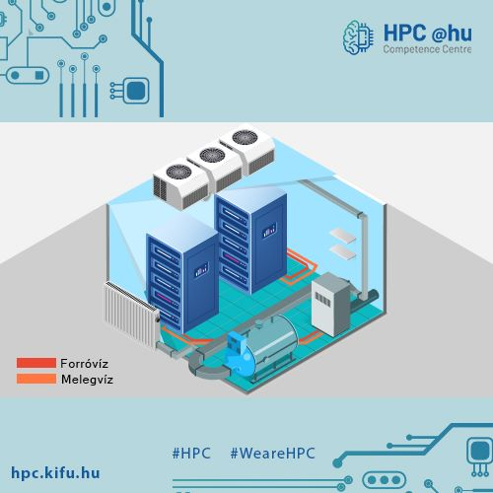

Contents
What’s HPC
HPC programme
History
Development project
DC Infrastructure
HPC Infrastructure
Portal System

Slide 3
HPC
RDI
Results
Staff
Competitiveness
Costs
Time

Slide 4
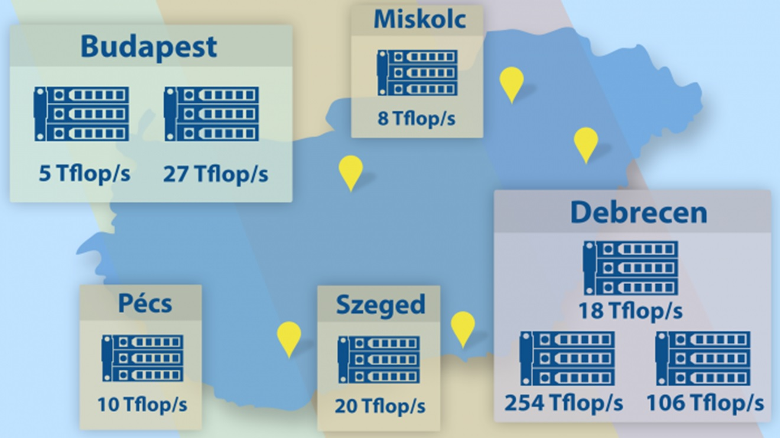



Slide 5

Knowledge Transfer
Competence Center
SME connections
HPC eco- system
Infrastructure Development

Slide 6


20 years of Hungarian HPC
2001 60 Gflop/s
2009 900 Gflop/s
2011 48 Tflop/s
2015 0.45 Pflop/s
2022 5+ Pflop/s
https://hpc.kifu.hu/jubileum

Slide 7
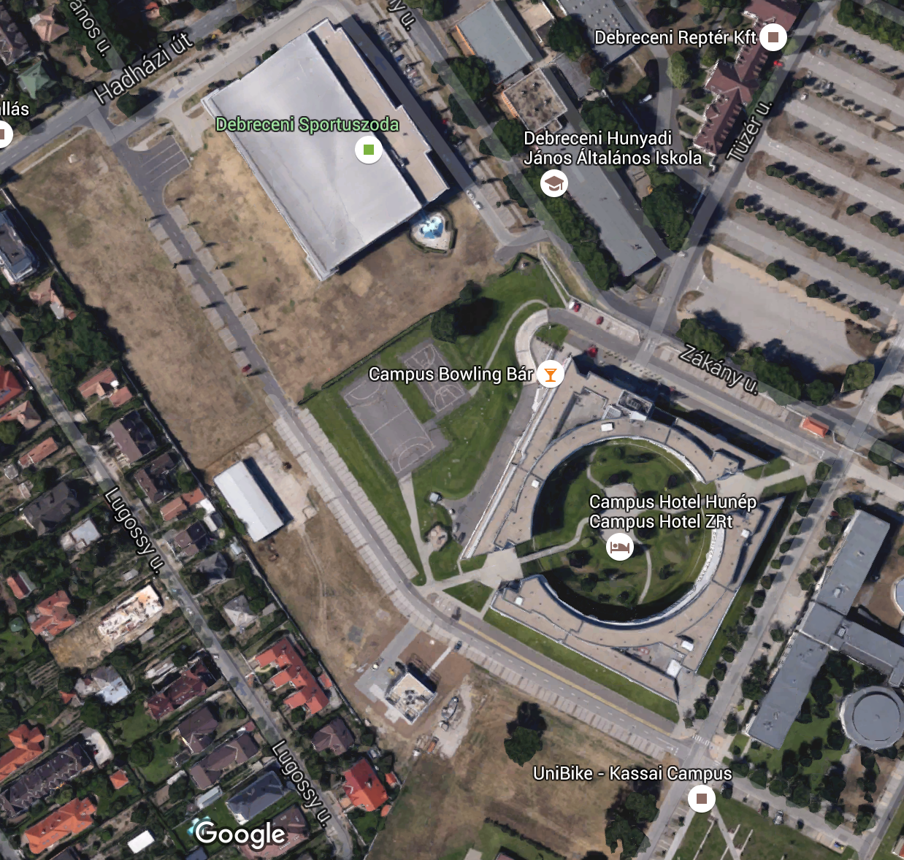
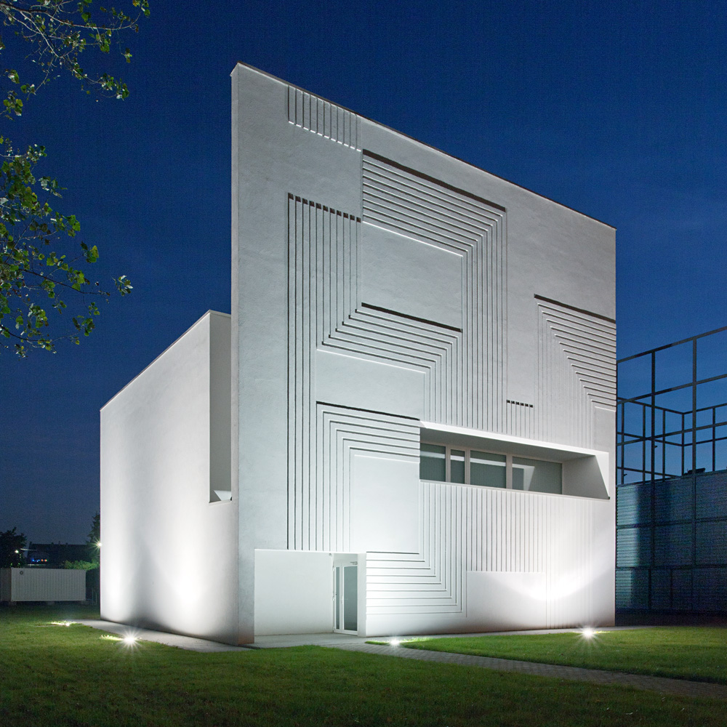
Green DC
Hot water cooled
90%- Free Cooling
Waste Heat reuse

Slide 8
Under the hood
1.3 MW power
2 x 1 MW UPS capacity
1 x 800 kW Aggregator
700 kW warm water cooling
300 kW cool water / aircooling
2 x 2 x 260 kW warm water chillers
3 x 177 kW cold chillers

Slide 9
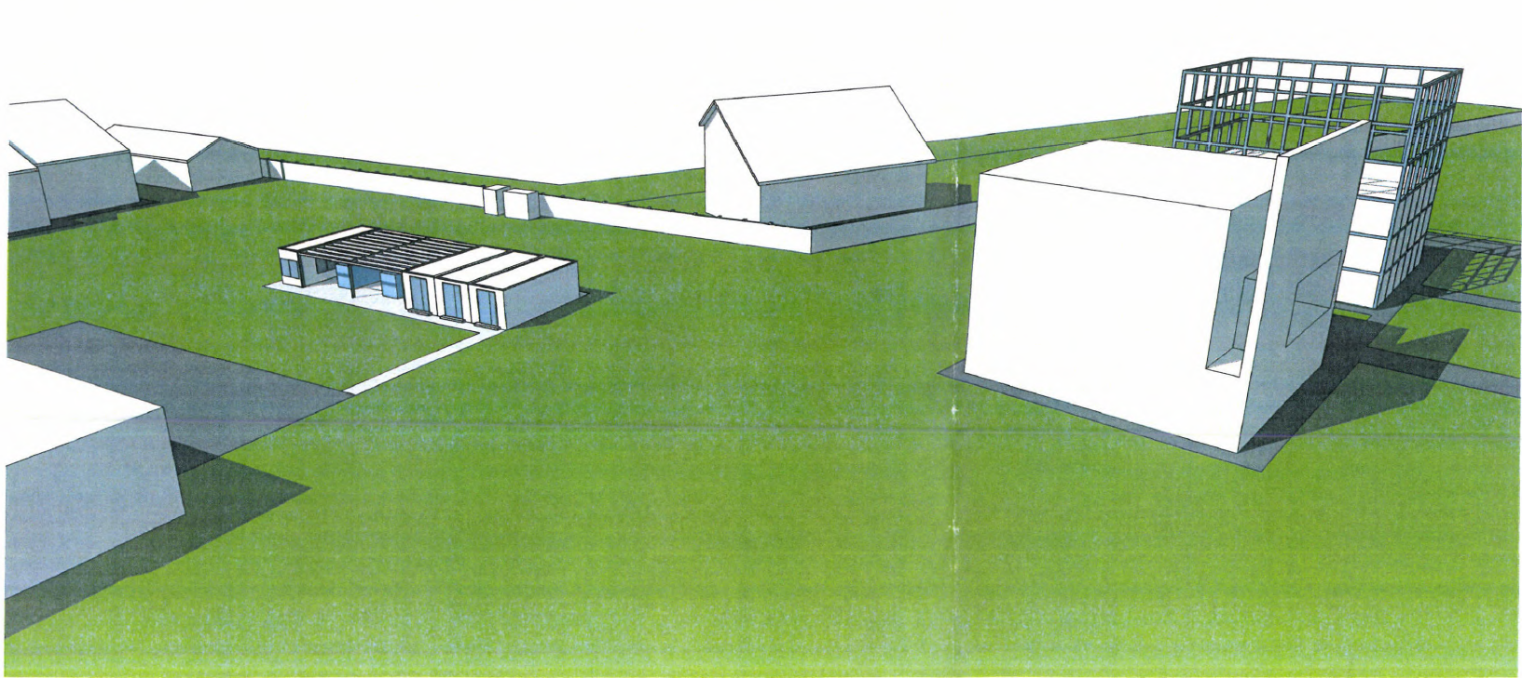
Power Infrastructure

Slide 10
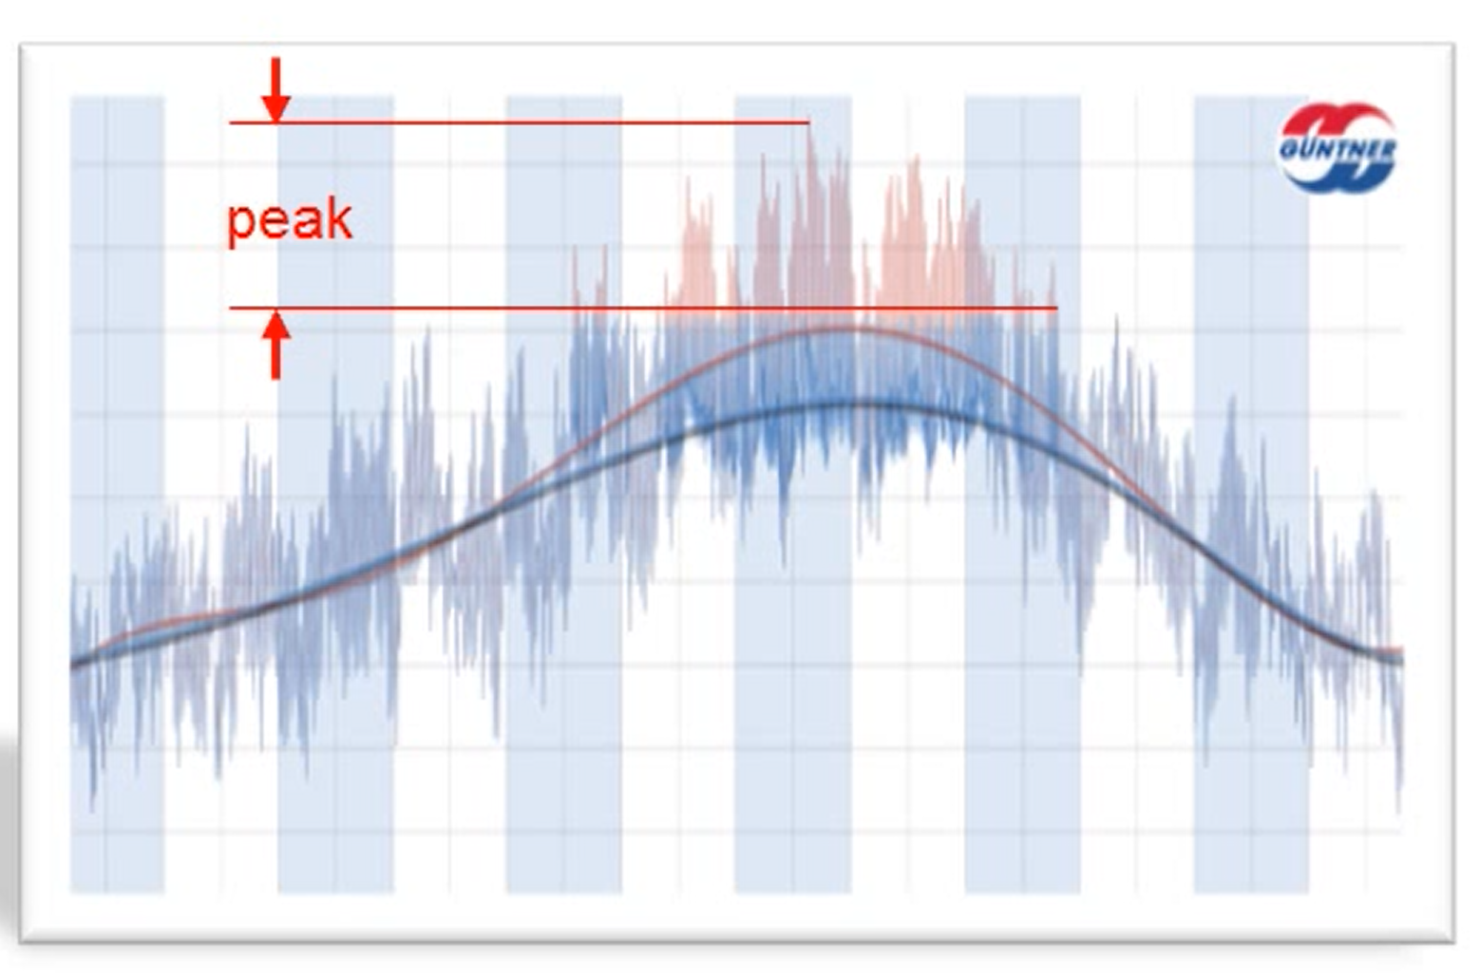
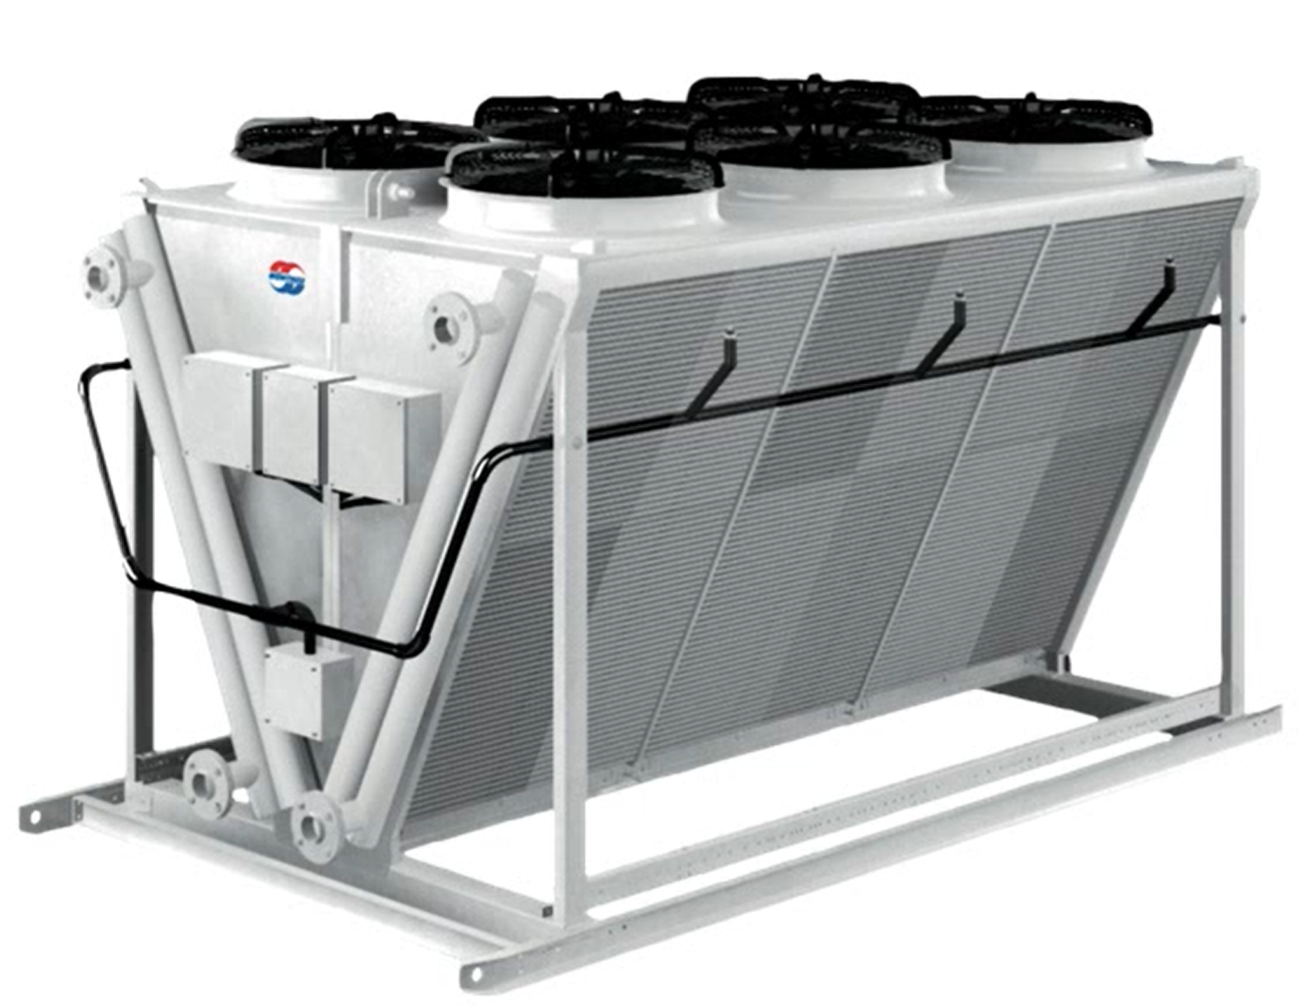
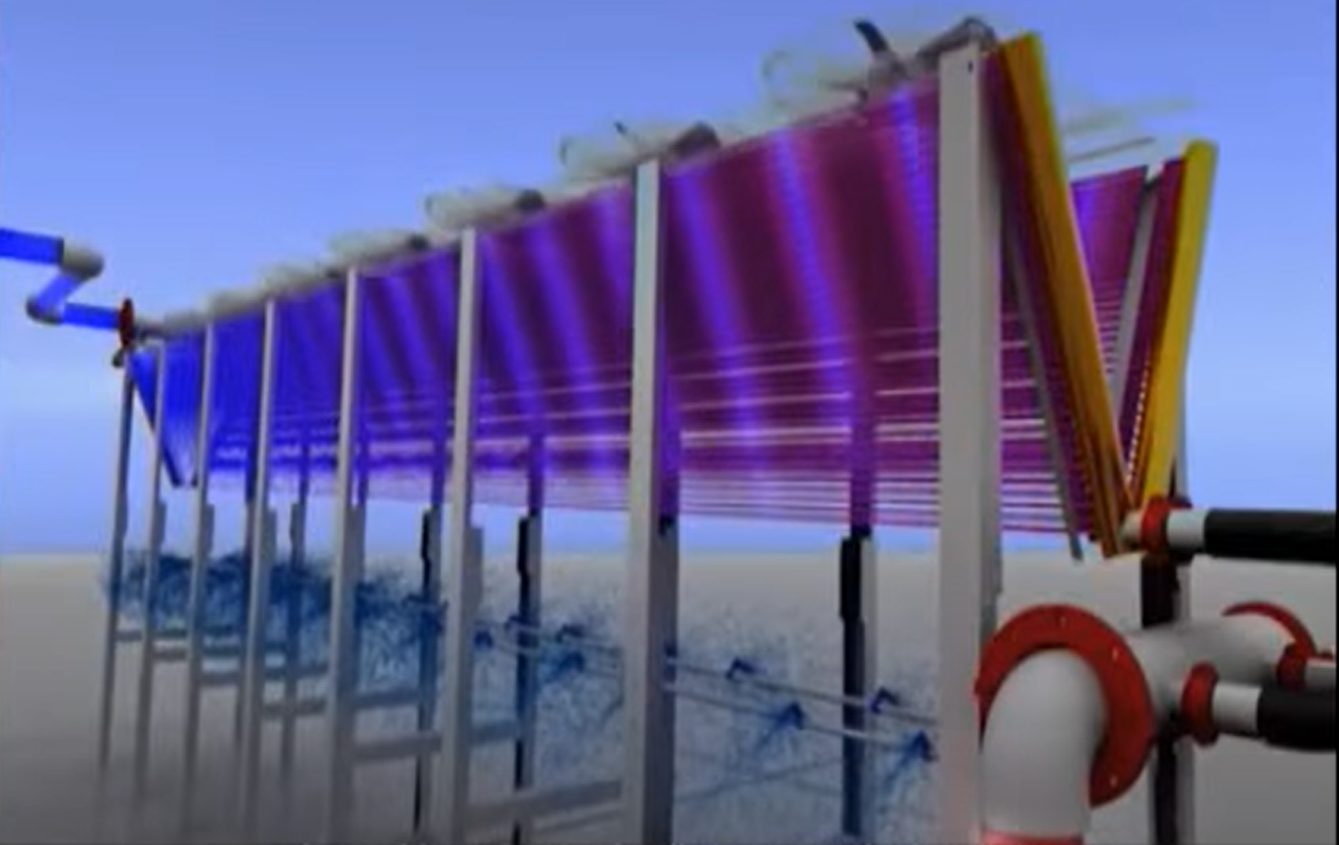
https://youtu.be/v6MaAJyUx4Q?t=106
Adiabatic chillers

Slide 11
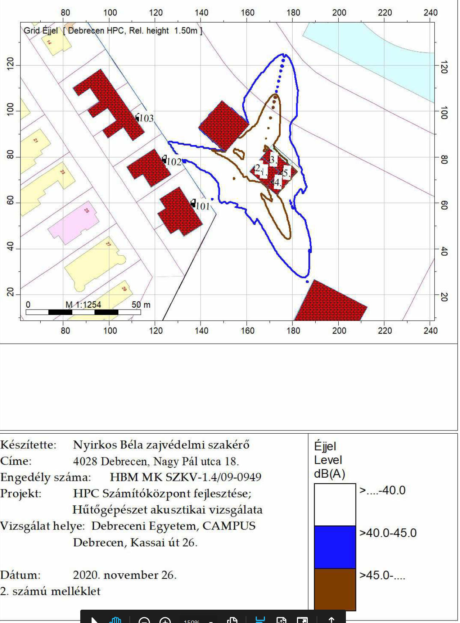
Acoustics

Slide 12
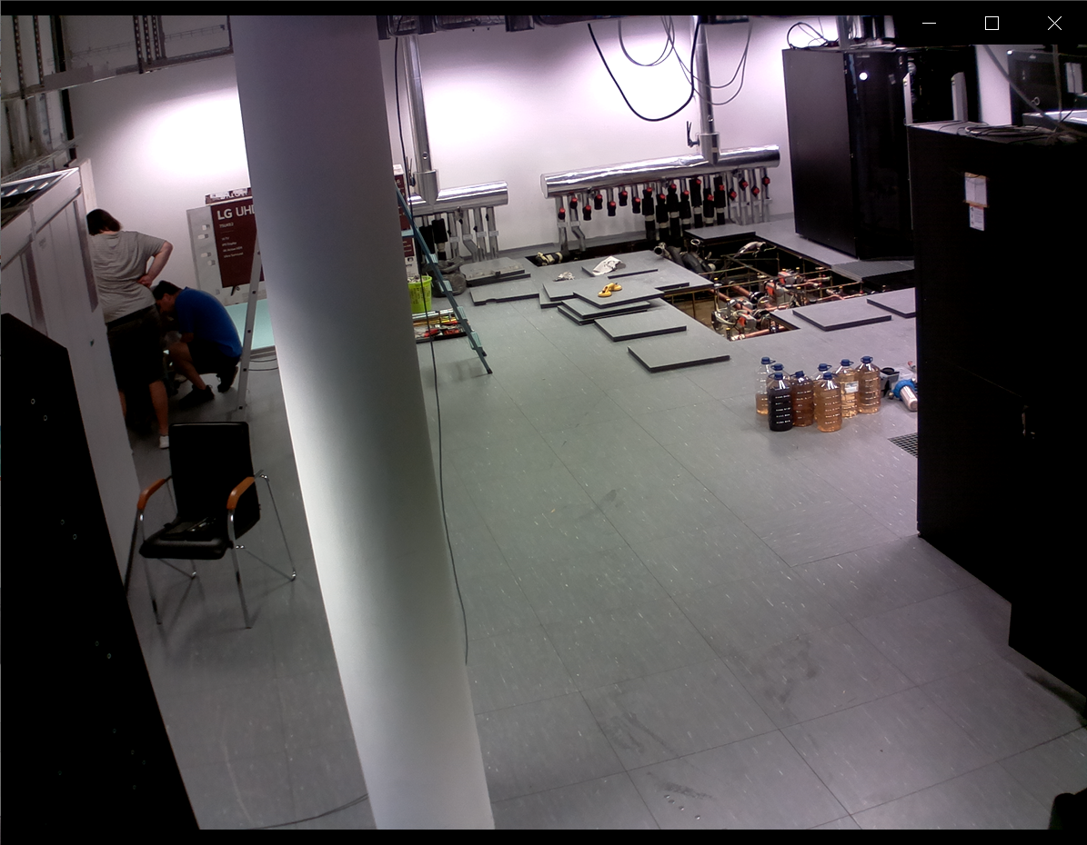
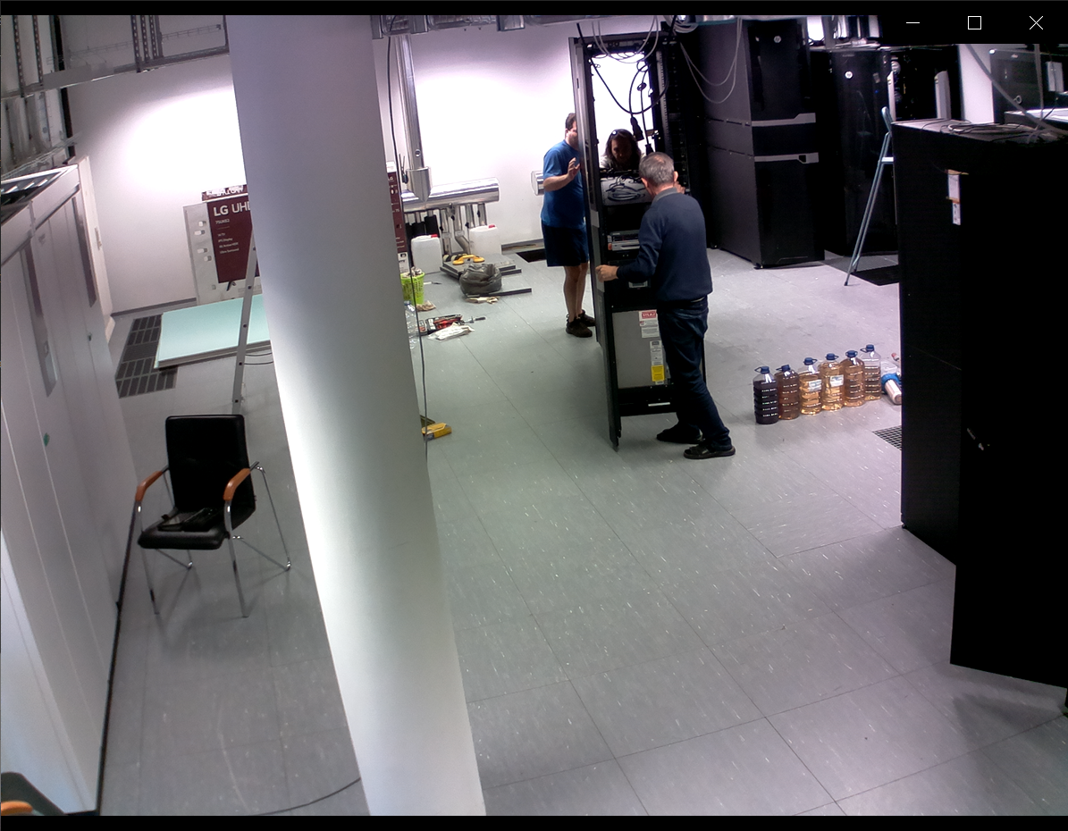
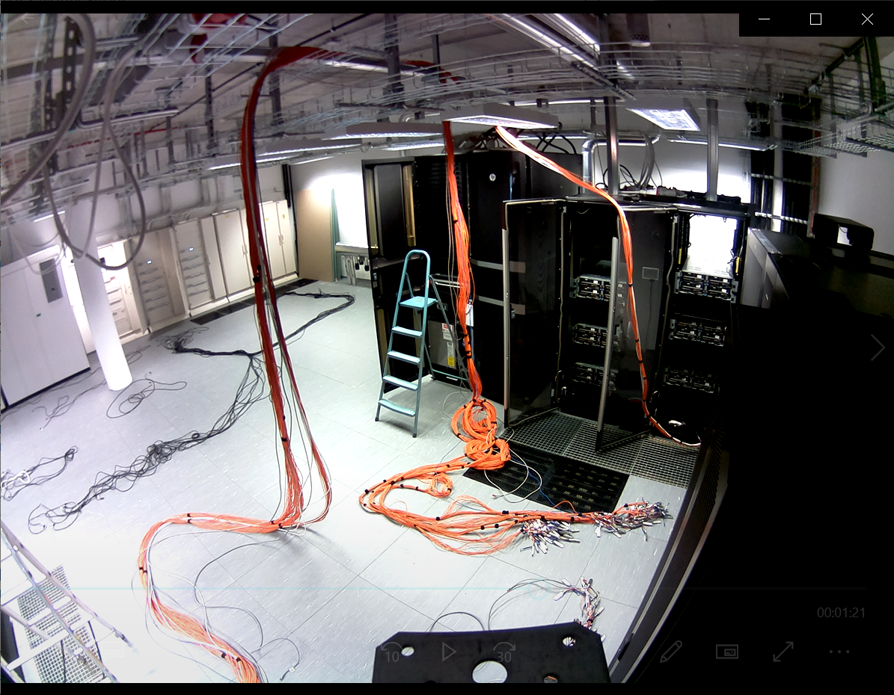
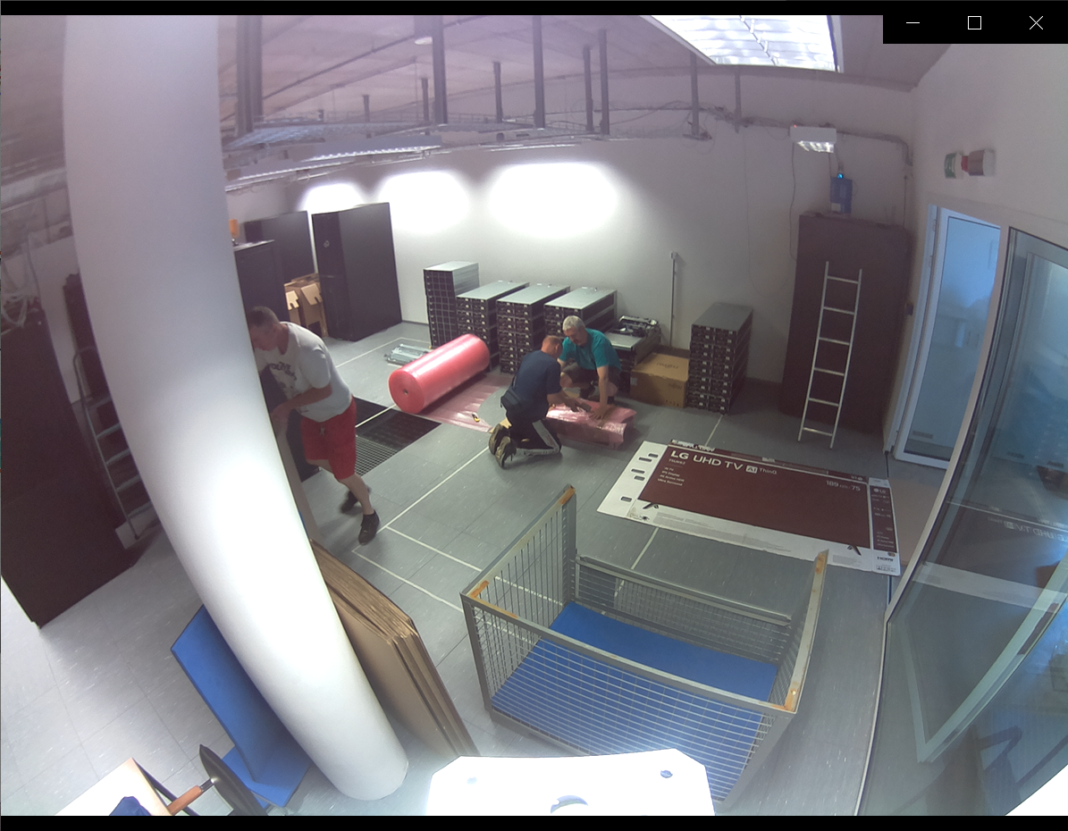
Moving out
2020.11 – Cloud, HSM
2021.06 - LEO
2021.07 - Apollo
2021.07 – Racks and Network

Slide 13

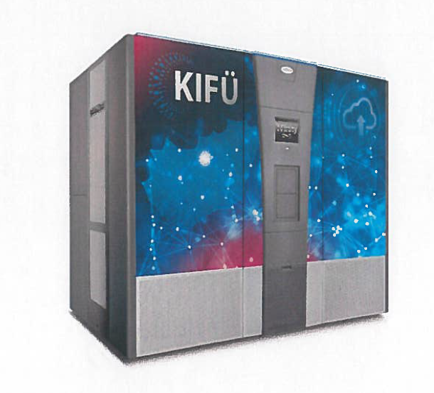
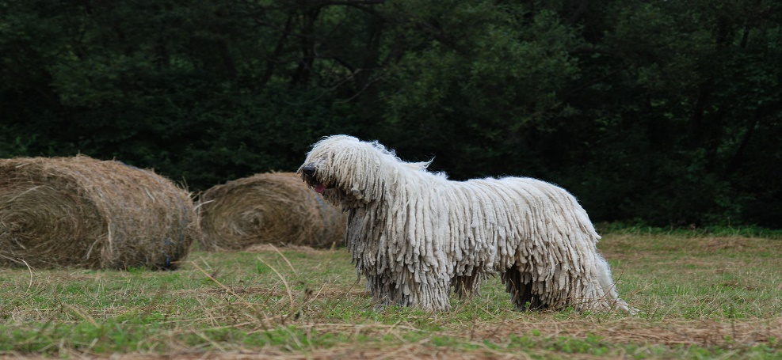

Komondor intro

Slide 14

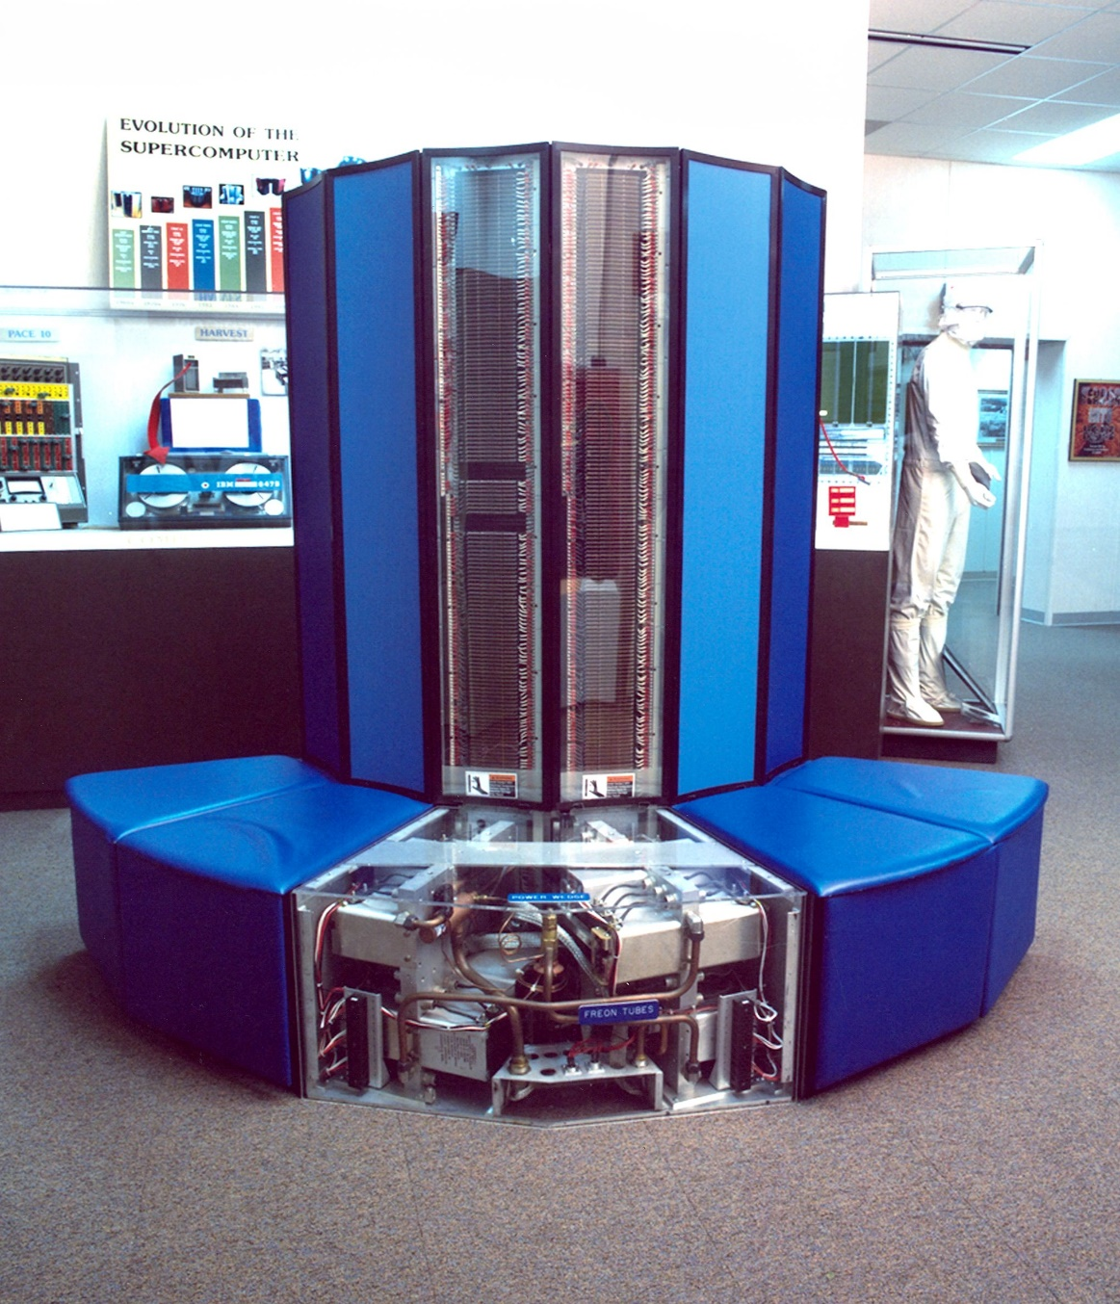
CRAY
1975-2019 - now HPE CRAY product line
1st HPC in the world
Most machines at top500, 28 from top100
High end
‘Optimized experience’
CRAY Linux Env/Aries Interconnect/Clusterstor
Weather, etc.
Dense, high performance, big etc.

Slide 15


HPE CRAY EX
Apollo – Generic / SGI – High Tech / Cray – High End
‘Unified experience’
CRAY Linux v/ SUSE compatibility
Slingshot eth based IC / Clusterstor storage
All workloads
Dense, high performance, big etc.

Slide 16
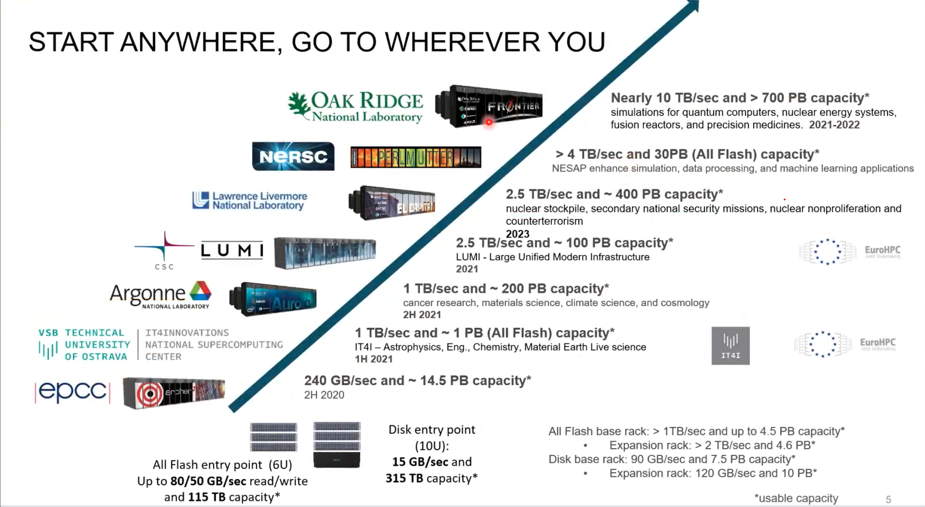

Slide 17
2022 – 5+ PF HPC
Most powerful
research HPC
20 000+ CPU core, 200+ GPU
GPU 4+ PF
CPU 0,7+ PF
Big Data 9+ TB memory
MI partition 8 GPU/node
2 PB superfast storage + 10 PB tape
Energy efficient DC
Extreme density
Award-winning plans
@ Heart of DE Campus

Slide 18
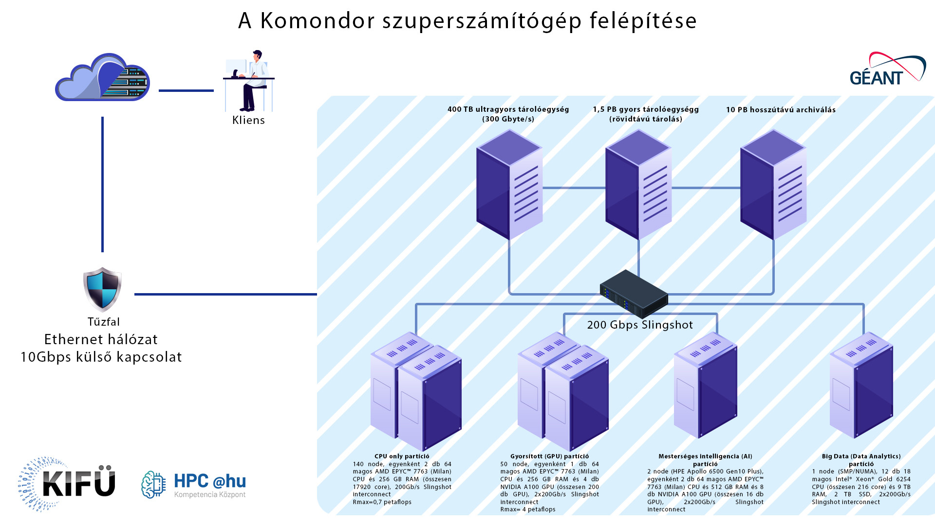

2M IOPS

Slide 19
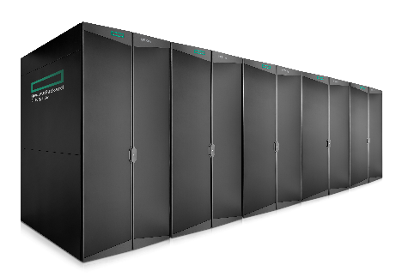
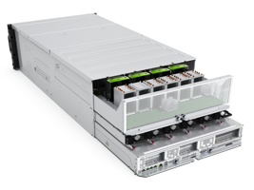
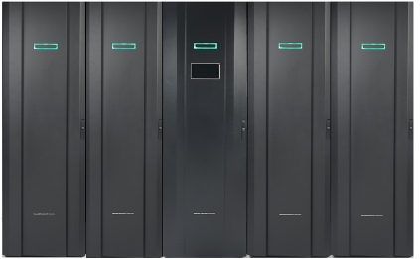
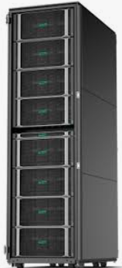
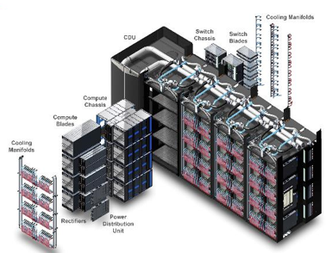
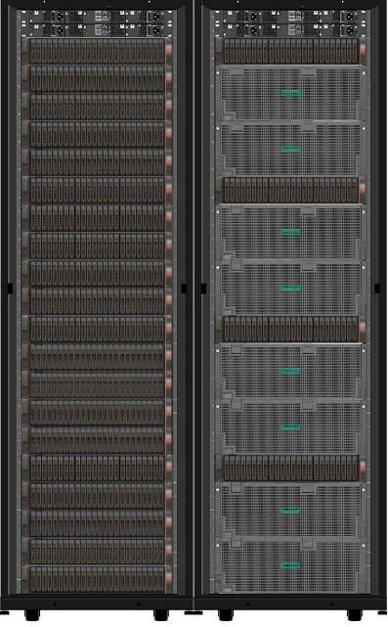
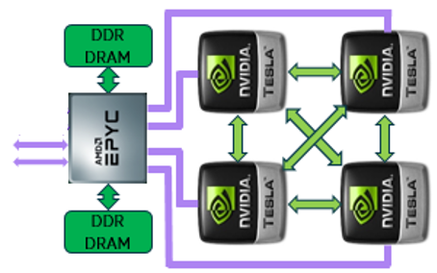
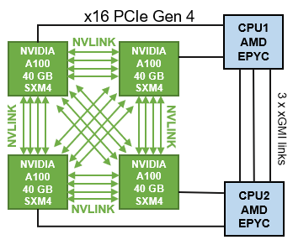

Slide 20
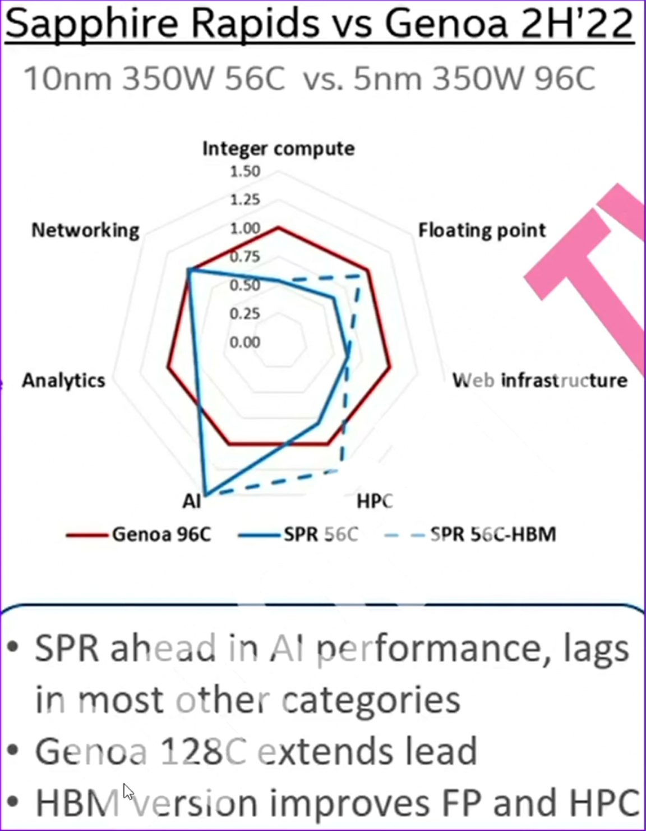
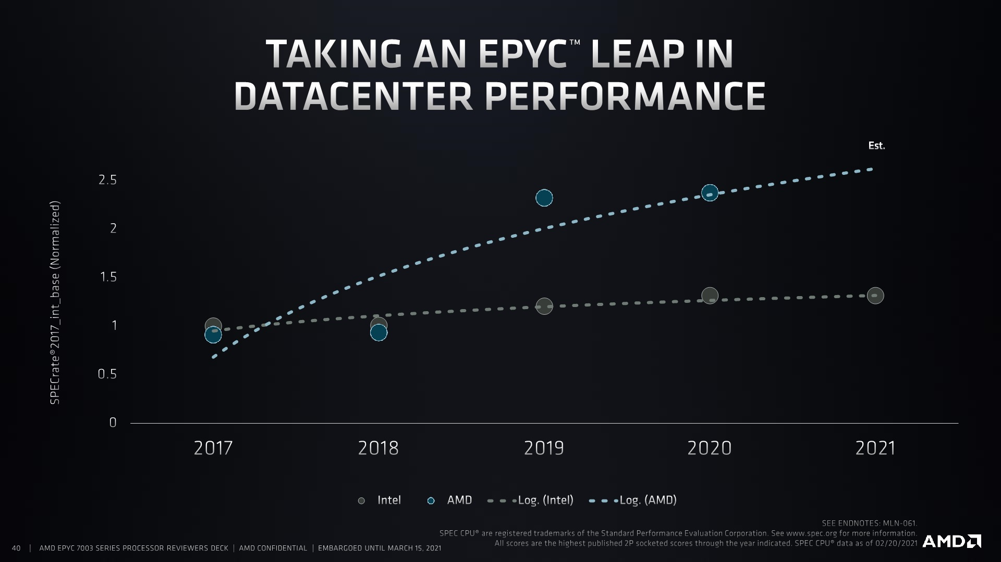
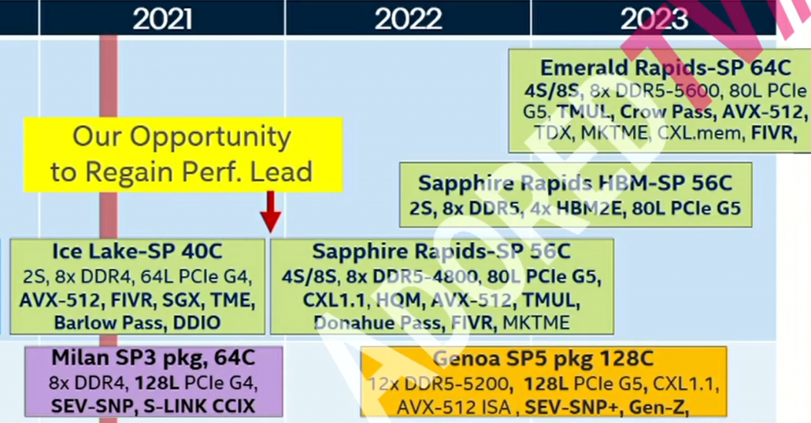
Miért AMD?

Slide 21
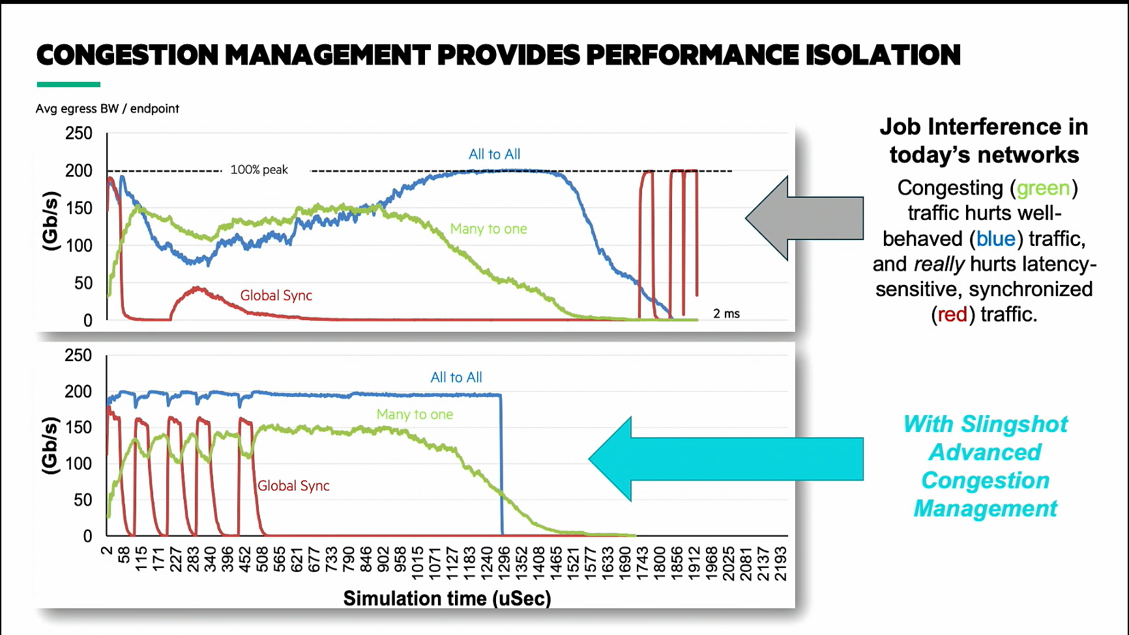
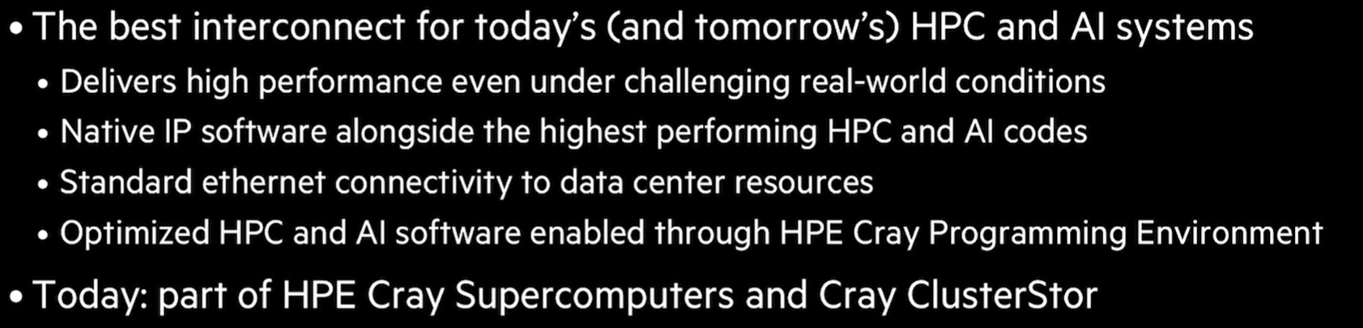
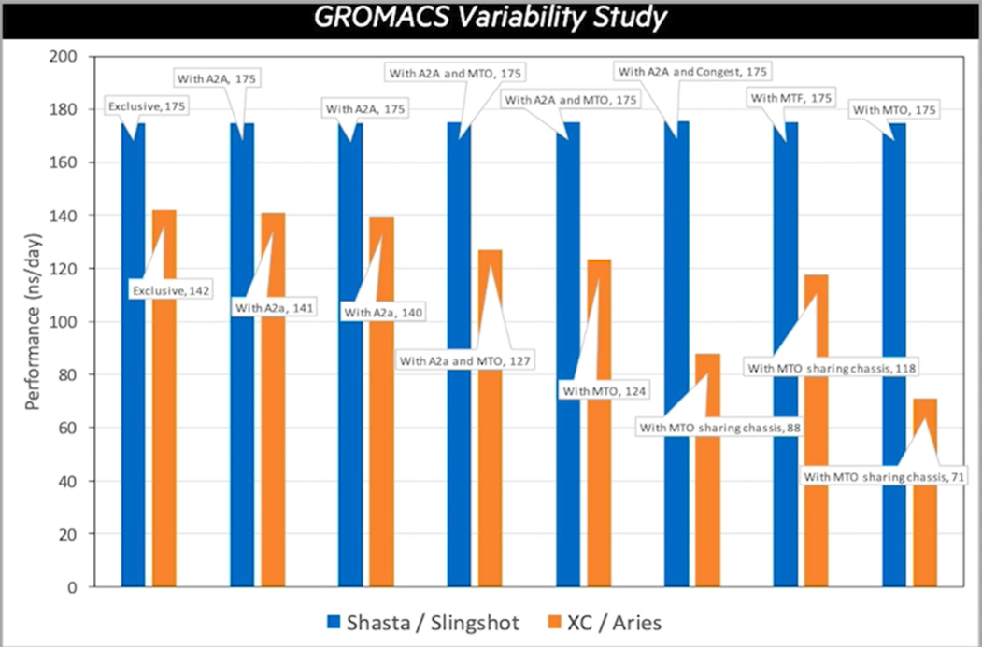
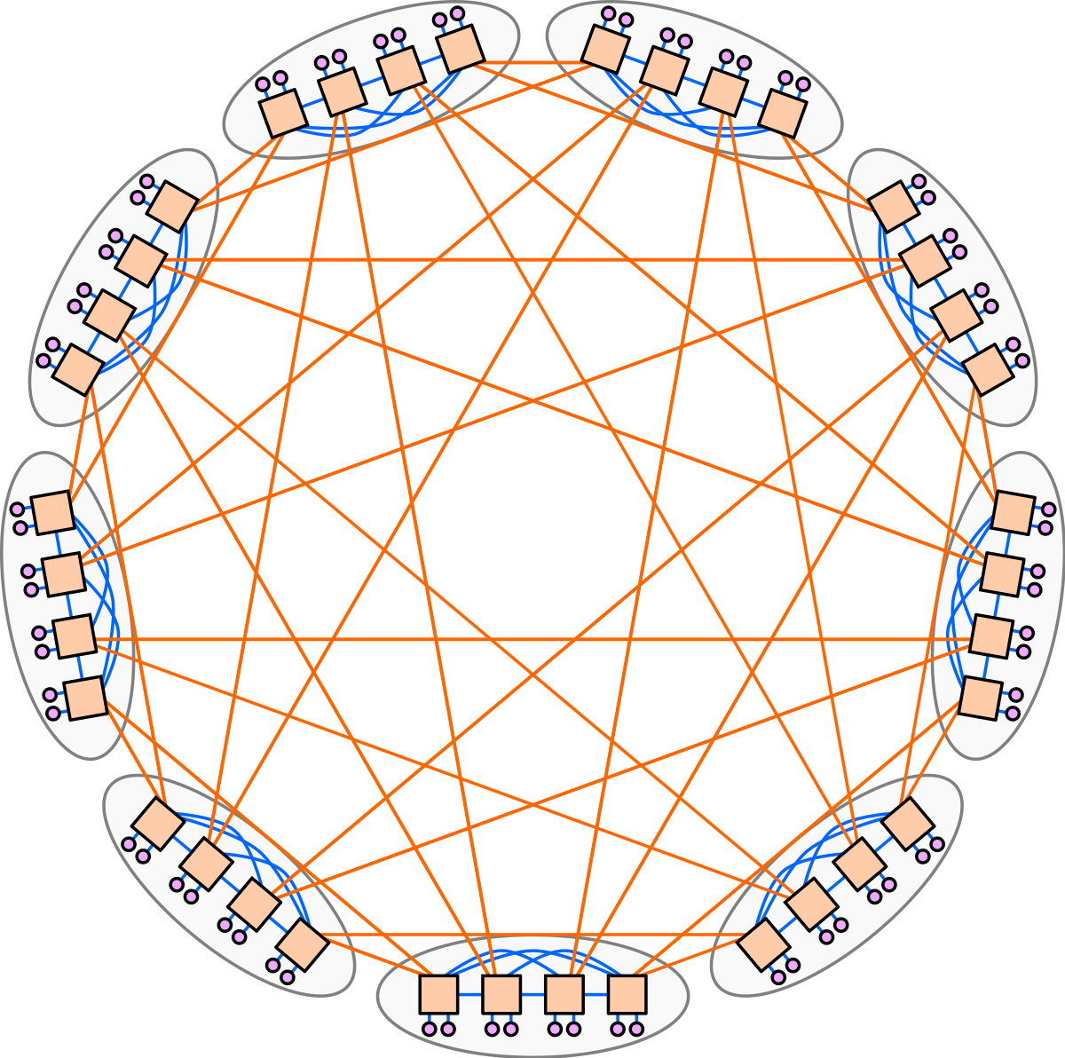

Slide 22
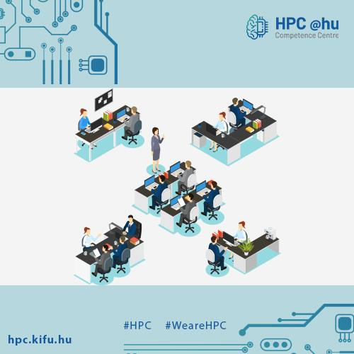
Software
Ansys
Amber20
Amsterdam Density Functional (ADF)
CharMM
Gaussian 16
Terachem
Schrödinger
MATLAB
TotalView

Slide 23
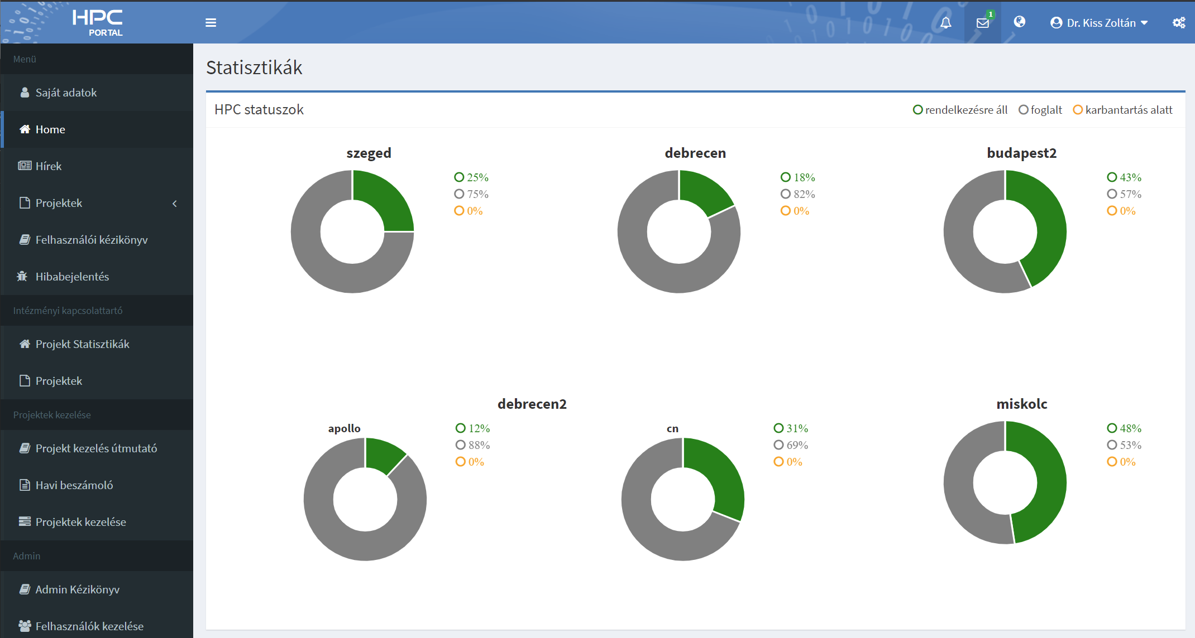
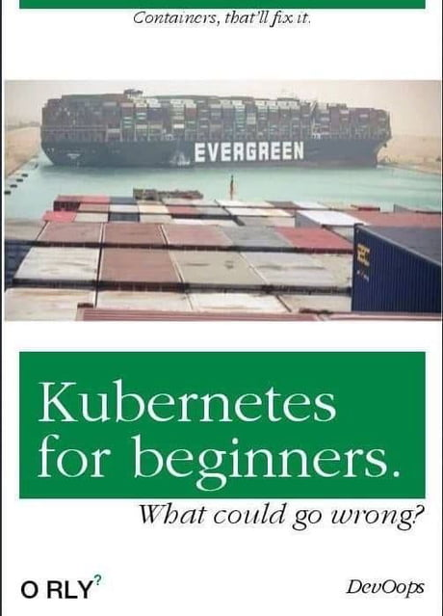
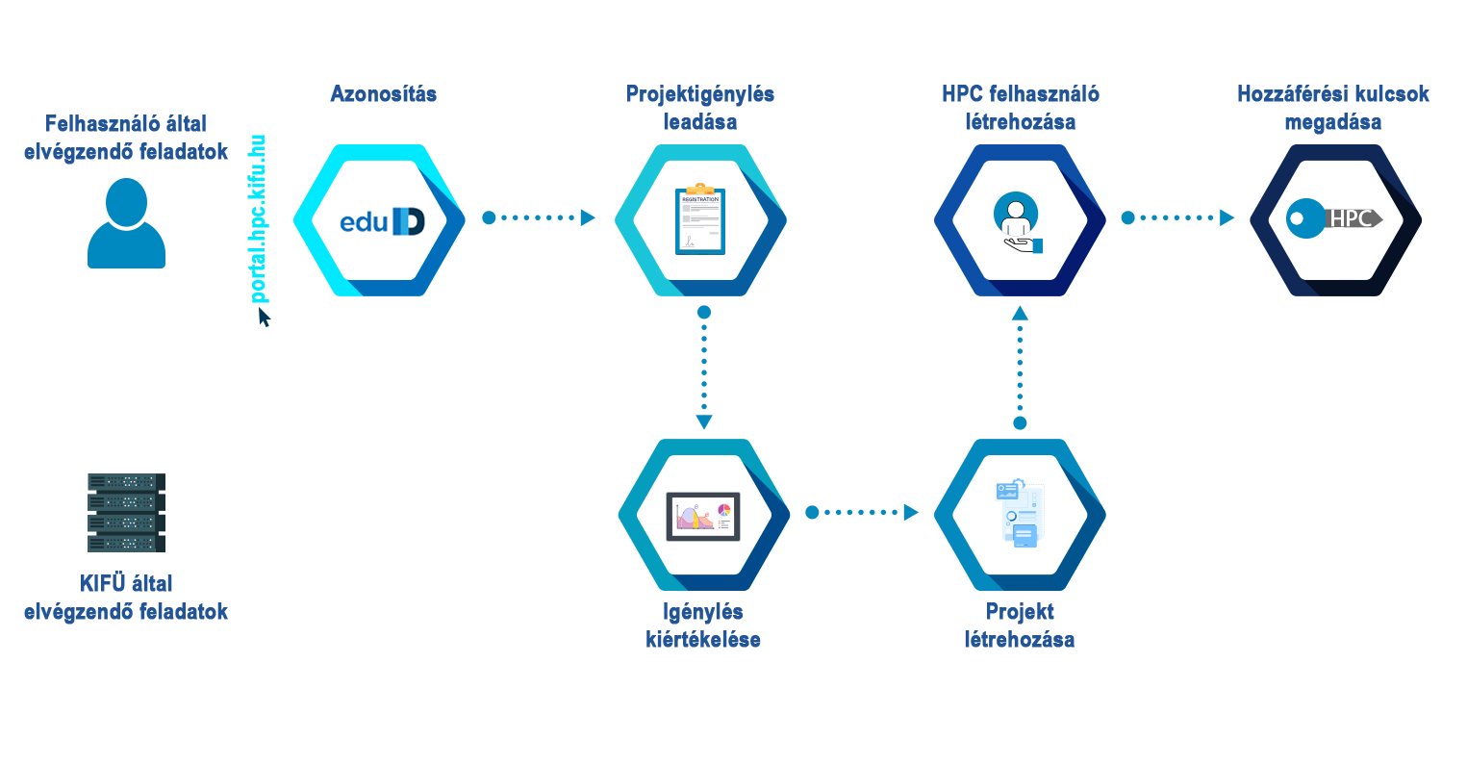

Portál
https://portal.hpc.kifu.hu
What could go wrong?
http://hpc.kifu.hu

Slide 24
Deploy workflow - plans
Visualization
Container
HPC
(Cloud)
CKAN
CI

Slide 25
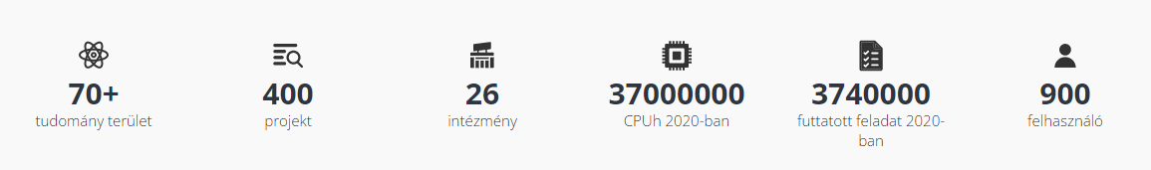

Results
Modeling Power Outages, Brain networks (Odor G, Hartmann B, Gustavo D, Jeffrey K)
Drug development (HEGELAB)

Slide 26

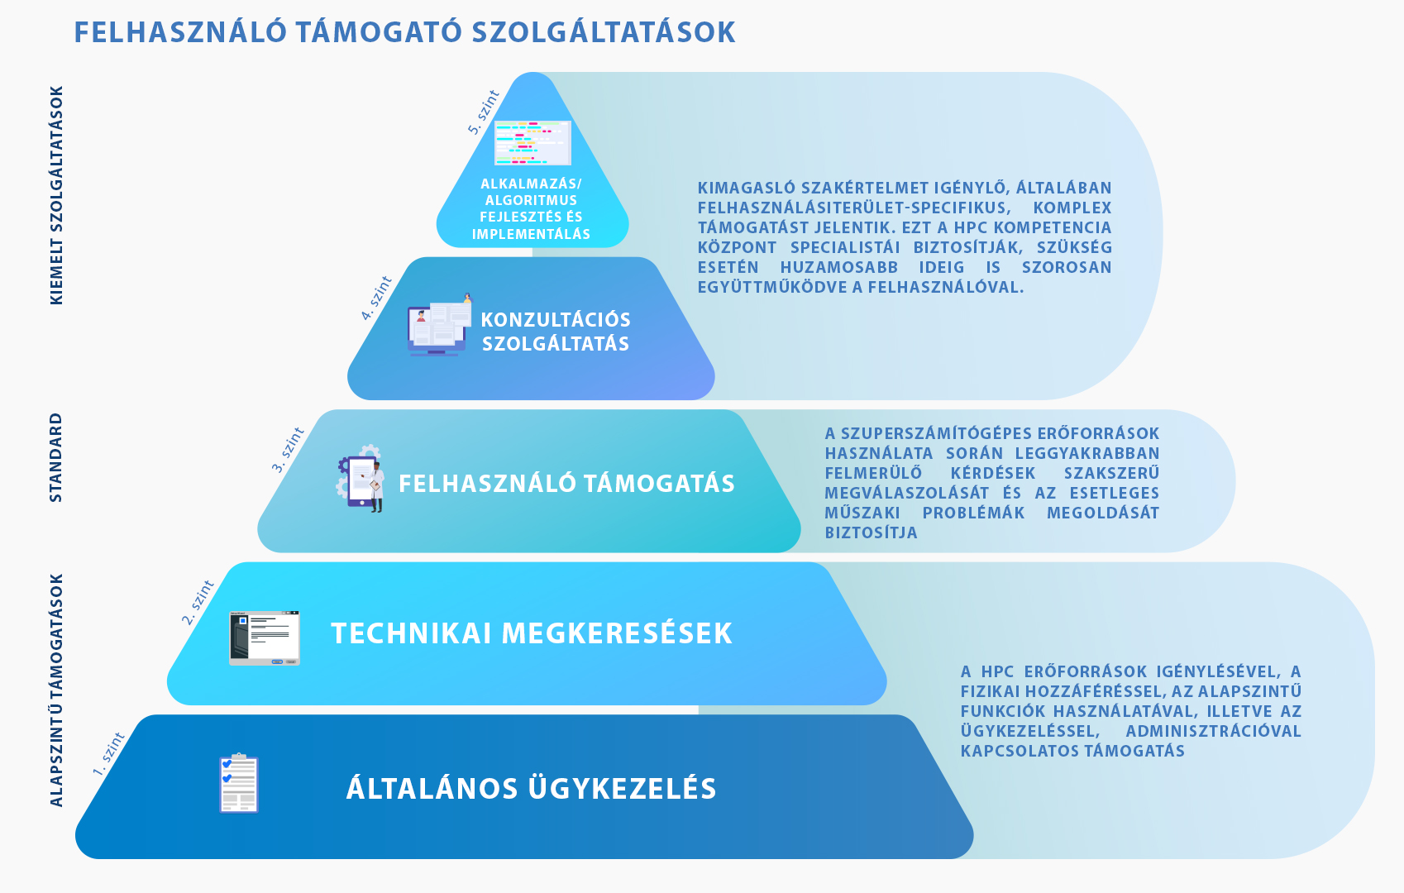
https://conference.kifu.hu/e/hpcuserforum21
#wearehiring

Slide 27
Thank You!
https://hpc.kifu.hu
hpc-cc@kifu.hu
kiss.zoltan@kifu.gov.hu

