Slide 1
Accelerating Tridiagonal Solvers
István Reguly, Dániel Balogh, PPCU ITK
Toby Flynn, Kamalavasan Kamalakkannan, Gihan Mudalige, University of Warwick
GPU Day 2021.11.10.

Slide 2
Tridiagonal equations
A traditional system of linear equations, with non-zeros on/above/below the diagonal
Gauss-Jordan elimination special case – Thomas algorithm
Most common in implicit formulation of finite difference discretization of PDEs
  Exact inverse
Inherently sequential algorithm…
  O(N) complexity

Slide 3
Solving tridiagonal equations in parallel
Parallel Cyclic Reduction
  Subtract row +/- 1, +/-2, +/-4, +/-8…
  O(N logN) steps, but only logN sequential steps
Hybrid
  Doing Forward on blocks in parallel
  Solving “reduced” system
  Backsubstitution in parallel
  O(N)

Slide 4
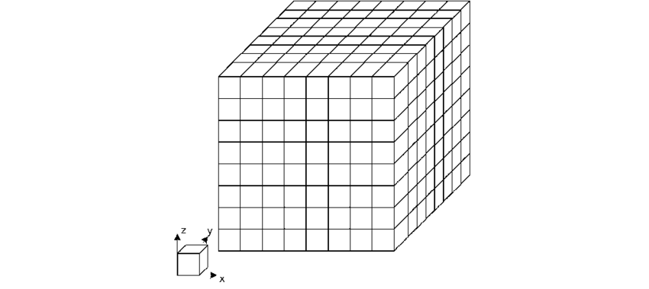
Batching & Higher dimensions
1D PDEs rarely come alone…
  In finance, large number of solves with slighly different initial conditions
Higher dimensional problem: Alternating Direction Implicit method
  Solve along x direction, then y direction, then z
  Coefficients & unknowns laid out on 3D mesh
X solve: #Y*#Z systems, each of length #X

Slide 5
Shared & Distributed Memory Parallelization
Grid is decomposed along all the axes, processes only hold a block of any given tridiagonal system
Within each partition: Thomas/PCR/Hybrid
Reduced system solve:
  Allgather, solve, backsubstitute
    One large comm step
  PCR
    Multiple smaller messages to increasingly distant processes
  Approximate solution with Jacobi iteration
    Multiple smaller messages to neighbors

Slide 6
Test setup & Single-node performance
Archer 2 – Cray EX: 2x64c AMD Rome, 256 GB
Cirrus – 4x V100 NVLink nodes
Comparison vs. TridiagLU library (MPI only)
512^3 problem per node
10 iterations for Jacobi solver
Archer2: 225-307 GB/s throughput
Cirrus: 458-739 GB/s on a single V100

Slide 7
CPU Scaling

Slide 8
GPU Scaling
No other
implementation
available
MPI Comms:
  Host-copy
  GPU Direct

Slide 9
Tridiagonal solvers on FPGAs
Key factors
  Resource usage (#DSP slices)
  Complexity/pipeline depth
  Fusion with coefficient calculation
Smaller systems
  32^2– 128^2, 32^3 – 96^3
Batches
  1500-3000 in 2D, 24-72 in 3D
Oversize systems
  Do not fit inside the FPGA, uses block approach
Performance modeling of various algorithms
Thomas: FW: 4* 1/ 2-. BW: 1* 1-
PCR: 9* 1/ 4-
Pipeline latency “l” – need l independent sytems to fill up
Latency of 1
iteration (forward)
~30 on Xilinx U280
System
length
Latency of 1
iteration (backward)
Latency of 1 PCR
iteration
Unroll factor

Slide 10
Tridiagonal solvers on FPGAs
If we interleave g number of systems, and there are B systems
Vectorized solvers – 8 Thomas
Feeding the solvers – depends on data layout
Total lantecy for Thomas
Total lantecy for PCR
PCR is times more expensive

Slide 11
Tridiagonal solvers on FPGAs
When doing X solve, transpose is needed

Slide 12
Performance
8000 Batch size

Slide 13
2D & 3D ADI – Heat diffusion
6 CUs
8 wide vectorization
292 MHz @ FP32
288 MHz @ FP64
85-90% prediciton

Slide 14
2D Stochastic Local Volatility
2nd order FD, FP64
Hundsdorfer-Verwer time integration
Coefficients for tridiagonal solver fused & recalculated
3 CUs on U280

Slide 15
Conclusions
Parallelization of tridiagonal system solves: within and across sytems
  Parallelism vs. complexity
Decomposition possible, resulting in a reduced system solve
  Can be used in distributed memory systems & FPGAs
  Considerable differences in reduced system solve strategies
Excellent scalability for an exact solve – almost as good as iterative solvers
FPGA implementaiton more sensitive to algorithm formulation
  On par with FPGAs on small and medium sized problems

Slide 16
Allgather (all processes gather all boundary values, solve the reduced system the substitute back):
- Data volume: 6n * p * p
- #of messages: p * p (worst case, if no aggregation happens)
- complexity of reduced solve: n x 2p
Gather-Scatter (a single process gathers all the boundary values, does the reduced solve, scatters the solution back, then everyone substitutes back):
- Data volume: 6n * p * 2
- #of messages: p * 2
- complexity of reduced solve: n x 2p
Gather-Scatter v2 (implemented by tridiagLU - n/p reduced solves are done on each process, so each process sends some of its values to every other process). Here, before reduced system solve, each process sends its last row to the next process to eliminate an extra row, thereby halving reduced system size.
- Data volume: 3n * p + 3n * p * 2
- #of messages: p + p * p * 2
- complexity of reduced solve: (n/p) x p
PCR (with the extra elimination step from above)
- Data volume: 3n * p + 3n * p * log2 p
- #of messages: p + p * log2 p
- complexity of reduced solve: n * log2 p
Jacobi (with the extra elimination step from above)
- Data volume: 3n * p + 3n * p * #ofIts
- #of messages: p + p * #ofIts
- complexity of reduced solve: n * #ofIts

