Slide 1
Implementing Hierarchical Bayesian Networks on the GPU
László Dobos, Tamás Budavári, Carrie Filion,
Rosie Wyse, Alex Szalay
Dept. of Physics & Astronomy, The Johns Hopkins University

Slide 2
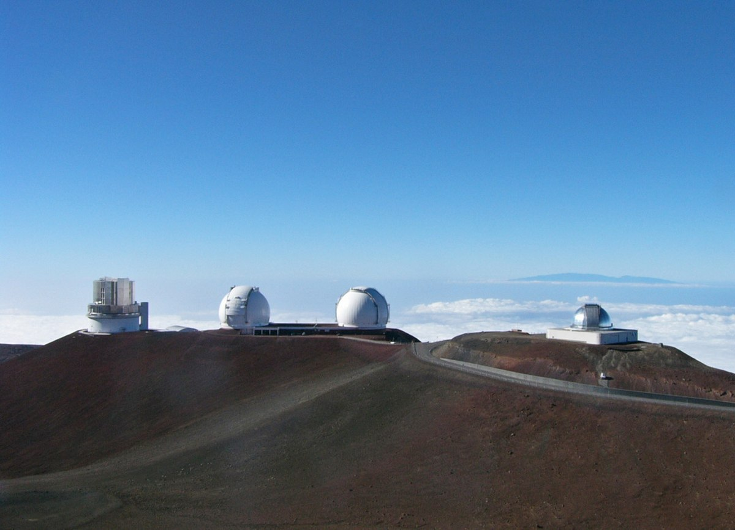
Subaru Prime Focus Spectrograph
Manua Kea Observatory, Hawaii
2400-fiber spectrograph for the 8.2 m Japanese Subaru telescope
Low and medium resolution spectroscopy from infrared to blue
Unique features: large mirror, large field of view

Slide 3
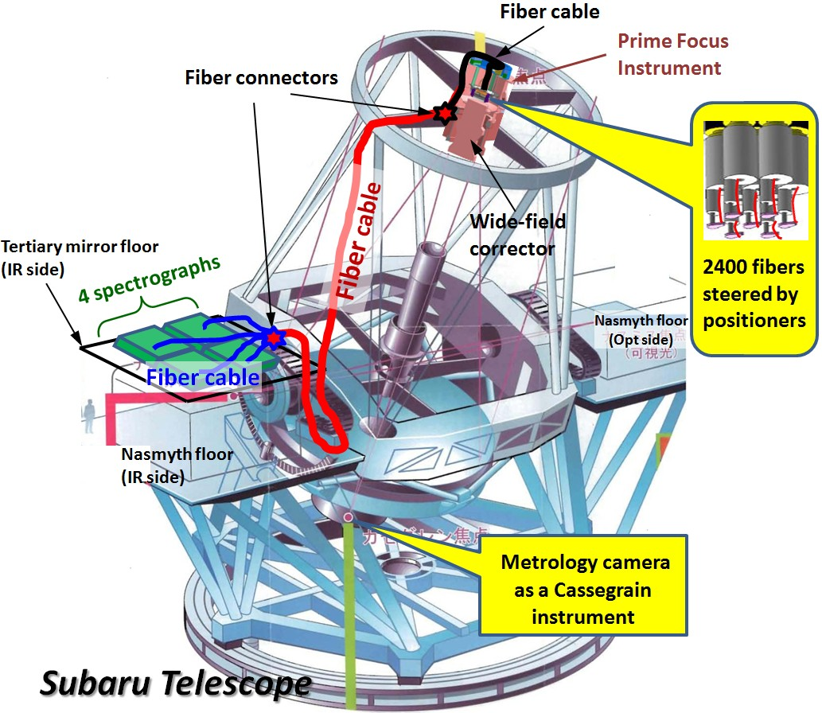
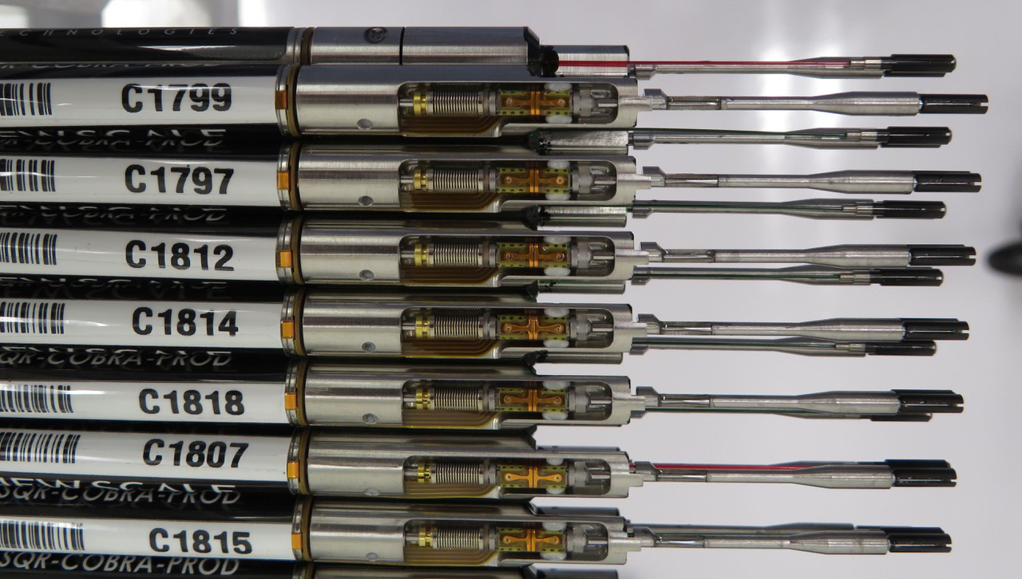
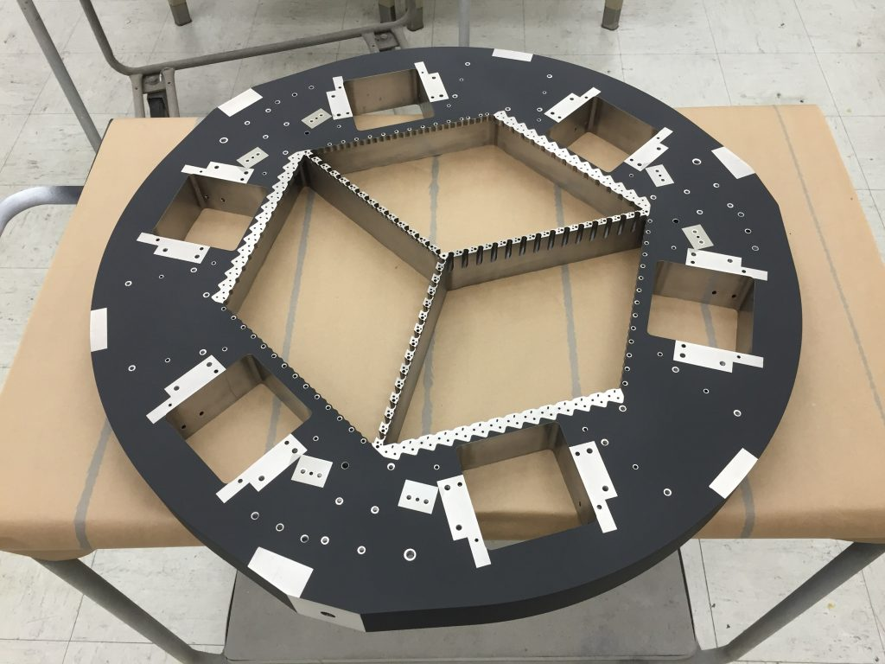
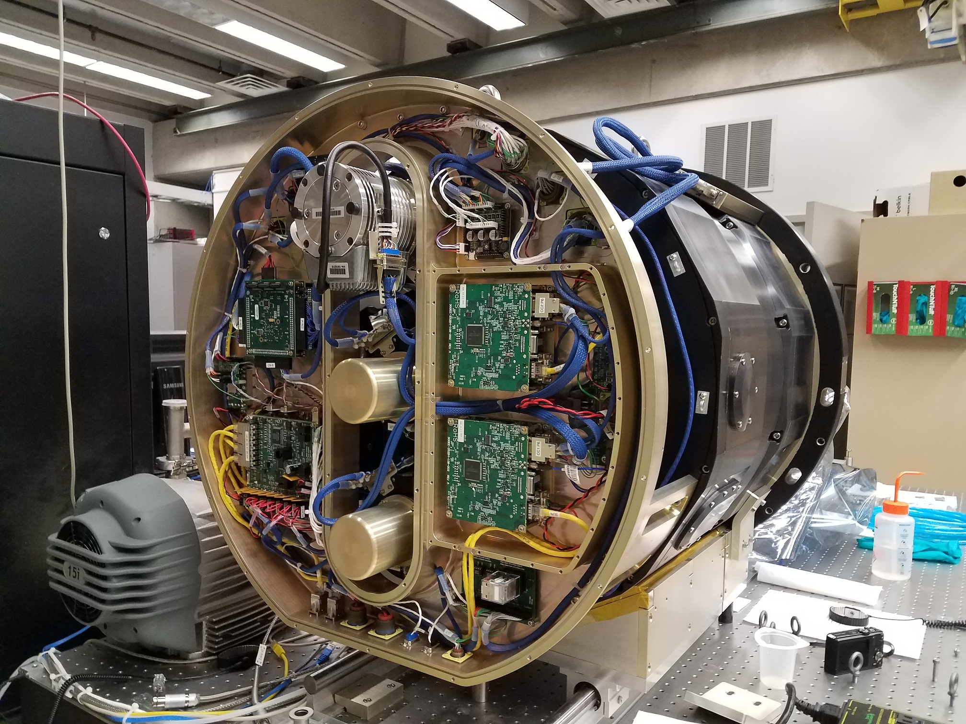
PFS on the Subaru
Fiber positioners
Prime focus array frame
Near infrared camera

Slide 4
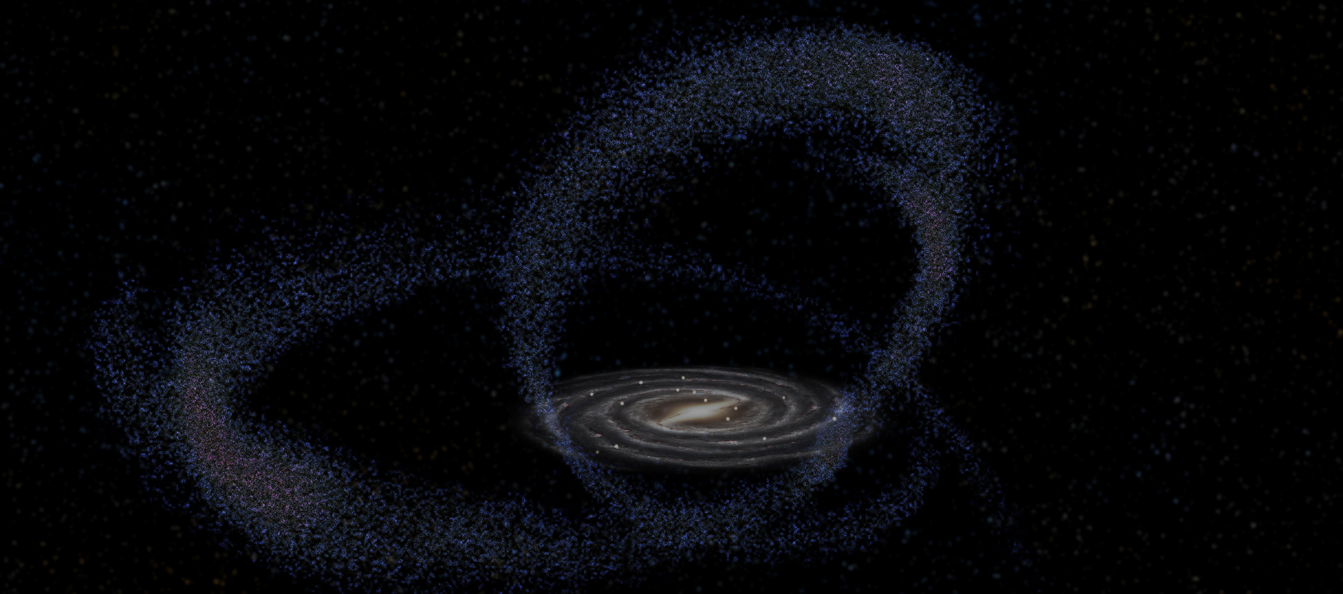
Galactic Archeology
Observing the oldest stars in the local Universe
In the halos of the Milky Way and the Andromeda galaxies
In satellite dwarf galaxies orbiting the Milky Way
Reconstructing the formation history of the Milky Way
Observing stars of tidal streams of disrupted satellite galaxies
Reconstructing the dark matter distribution around the Milky Way
Only possible through its gravitation effect on the motion of stars

Slide 5
Stellar observations
PHOTOMETRY
SPECTROSCOPY
Apparent brightness
Temperature
ASTROMETRY
2D position on the sky
Proper motion (2D velocity)
Parallax (distance)
Temperature
Gravity
Tell red giants from red dwarves
Metallicity
Fraction of elements heavier than Helium
Radial velocity
From the Dopples shift of spectral lines
possible only within the Milky Way

Slide 6
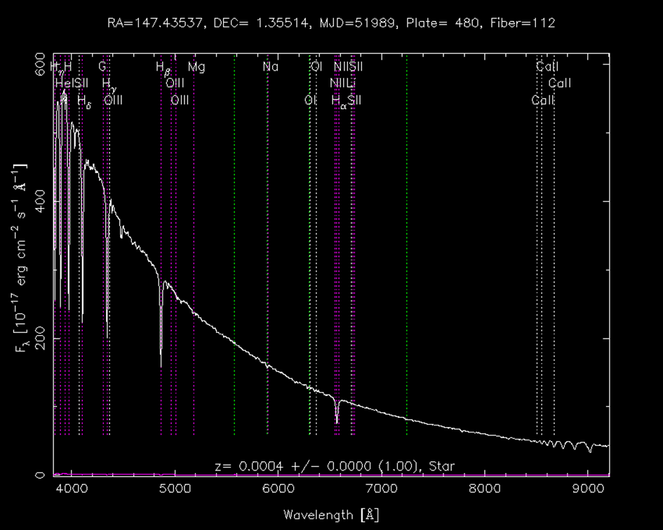
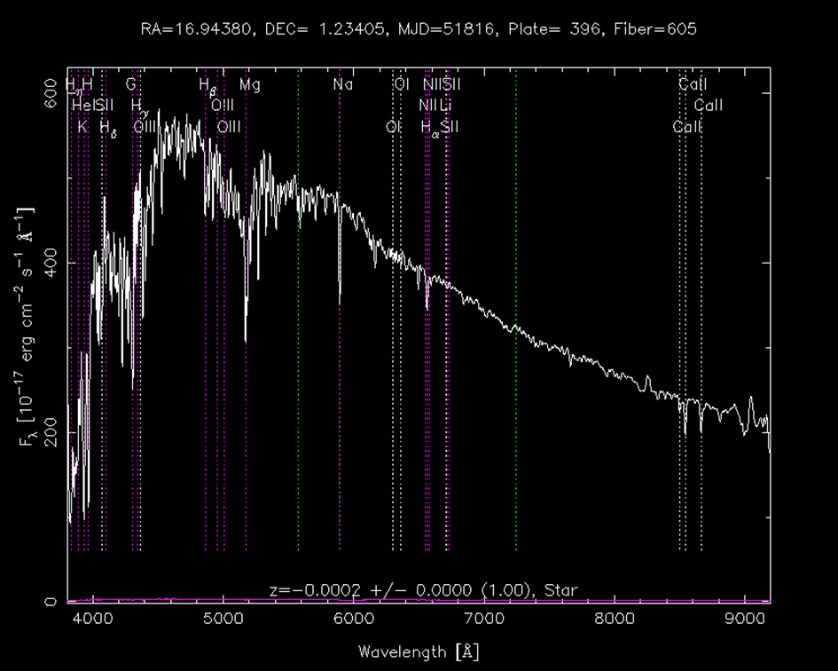
Blue and red stellar spectra
A type young blue star (short-lived)
K type red dwarf star (long-lived)

Slide 7
Red giant stars vs red dwarf stars
How they appear:
How they really compare:
Despite the huge difference in
radius and brightness they
can have very similar mass!
actually, they both appear as
faint dots, slightly smeared
A distant red giant
looks exactly like
a nearby red dwarf

Slide 8
Red giant stars vs red dwarf stars
red dwarf stars eventually become
red giants once they have
burned all Hydrogen in their
cores into Helium.
In a satellite dwarf galaxy, low mass stars
are still in the dwarf phase while
slightly larger mass stars are red giants

Slide 9
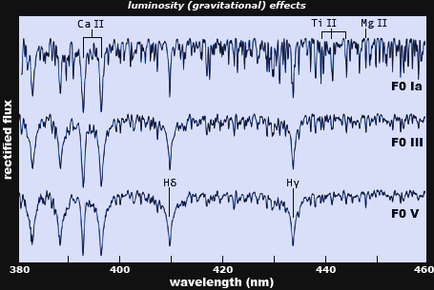
Red giant stars vs red dwarf stars
Red giant: narrow lines
Red dwarf: broad lines

Slide 10
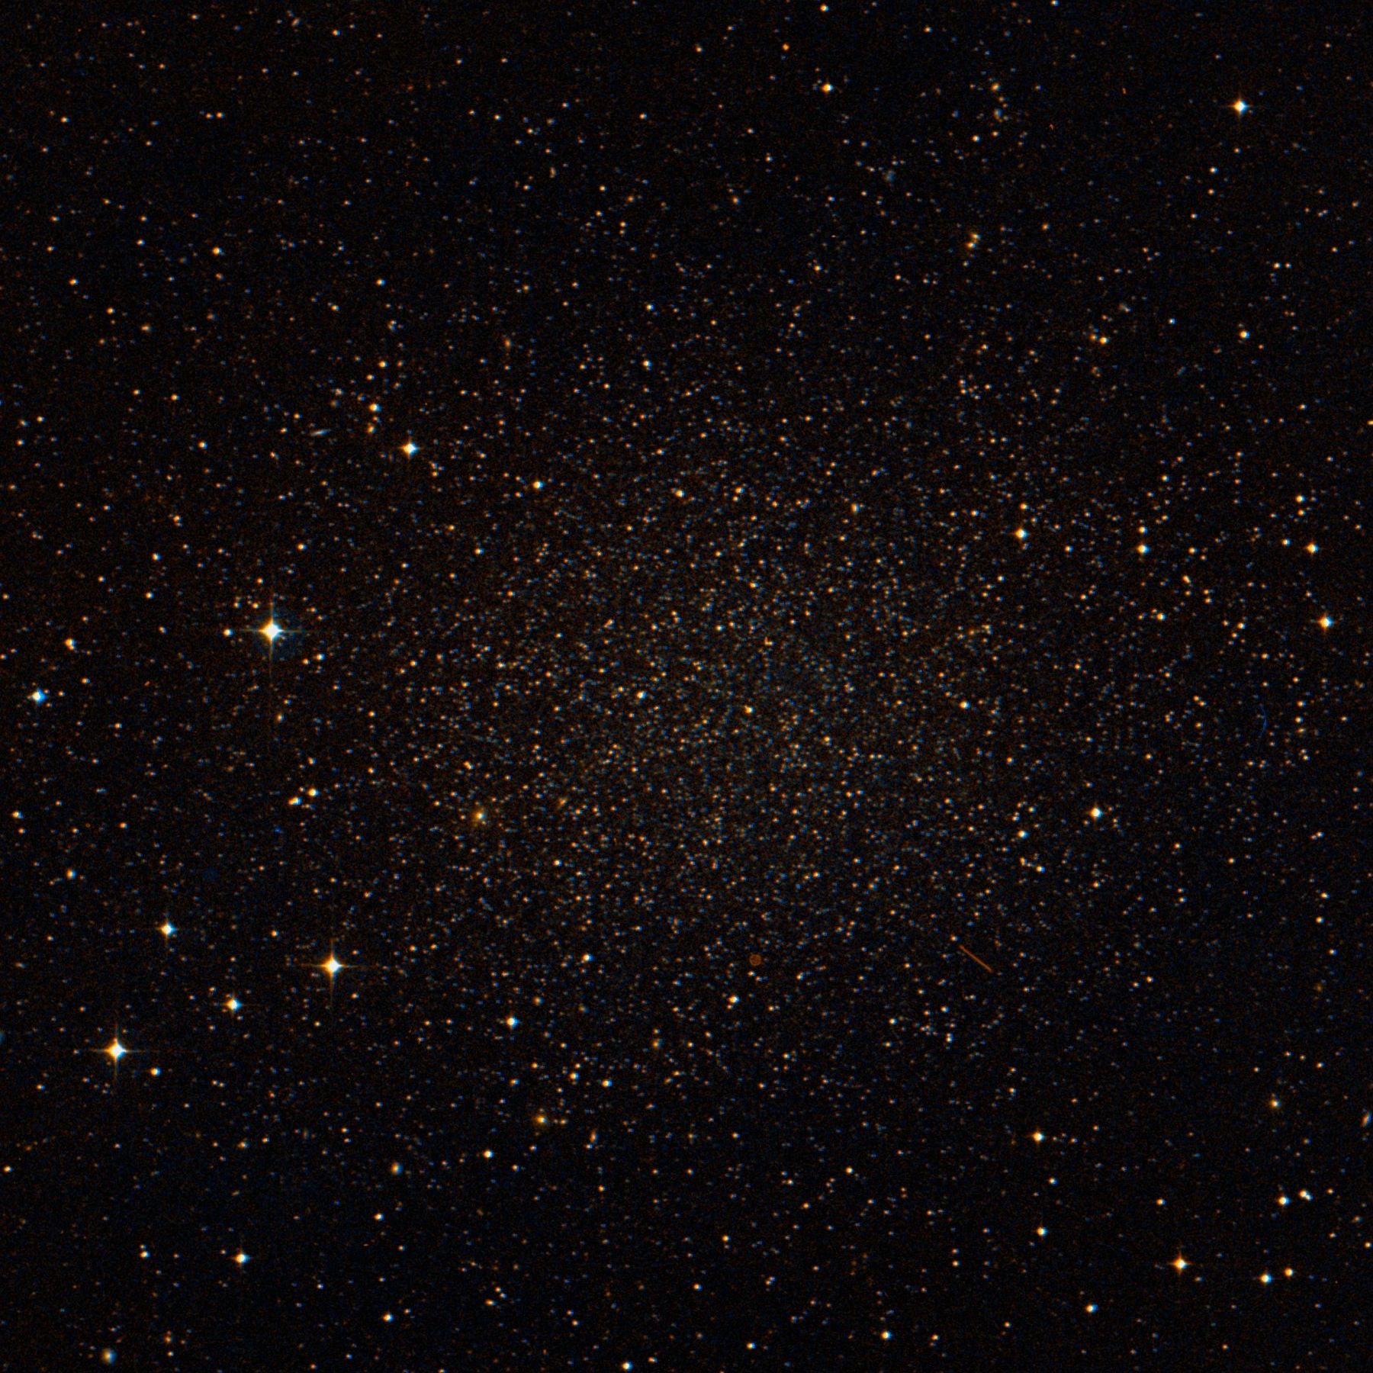
Dwarf spheroidal galaxy
Appears as an overdensity of stars
At a very large distance
Very old, red stars
Some of them are giants
Milky Way foreground
Nearby
Many red dwarf stars
We want to find the distant red giants. How?
At least we can calculate a membership probability

Slide 11
Photometric observations
We use multiple filters to photograph stars (colors)
We measure the magnitude (brightness)
everything else:
dwarf red stars of
different stellar
populations
of the Milky Way
red giants in a distant
satellite galaxy
color = temperature

Slide 12
Folding in the theory
Given the
metal content, mass and age of a star, we can calculate its color and brightness
Results of calculations are available in so-called isochrone tables
How can we invert the isochone tables?
Given the observed colors of a star, what are the possible physical parameters?
We don’t know the distance! Is it a red dwarf or a red giant?

Slide 13
We need more assumptions
We know quite a lot about the Milky Way
It consists of different stellar populations (disk, halo…)
Detailed model of the radial distribution of the stars
We think we know the mass function of the stars
There are a lot more low mass stars than massive stars
The dwarf galaxy member stars are at the same, but large distance

Slide 14
Bayesian Mixture Models
We model the problem as a mixture of stellar populations
For each population, we have priors (prescriptions) for the distributions of the parameters
We have some rough assumptions on the population weights
Every star belongs to exactly one population but we can’t tell which
We aim to calculate a membership probability
We want to fit the population parameters
Mean age and variance of red giant stars of the dwarf galaxy
As a byproduct, we calculate the probability distributions of all physical parameters of every single star

Slide 15
Monte Carlo on tens of thousand of stars
Almost nothing is known analytically, we have to go full numeric
Isochrone tables are non-invertible, degenerate functions
This is unfortunate, since
many MCMC codes (pyro, tf probabilty) usually aim at analytic Bayesian problems
e.g. No U-turn sampling (NUTS) where the kernel is differentiable
these problems can benefit a lot from automatic differentiation capabilities of deep learning frameworks
Our problem is computationally very intensive
Fast linear algebra on small but numerous matrices (SVD, Cholesky)
Fast random sampling of analytic but complex distributions
Isochrone table interpolation – iterative method

Slide 16
Spectroscopic targeting
Why is population membership so important?
We want to
observe member stars of satellite galaxies
but a fair sample of all stars is not necessarily the best!
Some stars carry more information than others
(more precisely: some subset of stars carry more information than other subsets)
trace the dark matter distribution better
maybe because they are further out from the center of the satellite galaxy

Slide 17
Implementation details
Code is written in eager mode TensorFlow
Easy debugging but no multi-GPU support
Some function could be compiled into execution graphs for more speed
Adaptive MCMC is implemented from scratch
None of the existing Bayesian libraries could handle the tricky isochrone interpolation and mixture models (sampling of categorical variables)
We could still reuse a lot from tf.linalg and tf probability
We are running on Tesla V100 GPUs with 12 GB of RAM
Enough to do 1 million isochrone interpolation in parallel
But powerful enough to run the MCMC only on about a 100k stars

Slide 18
Conclusions
Eager TF and other deep learning frameworks are excellent for implementing more traditional inference algorithms
GPUs enable tackling computationally very intensive problems
Advanced parameter inference algorithms can significantly increase spectroscopic survey efficiency

