Slide 1

Status of the ELI-ALPS laser facility
Péter Dombi

Slide 2
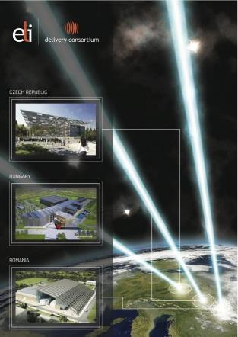
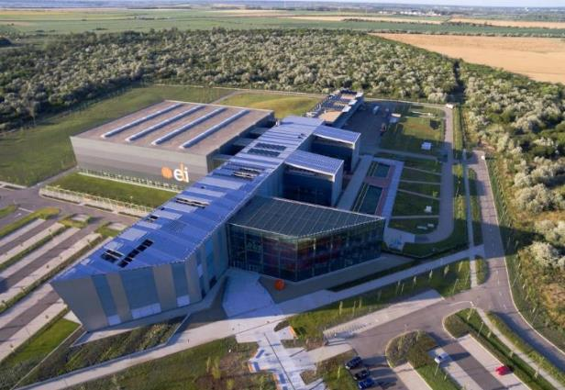
The ELI project: a laser user facility at 3 sites
3 complimentary pillars (CZ+HU+RO)
Mission of the ELI-ALPS pillar:
generate femtosecond and attosecond pulses
time-resolved electron dynamics in atoms, molecules, plasmas and solids.

Slide 3
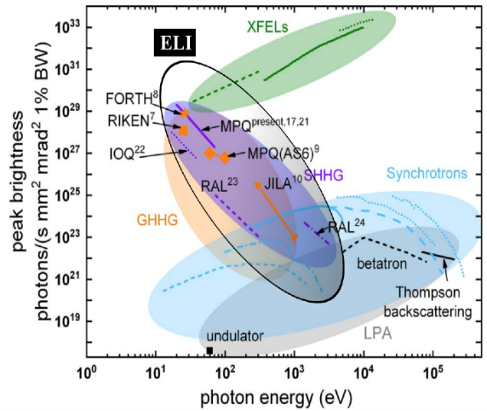
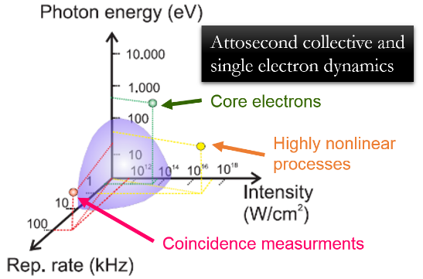
Global complementarity ELI-ALPS
J. Electron Spectros. Relat. Phenomena 204, 257 (2015)
J Phys B 50, 132002 (2017)
Optica 6, 280-287 (2019)

Slide 4
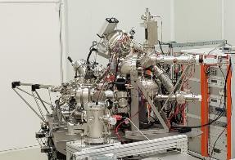
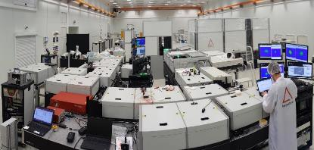
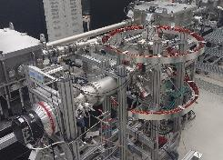
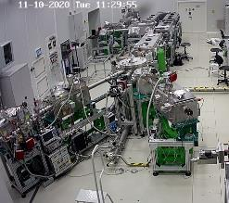
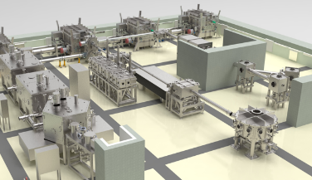
Portfolio of research opportunities
Capacity, Capability and Uniqueness
NanoEsca
Lasers
Endstations
Secondary sources
REMI

Slide 6
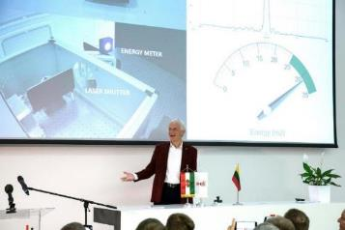
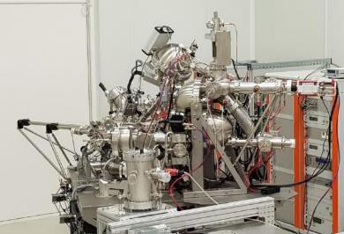
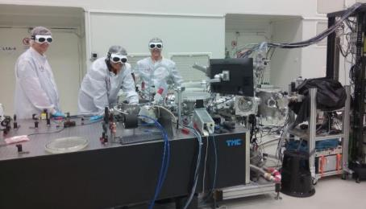
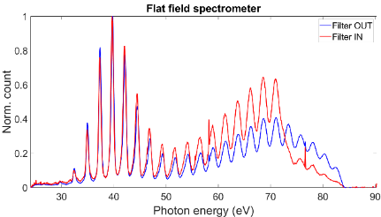
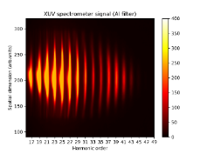
ELI ALPS - Achievements to date
Laser systems commissioned
5 of 9 lasers
user operational
Experimental stations / labs
5 of 12 experimental stations
user operational
1st attosecond pulses
~4 of 10 secondary sources user op
~40 completed collaborative / user campaigns
3000+ user hours

Slide 7
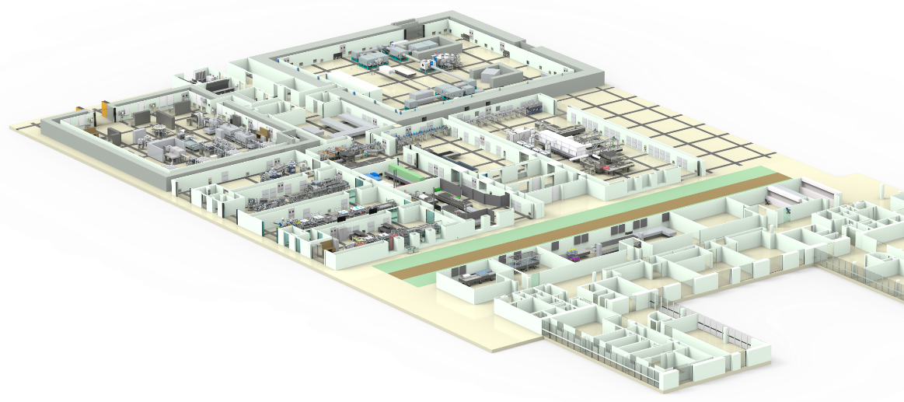
Facility overview
SYLOS 3
1 kHz, 8 fs, 120 mJ
SYLOS 2
1 kHz, 7 fs, 35 mJ
PW SHHG.
SHHG SYLOS
Transmutation
HF Physics (UFO).
SYLOS AL
10 Hz, 12 fs, 40 mJ
eSYLOS
PW Electron
HF PW
10 Hz, 17 fs, 34 J.
THz - NLTSF
SYLOS Long
THz pump
50 Hz, 500 fs, 500 mJ
SYLOS Compact
MIR HE (3.2 μm)
1 kHz, 40 fs, 15 mJ
HE THz
MIR HE HHG
NanoEsca
HR Condensed
RadioBiol
ReMi
HR Gas
MIR (3.2 μm)
100 kHz, 40 fs, 150μJ
HR1&HR2
100 kHz, 7 fs, 1 mJ
100 kHz, 7 fs, 5 mJ
VMI
NanoFab
Chem Reac Contr

Slide 8

Mid-infrared activity
~ 3μm
in development
MIR HE (3.2 μm)
1 kHz, 40 fs, 15 mJ
MIR (3.2 μm)
100 kHz, 40 fs, 150μJ
MIR HE HHG

Slide 9
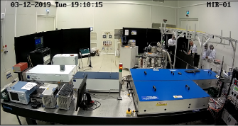
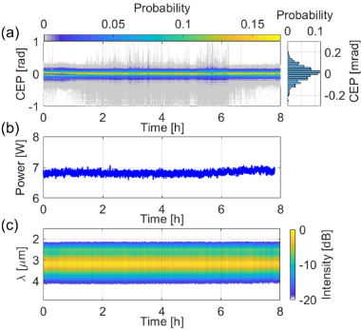
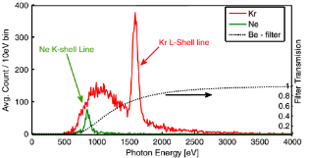
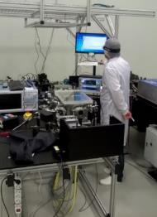

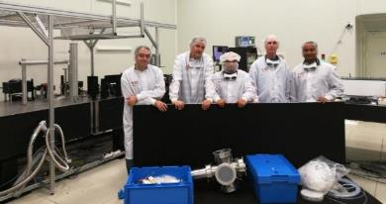
Status of the mid-infrared laser
user ready
14 user campaigns
Harmonics in bandgap materials
@10 kHz, active feedback loop, 82 mrad RMS
95% of points within [-150, +150]
0.9 % power stability
2.4 % pulse-to-pulse E stability
 | Parameters | Status | Operation due date
MIR | 100 kHz, <40 fs, 0.15 mJ, CEP 100 kHz, 17.5 fs, 88 μJ, CEP | Operational | since October 2017
FORTH-IESL
Paris Tzallas, et al.
Inner Shell x-ray Fluorescence
Hebrew University at Jerusalem
Gilad Marcus et al.

Slide 10
HR laser activity
100 kHz
HR Condensed + NanoEsca
HR Gas + ReMi/VMI
HR1&HR2
100 kHz, 7 fs, 1 mJ
100 kHz, 7 fs, 5 mJ

Slide 11

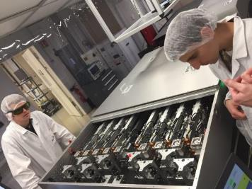
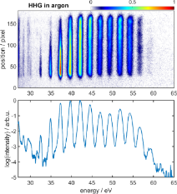

Status of HR laser
HR1: user ready
7 user campaigns
fiber laser technology
double MPC concept for postcompression to <7fs
ETH Zurich
HJ Wörner et al.
Study of dynamics in liquid phase
 | Parameters | Status | User readiness
HR1 | 100 kHz, 40 fs, 1.5 mJ 100 kHz, <7 fs, 1 mJ, CEP | Operational | since Dec 2017 Aug 2021
HR2 | 100 kHz, <6 fs, 5 mJ, CEP | In development | by Q4 2022

Slide 12

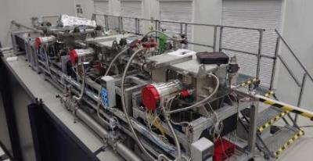
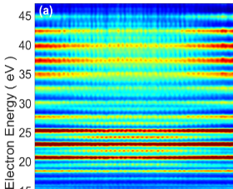
High harmonic generation beamline
user ready
XUV-IR pump-probe studies on gaseous targets at 100 kHz
diagnostics for the temporal, spectral and spatial characterization of the XUV pulses
flexible reconfiguration according to user needs (target area between CH04 nd CH05)
~166 as,
~150 pJ generated,
~50 pJ on target
@ 100 kHz
P. Ye et al., J. Phys. B 53, 154004 (2020)
P. Ye et al., submitted to Ultrafast Science (2021)
length of beamline: 856 cm
area of interferometer:
0,8 m x 3,6 m

Slide 13

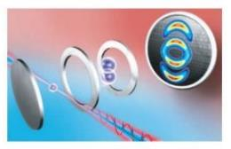
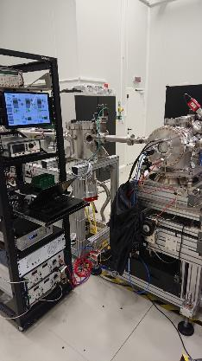

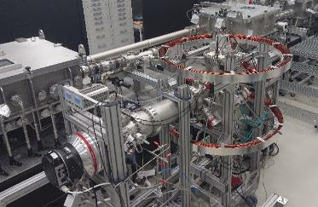
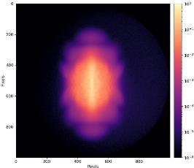
Experimental stations for gas phase studies
VMI-ES
user ready
mobile stations
to obtain energy- and angle resolved information on ions and electrons resulting from the photoionization or photofragmentation of atoms, molecules or nanoparticles
ReMi / Coltrims
Kinematically complete experimental study of ion and electron fragments detected in coincidence
Electron VMI, Xe, IR (ATI)

Slide 14


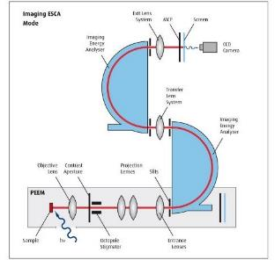
NanoESCA end station dedicated for condensed phase and surface dynamics
user ready
2 user campaigns
66 μm
Imaging Double Hemispherical Ananlyzer (IDEA)
Spin domains on an iron plate
(recorded at ELI w Hg lamp
lens system
TOF
Core capabilities, at 100 kHz XUV – IR / 70 MHz fs CEP oscillator:
Photoemission Electron Microscopy (PEEM) mode: laterally resolved microscopy of the sample surface with time resolution
Imaging Photoelectron Spectroscopy mode: lateral, time and energy resolution
Momentum microscopy: imaging of the momentum space, time and energy resolution
With a state-of-the-art Au/Ir(100) imaging spin filter (spin selective electron detection)
IR + XUV
MCP screen
sample

Slide 15
SYLOS activity
1 kHz
in development
SYLOS 2
1 kHz, 7 fs, 35 mJ
SYLOS 3
1 kHz, 8 fs, 120 mJ
SHHG SYLOS
Transmutation
SYLOS AL
10 Hz, 12 fs, 40 mJ
eSYLOS
SYLOS Long
SYLOS Compact

Slide 16


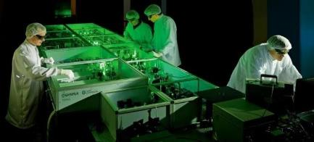
Status of SYLOS2 laser
user ready
3 user campaigns
Long term (>8h) operation
Energy stability: <1%rms
CEP stability: <200mrad
 | Parameters | Status | User readiness
SYLOS 2 | 1 kHz, <6.5 fs, 30 mJ, CEP | Operational | since May 2019
SYLOS alignment | 10 Hz, <12 fs, >40 mJ | Operational | since Jan 2019

Slide 17
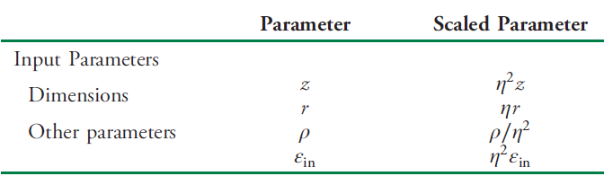

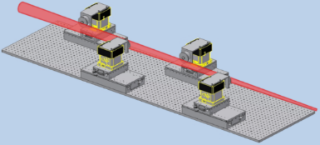
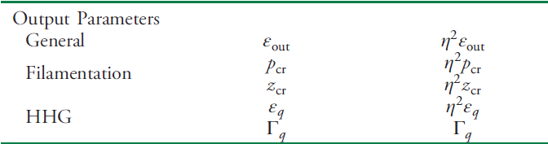
SYLOS high harmonic beamlines – scaling principles
Two beam lines – Two complementary approaches in phasematching
SYLOS GHHG COMPACT
SYLOS GHHG LONG
High pressure targets & loose focusing
Low pressure cell & very loose focusing
Quasi-phasematching
6 m
~1 mm

Slide 18

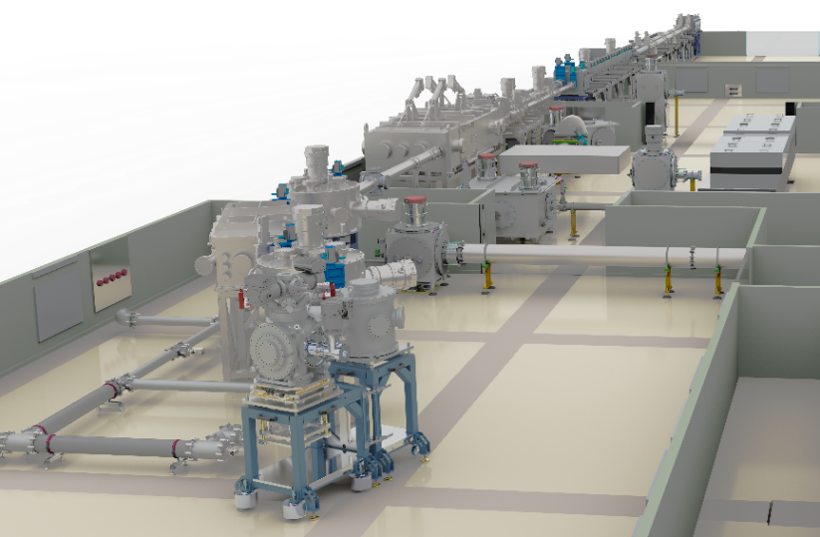
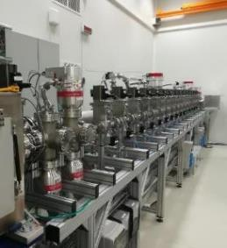
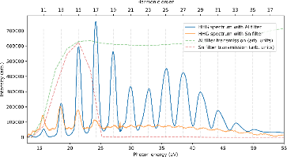
Sylos /long high harmonic beamline in commissioning
GHHG
Turning
User ready by Q3 2022
User ready by Q3 2022
Refocusing
Interaction
IR focusing
Interferometer
Split-and-Delay
Pump-probe options
XUV + XUV
XUV + IR
XUV + XUV + IR
XUV + XUV + IR + IR / SHG / THG / VUV / XUV

Slide 19
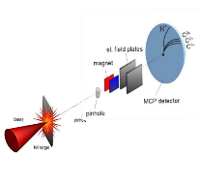

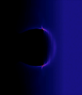
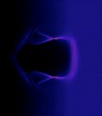
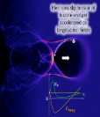
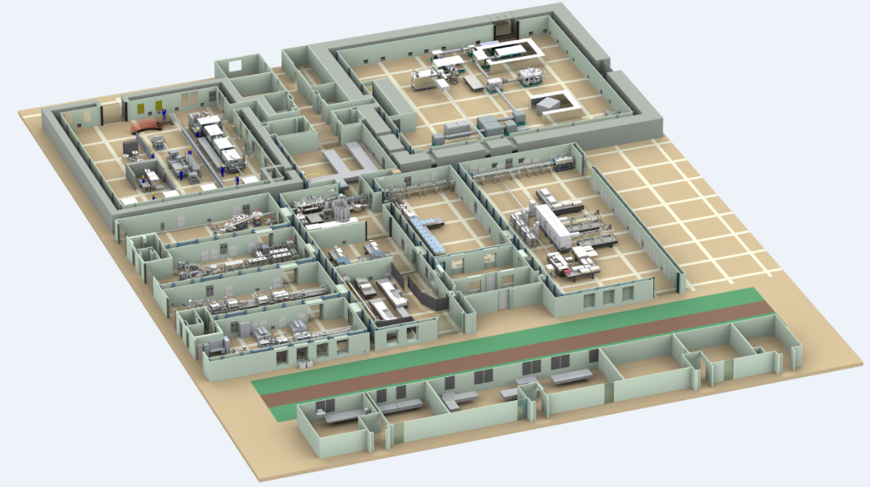
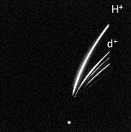

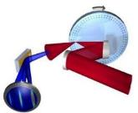

SYLOS driven high field interactions
User activity
Lu et al. PRSTAB 10, 061301, 2007

Slide 20
HF PW activity
10 Hz
HF PW
10 Hz, 17 fs, 34 J.

Slide 21
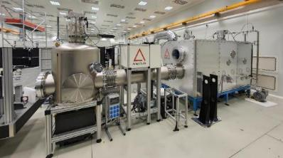

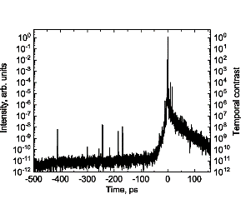
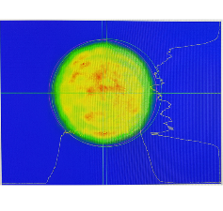
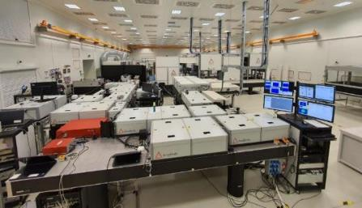
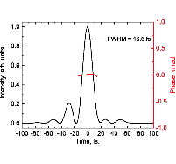
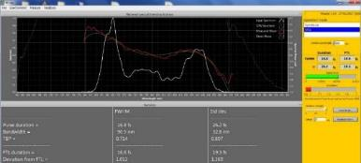
Status of the 2 PW laser system
User ready by Q4 2022
Energy: ≥ 23 J
@ 10 Hz
Compression of attenuated beam @ Twin 1
Duration: ≤17 fs
 | Parameters | Status | Operation due date
HF PW | 10 Hz, <17 fs, 34 J, 2 PW | Installation | by Q3 2022

Slide 22
PW driven high field interactions
PW SHHG.
HF Physics (UFO).
PW Electron
HF PW
10 Hz, 17 fs, 34 J.

Slide 23
THz activity
0.15-1.5 THz
THz - NLTSF
THz pump
50 Hz, 500 fs, 500 mJ
HE THz

Slide 24
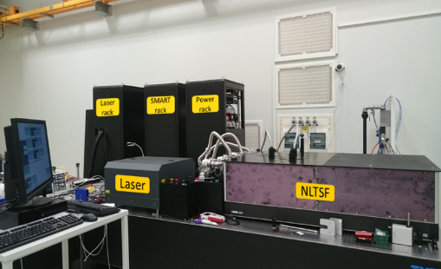

Nonlinear THz Spectroscopy Facility
user ready
8 user campaigns
THz pump—THz probe measurements
Charge carrier dynamics
Lattice anharmonicity
THz nonlinearities
Charge separation dynamics in biological molecules/complexes
[spectrally resolved THz imaging]
Pump laser (cryo-cooled Amplight)
  Wavelength: 1.03 µm
  Pulse duration: 200 fs
  Pulse energy: ≥6 mJ
  Repetition rate: 1 kHz
  Jitter to an external clock signal: ≤100 fs
  THz source:
  pulse energy: ≥10 µJ
  spectral maximum: in the 0.3-0.6 THz range
  useful spectral content: 0.15-1.5 THz
  peak THz field at the sample: ≥200 kV/cm

Slide 25


High Energy THz Beamline
user ready
Materials in extreme THz fields, phase transitions
Molecule orientation & alignment
Electron acceleration, manipulation, and bunch characterization
Relativistic (~1 MeV) ultrashort electron source for time-resolved diffraction & imaging (microscopy)
Proton post-acceleration
Pump laser: Amplitude Technologies
  Wavelength: 1.03 µm
  Pulse duration: 500 fs
  Pulse energy: ≥500 mJ
  Repetition rate: 50 Hz
  Synchronized short-pulse output:
    0.8 µm | 100 fs | 1 mJ | 1 kHz
THz source:
  pulse energy: ≥1 mJ
  spectral maximum: in the 0.3-0.6 THz range
  useful spectral content: 0.15-1.5 THz
  waveform: <2 cycles

Slide 26



Auxilliary facilities
Optical workshop for custom optics and coatings
(incl advanced metrology)
Zebrafish embryo model to investigate radiobiological effects of pulsed radiation.
Nanofab with EBL (8 nm resolution) and FIB (20 nm res),
plasmonics, nanooptics research, condensed matter analysis
RadioBiol
NanoFab

Slide 27

ELI-ALPS User Call
& Research Technology Information
User information
https://www.eli-alps.hu/en/Users-2/General-Information-2
user.office@eli-alps.hu
Online proposal submission system
ELI-ALPS provides beamtime as well as technical and scientific support for the experiments
Travel grant for young researchers
User office assists in project management, logistics arrangements, trainings, access procedures

Slide 28
THANK YOU
FOR YOUR
ATTENTION!

