Slide 1
Dynamic Electromagnetic Response of Viscous QGP
in Heavy Ion Collisions:
Magnetic Fields
Margaret Island Symposium on Vacuum Structure, Particles, and Plasmas 2022
Submitted Manuscript: C. Grayson, M. Formanek, B. Müller*
and J. Rafelski. “Dynamic Magnetic Response of Quark-Gluon Plasma to Electromagnetic Fields”
*Duke University
arXiv: 2204.14186

Slide 2
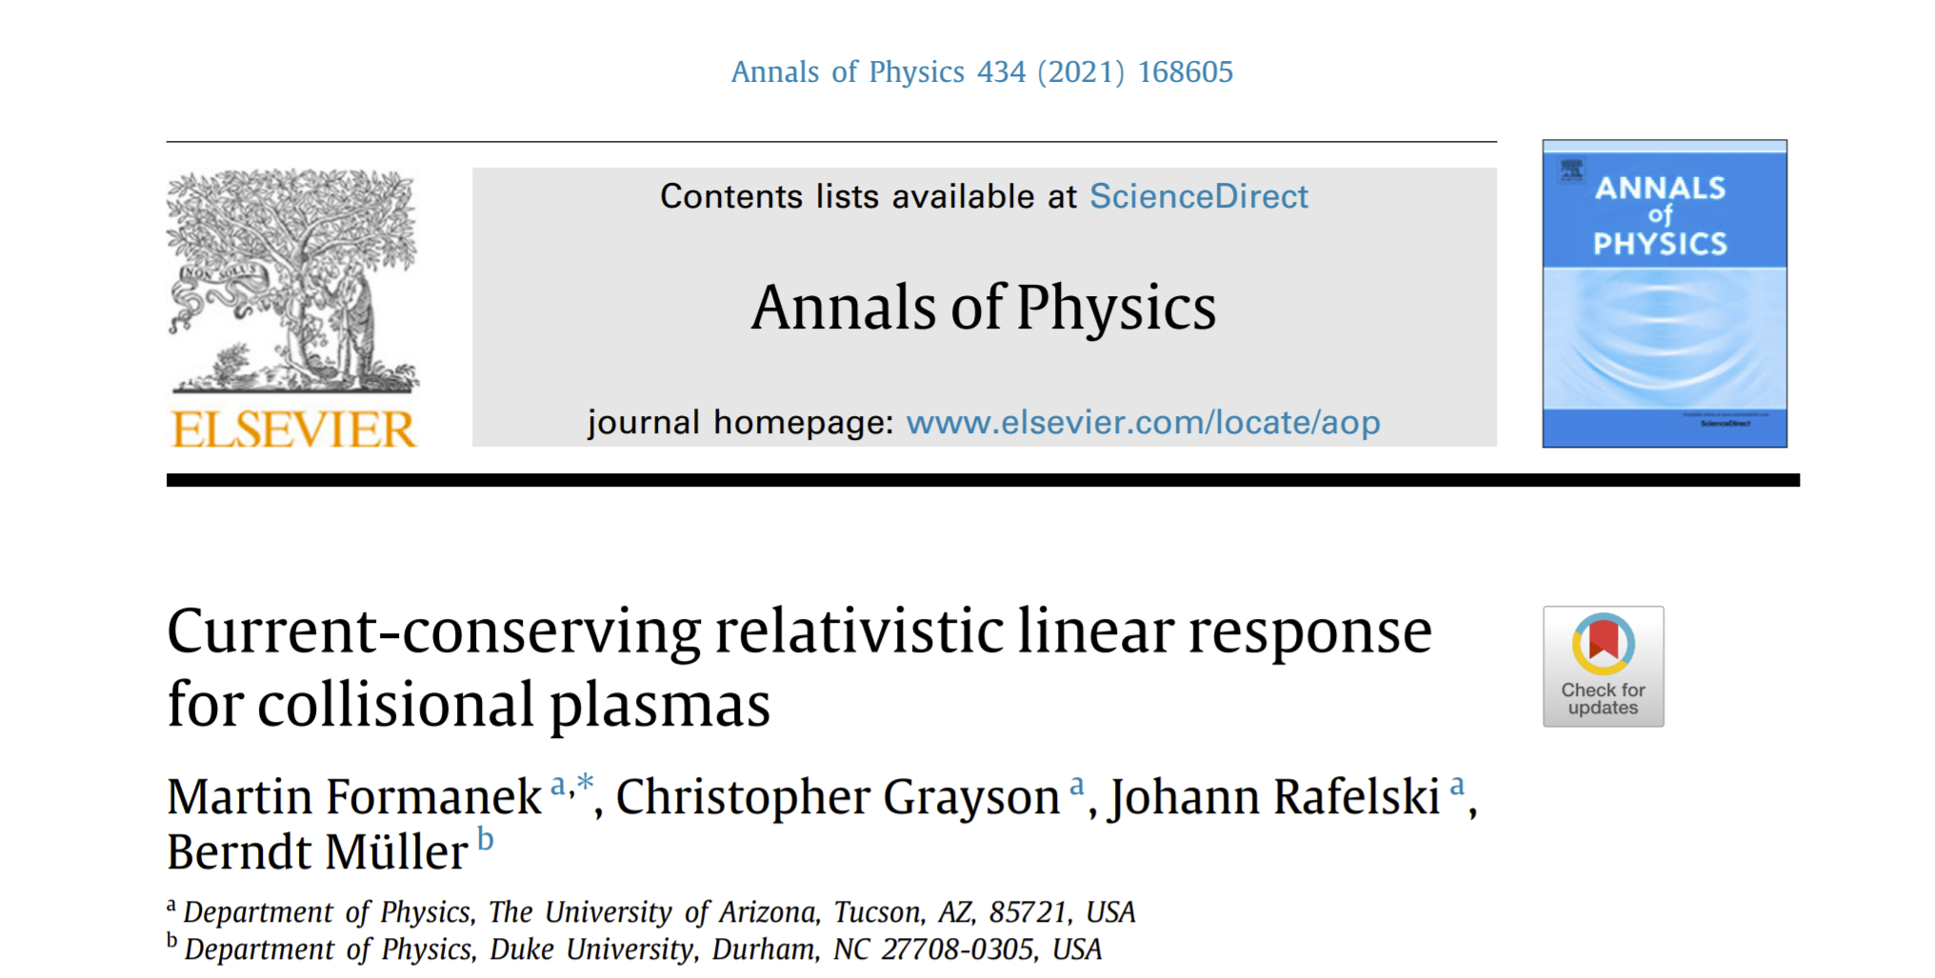
Current-Conserving Relativistic Linear Response
Applying previous work to QGP
Presents the polarization tensor for relativistic collisional plasmas.
M. Formanek, C. Grayson, J. Rafelski and B. Müller, Annals Phys. 434, 168605 (2021)
Electromagnetic Perturbations ↔ QGP Plasma
Calculate induced electromagnetic fields of QGP due to colliding heavy Ion fields.
Homogenous and Stationary
QGP
QGP

Slide 3
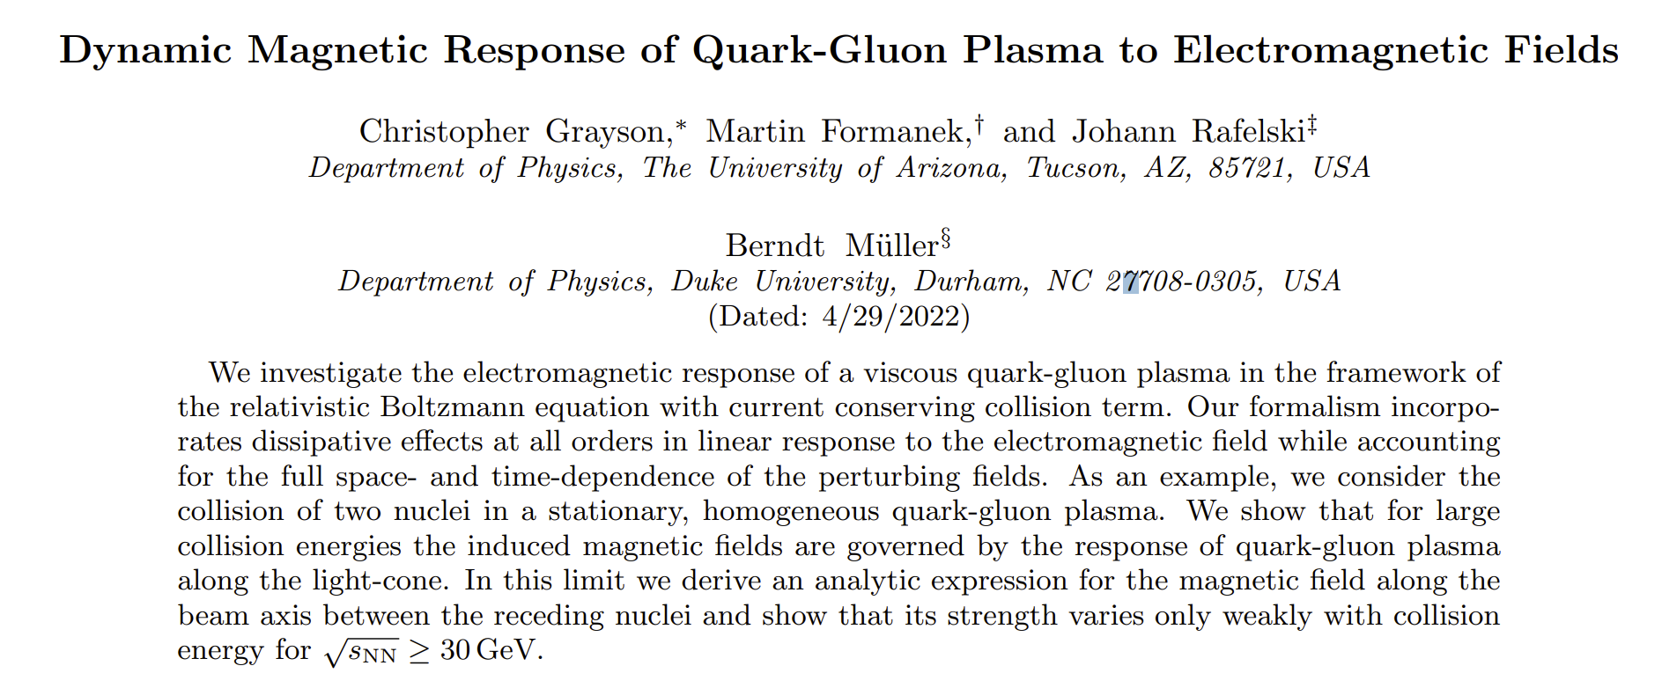
Dynamic Viscous QGP Response in Strong EM Fields
Forthcoming publication: arXiv: 2204.14186
Electromagnetic Perturbations ↔ QCD Plasma
We present:
The electromagnetic response of viscous QGP considering the full space- and time- dependece of perturbing heavy ion fields. (only constant and ideal conductivity previously studied)
The inclusion of collisions allows for a finite dynamic conductivity of QGP.
The corrected collision term generates a polarization tensor which conserves current and consequently energy.
QGP

Slide 4
Linear Response from the Vlasov-Boltzmann Equation
Using the Vlasov-Boltzmann equation for each quark flavor one can calculate the induced electromagnetic current in linear response and identify the polarization tenso M. Formanek, C. Grayson, J. Rafelski and B. Müller, Annals Phys. 434, 168605 (2021)
𝜅 is the QGP strong damping parameter and is obtained from the inverse of the (collisional) relaxation time 1/𝝉.
Where the current due to up, down, and strange quarks is,
ind
The first order response of a medium to fields can be described in fourier space using a simple relation,
Where Is the polarization tensor is the fourier transformed induced current in the medium and is the fourier transformed perturbing 4-potential of the colliding ions.
k is the 4 vector
Ohm’s Law
(R. Starke and G. A. H. Schober, Int. J. Mod. Phys. D 25, 1640010 (2016)
Notes:
We calculate the Polarization tensor in linear response and extract the conductivity in certain limits dletede

Slide 5
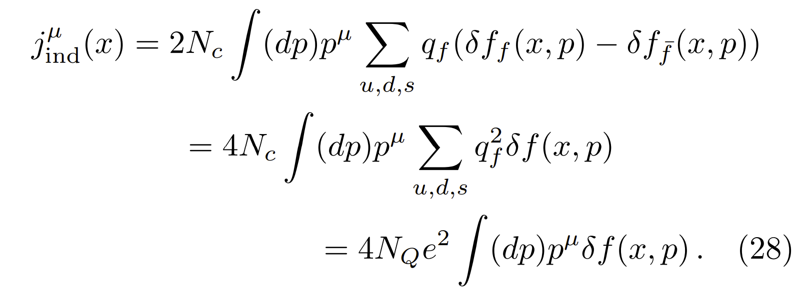
Linear Response from the Vlasov-Boltzmann Equation
Using the Vlasov-Boltzmann equation for each quark flavor one can calculate the induced electromagnetic current in linear response and identify the polarization tenso M. Formanek, C. Grayson, J. Rafelski and B. Müller, Annals Phys. 434, 168605 (2021)
𝜅 is the QGP strong damping parameter and is obtained from the inverse of the (collisional) relaxation time 1/𝝉.
Where the current due to up, down, and strange quarks is,
ind
Using this current one can calculate the polarization tensor using the method shown in the previous talk,
The polarization tensor is identical besides a change in the Debye mass due to the extra degrees of freedom.
- Enhancement due to quarks and color
Notes:
Explain origin of debye mass?

Slide 6
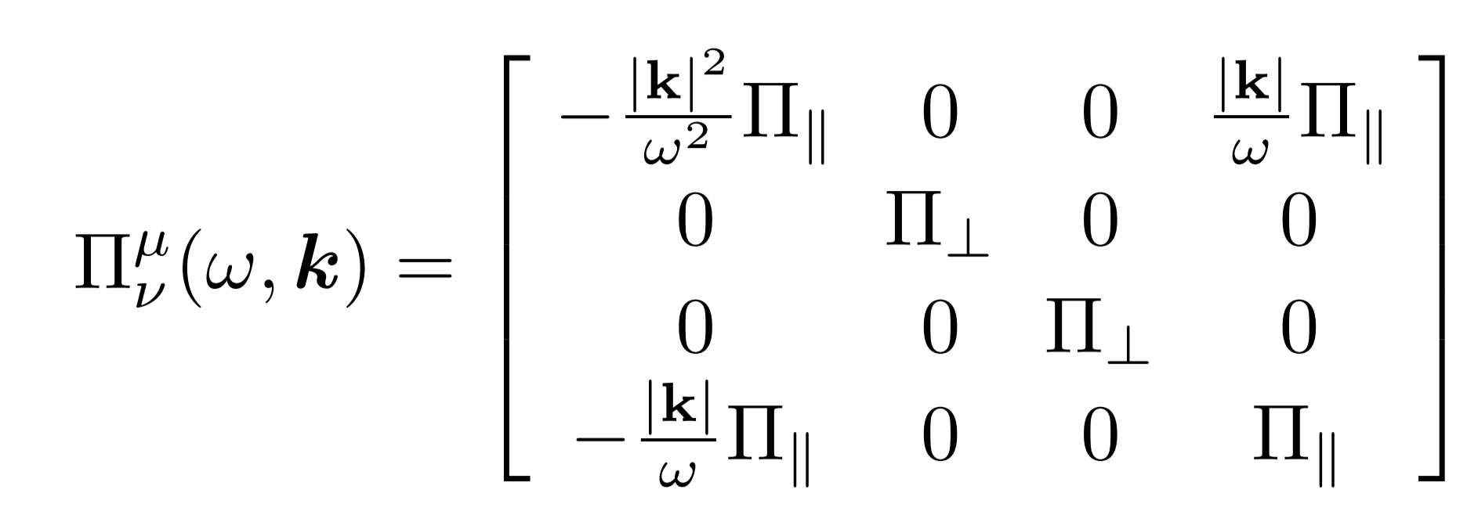
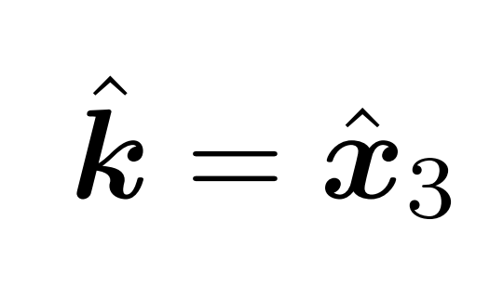
Electromagnetic Polarization Tensor: Infinite Medium
The polarization tensor for an infinite homogeneous plasma is composed of two independent response functions which can be found by projecting onto k and considering longitudinal and transverse polarization functions.
rest
Calculated in the ultrarelativisitic (p >>m) limit
Not to be confused with “transverse” and “longitudinal” to the collisions axis
Where m_{D} is the electromagnetic Debye mass of the plasma
Here we have chosen k to point along the third component x₃.
H.A. Weldon, Phys. Rev. D 26 (1982)
Notes:
{\color{Teal} \vec{\boldsymbol{A}} }, A is projected onto k

Slide 7
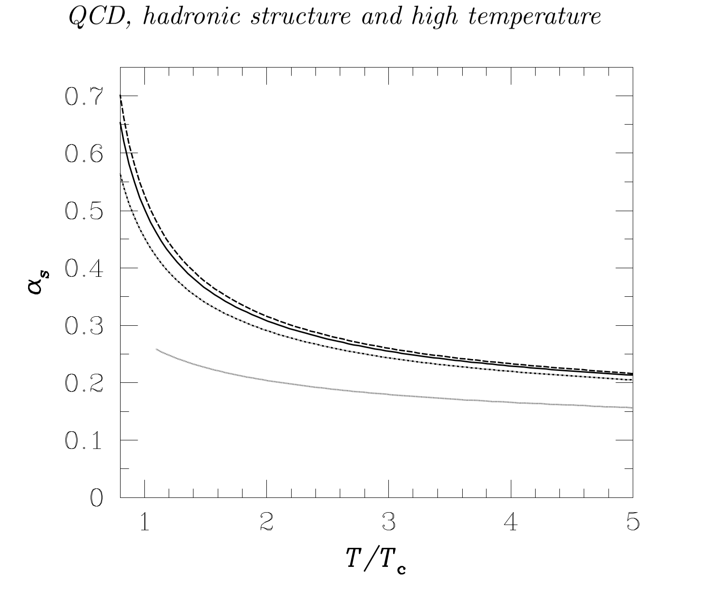
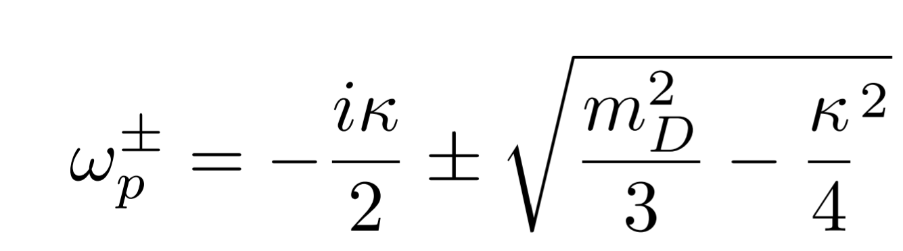
Estimating Quark Collision Term
To get an estimate of 𝜅 we multiply the parton-quark transport cross section by the parton density,
(P. Danielewicz and M. Gyulassy, Phys. Rev. D 31, 1985)
(Mrowczynski, Acta Phys. Polon 1988)
Where we model how the strong coupling varies with temperature using a fit.
Plasma Oscillation Frequency
If then plasma oscillations are overdamped
(Hadrons and Quark Gluon plasma, Letessier, J.,Rafelski 2002)
Notes:
Alpha 0.5 because of low momentum partons, the g^2ln(4 pi/g^2)t , choice of infrared cutoff ,

Slide 8
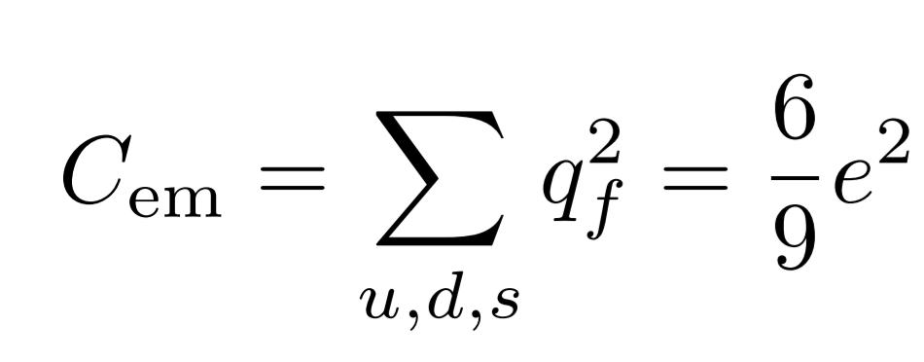
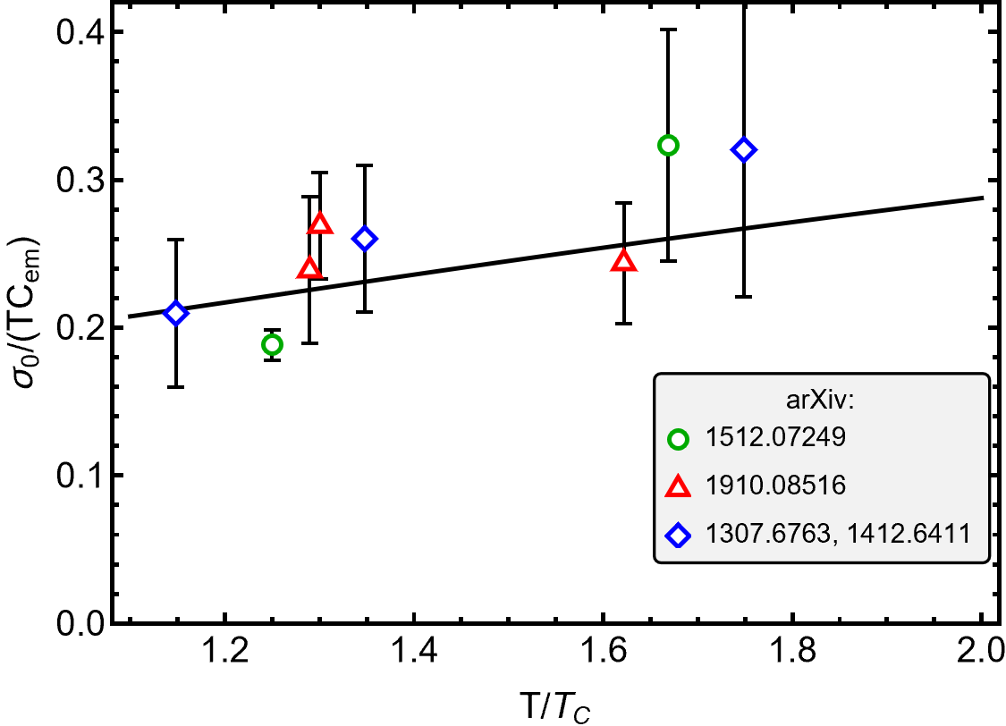
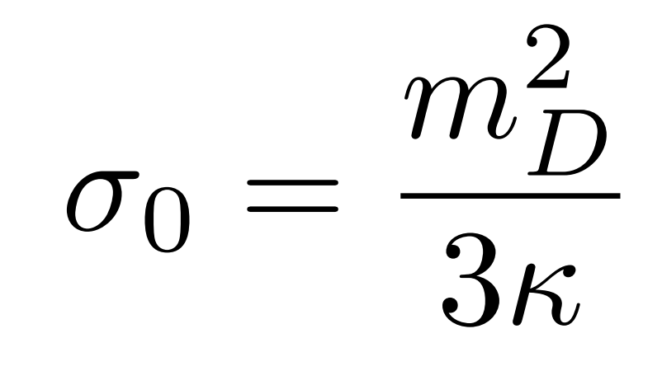
Comparison with Lattice Results
Kappa can also be compared to lattice conductivity calculations
Static conductivity
“Debye mass”
“QCD damping parameter”
Notes:
Alpha 0.5 because of low momentum partons

Slide 9
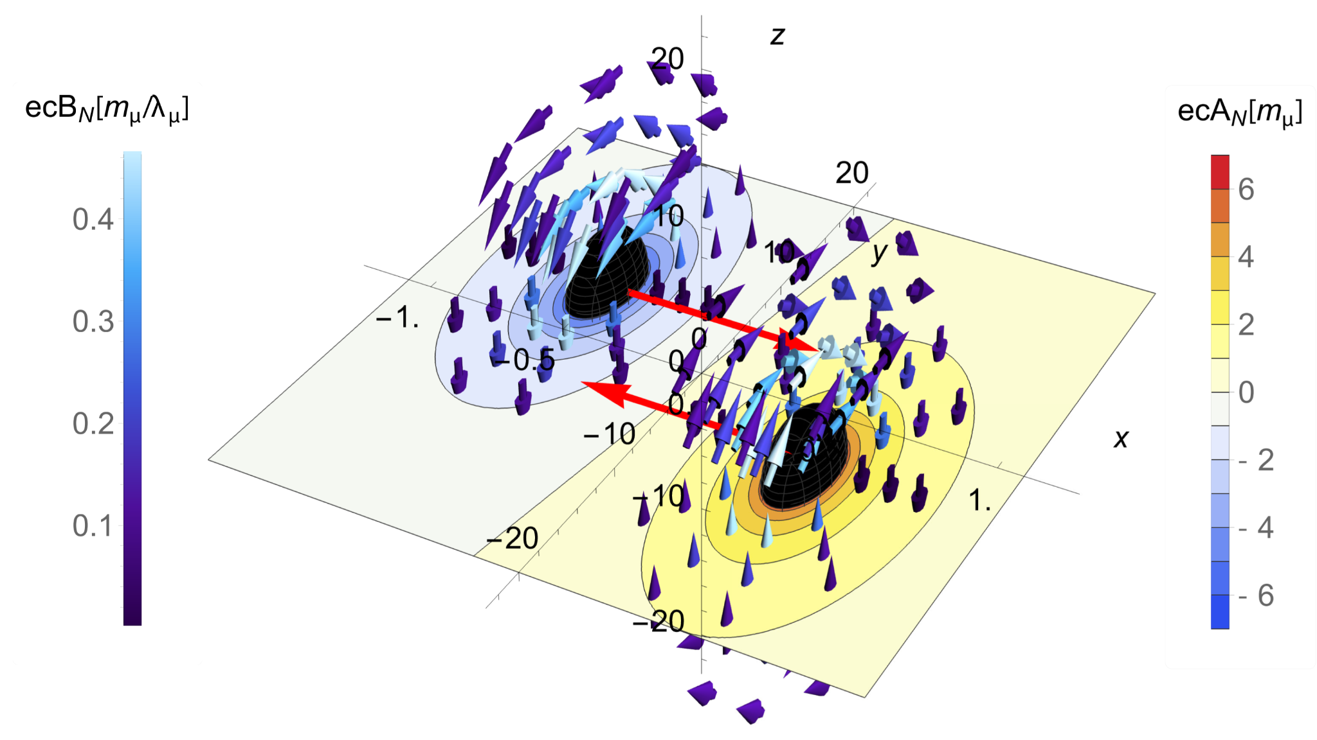
Magnetic field at the Center of Colliding Ions
For simplicity we present the magnetic field at the center of QGP where the magnetic field is largest.
t = 0

Slide 10
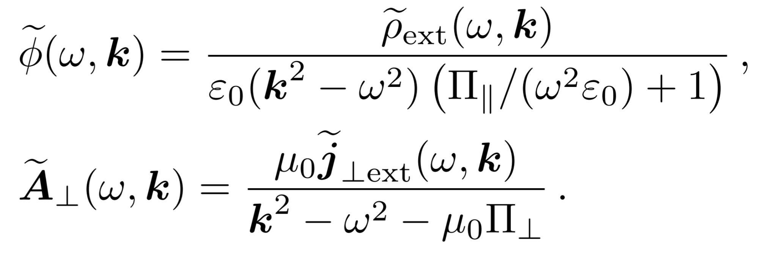
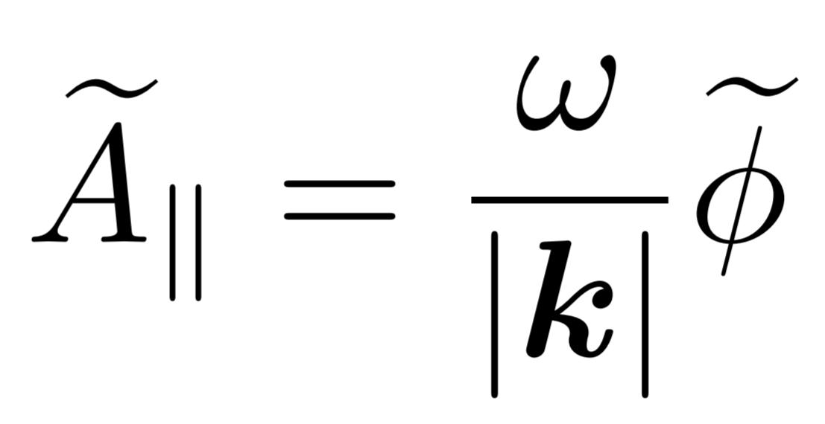
Self-consistent Fields
In order to calculate the induced charge and field using the longitudinal and transverse response functions one must project vector perturbations onto k
Then solving maxwell's equations in projected space one find the self consistent potentials,
Thus are 4-vectors in the different coordinates are,
The self consistent potentials can be used to calculate the self consistent fields.
Then we fourier transform the fields back to position space
Magnetic field at the origin
Notes:
Why are we focussing on magnetic field at the origin, picture of nuclei (location of calculation)

Slide 11
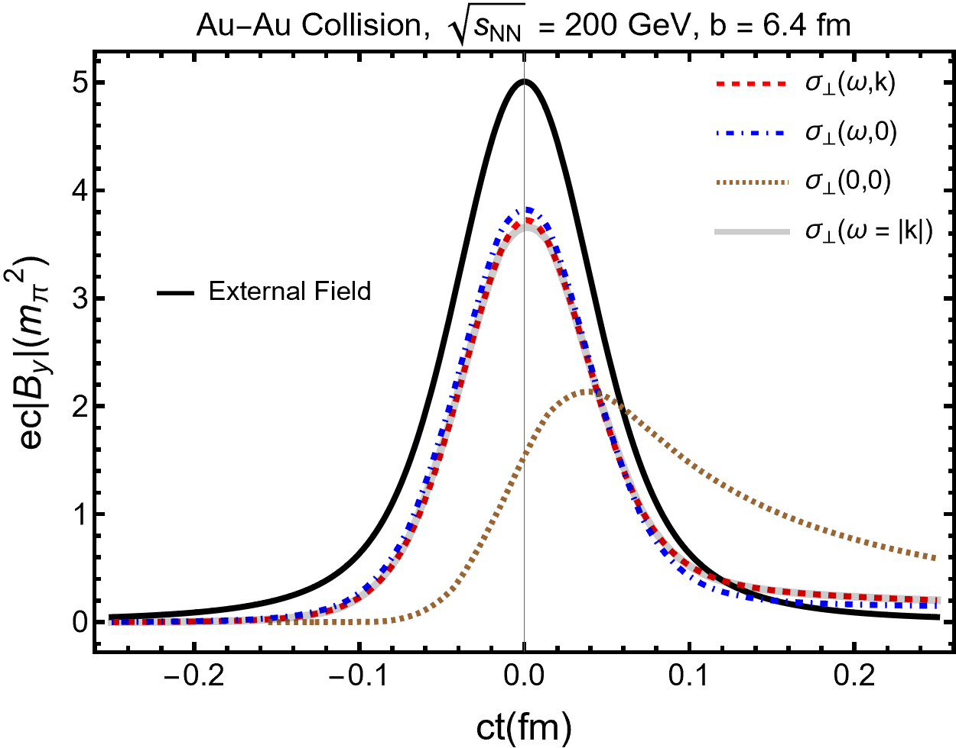
Magnetic Field of Heavy Ion Collisions at the Origin,
Electric field is shown in supplemental slides
Full time and space dependent response
Only time dependent response (Drude model)
Light-cone conductivity
Ohm’s Law
Static Conductivity
K. Tuchin, Phys. Rev. C 88 (2013)
Magnetic field persists due to induced currents.

Slide 12
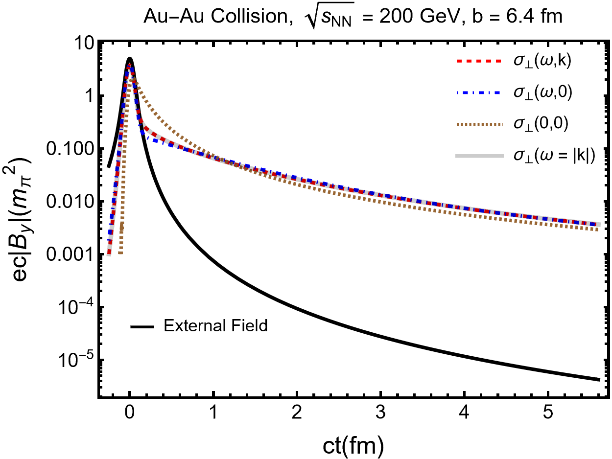
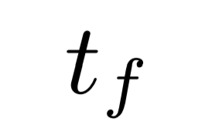
Magnetic Field of Heavy Ion Collisions at the Origin,
Electric field is shown in supplemental slides
Dynamic effects are important for t < 1/𝜅
After the solutions begin to approach the static solution:
At the freeze-out time the QGP begins to hadronize.
“Why does the light-cone solution match the full solution?”
- “Freeze-out time”

Slide 13
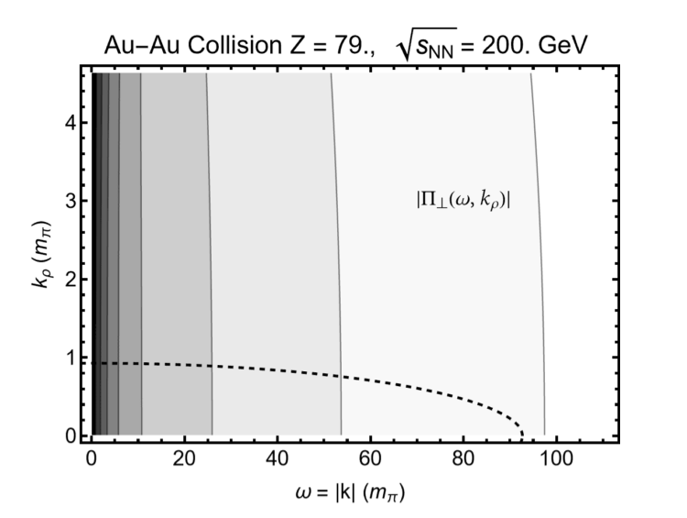
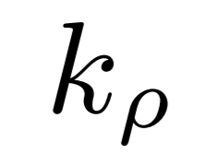
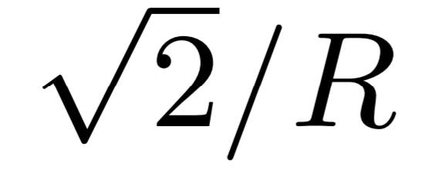
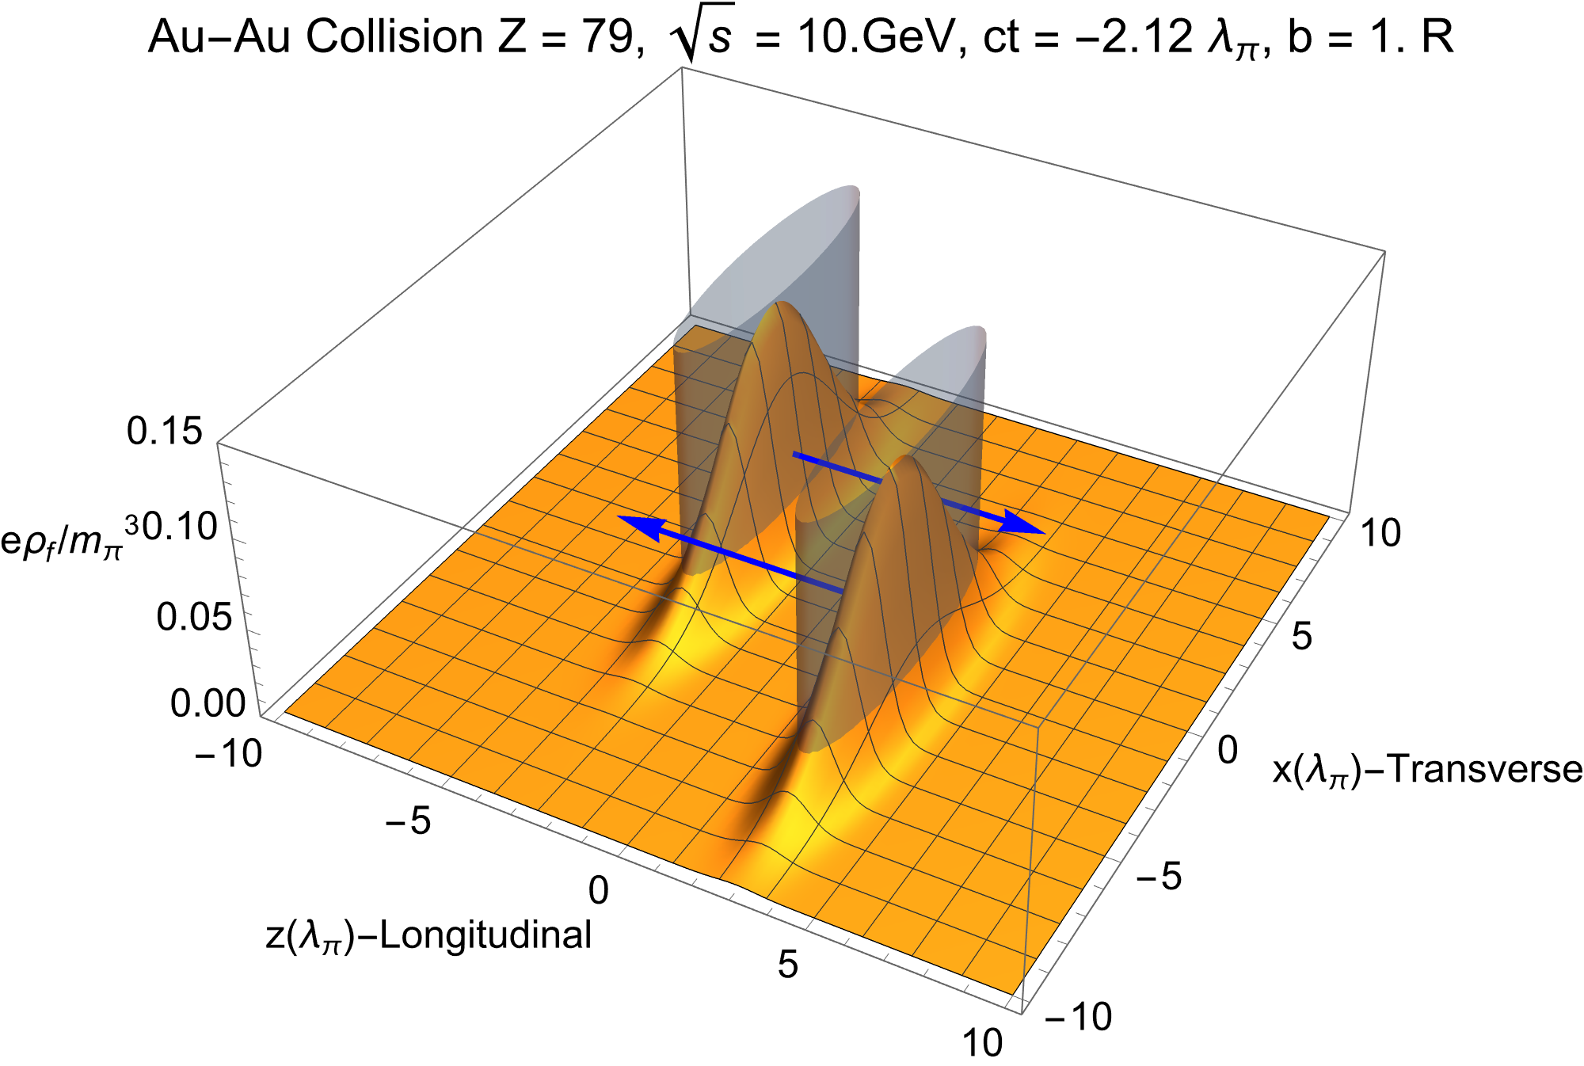
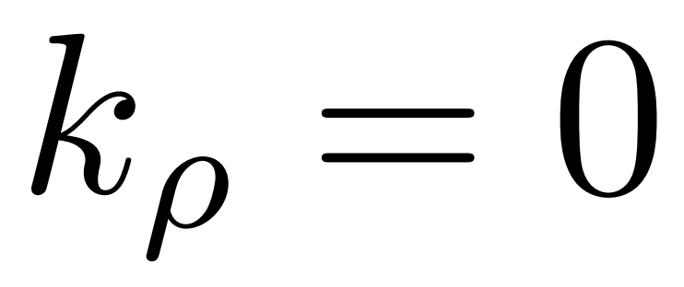
Light-cone Conductivity for Ultrarelativistic Ions
Width
Width
“Region of 2 sigma support”
The conductivity does not vary with and we can use its value at
“Lorentz contraction in direction of motion”
Notes:
This could be helpful for traverse size

Slide 14
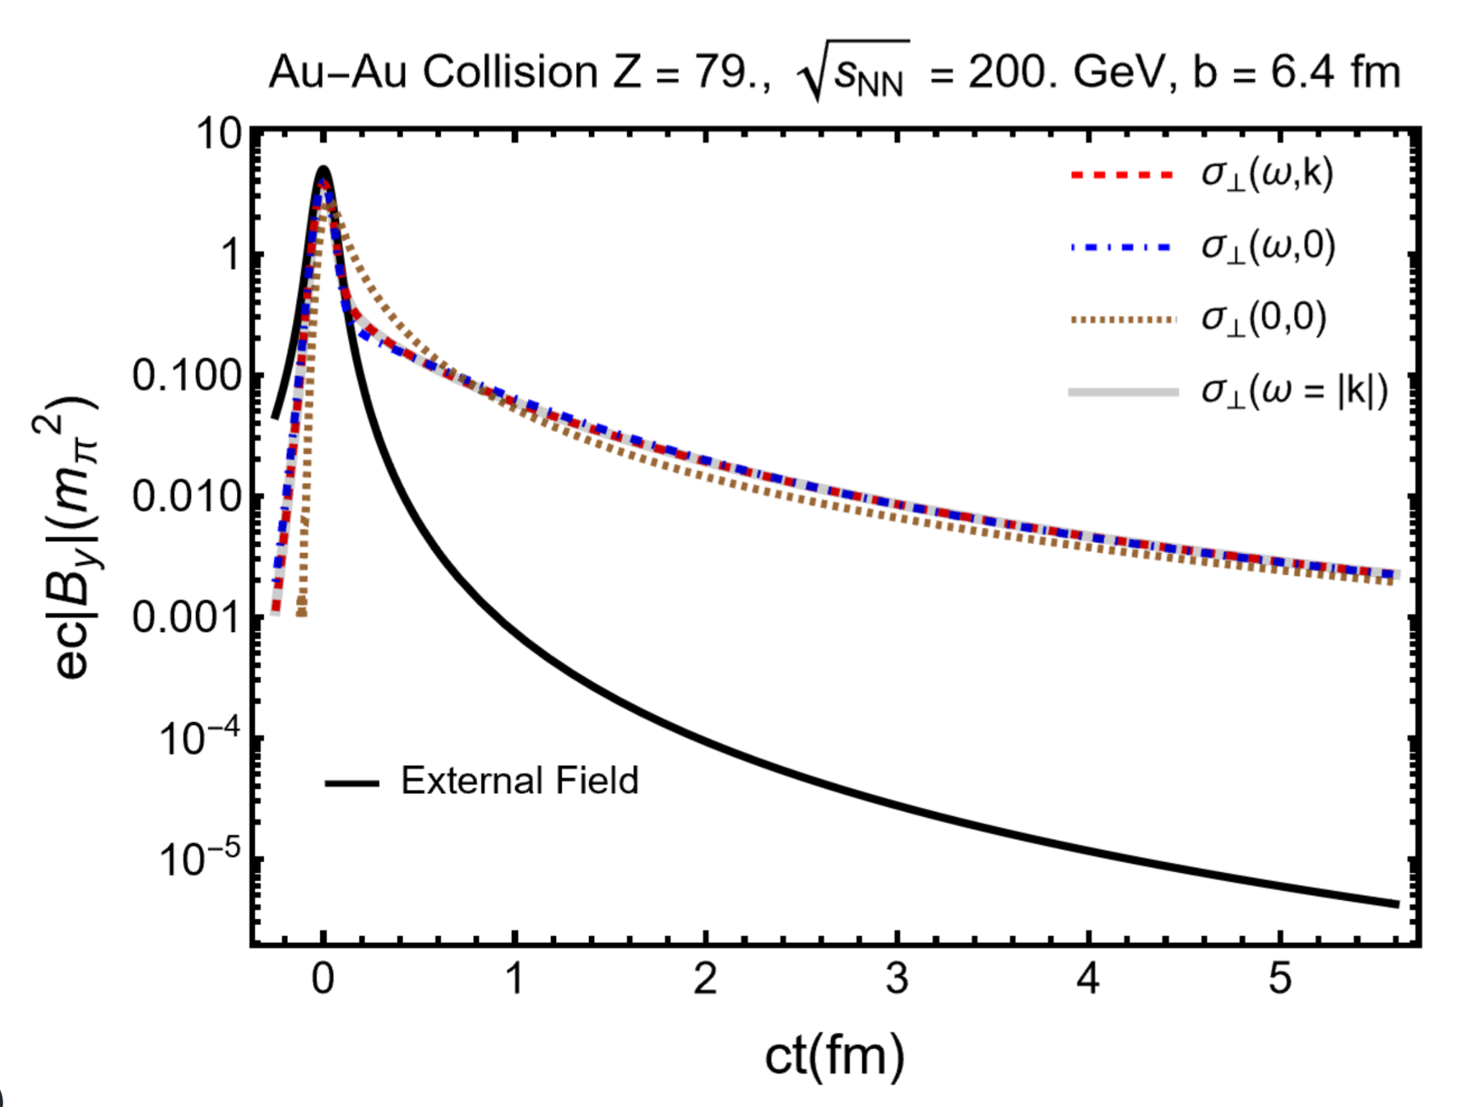
Magnetic Field of Heavy Ion Collisions at the Origin,
Expansion of the light cone conductivity in 𝜔/𝜅:
“Late time solutions do not depend on 𝛾.”
“Drude conductivity”
Simplified form of the denominator allows for contour integration:
K. Tuchin, Phys. Rev. C 88 (2013)

Slide 15
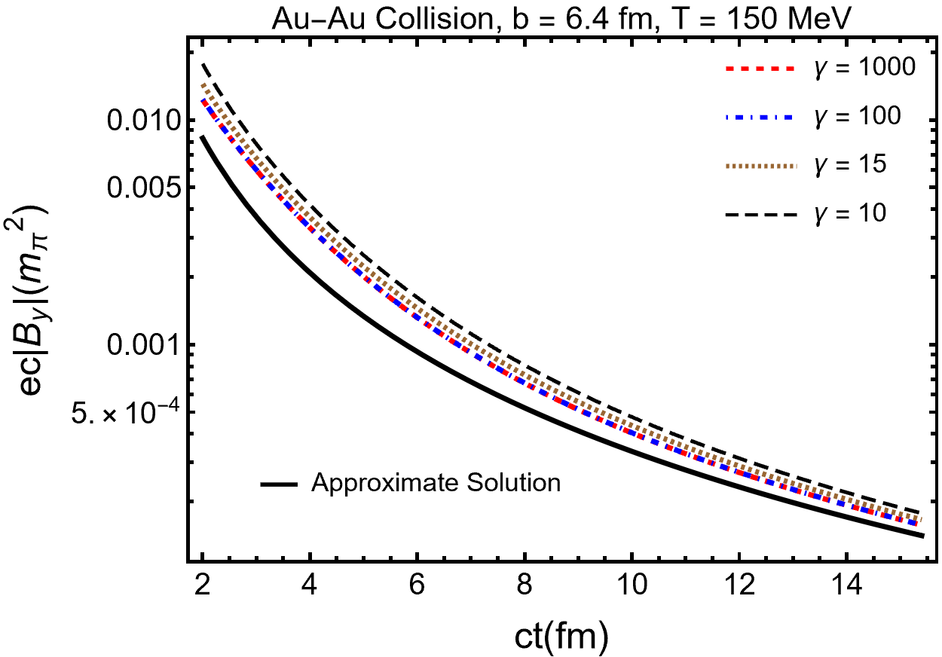
Freeze-out Magnetic Field at the Origin,
Freeze-out magnetic field induces polarization in final hadron spectrum
Numerical solutions for the full polarization tensor:
Approximation expected to apply till
“Static Conductivity solution”
“Freeze-out magnetic field depends more on than on collision energy”

Slide 16
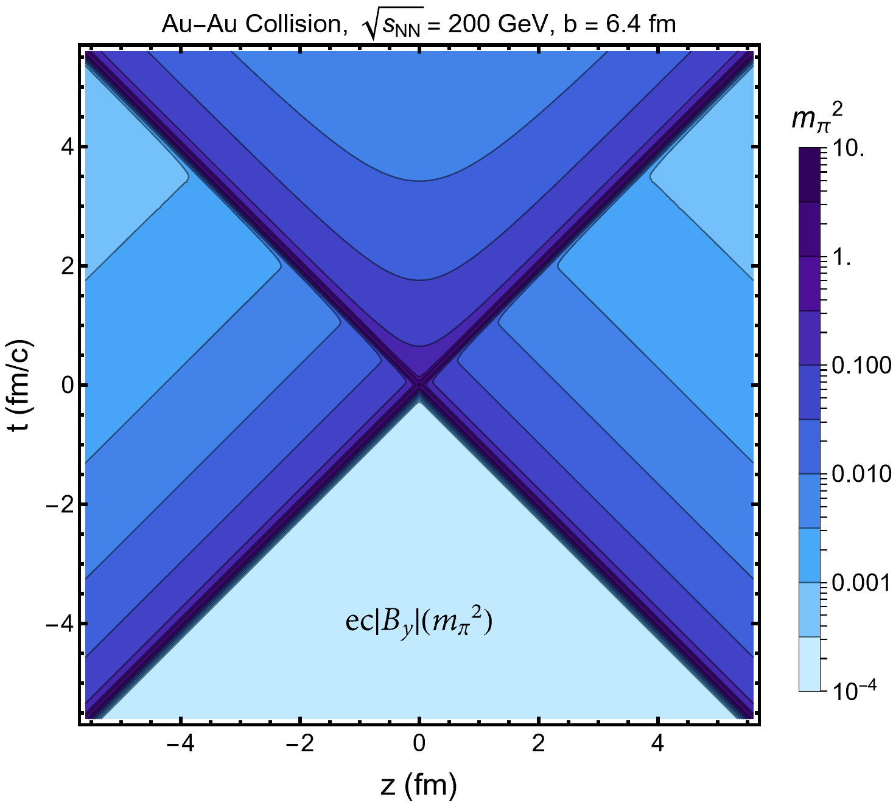
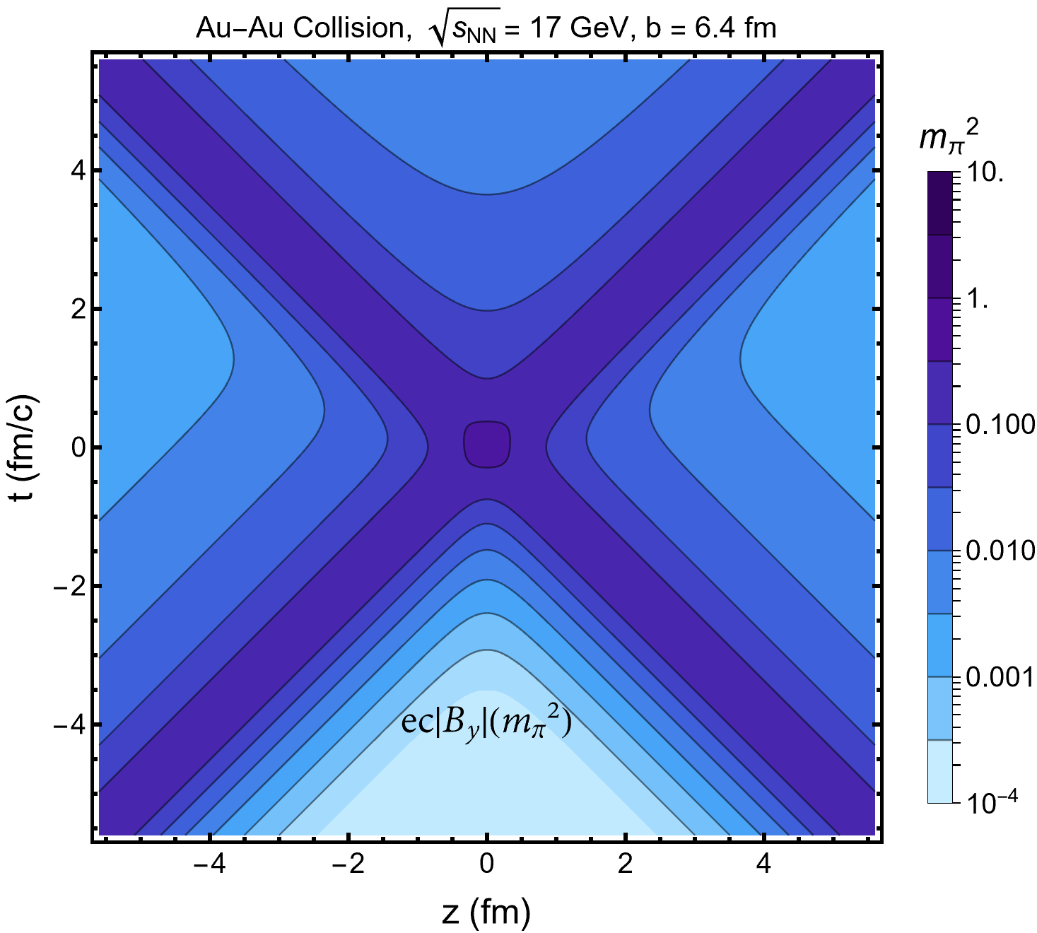
Space-time Magnetic Field,
Larger freeze-out field due to smaller freeze out time
Larger peak field
Notes:
The field at the higher collision energy (on the left) has a higher peak magnetic field. For lower collision energy (on the right) the field is less Lorentz contracted, and leads to a magnetic field at late times that is a factor of ∼ 1.1 larger. The freeze-out magnetic field will increase at lower collision energy mainly due to the decreasing freeze-out time.

Slide 17
Outlook: Just at the Beginning
Thank You!
Early Universe Plasma and BNN (See lecture by Cheng Tao Yang)
BBN fusion reactions in damped electron-positron-plasma.
Electric field: pair production and characterization of electric field in QGP.
QGP Switch-On and Evolution: create a realistic spacetime picture of the plasma.
This can be done by adding a source to the neutral plasma in the boltzmann equation.

Slide 18
Supplemental Slides

Slide 19
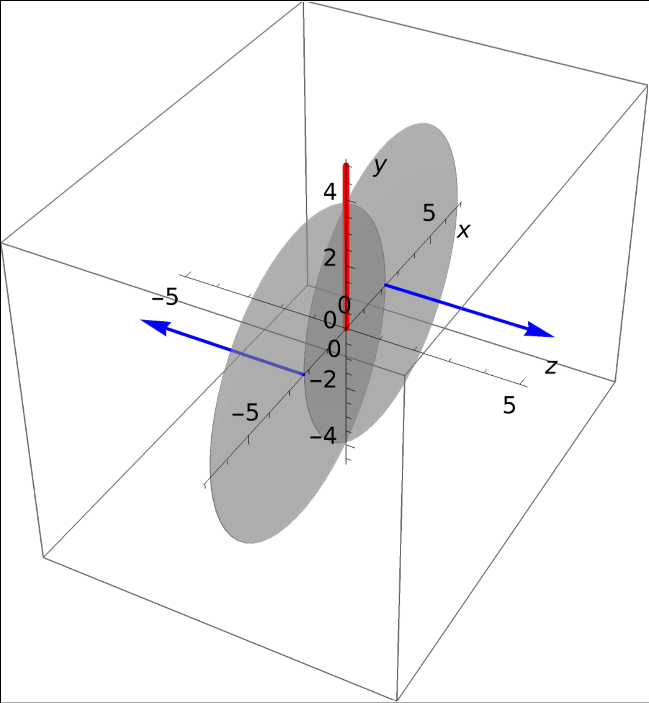
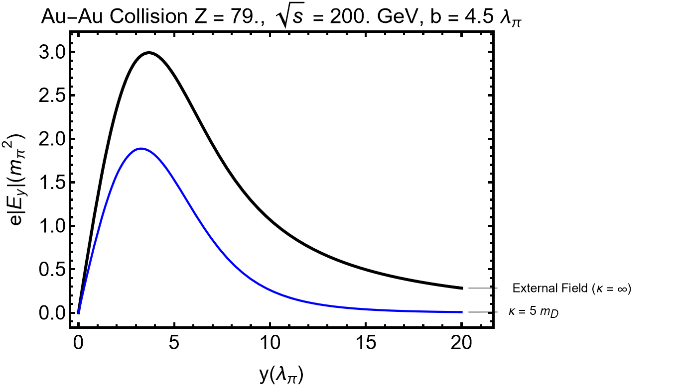
Electric Field
Transverse electric field is suppressed.

Slide 20
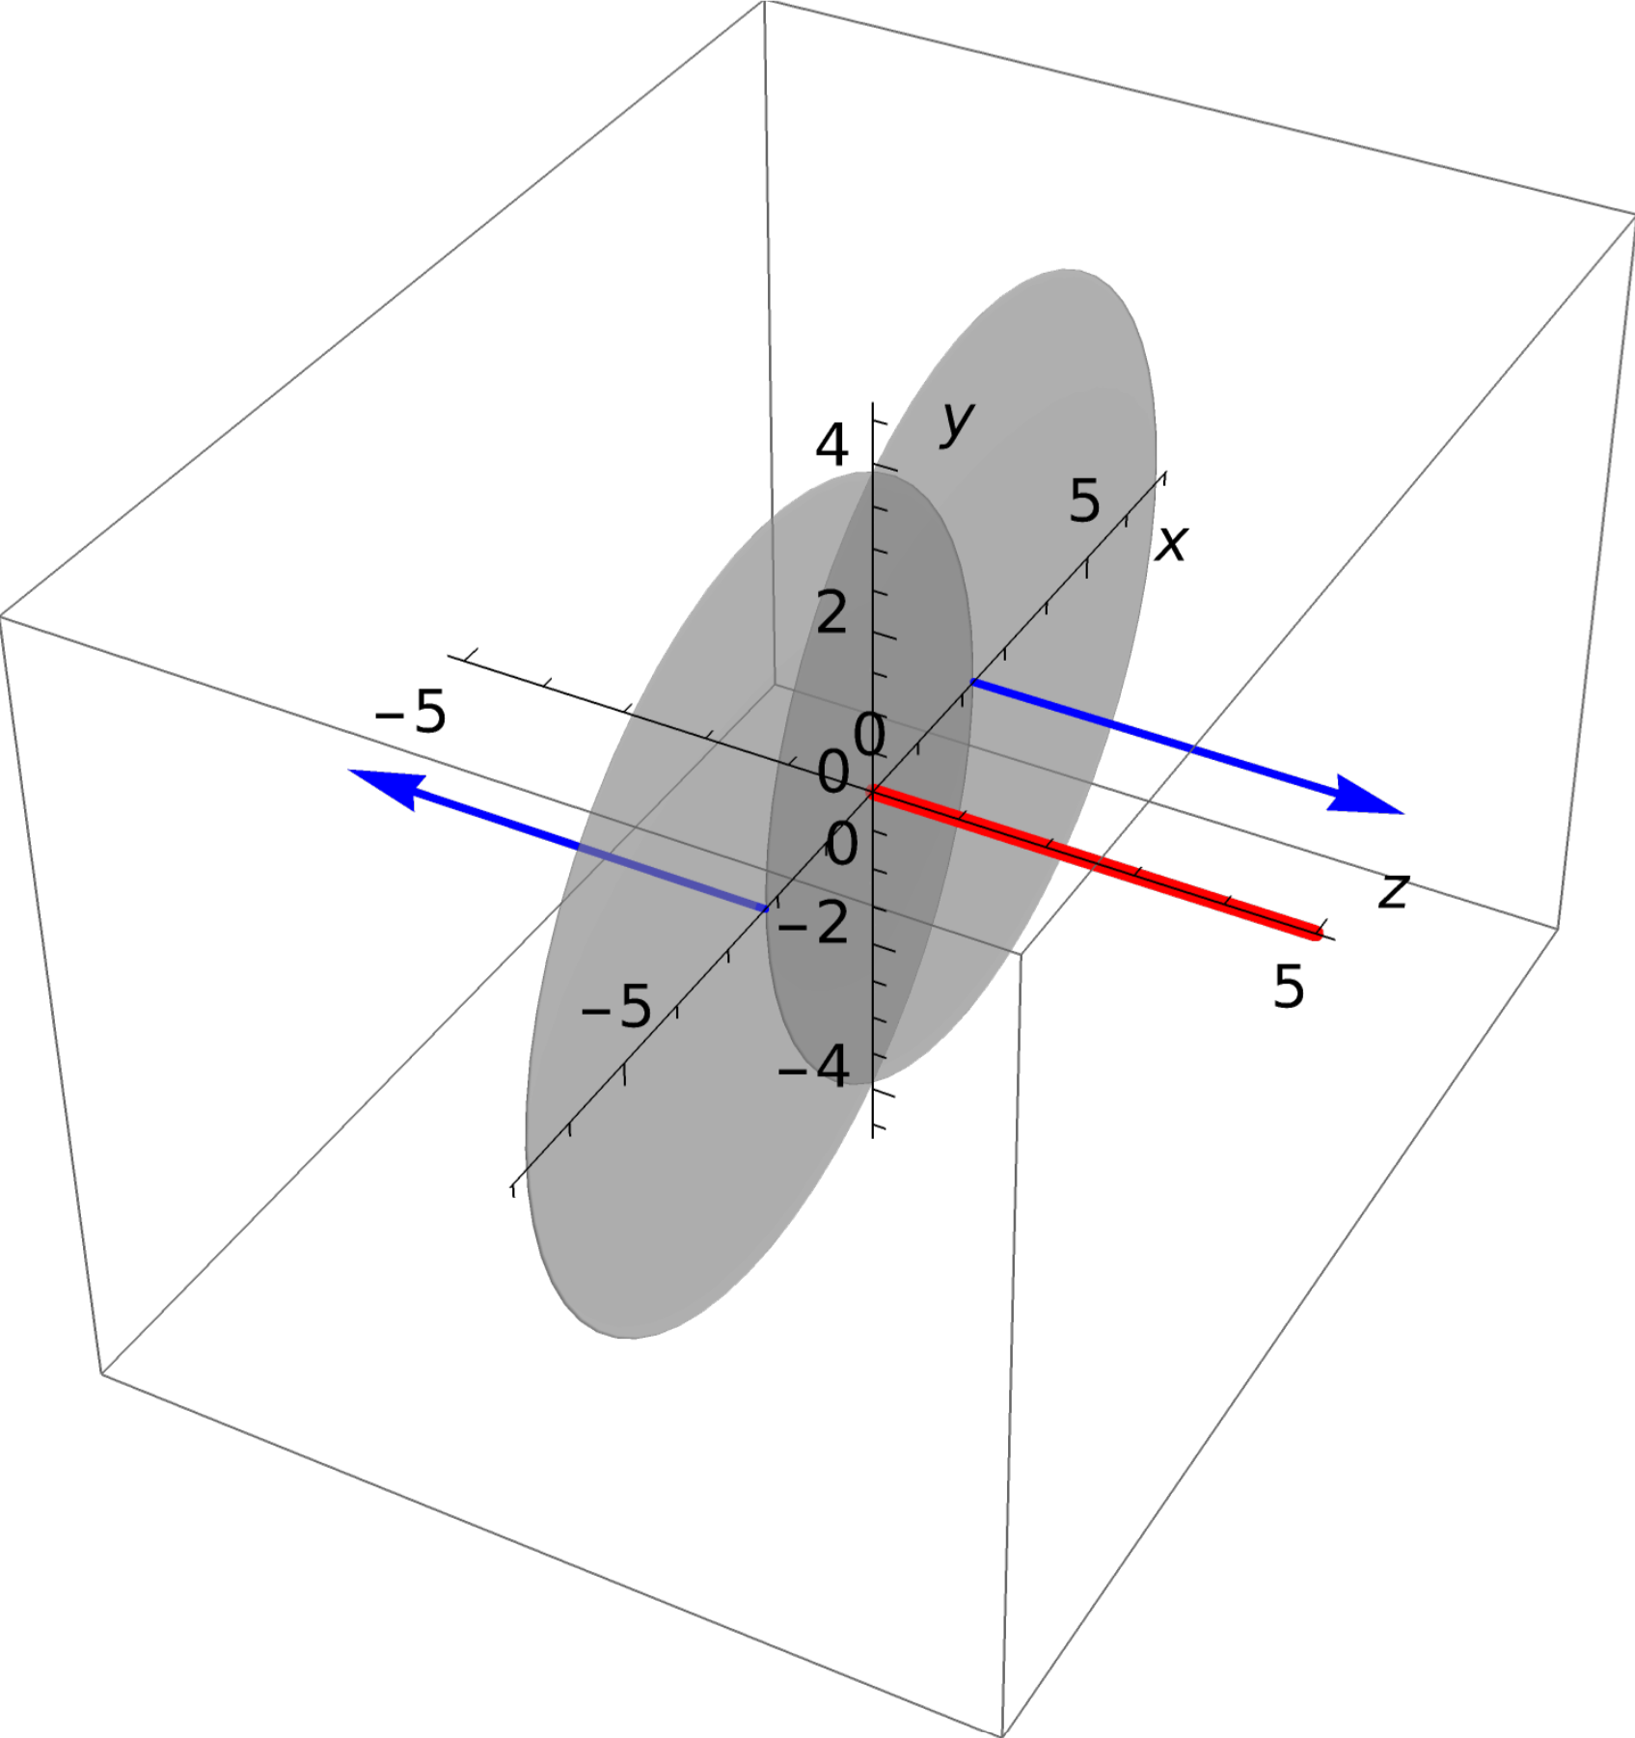
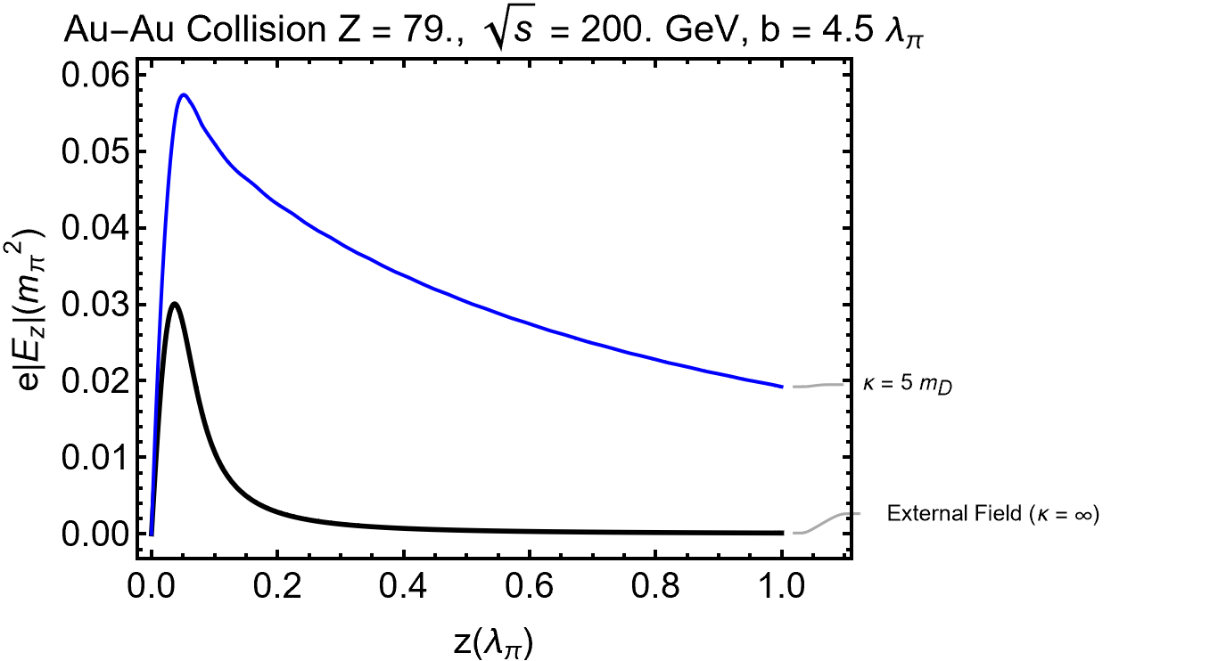
Electric Field
Longitudinal Electric field is enhanced

Slide 21
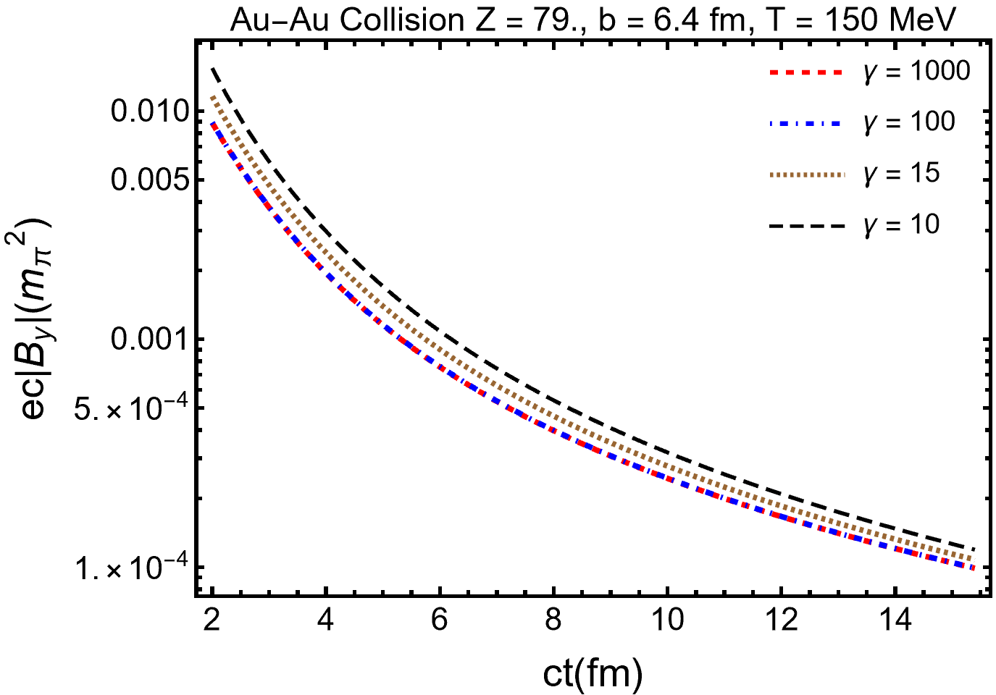
Freeze-out Magnetic Field at the Origin,
Freeze-out magnetic field induces polarization in final hadron spectrum
Numerical solutions for the full polarization tensor:
Approximate result expected to apply till
“Dynamic solution”
“Static solution”
“Freeze-out magnetic field depends more on than on collision energy”

Slide 22
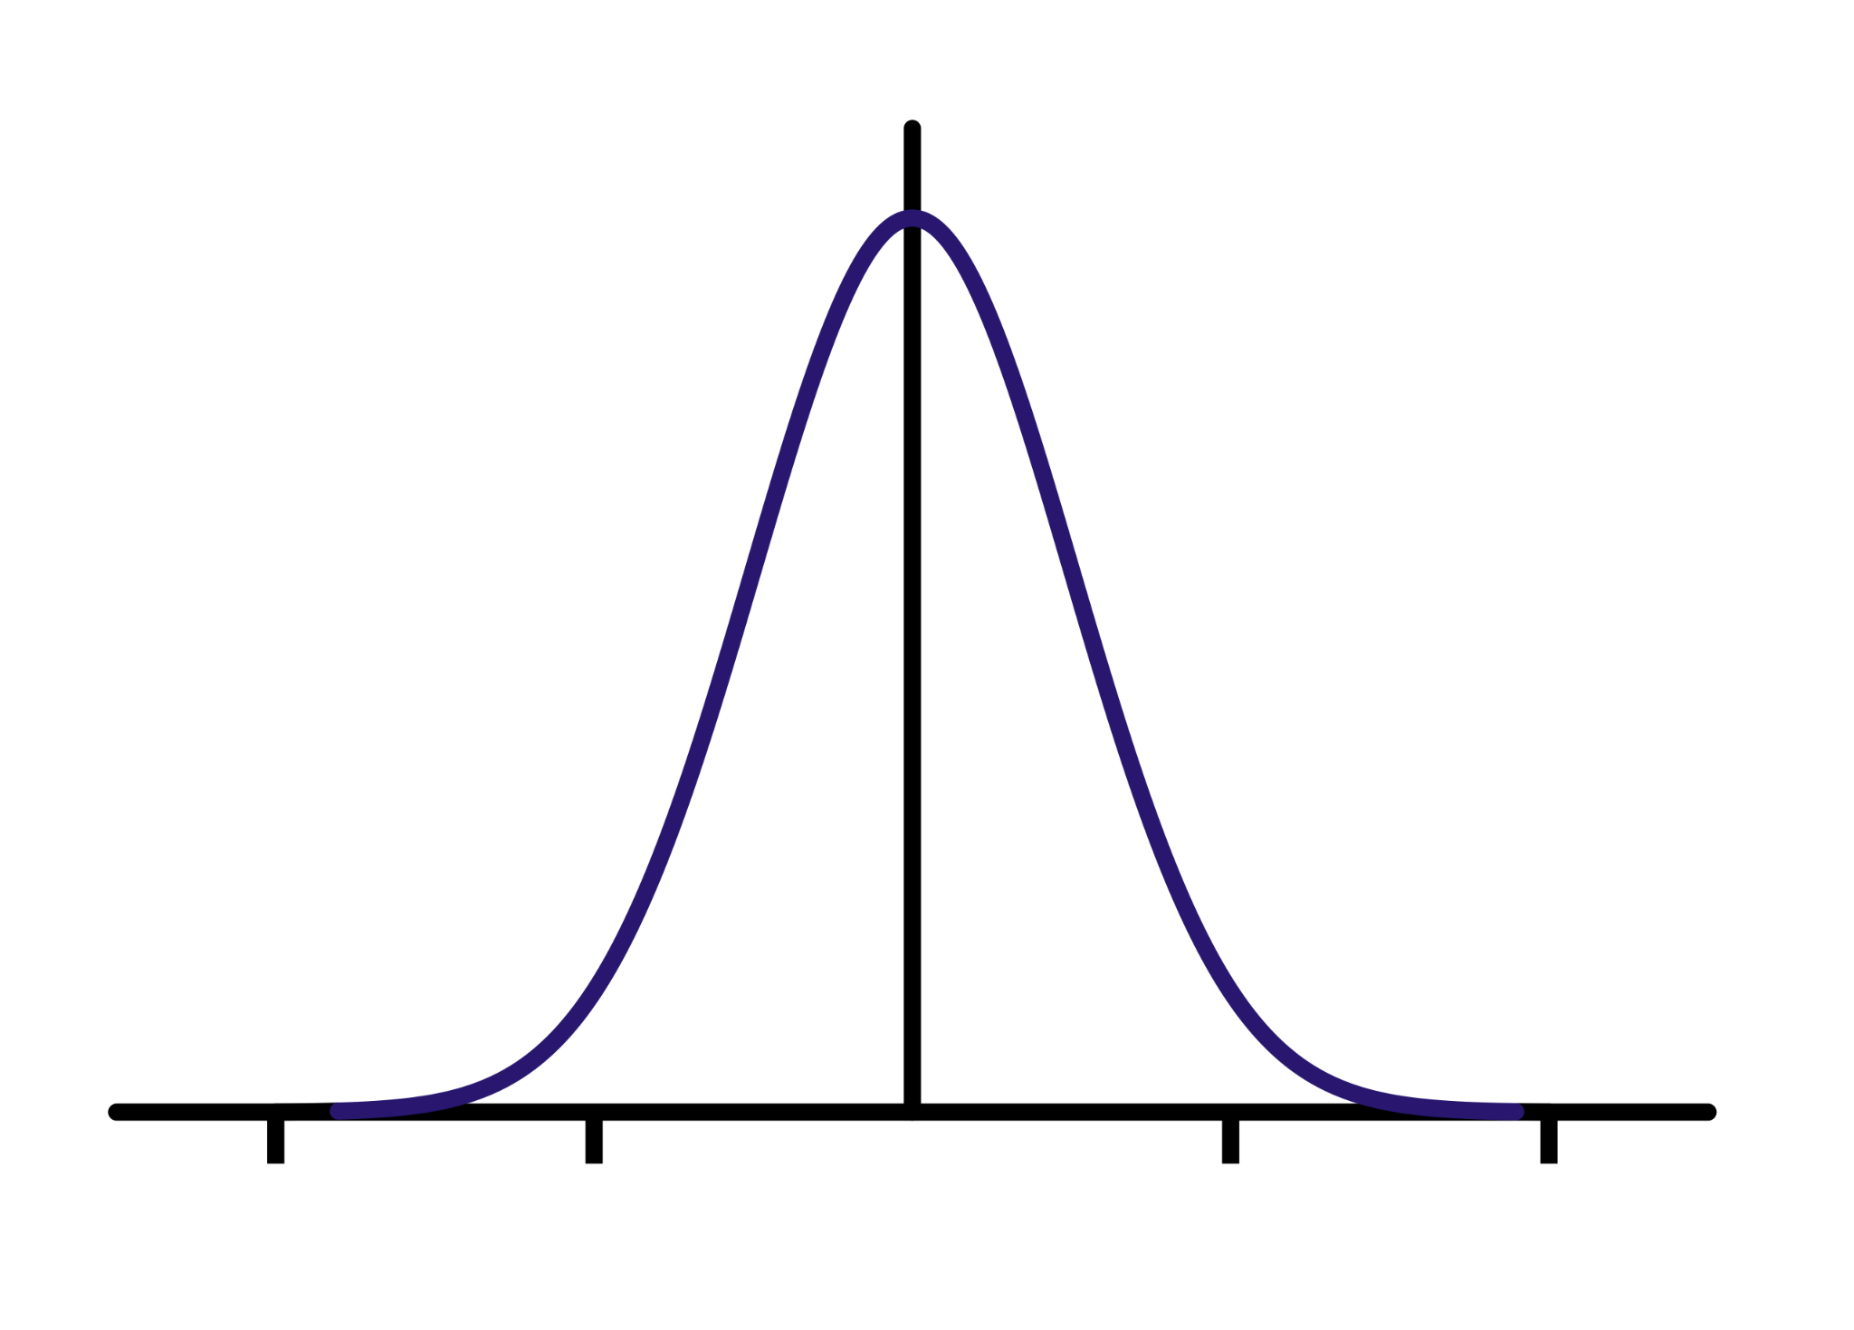
Outlook: Just at the Beginning
QGP Switch-On and Evolution: In order to accurately model in space and time QGP we would like to create a realistic spacetime picture of the plasma.
This can be done by adding a source to the neutral plasma in the boltzmann equation
The leads to a convolution integral in Ohm’s Law of the form,
where,
QGP

Slide 23
Free Charge Distribution
For simplicity we prescribe the external fields using a gaussian charge distribution normalized to the radius and charge of the nucleus.
Free Charge in Position Space
R_{rms} = 5.3 fm
Free Charge in Fourier Space
Notes:
Fix Z

Slide 24
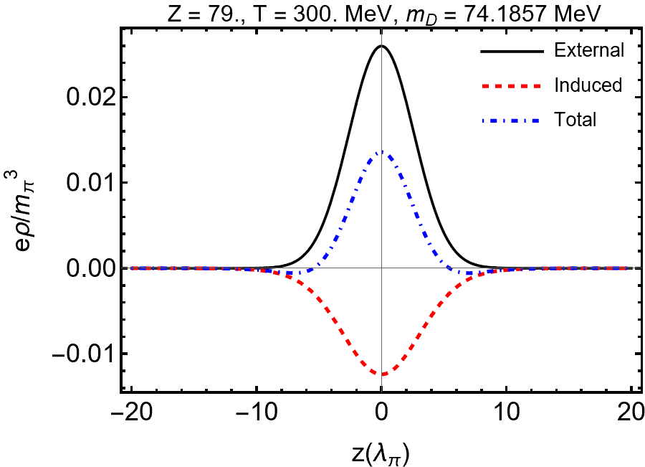
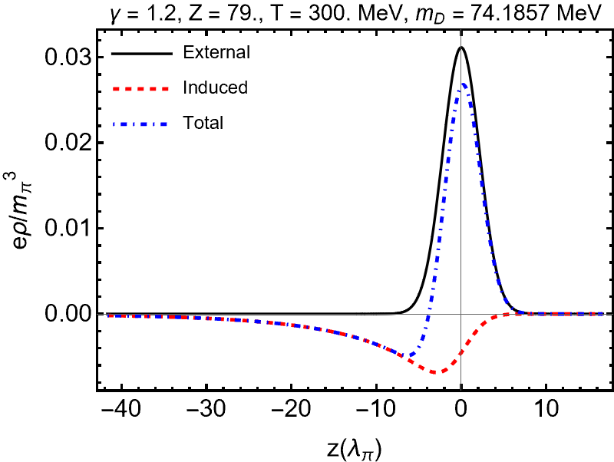
Induced Charge
As 𝛾 increases the external charge density is contracted (grows large in magnitude but smaller in space).The functional dependence of the tail changes little so appears to be small and more smeared out at high gamma.
Notes:
The charge doesn't get enhance because to lorentz invariance, calculating the induced charge for a stationary charge in a moving medium should give the same results

Slide 25
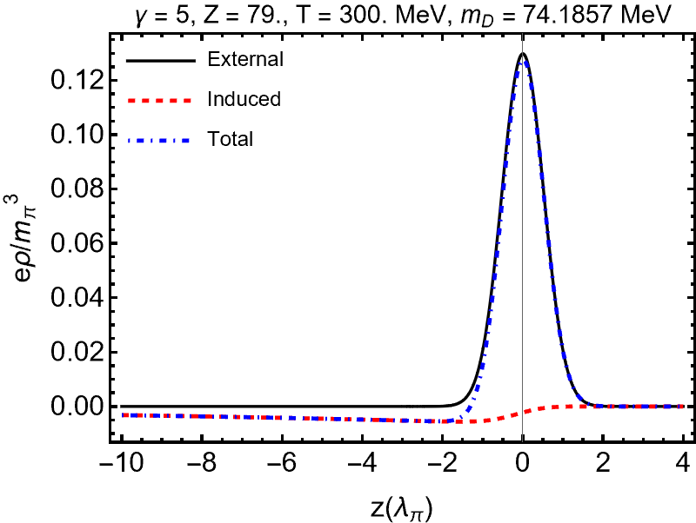
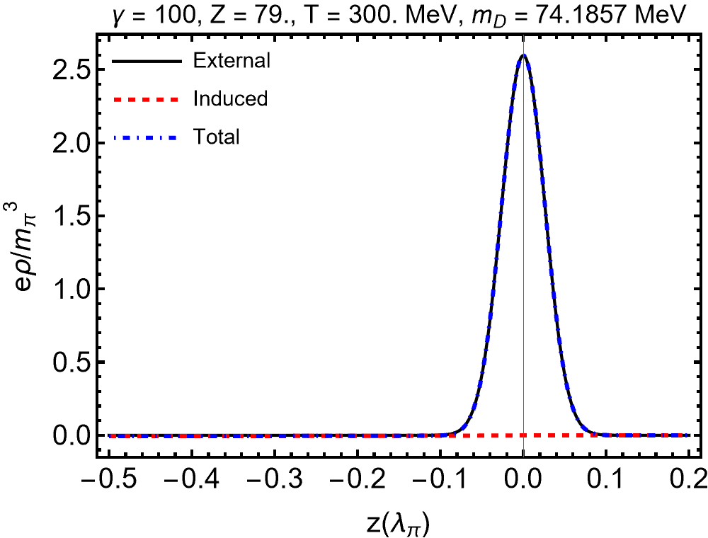
Induced Charge
As 𝛾 increases the external charge density is contracted (grows large in magnitude but smaller in space).The functional dependence of the tail changes little so appears to be small and more smeared out at high gamma.
Notes:
The charge doesn't get enhance because to lorentz invariance, calculating the induced charge for a stationary charge in a moving medium should give the same results

Slide 26
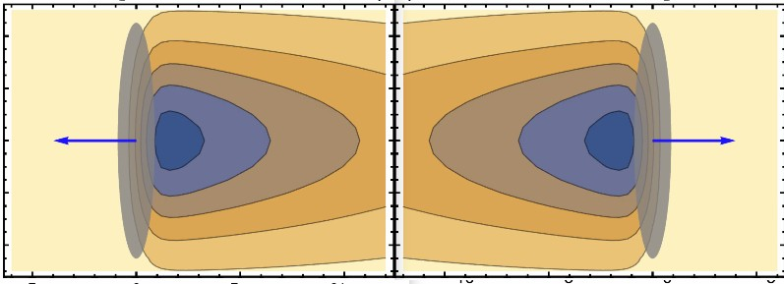
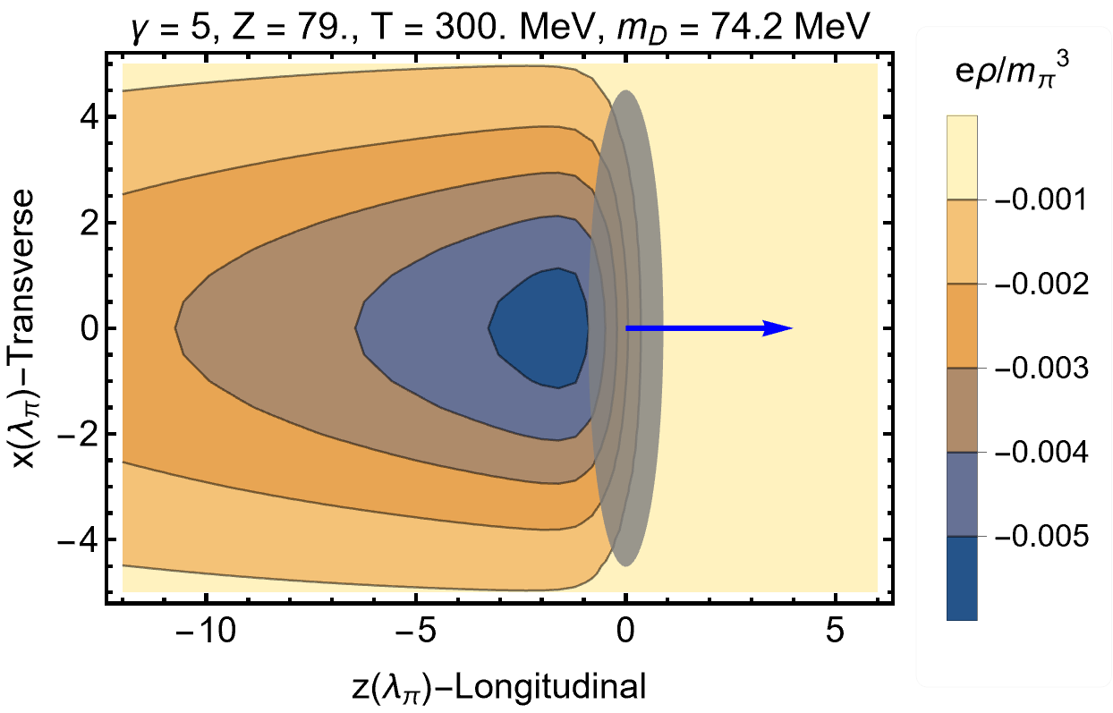
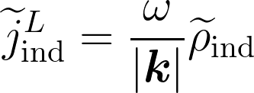
Induced Charge - (Single Nuclei)
Plot below shows a single ion traveling through the plasma. A trailing negatively charged wake is shown trailing behind the positive Ion.

Slide 27
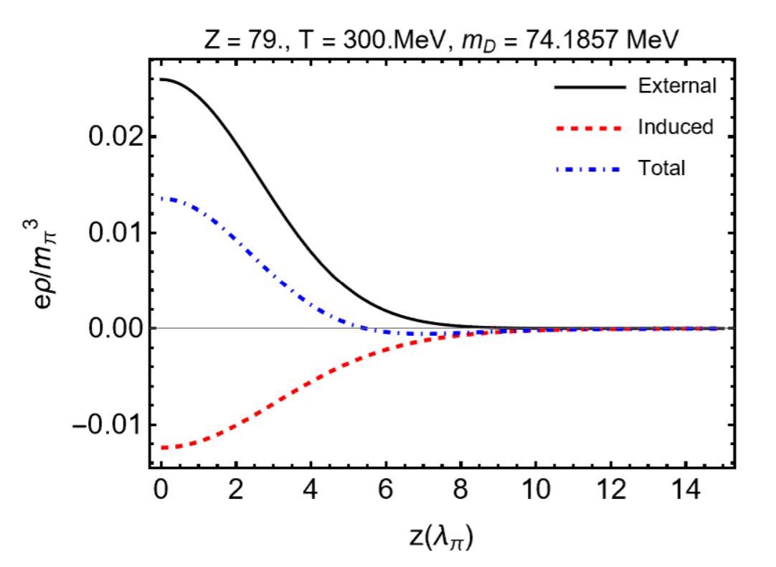
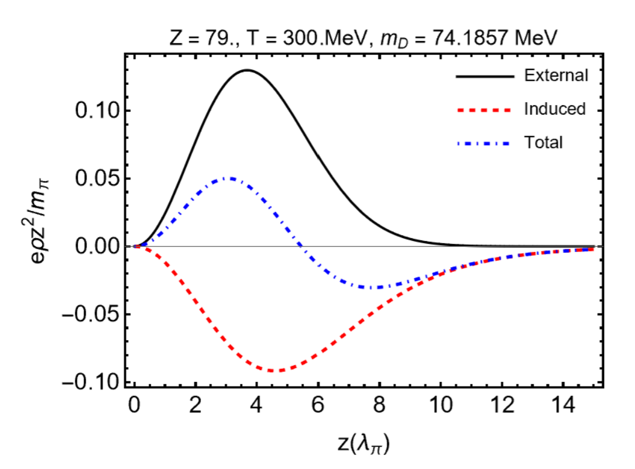
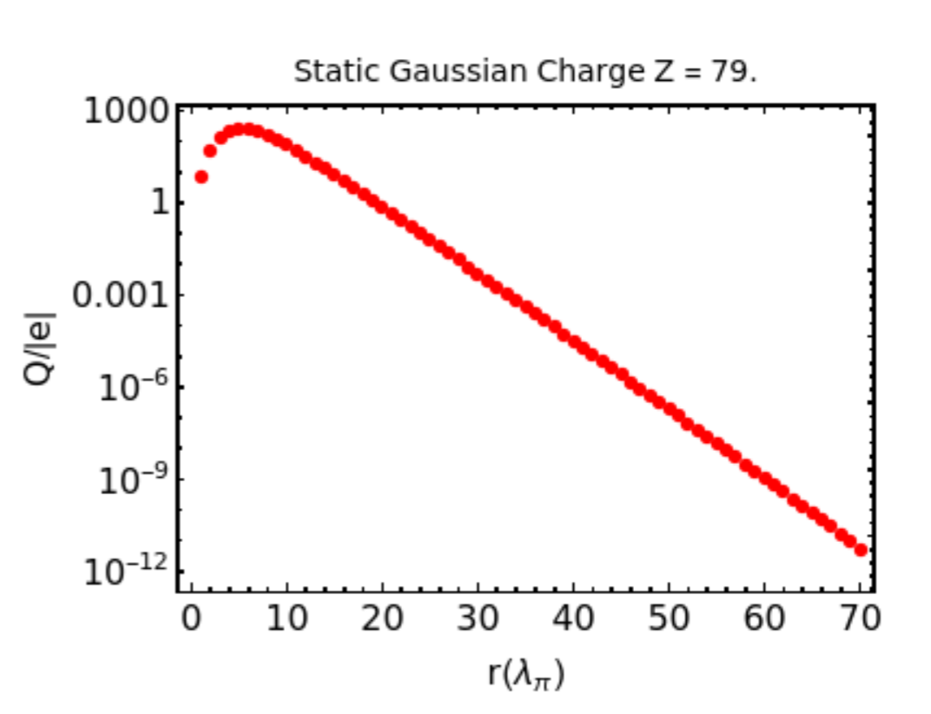
Charge Conservation in the Infinite Plasma
In the case of an infinite plasma in both space and time the induced charge balancing the induced screening charges has moves to infinity.

Slide 28
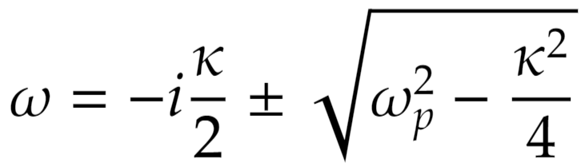
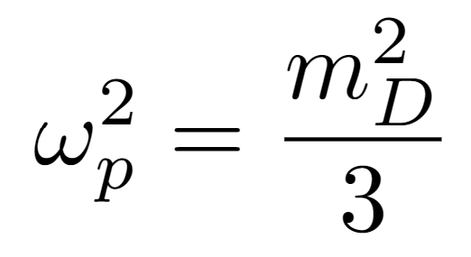
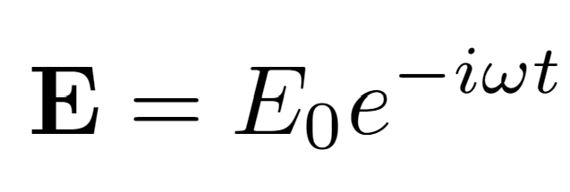
Plasma Frequency
We can use the dispersion relation to solve for the natural oscillations of the effective particles within the plasma i.e. plasmons, This is done by solving the dispersion relation in the limit k→0,
for both modes one finds,
For an oscillatory electric field, these modes are damped by the relaxation parameter
Where

Slide 29
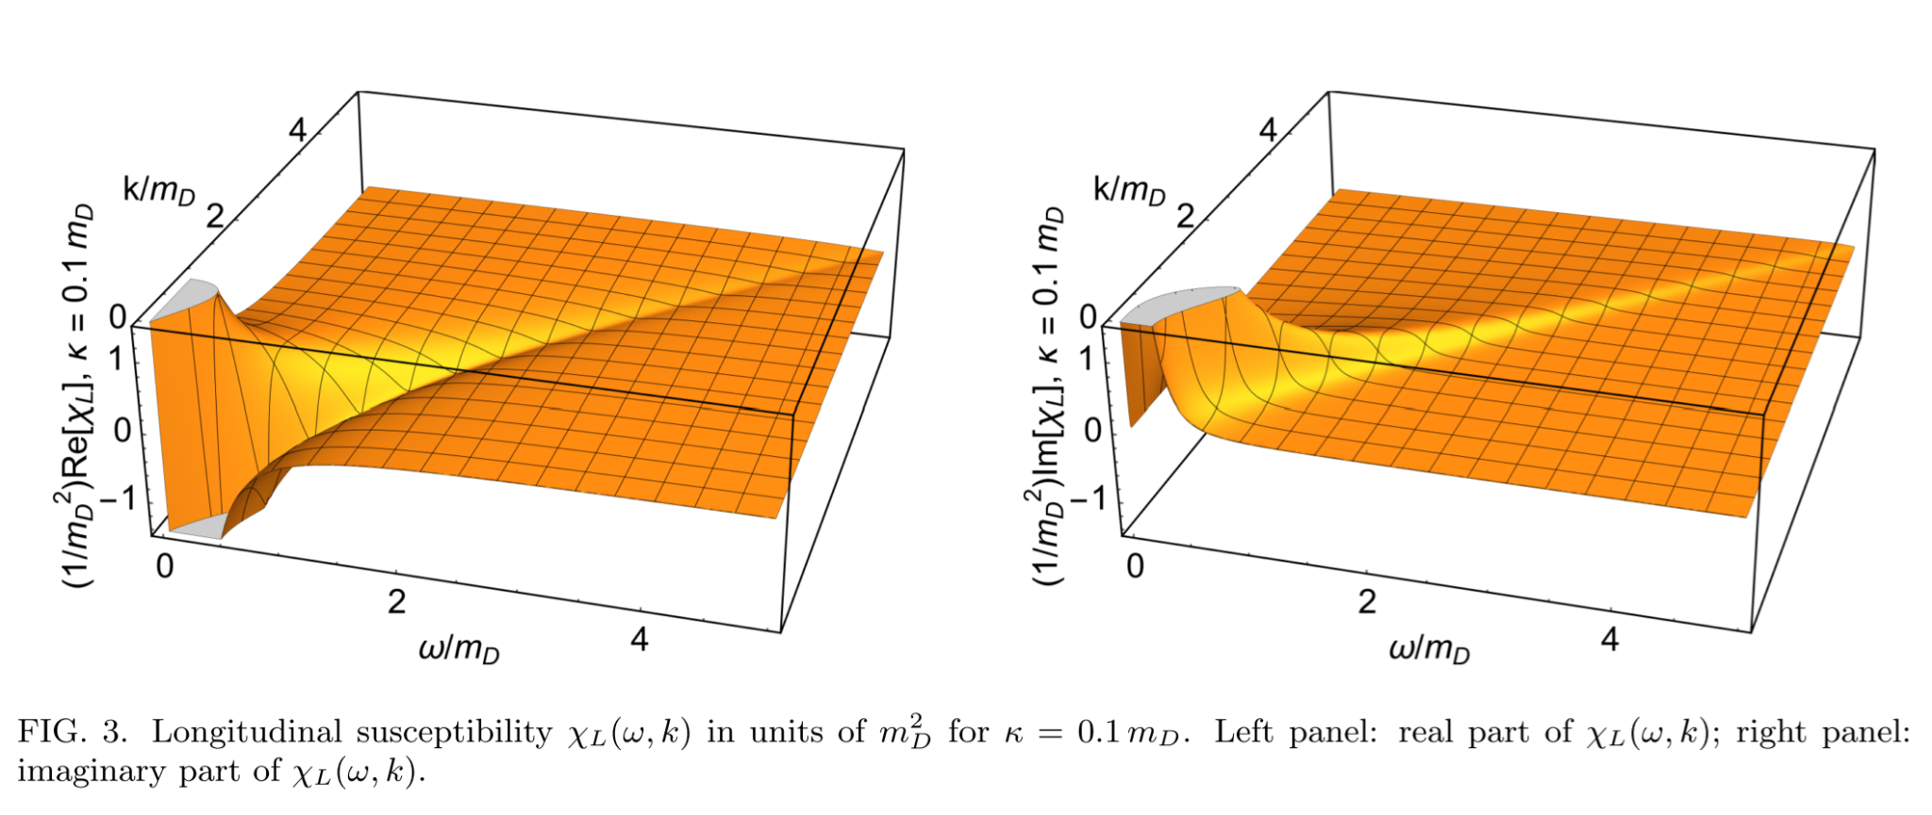
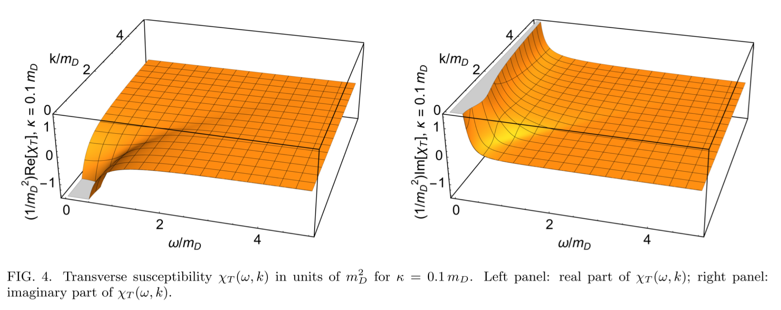
Susceptibility
(Rukhadze and Silin, 1961)
Notes:
Find references for Polarization tensor

Slide 30
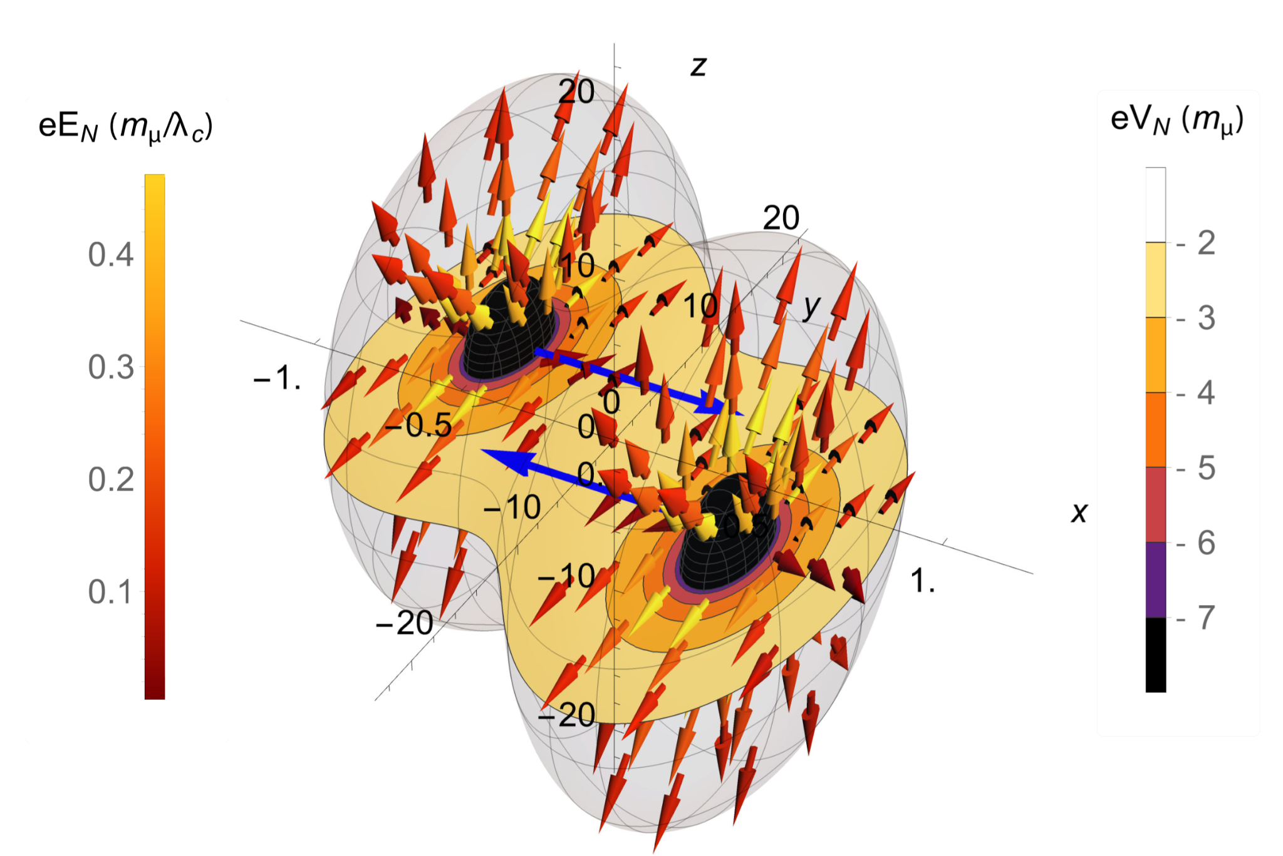
Fields of Colliding Ions
Surface indicates where potential reaches 2m𝜇
Velocity Field
Radiation Field
Blue arrows indicate direction of motion

Slide 31
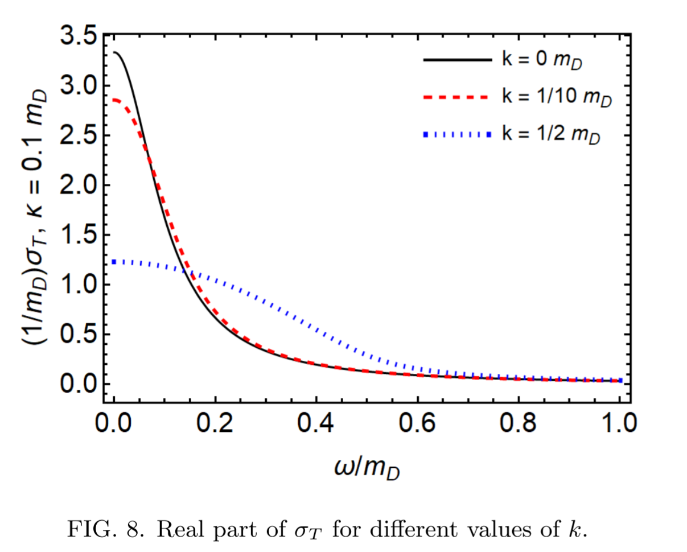
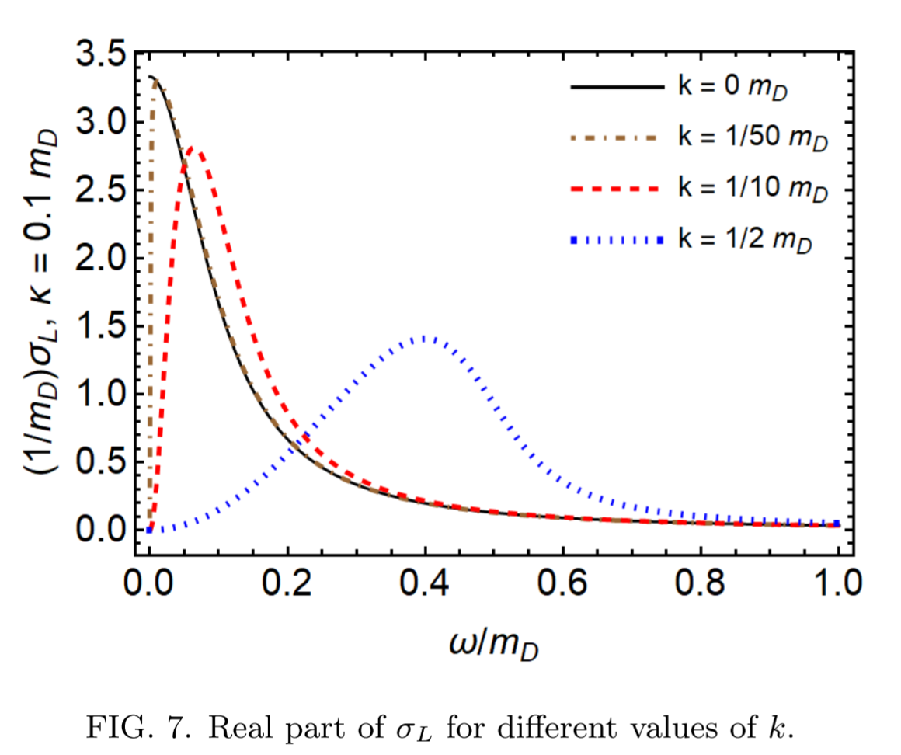
Conductivity
Discontinuity at k = 0 comes from infinite extent of plasma (Baranger 1989)

Slide 32
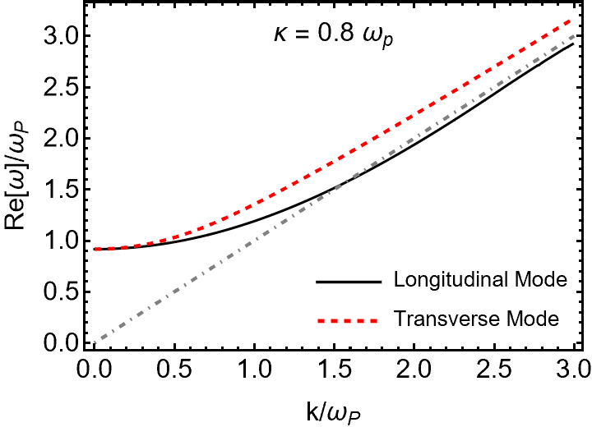
Modes - Dispersion Relation
Negative imaginary part means modes are damped
Longitudinal Modes: Electric Charge Oscillations → Langmuir waves (density fluctuations), Debye screening (charge screening)
Transverse Modes: Current Oscillations → Electromagnetic waves in vacuum
Finte 𝜅
Longitudinal solution runs into the branch cut at -i𝜅

Slide 33
Modes - Dispersion Relation
Longitudinal Modes: Electric Charge Oscillations → Langmuir waves (density fluctuations), Debye screening (charge screening)
Transverse Modes: Current Oscillations → Electromagnetic waves in vacuum
-i𝜅
Longitudinal solution runs into the branch cut at -i𝜅
(Schenke et al. 2006)

