Slide 1

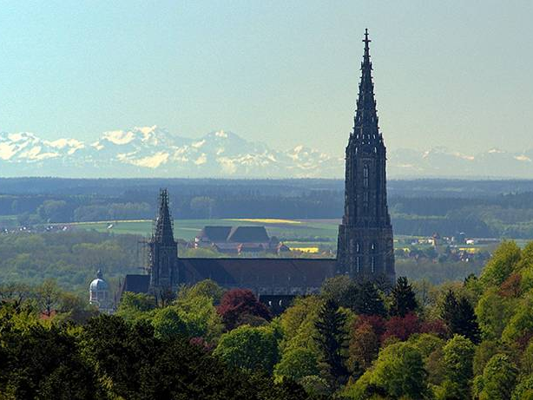
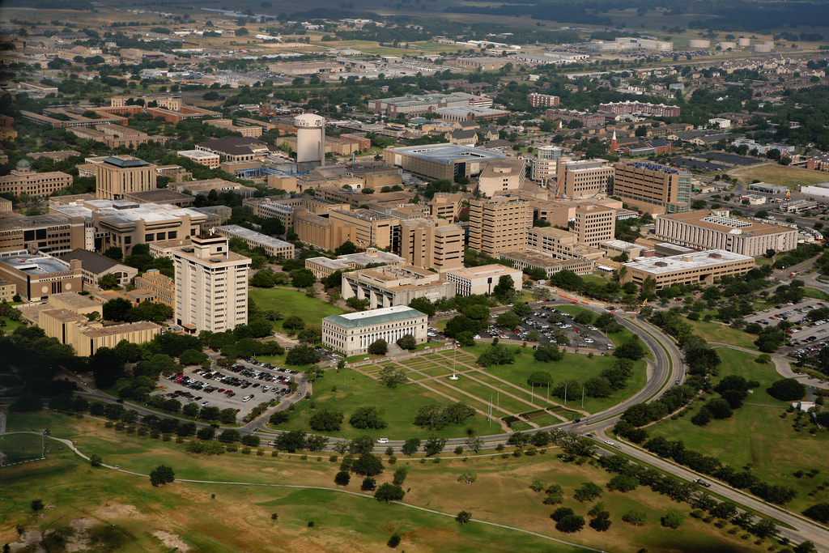

Cooling of quantum particles by
external fields
W.P. Schleich
Institut für Quantenphysik
Center for Integrated Quantum Science and Technology IQ^{ST}
Universität Ulm
Hagler Institute for Advanced Study at Texas A&M University Texas A&M AgriLife Research
Institute for Quantum Science and Engineering (IQSE) and Department of Physics and Astronomy
Texas A&M University, College Station

Slide 3
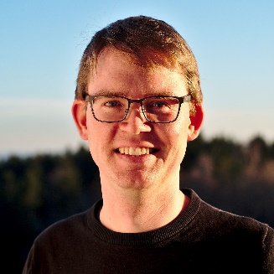
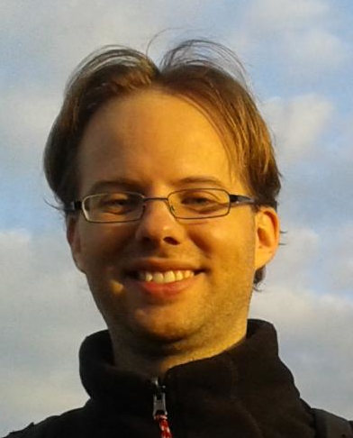

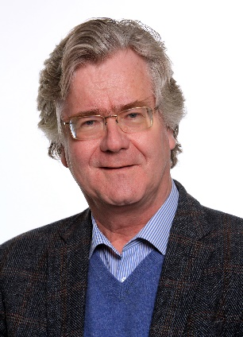

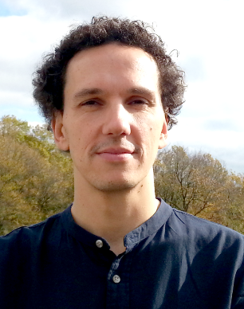

Slide 4
Overview
Deceleration of a classical particle
Deceleration of a quantum particle
Nonlinear Schrödinger equation
Deceleration à la Kostin

Slide 5
Dissipative Force

Slide 6
Time-dependent homogenous force

Slide 7
Inverted harmonic oscillator

Slide 8
Deceleration of a quantum particle

Slide 9
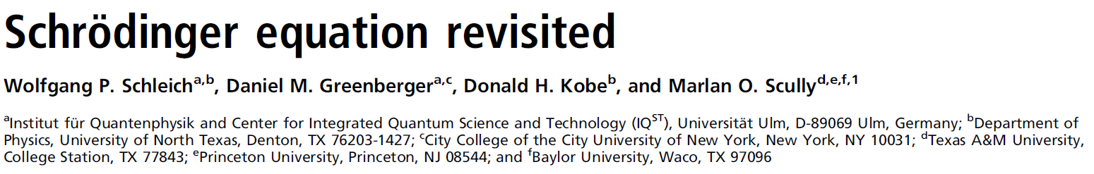

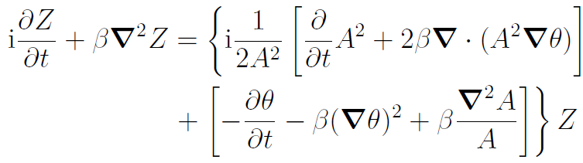

Slide 10
Potential

Slide 11
Solution

Slide 12
Nonlinear Schrödinger equation

Slide 15
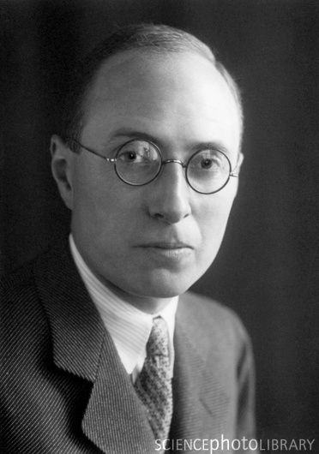
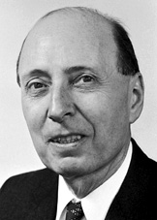
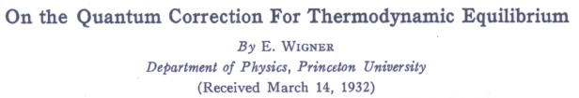
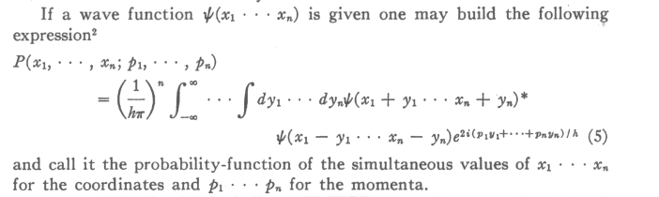

Slide 18
Summary
Deceleration of a classical particle
Deceleration of a quantum particle
Nonlinear Schrödinger equation
Deceleration à la Kostin

