Slide 1
Artificial Intelligence Coalition
Actionplan

Slide 2
AI Action plan
I. Building AI ecosystem
II. Starting data economy
III. Communication and dissemination
Goal: Boosting research, business and social AI ecosystem
Goal: Framing the exploitation of the data capital
Goal: Reaching a better position of AI in society
2020 Q1-
2020 Q2-
2020 Q1-

Slide 3
I. Building AI ecosystem
AI Coalition
(Innovation Hub)
Cooperation/ coordination
Support/motivation
Ecosystem managements, broker function
AI social dissemination
Market catalyst (stakeholder map, visibility, inspiration)
AI training organization
AI market expansion
Connection the international ecosystem
European Union analogy : AI Innovation Hub
Excellence Center
(National Lab)
Partners
(Multinational, SMEs, startups, developers, society)
Channel management
AI fundamental research
AI applied research
Provide in strategic partnerships
Annual membership fee
AI development
AI education
Cooperation in the ecosystem
Order (development, business adaptation)
Purchasing ad hoc services
International cooperation on AI research
Financing and funding of projects
In-kind contributions
European Union analogy: AI Center of Excellence
Description and collection of social demands
Longterm goals

Slide 4
II. II. Starting data economy
National Data Asset Agency
Integration of data market players
AI Coalition
Creating data supply
Creating data demand
Public data repository
Collection market application use cases
Development of an easy to use data marketplace
Non-personal or fully anonymised data
Establishing the data asset regulatory environment
Developing GDPR compliant recommendations
Framework for a secure and legal data sharing

Slide 5
III. Communication and dissemination
Sensitivity and awareness
Basic AI education
Business cases
Professional training
AI video editing competition
Online AI courses
www.miagyakorlatban.hu
Top level summer-school in Hungary
AI TV quiz
Permanent AI exhibiton
One-stop-shop platform for use cases, courses
Collection of available Hungarian curriculum
Special focus on SMEs and public domain
New AI courses – according to demand
AI-Hungary website
Cooperation with Hungarian stakeholders
Közigazgatás specifikus tananyagok fejlesztés
KPI by 2020
1M Hungarian citizens learn about AI technologies
KPI by 2020:
100k completed on-line or on-site courses
KPI by 2020:
Number of completed technological courses or bids by SMEs
KPI by 2020:
Number of enrolments to curriculum in AI Software Engineer, Data Sciences, BA specialized in digitalization
= Actions to by taken according to the Actioplan
AI Challenge Hungary

Slide 6
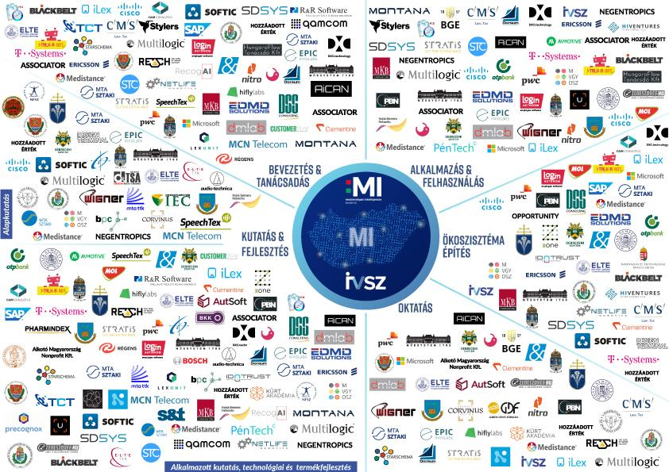
IV. Toward a rich AI ecosystem
108 institutions

Slide 7
Main pillars of the AI Strategy
2019.11.08.

Slide 8
AI strategy of Hungary
Implementing autonomous transportation
Health driven agriculture
Data Vallet
Hungarian voice assistant in customer service
AI supported education system
Transformative projects
AI technology development
Improving industry efficiency
Agriculture
Healthcare
Transportation and logistics
Industry and technology focuses
Computer vision
NLP
Anonymisation
Mathematical foundations
Manufacturing
Utilities
Government services
Developing competencies
Research-
development-
innovation
Applying across industries
Ethical and regulatory framework
Developing infrastructure
Accelerating the data economy
Grounding in business and society

Slide 9
Introduction of autonomous transport systems
To channel the lessons of the conciliation forum into the operational environment
International trends put pressure on domestic players, primarily the reactive regulator
1
Creation of a regulatory environment
2
Creation a physical environment
3
Creation of a safe operating environment
4
Creation of a market-mature / user-friendly environment
Regulating
A forum to reconcile the interests of critical actors
Users
Developers
Insurance companies
System integration and ecosystem integration
Public Transport Service Providers
Transport companies
Infrastructure developers/operators
Test environments

Slide 10
Health and data driven agriculture
State driven / regulated data collection
Individual / market driven data collection
Food production
Food processing
Nutrition and activity data
Healthcare

Slide 11
DATA VALET - enabling citizens to participate in the data economy
Layers of a data valet
Potential data services
Online behavioral data
Virtual personal assistant for individual user interests
Banking / transactional Information
Personalised banking and insurance
Telecommunication data
Personalised mobility and smart home applications
Educational data
Individual learning paths
Growing self-governence
Growing personal benefits
Health information
Personalised healthcare
Ügyfélkapu
E-ID

Slide 12
Automated voice assistance in Hungarian
Government
customer service
Utility customer service
Private customer service (Telco bank)
Process automatisation (rules / RPA)
Domain specific volcabulary
NLP + voice modul (corpus and technology development)
= Government funding
General goal: Handling 60% of all incoming customer service calls with Hungarian voice assistants
= Market funding
= Co-founded/open source

Slide 13
AI empowered, personalised education
1
2
3
Recommended education directions
Recommended learning modules
AI enabled learning assistant
What should I learn to have better chances on the job market?
What next modul should I take in my learning path, where do I need help?
Personalised learning coach to help individual modules to develop the general competencies

