Slide 1
Machine Learning and Reasoning for Exploratory Data Analysis and Model Extraction in Cyber-Physical Systems
András Földvári
András Pataricza

Slide 2
Automated model extraction
Background knowledge
Knowledge fusion
Discretized
observations
Knowledge base
Inductive learning
Qualitative model
Consistency checking
Fault diagnosis

Slide 3
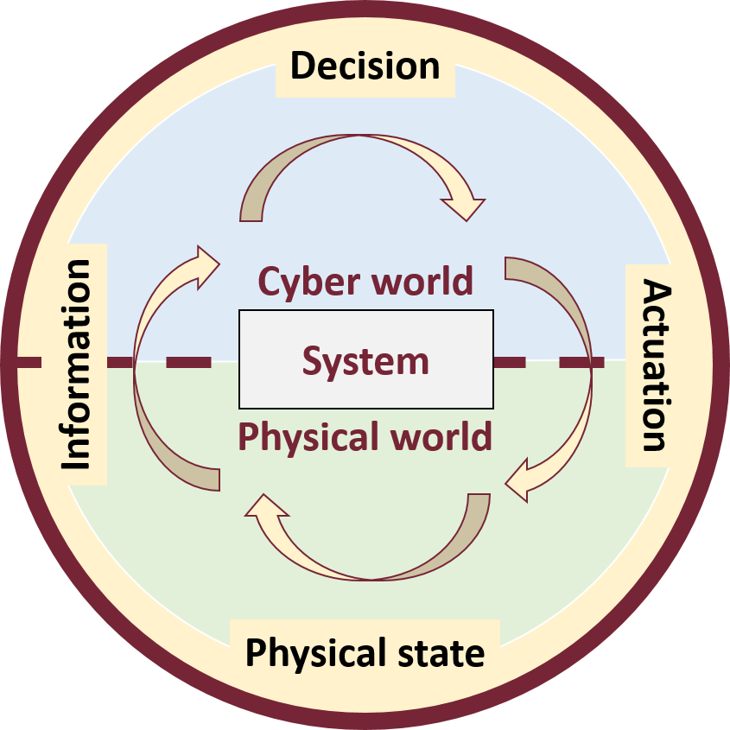
Context
Cyber-Physical Systems (CPS)
Component integration
Extra-functional requirements
Validation
Benchmarking
Operational log analysis
Big data sets
Hard-to-interpret
Many dimensional

Slide 4
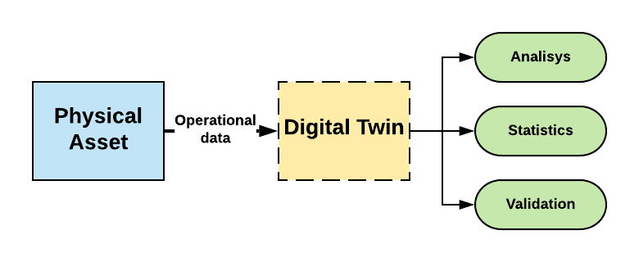
System analysis

Slide 5
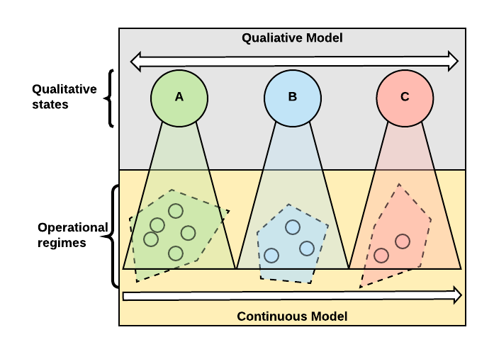
Hybrid modeling

Slide 6
Method: Steps
Background knowledge
Knowledge fusion
Observations
Semantic interpretation
Measurement
System Architecture
Knowledge Graph
Causal
Knowledge
Data
Causal Model
EDA
ASP Representation
Extracted
Qualitative
Model
Qualitative Model
Inductive Learning

Slide 7
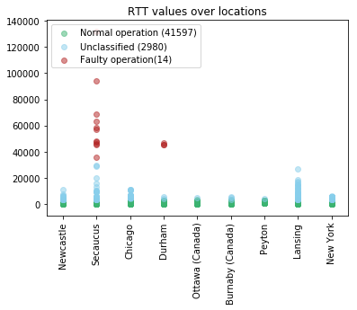
Operational Modes
Homogenous domains
Similar behaviors
Visual EDA
Thresholds
Clustering techniques
K-mean
3 operational domains
Faulty behavior
Unclassified
Normal behavior

Slide 8
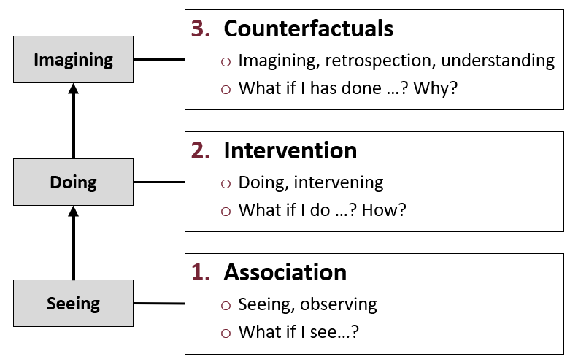
Ladder of Causation (Judea Pearl)

Slide 9
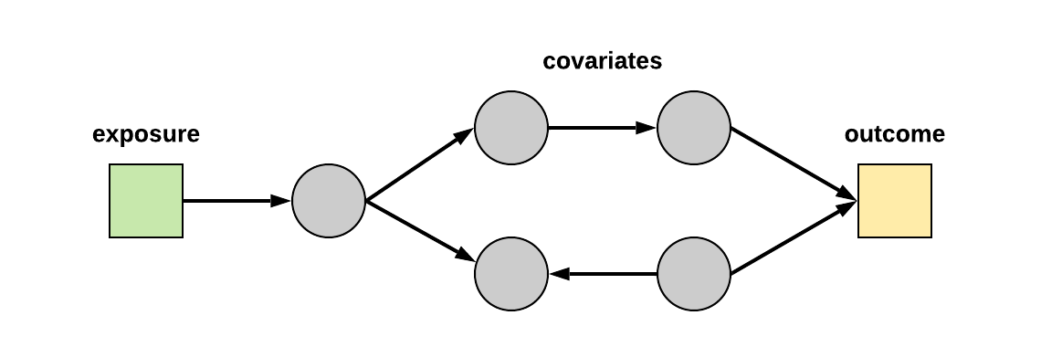
Causal model
Data propagation
Hidden relationships (e.g., shared resources)
Filtering false associations

Slide 10
Causal model building
Continuous processes
“Skeleton” of the causal model
Detailed causal relations
E.g., shared resources

Slide 11
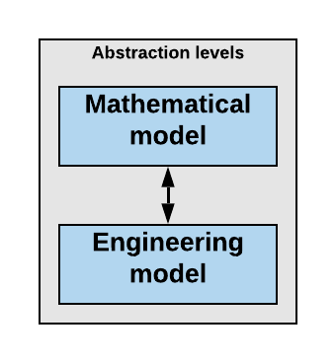
Semantic interpretation
Background knowledge
Knowledge fusion
Observations
Semantic interpretation
Measurement
System Architecture
Knowledge Graph
Causal
Knowledge
Data
Causal Model
EDA
ASP Representation
Extracted
Qualitative
Model
Qualitative Model
Inductive Learning

Slide 12
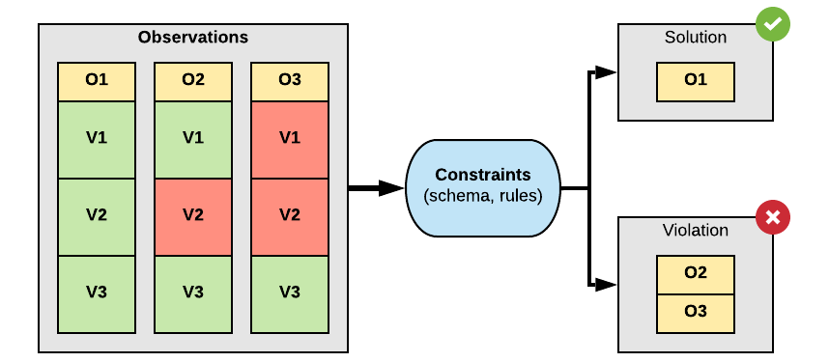
Knowledge graph
Schema
ER Diagram, Rules
Instances

Slide 13
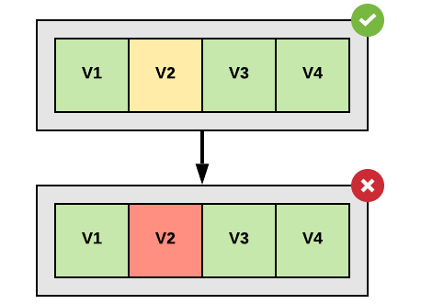
Incomplete knowledge
Answer Set Programming (ASP)
Stable Model Semantics
Logic program + negation as failure
Incomplete and default knowledge
normal_operation ← not fault.
We do not know about a fault in the system
normal_operation ← ~ fault.
We know, that there is no fault in the system.

Slide 14
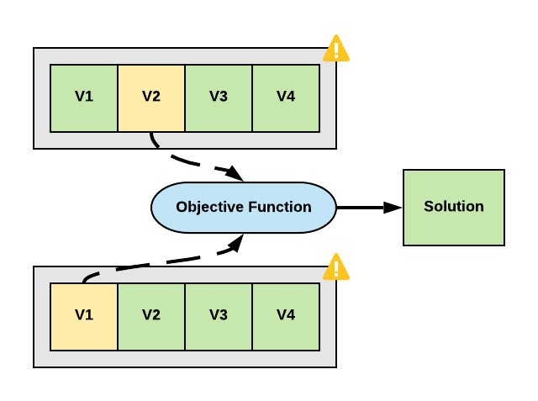
Weak constraints
Optimization problems

Slide 15
Inductive learning
Experimental observations
General hypothesis (inductive learning)
Engineering knowledge (validation)
Reuse

Slide 16
Inductive Arguments
Inductive logic
Conclusion follows not with certainty, but only with some PROBABILITY
Premise
…
Conclusion
90% of engineers drink coffee
Susan is an engineer
Susan drinks coffee
How strong is the inference?
How high does the probability have to be before it’s rational to accept the conclusion?

Slide 17
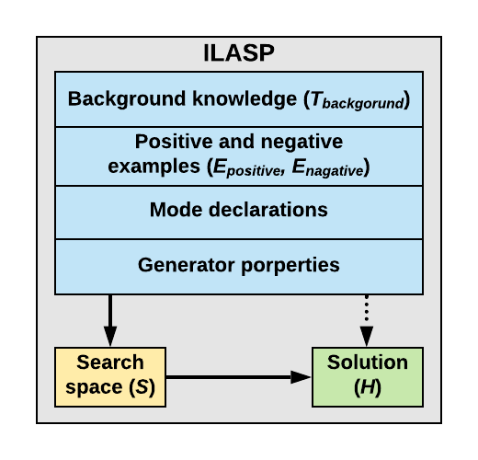
Hypothesis
The goal is to find a hypothesis H
H ⊆ S
∀ p ∈ E_{p}: T_{background} ∪ H ⊧ p
∀ n ∈ E_{n}: T_{background} ∪ H ⊭ n
S
T_{background}
H
E_{p}
E_{n}

Slide 18
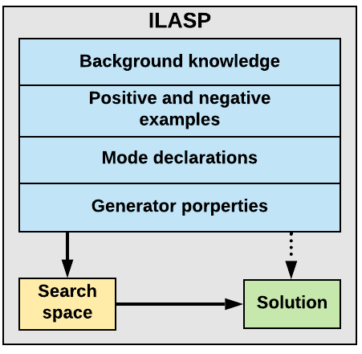
Inductive Learning of ASP Programs
ASP program
Obeservations, kauzális modell
Observations (faulty, normal)
Template for the search space
Question formalization
Restrictions
Solution candidates
Solution

Slide 19
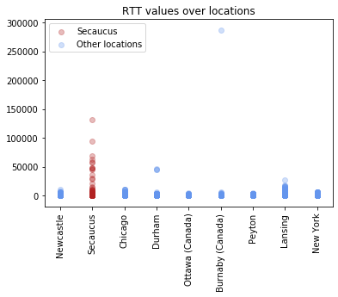
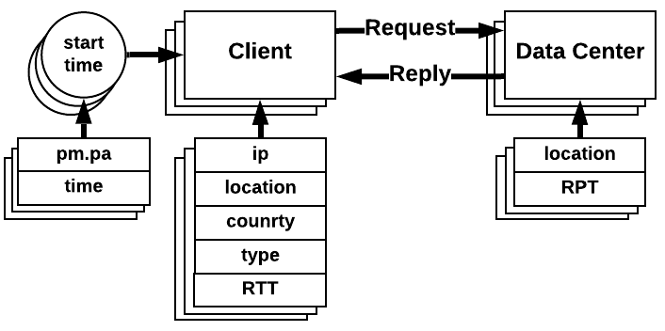
Example: Benchmarking Cloud Services
Communication channel delays
Multiple locations

Slide 20
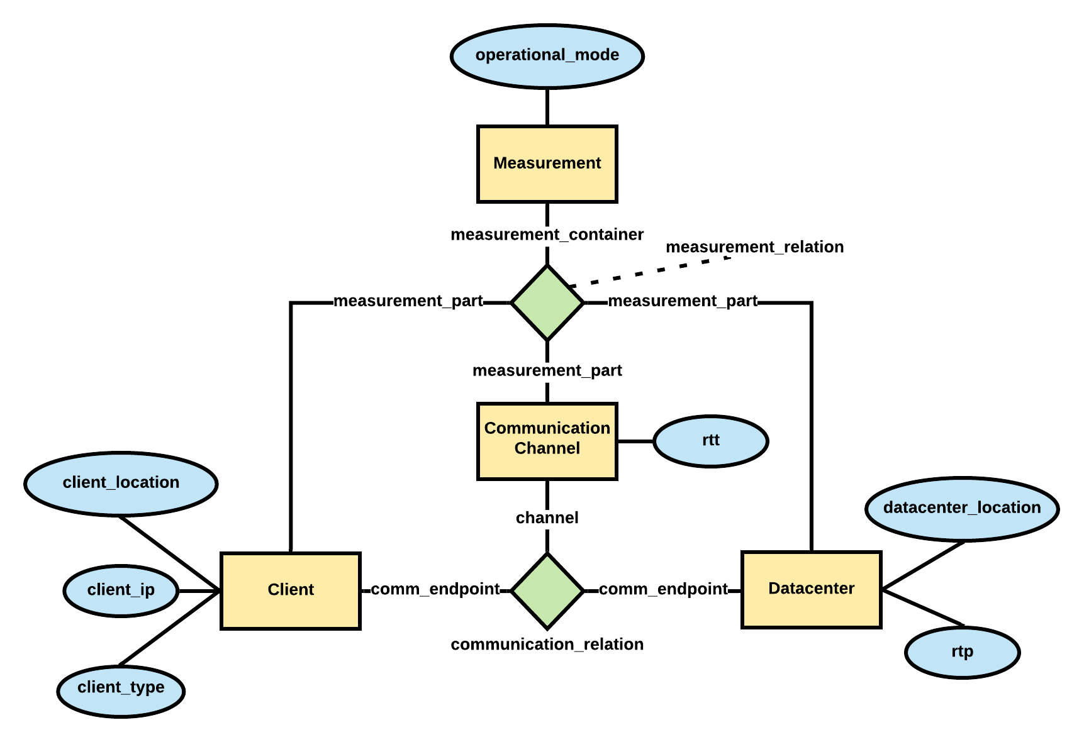
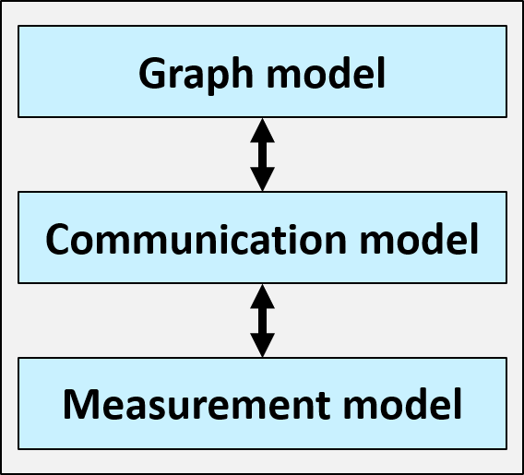
Knowledge graph
Mathematical model
Engineering model

Slide 21
Causal model

Slide 22
Knowledge representation with ASP
Knowledge Graph
Causal Model
ASP program
Schema
Causality
Integrity constraints
Resources
Instances
Hierarchy

Slide 23
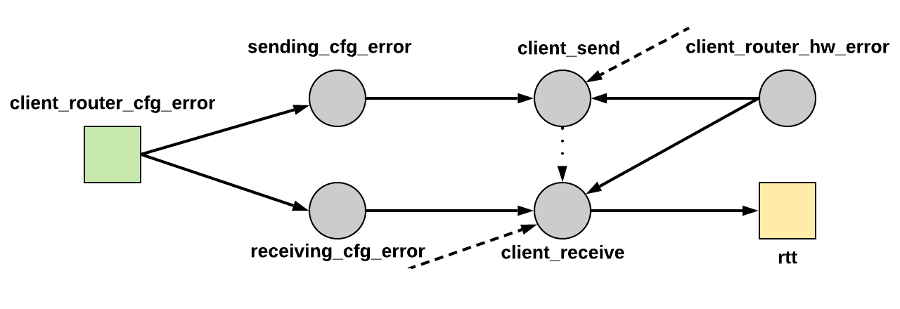
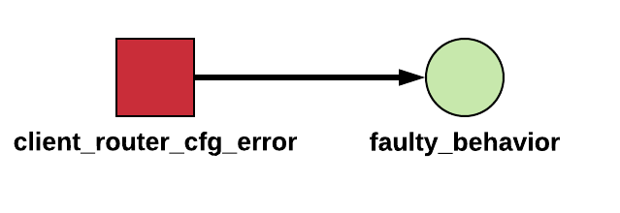
Reasoning: Hidden causal effects
Goal: determine which non-observed causal effects could lead to the faulty behavior.

Slide 24
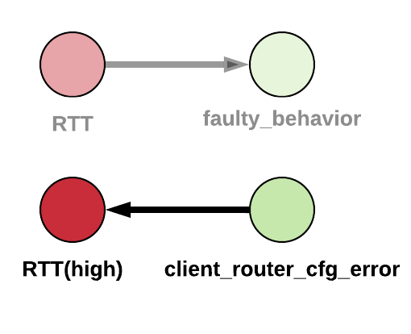
Reasoning: Fault indication
Goal: Identify the phenomenon of a specific event.

Slide 25
Future work
Background knowledge
Knowledge fusion
Observations
Semantic interpretation
Measurement
System Architecture
Knowledge Graph
Causal
Knowledge
Data
Causal Model
EDA
ASP Representation
Extracted
Qualitative
Model
Qualitative Model
Inductive Learning
The project was funded by the European Union, co-financed by the European Social Fund (EFOP-3.6.2-16-2017-00013).

