Slide 1

Computational Challenges In Numerical Relativity
Szilágyi Béla
(bela@caltech.edu)
KFKI, Sept 12, 2013
BDD2013@Wigner – Big Data Day 2013

Slide 2
Numerical Relativity: What is it?
exploration of General Relativity /
Astrophysics via numerical techniques
Szilágyi Béla
BDD2013@Wigner – Big Data Day 2013

Slide 3
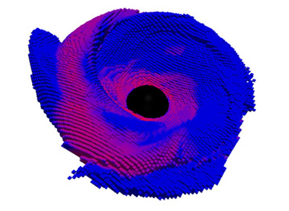
Numerical Relativity: What is it?
exploration of General Relativity /
Astrophysics via numerical techniques
3D structure of the remnant accretion disk of a black-hole—neutron-star merger color-coded for outgoing neutrino luminosity (Deaton et al., SXS Collaboration)
Szilágyi Béla
BDD2013@Wigner – Big Data Day 2013

Slide 4
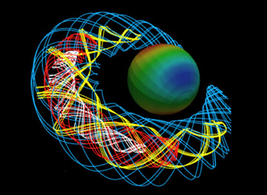
Numerical Relativity: What is it?
exploration of General Relativity /
Astrophysics via numerical techniques
Vertex and Tendex fields describing outgoing gravitational waves from a black hole horizon.
Szilágyi Béla
BDD2013@Wigner – Big Data Day 2013

Slide 5
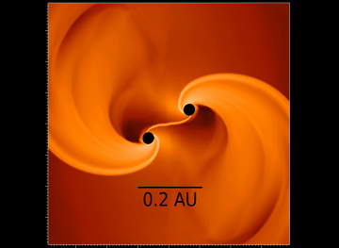
Numerical Relativity: What is it?
exploration of General Relativity /
Astrophysics via numerical techniques
Two black holes formed in the collapse and fragmentation of a cosmological supermassive star. (Reisswig et al. 2013, SXS Collaboration)
Szilágyi Béla
BDD2013@Wigner – Big Data Day 2013

Slide 6
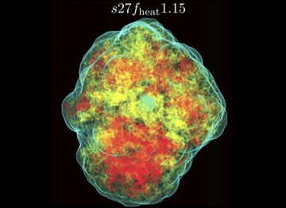
Numerical Relativity: What is it?
exploration of General Relativity /
Astrophysics via numerical techniques
Volume rendering of the specific entropy distribution in a 3D GR core-collapse supernova simulation. The blue outer layer indicates the expanding shock front. (Ott et al. 2013, SXS Collaboration)
Szilágyi Béla
BDD2013@Wigner – Big Data Day 2013

Slide 7
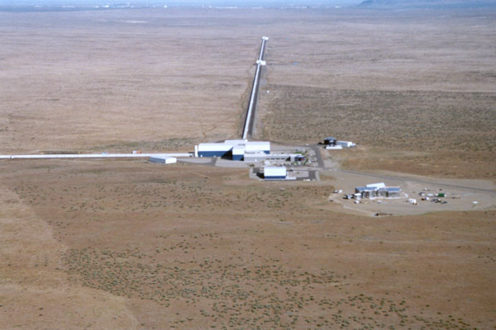
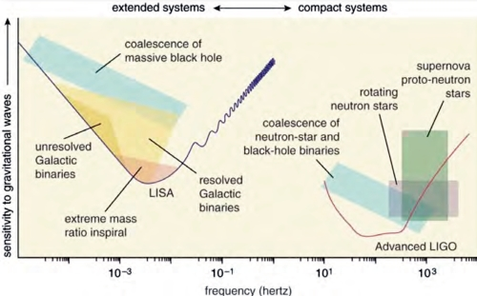
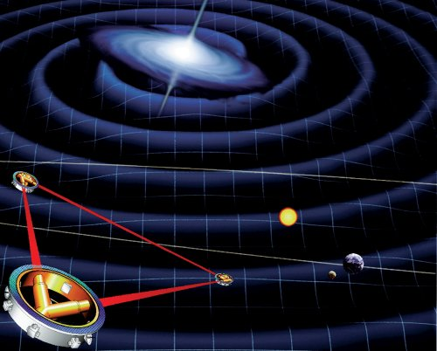
Numerical Relativity: Goals
aid gravitational wave science
graphic (c) by LISA Science Case LISA-LIST-RP-436 Version 1.0
graphic (c) by NASA
Szilágyi Béla
BDD2013@Wigner – Big Data Day 2013

Slide 8
Numerical Relativity: Goals
aid gravitational wave science
graphic (c) by LISA Science Case LISA-LIST-RP-436 Version 1.0
graphic (c) by NASA
Szilágyi Béla
BDD2013@Wigner – Big Data Day 2013

Slide 9
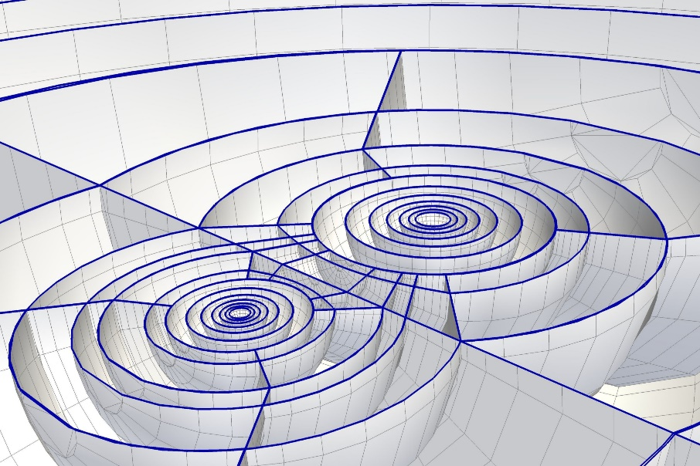
Numerical Relativity: Status
Binary Black Holes @ Caltech/Cornell/CITA:
The most efficient and accurate BBH code in the field
(500,000 lines, over a decade of work)
Szilágyi Béla
BDD2013@Wigner – Big Data Day 2013

Slide 10
Numerical Relativity: Status
Binary Black Holes @ Caltech/Cornell/CITA:
The most efficient and accurate BBH code in the field
(500,000 lines, over a decade of work)
This simulation used to take months.
Szilágyi Béla
BDD2013@Wigner – Big Data Day 2013

Slide 11
Numerical Relativity: Status
Binary Black Holes @ Caltech/Cornell/CITA:
The most efficient and accurate BBH code in the field
(500,000 lines, over a decade of work)
This simulation used to take months.
Today we can do it in 2 days.
Szilágyi Béla
BDD2013@Wigner – Big Data Day 2013

Slide 12
Numerical Relativity: Status
Binary Black Holes @ Caltech/Cornell/CITA:
The most efficient and accurate BBH code in the field
(500,000 lines, over a decade of work)
This simulation used to take months.
Today we can do it in 2 days.
(16 orbits, equal mass, non-spinning)
We tend to use 48 cores for a BBH simulation.
Szilágyi Béla
BDD2013@Wigner – Big Data Day 2013

Slide 13
Numerical Relativity: Status
Binary Black Holes @ Caltech/Cornell/CITA:
The most efficient and accurate BBH code in the field
(500,000 lines, over a decade of work)
We can do 130+ orbits at mass ratio 7:1 in about six months (low res), 48 cores, 1TByte of data
Szilágyi Béla
BDD2013@Wigner – Big Data Day 2013

Slide 14
Numerical Relativity: Status
Binary Black Holes @ Caltech/Cornell/CITA:
The most efficient and accurate BBH code in the field
(500,000 lines, over a decade of work)
We can do 130+ orbits at mass ratio 7:1 in about six months (low res), 48 cores, 1TByte of data
After post-processing the data shrinks by 80%
Szilágyi Béla
BDD2013@Wigner – Big Data Day 2013

Slide 15
Numerical Relativity: Status
Binary Black Holes @ Caltech/Cornell/CITA:
The most efficient and accurate BBH code in the field
(500,000 lines, over a decade of work)
We can do 130+ orbits at mass ratio 7:1 in about six months (low res), 48 cores, 1TByte of data
After post-processing the data shrinks by 80%
A run of this length is out of question for any other code.
-- Typical run length in the field is below 10 orbits.
Szilágyi Béla
BDD2013@Wigner – Big Data Day 2013

Slide 16
Numerical Relativity: Status
Binary Black Holes @ Caltech/Cornell/CITA:
The most efficient and accurate BBH code in the field
(500,000 lines, over a decade of work)
We can do 130+ orbits at mass ratio 7:1 in about six months (low res), 48 cores, 1TByte of data
After post-processing the data shrinks by 80%
A run of this length is out of question for any other code.
-- Typical run length in the field is below 10 orbits.
This is about as long as any run would need to get
Szilágyi Béla
BDD2013@Wigner – Big Data Day 2013

Slide 17
Numerical Relativity: Status
Binary Black Holes @ Caltech/Cornell/CITA:
We can fit a BBH run onto a laptop.
Speed-up by parallelization is far from trivial.
Szilágyi Béla
BDD2013@Wigner – Big Data Day 2013

Slide 18
Numerical Relativity: Status
Binary Black Holes @ Caltech/Cornell/CITA:
We can fit a BBH run onto a laptop.
Speed-up by parallelization is far from trivial.
We tend to use 48 cores for a BBH run.
Szilágyi Béla
BDD2013@Wigner – Big Data Day 2013

Slide 19
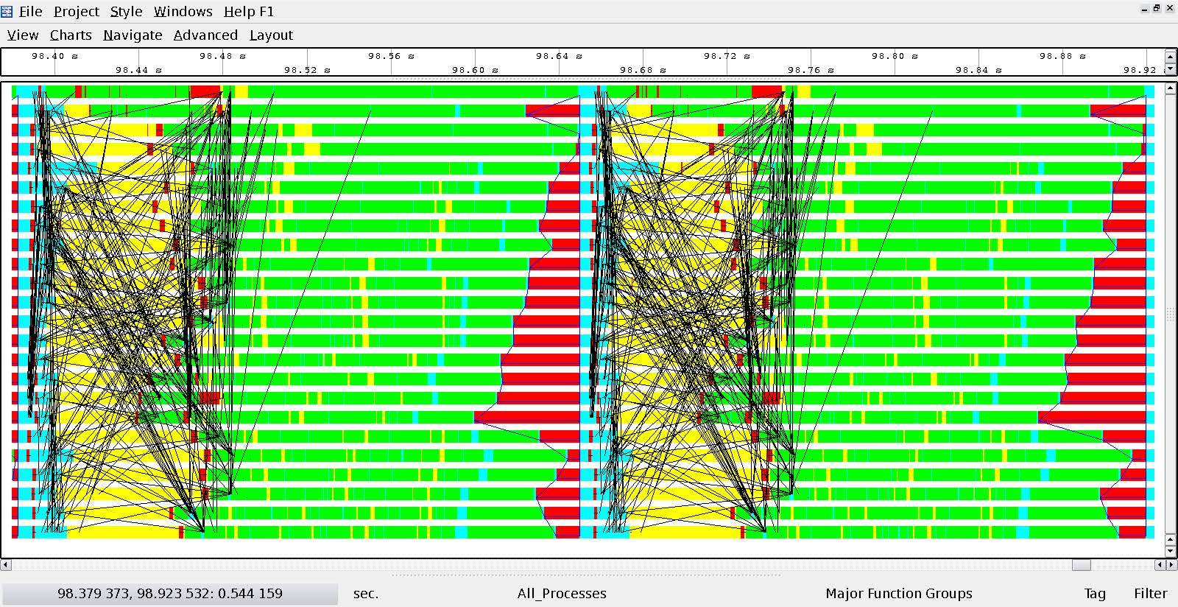
Numerical Relativity: Status
Binary Black Holes @ Caltech/Cornell/CITA:
We can fit a BBH run onto a laptop.
Speed-up by parallelization is far from trivial.
We tend to use 48 cores for a BBH run.
Szilágyi Béla
BDD2013@Wigner – Big Data Day 2013

Slide 20
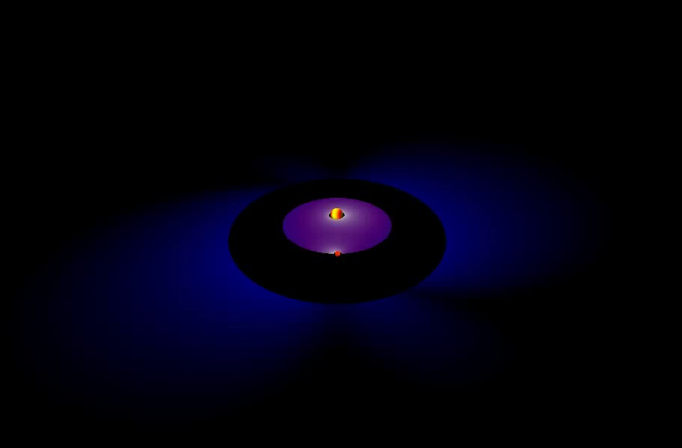
Numerical Relativity: Status
Szilágyi Béla
BDD2013@Wigner – Big Data Day 2013

Slide 21
Numerical Relativity: Status
Binary Black Holes @ Caltech/Cornell/CITA:
Barely scratched the surface in the 7-d space
Szilágyi Béla
BDD2013@Wigner – Big Data Day 2013

Slide 22
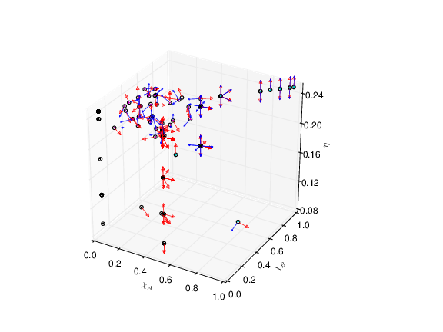
Numerical Relativity: Status
Binary Black Holes @ Caltech/Cornell/CITA:
Barely scratched the surface in the 7-d space
Szilágyi Béla
BDD2013@Wigner – Big Data Day 2013

Slide 23
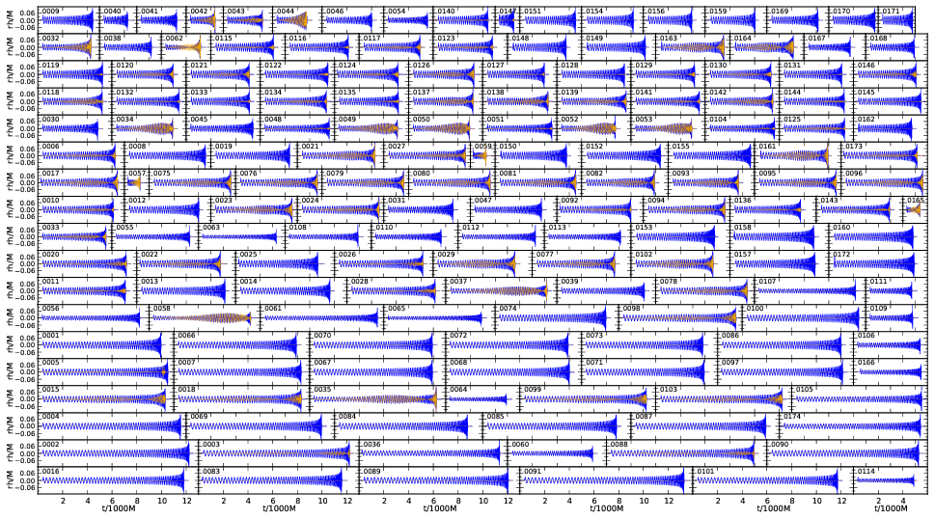
Numerical Relativity: Status
Binary Black Holes @ Caltech/Cornell/CITA:
Barely scratched the surface in the 7-d space
Szilágyi Béla
BDD2013@Wigner – Big Data Day 2013

Slide 24
Numerical Relativity: Needs
Goal: a complete “template bank”
in 2-3 years
Béla Szilágyi
BDD2013@Wigner – Big Data Day 2013

Slide 25
Numerical Relativity: Needs
Goal: a complete “template bank”
in 2-3 years
Will need sequences of 2-500 runs
Béla Szilágyi
BDD2013@Wigner – Big Data Day 2013

Slide 26
Numerical Relativity: Needs
Goal: a complete “template bank”
in 2-3 years
Will need sequences of 2-500 runs
Will need thousands of runs (5000?)
Béla Szilágyi
BDD2013@Wigner – Big Data Day 2013

Slide 27
Numerical Relativity: Needs
Goal: a complete “template bank”
in 2-3 years
Will need sequences of 2-500 runs
Will need thousands of runs (5000?)
Won’t know we’re done before
we’re at the end.
Béla Szilágyi
BDD2013@Wigner – Big Data Day 2013

Slide 28
Numerical Relativity: Payoff
Can increase effective sensitivity of
LIGO,VIRGO
Szilágyi Béla
BDD2013@Wigner – Big Data Day 2013

Slide 29
Numerical Relativity: Payoff
Can increase effective sensitivity of
LIGO,VIRGO
Can help make sense of observations
Szilágyi Béla
BDD2013@Wigner – Big Data Day 2013

Slide 30
Numerical Relativity: Payoff
Can increase effective sensitivity of
LIGO,VIRGO
Can help make sense of observations
Can contribute in essence to this
fundamentally new way of studying
the Universe
Szilágyi Béla
BDD2013@Wigner – Big Data Day 2013

Slide 31
Summary
Advanced LIGO/VIRGO is being built
The code is ready to go
All we need is CPU- and man-power.
Szilágyi Béla
BDD2013@Wigner – Big Data Day 2013

