Slide 1
Adatintenzív tudomány: lehetőségek és kihívások
István Csabai
Dept. of Physics of Complex Systems, Eotvos University, Budapest
Big Data Day @ Wigner, September 12, 2013.

Slide 2
Evolution of the data intensive scientist: early times
theory
observation
reality

Slide 3
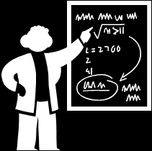
Evolution of the data intensive scientist: past
instruments
theory
observation
reality
experiment
models
test
predictions

Slide 4
Evolution of the data intensive scientist: present
instruments
theory
observation
reality
experiment
models
test
virtual reality
predictions

Slide 5

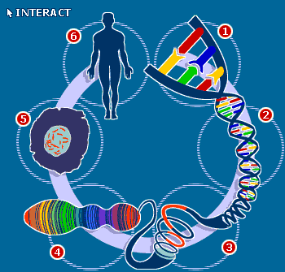
Other disciplines are similar: whole genomes, satellite maps, sensor networks, etc.
instruments
theory
observation
reality
experiment
models
test
virtual reality
predictions

Slide 6
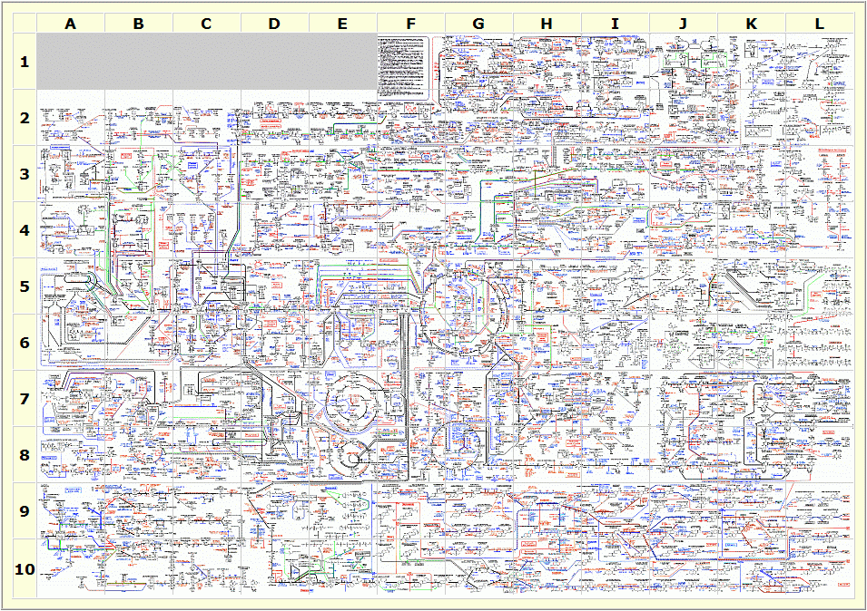
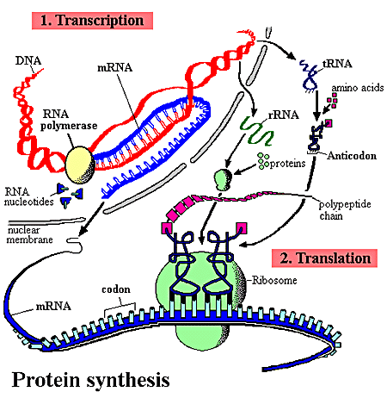
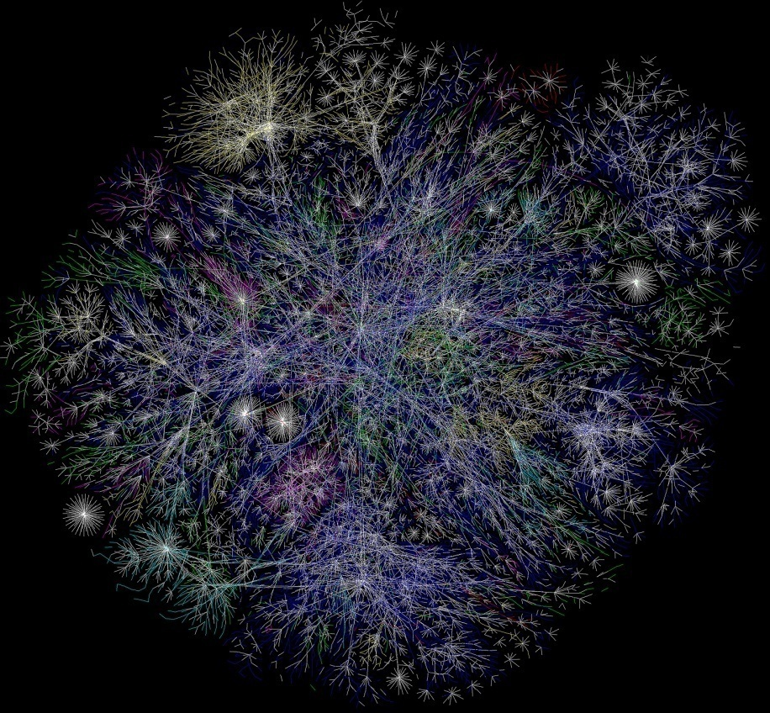
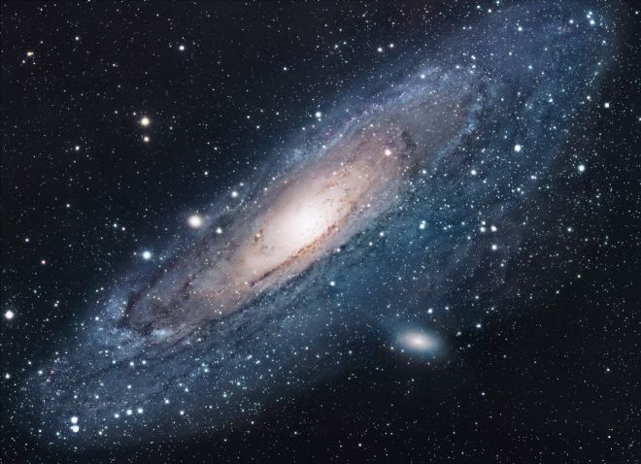
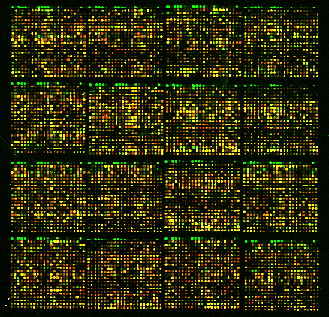
To understand the complex reality, we need complex models
To verify complex models we need a lot of data (large statistical sample -> statistical databases)

Slide 7
Mining Big Data – Understanding Complex
Astronomy
  Photometric redshifts
  Galaxy spectra
  Order statistics, cluster evolution
  Star crossmatch, photometric parallax
  Composites, coadd
  LSS, n-body simulation DB
  Gravitational redshifts
Communication networks
  Self similar traffic
  New protocols
  ETOMIC, SoNoMa, OpenLab
  Geolocalization, Spotter
  NmVO
  TwitterDB
Genomics
  Signal peptides
  Expression chips
  NGS
  Cancer markers, metagenomics
Dimension reduction
  PCA
  Streaming PCA
  Robust PCA
  Galaxy spectra, continuum/lines
  Graph PCA / metric spaces
  CUR decomposition
  Sparsity, L1
  + „supervised” regression, classification
Database technologies
  Procedural code-in-db (vs. declarative), CLR, array library, GPU
  Multidimensional indexing
  Distributed databases
    SkyQuery
    NoSQL, column stores
  Data sharing, data standardization
    Virtual Observatories, CasJobs
    astro, spectro, network
  Virtualization
    Network + cloud
    DataScope
Etc
  Echo state neural net
  Lattice-Boltzmann, aneurysm
  Spin-glasses, long range correlation, averaging
  EEG
  Cosmic signals on Earth, lightnings and earthquakes
  Data mining challenges
  Arsenic life
  Artifacts

Slide 8
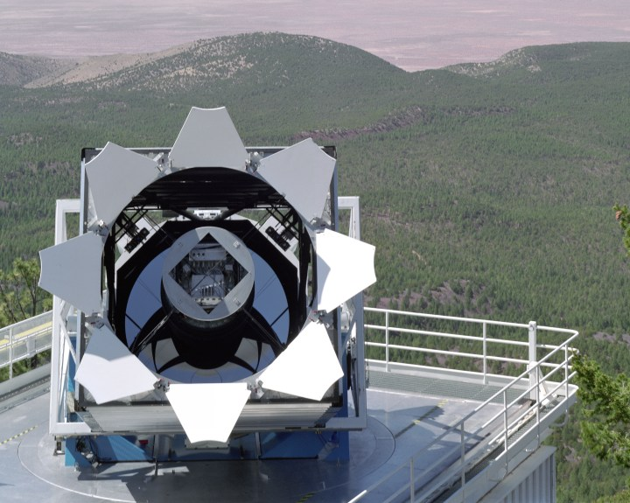
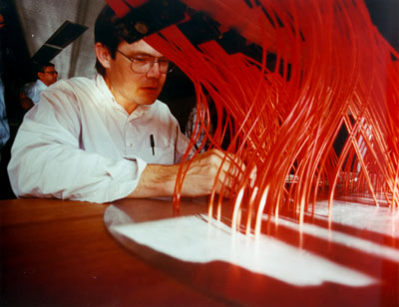
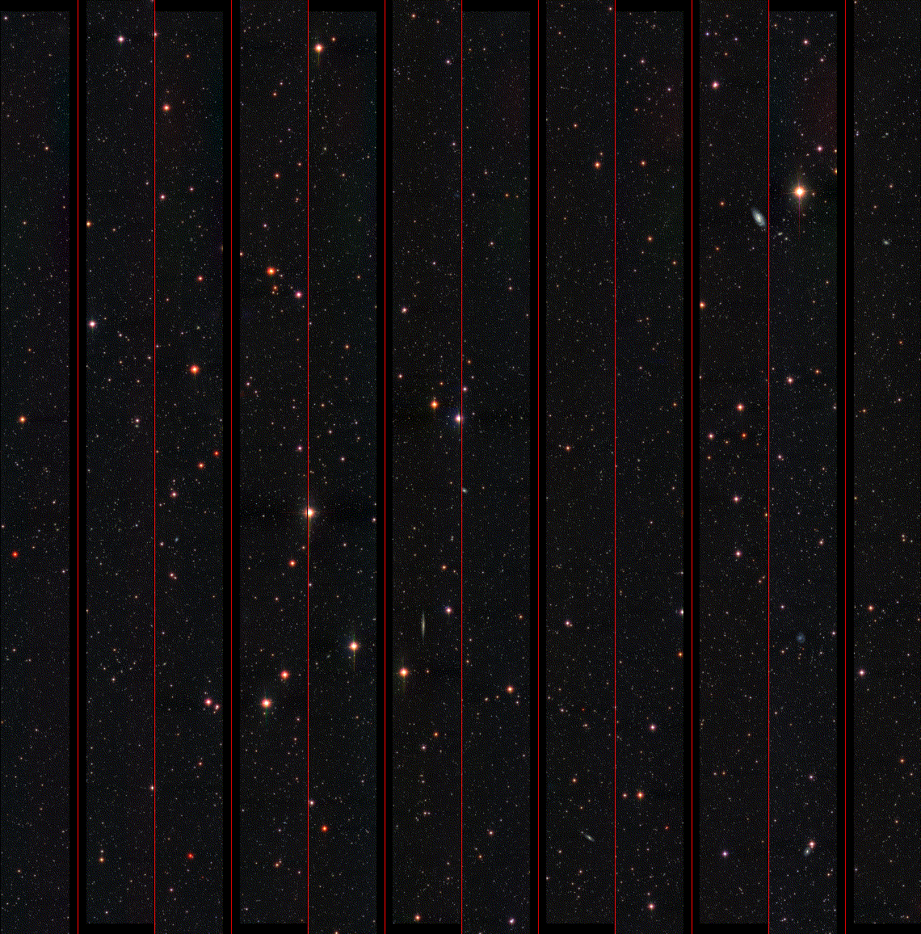
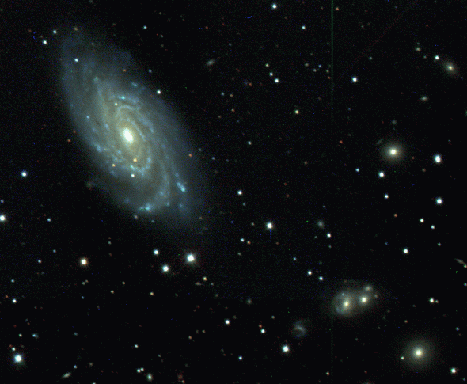
Astronomy: The Sloan Digital Sky Survey
Special 2.5m telescope, located at Apache Point, NM
  3 degree field of view.
  Zero distortion focal plane.
Huge CCD Mosaic
  30 CCDs 2K x 2K (imaging)
  22 CCDs 2K x 400 (astrometry)
Two high resolution spectrographs
  2 x 320 fibers, with 3 arcsec diameter.
  R=2000 resolution with 4096 pixels.
  Spectral coverage from 3900Å to 9200Å.
Automated data reduction pipeline
  Over 150 man-years of development
  effort.
Very high data volume
  Over 300 million objects, over 300 parameters
  Over 40 TB of raw data, 5 TB catalogs,
  2.5 terapixels
  Data made available to the public.

Slide 9
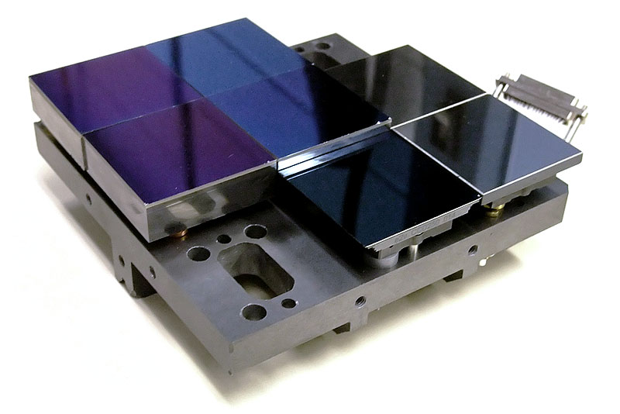
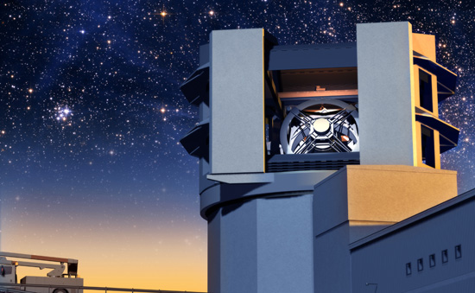
Astronomy: new surveys
SDSS : 120Mp, 100TB
PanSTARRS 4Gp, 1PB/yr
LSST 3Gp,6 PB/yr
…

Slide 10
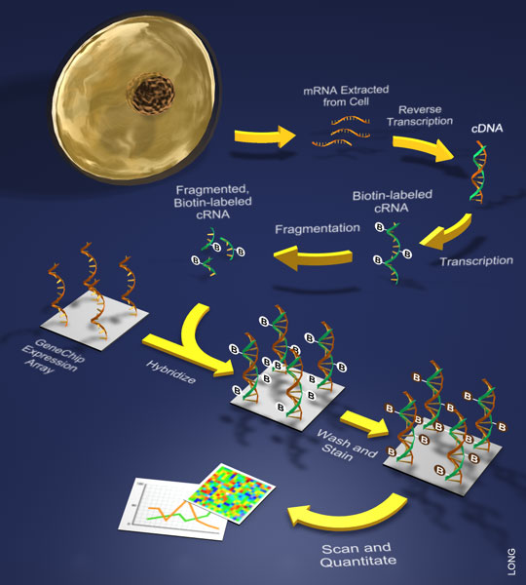

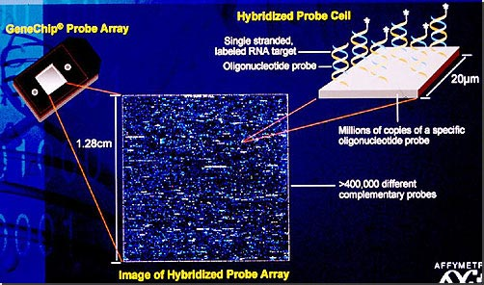
Genomics:Microarrays
Affymetrix HG U133 Plus2
  Raw image 67Mpix (photometry!)
  604258 probes
  54675 probe sets

Slide 11
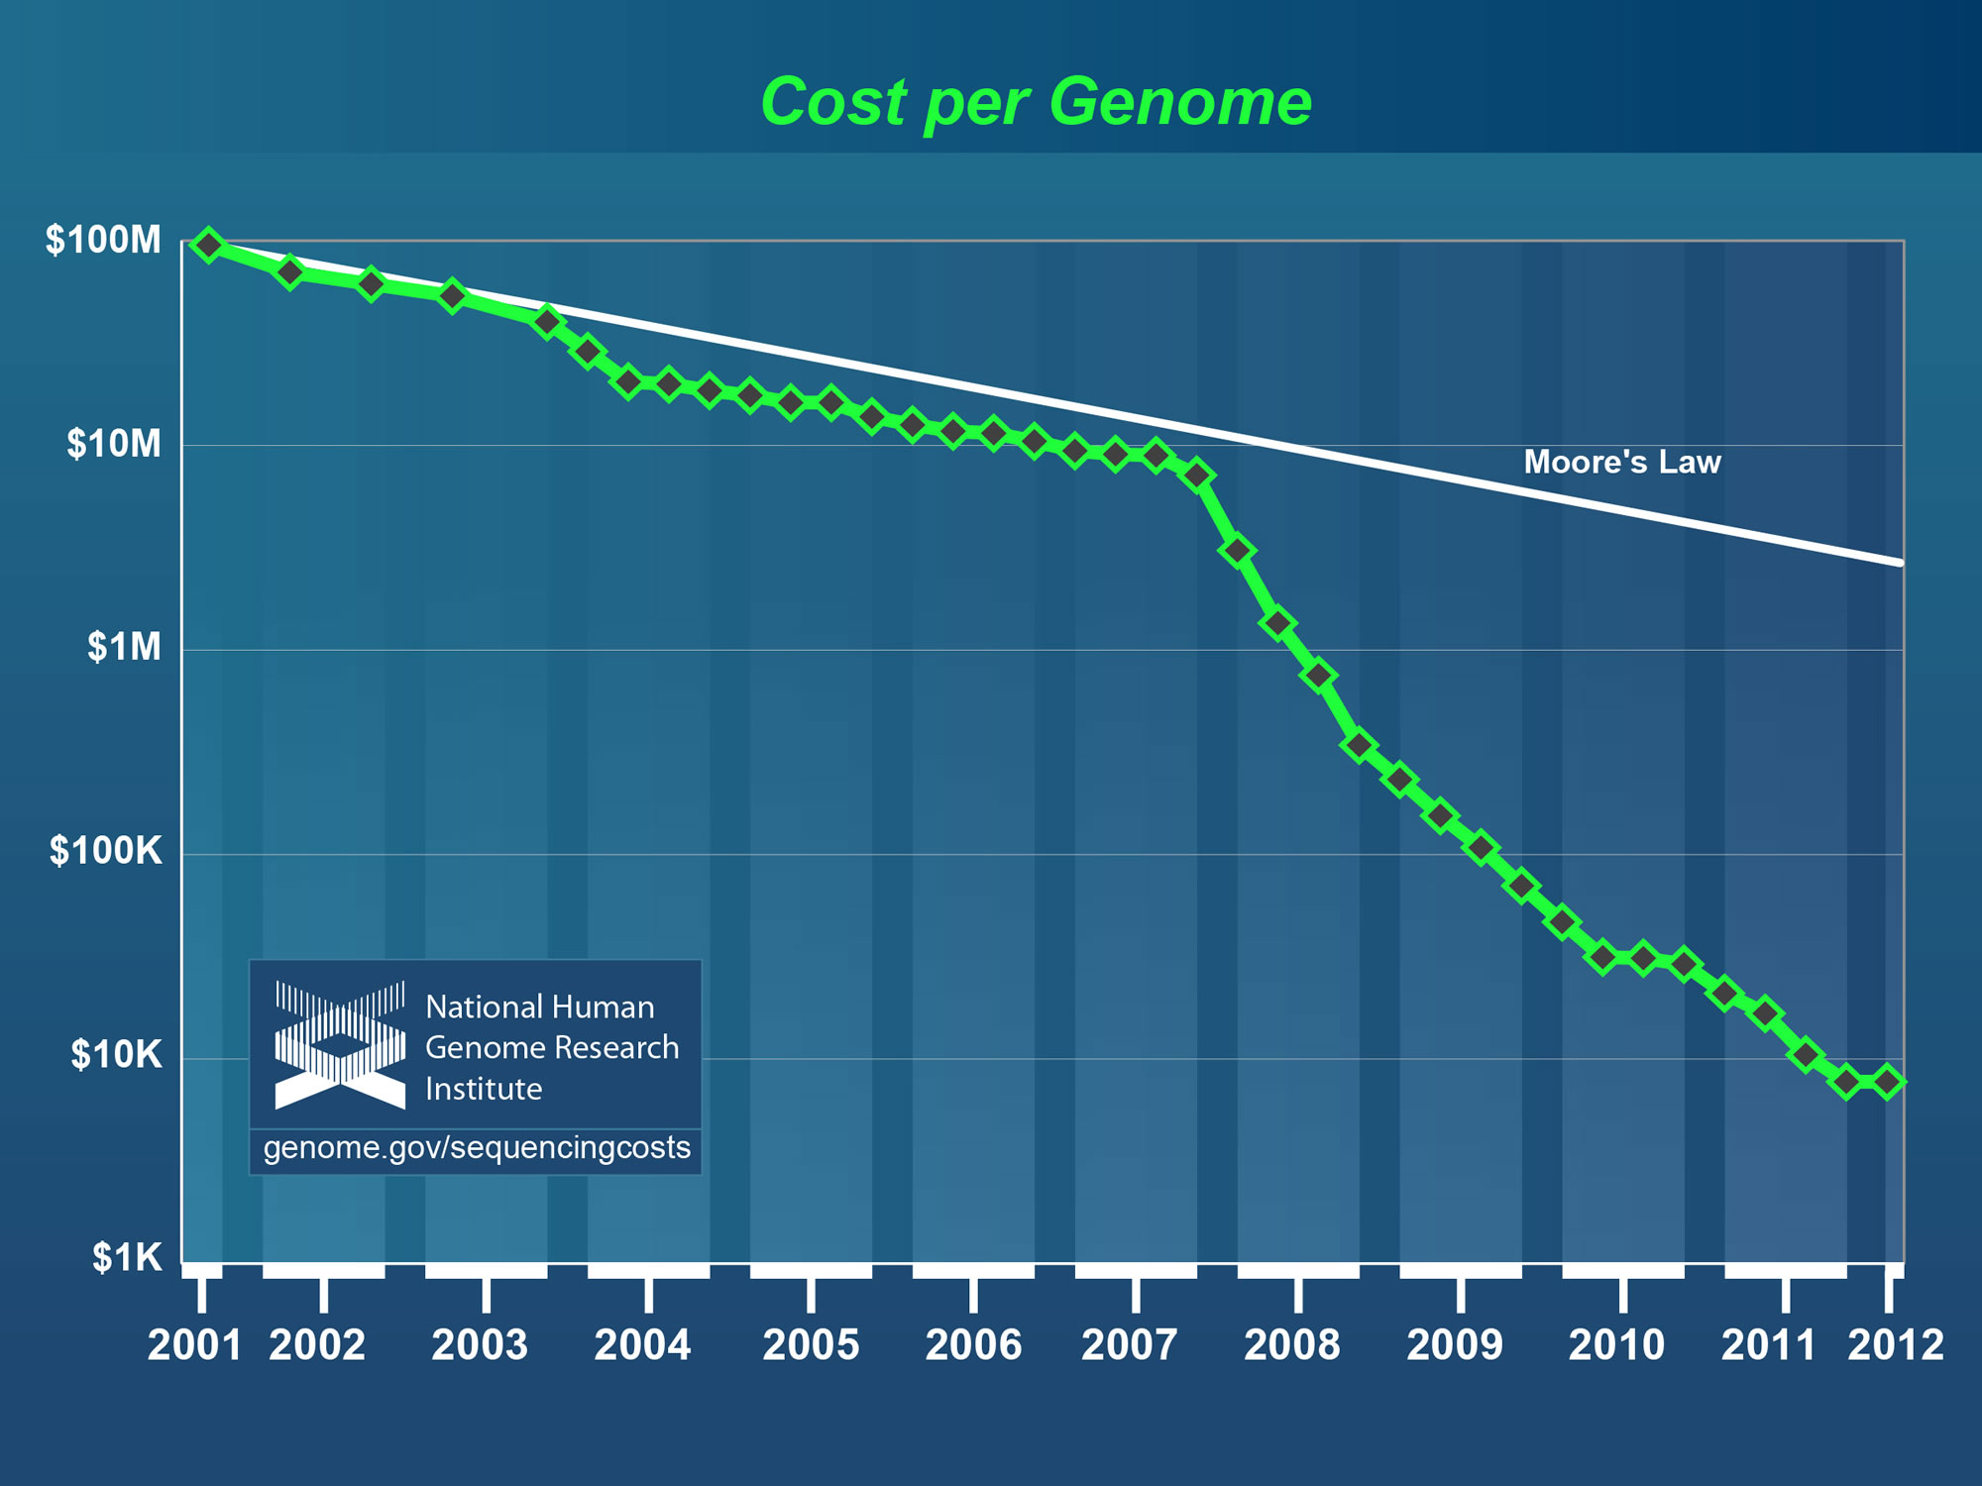
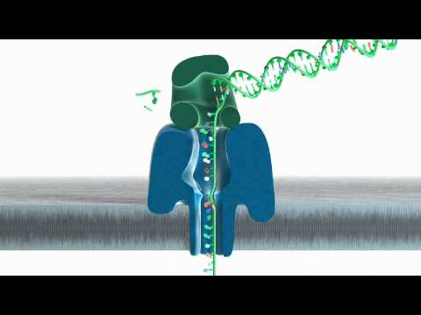
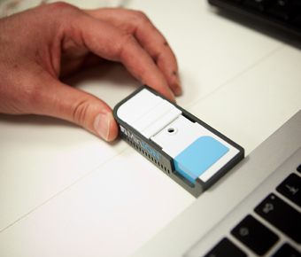
Genomics:Next Generation Sequencing
MANY OTHERS:
- Microarrays
Mass spectrometry
Digital microscopy
X prize cancelled
…
CCD!
Oxford Nanopore
2012 Q4, 100Mb,$900

Slide 12
Genomics Data – Big Data Challenge
Data size per Genome
Structured data
(databases)
Clinical Researchers,
non-infomaticians
Individual
features
(3MB)
Variation data (1GB)
Sequencing informatics
specialists
Alignments (200 GB)
Sequence + quality data (500 GB)
Unstructured data
(flat files)
Intensities / raw data (2TB)
Source: Guy Coates, Wellcome Trust Sanger Institute

Slide 13
Data size per Genome
Structured data
(databases)
Clinical Researchers,
non-infomaticians
Multiply this with the 7Bn people,
few dozen tissue types for each …
Individual
features
(3MB)
Variation data (1GB)
Sequencing informatics
specialists
Alignments (200 GB)
Sequence + quality data (500 GB)
Unstructured data
(flat files)
Intensities / raw data (2TB)
Source: Guy Coates, Wellcome Trust Sanger Institute

Slide 14
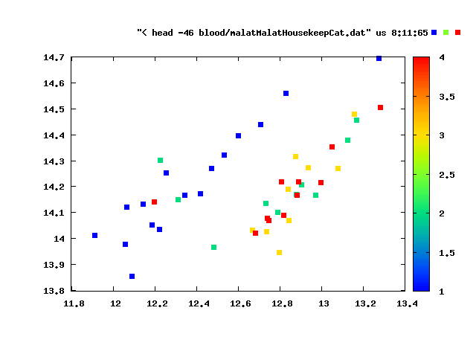
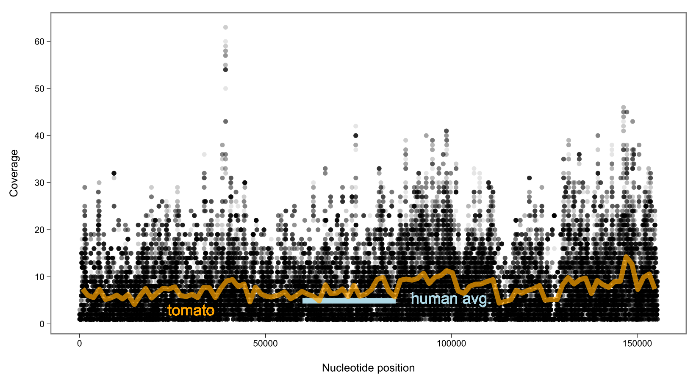
Have to keep raw data

Slide 15
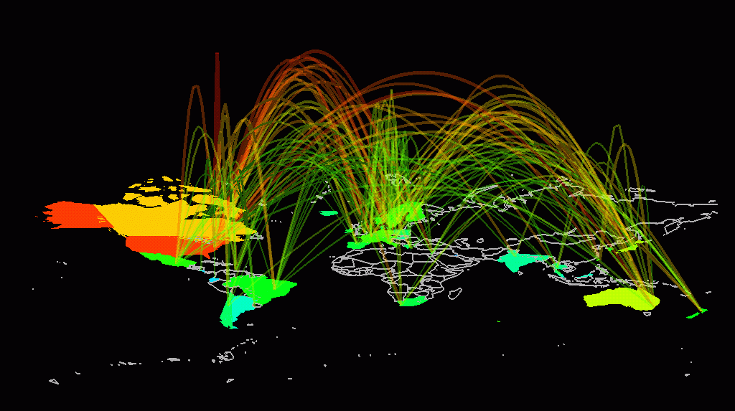
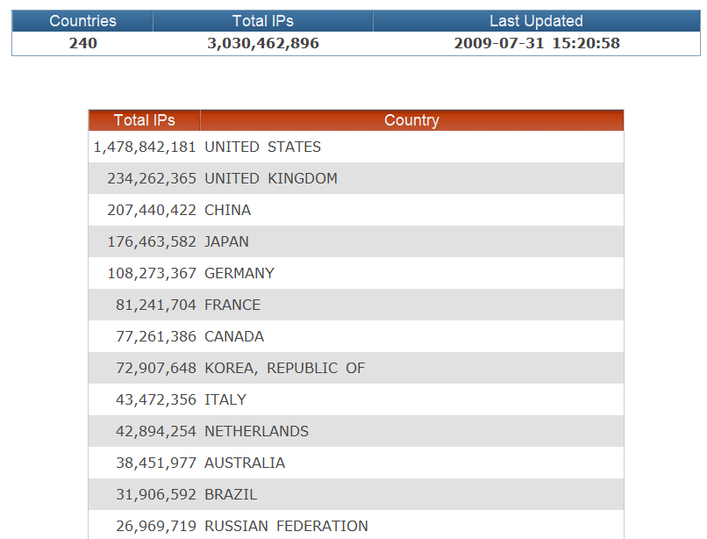
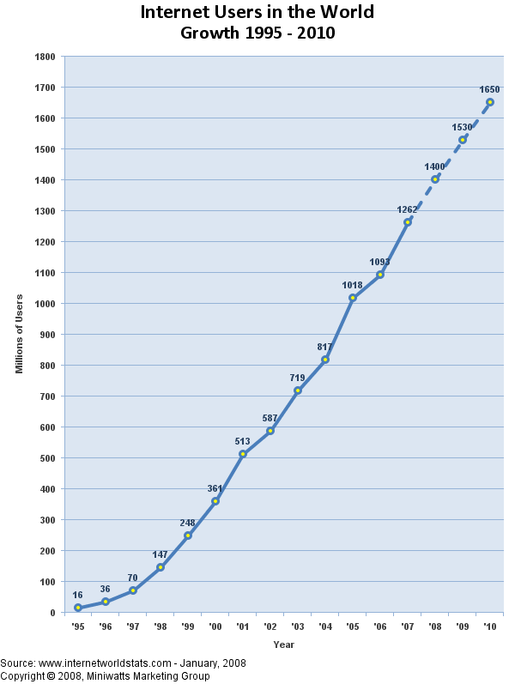
Internet
“Transfer is more critical than storage”
Although man-made but there is no “blueprint”
“Astronomical” number of components, complex non-linear interactions
We need similar methods as in natural sciences to understand its behavior
We need to
  observe / experiment
  Model
  Design a better one
Future internet: self-aware, self-managing, self-healing …

Slide 16
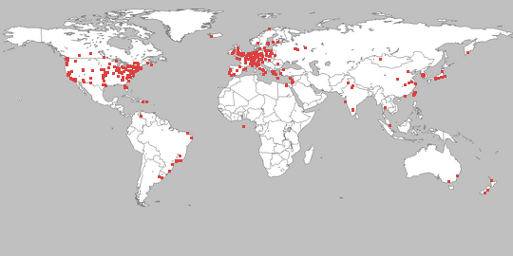
Measurement/experiment facilities: obcervatories
Planetlab / Onelab
  A network of open computers distributed across the world and available for the development of new network services.
  Realistic platform available for trial deployment and experimentation, with services such as distributed storage, network mapping, peer-to-peer systems, distributed hash tables and query processing.
  Over 1000 nodes worldwide
OneLab2 EU Integrated Project 2008-2010 ,29 participants Europe wide + 1 from Japan

Slide 17

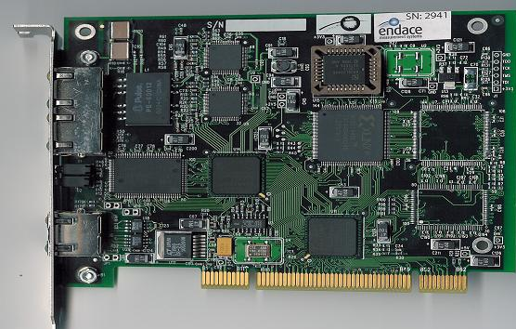
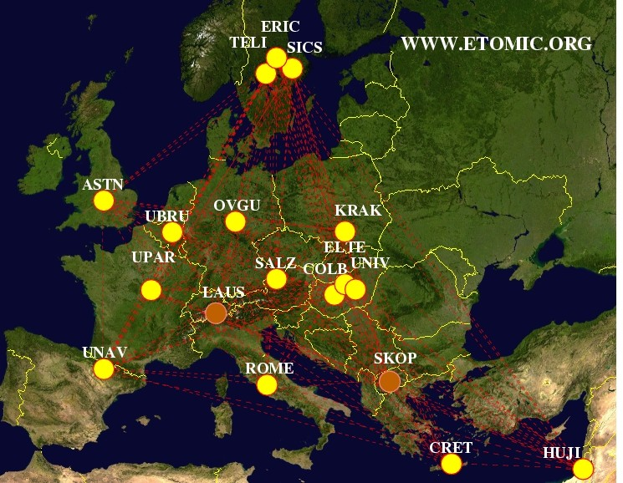
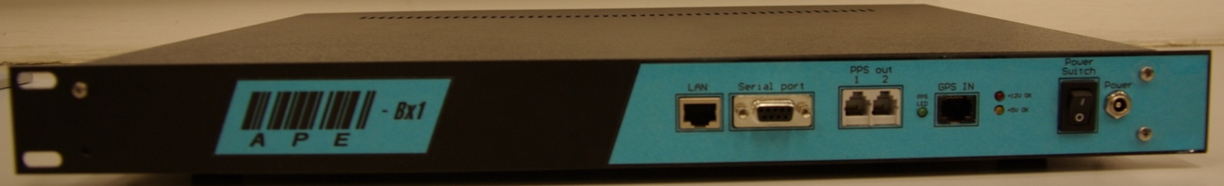
Our telescope: NMVO
ETOMIC/Sonoma/Spotter
Server PC architecture, Linux
Endace DAG 3.6 GE card
or ARGOS FPGA measurement card ($3000+)
with packet sending capability (packet offset ~60 ns)
GPS for global time synchronization
New low cost version
based on Blackfin microcontroller
dedicated IP packet time stamping module
Can be called as SOAP web services / from stored procedures
low cost (300 €)

Slide 18
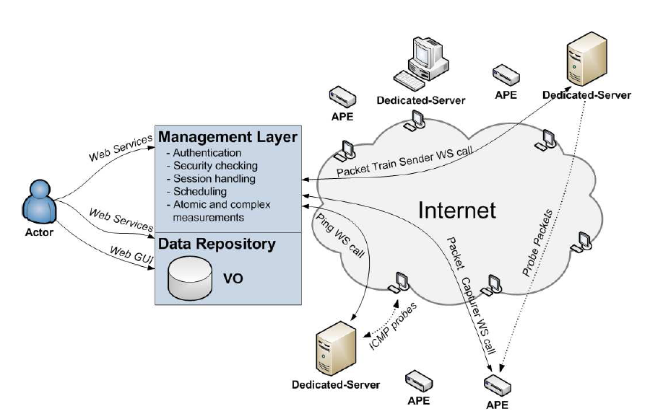
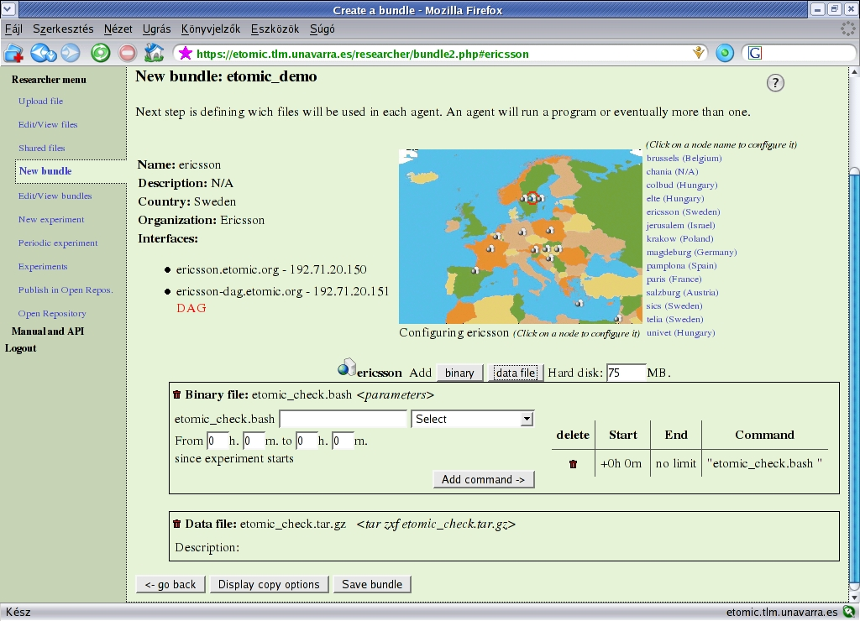
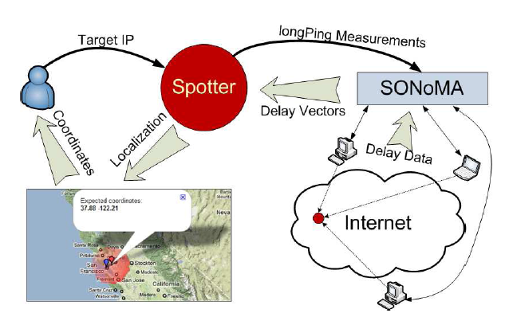
ETOMIC/SONOMA/SPOTTER/NMVO
- experiment scheduling, management
- data management
Integrated:
Measurement – data management –analysis
Many ideas, concepts from
astronomical VO

Slide 19

database
traceroute archive
Mediator/query broker
SQL
graphical user
interface
GUI
data subset
WS
Processing functions
Stored procedures
Search tools
Visualization tools
Web service
interface
XML, SOAP
WSDL, processed data
database
delay archive
database
BGP archive
SQL
graphical user
interface
SQL
graphical user
interface
data subset
data subset
Processing functions
Stored procedures
Search tools
Visualization tools
Web service
interface
Processing functions
Stored procedures
Search tools
Visualization tools
Web service
interface
XML, SOAP
XML, SOAP
WSDL, processed data
WSDL, processed data

Slide 20
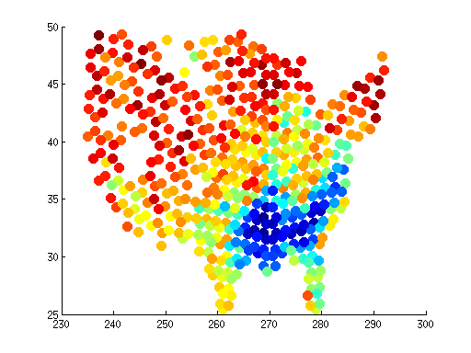
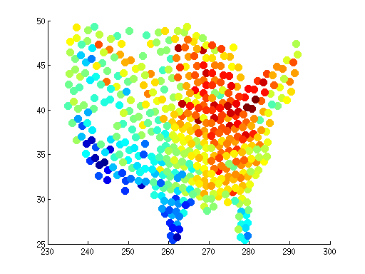
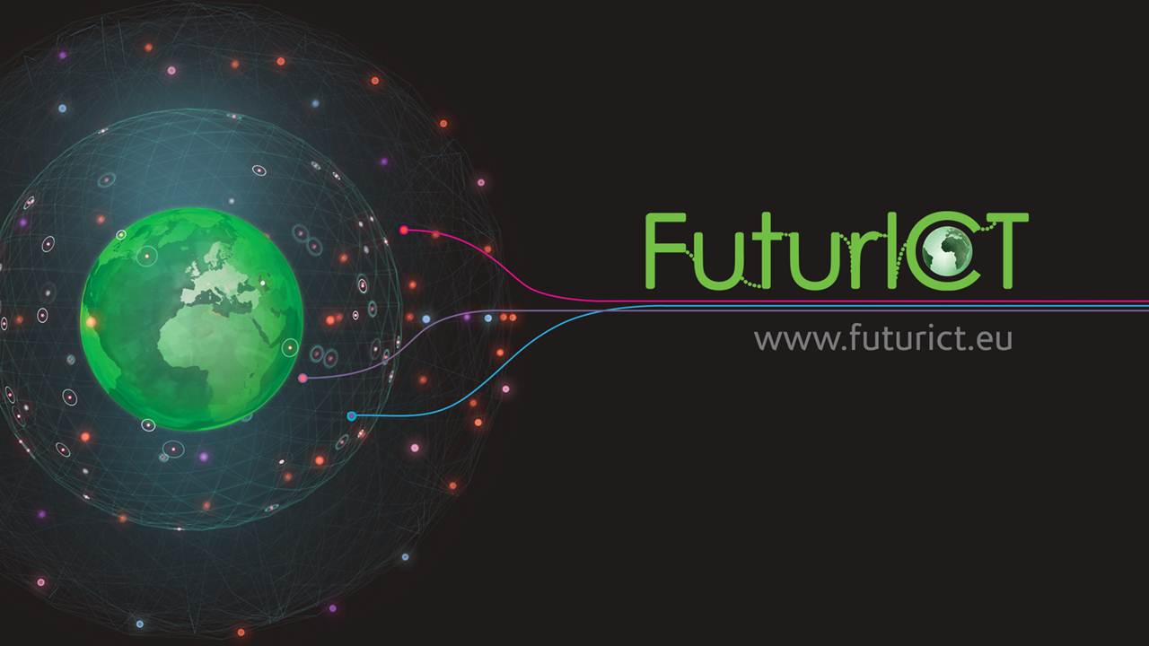
Social and financial systems
goodmorning, wit, everybody,somebody
lil, jus, hoes, yall, sleepy,tryna,af
imma,smh,yu,kno,bout,gon,hoe
ima,wat,swear,dnt,aint,nobody
nigga,niggas
amazing,excited, awesome, nice
idea,favorite,holy,snow,guys
looks,sounds,makes,ever,actually
does,hours,such,into,were,doesn,
little
TwitterDB:
Bitcoin: rich get richer

Slide 21
Now we have more data that we can handle
We have the most complex questions ever
Need for new research tools
Integrate data collection, management and data mining in the same framework:
  Coordinate observation, data collection
    NMVO*
  Handles arrays / has all algebra like Matlab (Problem with memory algorithms!!)
    Array library/LAPACK for SQL Server*
    Integrated data mining tools
  Visualize data, zooms on scatter/contour plots, graphs like Google maps – interact with DB
    Prototype: zoom on random subset of 300M “galaxies”*
  Manage data / run queries like DBMS (multidimensional spatial indices)
    K-d tree based multidim spatial index for SQL Server*
  Flexible like C++ (simulations)
    We use CLR
  Shares data / handles shares of others like Facebook
    CasJobs*
  Do it fast while I type my query

Slide 22





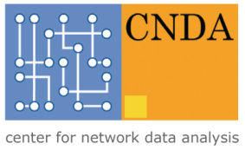


Munkatársak, támogatás
ITΠ
Ács Zoltán
Mátray Péter
Laki Sándor
Stéger József
Korbuly Bálint
Vattay Gábor
Solymosi Norbert
Bodor András
Kondor Dániel
Dobos László
Varga József
Trencséni Márton
Purger Norbert
Ittzés Péter
Spisák Sándor
Molnár Béla
Budavári Tamás
Szalay Sándor
SOTE
Universidad Autonoma de Madrid
Universidad Publica de Navarra
Ericsson Research
Tel Aviv University
Johns Hopkins University
Ericsson, 3Dhistech
NKTH TECH08:3dhist08,
KMR_12-1-2012-0216
NAP 2005/ KCKHA005, Polányi
TAMOP: FuturIct
OTKA-103244
OTKA 7779
EU ICT OneLab2 IP #224263
EU FIRE NOVI #257867
EIT KIC

