Slide 1

ML and VA tools
in support of
software testing
Beatrix Benkő^{1,2} András Lukács¹
¹Eötvös Loránd University
²Ericsson Hungary
AIME'18 Workshop 30-10-2018

Slide 2
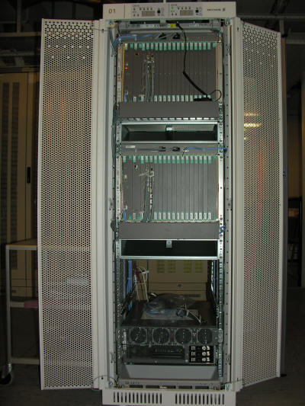
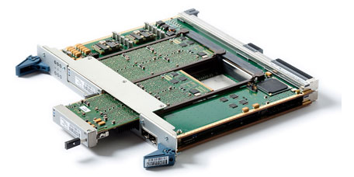
The task
IP Multimedia Subsystem (IMS) applications
Non-functional > performance > endurance tests: software can sustain the continuous expected load without performance degradation

Slide 3
Data
Test on each new software version
Several hours/days for a test (block)
Tests/blocks are labelled by OK (64) or NOK (5) or unlabbeled (72)
Every 15 minutes an XML file with aggregated data (sample) is generated (10240)
There is no expert labelling for samples
Data from about one year

Slide 4
Understanding data
1664 types of measured values
several hardware locations
altogether 10131 individual features
#NaN
#0
#0<

Slide 5
Feature engineering
100 important types by software tester experts (731 features)
Features with NaN values or only zeros are dropped
Finally 328 features

Slide 6
ML methods
Prediction for samples or blocks?
Test data should not cut block
Supervised
  Random Forest
  Adaptive Boosting
  Extreme Gradient Boosting
Unsupervised
  One-Class Support Vector Machine
  Isolation Forest

Slide 7
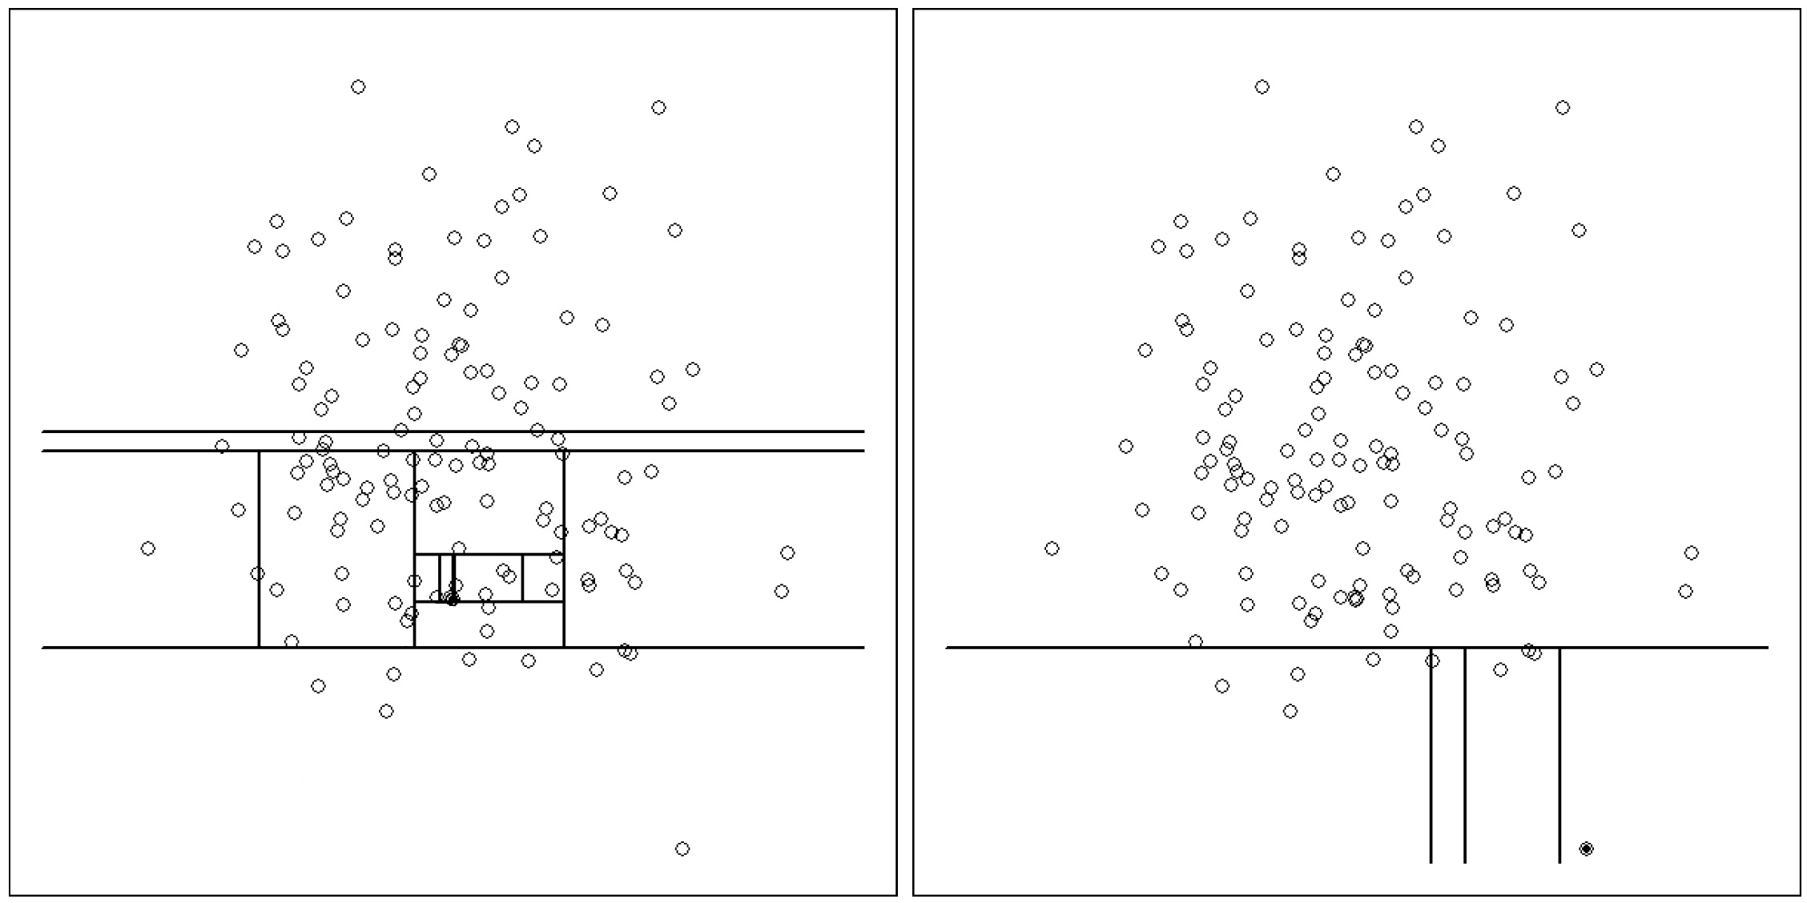
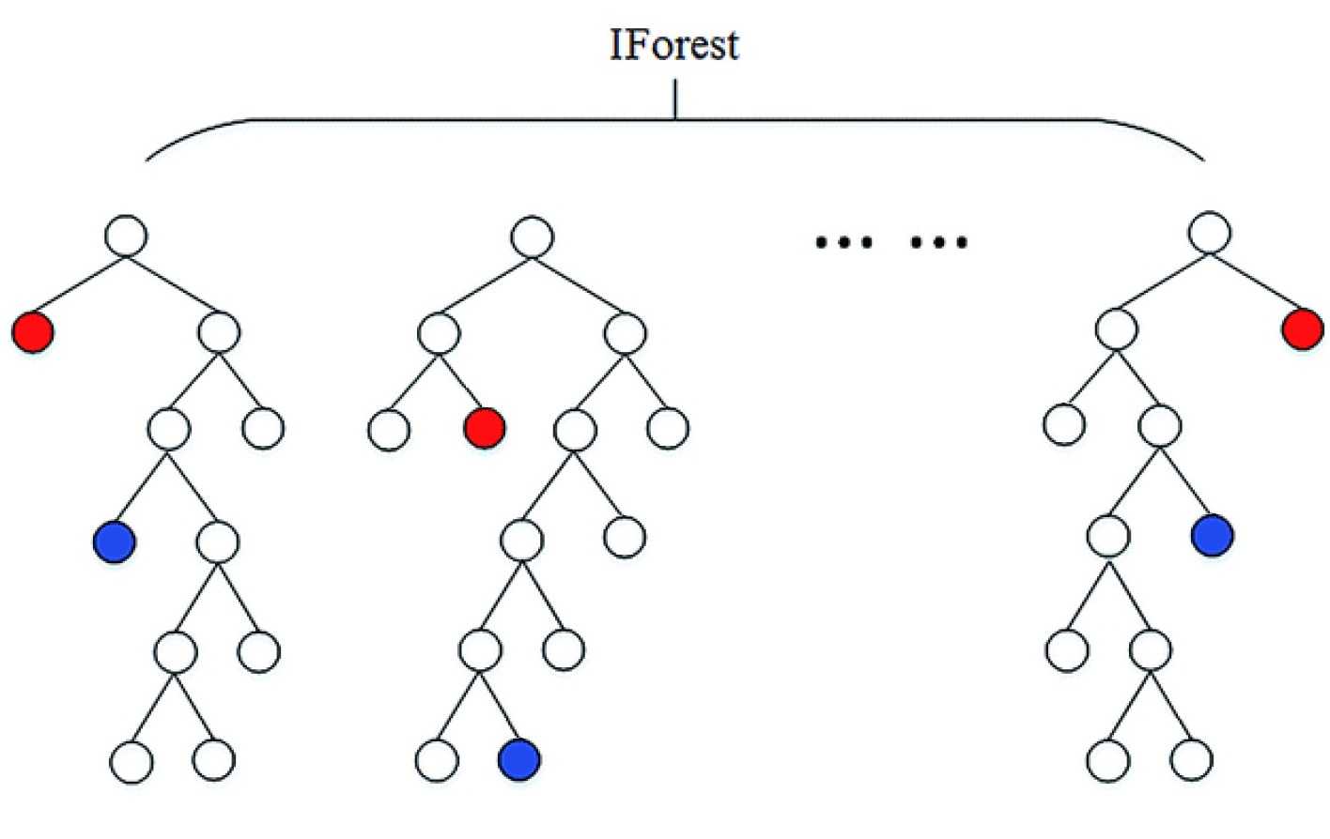
Isolation Forest
Trees by random splits on samples
Labels contain only one sample
I(s) – average level of single sample s in the trees

Slide 8
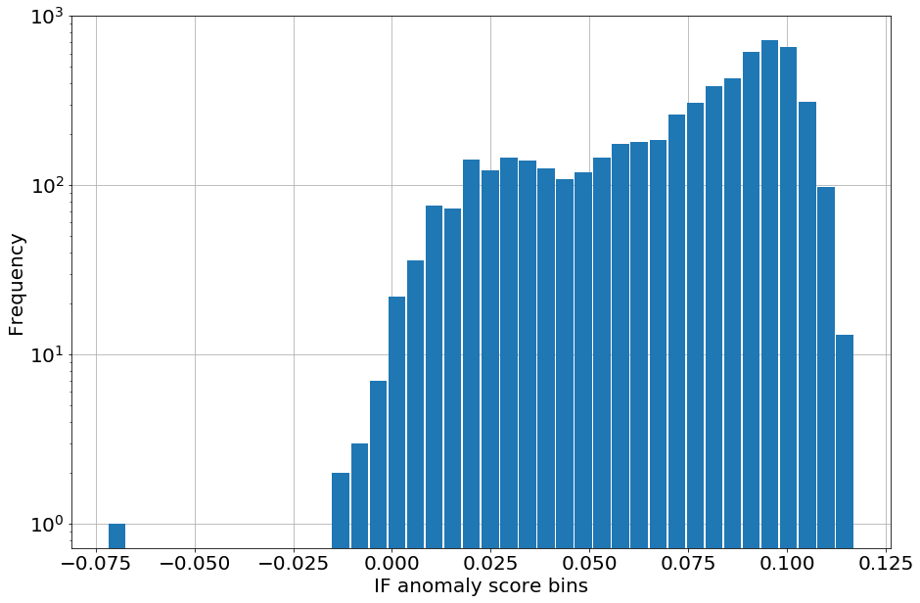
Histogram of I(s) values

Slide 9
Histogram of I(s) values
measurement
error

Slide 10
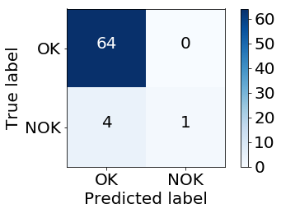
Histogram of I(s) values
Prediction for blocks by by simple majority model on samples with threshold 0.025 for I(s)

Slide 11
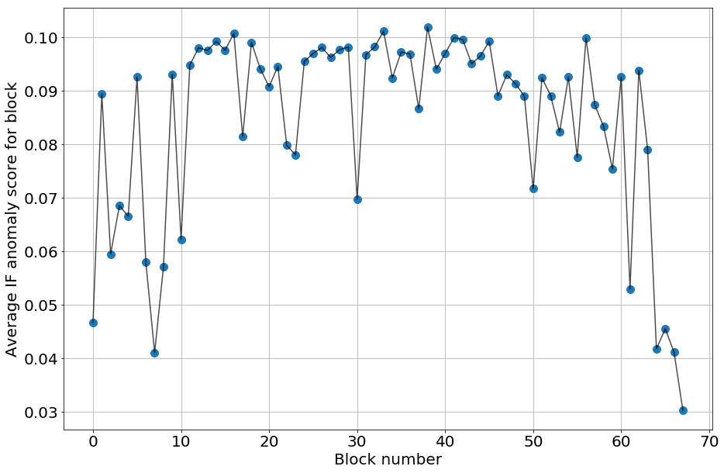
Average of I(s) values in blocks – 4 NOK at the end

Slide 12
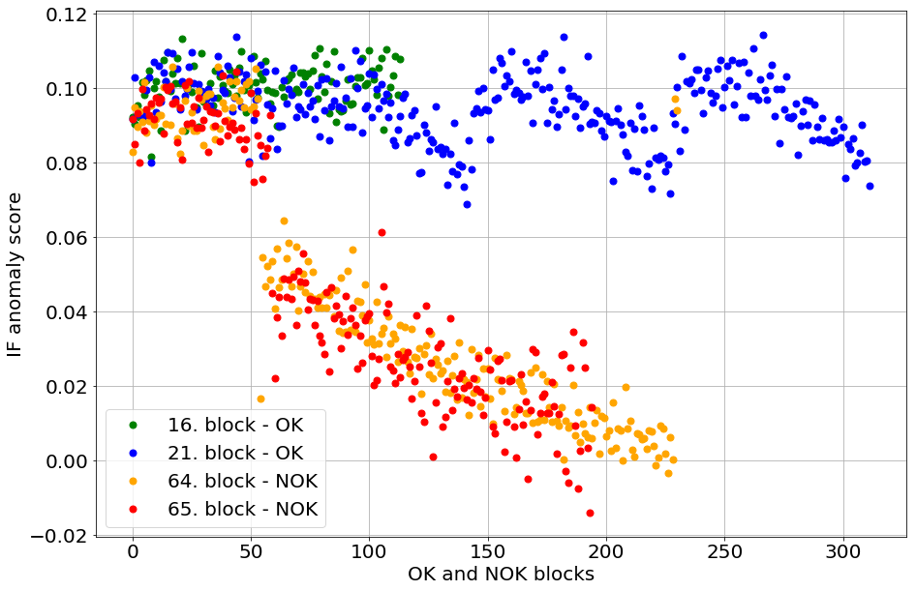
I(s) values in blocks

Slide 13
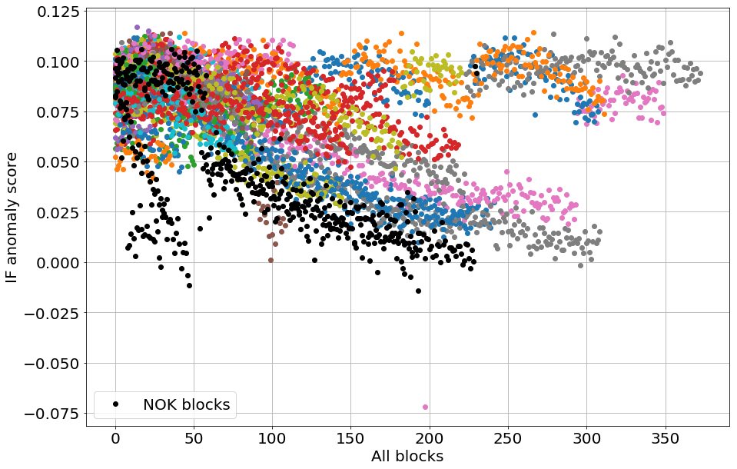
I(s) values of all blocks

Slide 14
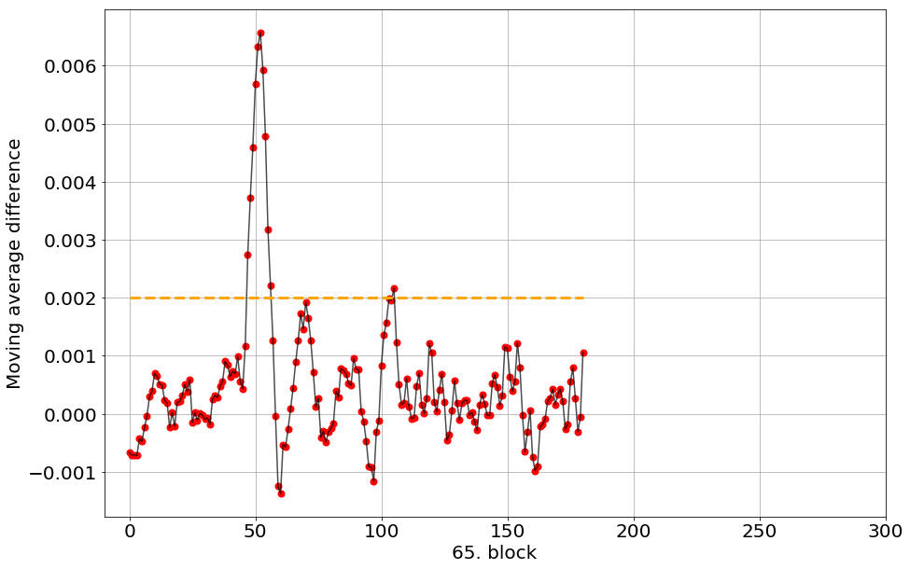
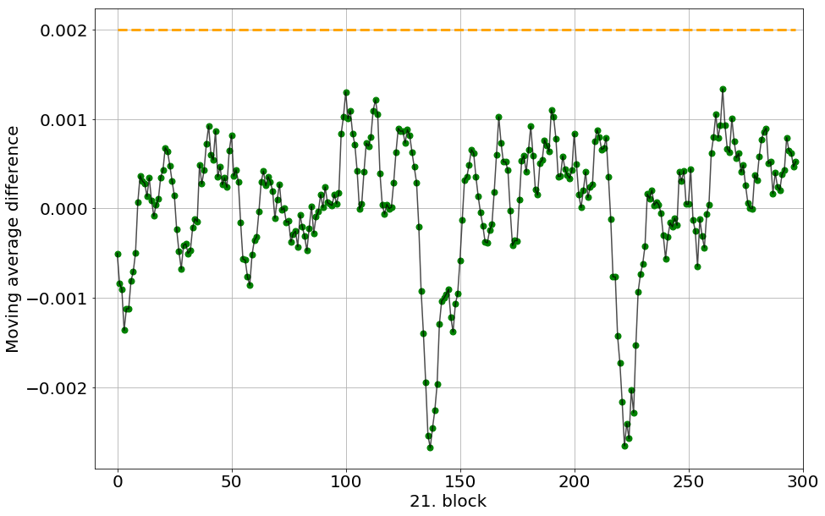
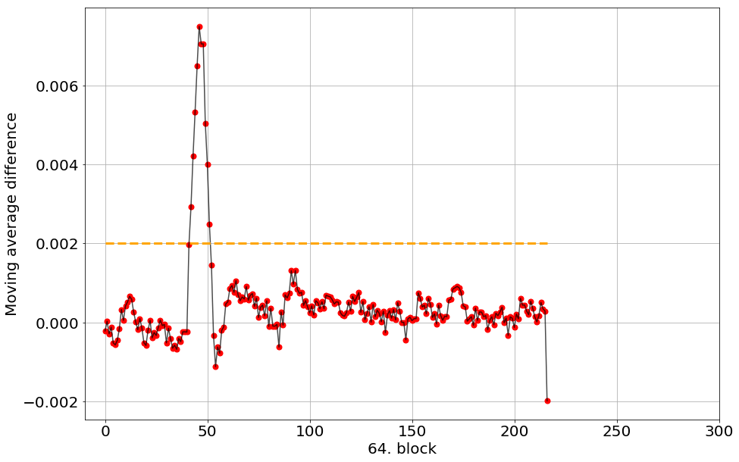
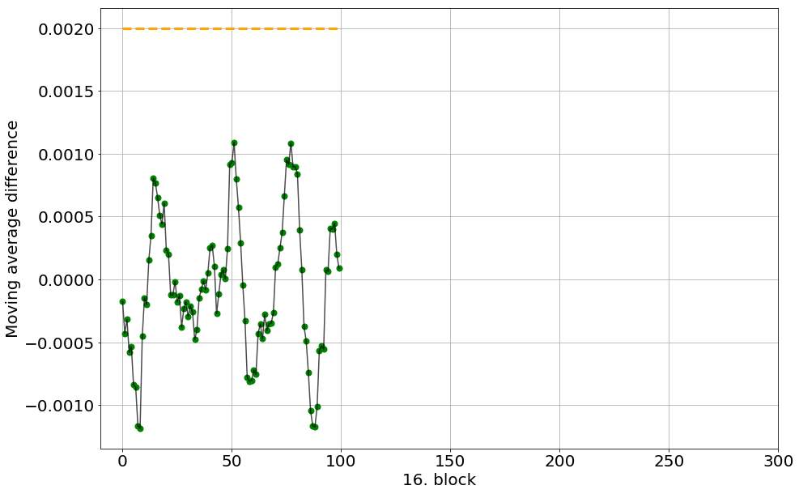
Differences in moving average of I(s)

Slide 15
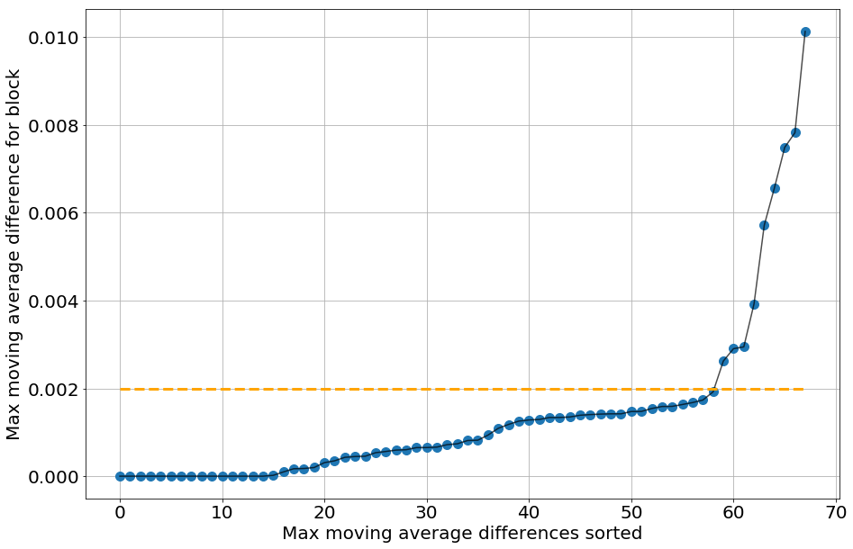
Blocks ordered by maximum diffs in moving average of I(s)

Slide 16
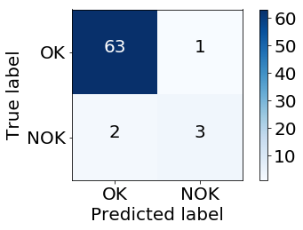
Predictions for blocks
One-leave-out
Treshold for critical jumps by ratio of the experts’ labels

Slide 17
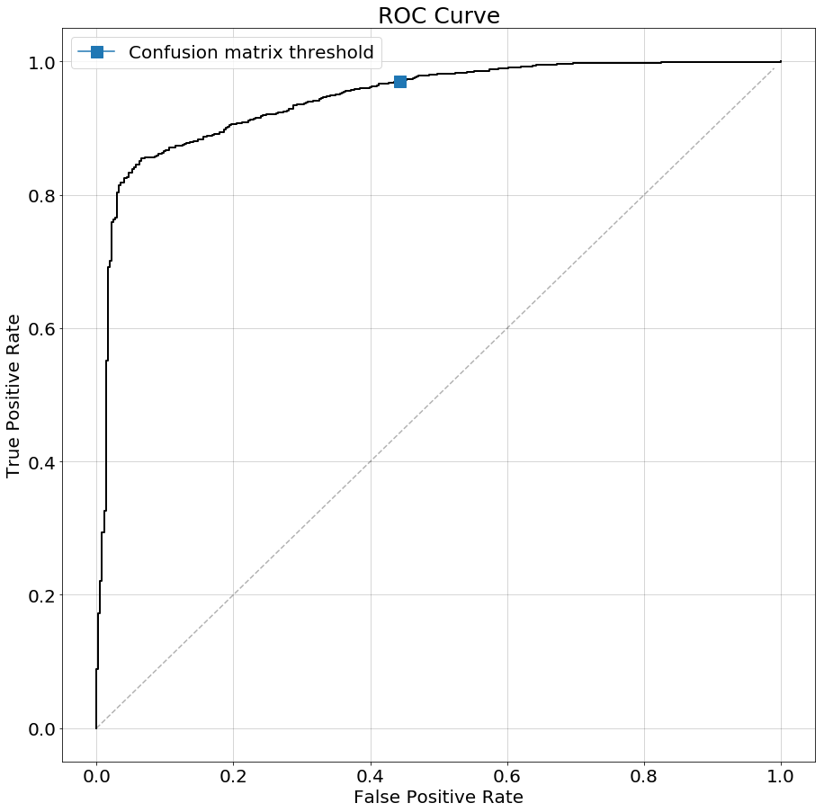
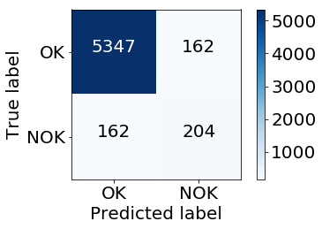
Predictions for samples
Derived labelling as ”original”
NOK samples after ”errors” in block

Slide 18
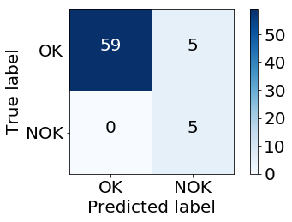
Predictions for blocks based on derived labels of samples
Prediction for blocks by majority model on samples with threshold by OK-NOK ratio

Slide 19
Details of errors by IF
Collecting variables along paths from the root leads to NOK samples from a given block
Statistics on these variables (hardware location and type)

