Slide 1
Introduction to the the ACCELERATE Project
Dr Steve Welch, ESP Central Ltd

Slide 2
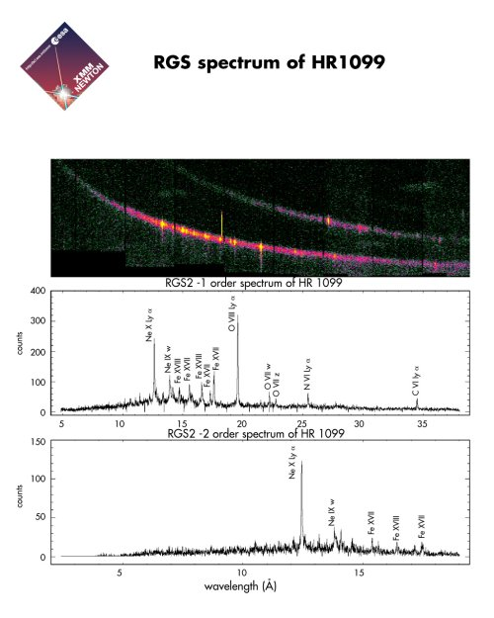
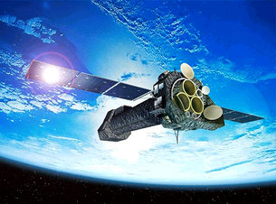

Slide 3
ACCELERATE aims at developing the tools to foster the long-term sustainability of European Research Infrastructures.
4 years
2017 - 2020
7 Work Packages
Main focus: support of RI’s sustainability, promotion of Open Access and attraction of new scientific and industrial users from target countries, develop services for their commercial access, foster exploitation of projects’ results.
8 Partners
CERIC, ELI-DC, ESP, ESS, Rathenau Institute, FRMII, HZG, UZHNU

Slide 4
The Goals of ACCELERATE
Develop clear and practical strategies for the long-term sustainability of Research Infrastructures (RIs)
Find efficient solutions to address common legal and administrative issues in ERICs’* operations.
Develop a methodology to measure the socio-economic impact of RIs.
Capacity building through training activities for TT officers and users
Increase the visibility of Research Infrastructures (RIs) among academic and industrial communities and attract new users: “Making RIs Business-Friendly”
*ERIC: European Research Infrastructure Consortium is a full legal entity under Union law with the objective of establishing and operating, through its Members, a research infrastructure of European importance on a non-economic basis.

Slide 5

How can we build a robust bond between Research Infrastructures and industry ?
Understanding Needs of Industry
Informing and inspiring Industry with capability
Smooth impediments to cross-working
Creating opportunities for interactions to take place

