Slide 1
Learning from Data Streams Theory and Practice
STREAMLINE: Improving Competitiveness of European Enterprises
through Streamlined Analysis of Data at Rest and Data in Motion
András Benczúr
Institute for Computer Science and Control
Hungarian Academy of Sciences (MTA SZTAKI)
Joint work with
Domokos Kelen, Daniel Berecz (Flink parameter server)
Robert Palovics (recommenders, now at Stanford)
Levente Kocsis (reinforcement learning – ECML TEST-OF-TIME Prize 2016 / Bandit based Monte-Carlo planning 2006 w/ Szepesvári)
This project has received funding from the European Union’s Horizon 2020 research and innovation programme under grant agreement No 688191
AIME 29/10/2018

Slide 2
Presentation based on four chapters on Online Machine Learning in Big Data
Requirements and distributed systems
The Parameter Server
Classification
Linear methods, Neural networks; Trees
Recommender Systems
Other online learning methods
Reinforcement learning
Unsupervised
Concept drift
Due: February 14, 2019
Chapters should be available online
All in one ArXiv: 1802.05872

Slide 3
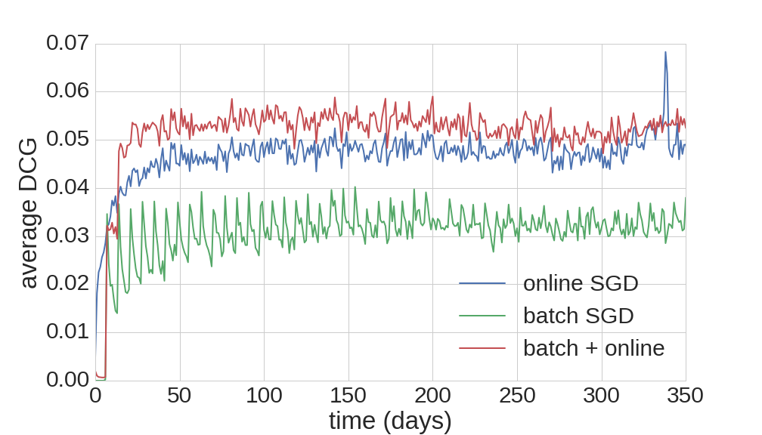
I will show two applications
Recommenders
Surprisingly, reading the data only once and forgetting helps!
Our first main observation from back in 2013
Concept Drift in industrial IoT time series

Slide 4
Terminology – all depend on data scale („Big Data”)
Batch
Repeatedly read all training data multiple times
Stochastic gradient descent: use multiple times in random order
Elaborate optimization procedures, e.g. SVM, gradient boosting
+ More accurate (?)
+ Easy to implement (?)
Online learning
Update immediately, e.g. with large learning rate
Data streaming
Read training/testing data only once, no chance to store
Real time / Interactive
+ More timely, adapts fast
- Challenging to implement
Notes:
46

Slide 5
Online learning in Big Data: Overview of the main issues
Limitations of the data steam model. Limited memory.
Certain evaluation methods fail since model can change during evaluation.
Concept Drift can occur.
Scalability, distributed processing.

Slide 6
Issue 1: Algorithmic limitations
We have to update the model after each data instance
No access to (majority of) past data
No stochastic gradient descent: we cannot iterate over the data
Online gradient descent is possible
No decision trees: after deciding about a split, we cannot use data inside the new nodes for a next split
If confident about a split seeing some data, build further splits by the new data
Use concept drift statistics to rebuild certain branches
Data streaming computational model

Slide 7
The Data Streaming Computational Model Illustration: number of different elements in data
2
2
1
1
1
Data Stream: 2, 0, 1, 3, 1, 2, 4, . . .
m₀ m₁ m₂ m₃ m₄
In-Memory
Hash tables
On disk
Sort (mergesort)
Distributed
Map-reduce – basically sorting again
Streams?
No exact algorithm without storing all data – Proof:
Trivial information bound to decide if the next element is new or already present earlier in the stream
We may reconstruct the entire past stream as a set by probing with next elements
Random sampling fails very bad on rare elements
Assume sample consist of identical elements only
A likely answer is that there are no other elements
But we may have, with large probability, a large number of other elements that appear only once
Numerical example: 20% random sample, for any guess there is a data stream where relative error on count > 20%
Distinct sampling: read all data, make adaptive decisions
Muthukrishnan, S., et al.: Data streams: Algorithms and applications. Foundations and Trends in Theoretical Computer Science1(2), 117–236 (2005)

Slide 8
Issue 2: Difficulty in evaluation
Model changes right after prediction is made
Precision, Recall and many other metrics compare a SET of items consumed against recommended
But for the next item consumed, a new model may potentially recommend completely different items
Natural evaluation metric is clickthrough rate
Equivalent of the “Precision” of a single item
AUC for classification is also a problem
Prequential (predictive sequential) evaluation
Give a prediction for the next data point
Read its label, compare to the prediction and update quality metrics
Update the model to be used for the next data point
Slightly modified metrics are needed
Dawid, A.P.: Present position and potential developments: Some personal views: Statistical theory:The prequential approach. Journal of the Royal Statistical Society. Series A (General) pp. 278–292 (1984)

Slide 9
Issue 3: Concept drift
Model performance very often deteriorates in time
Observe the weekly retraining periods in performance on the right
Concept drift detection either
Detects sharp changes in distribution, e.g. failures, or
Measures deterioration to schedule retraining
Auto-forgetting old events can be an option
Gradient descent with negative sample generation
Remark about recommenders
Items have stable characteristics in time, maybe novelty peaks and decays later, both easily described by item popularity
Users frequently change taste – session-based effect
Last.fm “30M” Music listening dataset crawled by the CrowdRec team

Slide 10
Issue 4: Distributed stream processing architectures
Easiest and typical way to train models is a single-server (maybe multicore or GPU but still in-memory) using static data
Distributed is much less convenient
Install, optimize performance
Training labels are rarely available in huge quantities
Online learning seems like a small niche application now
Distributed and streaming
SAMOA: standalone library (Hoeffding trees, bagging, boosting, clustering) with connectors to many stream processing engines
SparkML: although Spark can process streams in mini-batches, SparkML methods are batch. Several external „parameter server” implementations
FlinkML under (also our) development with low community support – core system elements missing

Slide 11
Recommender Systems – illustration by Yehuda Koren
Items and users described by unobserved factors
Each item is summarized by a d-dimensional vector Q_{i}
Similarly, each user summarized by P_{u}
Predicted rating for Item i by User u
Inner product of Q_{i} and P_{u}
∑ P_{uk} Q_{ik}
serious
Braveheart
The Color Purple
Amadeus
Lethal Weapon
Sense and Sensibility
q_{i}
Ocean’s 11
Q
Geared towards females
Geared towards males
P
Dave
The Lion King
Dumb and Dumber
1
p_{u}
The Princess
Diaries
?
Independence Day
1
Gus
1
escapist
R
Notes:
56

Slide 12
Batch and then data streaming gradient descent recommendation
Pálovics, Benczúr: Temporal inﬂuence over the Last.fm social network. ASONAM 2013
Gradient descent is most commonly used optimization [LeCun et al. 1998, etc.]
Natural online method [Juang et al. 1998]
Traditional gradient descent is impractical for very large neural networks
Downpour SGD: scalable online distributed version [Dean et al. 2011]
asynchronous updates
parameter server
Surprisingly, reading the data only once and forgetting helps!
Our first main observation
Notes:
41

Slide 13
Preliminary application idea: Manufacturing lead time prediction
Material flow of product B visualized on a Sankey diagram (generated by simulator)
Szaller, Béres, Piller, Gyulai, Pfeiffer, Benczúr
Real-time prediction of manufacturing lead times in complex production environments
25th Conf of European Operations Management Association. 2018

Slide 14
Comparison of methods that only use last 7 days
In general, Gradient Boosted Tree is the best method
Trees adapt faster than regression
$$SMAPE = \frac{1}{n}\sum_{i=1}^{n}{\frac{{|F}_{i}−A_{i}|}{(|F_{i}|+|A_{i}|) / 2}}$$

Slide 15
More Industrial IoT Prediction tasks
Radio connection loss
Contamination in transfer molding
Magnetron sputtering (glass coating) setpoint determination

Slide 16
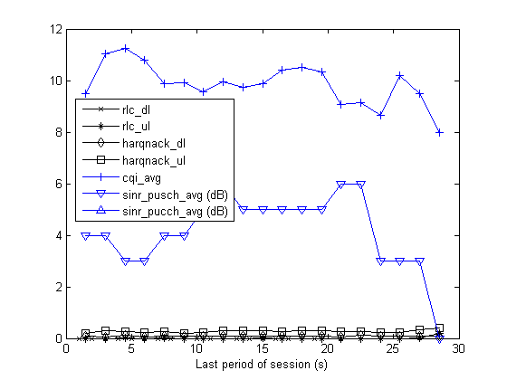
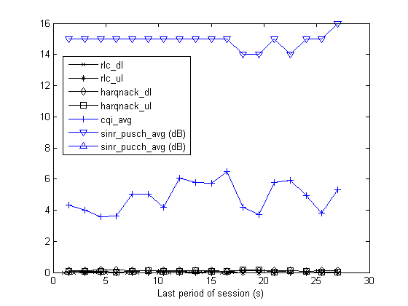
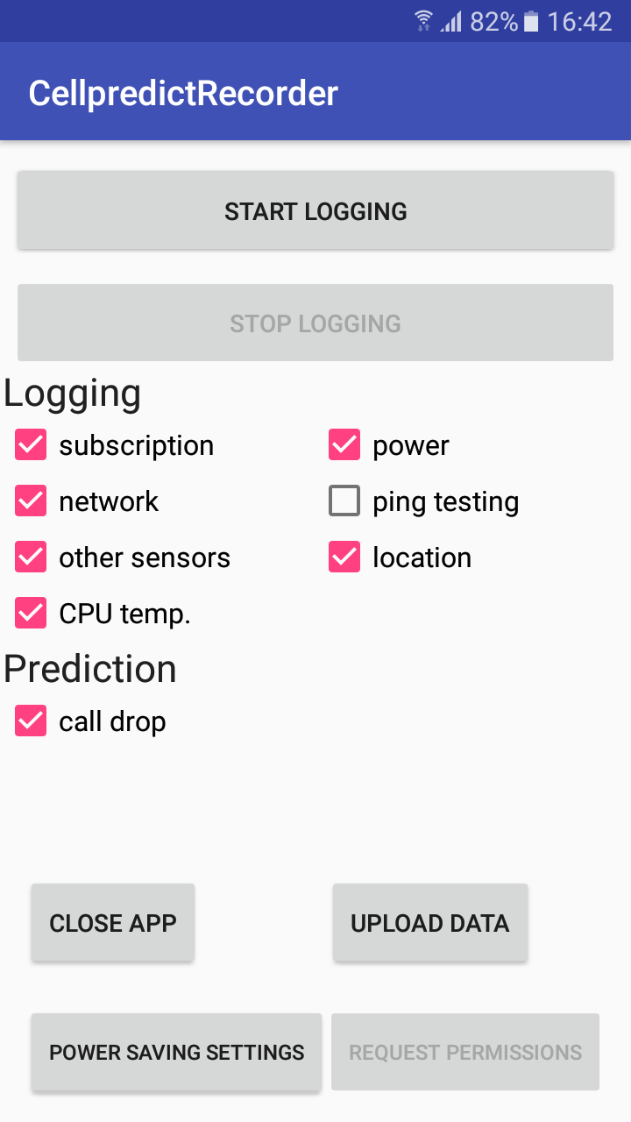
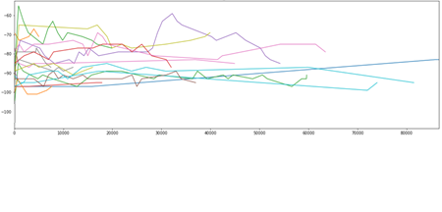
Radio connectivity - examples of low quality and loss
Low quality
High quality
Dropped
Normal
dBm
dBm
Time (ms)
Time (ms)
Daróczy, Bálint, Péter Vaderna, and András Benczúr. "Machine learning based session drop prediction in LTE networks and its SON aspects." Vehicular Technology Conference (VTC Spring), 2015 IEEE 81st. IEEE, 2015.

Slide 17
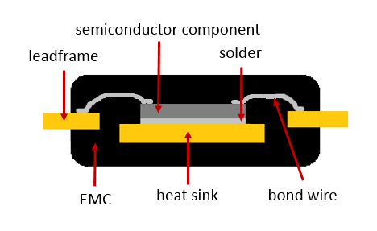
Scrap rate prediction in transfer molding
Filling pressure – shape indicates contamination
Transfer Pressure
Tomorrow 16:45-17:20 Failure root-cause analysis by data analytics: concept and a case study – László Milán Molnár
Mándli, Anna, Róbert Pálovics, Mátyás Susits, and András A. Benczúr. "Time Series Classification for Scrap Rate Prediction in Transfer Molding.” 3rd SIGKDD Workshop on Mining and Learning from Time Series Held in conjunction with KDD'17 Aug 14, 2017 - Halifax, Nova Scotia, Canada

Slide 18
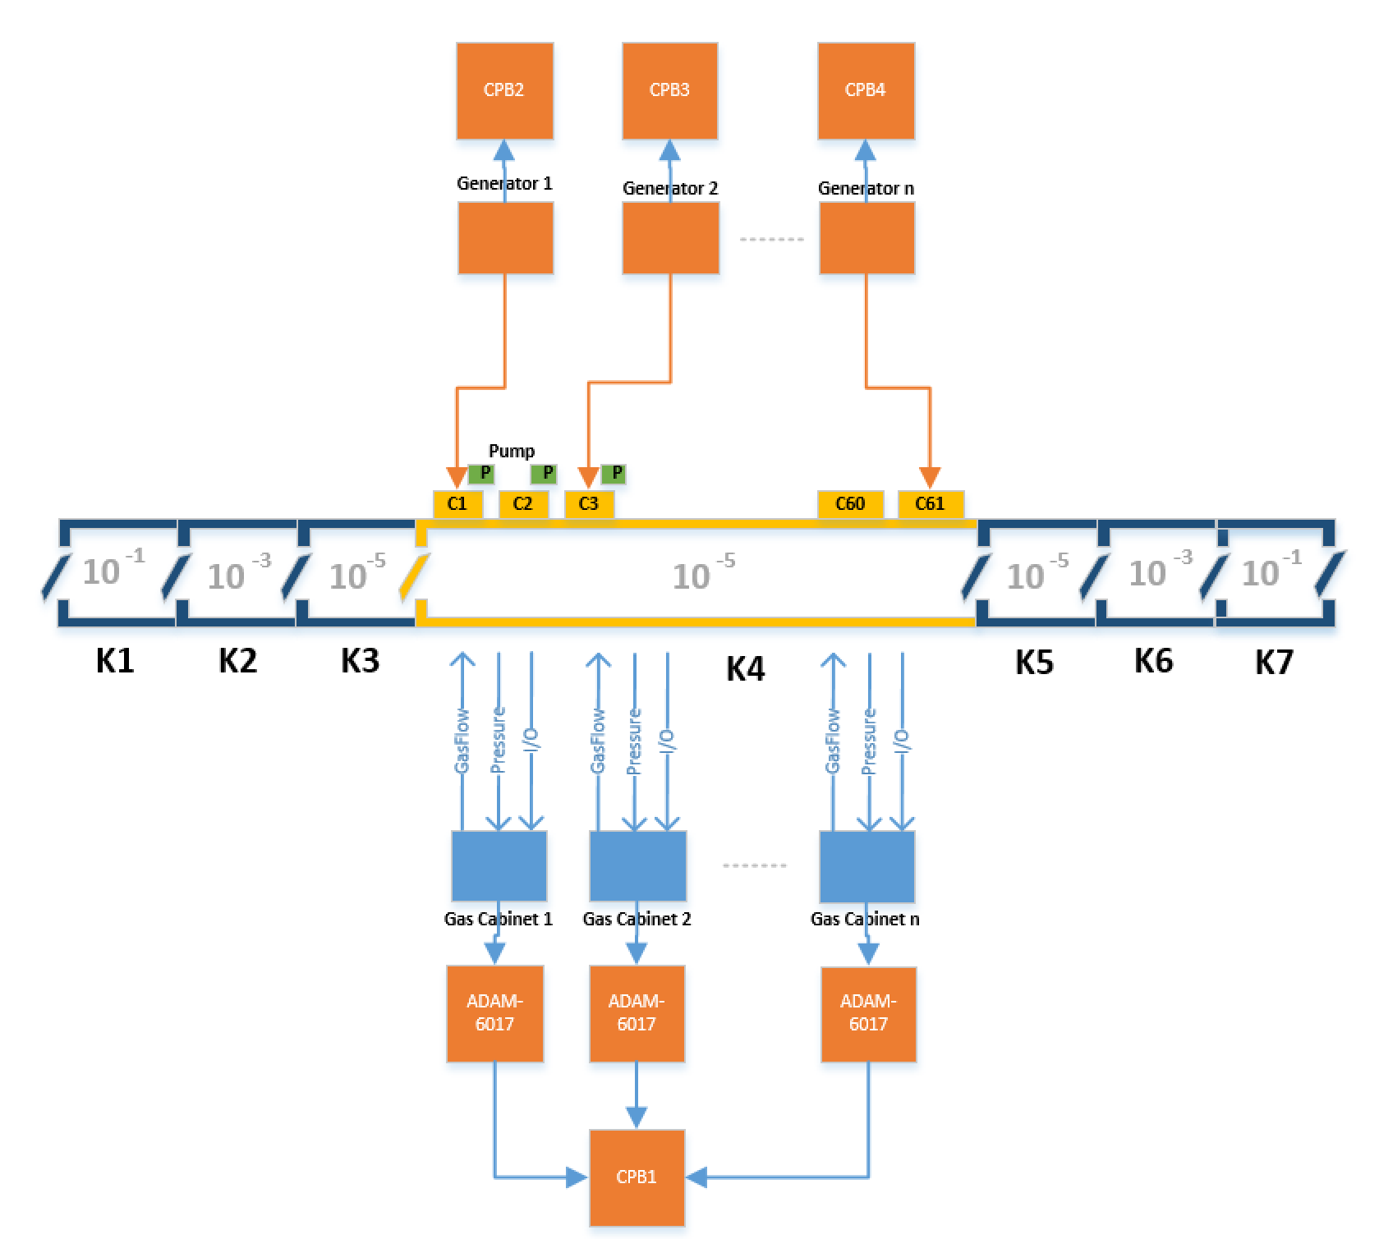
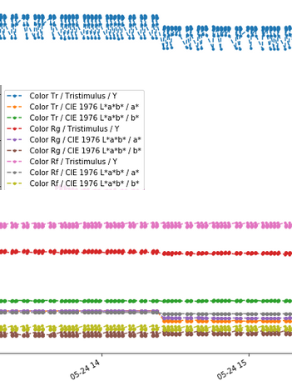
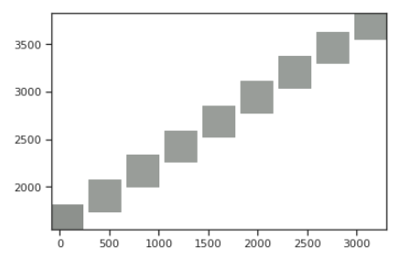
Magnetron Sputtering (glass coating technology): find the optimal power and N₂, Ar, … pressure as cathode wears out
Pressure
Hard arc: cathode conditioning
Connected Power Boxes
Micro arc
Glass panel Ex-Situ true color
(reflection and transmission,
both sides)
Glass Coating Compartments: - Power Generators - Gas Mass-flow controllers - In-Situ and Ex-Situ Quality Inspection (glass panel resistance, Color…)

Slide 19
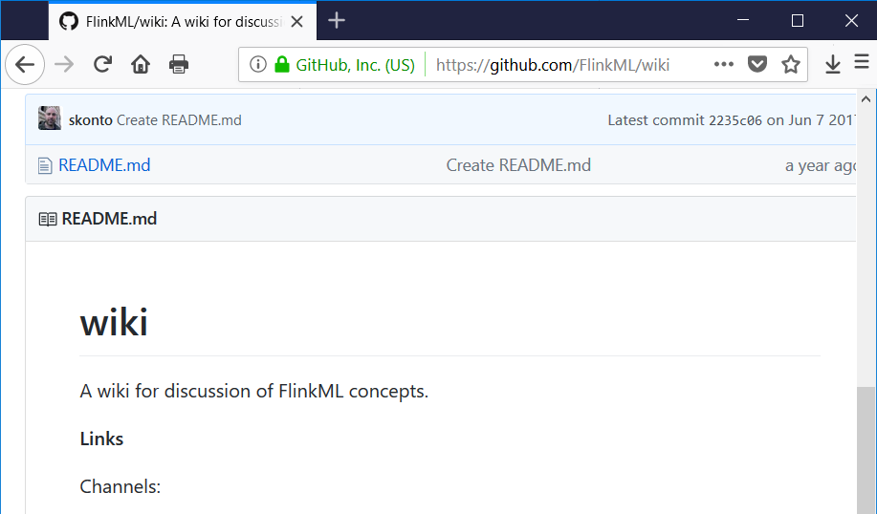
Future of Online Learning? Future of Flink ML?
Theodore Vasiloudis Feb 21, 2017; 12:04pm
Re: [DISCUSS] Flink ML roadmap
“The idea of an online learning library for Flink has been broached before, and this semester I have one Master student working on exactly that. From my conversations with people in the industry however, almost nobody uses online learning in production, at best models are updated every 5 minutes. So the impact would probably not be very large.”
Will practitioners have really big training tasks? Or only model serving tasks?
Will real recommender systems ever need distributed matrix factorization, or will they always work either multicore only, or use session-based methods?
Will we find more convincing use cases?

Slide 20
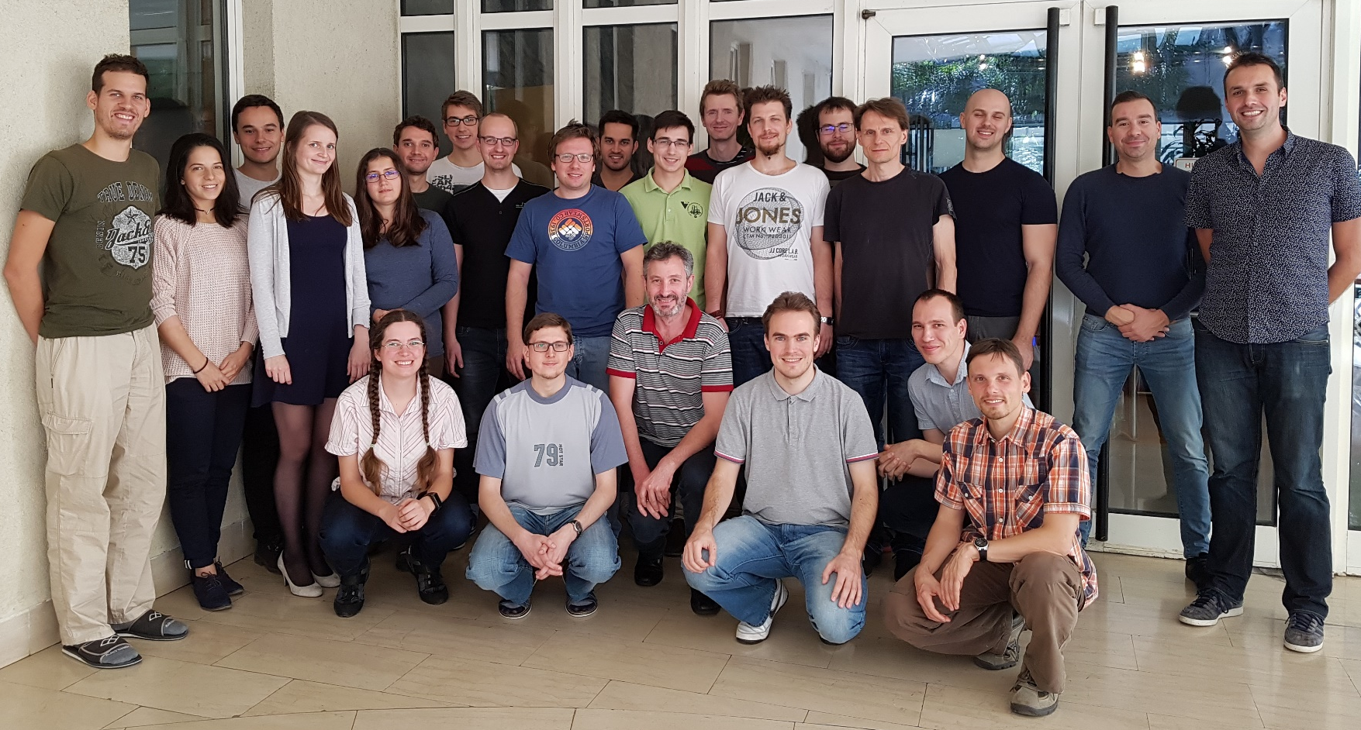
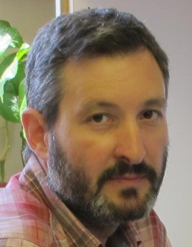
Questions?
András Benczúr,
head, Informatics Lab

