Slide 1
Big Data – Lendület kutatócsoport
Andras Benczur
Insitute for Computer Science and Control
Hungarian Academy of Sciences
benczur@sztaki.mta.hu
http://datamining.sztaki.hu

Slide 2
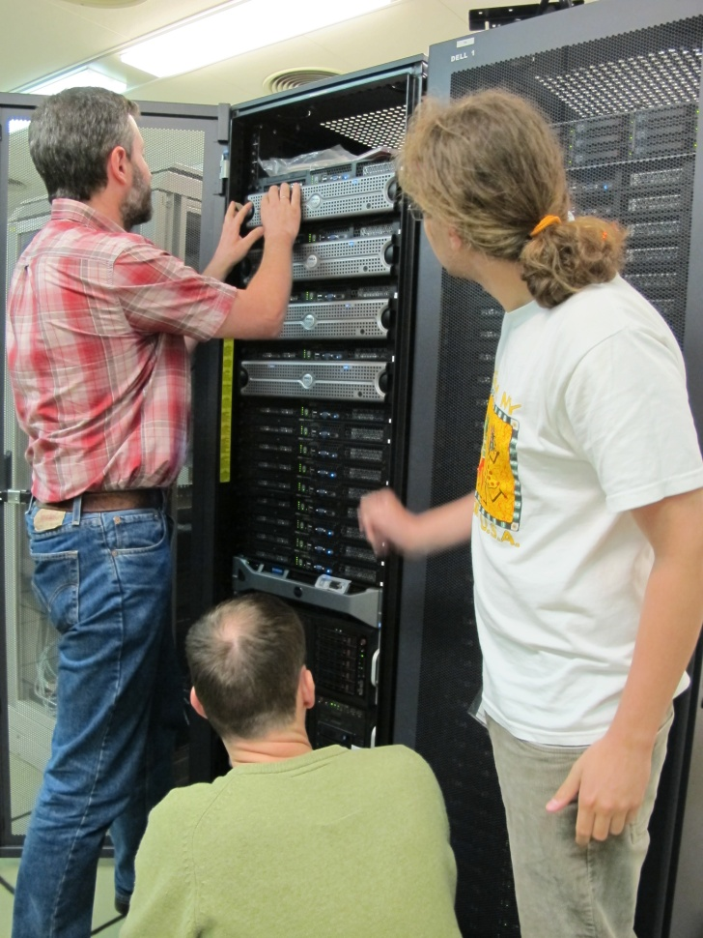
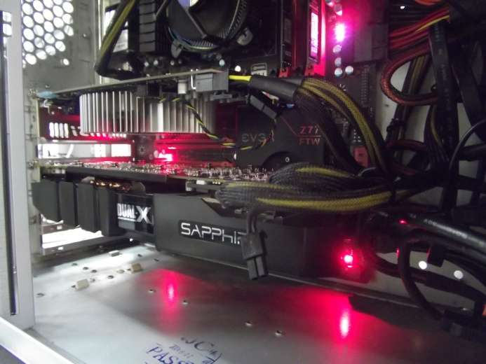
Types of Big Data problems
Data intense:
Map-reduce (Hadoop), cloud, …
Web and text processing
Compute intense:
Shared memory
Message passing
Processor arrays, GPUs
Data
AND
compute intense??
Social contacts, friendship
Recommender systems
Sensors, IT logs, Mobility traces
Notes:
Szekrény jelenleg 150TB/500GB de csak 200 core

Slide 3
Past results: Image Classification on GPU
Descriptors per image: 150,000
Dimension of local HOG descriptors : 144 (96 after PCA)
Gaussians: 512
Dimension of feature space: 97,000

Slide 4
Data and Compute intense research overview
Web classification
Temporal search, trends
SZTAKI Text Mining Center
Frameworks
Stratosphere (TU Berlin)
GraphLab (CMU)
Streaming data
Mobility trace analytics
The Big Data Lab infrastructure and the SZTAKI Cloud

Slide 5
Web classification
Goals
Save resources, select quality and topic, filter spam
Legal regulation (porn, illicit content)
Scale (ClueWeb09 25TB – 0.5 Billion English docs)
Large set of features
Term frequency
tf.idf or BM25 scores for frequent terms
Content
DOM, HTML, HTTP elements
Appearance of popular terms
Term, n-gram statistics, compressibility
Linkage
PageRank (truncated variants; ratios)
Neighborhood (only approximate counting is possible)
TrustRank

Slide 6
Workflow (MapRed jobs indicated)

Slide 7
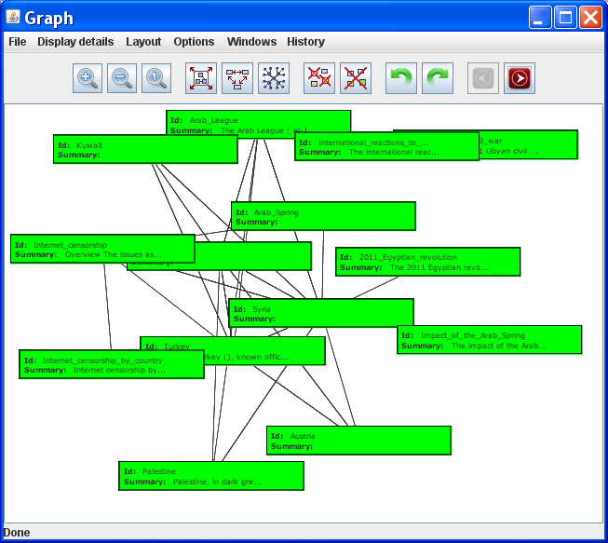
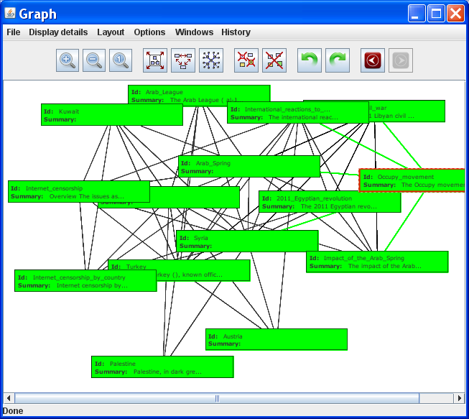
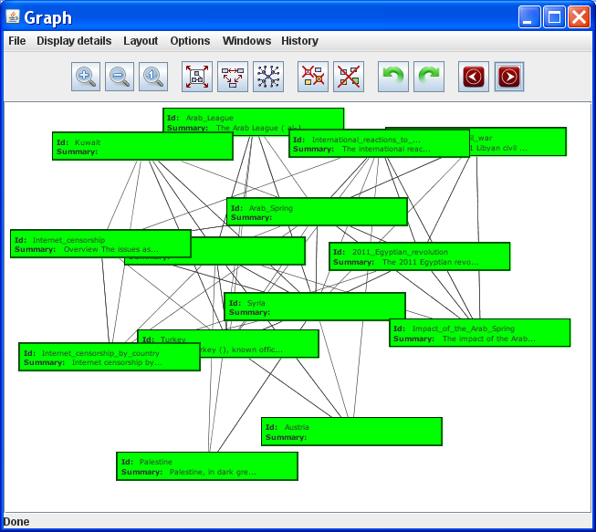
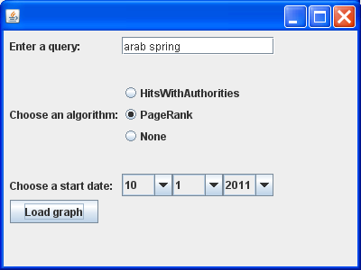
Temporal Search, Trends

Slide 8
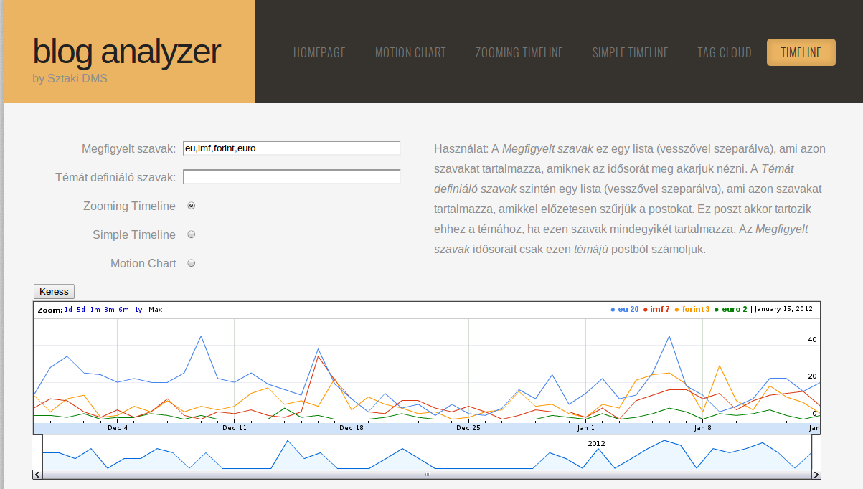
Temporal trends in blog data
Real time response for complex queries that select part of the data
Needs approximate, in-memory data structures
Distributed architecture for memory access

Slide 9
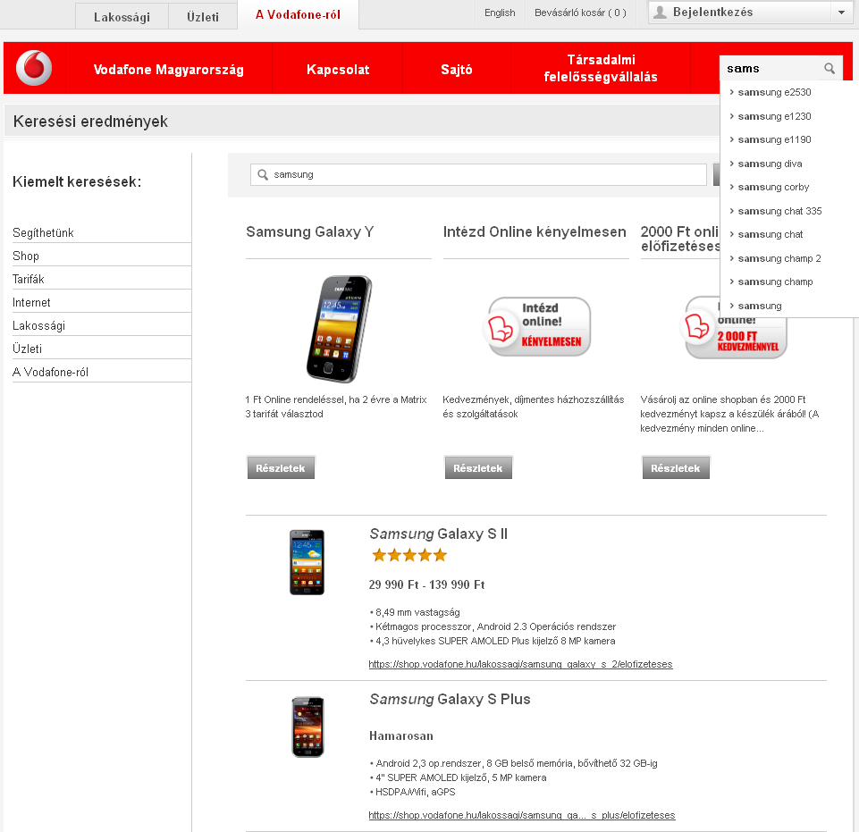
SZTAKI Full Text Search Technology
Notes:
Search (T), Graphvis, ITLog

Slide 10
SZTAKI Text Mining Center
Funded by the President of the Hungarian Academy of Sciences
Led by Prof. Laszlo Monostori, Research Laboratory on Engineering & Management Intelligence
Informatics Laboratory (András Benczúr)
Laboratory of Parallel and Distributed Systems (Péter Kacsuk)
Internet Technology Department (István Tétényi)
Department of Distributed Systems (László Kovács)
Topics:
trend monitoring; novelty recognition; concept-flow, concept-mapping;
analysis, monitoring and visualization of theme, professional relation, joint authorship, citations, etc.
opinion extraction; semantic annotation; domain ontology development;
identification and resolution of names of persons and organization;
plagiarism detection
Notes:
We received funds for purchasing data and storage. The project is led on the deputy director level and is in collaboration with many departments, an indication that SZTAKI (and not just our lab) considers the topic as high priority.

Slide 11
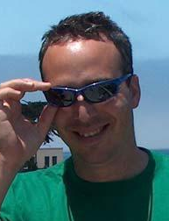
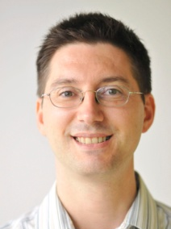
Compute Intense Tasks Distributed
Hadoop gathered bad reputation recently
Wants to be too robust, keep writing all temporal data several times to disk
Fails after a given number of servers
Not for compute intensive tasks
My personal choice of frameworks
GraphLab (Danny Bickson, HUJI)
Nearly as efficient as possible C++ codes
Collaboration on implementing learning-to-rank methods
Stratosphere (Volker Markl, Kostas Tzoumas, TU Berlin)
Developments coordinated by TU Berlin with lots of partners including us
Promises to simplify complex workflows like the spam filter
Yet what many applications need would be
Streaming (read data only once, no batch computations)
Fully distributed: no Facebook, Google, Netflix knowing each and every online action ever in our life – have P2P learning

Slide 12
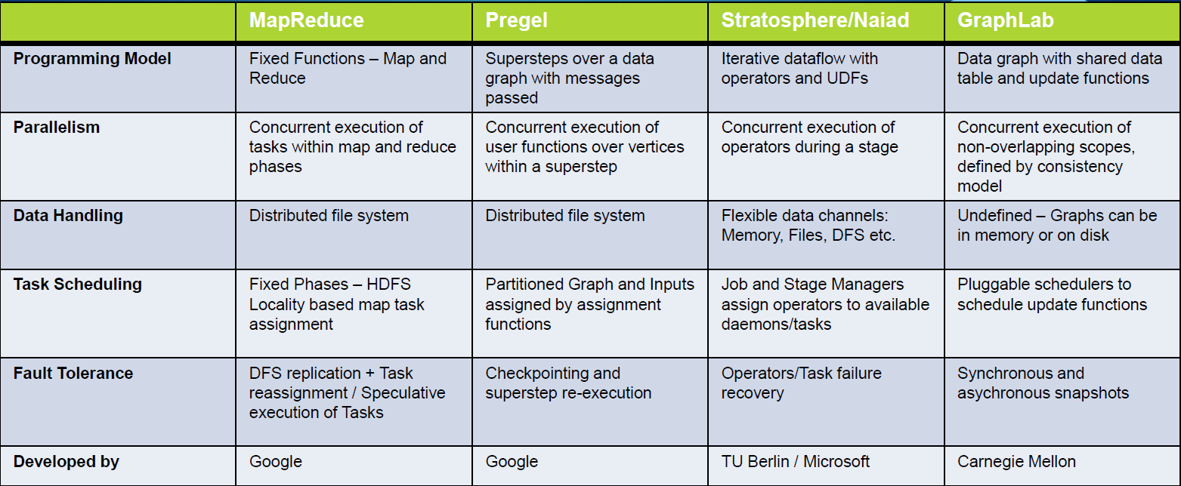
A distributed systems comparison slide
“Scalable Machine Learning for Big Data” tutorial at ICDE 2012

Slide 13
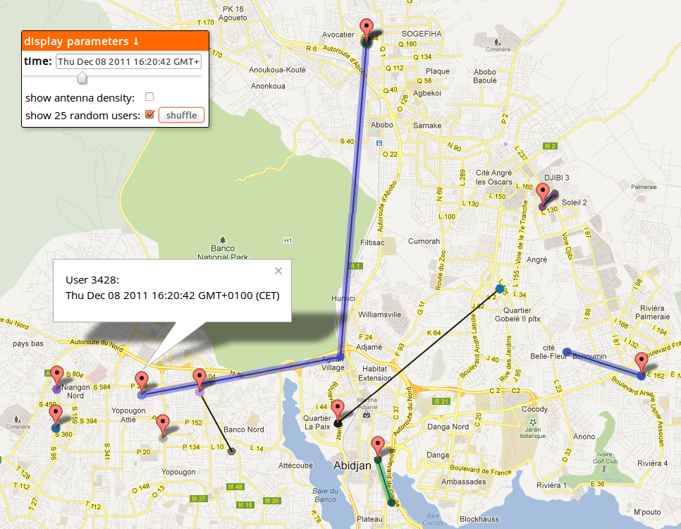
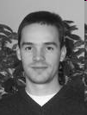
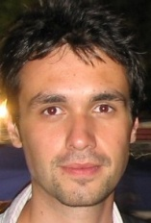
Mobility Data Stream processing (Orange D4D)

Slide 14
Stream Processing Architecture Overview
Goal is to hide Storm details from user
Streaming infrastructure pluggable (could combine with Stratosphere)
Persistence layer pluggable

Slide 15
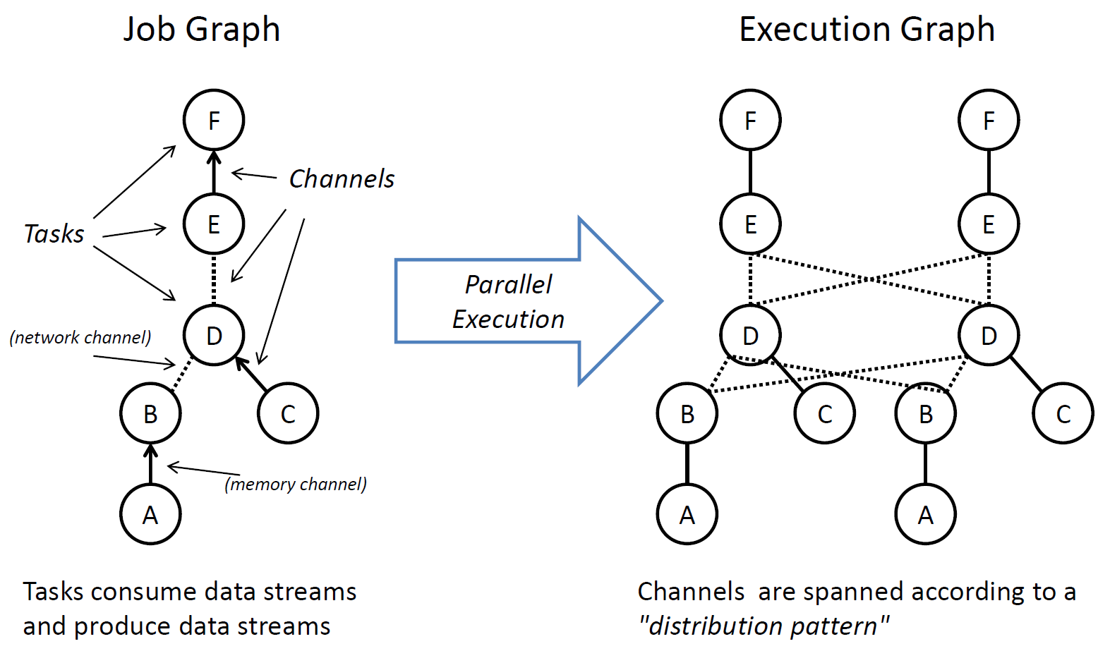
Stratosphere (Source: Volker Markl, TU Berlin)
http://www.stratosphere.eu/ - iterative MapReduce; Streaming

Slide 16
GraphLab (Source: Danny Bickson, CMU)
Graph Based
Data Representation
Update Functions
User Computation
Scheduler
Consistency Model
http://www.graphlab.org/ - v2.1 distributed; GraphChi multicore

Slide 17
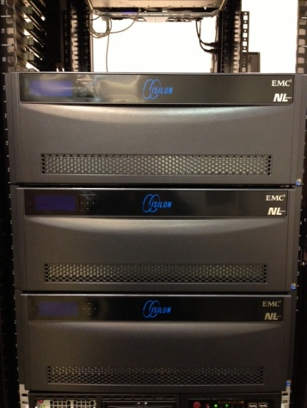
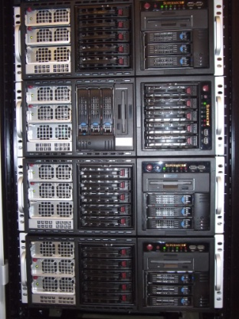
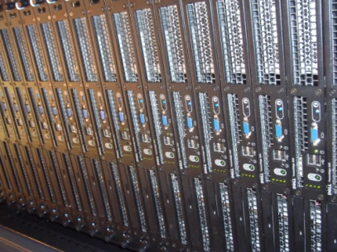
Conclusions: the SZTAKI cloud
Limitations for data and compute intensive tasks
Most of the big data mining problems - Emerging alternatives
Own experiments
Web, text mining, mobility traces - Collaboration with leading research centers
SZTAKI cloud and Big Data group research infrastructure
SZTAKI
testing cloud
108x4TB
Isilon
Big Data Lab
virtual servers
SZTAKI
production cloud

Slide 18
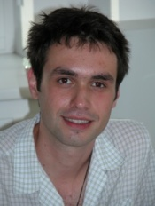
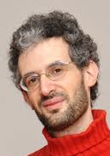
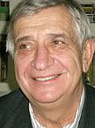
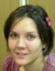
Questions?
András Benczúr
Head,
Informatics Laboratory
and
“Big Data” lab
http://datamining.sztaki.hu/
benczur@sztaki.mta.hu

