Slide 1
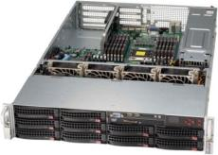
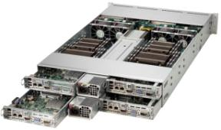
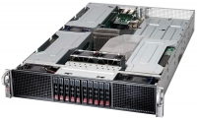
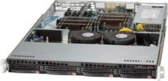
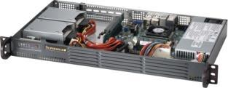
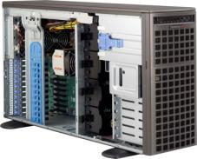
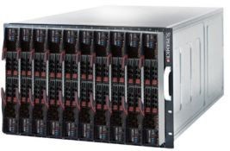
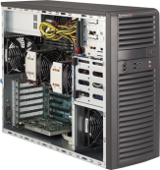
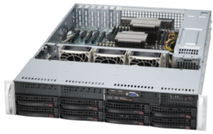
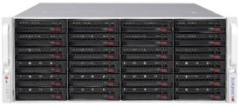
GPU SuperComputing High-Performance, Enterprise-Class Super Computing GPU Accelerated Computation Engineering & Scientific
Resource Optimized (WIO/UIO)
Twin Architecture
GPU SuperComputing
Data Center Optimized
Embedded
Application Optimized: Multi I/O
SuperBlade
Workstation
Mainstream Business Solutions
Storage Server
Notes:
Twin Architecture
Double or Triple The Density
Advanced Storage and I/O Options
Resource Optimized
UIO/WIO/WIO+ Design Lead To Enhanced Expandability
GPU SuperComputing
Taking Full Advantage Of Parallel Processing Power
Mainstream
Cost Effective General Application
Application Optimized
Focus n Expansion and Data center
Workstation
Entry to Professional Workstations

Slide 2
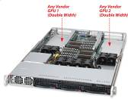
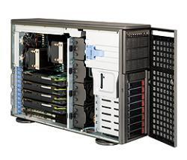
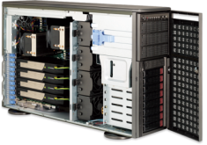
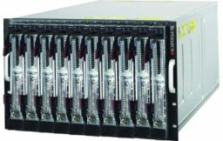
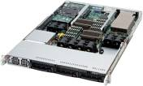
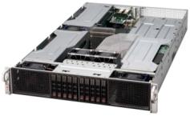
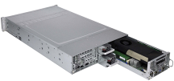
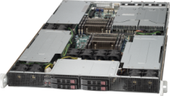
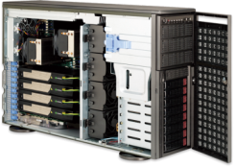
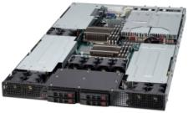
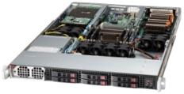
Technology Progression
The Possibility is
Unlimited!!!
The fastest 1U server
in the world
X9 4U 4-A&P GPU
GPU Blades
integrated
X8
Telsa S1070
and X9
X9 2U 6-GPU
1U 4-GPU
Standalone box
New generation
CPU & GPU
supports
The first optimized
CPU/GPU integrated
Hybrid System
2U 4-GPU
PCI-E x16
PCI-E x16
2U GPU / with QDR IB onboard
X9 1U 4-GPU
2U Twin
6016TT-TF
1U Twin™
1U 3-GPU
SC827HD-R1400B
X9(UP) 1U 2-GPU
SW7046GT-TRF
The most powerful PSC
front view
2008
2009
2010
2011
2012

Slide 3
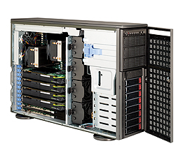
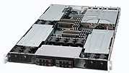
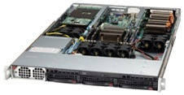
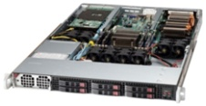
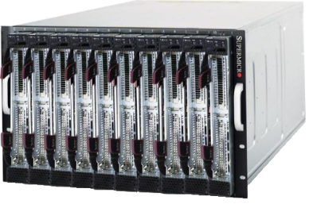
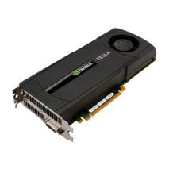
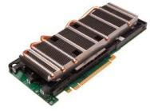
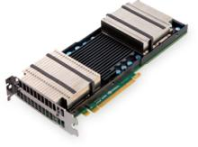
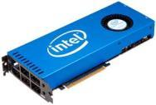
X9 GPU Solutions
GPU Servers
GPU Workstations
2U 4/6 GPU
1U 3/4 GPU
4 GPU + 3 more slots
SuperServer
SYS-2027GR-TRF/TRFT
SYS-2027GR-TRFH/TRFHT
SuperServer
SYS-1027GR-TRF/TRFT
SYS-1027GR-TQF/TQFT
SYS-1027GR-TSF
Tesla C-series
Tesla M-series
Tesla Kepler
Intel MIC
SuperWorkstation
SYS-7047GR-TRF
SYS-7047GR-TPRF
1U 2 GPU
1U 2 GPU
GPU Blades
7U 10-Blade 20 GPU
SuperServer
SYS-5017GR-TF
SuperServer
SYS-1017GR-TF
Tesla M-series, Tesla Kepler, Intel MIC
SuperBlade
SBI-7127RG
Tesla M-series
Tesla Kepler
Intel MIC
C-series
M-series
Kepler
Intel MIC

Slide 4
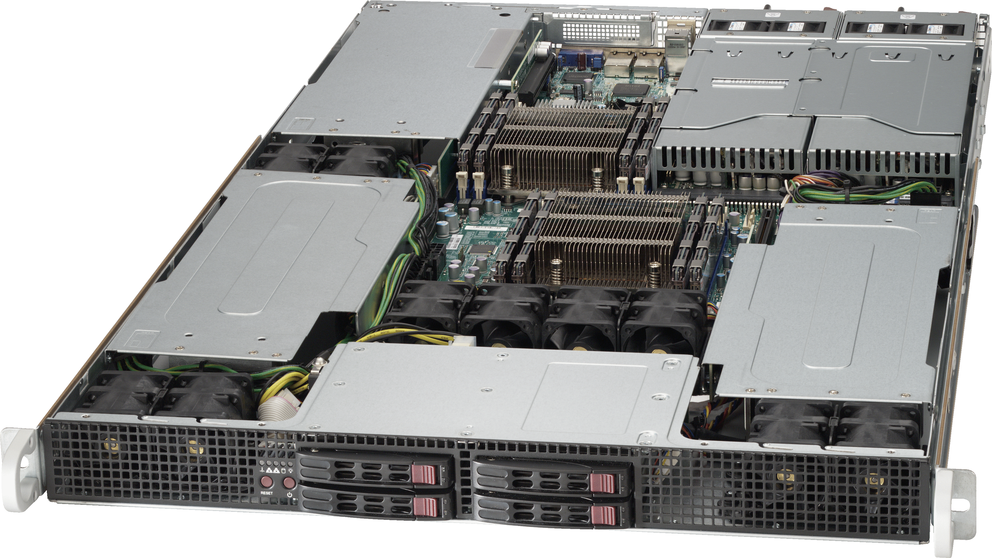
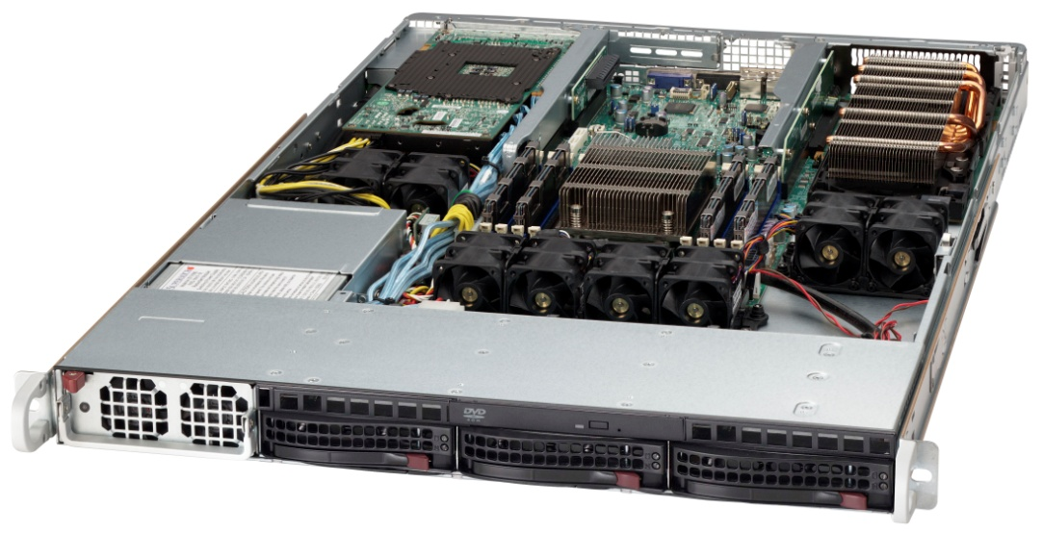
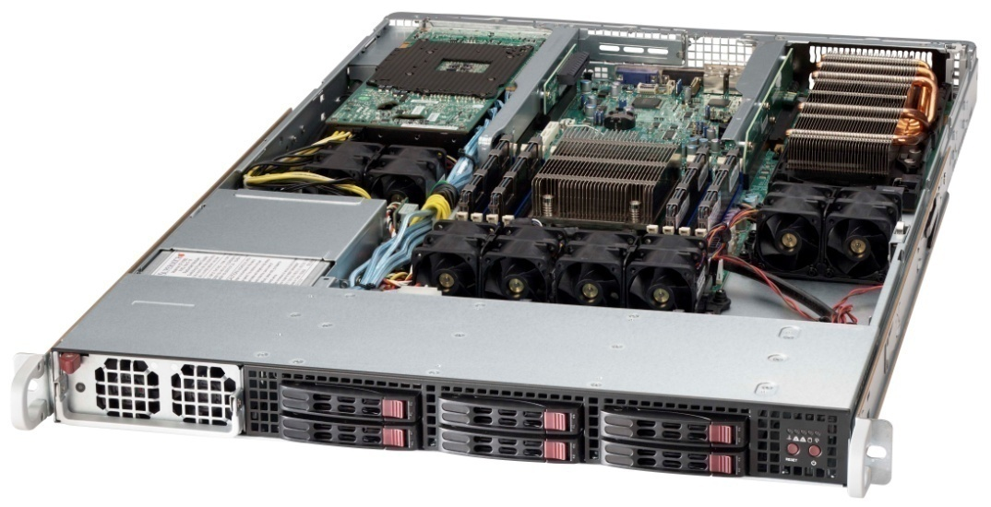
X9 GPU solutions Standard models
Model | SuperServer SYS-2027GR-TRF | SuperServer SYS-1027GR-TRF | SuperServer SYS-5017GR-TF | SuperServer SYS-1017GR-TF | SuperServer SYS-7047GR-TRF
CPU | Sandy bridge DP | Sandy bridge DP | Sandy bridge UP | Sandy bridge UP | Sandy bridge DP
Memory | Up to 256GB in 8 DIMM | Up to 256GB in 8 DIMM | Up to 256GB in 8 DIMM | Up to 256GB in 8 DIMM | Up to 512GB in 16 DIMM
HDD | 10 x 2.5” | 4 x 2.5” | 3 x 3.5” | 6 x 2.5” | (8 + 2) x 3.5"
Expansion slot | 4 GPU 1 PCI-e 3.0 x4 1 PCI-e 3.0 x8 (LP) | 3 GPU 1 PCI-e 3.0 x8 (LP) | 2 GPU 1 PCI-e 3.0 x8 (LP) | 2 GPU 1 PCI-e 3.0 x8 (LP) | 4 GPU (Active Cooling) 2 PCI-e 3.0 x8
Power Supply | 1800W platinum redundant | 1800W platinum redundant | 1400W platinum | 1400W platinum | 1620W platinum redundant
* Pictures are reference only

Slide 5
X9 GPU solutions Enhanced models
Model | 6 GPUs in 2U SuperServer SYS-2027GR-TRFH | 4 GPUs in 1U SuperServer SYS-1027GR-TQF | 10GbE onboard SuperServer SYS-6027GR-TRFT | 10GbE onboard SuperServer SYS-1017GR-TRFT | M-series GPU SuperServer SYS-7047GR-TPRF
CPU | Sandy bridge DP | Sandy bridge DP | Sandy bridge DP | Sandy bridge DP | Sandy bridge DP
Memory | Up to 256GB in 8 DIMM | Up to 256GB in 8 DIMM | Up to 256GB in 8 DIMM | Up to 256GB in 8 DIMM | Up to 512GB in 16 DIMM
HDD | 10 x 2.5” | 4 x 2.5” | 10 x 2.5” | 4 x 2.5” | (8 + 2) x 3.5"
Expansion slot | 6 GPU 1 PCI-e 3.0 x8 (LP) | 4 GPU 1 PCI-e 3.0 x8 (LP) | 4 GPU 1 PCI-e 3.0 x4 1 PCI-e 3.0 x8 (LP) | 3 GPU 1 PCI-e 3.0 x8 (LP) | 4 GPU (Passive Cooling) 2 PCI-e 3.0 x8
Power Supply | 1800W platinum redundant | 1800W platinum | 1800W platinum redundant | 1800W platinum redundant | 1620W platinum redundant
* Pictures are reference only

Slide 6
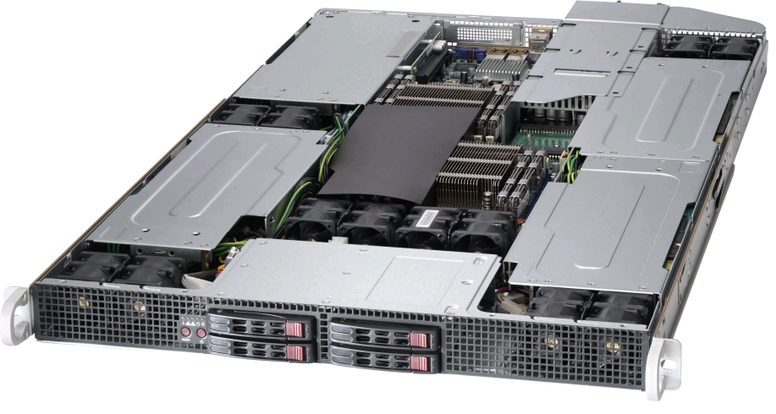
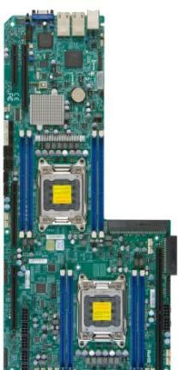
1U DP Rackmount GPU Server Features
Up to 4 Double Width GPU cards + 1 LP add on card
4 GPUs: SYS-1027GR-TQF
SYS-1027GR-TQFT
3 GPUs: SYS-1027GR-TRF
SYS-1027GR-TSF
SYS-1027GR-TRFT
10GbE onboard
SYS-1027GR-TQFT
SYS-1027GR-TRFT
4 GPU Cards (Fermi/Kepler)
Mellanox ConnectX QDR/FDR InfiniBand
Intel® Xeon® Sandy Bridge
E5-2600 Series Socket R
Intel MIC solution
Platinum level high efficient 1800W redundant power supply
Optimize Cooling System Design
4 Hotswap 2.5”
SATA/SSD Drive
X9DRG-HF/HTF

Slide 7
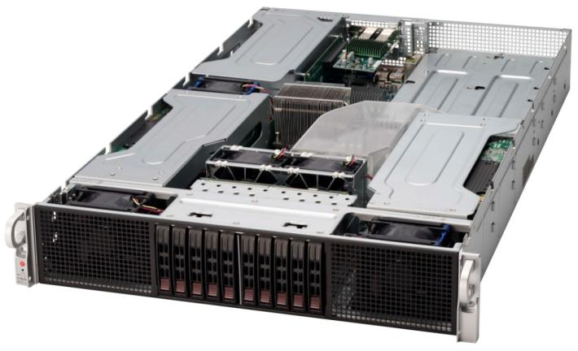
2U Rackmount GPU Server Features
Up to 6 Double Width GPU cards + 1 LP add on card
6 GPUs: SYS-2027GR-TRFH
SYS-2027GR-TRFHT
4 GPUs: SYS-2027GR-TRF
SYS-2027GR-TRFT
10GbE onboard
SYS-2027GR-TRFT
SYS-2027GR-TRFHT
6 GPU Cards (Fermi/Kepler)
Mellanox ConnectX QDR/FDR InfiniBand
Intel® Xeon® Sandy Bridge
E5-2600 Series Socket R
Intel MIC solution
Platinum level high efficient 1800W redundant power supply
Optimize Cooling System Design
10 Hotswap 2.5”
SATA/SSD Drive
X9DRG-HF/HTF

Slide 8
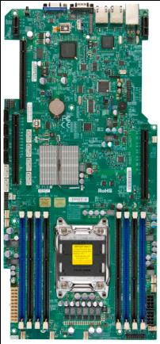
1U UP Rackmount GPU Server Features
Up to 2 Double Width GPU cards + 1 LP add on card
SYS-1017GR-TF
SYS-5017GR-TF
Intel® Xeon® Sandy Bridge
E5-2600 Series Socket R
2 GPU Cards (Fermi/Kepler)
Mellanox ConnectX QDR/FDR InfiniBand
Platinum level high efficient 1400W power supply
Intel MIC solution
Optimize Cooling System Design
6 Hotswap 2.5” : SYS-1017GR-TF
3 Hotswap 3.5” : SYS-5017GR-TF
X9SRG-F

Slide 9
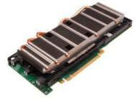
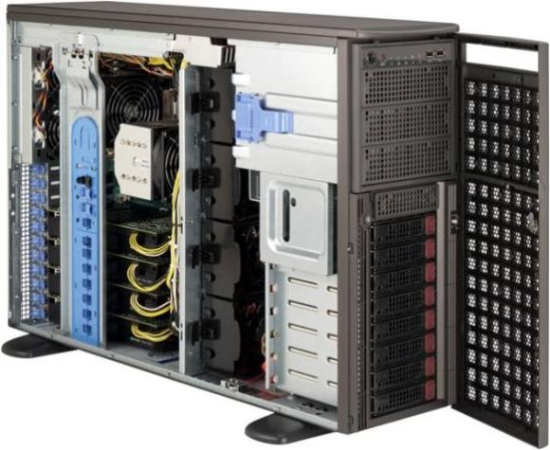
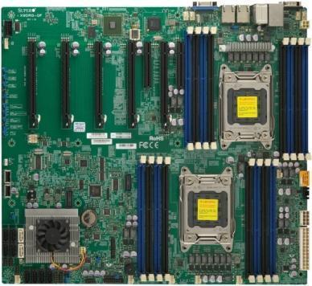
Tower / 4U Rackmount GPU Server Features
Up to 4 Double Width GPU cards + 2 PCIe3.0x8, 1 PCIe2.0x4
SYS-7047GR-TRF
4 C-series
GPU Cards
SYS-7047GR-TPRF
4 M-series
GPU Cards
Intel® Xeon® Sandy Bridge E5-2600 Series Socket R
Platinum level
high efficient 1620W redundant power supply
Optimize Cooling System Design
8 Hotswap 3.5”
SATA/SSD Drive
X9DRG-QF

