Slide 1
Activation experiments on neutron beam guide materials
Eszter Dian, Dénes Párkányi, Szabina Török, Péter Zagyvai

Slide 2
Content
Introduction
Instrumentation
Experiment
Conclusion
Eszter Dian, HAS Centre for Energy Research

Slide 3
Introduction
Neutron activation
Radiation protection
Waste management
Inventory calculation
Modelling (e.g. NAAPRO)
Measurement
Initial composition
Irradiation
Spectroscopy
&

Slide 4
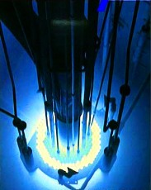
irradiation
Instrumentation

Slide 5
BRR – Budapest Neutron Centre
VVR-type research reactor
light water-cooled and moderated tank type reactor with a beryllium reflector
low enriched uranium fuel (LEU: 19.9% ²³⁵U)
nominal thermal power: 10 MW
maximal thermal flux: 2.1 × 10¹⁴ n/cm²s
Reactor „campaign”: 10 effective days + break for weekend
~ 160 operational days/year, flexible timetable

Slide 6
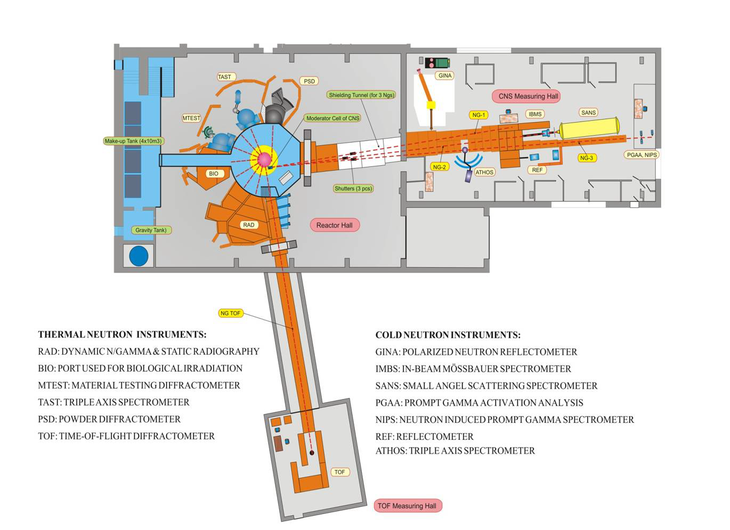
Reactor zone,
vertical irradiation channels

Slide 7
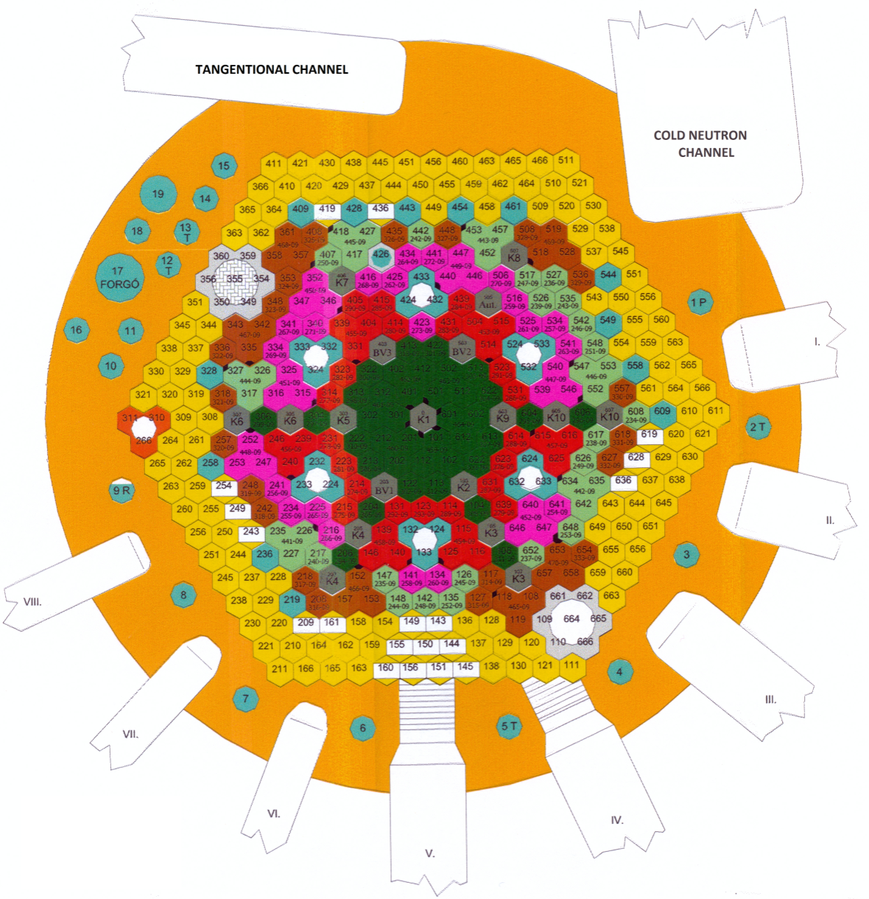
Irradiation I.
Vertical irradiation channels inside and outside of the zone
13 irradiation channel
1 fast neutron channel
2 B-filtered channel
…

Slide 8
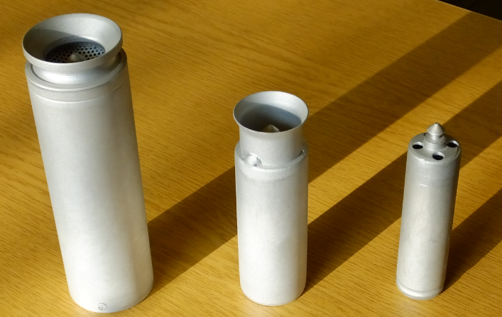
Irradiation II.
5 position / channel
10-10 cm distance
Al capsules as sample holders

Slide 9
Experiment
Example:
Irradiation of neutron guide

Slide 10
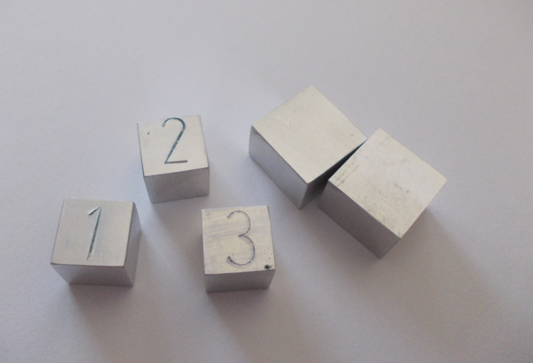
Neutron Guides
Aluminium samples (1, 2, 3)
Input composition
Nominal composition
XRF, µXRF, …
m %
No. | V [cm³] | m [g] | Si | Fe | Cu | Mn | Mg | Cr | Ni | Zn | Ti | Zr | Ga | V | Mn | Cr
1 | 1*1*1 | 2.87 | - | - | 2 | - | 2.3 | - | - | 6 | - | - | - | - | - | -
2 | 1*1*1 | 2.72 | 0.4 | 0.4 | 0.1 | 0.4-1.0 | 4.0-4.9 | 0.05-0.25 | - | 0.3 | 0.15 |  |  | - | - | -
3 | 1*1*1 | 2.88 | 0.4 | 0.4 | 0.1 | 0.5 | 2.6-3.6 | 0.3 | - | 0.2 | 0.1 | - | - | - | 0.1-0.6

Slide 11
Irradiation
Channel 426 (vertical fast neutron channel)
thermal neutron flux variation along the axis of the irradiation capsule is less than 5 %
Irradiation time: 6 h
Cooling time: 6-10 day
Neutron flux parameters | Channel 426 [long-time irradiation]
Thermal neutron flux | 6.00×10¹³ n cm⁻²s⁻¹
Fast neutron flux | 5.42×10¹³ n cm⁻²s⁻¹

Slide 12
Irradiation
Vertical irradiation channels inside and outside of the zone
13 irradiation channel
1 fast neutron channel
2 B-filtered channel
…

Slide 13
Irradiation
Channel 426 (vertical fast neutron channel)
thermal neutron flux variation along the axis of the irradiation capsule is less than 5 %
Irradiation time: 6 h
Cooling time: 6-10 day
Neutron flux parameters | Channel 426 [long-time irradiation]
Thermal neutron flux | 6.00×10¹³ n cm⁻²s⁻¹
Fast neutron flux | 5.42×10¹³ n cm⁻²s⁻¹

Slide 14
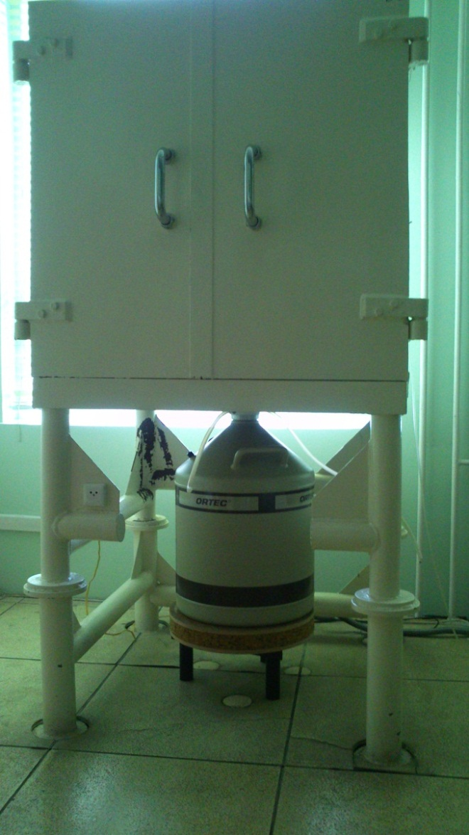
γ-spectroscopy
3 low-level chambers
pre-World War II steel
free of any man-made radioactivity
10 cm thick wall
2 mm thick Cu-lining (attenuate the X-rays)
HPGe detectors
Detectors | Efficiency | Resolution [59.5 keV] | Resolution [1332.5 keV]
ORTEC PopTop 55195-P HPGe detector | 55% | 0.95 keV | 1.75 keV
Canberra GC3618 HPGe detector | 36% | 0.80 keV | 1.80 keV
Canberra GC1318 HPGe detector | 13% | 0.95 keV | 1.80 keV

Slide 15
Results I. - NA
Zn-65
E=1115.54 keV
T_{1/2}=244.3 d
Cr-51
E=320.08 keV
T_{1/2}=27.7 d
Isotope | A (Bq)
 | 1 | 2 | 3
Zn-65 | 5.20E+07 | 5.93E+04 | 4.98E+07
Cu-64 | 3.81E+06 | - | 4.02E+06
Na-24 | 5.52E+05 | 6.51E+05 | 5.19E+05
Ga-72 | 4.38E+04 | 3.15E+04 | -
Mn-54 | 4.67E+04 | 3.41E+04 | -
Fe-59 | 4.59E+04 | 4.83E+04 | 4.78E+04
Co-60 | - | 8.47E+03 | 1.21E+04
Sc-46 | - | 7.19E+03 | -
Co-58 | - | 9.93E+03 | -
Cr-51 | - | 3.95E+06 | 3.09E+06
Zr-95 | - | - | 7.07E+04

Slide 16
Results II. - XRF
m %
No |  | V [cm³] | m [g] | Si | Fe | Cu | Mn | Mg | Cr | Ni | Zn | Ti | Zr | Ga | V
1 | Nom | 1*1*1 | 2.87 | - | - | 2 | - | 2.3 | - | - | 6 | - | - | - | -
 | XRF |  |  | - | 0.18 | 2.38 | 0.03 | - | 0.07 | - | 8.63 | - | 0.03 | 0.02 | -
2 | Nom | 1*1*1 | 2.72 | 0.4 | 0.4 | 0.1 | 0.4-1.0 | 4.0-4.9 | 0.05-0.25 | - | 0.3 | 0.15 |  | - | -
 | XRF |  |  | - | 0.33 | 0.03 | 0.64 | - | 0.09 | 0,01 | 0.02 | - | - | 0.01
3 | Nom | 1*1*1 | 2.88 | 0.4 | 0.4 | 0.1 | 0.5 | 2.6-3.6 | 0.3 | - | 0.2 | 0.1 | - | - | -
 | XRF |  |  | - | 0.2 | 2.4 | 0.01 | - | 0,.3 | - | 8.98 | - | 0.03 | 0.00 | -

Slide 17
Results III.
Isotope | A (Bq)
 | Al sample 1 |  | Al sample 2 |  | Al sample 3
 | Meas. | Calc. | Meas. | Calc. | Meas. | Calc.
Zn-65 | 5.20E+07 | 3.35E+07 | 5.93E+04 | 5.69E+04 | 4.98E+07 | 3.50E+07
Cu-64 | 3.81E+06 | 3.39E+06 | - | 2.46E+04 | 4.02E+06 | 3.37E+06
Ga-72 | 4.38E+04 | 3.40E+04 | 3.15E+04 | 1.66E+04 | - | 3.06E+03
Mn-54 | 4.67E+04 | 7.42E+03 | 3.41E+04 | 1.40E+04 | - | 8.74E+03
Fe-59 | 4.59E+04 | 4.13E+04 | 4.83E+04 | 4.88E+04 | 4.78E+04 | 4.89E+04
Co-60 | - | - | 8.47E+03 | 1.22E+04 | 1.21E+04 | 3.92E+03
Co-58 | - | - | 9.93E+03 | 1.38E+04 | - | -
Cr-51 | - | - | 3.95E+06 | 3.72E+06 | 3.09E+06 | 2.03E+06

Slide 18
Conclusion I.
Activation products:
Radiation protection
Waste management
Nominal composition is not always reflecting the real elemental chemistry
Zn-65
T_{1/2}=244.3 d
Cr-51
T_{1/2}=27.7 d
Aluminium sample No. 2

Slide 19
Conclusion II.
Know-how
considerable experience in
neutron activation
material testing methods
γ-spectroscopy
Facilities
various irradiation channels & fluxes
analytical devices

Slide 20
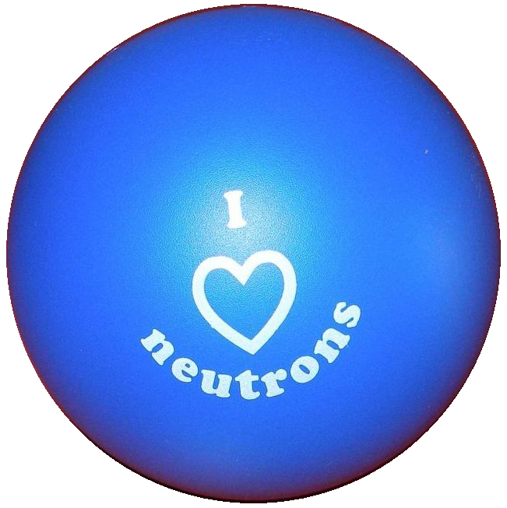
Thank you for your attention!

