Slide 1



P.S. Shternin and M. Baldo
Modified Urca processes in neutron star cores in the BHF framework
NewCompStar—2015
Budapest, Hungary, 14—19 June 2015

Slide 2
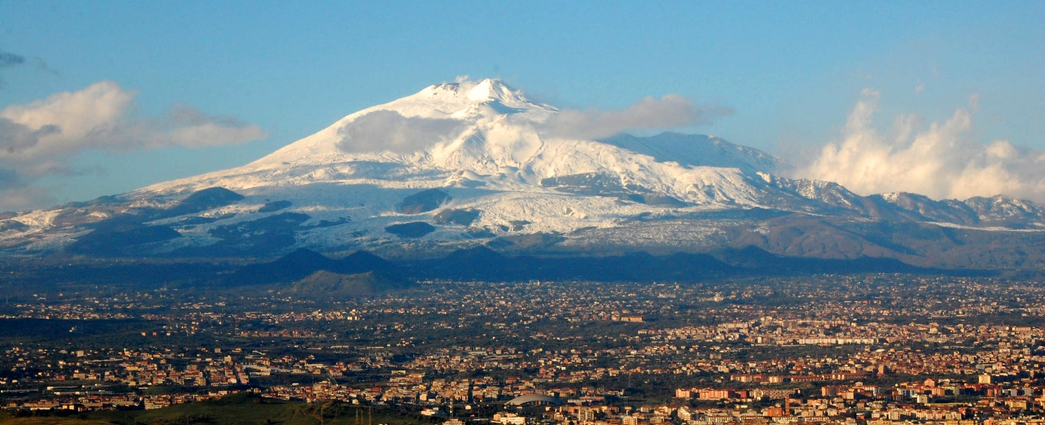
COST Action “NewCompStar”
COST Action: MP1304
STSM: ECOST-STSM-MP1304-061014-049724
STSM dates: from 06-10-2014 to 26-10-2014
Location: Instituto Nazionale di Fisica Nucleare, Sez. di Catania

Slide 3
Plan
Introduction. Neutron star cooling and neutrino emission
Modified Urca processes
In-medium effects on mUrca
mUrca in BHF
Effects on neutron star cooling
Conclusions

Slide 4
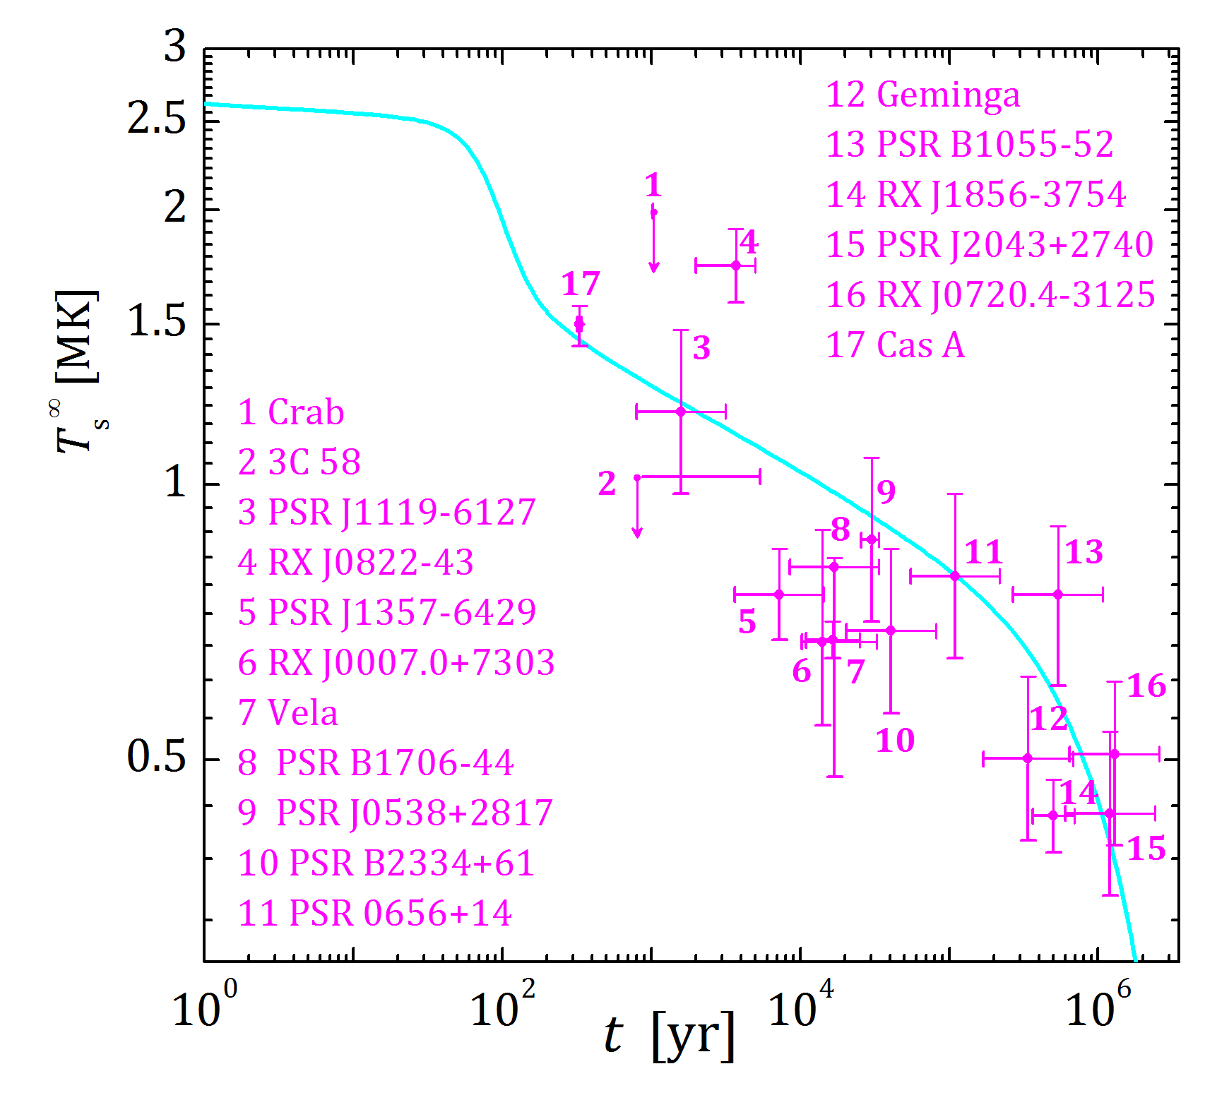
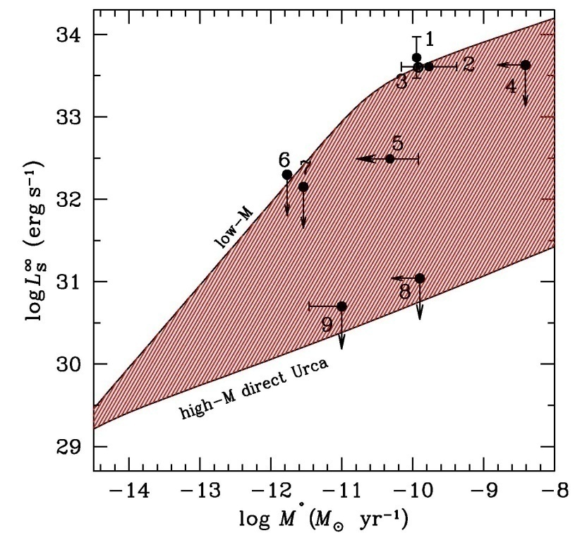
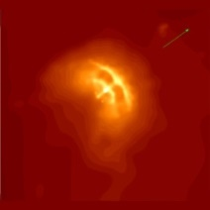
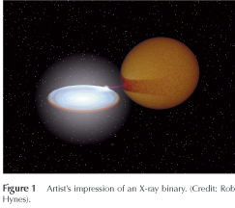
Introduction. Neutrino emission in NS cooling theory
Cooling isolated NSs
NSs in X-ray transients
Thermal evolution
Quiescent state: thermal balance

Slide 5
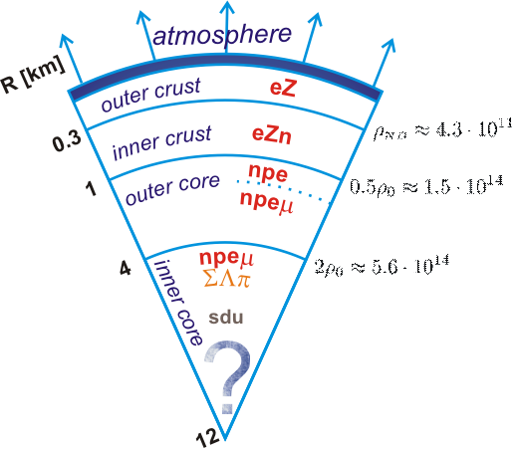
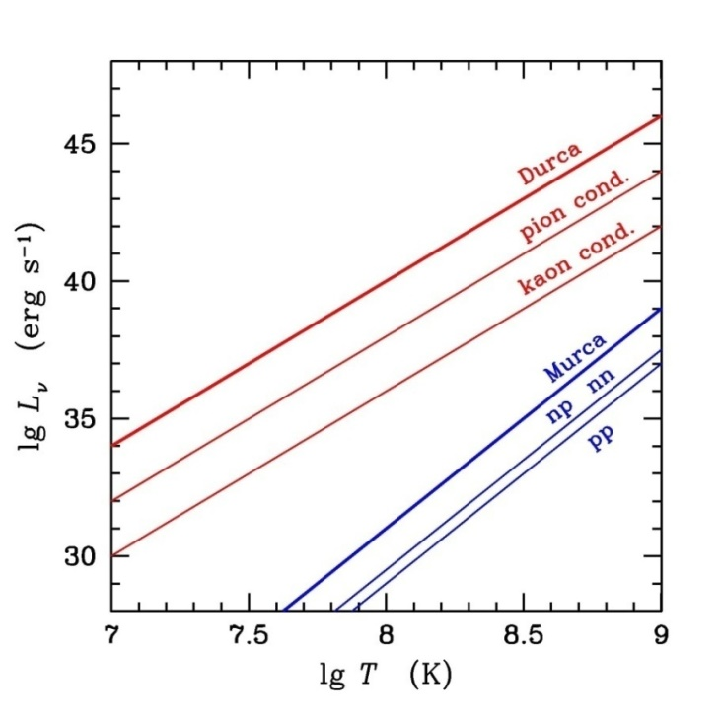
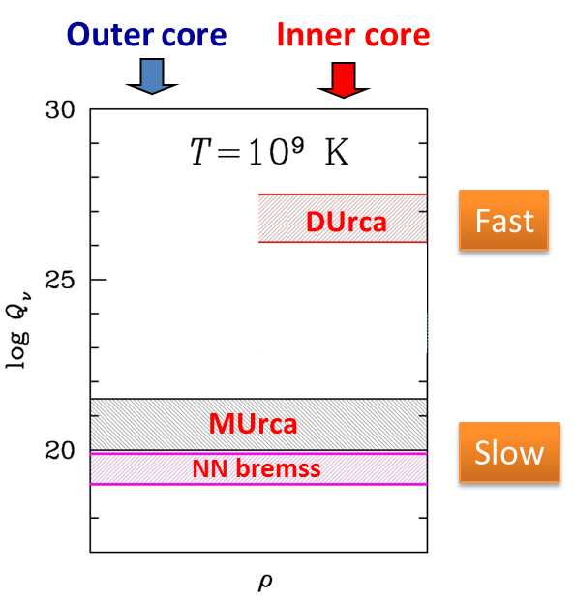
Introduction. Neutrino emission in NS cooling theory
Many processes depending on composition, EOS, etc.
Non-superfluid beta-stable npeμ matter
Basic neutrino emission levels in the core

Slide 6
Introduction. Direct Urca Processes
Urca processes
(β-transformations)
Gamov&Schoenberg, 1941
escape the star, thieving energy
Nucleon Direct Urca process
The strongest neutrino emission
Fastest cooling
DUrca is a threshold process:
Should be enough protons
Operates in the inner core depending on the EOS

Slide 7
Introduction. Modified Urca processess
Urca processes
(β-transformations)
Gamov&Schoenberg, 1941
escape the star, thieving energy
Nucleon Modified Urca process
Operates always
Additional fermions add
Slow cooling
This talk

Slide 8
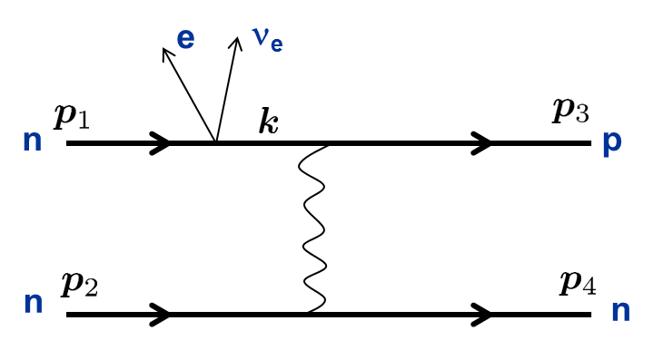
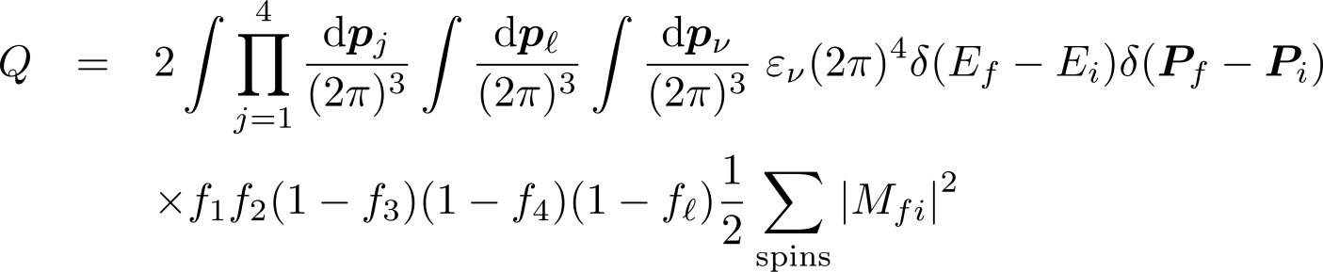
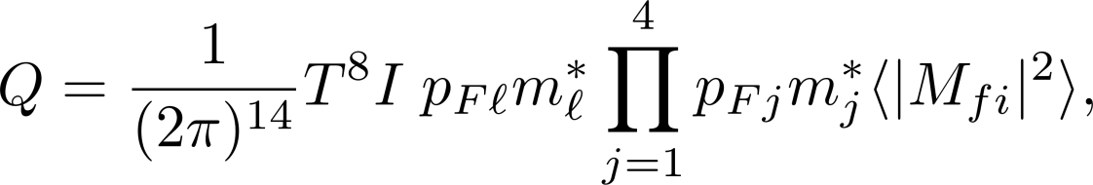
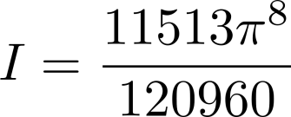
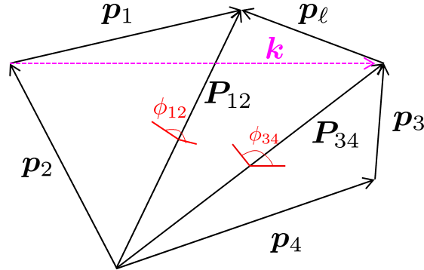
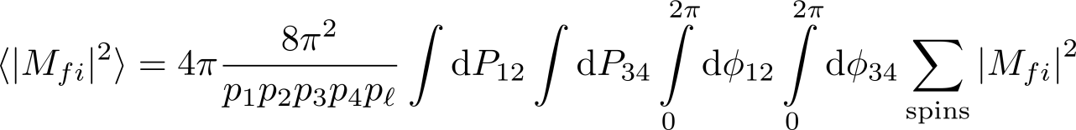

Modified Urca processes. Basic Formalism
Fermi golden rule
All particles on Fermi surface
Phase space integration
One-pion exchange (Friman & Maxwell, 1979)

Slide 9



Medium modifications
From Blaschke et al. 1995
Voskresenskii & Senatorov (1986), Migdal et al. (1990), Blaschke et al. (1995),
Voskresenskii (2001), Hanhart et al. (2000)
Effective masses
T-matrix instead of OPE;
in-medium interaction
Blaschke et al. (1995)
Renormalized vertices,
Additional processes
e.g., Voskresenskii (2001)
In the soft pion regime (b) dominates
MMU in Blaschke et al., 2004
We consider processes (a) by means of G-matrix

Slide 10
Bethe-Brueckner-Goldstone equation
See F. Burgio talk
All diagrams on two hole-line level are included
– Pauli operator
minimizes the contribution from the three-hole line diagrams
Continuous choice of auxiliary single-particle potential
BHF energy:
Three-nucleon forces by means of effective interaction
– defect function
BBG equation solved in partial wave representation up to J=12 with Argonne v18 potential + Urbana IX three-body forces

Slide 11
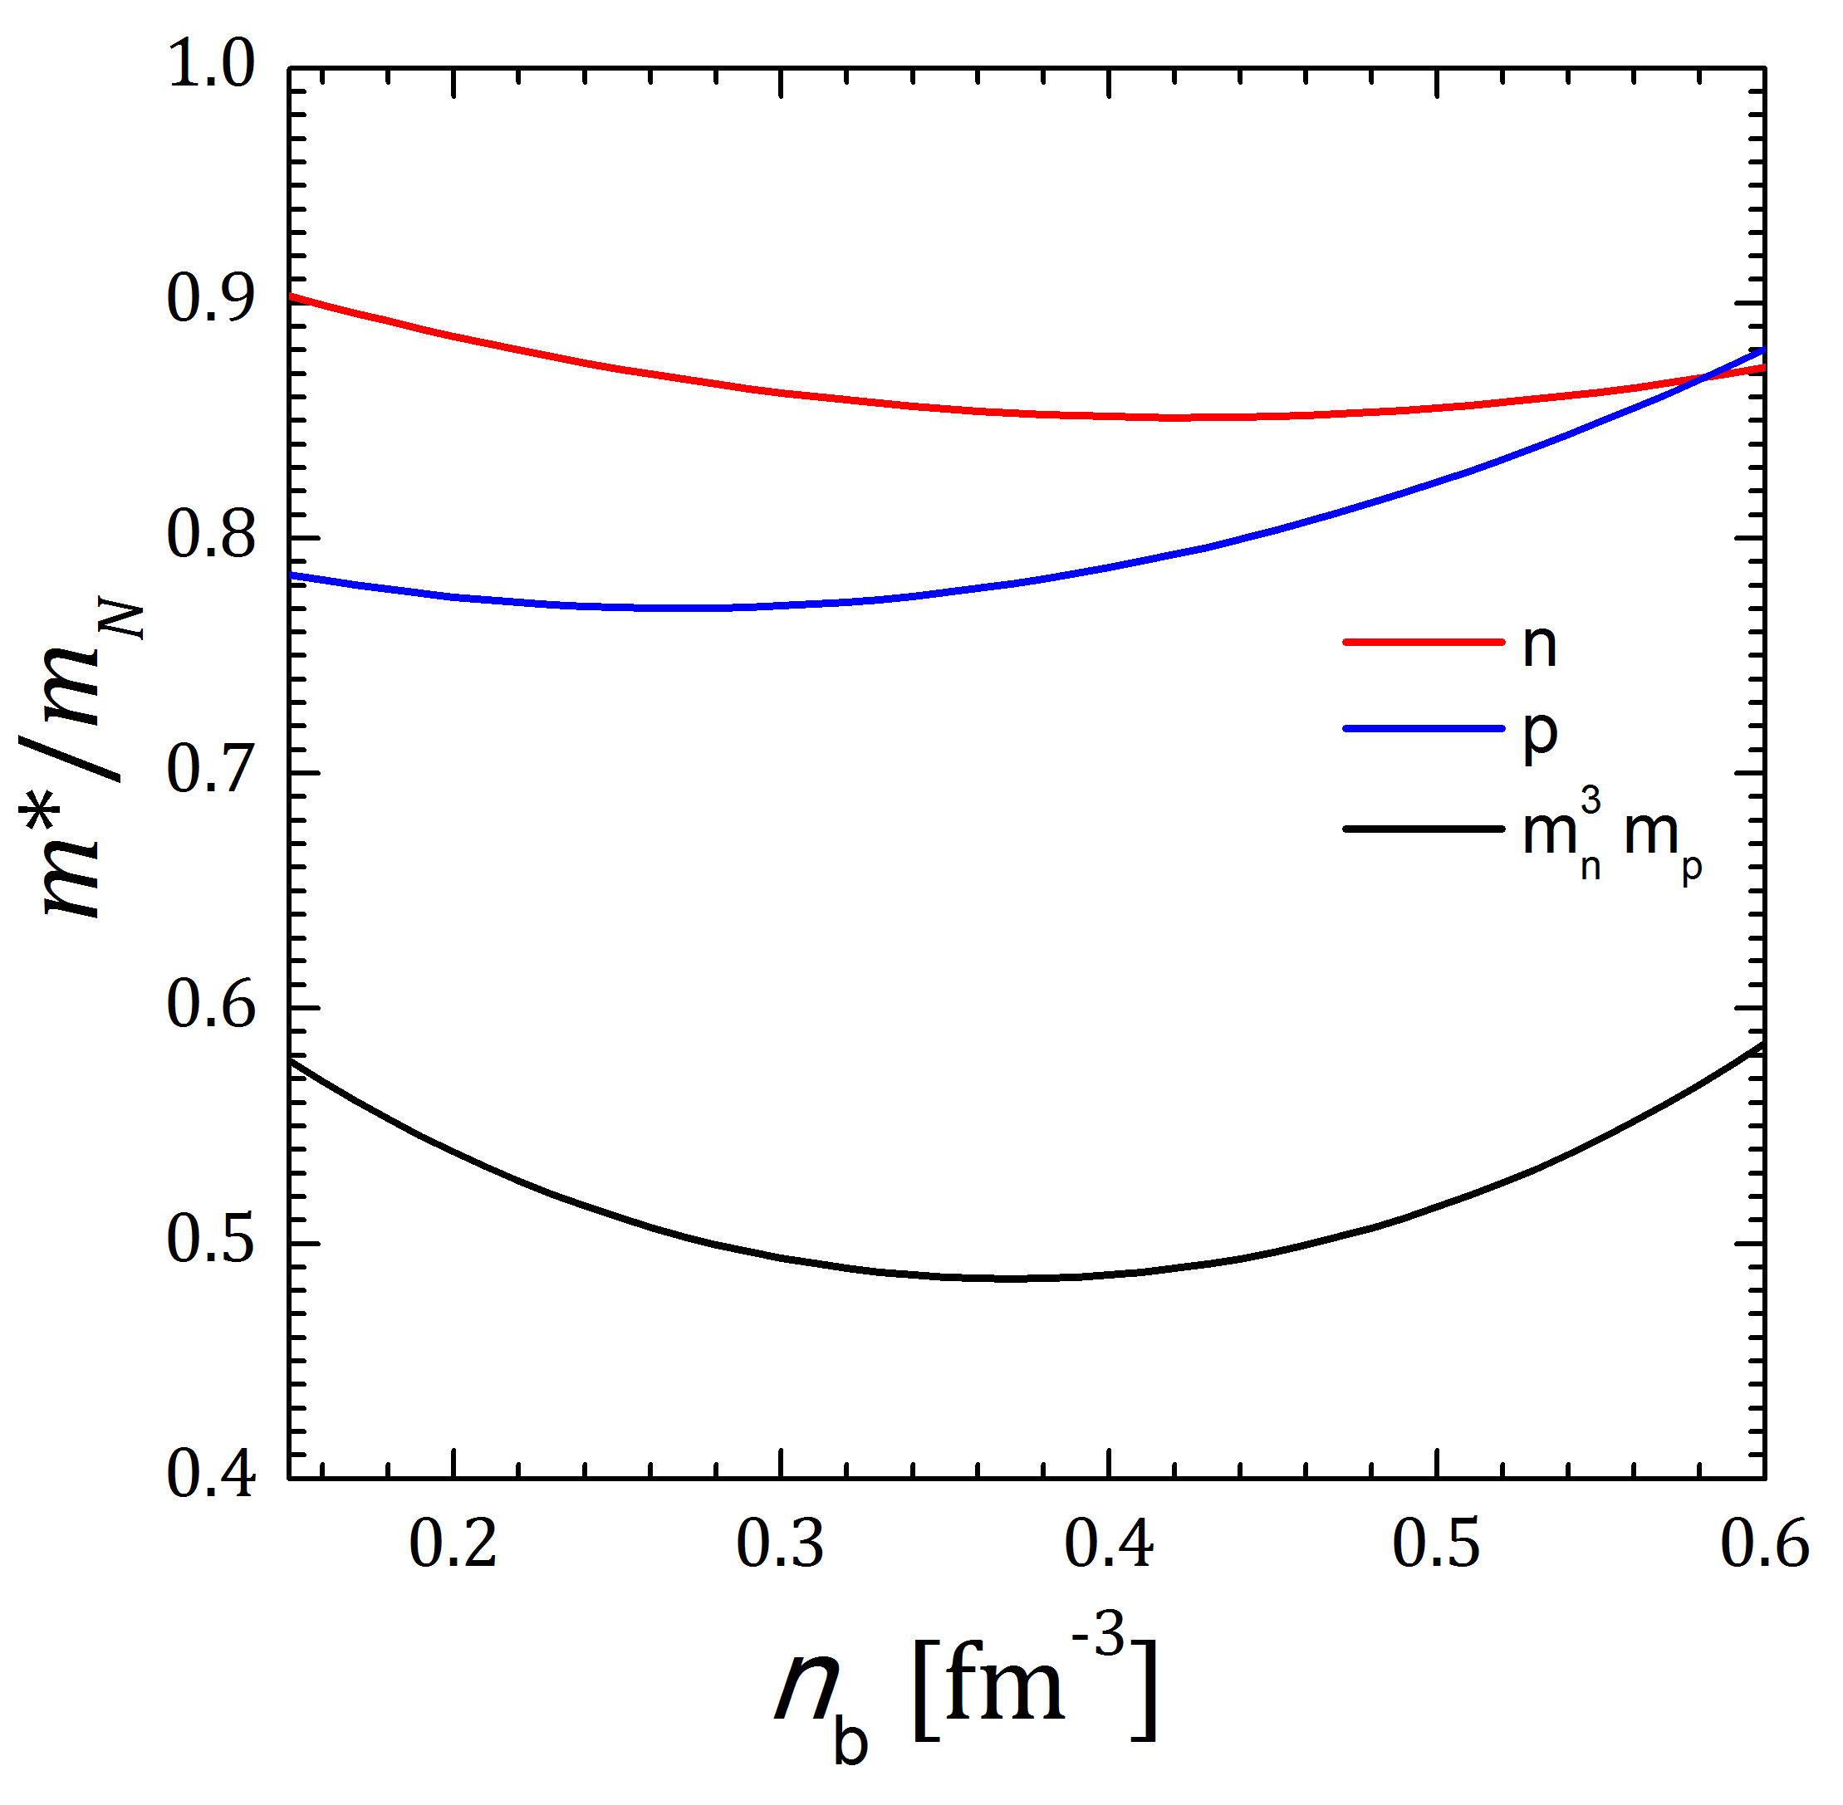
Results. Effective mass
BHF Effective masses at Fermi surface
Not far from constant effective mass
e.g. FM79 m*=0.8
model-dependence: Baldo et al., 2014;
G. Taranto talk previous year

Slide 12
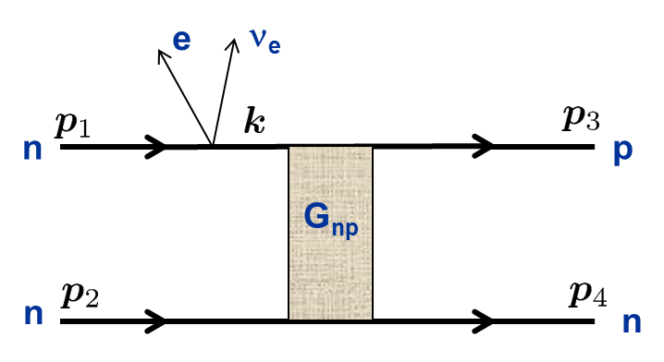
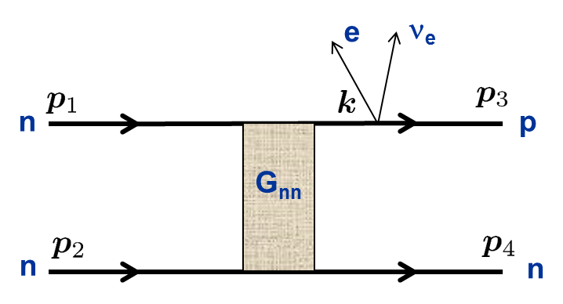


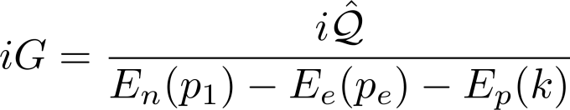
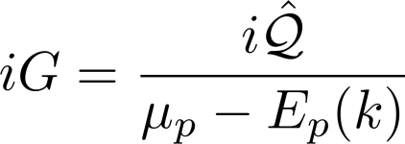
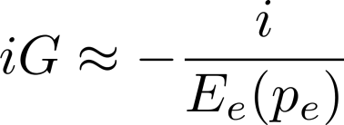

Modified Urca. Neutron branch
Pauli principle in the intermediate nucleon line
Nucleon propagator
Forbidden under DU threshold
beta—stability
FM79 approximation:
important when

Slide 13
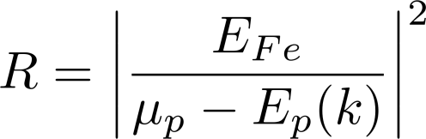
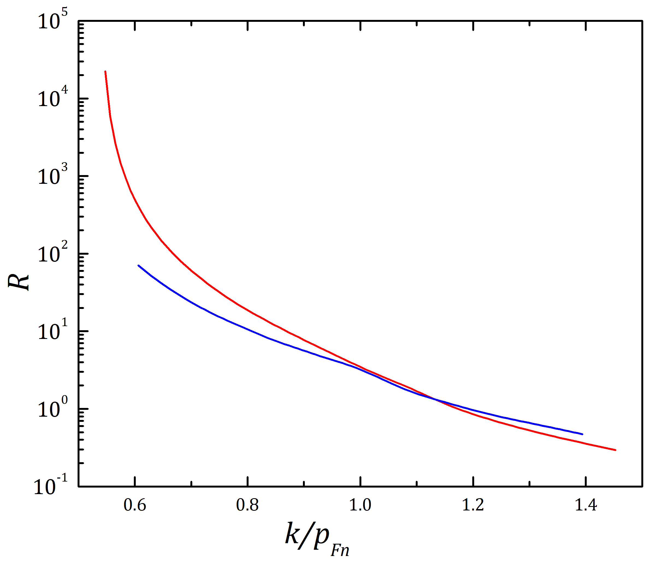




Nucleon propagator in beta—stable matter
beta equilibrium
FM79 approximation:
Correction factor
Approaching DU
threshold

Slide 14
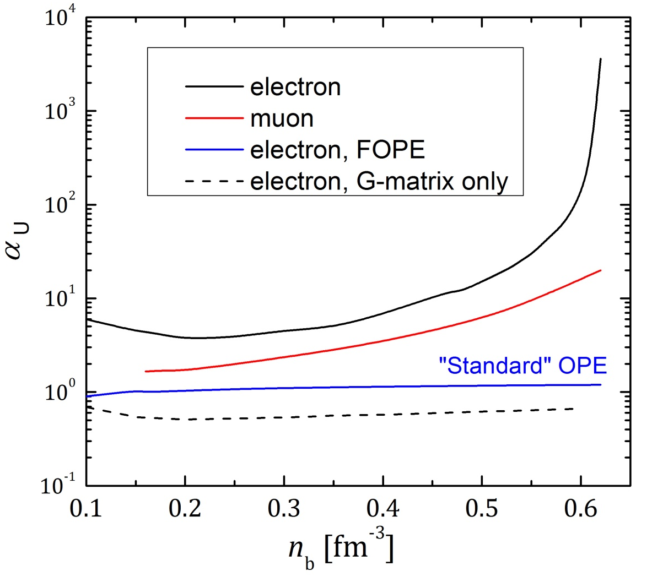
Results. The mUrca rate
G-matrix alone suppresses the rate
Blaschke et al., 1995
R-factor increases the rate
muon dUrca threshold is higher
hence, the increase for muon
branch is smaller

Slide 15
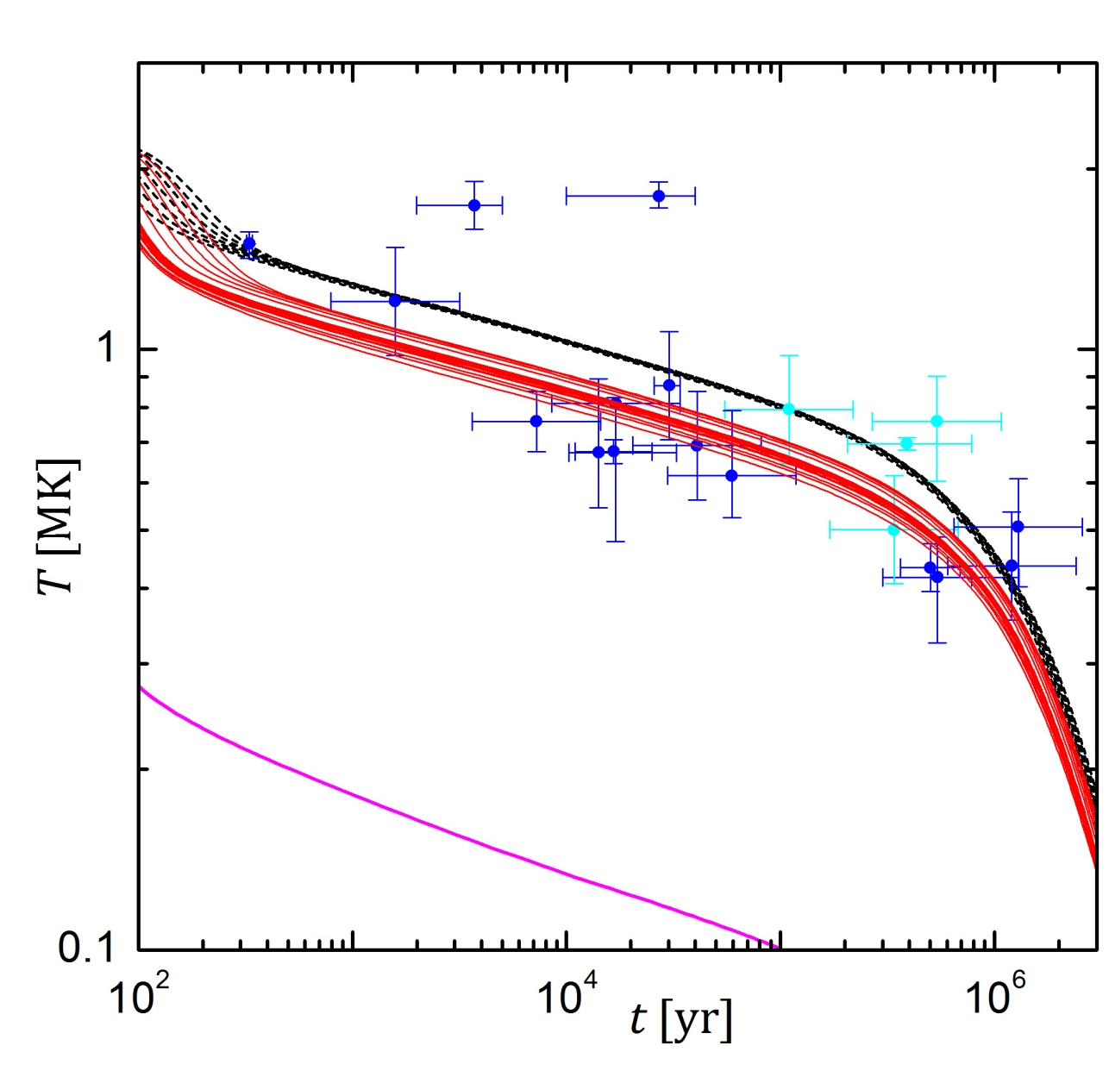

Results. Neutron star cooling
Preliminary
(illustration)
DU
Integral neutrino luminosity increase 4—20 times

Slide 16
Summary
Preliminary results of simple treatment
The rates of nucleon mUrca processes in neutron star cores are calculated in the BHF framework
The use of the in-medium energies in the nucleon propagator lead to the increase of the rate, especially near the direct Urca threshold
The sole effect of the G-matrix is to decrease the rate by approximately a factor of 2
The cooling is enhanced and the cooling curves region is smeared
Work in progress
Proton branch
Asymptotic expression, analogous to soft bremms. theorem (Hanhart et al. 2000, Timmermans et al. 2002), more sophisticated treatment
FL effects
Transition to direct Urca
…

