Slide 1
Vortex Creep Against Toroidal Flux Lines and Implications for Pulsar Glitches and Neutron Star Structure
Erbil Gügercinoğlu
Istanbul University, Department of Astronomy and Space Sciences
Compstar 2015 15-19 June, Budapest
Work Supported by Scientific and Technological Resarch Council of Turkey
Project Number: 113F354

Slide 2
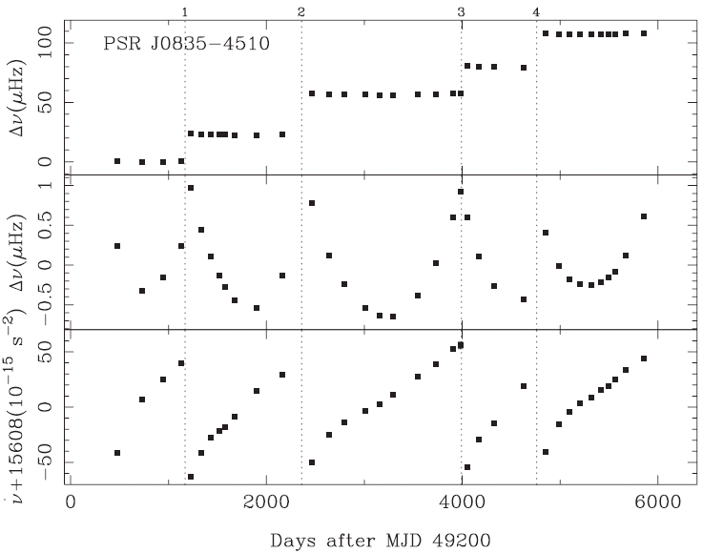
Pulsar Glitches
Glitch sudden spin up in the rotation rate of pulsars
Also increase in the spin down rate:
These changes tend to relax back to the their corresponding pre-glitch values .
Up to now 481 glitches observed in 157 pulsars.
Healing Parameter

Slide 3
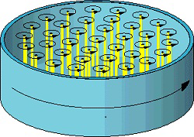
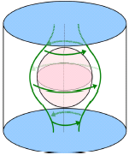
Superfluid Dynamics Inside Neutron Stars
Long postglitch recovery timescales indicate that neutron stars contain a superfluid component which is weakly interacting with the normal matter crust (Baym et al. 1969).
Rotational dynamics of neutron stars is governed by the motion of quantized vortex lines in the neutron superfluid.
Superfluid will spindown if it sustains a vortex current migrating radially outward direction.
Outward vortex flow reduces the differential rotation between the neutron superfluid and the crust.
In the inner crust vortex lines coexist with lattice nuclei, which they pin to.

Slide 4
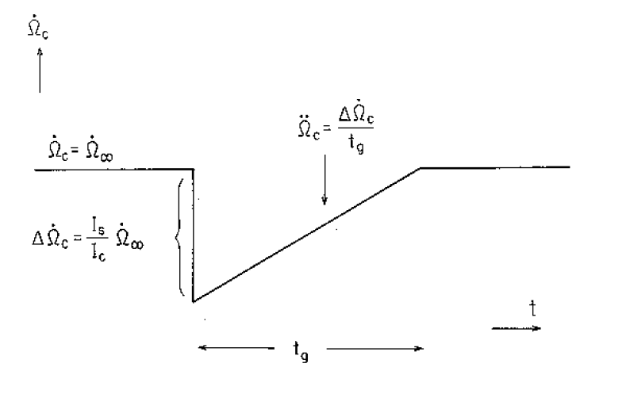
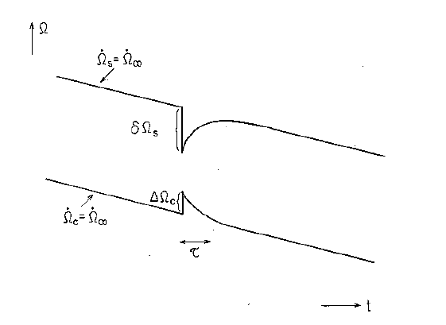
Vortex Creep Model
Crustal superfluid and crust are coupled via thermally activated creep.
At the time of the glitch
A very large number of vortices unpin
Vortices impart their angular momentum to the crust
The crust spins up
The lag decreases
So the coupling decreases
Superfluid decouples
Torque acts on smaller moment of inertia
So spin-down increases
Recovery takes place as superfluid recouples to some other regions of the crust.

Slide 5
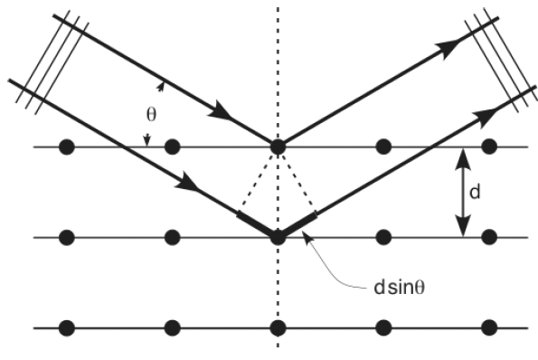
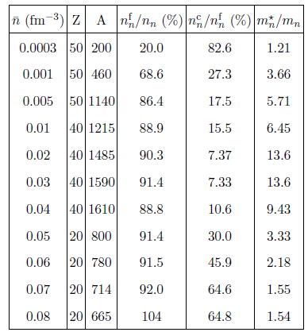
Crustal Entrainment Effect
In the crust dripped neutrons are Bragg scattered
from crystal lattice.
Velocity of reflected neutrons decreases:
Neutrons acquire effective mass larger than
bare neutron mass:
Superfluid neutron’s capability of storing and
imparting angular momentum severely reduces.
Deduced moments of inertia from
postglitch relaxation must be
multiplied by enhancement factor:

Slide 6
THE CRUST IS NOT ENOUGH...
PINNING/CREEP IN THE CORE?

Slide 7
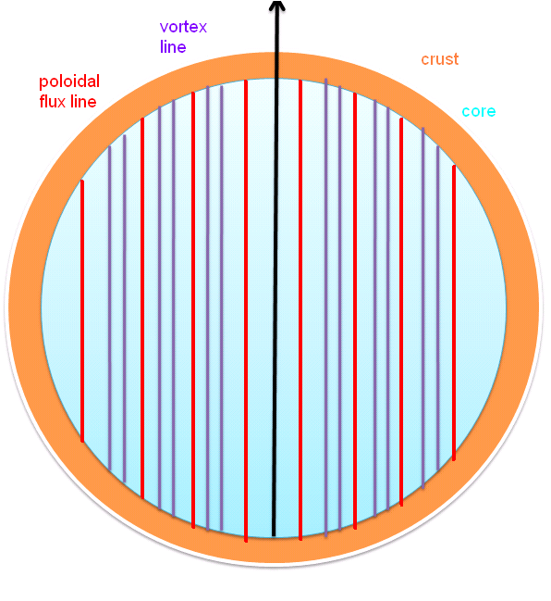
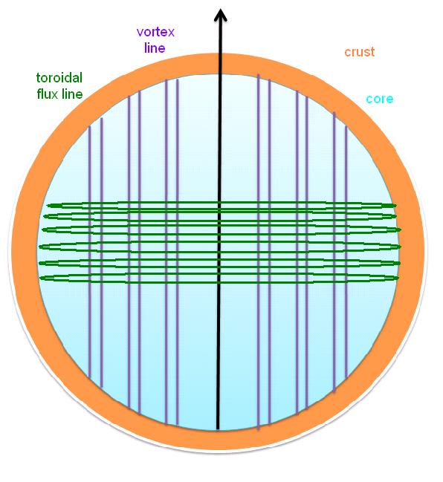
Vortex Pinning and Creep Against Flux Tubes
Flux tubes provide pinning/creep sites for
vortex lines (Sidery & Alpar 2009).
If flux tubes have poloidal configuration, pinning
and creep in the core will depend on the angle
between the rotation and magnetic axes.
By contrast, toroidal arrangement of flux tubes
inevitably constrain the motion of the vortices.
Lander (2014)

Slide 8
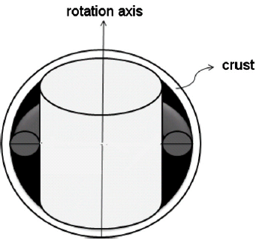
Gügercinoğlu & Alpar (2014)
Response of toroidal field region in the outer core to a glitch is exponential relaxation:
Depending on the radial extent of the toroidal field, the moment of inertia of the associated region can be comparable to and even larger than that of the inner crust superfluid:

Slide 9
Implications for Crustal Entrainment
With crustal entrainment is taken into account angular momentum balance (glitch magnitude) is given by
Considering Vela glitches we obtain which is close to the average value over the entire inner crust:
Entrainment calculations contain large uncertainties so that enhancement factor is expected to be reduced.
? Dripped neutrons destabilises the bcc lattice (Kobyakov & Pethick 2014)
? Uncertainties about crust-core transition can lead to thicker crust (Piekarewicz et al. 2014)
? Presence of impurities and defects in the lattice (Chamel 2013)

Slide 10
Observations vs Model
Observation
Model
then .
≫ then can be said.
Then glitch observations bring constraints into the neutron star internal structure and especially about magnetic field configuration.
40 pulsars underwent 73 glitches with exponential decay.
Of these, 57 glitches with one exponential decay component, 14 glitches with two exponential decay components and 2 glitches with three exponential decay commponents have been determined.

Slide 11
EOS
Akmal et al. (1998)
Douchin & Haensel (2001)
Lattimer & Swesty (1991)

Slide 12
Among 40 pulsars 23 of them have postglitch parameters consistent with the model.
Main reasons for the others’ discrepancies can be summarised as follows:
For 8 sources > and Q ≪ 1 → relaxation is not completed.
For 4 sources > glitch date uncertainty > → may be simply missed from obsevations.
For Magnetar class ≫ and Q ≳ 1 requires a different physical explanation.

Slide 13
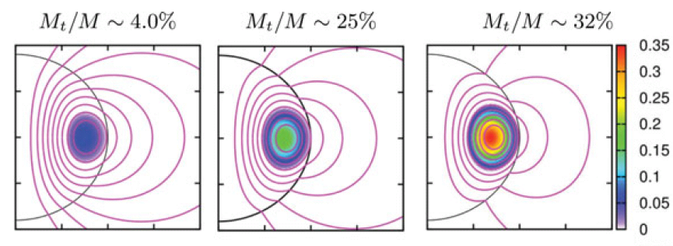
Magnetars
For magnetars’ strong magnetic fields, Hall drift time scale≪Ohmic diffision time scale.
Hall drift turns toroidal field into poloidal field by splitting and carrying over magnetic energy to dipole and higher multipoles.
For magnetars’ strong magnetic fields, closed field region where toroidal field reside extends to deeper regions of the neutron star.
Within a shell close to the inner core Direct Urca takes place of Modified Urca as cooling agent and leads to a cooler core.

Slide 14
Magnetar | τ_{d} (days) (obs) | τ_{tor} (days) (formula APR) Modified Urca | τ_{tor} (days) (formula APR) Direct Urca
4U_0142+61 | 17.0(1.7) | 273 | 18
1RXS J1708−4009 | 50(4) | 120 | 9
SGR J1822-1606 | 40(6) | 3648 | 162
1E 1841−045 | 43(3) | 91 | 7
1E 2259+586 | 15.9(6) | 400 | 24

Slide 15
Conclusions
Inclusion of toroidal field region’s moment of inertia to the angular momentum conservation equation during a glitch resolves the entrainment crisis.
With a plausible choice of set of physical parameters it was shown that the relaxation timescale of the model is able to explain observed decay times.
For magnetars with cooling via Direct Urca process model gives toroidal relaxation in agreement with the observed exponential decay timescales.
Glitch exponential decay timescales can bring constraints on neutron star structure (EOS, crust-core interface etc.) and magnetic field geometry (toroidal/poloidal field strengths and corresponding volume ratios).

Slide 16
Thank You for Attention...

Slide 17
EXTRA SLIDES
TABULAR RESULTS

Slide 18
Pulsar Name | Age (10⁴ Yrs) | B_{p} (10¹²G) | B_{φ} (10¹⁴G) | Glitch Date (MJD) | Δν/ν (10⁻⁹) | (10⁻³) | τ_{d}(days) Obs. | τ_{tor}(days) (APR) | τ_{tor}(days) (L&S) | τ_{tor}(days) (D&H) | Q
4U_0142+61 | 6,8 | 134 | 16,37 | 53809 | 1630(350) | 5100(1100) | 17.0(1.7) | 9554 | 37744 | 30146 | 1.1(3)
J0205+6449 | 0,55 | 3,61 | 2,69 | 52920(144) | 5400(1800) | 52(1) | 288(8) | 3.5 | 14 | 11 | 0.77(11)
B0355+54 | 55,5 | 0,84 | 1,3 | 46497(8) | 4368(2) | 96(17) | 160(8) | 282 | 1116 | 891 | 0.00117(4)
B0525+21 | 148 | 12,4 | 4,98 | 42057(14) | 1.2(2) | 2(2) | 140(80) | 29611 | 116982 | 93431 | 0.6(2)
B0525+21 | 148 | 12,4 | 4,98 | 52280(4) | 1.6(2) | 1.1(1) | 650(50) | 29611 | 116982 | 93431 | 0.44(5)
B0531+21 | 0,12 | 3,78 | 2,75 | 40494 | 4.0(3) | 0.116(19) | 18.7(1.6) | 0.53 | 2,1 | 1,7 | 0.6(1)
B0531+21 | 0,12 | 3,78 | 2,75 | 42447.5 | 43.8(7) | 2.15(19) | 18(2), 97(4) | 0.53 | 2,1 | 1,7 | 0.8(1), 0.536(12)
B0531+21 | 0,12 | 3,78 | 2,75 | 46664.42(5) | 4.1(1) | 2.5(2) | 9.3(2), 123(40) | 0.53 | 2,1 | 1,7 | 1.00(4), 0.89(9)
B0531+21 | 0,12 | 3,78 | 2,75 | 47767.4 | 85.1(4) | 4.5(5) | 18(2), 265(5) | 0.53 | 2,1 | 1,7 | 0.894(6), 0.827(5)
B0531+21 | 0,12 | 3,78 | 2,75 | 48947.0(2) | 4.2(2) | 0.32(3) | 2.0(4) | 0.53 | 2,1 | 1,7 | 0.87(18)
B0531+21 | 0,12 | 3,78 | 2,75 | 50020.6(3) | 2.1(1) | 0.20(1) | 3.2(2.2) | 0.53 | 2,1 | 1,7 | 0.8(0.2)
B0531+21 | 0,12 | 3,78 | 2,75 | 50259.93(0.25) | 31.9(1) | 1.73(3) | 10.3(1.5) | 0.53 | 2,1 | 1,7 | 0.680(10)

Slide 19
Pulsar Name | Age (10⁴ Yrs) | B_{p} (10¹²G) | B_{φ} (10¹⁴G) | Glitch Date (MJD) | Δν/ν (10⁻⁹) | (10⁻³) | τ_{d}(days) Obs | τ_{tor}(days) (APR) | τ_{tor}(days) (L&S) | τ_{tor}(days) (D&H) | Q
B0531+21 | 0,12 | 3,78 | 2,75 | 50459.15(5) | 6.1(4) | 1.1(1) | 3(0.5) | 0.53 | 2,1 | 1,7 | 0.87(6)
B0531+21 | 0,12 | 3,78 | 2,75 | 50812.9(1.5) | 6.2(2) | 0.62(4) | 2.9(1.8) | 0.53 | 2,1 | 1,7 | 0.9(3)
B0531+21 | 0,12 | 3,78 | 2,75 | 51452.3 | 6.8(2) | 0.7(1) | 3.4(5) | 0.53 | 2,1 | 1,7 | 0.8(2)
J0631+1036 | 4,35 | 5,55 | 3,33 | 52852.0(2) | 19.1(6) | 3.1(6) | 120(20) | 98 | 389 | 310 | 0.62(5)
J0631+1036 | 4,35 | 5,55 | 3,33 | 54632.41(14) | 44(1) | 4(2) | 40(15) | 98 | 389 | 310 | 0.13(2)
B0833−45 | 1,13 | 3,38 | 2,6 | 40280(4) | 2338(9) | 10.1(3) | 10(1), 120(6) | 9 | 35 | 28 | 0.001980(18), 0.01782(5)
B0833−45 | 1,13 | 3,38 | 2,6 | 41192(8) | 2047(30) | 14.8(2) | 4(1), 94(5) | 9 | 35 | 28 | 0.00158(2), 0.01311(9)
B0833−45 | 1,13 | 3,38 | 2,6 | 41312(4) | 12(2) | 1.9(2) | 10.0(5) | 9 | 35 | 28 | 0.1612(15)
B0833−45 | 1,13 | 3,38 | 2,6 | 42683(3) | 1987(8) | 11(1) | 4.0(4), 35(2) | 9 | 35 | 28 | 0.000435(5), 0.003534(16)
B0833−45 | 1,13 | 3,38 | 2,6 | 43693(12) | 3063(65) | 18.3(2) | 6.0(6), 75(3) | 9 | 35 | 28 | 0.00242(2), 0.01134(2)
B0833−45 | 1,13 | 3,38 | 2,6 | 44888.4(4) | 1138(9) | 8.43(6) | 6.0(6), 14(2) | 9 | 35 | 28 | 0.000813(8), 0.00190(4)
B0833−45 | 1,13 | 3,38 | 2,6 | 45192.1(5) | 2051(3) | 23.1(3) | 3.0(6), 21.5(2.0) | 9 | 35 | 28 | 0.002483(7), 0.00550(8)
B0833−45 | 1,13 | 3,38 | 2,6 | 46259(2) | 1346(5) | 6.16(3) | 6.5(5), 332(10) | 9 | 35 | 28 | 0.0037(5), 0.1541(6)
B0833−45 | 1,13 | 3,38 | 2,6 | 47519.80360(8) | 1805.2(8) | 77(6) | 4.62(2), 351(1) | 9 | 35 | 28 | 0.005385(10), 0.1684(4)

Slide 20
Pulsar Name | Age (10⁴ yrs) | B_{p} (10¹²G) | B_{φ} (10¹⁴G) | Glitch Date (MJD) | Δν/ν (10⁻⁹) | (10⁻³) | τ_{d}(days) Obs | τ_{tor}(days) (APR) | τ_{tor}(days) (L&S) | τ_{tor}(days) (D&H) | Q
B0833−45 | 1,13 | 3,38 | 2,6 | 51559.3190(5) | 3152(2) | 495(37) | 0.53(3), 3.29(3), 19.07(2) | 9 | 35 | 28 | 0.0088(6), 0.00547(6), 0.006691(7)
B0833−45 | 1,13 | 3,38 | 2,6 | 53193.09 | 2059(6) | 11(2) | 0.23, 2.1, 26.14 | 9 | 35 | 28 | 0.00898, 0.00556, 0.00685
B1046-58 | 2,03 | 34,9 | 8,36 | 49034(9) | 2995(7) | 3.7(1) | 160(43) | 36 | 140 | 112 | 0.026(6)
B1046-58 | 2,03 | 34,9 | 8,36 | 50788(3) | 771(2) | 4.62(6) | 60(20) | 36 | 140 | 112 | 0.008(3)
J1052-5954 | 14,32 | 1,92 | 1,96 | 54495(10) | 495(3) | 86(14) | 46(8) | 128 | 505 | 403 | 0.067(4)
J1112-6103 | 3,27 | 1,45 | 1,7 | 53337(30) | 1202(20) | 7(2) | 302(146) | 13 | 49 | 39 | 0.022(2)
J1119-6127 | 0,16 | 41 | 9,05 | 53290 | 330(40) | 6.1(4) | 41(2) | 15 | 58 | 46 | 0.84(3)
J1119-6127 | 0,16 | 41 | 9,05 | 54240 | 1670(30) | 180(40) | 15.7(3), 186(3) | 15 | 58 | 46 | 0.81(4), 0.214(7)
J1123−6259 | 81,9 | 1,21 | 1,56 | 49705.87(1) | 749.12(12) | 1.0(4) | 840(100) | 731 | 2891 | 2309 | 0.0026(1)
J1141−6545 | 144,9 | 1,32 | 1,62 | 54277(20) | 589.0(6) | 5.0(9) | 495(140) | 1745 | 6896 | 5507 | 0.0040(7)

Slide 21
Pulsar Name | Age (10⁴ Yrs) | B_{p} (10¹²G) | B_{φ} (10¹⁴G) | Glitch Date (MJD) | Δν/ν (10⁻⁹) | (10⁻³) | τ_{d} (days) Obs | τ_{tor}(days) (APR) | τ_{tor}(days) (L&S) | τ_{tor}(days) (D&H) | Q
B1259−63 | 33,21 | 0,34 | 0,82 | 50690.7(7) | 3.20(5) | 2.5(1) | 100 | 44 | 174 | 139 | 0.328(16)
J1301-6305 | 1,1 | 7,1 | 3,77 | 51923(23) | 4630(2) | 8.6(4) | 58(6) | 21 | 84 | 67 | 0.0049(3)
B1338−62 | 1,21 | 7,08 | 3,77 | 48645(10) | 993(2) | 0.7(5) | 69(8) | 24 | 96 | 76 | 0.016(2)
B1338−62 | 1,21 | 7,08 | 3,77 | 50683(13) | 703(4) | 1.2(3) | 24(9) | 24 | 96 | 76 | 0.0112(19)
J1412-6145 | 5,06 | 5,64 | 3,36 | 51868(10) | 7253.0(7) | 17.5(8) | 59(4) | 123 | 485 | 387 | 0.00263(8)
J1420-6048 | 1,3 | 2,41 | 2,2 | 52754(16) | 2019(10) | 6.6(8) | 99(29) | 7 | 27 | 22 | 0.008(4)
J1522-5735 | 5,18 | 1,81 | 1,9 | 55250 | -11.4(6) | -1.2(13) | 27(5) | 31 | 121 | 96 | 1.4(2)
J1531-5610 | 9,71 | 1,09 | 1,48 | 51731(51) | 2637(2) | 25(4) | 76(16) | 37 | 148 | 118 | 0.007(3)
J1702-4310 | 1,70 | 7,43 | 3,858 | 53943(169) | 4810(27) | 17(4) | 96(16) | 40 | 160 | 128 | 0.023(6)

Slide 22
Pulsar Name | Age (10⁴ Yrs) | B_{p} (10¹²G) | B_{φ} (10¹⁴G) | Glitch date (MJD) | Δν/ν (10⁻⁹) | (10⁻³) | τ_{d} (days) Obs | τ_{tor}(days) (APR) | τ_{tor}(days) (L&S) | τ_{tor}(days) (D&H) | Q
B1706-44 | 1,75 | 3,12 | 2,5 | 48775(15) | 2057(2) | 4.0(1) | 122(3) | 14 | 56 | 45 | 0.01748(8)
B1706-44 | 1,75 | 3,12 | 2,5 | 52716(57) | 2872(7) | 8.0(7) | 155(29) | 14 | 56 | 45 | 0.0129(12)
B1706-44 | 1,75 | 3,12 | 2,5 | 54711(22) | 2743.9(4) | 8.41(8) | 85(2) | 14 | 56 | 45 | 0.00849(7)
1RXS J1708−4009 | 0,9 | 467 | 30,56 | 52014.77 | 4210(330) | 546(62) | 50(4) | 3063 | 12101 | 9665 | 0.97(11)
B1727−33 | 2,6 | 3,48 | 2,64 | 47990(20) | 3070(10) | 9.7(7) | 110(8) | 28 | 109 | 87 | 0.0077(5)
B1727−33 | 2,6 | 3,48 | 2,64 | 52107(19) | 3202(1) | 5.9(1) | 99(23) | 28 | 109 | 87 | 0.0102(9)
B1727-47 | 8,04 | 11,79 | 4,86 | 52472.70(2) | 126.4(3) | 3.4(2) | 210(37) | 571 | 2255 | 1801 | 0.073(7)
B1737−30 | 2,06 | 17 | 5,83 | 50936.803(4) | 1445.5(3) | 2.6(8) | 9(5) | 147 | 582 | 465 | 0.0016(5)
B1737−30 | 2,06 | 17 | 5,83 | 52347.66(6) | 152(2) | 0.1(7) | 50 | 147 | 582 | 465 | 0.103(9)
B1737−30 | 2,06 | 17 | 5,83 | 53036(13) | 1853.6(14) | 3.0(2) | 100 | 147 | 582 | 465 | 0.0302(6)
B1757−24 | 1,55 | 4,04 | 2,84 | 49476(6) | 1990.1(9) | 5.6(3) | 42(14) | 17 | 66 | 53 | 0.0050(19)

Slide 23
Pulsar Name | Age (10⁴ Yrs) | B_{p} (10¹²G) | B_{φ} (10¹⁴G) | Glitch Date (MJD) | Δν/ν (10⁻⁹) | (10⁻³) | τ_{d} (days) Obs | τ_{tor}(days) (APR) | τ_{tor}(days) (L&S) | τ_{tor}(days) (D&H) | Q
B1757−24 | 1,55 | 4,04 | 2,84 | 52055(7) | 3755.8(4) | 6.8(1) | 208(25) | 17 | 66 | 53 | 0.024(5)
B1757−24 | 1,55 | 4,04 | 2,84 | 54661(2) | 3101(1) | 9.3(1) | 25(4) | 17 | 66 | 53 | 0.0064(9)
B1758−23 | 5,9 | 6,93 | 3,72 | 53309(18) | 494(1) | 0.19(3) | 1000(100) | 194 | 765 | 611 | 0.009(2)
B1800−21 | 1,58 | 4,28 | 2,93 | 48245(20) | 4073(16) | 9.1(2) | 154(3) | 18 | 73 | 58 | 0.0137(3)
B1800−21 | 1,58 | 4,28 | 2,93 | 50777(4) | 3184(1) | 8.0(2) | 12(2), 69(13) | 18 | 73 | 58 | 0.0094(11), 0.0030(17)
B1800−21 | 1,58 | 4,28 | 2,93 | 53429(1) | 3929.3(4) | 10.6(1) | 133(11) | 18 | 73 | 58 | 0.00630(16)
J1809-1917 | 5,13 | 1,47 | 1,72 | 53251(2) | 1625.1(3) | 7.8(3) | 126(7) | 23 | 92 | 73 | 0.00602(9)
B1809−173 | 96,6 | 4,85 | 3,11 | 53105(2) | 14.8(6) | 3.6(5) | 800(100) | 5274 | 20836 | 16641 | 0.27(2)
SGR J1822-1606 | 625,84 | 13,5 | 5,2 | 56756.0 | 230(10) | - | 40(6) | 226323 | 894122 | 714116 | 1.0
B1823-13 | 2,14 | 2,79 | 2,36 | 53737(1) | 3581(1) | 9.6(4) | 80(9) | 16 | 64 | 51 | 0.0066(3)

Slide 24
Pulsar Name | Age (10⁴ Yrs) | B_{p} (10¹²G) | B_{φ} (10¹⁴G) | Glitch Date (MJD) | Δν/ν (10⁻⁹) | (10⁻³) | τ_{d}(days) Obs | τ_{tor}(days) (APR) | τ_{tor}(days) (L&S) | τ_{tor}(days) (D&H) | Q
B1830−08 | 14,74 | 0,9 | 1,34 | 48041(20) | 1865.9(4) | 1.8(5) | 200(40) | 51 | 202 | 161 | 0.0009(2)
B1838−04 | 46,12 | 1,1 | 1,48 | 53408(21) | 578.8(1) | 1.4(6) | 80(20) | 304 | 1200 | 958 | 0.00014(20)
1E 1841−045 | 0,46 | 734 | 38,31 | 5246,400448 | 15170(711) | 848(76) | 43(3) | 2083 | 8231 | 6574 | 0.63(5)
J1846−0258 | 0,07 | 48,6 | 9,86 | 53883.0(3.0) | 4000(1300) | 4.1(2) | 127(5) | 6 | 25 | 20 | 8.7(2.5)
J1853+0545 | 327,77 | 0,28 | 0,75 | 53450(2) | 1.46(8) | 3.5(7) | 250(30) | 751 | 2967 | 2370 | 0.22(5)
1E 2259+586 | 22,93 | 58,88 | 10,85 | 52443.13(9) | 4240(110) | -22(3) | 15.9(6) | 17197 | 67940 | 54262 | 0.185(10)
B2334+61 | 4,1 | 9,86 | 4,44 | 53615(6) | 20579.4(12) | 156(4) | 21.4(5), 147(2) | 186 | 734 | 587 | 0.0046(7), 0.0029(1)

