Slide 1
Sub-saturation EoS for Core Collapse Supernova and Neutron Stars
Francesca Gulminelli - LPC Caen, France
Collaboration:
LPC Caen, LUTH Meudon, IPN Lyon, IFIN Bucarest

Slide 2
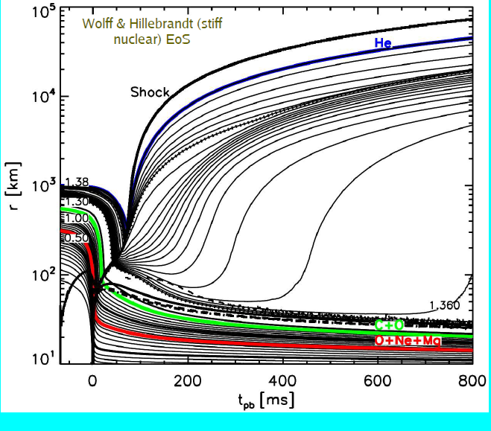
Dense matter in the universe
Supernova explosion occurs via core-collapse in very massive stars (M>8M_{sun})
F.S.Kitaura et al, A&A 450 (06) 345
Notes:
Mass trajectories for the simulation with the W&H EoS as a
function of post-bounce time (tpb). Also plotted: shock position (thick
solid line starting at time zero and rising to the upper right corner),
gain radius (thin dashed line), and neutrinospheres (e: thick solid;
¯e: thick dashed; μ, ¯μ, , ¯: thick dash-dotted). In addition, the
composition interfaces are plotted with different bold, labelled lines:
the inner boundaries of the O-Ne-Mg layer at ∼0.77 M⊙, of the C-O
layer at ∼1.26 M⊙, and of the He layer at 1.3769 M⊙. The two dotted
lines represent the mass shells where the mass spacing between
the plotted trajectories changes. An equidistant spacing of 5×10−2M⊙
was chosen up to 1.3579M⊙, between that value and 1.3765M⊙ it was
1.3 × 10−3M⊙, and 8 × 10−5M⊙ outside.

Slide 3
Dense matter in the universe
Supernova explosion occurs via core-collapse in very massive stars (M>8M_{sun})
10⁶ <ρ<10¹⁵ g/cm³ 0.01<T<50 MeV in the core
40 M_{sun} progenitor
T.Fischer et al, 2011 ApJS 194 39
Notes:
Supernovae: 4 observations dans notre galaxie (CRABE 1054)
~ 600 en tout

Slide 4
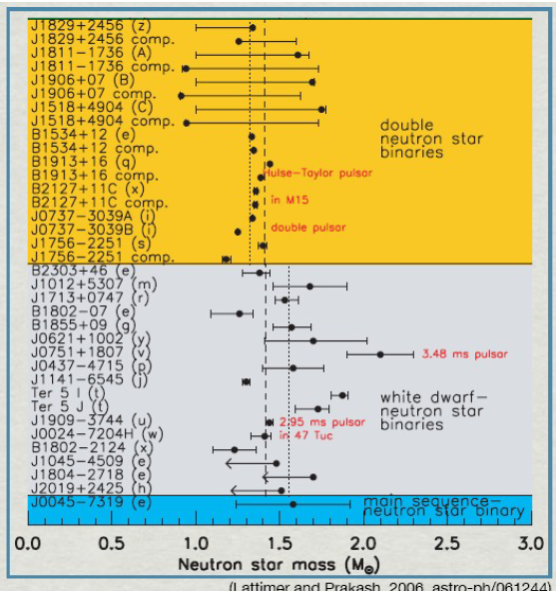
Dense matter in the universe
Supernova explosion occurs via core-collapse in very massive stars (M>8M_{sun})
10⁶ <ρ<10¹⁵ g/cm³ 0.01<T<50 MeV in the core
The density in the residual pulsar (neutron star) is of the same order <ρ> ∼ρ₀∼10¹⁴ g/cm³
=> Matter with nucleonic or sub-nucleonic dof !
Notes:
About 1800 pulsar observations in the different wavelength domains

Slide 5
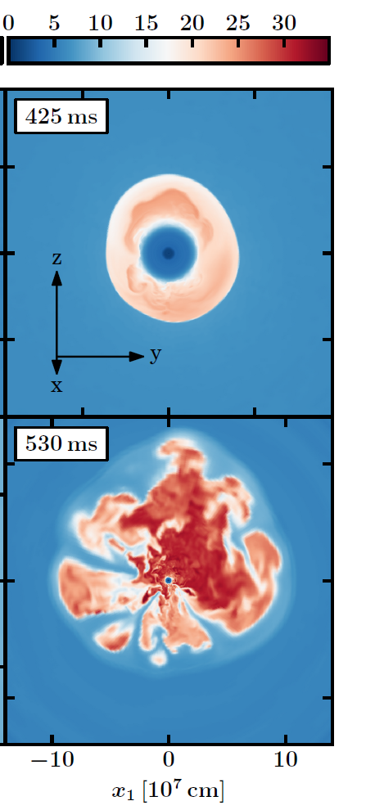
The 2 BIG EoS challenges
Present best 3D hydro simulations do not yet produce satisfactory explosions
Incertainty in the initial conditions
ν−N interaction ?
=> Microphysics essential !
Melson et al. 2015
Notes:
Chimera collaboration: Oakridge group
Hanke : Garching group (Janka et al)
Incertainty in the nu opacity, mainly the nu-nucleon scattering at subnuclear density
strange-quark contributions to the nucleon spin, which affect neutral-current neutrino scattering. We demonstrate on the basis of a 20 M
progenitor star that a moderate strangeness-dependent contribution of gsa = -0.2 to the axial-vector coupling
constant ga = 1.26 can turn an unsuccessful three-dimensional (3D) model into a successful explosion.
Indeed a nonzero value of gsa does not affect charged current interactions, but neutral yes:
reduces the scattering opacity of heavy flavor neutrinos. They leave easier the PNS leading to more heating in the gain region

Slide 6
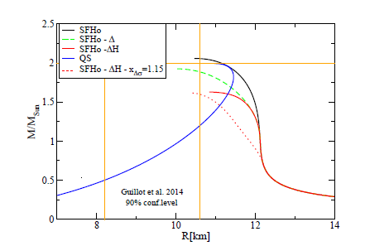
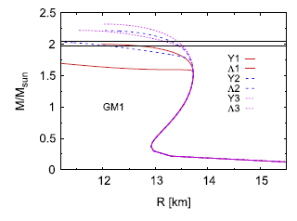
The 2 BIG EoS challenges
A.Drago et al 2014
Present best 3D hydro simulations do not yet produce satisfactory explosions
Incertainty in the initial conditions
ν−N interaction ?
J0348+0432
x_{σΔ}>1
+conversion into QM
x
M.Oertel et al 2015
Present best EoS modelling cannot yet explain the most massive NS
Strangeness couplings at high density ?
Transition to quark matter ?
x_{σ∗Y}>0
x_{ΦY}>0
=> Microphysics essential !
Notes:
v

Slide 7
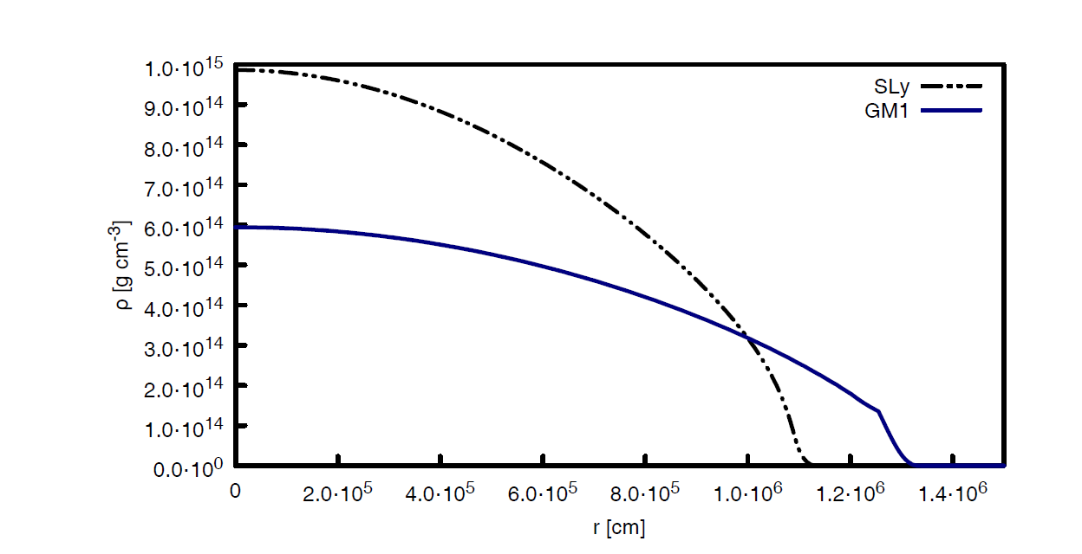
Matter below saturation
Standard nuclear physics: theory very (?) well known
Most of the supernova dynamics + NS crust
SN: T>0, y_{p} given by weak rates
NS: T=0, β-equilibrium
Same physical system but different
thermo conditions =>
very different formalisms
Cluster dof
Nucleon dof

Slide 8
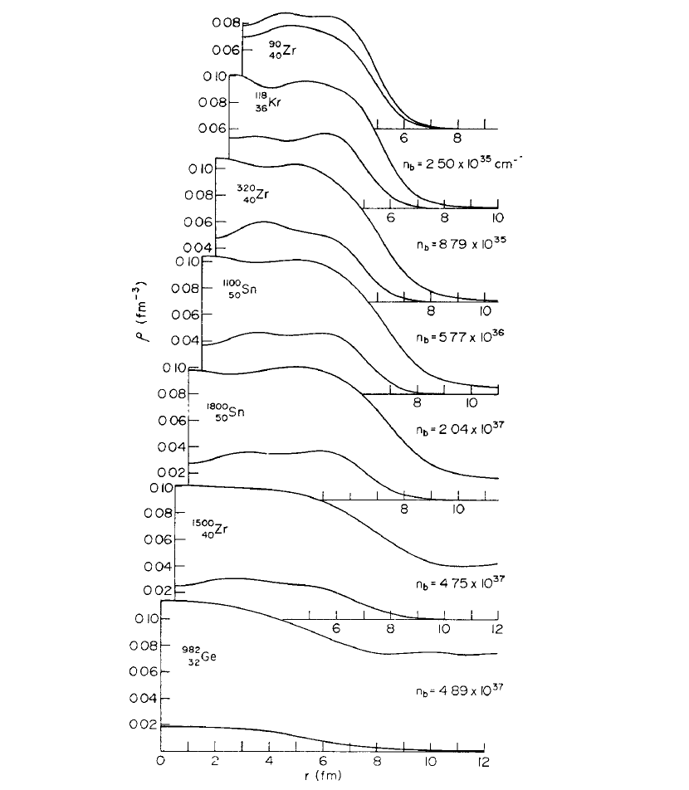
I- DFT for neutron star matter
HF(B) or (E)TF in the WS cell
Extended to finite temperature
J. W. Negele and D. Vautherin,
NPA 207, 298 (1973)
Notes:
Constanca: calculation with TF and NL3
Horpwitz: yp=0.2

Slide 9
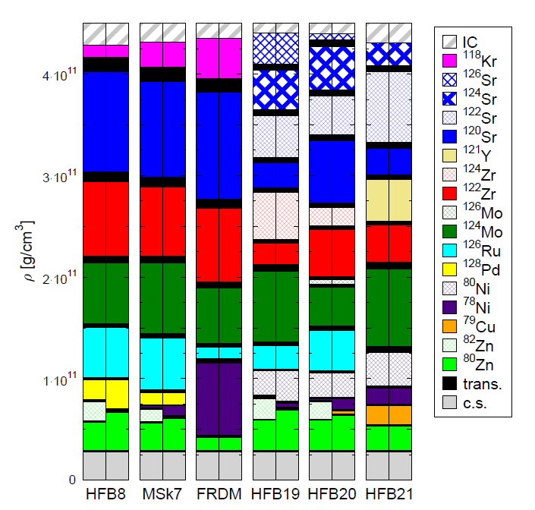
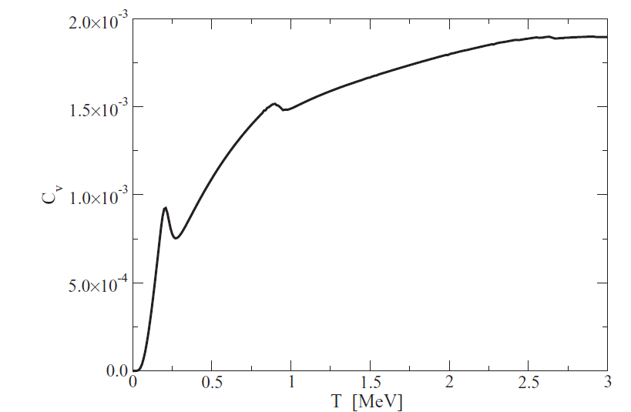
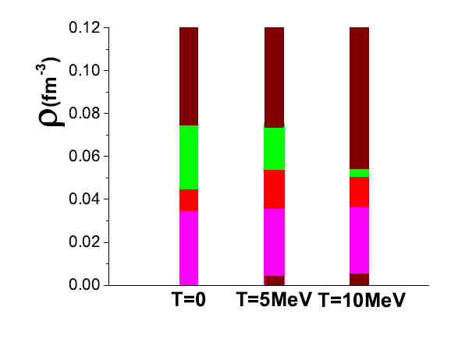
I- DFT for neutron star matter
HF(B) or (E)TF in the WS cell
Extended to finite temperature
Many applications: crust composition, pasta, cooling….
M.Fortin et al., PRC 82 (2010), 065804
S.S.Avancini et al., PRC 79 (2009),035804
homogeneous
slabs
rods
,
R.Wolf et al, PRL 110, 041101 (2013)
droplets
Notes:
Constanca: calculation with TF and NL3
Horpwitz: yp=0.2

Slide 10
II- NSE for supernova matter
R.I.Epstein W.D.Arnett APJ 201 (1975) 202
Non-interacting ideal-gas of nuclei + (interacting) nucleon gas
A. R. Raduta and F. Gulminelli, Phys. Rev. C 82, 065801 (2010) A. S. Botvina and I. N. Mishustin, Nucl. Phys. A 843, 98 (2010)
M. Hempel and J. Schaffner-Bielich, Nucl. Phys.A 837, 210 (2010) S. Furusawa, K. Sumiyoshi, S. Yamada, and H. Suzuki, A&A 772, 95 (2013)
No WS cell: energy (and entropy) calculated in the $V→∞$space
No nucleus-gas interactions
Excluded volume
No match with microscopic calculations in the WS cell

Slide 11
Finite temperature stellar matter Cluster distribution + consistency with DFT&correct T=0 limit
Elementary WS cell at T>0: volume associated to each (dressed) cluster
mapping microscopic WS cell <=> cluster+gas
distribution of WS cells

Slide 12
A WS cell with cluster DoF
Ingredients: E₀(A,I) your favorite mass table
ε(ρ_{n},ρ_{p}) your favorite energy functional
in-medium binding energy shift : $δE=δE_{bulk}\text{+ }δE_{surf}$
$V_{WS}ε_{tot}=E_{0}\left(A,I\right)+V_{WS}ε\left(ρ_{g},y_{g}\right)+δE$
$$δE=\int_{V_{WS}}{d^{3}r ε_{ETF}\left(ρ_{n}(r),ρ_{p}(r)\right)}−E_{0}{−V}_{WS}ε\left(ρ_{g},y_{g}\right)$$
Sly4 Skyrme functional
A.Raduta et al, EPJA 2014 ; F.Aymard et al, PRC 2014

Slide 13
Cluster DoF: T=0
G.Baym et al NPA 175 (1971)225
T=0: a variational problem for each $\left(ρ_{B},ρ_{I}\right)$
$d\left(ε_{tot}\left( A,I,ρ_{g},y_{g}\right)−μ\left(\frac{A_{WS}}{V_{WS}}−ρ_{B}\right)−μ_{I}\left(\frac{I_{WS}}{V_{WS}}−ρ_{I}\right)\right)=0$ => ${A,I,ρ}_{g},y_{g}$,$V_{WS}$
$\frac{∂E_{m}}{∂A}=$ $μ_{g}\left(1−\frac{ρ_{g}}{ρ_{0}}\right)−$ $μ_{Ig}\left(δ−\frac{ρ_{Ig}}{ρ_{0}}\right)$
$$\frac{1}{A}\frac{∂E_{m}}{∂δ}={μ_{Ig}+\frac{1}{{ρ_{0}^{}}_{}^{2}}\frac{∂ρ_{0}}{∂δ}\left(μ_{g}ρ_{g}+μ_{Ig}ρ_{Ig}\right)}_{}$$
$$A\frac{∂E/A}{∂A}=\frac{δE}{V_{WS}}$$
$$μ_{g}=\frac{∂ε_{}}{∂ρ_{g}}$$
$$μ_{Ig}=\frac{∂ε_{}}{∂ρ_{Ig}}$$
$$δ=\frac{\left(ρ_{0n}−ρ_{0p}\right)}{ρ_{0}}$$
$$E_{m}=E+δE$$

Slide 14
Cluster DoF: T=0
NV: HF in the WS cell (Negele&Vautherin)
BPS+BBP: LDM (Baym et al.)
Sly4
SKM*
This work with different Skyrme
Melting of nuclei in the dense medium
(Small) effect of the effective interaction
Shell effects important even after drip
Surprising model dependence even in the outer crust
F.Gulminelli, A.Raduta, ArXiV:1504.04493

Slide 15
The importance of mass measurements
FRDM: up to date LDM (Moller&Nix)
BPS: LDM Myers-Swiatecki (Baym et al.)
Sly4
SKM*
This work with exp data when
available
Many quasi-degenerate minima!
F.Gulminelli, A.Raduta, ArXiV:1504.04493

Slide 16
T>0: the SNA limit
Free energy density in the (ρ_{p,}y_{p}) WS cell:
$$f_{tot}=\frac{E_{0}}{V_{WS}}+f_{gaz}−\frac{T}{V_{WS}}ln\left({V_{WS}A}^{3/2}\right)−\frac{T}{V_{WS}}lnρ\left(E^{∗}\right)+δf$$
Single Nucleus Approximation: (A,I,ρ_{g,}y_{g}) such that f_{tot} =min
It is the standard strategy for supernova simulations (Lattimer-Swesty EoS, Shen EoS)
SNA converges (by construction) to the T=0 limit => consistence with DFT insured
Still, it is a very poor treatment of the finite temperature problem.

Slide 17
WS free energy surface
$$ρ_{B}={10}^{−3}{fm}^{−3}, Y_{p}=0.39$$
T=0.5 MeV
T=2.4 MeV
The absolute minimum is not representative of the free energy landscape
F.Gulminelli, A.Raduta, ArXiV:1504.04493

Slide 18
Specificity of T>0
Finite T is more than {δE=0}=>{δF=0}
Finite T implies a distribution of microstates
A distribution of « dressed » clusters i.e. WS cells (e-cluster+continuum states+interactions)
$−\sum_{k}{p_{k}lnp_{k}−β\left(E_{tot}−{\left\langle \hat{H}\right\rangle }_{V}\right)+βμ\left(A_{tot}−{\left\langle \hat{N}\right\rangle }_{V}\right)+βμ_{I}\left(I_{tot}−{\left\langle \hat{I}\right\rangle }_{V}\right)}$ =max
$${\overline{p}}_{k}=\frac{1}{Z_{β}}{{(z}_{gaz})}^{V}\prod_{A,I}{\frac{1}{n_{AI}^{(k)}!}exp−βn_{AI}^{\left(k\right)}F_{m}(A,I)}$$
$$k=\left\{n_{i}^{(k)},A_{i},I_{i} i=1,…,N_{k};N_{free}^{\left(k\right)}Z_{free}^{(k)}\right\}$$
Free energy
of the
in-medium
cluster
Free particles
Cluster distribution

Slide 19
NSE versus SNA
The Single Nucleus Approximation is valid as long as average values are concerned
Still, deviations increase with density and temperature
β−equilibrium
$$ρ_{B}$$
F.Gulminelli, A.Raduta, ArXiV:1504.04493

Slide 20
Results: average quantities

Slide 21
Results at beta equilibrium

Slide 22
The role of light resonances

Slide 23
Dependence on the energy functional
T=1 MeV
A.Raduta, F.Aymard, F.G. ArXiv 1307.0242

Slide 24
Dependence on the energy functional
A.Raduta, F.Aymard, F.G. ArXiv 1307.0242

Slide 25
The importance of the cluster distribution

Slide 26
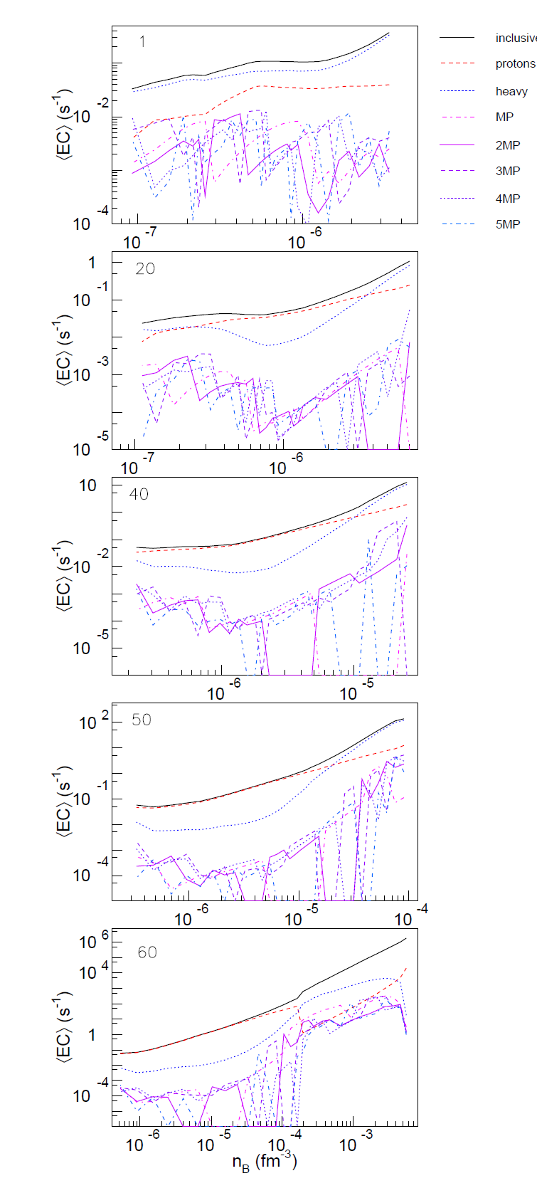
Application I: electron capture rates
Core collapse 25 Mo - CoConuT
Notes:
Stellar processes influenced by electron capture rate
onset of the collapse of O+Ne+Mg core of 8-10 Msun stars ,
growth of the mass of the iron core of M >10Msun,
size of the bouncing core of the supernova explosion through the trapped lepton fraction,
Nucleosynthesis and energy generation in X-ray bursts and other rp-process sites

Slide 27
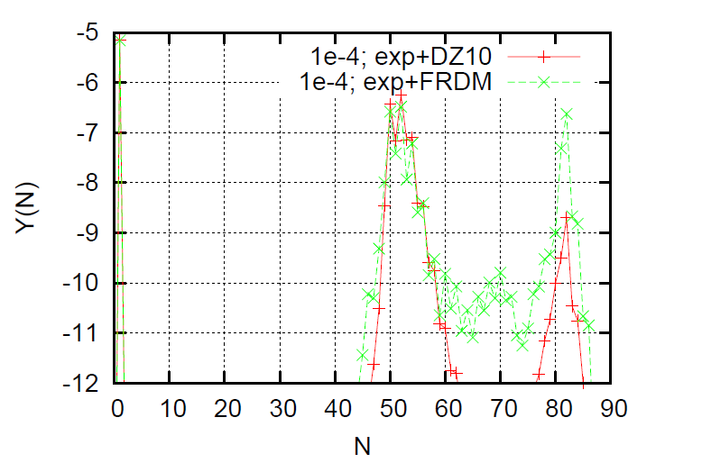
Application II: matter composition and magic numbers
22<Z<28
38<Z<44
26<Z<30
38<Z<42
Central element of 25 Mo CCSN
T~2-3 MeV
PNS deep outer crust
T~0.5 MeV
A. Juodagalvis, et al Nucl. Phys. A848, 454 (2010).

Slide 28
Application III: cooling properties
Inner crust at ρ_{Β}=9.10⁻³ fm⁻³
Pairing gap from BHF
NSE
SNA
Dissolution of clusters
into light resonances
Superfluid –normal
fluid transition
Cluster distribution at different
temperatures
Heat capacity

Slide 29
Conclusions
Unified theoretical modelling of T=0 (NS) and T>0 (SN) matter
T=0: a single WS cell variationally determined
T>0: a statistical distribution of WS cells=dressed clusters
Exp. Information when available for a better predictive power
Energy functional (Skyrme, RMF) otherwise
Still to do:
Full ETF+shell effects for the cluster functional
Consistent pairing in free neutrons,protons and nuclei
pasta@T>0
Different applications:
Weak processes in CC dynamics
Configuration transition in PNS and supernova matter
PNS cooling
Effect of the effective interactions
……….

Slide 31
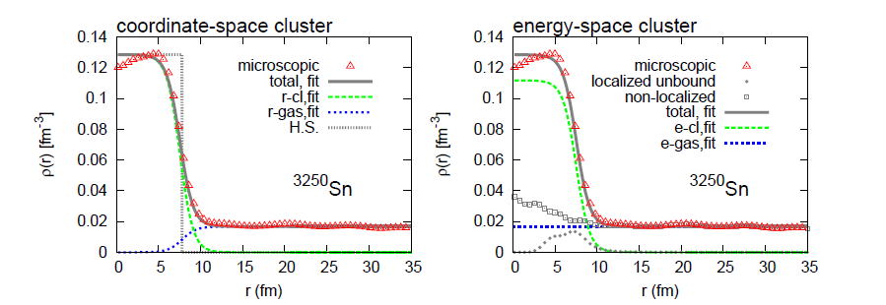
Clusters in a medium: particles in the continuum
P. Papakonstantinou, et al. Phys.Rev.C 88(2013) 045805
A density fluctuation?
An ensemble of bound states?
LS, Shen, Hempel, Sumiyoshi, Mishustin, Raduta&FG…
Some micro calculations (Typel) but no ready-to-use EoS
c
Total HF density
c
Total HF density
Cluster
Cluster
Free nucleons
Free nucleons
3078n +
172
3078n +
172
electrons
electrons
r-cluster
e-cluster

Slide 32
Clusters in a medium: particles in the continuum
P. Papakonstantinou, et al. Phys.Rev.C 88(2013) 045805
A density fluctuation?
An ensemble of bound states?
LS, Shen, Hempel, Sumiyoshi, Mishustin, Raduta&FG …
Some micro calculations (Typel) but no ready-to-use EoS
The two descriptions correspond to the same density profile
They can be mapped to produce the same energy iff the excluded
volume is properly accounted for
c
Total HF density
c
Total HF density
Cluster
Cluster
Free nucleons
Free nucleons
3078n +
172
3078n +
172
electrons
electrons
r-cluster
e-cluster

Slide 33
Clusters in a medium: particles in the continuum
A density fluctuation?
An ensemble of bound states?
r-cluster
e-cluster
c
c
Mean field potential
Mean field potential
nucleons states
3078n +
172
3078n +
172
cluster states
c
Total HF density
c
Total HF density
Cluster
Cluster
Free nucleons
Free nucleons
3078n +
172
3078n +
172
electrons
electrons

Slide 34
Clusters in a medium: particles in the continuum
A density fluctuation?
An ensemble of bound states?
The two descriptions do not lead to the same thermal weight
for the clusters.
Only the e-cluster picture converges
to the DFT T=0 limit beyond the drip (inner crust).
$ω_{A}=\left(V−V_{0}\right)\int_{0}^{∞}{dE{ρ_{A}}_{}^{vac}(E)e^{−βE}}$ $ω_{A}=V\int_{0}^{S_{n}}{dE{ρ_{A}}_{}^{vac}{(E)e}^{−βE}}$
c
c
Mean field potential
Mean field potential
nucleons states
3078n +
172
3078n +
172
cluster states
r-cluster
e-cluster

Slide 35
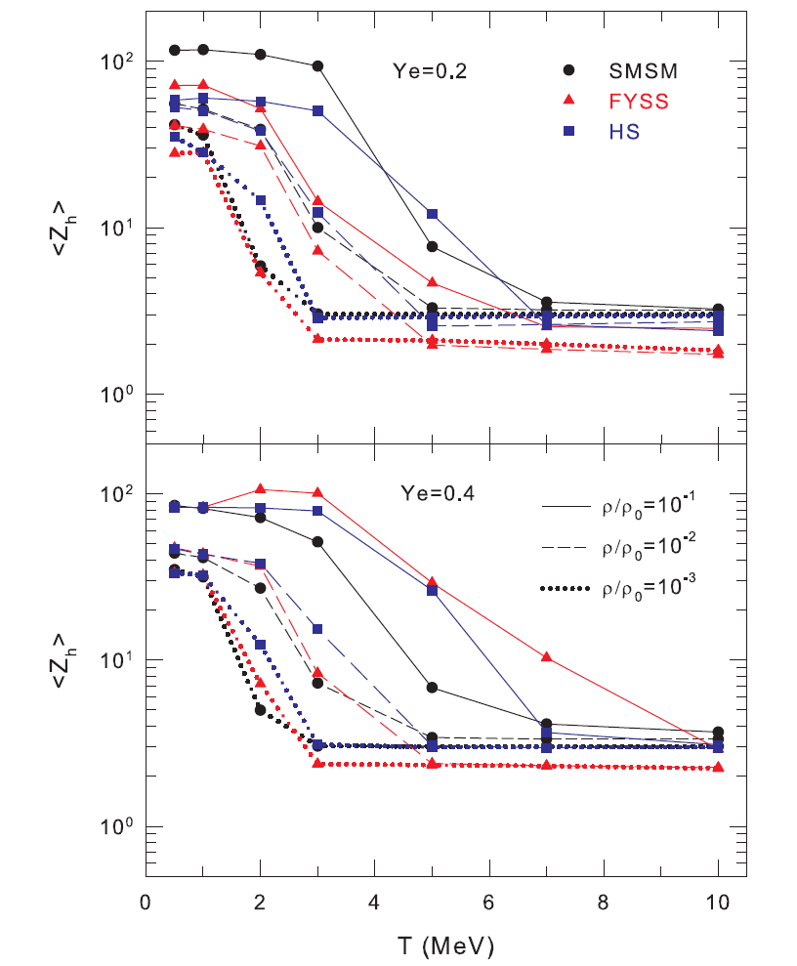
II- NSE for supernova matter
Non-interacting ideal-gas of nuclei + free nucleons
A. R. Raduta and F. Gulminelli, Phys. Rev. C 82, 065801 (2010)
M. Hempel and J. Schaffner-Bielich, Nucl. Phys.A 837, 210 (2010)
A. S. Botvina and I. N. Mishustin, Nucl. Phys. A 843, 98 (2010)
S. Furusawa, K. Sumiyoshi, S. Yamada, and H. Suzuki, A&A 772, 95 (2013)
Different prescriptions for the excited states
Different prescriptions for the GS energies
Huge differences even in mean values!
No WS cell: energy (and entropy) calculated in the $V→∞$space
No nucleus-gas interactions
Excluded volume
The definition of clusters from a DFT model is not trivial: No match with microscopic calculations in the WS cell
N.Buyukcizmeci et al, NPA 907 (2013) 13

