Slide 1
C++ AMP
Alexandru Voicu, Ph.D.
Software Engineer
Visual C++ Libraries

Slide 2
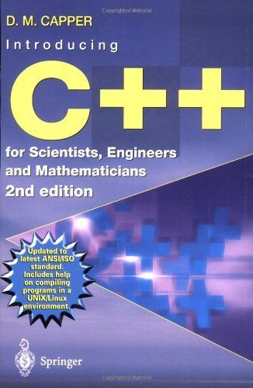
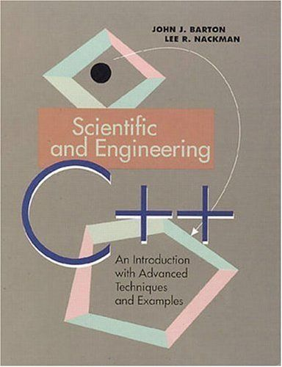
Inspiration
THIS
!THIS
Notes:
2

Slide 3
Goals
Describe the fundamental abstractions lying at the core of the C++ AMP programming model;
Introduce the core elements of the C++ AMP programming model:
The array_view Abstract Data Type (ADT);
The accelerator ADT;
The simple, implicitly partitioned execution model;
The tiled, explicitly partitioned execution model;
Discuss inter-operation with graphics APIs (e.g. DirectX).
Notes:
3

Slide 4
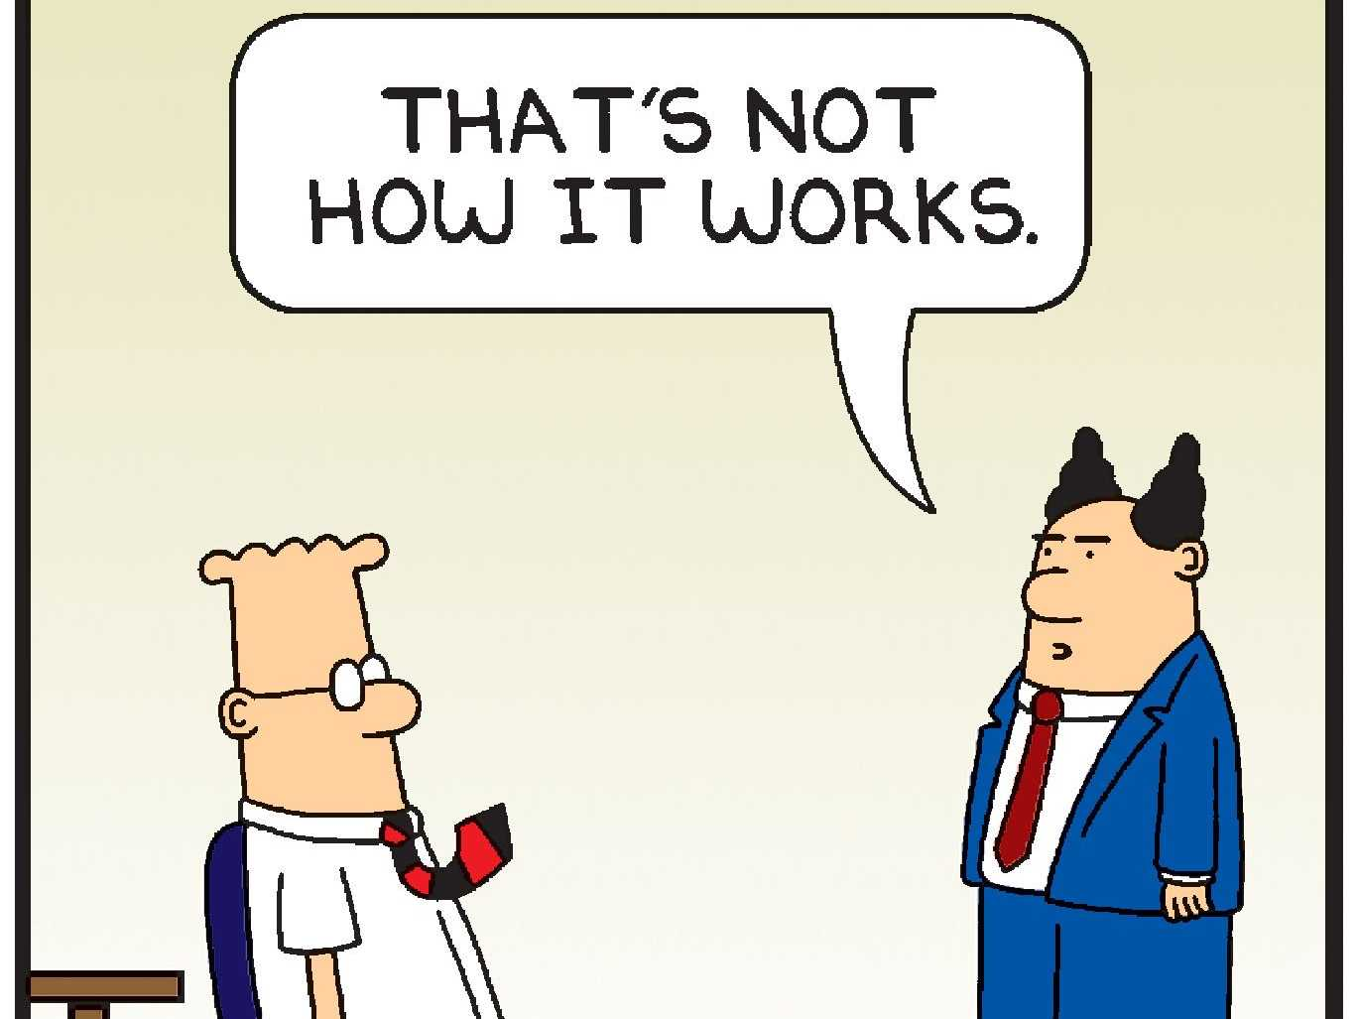
C++ AMP FUNDAMENTALS

Slide 5
C++ AMP at a glance?
accelerator
accelerator_view
index<...>
tiled_index<...>
extent<...>
tiled_extent<...>
array<...>
array_view<...>
parallel_for_each<...>(…)
restrict(...)
tile_static
barrier

Slide 6
C++ AMP at a glance
It is JUST C++, not C or pseudo-C, not intrinsics, not a heavy handed extension:
C++ code is written inline;
No mysterious invocations of unutterable functions;
Seamless data-movement (when using array_views);
Unique parallel_for_each entry-point (library function, not “magical”).

Slide 7
The abstract machine model
We program processors:
With a variable number of cores;
Capable of executing SIMD threads;
Which follow the Von Neumann paradigm.
Everything else is business as usual:
The interaction with memory matters for performance– locality, regularity etc.
“It’s all about algorithms and data-structures!” Alexander Stepanov
This is necessary and sufficient understanding for efficiently programming {C, G, A, *}PUs!

Slide 8
C++ AMP – first steps
Answering three key questions:
“What to do?” -> the parallel_for_each function;
“Where to do it?” -> the accelerator ADT;
“With what data?” -> the array_view ADT.

Slide 9
What to do (I)
The parallel_for_each function logically:
Describes a computation:
To be performed by an accelerator;
Across some N-dimensional execution domain;
Which can be performed in SIMD fashion;
That meets a set of constraints (restrict);
Juxtaposes the “where” (accelerator) and the “with what” (data, preferably wrapped in an array_view).

Slide 10
What to do (II)
The parallel_for_each function practically:
Receives an N-dimensional execution domain in the form of an extent<N> object of size K, which yields P SIMD threads of width W will be spawned, where $K==P×W$;
Receives a functional object (functor, lambda function) which takes as its unique parameter an index<N> object and is decorated with restrict(amp) -> the body describes the computation to be performed by each of the $P×W==K$ SIMD lanes;
Favours using a lambda function – the data that is used during computation can only be marshalled in indirectly, not via parameter passing, and lambda capture makes this cleaner.

Slide 11
What to do (III)
The tiled parallel_for_each overload practically:
Receives an explicitly partitioned N-dimensional execution domain, in the form of a tiled_extent<D₀, …, D_{N-1}> object of size K, which yields P SIMD threads of width $W=\prod_{i=0}^{N−1}{D_{i}}, K==P×W$;
Receives a functional object whose operator() takes as its unique argument a tiled_index<D₀, …, D_{N-1}> object and is decorated with restrict(amp) -> the body describes the computation to be performed by each of the K SIMD lanes, including cooperative work;
The tiled_index<D₀, …, D_{N-1}> object is a proxy for a SIMD thread;
The partitioning is under user control, and does not have to be an orthographic projection from lane to datum i.e. one lane can process multiple data.

Slide 13
Where (I)
The accelerator ADT logically:
Acts as an abstraction for a computation capable resource, which can be a CPU or a GPU (today), might be an FPGA, DSP or some other physical accelerator (tomorrow);
Alongside array_view, makes heterogeneous, locality aware computing possible:
HETEROGENEOUS -> the abstract model maps to different types of processors;
LOCALITY AWARE -> accelerator has unique identity and location in a system’s topology, and can “own” resources e.g. a set of datum.

Slide 14
Where (II)
The accelerator ADT practically:
Exposes a mechanism for enumerating all computation capable resources available in a system (accelerator::get_all());
Enables the introspection of hardware properties through its member functions;
Creates accelerator_views that are used to associate computation or data with a particular accelerator.
The runtime provides reasonable defaults, so you can frequently blissfully ignore the above!

Slide 16
What data (I)
The array_view ADT logically:
Represents an N-dimensional space which:
Resides either on the host’s or an accelerator’s memory space;
Can be accessed and “understood” by accelerators.
Alongside accelerator, makes SEAMLESS heterogeneous, locality-aware, computing possible and ACCESSIBLE:
SEAMLESS – the programmer does not have to worry about shuffling data;
ACCESSIBLE – the programmer does not have to get into low-level data movement and locality details for writing efficient programs.

Slide 17
What data (II)
The array_view ADT practically:
Wraps a set of datum (e.g. an int, a std::vector, built-in array etc.):
Makes it trivial to view flat data as an N-dimensional space – a matrix is a matrix and behaves like one, not std::vector<std::vector<T>> or T[m][n];
Allows the programmer to focus on the algorithm – synchronization between host - accelerator and accelerator – accelerator is implicit;
Future-proofs code by rapport with the extension towards other accelerators – let the implementation do the work of getting data into the cloud!
Unless absolutely necessary, try to write against the array_view abstraction!

Slide 19
Clarification – restrict(amp) (I)
Compile-time safety net – check if your elemental function can be compiled for accelerators;
The restrictions are there mostly due to historical reasons and a slant towards “nanny”-ism by rapport with the developer;
For a comprehensive list see section 2 in the open specification: http://download.microsoft.com/download/2/2/9/22972859-15C2-4D96-97AE-93344241D56C/CppAMPOpenSpecificationV12.pdf

Slide 20
Clarification – restrict(amp) (II)
In hindsight, restrict(amp), as implemented, was probably an uninspired design choice:
composing functions becomes tricky, there is a ripple effect;
reusing perfectly valid existing code is non-trivial (e.g. std::min);
adds cognitive overhead and can be confusing – C++ does not really need more keywords, especially special ones!
AMD and Multicoreware did a great job with the C++ AMP programming model:
implemented it for Linux and OS X (on top of Clang / LLVM);
“eviscerated” most of the restrictions (and ultimately restrict itself);
https://bitbucket.org/multicoreware/cppamp-driver-ng/wiki/Home

Slide 21
Code!

Slide 22
Example I – Vector Valued Functions
Let $F:D→C$ be a vector valued function, for example:
Addition: $F\left(X\right)=\left(x_{0}+k, x_{1}+k, …,x_{N−1}+k\right), k∈ℝ, X∈ℝ^{N}$
2nd degree polynomial: $F\left(X\right)=\left({αx}_{0}^{2}+βx_{0}+γ, …\right), α,β,γ∈ℝ, X∈ℝ^{N}$
Logit: $F\left(X\right)=\left(\log{\frac{x_{0}}{1−x_{0}}},\log{\frac{x_{1}}{1−x_{1}}}, …,\log{\frac{x_{N−1}}{1−x_{N−1}}}\right), X∈ℝ^{N}$
Logistic: $F\left(X\right)=\left(\frac{1}{1+e^{−x_{0}}},\frac{1}{1+e^{−x_{1}}}, …,\frac{1}{1+e^{−x_{N−1}}}\right), X∈ℝ^{N}$
How do we efficiently express the above in modern C++?

Slide 23
Vector Valued Function in C++
template<typename T, typename Op>
void vector_transform(vector<T>& X, Op F)
{
transform(begin(X), end(X), begin(X), F);
}

Slide 24
Vector Valued Function in C++ AMP
template<typename T, typename Op>
void vector_transform(vector<T>& X, Op F)
{
array_view<T> X_acc(X);
const auto lanes = X.extent;
parallel_for_each(lanes, [=](index<1> lane) restrict(amp) {
X_acc[lane] = F(X_acc[lane]);
});
}

Slide 25
Code example II – rotate
Let $X=(x_{0}, x_{1},…,x_{N−1})$ be an N-dimensional vector, $r∈ℕ∖\left[N, ∞\right)$ an integral quantity and rotate a vector valued function that rotates $X$ left by $r$ positions:
$$\text{rotate}\left(X, r\right)=\left(x_{r}, x_{r+1},…,x_{N−1},x_{0},x_{1},…,x_{r−1}\right)$$
Fundamental algorithm, very important – if in doubt, ask Sean Parent! (https://www.youtube.com/watch?v=IzNtM038JuI).
Beautifully (and compactly) described in 2.2 from Jon Bentley’s Programming Pearls.
Let’s use the triple reversal algorithm (ancient lore even in the ‘70s, elegant and fast):
$$\text{rotate}\left(X, r\right)=\text{reverse}\left(X[0:r−1]\right)≺\text{reverse}\left(X\left[r:N−1\right]\right)≺\text{reverse}\left(X\right)$$
$$X\left[m:n\right]=\left(x_{m}, x_{m+1},…,x_{n−1},x_{n}\right)$$
$$\text{r}\text{e}\text{verse}\left(X\right)=(x_{N−1}, x_{N−2},…, x_{1}, x_{0})$$

Slide 26
rotate in C++ (NOT std::rotate)
template<typename I>
I rotate(I first, I new_first, I last)
{
if (first == new_first) return last;
if (new_first == last) return first;
reverse(first, new_first);
reverse(new_first, last);
reverse(first, last);
return first + distance(new_first, last);
}

Slide 27
rotate in C++ AMP
template<typename I>
I rotate(I first, I new_first, I last)
{
if (first == new_first) return last;
if (new_first == last) return first;
reverse(first, new_first);
reverse(new_first, last);
reverse(first, last);
return first + distance(new_first, last);
}

Slide 28
rotate reverse in C++ AMP
template<typename I>
void reverse(I first, I last)
{
if (distance(first, last) <= 1u) return;
const array_view<Value_type<I>> range(distance(first, last), &*first);
const auto lanes = range.extent / 2u;
parallel_for_each(lanes, [=](index<1> lane) restrict(amp) {
swap(range[lane], range[range.extent.size() - lane[0] - 1u]);
});
}

Slide 29
rotate reverse swap in C++ AMP
template<typename T>
inline void swap(T& x, T& y) restrict(amp)
{
T tmp(y);
y = x;
x = tmp;
}

Slide 30
Why (A)

Slide 31
What have we learned (A)
Data movement is frequently the elephant in the room:
Be aware of your workload’s arithmetic intensity, if you want to execute on a disjoint accelerator – make sure that you’re doing enough work per byte to amortise the cost of hauling it across into accelerator memory
Be aware of your data’s residence and locality – try to cut out movement, process the data where it resides (array_views take away this concern)
GPUs aren’t orders of magnitude faster (it is a nonsensical claim), however the presence of dedicated hardware or graphics specific features can yield super-linear speedups – e.g. transcendental functions or bilinear filtering are much faster

Slide 32
Why (B)

Slide 33
What have we learned (B)
What we had discovered at (A) with a bonus:
Revisiting algorithms in order to find solutions for accelerators can lead to interesting insights – Gries-Mills (this implementation of the standard library used the “Dolphin” for std::rotate), appears to have some glass jaws – theories?
Accelerators (in this case GPUs) can be useful in general, not only for arithmetic tasks – as long as we carefully analyse the workload and the greater context.

Slide 34
So how many pictures are 10⁹ bytes of data worth?

Slide 35
Visualisation is important – interoperability should be your friend
Having a large amount of data is merely the start of an analysis, not its end;
Visualising a dataset is almost a sine qua non requirement in various fields:
In spite of this, interoperability between GPU compute APIs (e.g. CUDA or OpenCL) and rendering APIs (e.g. DirectX, OpenGL) is a rather awkward / unwieldy proposition;
There are historical and practical reasons for this (e.g. different API infrastructure, undefined / implementation specific behaviour etc.);
This is one area where the tight coupling between C++ AMP and DirectX is beneficial (this does not apply to the AMD/MCW implementation).

Slide 36
Visualisation is important – with C++ AMP, interoperability is your friend
The shared infrastructure makes interop between C++ AMP and DirectX trivial:
Two functions to retrieve the accelerator (create_accelerator_view) and the data being operated on (make_array) from Direct3D 11+;
Two functions to pass the accelerator (get_device) and the data being operated on (get_buffer) to Direct3D 11+;
Beyond these mechanisms, if you know Direct3D, it's business as usual:
No performance loss versus using DirectCompute (but productivity is gained);
No reliance on IHV specific solutions (beyond the need for compliant Direct3D 11+ drivers).

Slide 37
Conway's game of life – putting it all together
Cellular automaton devised by British mathematician John Horton Conway in 1970:
Can be regarded as the catalyst for research into cellular automata;
Straightforward rules;
Classical case of an iterated, stencil based computation – excellent demonstration of the tiled parallel_for_each and usage of scratch-pad memory;
Visually interesting – an opportunity to demonstrate C++ AMP – DirectX interoperability with a meaningful example!

Slide 38
Conway's game of life – code
Separate demo

Slide 39
Preliminary conclusions
Writing heterogeneously accelerated parallel programs is not hard!
Still about algorithms and data structures (come tomorrow for more on this topic)!
Rely on the implementation for tedious work (accelerator choice, data shuffling)!
Act now, start programming these new, parallel, heterogeneous machines!
C++ AMP is available on Linux, Windows and OS X – why not give it a spin?

Slide 40
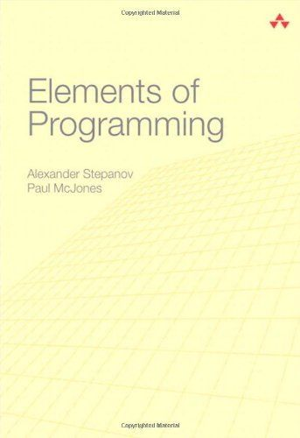
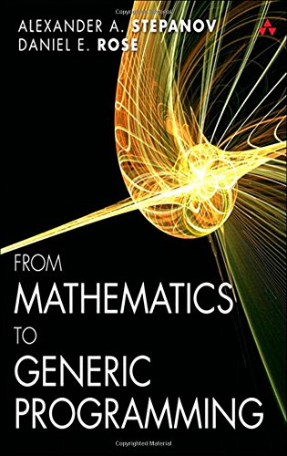
if (time) read({A, B});
Excellent book on programming
EXCELLENT BOOK ON PROGRAMMING

Slide 41
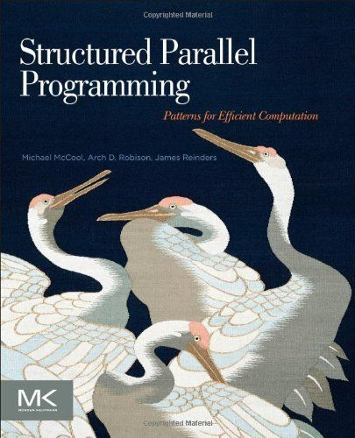
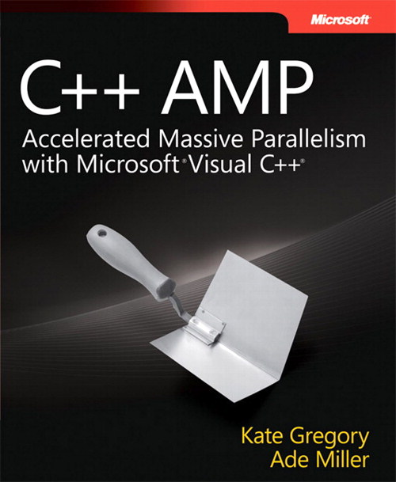
if (more_time) read({B, C});
GOOD book on PARALLEL programming
GOOD BOOK ON Parallel PROGRAMMING with C++ AMP

Slide 42
Useful links (I)
Multicoreware && AMD C++ AMP implementation (Linux!)
https://bitbucket.org/multicoreware/cppamp-driver-ng/overview
Microsoft C++ AMP Landing Page
https://msdn.microsoft.com/en-us/library/hh265137(v=vs.140).aspx

Slide 43
Useful links (II)
Algorithms library: http://ampalgorithms.codeplex.com/
pRNG library: http://amprng.codeplex.com/
FFT library: http://ampfft.codeplex.com/
BLAS library: http://ampblas.codeplex.com/
LAPACK library: http://amplapack.codeplex.com/

Slide 45
“Lasciate ogni speranza, voi ch’entrate!”

