Slide 1

Cross-matching the sky with database server cluster
László Dobos
Eötvös University
Dept. of Physics of Complex Systems

Slide 2
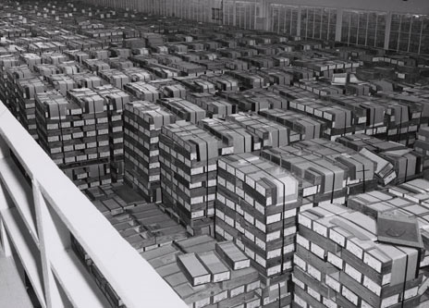
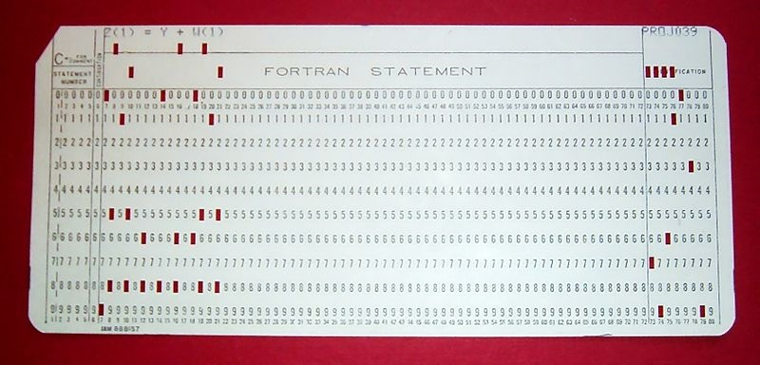
Data tsunami 1959
4GB of punched cards

Slide 3
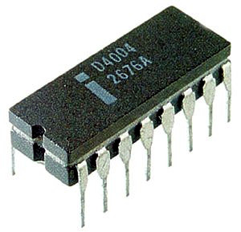
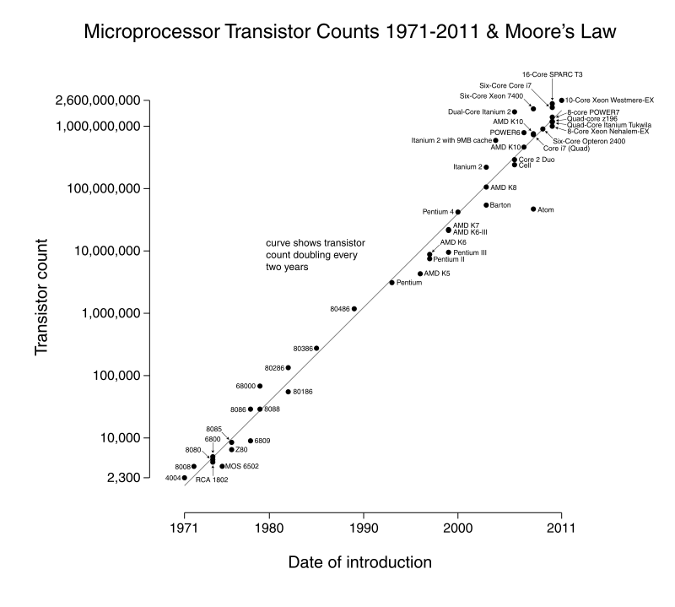


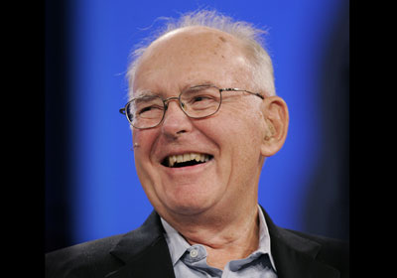
Driving force: Moore’s law

Slide 4
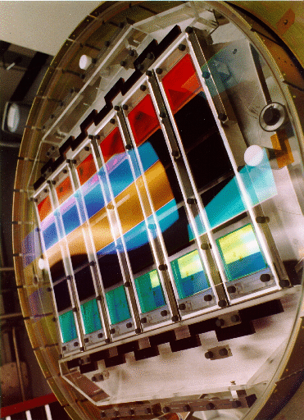


Exponential growth
Electronics
Detectors
Data size

Slide 5

Tractable algorithms
Data size ∝ e^{t}
Computing power ∝ e^{t}
Algorithms must be o(N)
o(N log N) at most!
A⁻¹

Slide 6
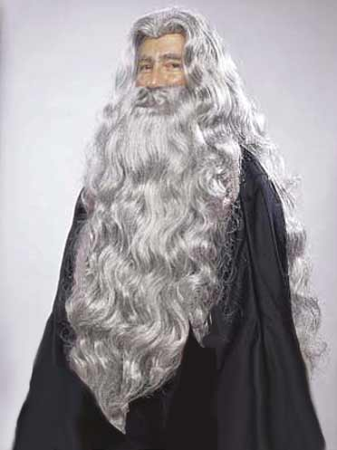
Reading a 1TB disk
Sequentially: 4.5 hours
Random access: 15-150 day

Slide 7
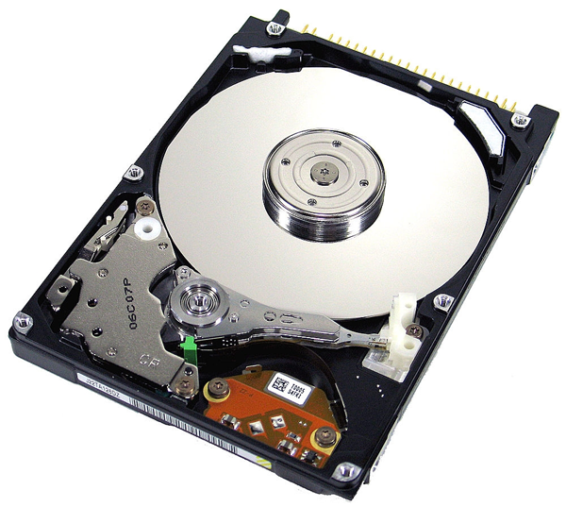
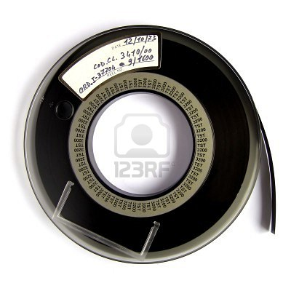
Main limitation: Disk = tape = 

Slide 8
Solution: parallelize

Slide 9
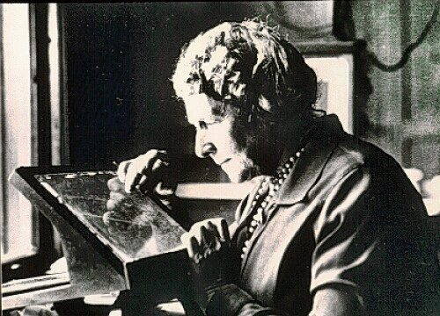


Slide 10
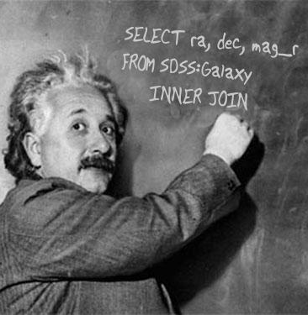
Relational databases
Optimized disk access
Declarative prog. Model
Ad hoc query support
User-defined functions
But: interpreted

Slide 11
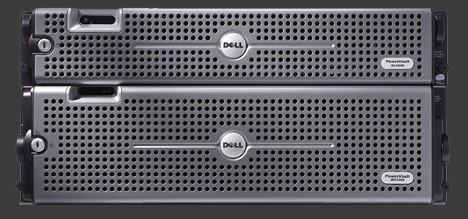

RDBMS: scale-up

Slide 12


RDBMS: scale-out

Slide 13

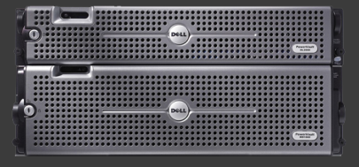
RDBMS: scale-out

Slide 14



Algorithms
scan
sort
join
random seek
N log N
only local!
(sorted in the same order)

Slide 15
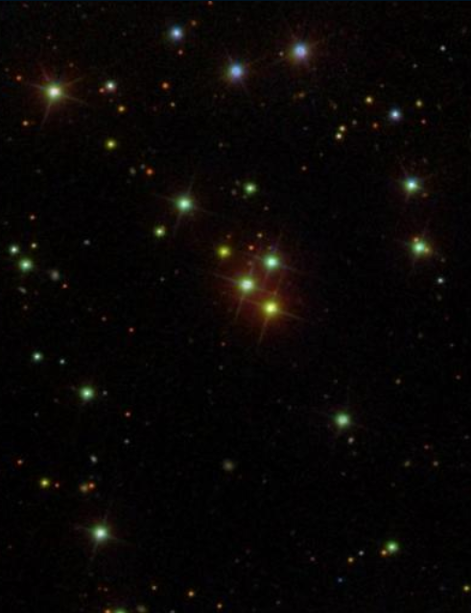
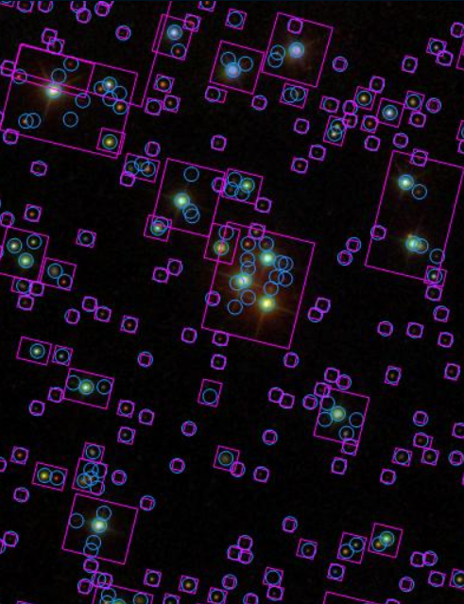
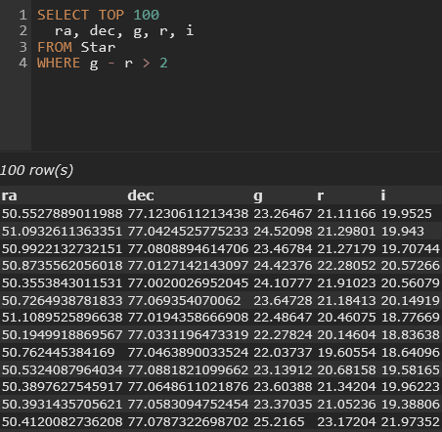
Sky surveys, catalogs

Slide 16
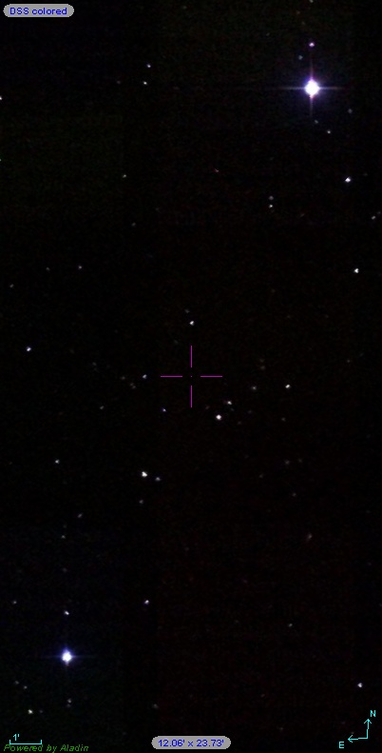
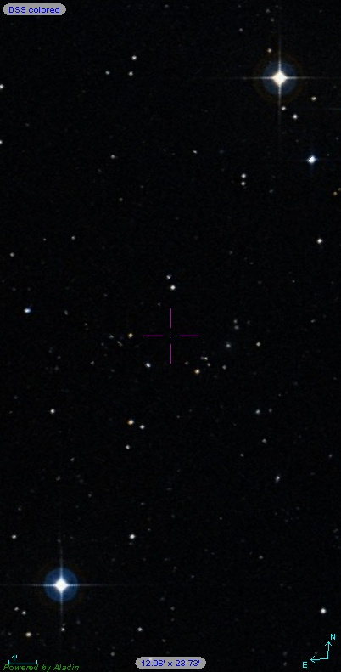
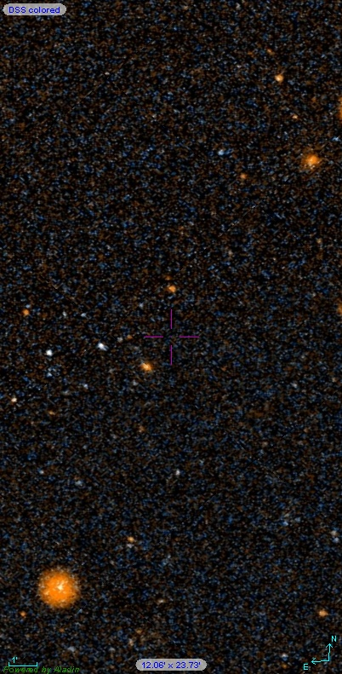
The multiwavelength sky
infrared (2MASS)
visible (DSS)
ultraviolet (Galex)

Slide 17
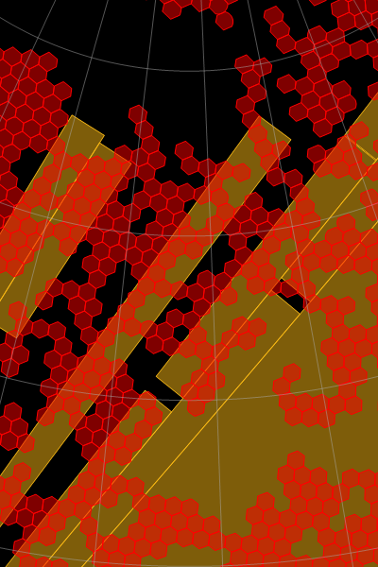
Crossmatching
Astronomical catalogs today
  in RDBMS
  o(100 million) objects
  o(1TB – 10TB) DB size
Match by coordinates
  RA, Dec
  Astrometric error
  Different sky coverage
  Different wavelength range
  Moving objects etc.

Slide 18
Sample XMatch query
SELECT s.objId, g.objID, t.objID,
s.ra, s.dec, g.ra, g.dec, t.ra, t.dec,
x.ra, x.dec
FROM SDSSDR7:Galaxies AS s
WITH (POINT(s.cx, s.cy, s.cz), ERROR(0.1))
CROSS JOIN Galex:Galaxies AS g
WITH (POINT(g.cx, g.cy, g.cz), ERROR(0.2))
CROSS JOIN TwoMASS:ExtendedSources AS t
WITH (POINT(t.ra, t.dec), ERROR(0.5))
XMATCH BAYESIAN AS x
MUST EXIST g, MAY EXIST t
HAVING LIMIT 1e3
REGION 'CIRCLE J2000 165.7 0.3 60'
Standard SQL
Probabilistic crossmatch
Spatial constraint

Slide 19
How to extend SQL
SQL is declarative
  everything can be executed that can be expressed
  extensions must be executable in any case
Query optimization is hard
Design language for easy optimization in mind
  constrain on the level of the grammar
  custom clauses instead of complex where clause logic

Slide 20
Scaling out: query partitioning
Zone algorithm to index sphere
Mirror everything
  go for speed, old catalogs are small
  be able to partition small queries by RA
  avoid „sweet spot” problems
Statistics gathered on the fly
  use sampled data with cardinality of ∛N
  apply WHERE clause and REGION

Slide 21
Zone algorithm
Find close matches in catalog B
of every object in catalog A
  Distance calculation is expensive
  Filter out distant objects using cheap algorithm
Stripe sphere by Dec into zones
  Stripe height slightly bigger than typical match radius
Divide stripes by RA into cells
Filter by cells first
  Calculate distances within cells only
  nN ≪ N², because n ≪ N

Slide 22
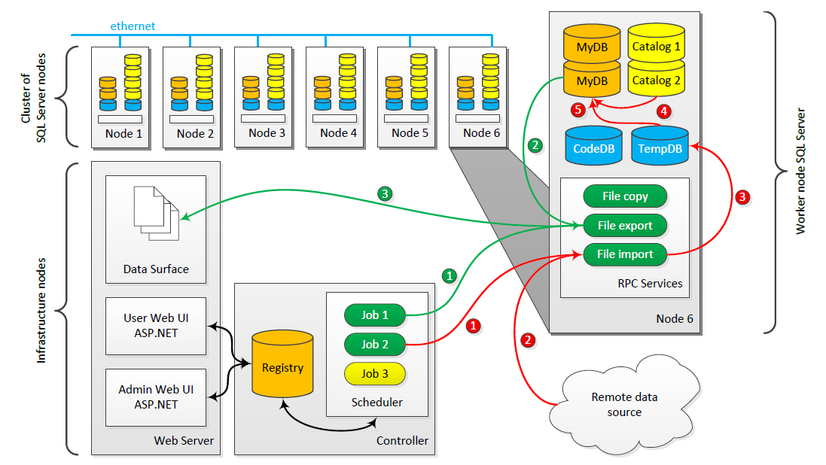
New generation SkyQuery

Slide 23
Graywulf software stack
Generic infrastructure based on MSSQL
Distributed queries for scientific data
Import, export, scheduling, web access
SQL parser and name resolver
Schema browser, extended meta-data

Slide 24
SkyQuery features (ongoing work)
Fetch data from remote sources
  Protocol plug-ins
  Pre-filtering using WHERE clause
  Works with MySQL, Postgres, no VO TAP yet
VO compliancy
  via plug-ins
  Keep system generic and domain independent
Region-based filtering
  Drop-out detection

Slide 25
SkyQuery (ongoing work)
Storage optimizations
  Access to data columns is not equally distributed
  Move less-accessed data to big but slow storage
  Lazy joins
Full SQL support
  Currently limited to single SELECT queries
  Add support for full T-SQL scripting

Slide 26
http://voservices.net/skyquery
dobos@complex.elte.hu
A projekt megvalósítása az OTKA-103244 projekt keretében történt.

