Slide 1
"Microsoft BIG DATA megoldások: adattömeg (hogyan), és social analitika témakörben (milyen)."
Dóczi Barnabás
BI, és SQL megoldás szakértő

Slide 2
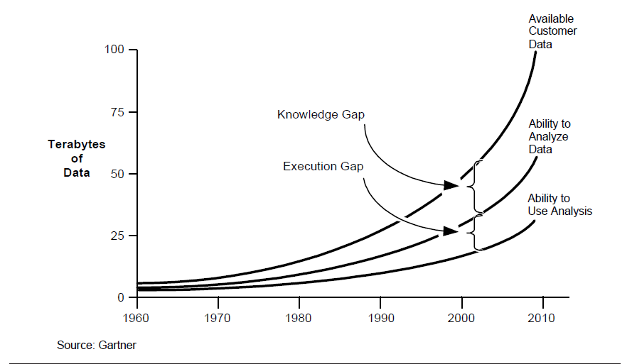
Notes:
Every year we get such statistics from various market research organization. Well, even if we believe fraction of that is true still it’s a big number .
So impact of data quality on general day to day profitability is well known and I don’t need to emphasize .
Lets look how much data quality matter for effective analytics.
1.
- Analytics requires both past and current data about many different things including customers, businesses, products, and the economy.
-All data is a representation of some reality. The more closely the data mirrors that reality, the more accurate the data is.
2.
Analytics is adopted as strategic initiative for most of the organization with a broad consequence.
Data quality issues in a transactional system may cause you too loose a single customer or deal. However same data quality issue once percolated to Analytical system on which strategic decision are made may wipe out a set of customers
Analytics with appropriate attention paid to data quality makes easier than ever for businesses to make accurate market and consumer predictions and thus smarter decisions for the growth of their company.
3.
Garbage in, Garbage out. This holds true for any computing system, but it impact on Analytics and decsion based on that have bigger and larger impact.
The above chart suggest that as the data volume grow our ability to analyze that data is limited to an extent. This knowledge & execution gap is related to multiple factors. It is bcoz of tools availability, skill gap and the business value. You can bridge this knowledge and execution gap by maintiaing proper Data quality .
Some of you may be wondering that we maintain our transaction system so well, how does data quality issues originates.

Slide 3
Today there is more data than ever before
50% global data growth
15 17 U.S. business sectors
4.3 average
out
of
55 GBs
of Market Data
Versus 5% IT spending growth
Have more data stored per company than the U.S. library of congress
Number of connected devices
per U.S. adult
Generated by NYSE every day
“Information volume is growing worldwide at a minimum rate of 59% annually with 15% of that data as structured data and the rest comprised of new complex data types all helping contribute to Big Data.” - Donald Feinberg, Gartner IT Symposium, October 2010

Slide 4
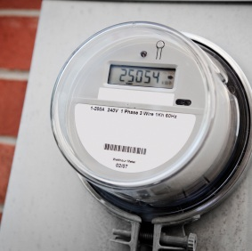
A New Set of Questions are Being Asked by Government Leaders
Transportation Optimization
Natural Event Preparedness
Improved Research
Logistics Planning
Pandemic Tracking
Environmental Sustainability
Social Network Awareness
Employment Analysis
Fraud Detection
Economic Forecasting

Slide 5
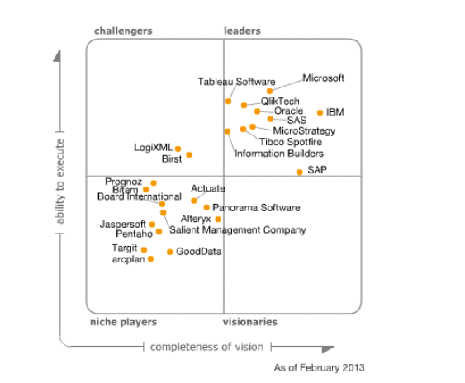
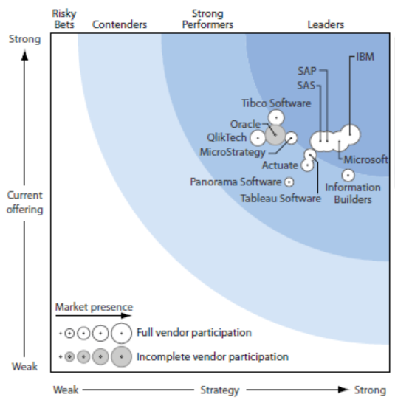
What Analysts are Saying
“The bundling and pricing of Microsoft’s BI products makes an economically attractive offering that will be considered by many organizations…Microsoft's large development community will further the platform”
“Microsoft has been positioned as a Leader “
“
-Gartner
“Microsoft Named a Self-Service Business Intelligence Leader”
“Microsoft has built on its broad, omnipresent, SQL Server-based BI functionality, which already includes Integration Services, Reporting Services, and Analysis Services…Think of this as Excel on steroids. If you are already using Excel (and who isn’t?) look no further for your self-service BI platform”
-Forrester

Slide 6
Infrastructure and Architecture

Slide 7
Adattömeg > folyamatok és megközelítés (hogyan)
50% global data growth
15 17 U.S. business sectors
4.3 average
out
of
55 GBs
of Market Data
Versus 5% IT spending growth
Have more data stored per company than the U.S. library of congress
Number of connected devices
per U.S. adult
Generated by NYSE every day
“Information volume is growing worldwide at a minimum rate of 59% annually with 15% of that data as structured data and the rest comprised of new complex data types all helping contribute to Big Data.” - Donald Feinberg, Gartner IT Symposium, October 2010

Slide 8
Teljesítményteszt – Relációs DWH
FORGALOM tábla forrás
2,5 Milliárd record
460GB forrás adatbázisban
Indexelt, partícionált
SQL Adattárház
93% importálva minimális adattisztítással
150 GB hópehely sémában
90 GB SQL Page Compression után
50 GB “univerzális” ColumnStore Index
Összesen kevesebb, mint 140GB
Notes:
Napi betöltés; 500Gb Oracle – nálunk 100Gb; mennyiből mennyi lett, erről beszélni, hogyan
A teszt célja: feldolgozás gyorsaságának demonstrálása kimutatások előállításával, bér jellegű kifizetésekről, nagyszámú forgalom tényadat alapján.
Egyéb, ad- hoc, valós időben számolt, - tipikusan kereszttáblás – lekérdezések:
A bemutató során lehetőség lesz a résztvevők kérése szerint lekérdezéseket összeállítani, az alábbiak tetszőleges kombinációival, mind szűrésekhez, mind bontásokhoz és összegzésekhez használhatóan (dimenziók):
Foglalkoztatás jellege
Munkajogi törvény
Bérkifizetés típusa
Finanszírozási forma
Feldolgozás ideje
Kereszttáblás lekérdezésekben alkalmazható mérőszámok: bér jellegű kifizetések összege, bér jellegű kifizetésekhez kapcsolódó jogviszonyok száma.
Lefúrás lehetséges napra és egyedi jogviszonyra, felgörgetés értelemszerűen, pl. feldolgozás ideje szerint nap, hónap, év.

Slide 9
Miért szükséges adattárház a KIRA-hoz? II.
Példa: „Mi lenne ha..” adatszolgáltatás
IDŐ, MUNKA
Jelenlegi munkafolyamat modell
Belső felhasználók
További pontosítás
Egyedi lekérdezések, segédtáblák,
újabb nézetek,
másolat
AMFORA
(SQL Server)
Halmozott adatok, dimenziók másolása
NGM

Slide 10
Miért szükséges adattárház a KIRA-hoz? II.
Példa: „Mi lenne ha..” adatszolgáltatás
Munkafolyamat modell adattárházzal
Belső felhasználók
IDŐ, MUNKA
Vezetői dashboardok
AMFORA
(SQL Server)
SQL Server Adattárház
PowerPivot,
PowerView
NGM,
Egyéb külső felhasználók

Slide 11
A New Set of Questions are Being Asked by Government Leaders
Transportation Optimization
Natural Event Preparedness
Improved Research
Logistics Planning
Pandemic Tracking
Environmental Sustainability
Social Network Awareness
Employment Analysis
Fraud Detection
Economic Forecasting

Slide 12
A New Set of Questions... (milyen)
Social Network Awareness

Slide 13
Mit értünk közösségi alatt?
Közösségi hálók
Blogok
Social Bookmarking , Geo Social, media megosztás
Ecommerce és márka közösségek
Nagyvállalati közösségi hálók
Notes:
Social Networks - An online network to help maintain existing relationships or help connect people based on shared interests
Blogs - A platform for users to create personal sites for posting of written, video or other content

Slide 14
Mi történik 60 másodperc alatt?
1090 látogató
2000 bejelentkezés
3500 új kapcsolat
7610 keresés
7630 felfedezés
175,000 tweet
700,000 elküldött üzenet
2 million megnézett videó
3125 feltöltött fotó
5

Slide 15
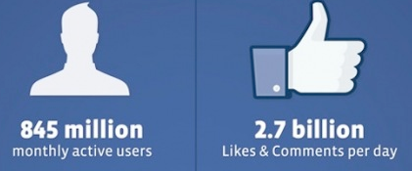
Mi jelenti a legfőbb problémát?
Túl sok adat
Ami rólunk szól
Ez az amivel teendőnk is van

Slide 16
Közösségi monitorozás
Figyelni
Reagálni
Megváltoztatni
Notes:
Social Networks - An online network to help maintain existing relationships or help connect people based on shared interests
Blogs - A platform for users to create personal sites for posting of written, video or other content

Slide 17
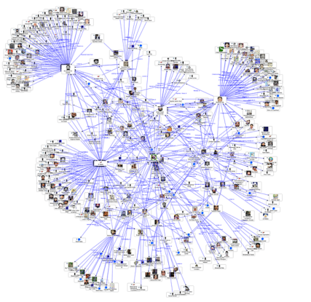
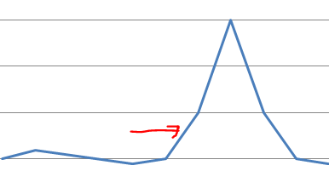
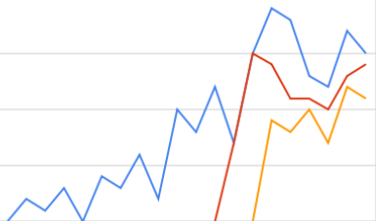
A tudás hatalom
Befolyásolók elérése
Tartalom elemzés
Azonosítás
Hangulat
Mik az aktuális trendek?
.Kérdések/válaszok
.Reklamációk
.Támogatási kérések
.Ajánlások
Termék értékelések
Javaslatok
.
Adatok összekapcsolása
Fordítások
Trendfigyelés
Demográfiai adatok
Termék adatok
Versenytársak
Adatok piactérről
Kereső adatok
Negatív PR esemény
Befolyásolók hatása
Következtetés
Földrajzi elhelyezkedés

Slide 18
Notes:
Every year we get such statistics from various market research organization. Well, even if we believe fraction of that is true still it’s a big number .
So impact of data quality on general day to day profitability is well known and I don’t need to emphasize .
Lets look how much data quality matter for effective analytics.
1.
- Analytics requires both past and current data about many different things including customers, businesses, products, and the economy.
-All data is a representation of some reality. The more closely the data mirrors that reality, the more accurate the data is.
2.
Analytics is adopted as strategic initiative for most of the organization with a broad consequence.
Data quality issues in a transactional system may cause you too loose a single customer or deal. However same data quality issue once percolated to Analytical system on which strategic decision are made may wipe out a set of customers
Analytics with appropriate attention paid to data quality makes easier than ever for businesses to make accurate market and consumer predictions and thus smarter decisions for the growth of their company.
3.
Garbage in, Garbage out. This holds true for any computing system, but it impact on Analytics and decsion based on that have bigger and larger impact.
The above chart suggest that as the data volume grow our ability to analyze that data is limited to an extent. This knowledge & execution gap is related to multiple factors. It is bcoz of tools availability, skill gap and the business value. You can bridge this knowledge and execution gap by maintiaing proper Data quality .
Some of you may be wondering that we maintain our transaction system so well, how does data quality issues originates.

Slide 19
© 2013 Microsoft Corporation. All rights reserved. Microsoft, Windows and other product names are or may be registered trademarks and/or trademarks in the U.S. and/or other countries.
The information herein is for informational purposes only and represents the current view of Microsoft Corporation as of the date of this presentation. Because Microsoft must respond to changing market conditions, it should not be interpreted to be a commitment on the part of Microsoft, and Microsoft cannot guarantee the accuracy of any information provided after the date of this presentation. MICROSOFT MAKES NO WARRANTIES, EXPRESS, IMPLIED OR STATUTORY, AS TO THE INFORMATION IN THIS PRESENTATION.

