Slide 1


Adat- és tudásfúziós módszerek fejlődésétől a sok adat indukálta adatelemzési tudásdarabkákig
BDD2013@Wigner – Big Data Day 2013
Antal Péter
Computational Biomedicine (Combine) workgroup
Department of Measurement and Information Systems,
Budapest University of Technology and Economics

Slide 2
Overview
The „common”/hétköznapi „big data”
Definition(s)
The biomedical „big data”
Biomedical „big data” trends and conclusions
Data and knowledge fusion
  From correlation to causation ➔ lessons for DBD
  Kernel methods ➔ lessons for DBD
  Semantic X ➔ lessons for DBD
Synergies of biomedical and common big data

Slide 3
The „Common”/”hétköznapi” big data
Financial transaction data, mobile phone data, user (click) data, e-mail data, internet search data, social network data, sensor networks, ambient assisted living, intelligent home, wearable electronics,...
Gadgets
Internet
Moore’s law
Factors:
“The line between the virtual world of computing and our physical, organic world is blurring.” E.Dumbill: Making sense of big data, Big Data, vol.1, no.1, 2013

Slide 4
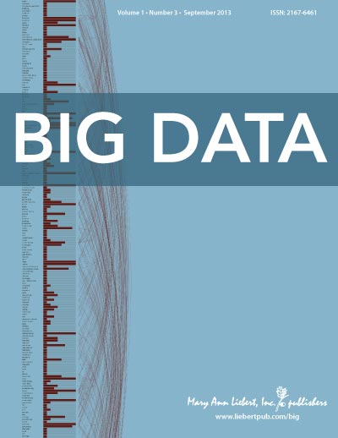
Definitions of „big data”
M. Cox and D. Ellsworth, “Managing Big Data for Scientific Visualization,” Proc. ACM Siggraph, ACM, 1997
The 3xV: volume, variety, and velocity (2001).
The 8xV: Vast, Volumes of Vigorously, Verified, Vexingly Variable Verbose yet Valuable Visualized high Velocity Data (2013)
Not „conventional” data: „Big data is data that exceeds the processing capacity of conventional database systems. The data is too big, moves too fast, or doesn’t fit the strictures of your database architectures. To gain value from this data, you must choose an alternative way to process it (E.Dumbill: Making sense of big data, Big Data, vol.1, no.1, 2013)

Slide 5
„Big data, big hype, big danger”??
„Data over algorithms”
‘‘correlations from more&messy data’’ vs. „ causation from small, clean data”
„Hype”
Application
„Boom”
Criticism, re-evaluation
Lack of results, problems,
Technology
trigger
Present?

Slide 6
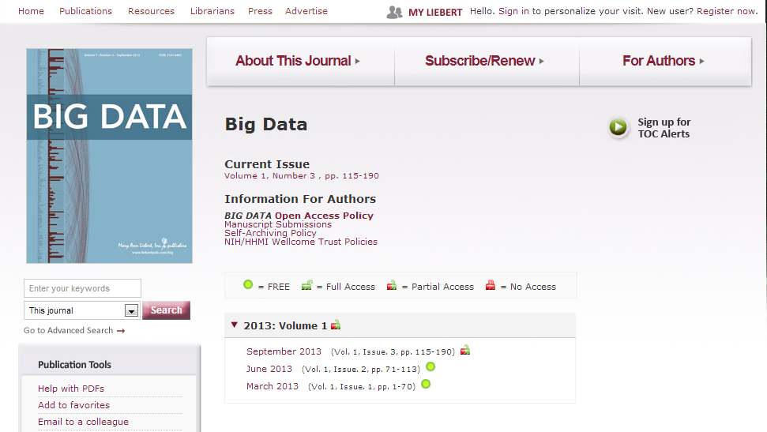
Definitions of „big data”, cont’d

Slide 7
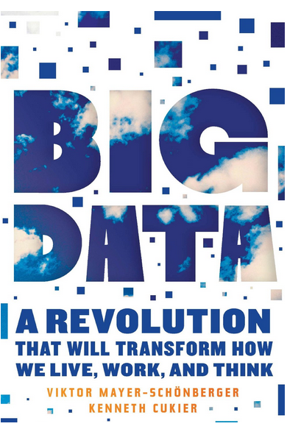
Definitions of „big data”, cont’d
.. [data] is often big in relation to the phenomenon that we are trying to record and understand. So, if we are only looking at 64,000 data points, but that represents the totality or the universe of observations. That is what qualifies as big data. You do not have to have a hypothesis in advance before you collect your data. You have collected all there is—all the data there is about a phenomenon.
OMIC DATA

Slide 8
Hierarchy of genetic data
Effect validation
Samples
Candidate gene assoc.
Partial genome screening (x100 SNP)
Genome-wide assoc, <2.5million SNPs, x1000 samples
Sequencing --- Genotyping
Exome sequencing (~30Mb, 1% data, 10% cost)
Full genome sequencing
Variables

Slide 9
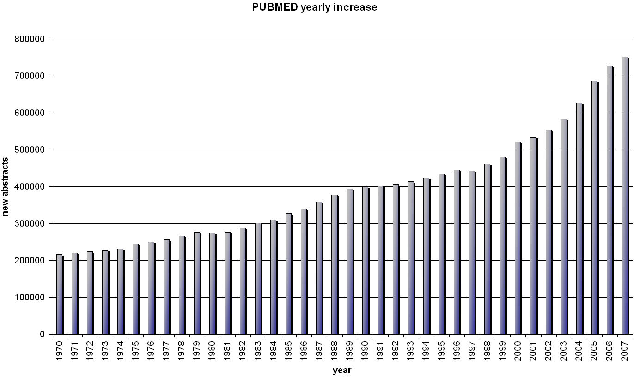
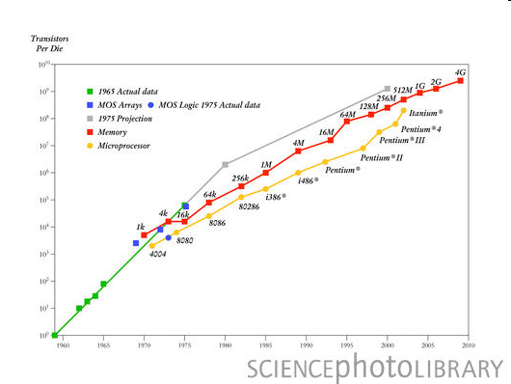
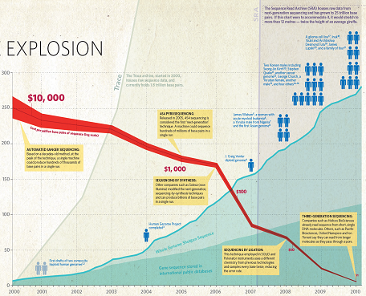
Biomedical omic data/big data
2010<: “Clinical phenotypic assay”/drugome: open clinical trials, adverse drug reaction DBs, adaptive licensing, Large/scale cohort studies (~100,000 samples)
Environment&life style
Phenome (disease, side effect)
Metabolome
Proteome
Transcriptome
Genome(s), epigenome, microbiome
Drugs
Moore’s law
Carlson’s law

Slide 10
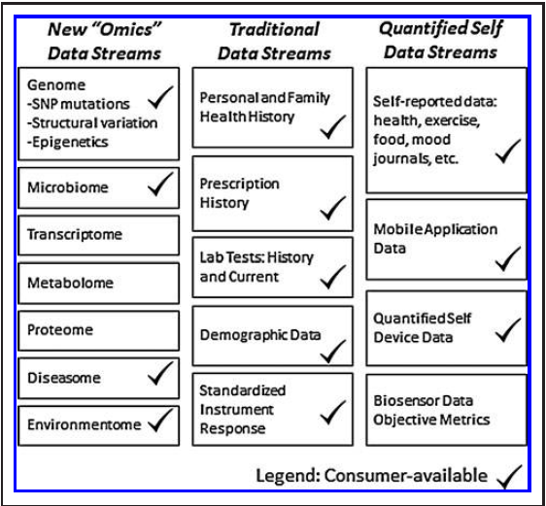
Big health data streams
M.Swan: THE QUANTIFIED SELF: Fundamental Disruption in Big Data Science and Biological Discovery, Big data, Vol 1., No. 2., 2013

Slide 11
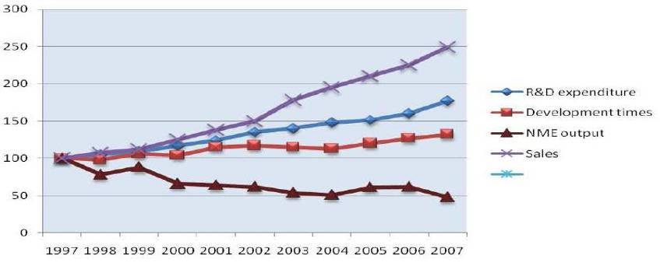
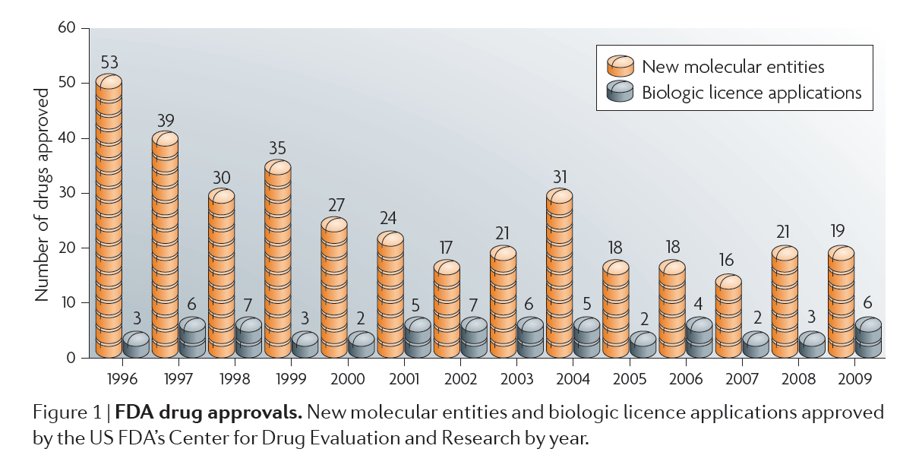
The pharma gap

Slide 12
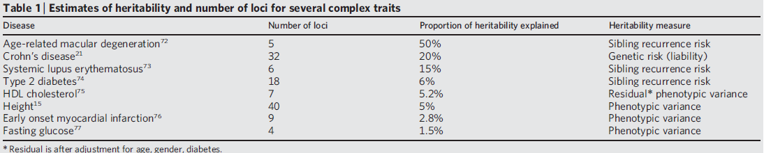
Missing heritability
Better outcome variable
  „Lost in diagnosis”: phenome
Better and more complete set of predictor variables
  „Right under everyone’s noses”: rare variants (RVs)
  „The great beyond”: Epigenetics, environment
Better statistical models
  „In the architecture”: structural variations
  „Out of sight”: many, small effects
  „In underground networks”: epistatic interactions
Causation (confounding)
Statistical significance („multiple testing problem”)
Complex models: interactions, epistatis
Interpretation

Slide 13
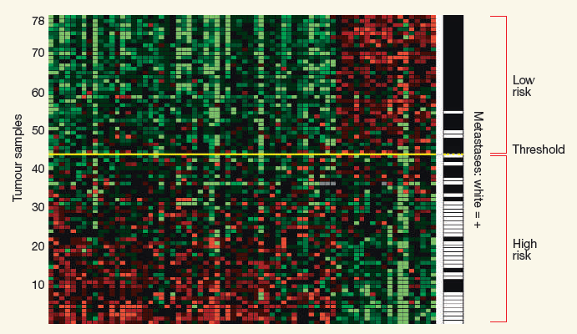
Robust tumormarkers?
Missing the mark, Nature, 2007
MISSING THE MARK: Why is it so hard to find a test to predict cancer?, Nature, 2011

Slide 14
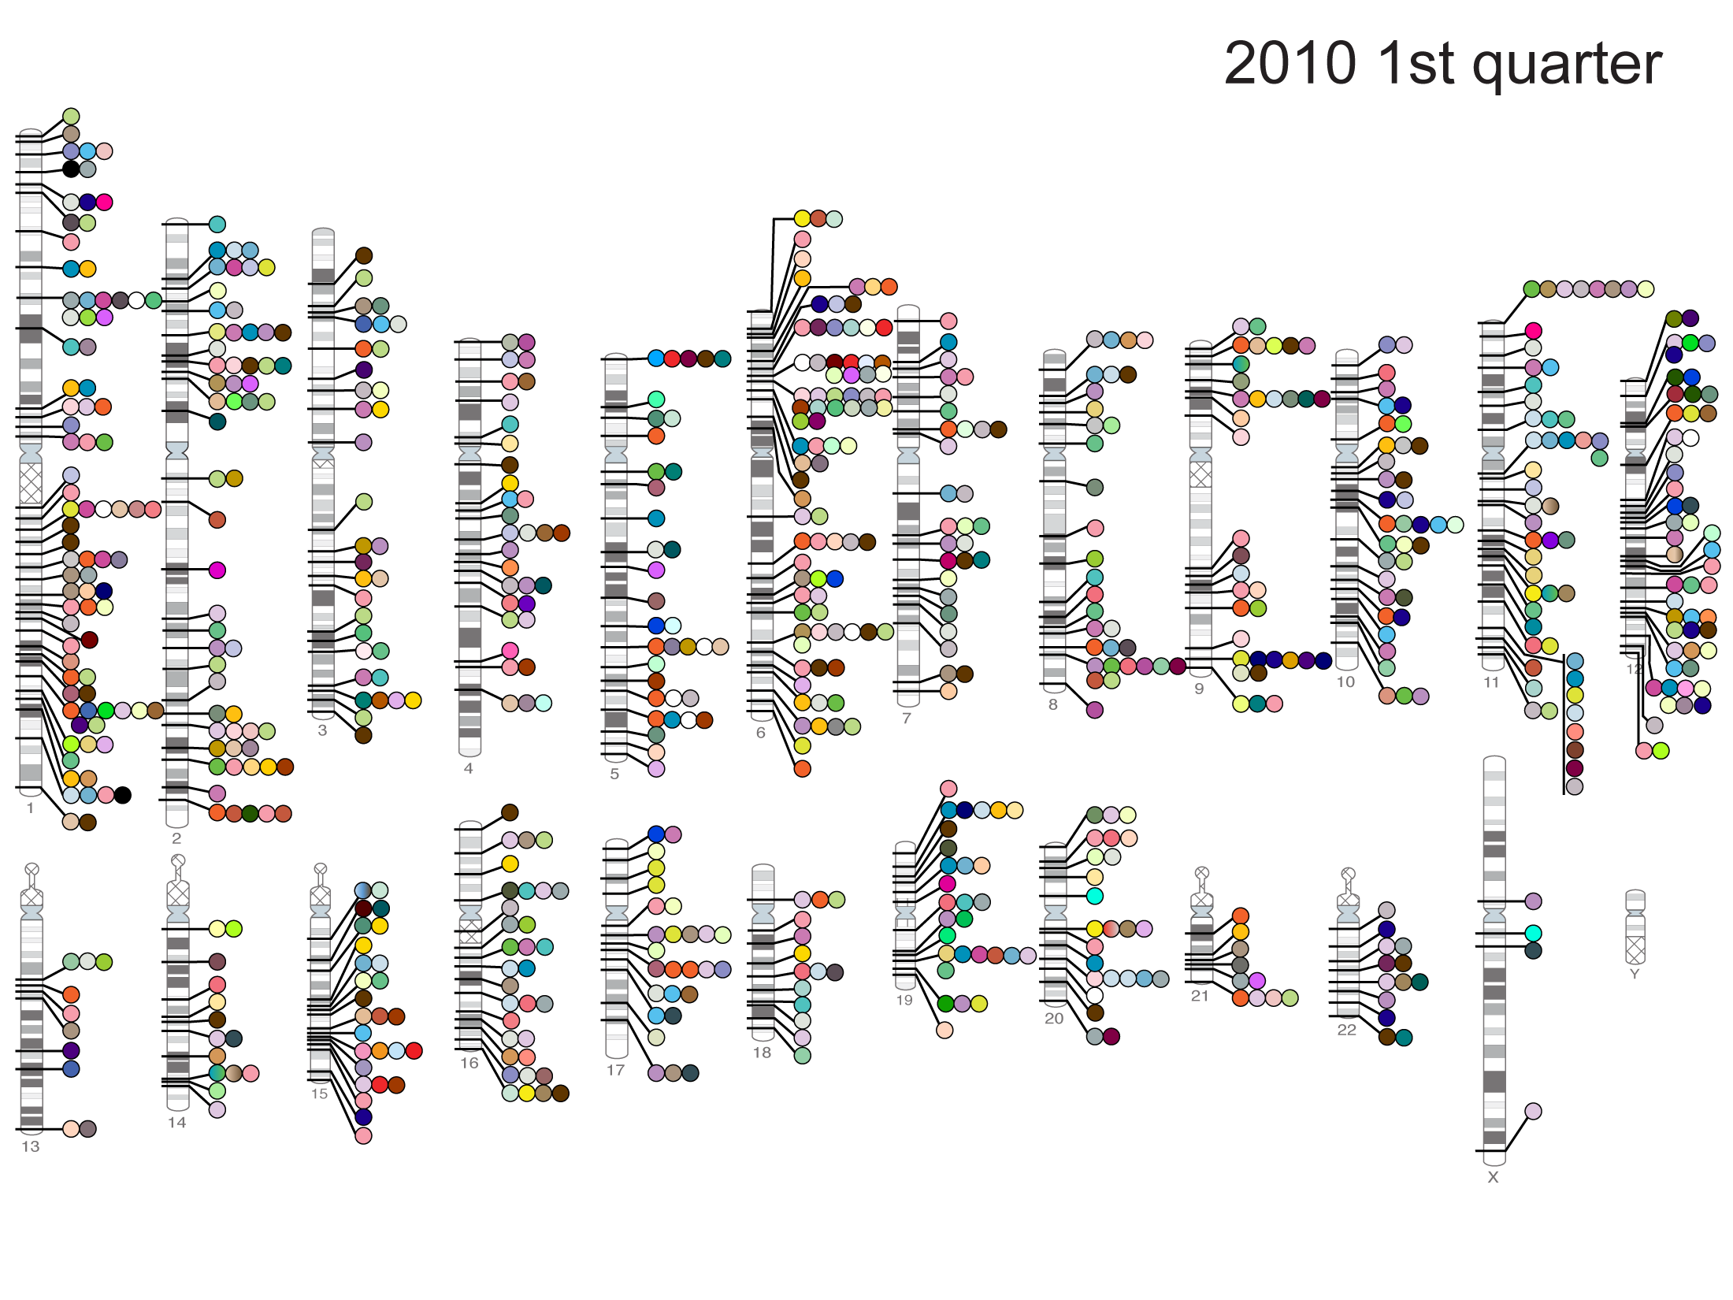

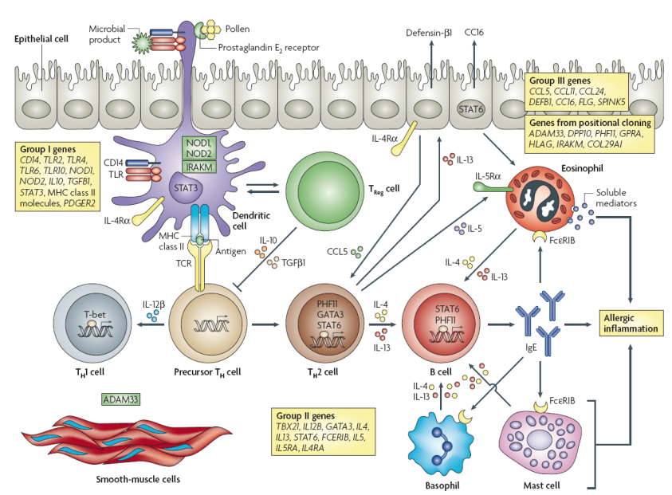



The hypothesis-free pitfall in omics
Hypothesis-free measurement
Hypothesis-free data analysis
Interpretational/translational bottleneck
Ingenuity
GEO
GO
STRING
…..
HAPMAP

Slide 15
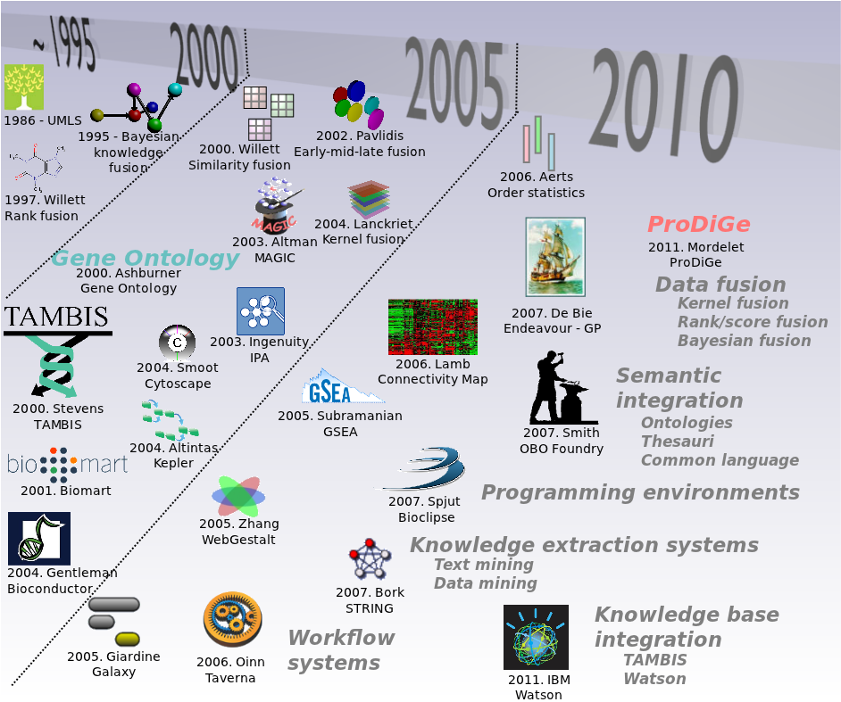
Fusion methods in omics

Slide 16
Classification of fusion methods
Why:
  visualization,
  retrieval,
  extraction/reduction,
  inference (deductive, inductive, predictive/transductive)
What: raw data vs. similarities vs. (free-text...logical) statements
How:
  Raw data: * (probabilistic graphical models)
  Similarities: * (kernel methods)
  Statements: * (probabilistic logic)
Technology: -

Slide 17
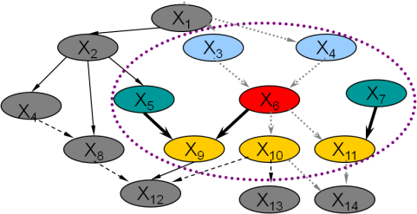
„all models are wrong, but some are useful”
➔e.g. there are stable, interesting properties
Systems-based, Bayesian biomarker discovery
Bayes’ rule:
A priori distribution (prior), p(Model):
is a technical tool for inversion (to achieve a direct probabilistic statement),
provides a principled solution to incorporate prior knowledge.
Open problem: derivation and formalization of informative (domain/data specific) priors.
lipids
Samples
Heterogeneos entities
PCR
mABs
Phenome
SNP
MS
CGH
mRNA
miRNA

Slide 18
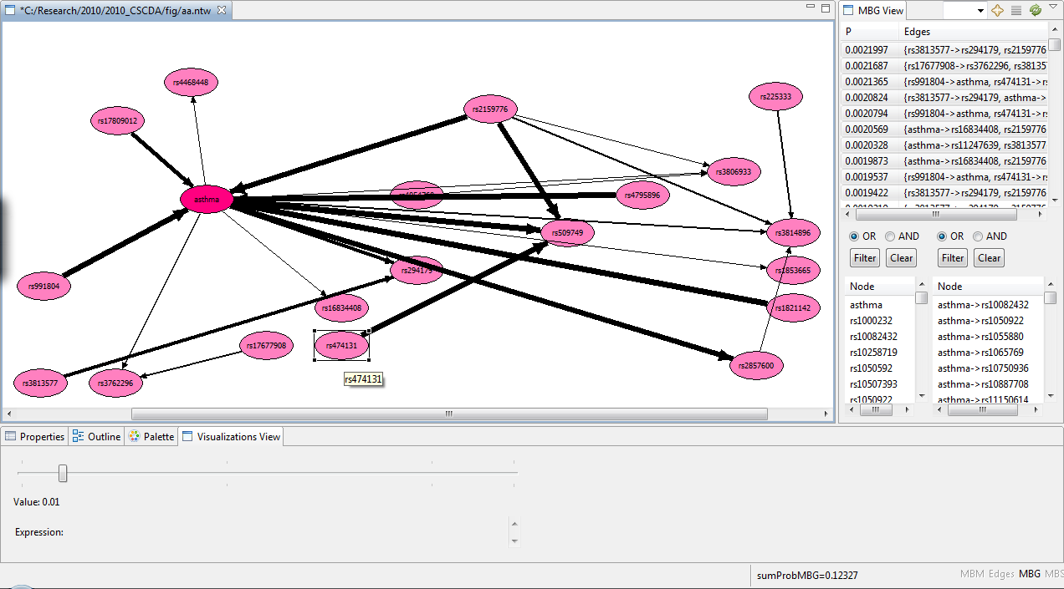
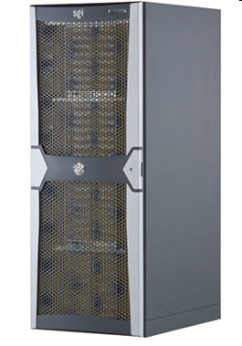
BayesEye:
relevance map/tree/interactions

Slide 19
Biomarker discovery II.
Methodological papers & applications:
P. Antal, A. Millinghoffer, G. Hullam, C. Szalai, and A. Falus, "A Bayesian view of challenges in feature selection: Feature aggregation, multiple targets, redundancy and interaction“, JMLR proceedings, 2008
...
Hullam G, Juhasz G, Bagdy G, Antal P.: Beyond Structural Equation Modeling: model properties and effect size from a Bayesian viewpoint. An example of complex........ Neuropsychopharmacol Hung. 2012
O. Lautner-Csorba, A. Gezsi, A. F. Semsei, P. Antal, D. J. Erdelyi, G. Schermann, et al., "Candidate gene association study in pediatric acute lymphoblastic leukemia evaluated…..…," BMC Med Genomics. 2012
I. Ungvari, G. Hullam, P. Antal, P. Kiszel, A. Gezsi, E. Hadadi, et al., "Evaluation of a Partial Genome Screening of Two Asthma Susceptibility Regions Using Bayesian Network Based…..…. " Plos One, 2012.
G. Varga, A. Szekely, P. Antal, P. Sarkozy, Z. Nemoda, Z. Demetrovics, et al., "Additive Effects of Serotonergic and Dopaminergic………," AMERICAN JOURNAL OF MEDICAL GENETICS PART B, 2012
O. Lautner-Csorba, A. Gézsi, D. Erdélyi, G. Hullám, P. Antal, Á. Semsei, et al., "ROLES OF GENETIC POLYMORPHISMS IN THE FOLATE PATHWAY IN CHILDHOOD ACUTE……………….," Plos One, 2013.
Vereczkei, Z. Demetrovics, A. Szekely, P. Sarkozy, P. Antal, A. Szilagyi, M. Sasvári-Székely., "Multivariate Analysis of Dopaminergic Gene Variants as Risk Factors of Heroin.............," Plos One, 2013
Chapters:
G.Hullám, A.Gézsi, A.Millinghoffer, P Sárközy, B. Bolgár, Z Pál, E Buzás, P Antal: Bayesian, systems-based genetic association analysis with effect strength estimation and omic wide interpretation, in press
P. Antal, A. Millinghoffer, G. Hullám, G. Hajós, Csaba Szalai, András Falus: Bayesian, systems-based, multilevel analysis of associations for complex phenotypes: from interpretation to decisions, in press
Tools:
The biomarker computational service is available at http://mitpc40.mit.bme.hu/bmla.
The biomarker visualization tool, BayesEye, is available at http://mitpc40.mit.bme.hu/bayeseye.
The gene prioritizer tool applied after BMLA can be accessed at http://mitpc40.mit.bme.hu/GP

Slide 20
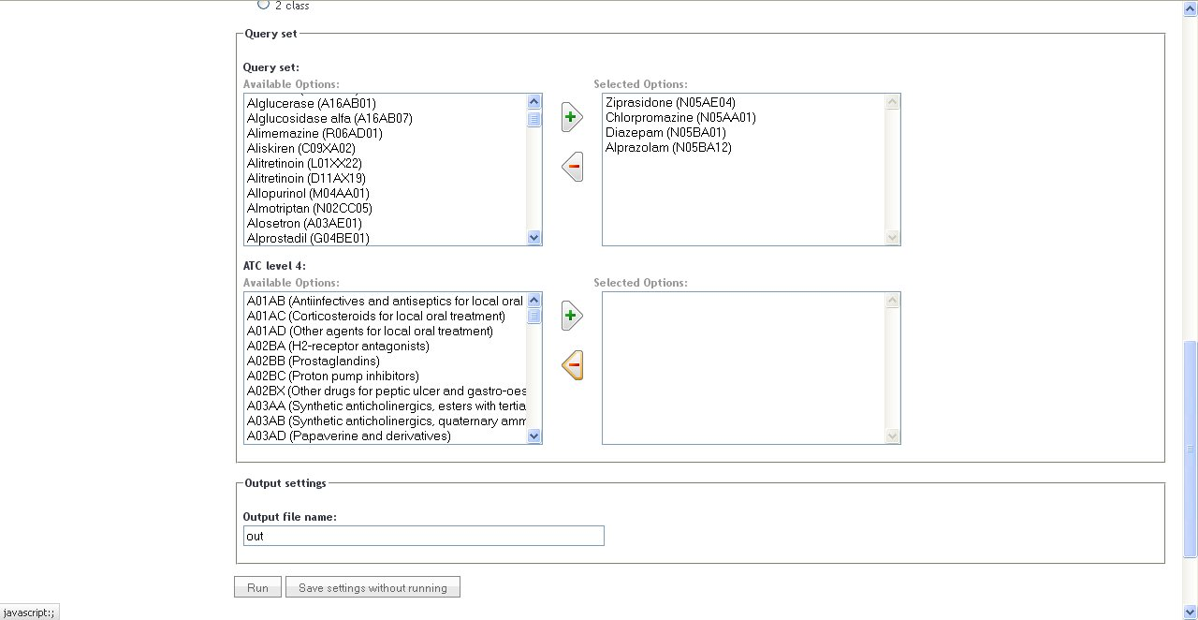
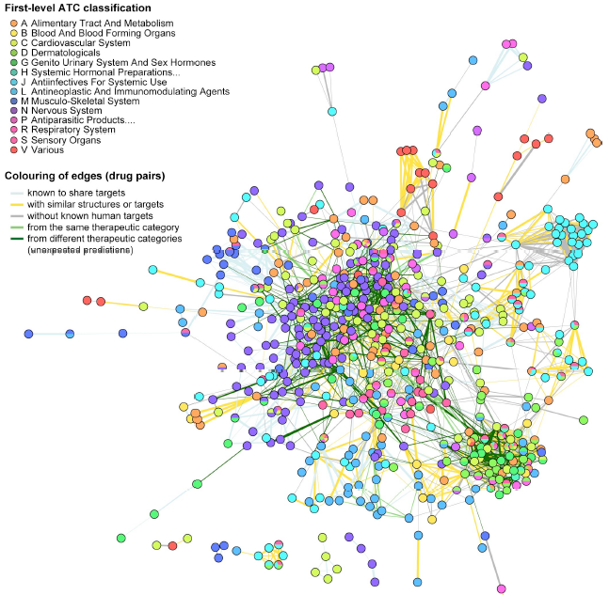
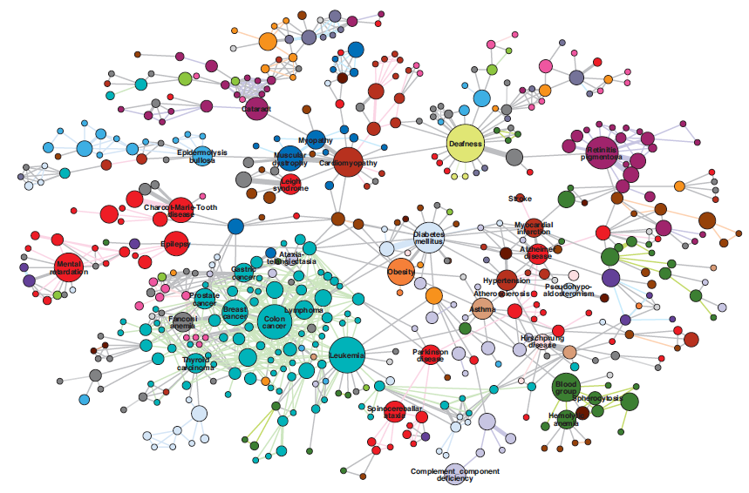
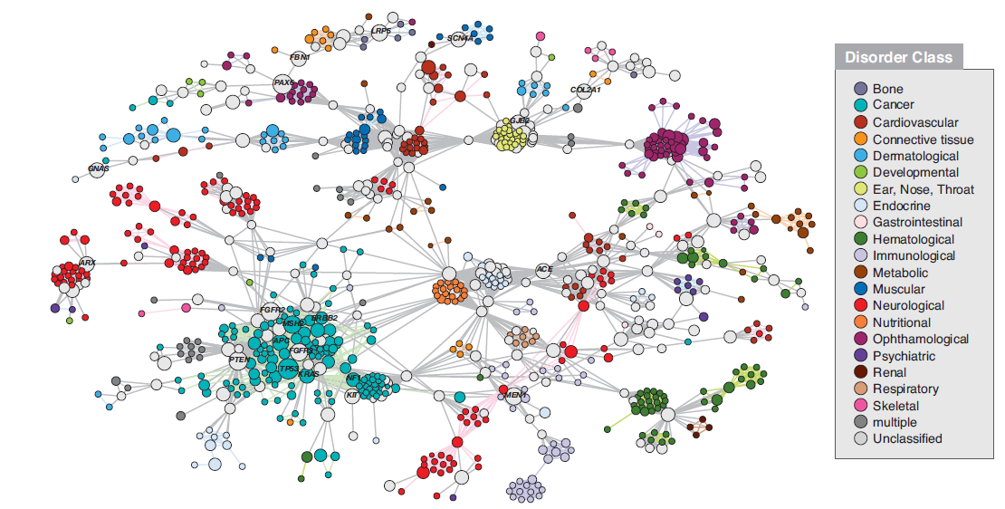
Integration of chemo- and systems biologic information resources for drug repositioning
?

Slide 21
Similarity-based fusion in drug repositioning
Chemical
Side-effects
Target prot.
MMoA
Pathways
Ontology
Tanimoto
Txtmining
Preval.
BLASTp
Query: set of corresponding drugs
Query-based optimal fusion
Notes:
21

Slide 22
On the use of query analysis
The information content of
  the query,
  the information resources,
  and the unknown observations(!)
allow a one-class analysis of the query
(data description)
and this induction is used in prioritization.
JOINTLY OPTIMIZED:
weighting the members in the query (e.g. detection of outliers in the query),
  ➔GETTING THE RIGHT/IMPROVED QUERY
weighting the similarity measures (e.g.information resources),
  ➔GETTING THE SCORING (SIMILARITY) FOR THE RIGHT/IMPROVED QUERY
scoring/ranking the aggregate similarity of the unknown data points to the query.

Slide 23
Kernel-based fusion in drug discovery
Ádám Arany, Bence Bolgár, Balázs Balogh, Péter Antal, Péter Mátyus: Multi-Aspect Candidates for Repositioning: Data Fusion Methods Using Heterogeneous Information, Current Medicinal Chemistry, 2013
Bence Bolgár, Ádám Arany, Gergely Temesi, Balázs Balogh, Péter Antal, Péter Mátyus: Drug repositioning for treatment of movement disorders: from serendipity to rational discovery strategies, Current Topics in Medicinal Chemistry, in press
Gergely Temesi, Bence Bolgár, Ádám Arany, Balázs Balogh, Csaba Szalai, Péter Antal, Péter Mátyus: Early repositioning through Compound Set Enrichment, Future Medicinal Chemistry, in prep.

Slide 24
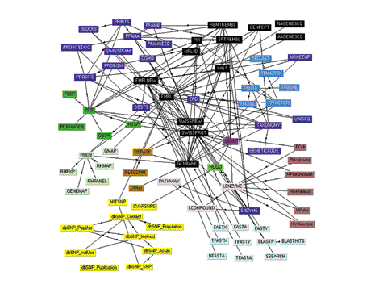
Semantic publishing: papers vs DBs/KBs
M. Gerstein, "E-publishing on the Web: Promises, pitfalls, and payoffs for bioinformatics," Bioinformatics, 1999
M. Gerstein: Blurring the boundaries between scientific 'papers' and biological databases, Nature, 2001
P. Bourne, "Will a biological database be different from a biological journal?," Plos Computational Biology, 2005
M. Gerstein et al: "Structured digital abstract makes text mining easy," Nature, 2007.
M. Seringhaus et al: "Publishing perishing? Towards tomorrow's information architecture," Bmc Bioinformatics, 2007.
M. Seringhaus: "Manually structured digital abstracts: A scaffold for automatic text mining," Febs Letters, 2008.
D. Shotton: "Semantic publishing: the coming revolution in scientific journal publishing," Learned Publishing, 2009

Slide 25
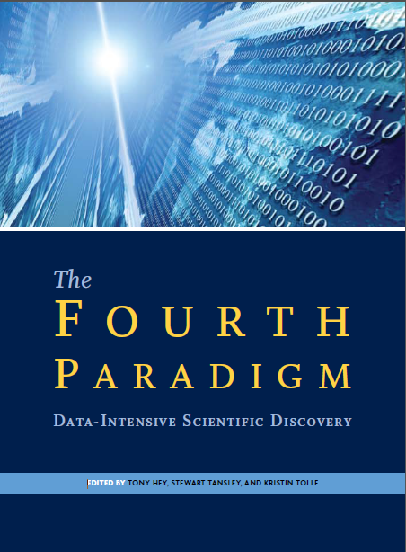
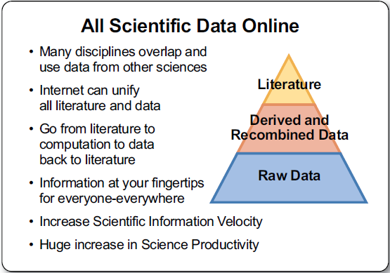
E-science, data-intensive science, the fourth paradigm

Slide 26
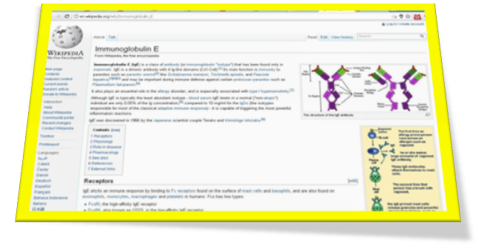
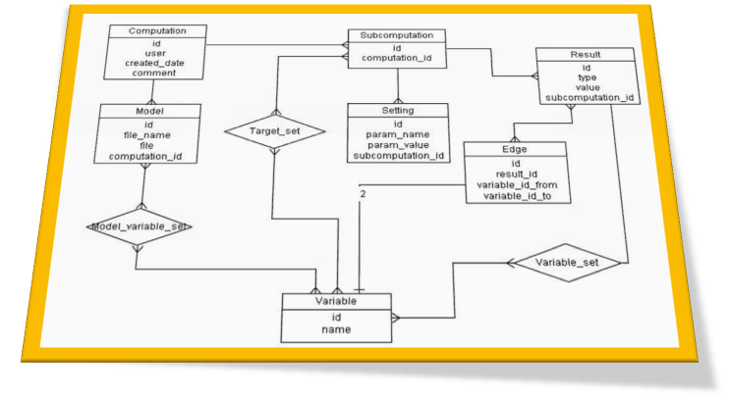
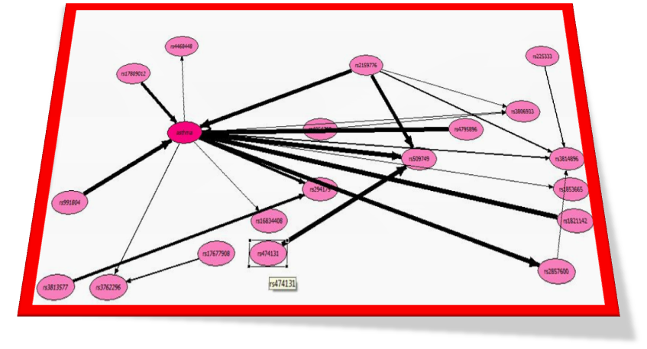
Adatelemzési tudásbázis
Jellemzők:
  Többszintű struktúra
    Szabadszöveg
    Valószínűségi adatbázis
    Kiértékelő felület
  Kapcsolat a rétegek között
Wiki
Valószínűségi adatbázis
BayesEye
Előnyök:
Újrafelhasználhatóság -> megszerzett tudás nem vész el
Utófeldolgozás támogatása -> adat erejének bemutatása
  Bayes hálók, relevancia szintek, más szempontok,…
Döntéstámogatás
Notes:
Mivel a levonható következtetések száma igen nagy lehet, fontos, hogy legyen egy olyan adatelemzési tudásbázis, ahol a már meglévő információkat tudjuk összegyűjteni, illetve keretet tudjunk biztosítani további elemzésekhez.
ezekhez le tudjuk horgonyozni az adathalmazt, amelyen az elemzést végeztük és amelyekben feltehetően a háttérben még megbújik új információ, ismeret.
A tudásbázis egy több szintű struktúrára épül. Hátterét a valószínűségi adatbázis adja amely a mérési eredményeket tartalmazza.
Legfelső szinten egy komprehenzív, szabadszöveges wiki felület található. Betegek számára is érthető leírásoktól kezdve a genetikusok és adatelemzők számára is fontos információkat tartalmaz. (információk is kinyerhetők)
Az elemzésekhez kapcsolt Bayesi kiértékelések a szövegbe ágyazott linkeken keresztül a BayesEye kiértékelő felületen jeleníthetők meg.
Ez a felület lehetőséget nyújt további utófeldolgozási munkálatokra, az adatnak más szempont szerinti vizsgálatára.
Ezzel a rendszerrel kívánjuk megteremteni azt a tudás fúzió lehetőségét, az megszerzett tudás újrahasznosíthatóságát.

Slide 27
„Data-driven” positivism
Positivism (19th century-)
  experience-based knowledge
Logical positivism (1920-)
  L. Wittgenstein: all knowledge should be codifiable in a single standard language of science + logic for inference
Data/www-driven positivism
  Data are available in public repositories
  Scientific papers are available public repositories
  In a formal, single probabilistic representation the results of statistical data analyses are available in KBs
  In a formal, single probabilistic representation models, hypotheses, conclusions linked to data are available in KBs
  …

Slide 28


Synergies between common and biomedical big data
Common big data provides
  detailed (quantitative, deep, complex) phenotype
  NEW ENDPOINTs
Common big data provides „common sense”
  A.M.Turing: Computing Machinery and Intelligence, 1950
  D. Lenat: The CYC project, 1990<

Slide 29
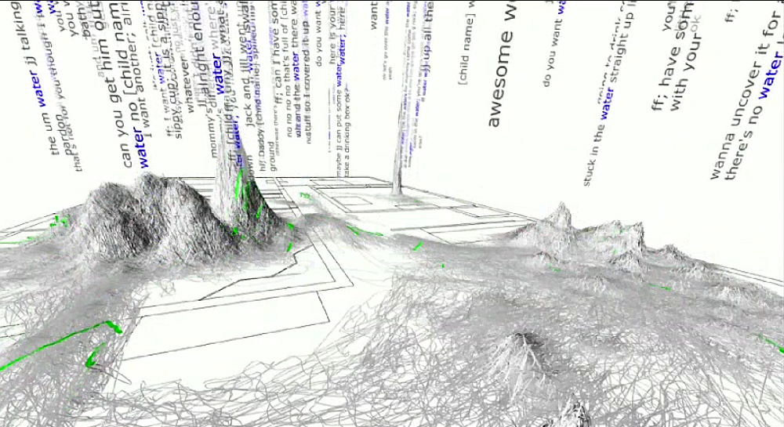
Learning the concept “water”

Slide 30
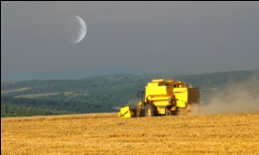
Conclusion
„Big” data = „Multilevel, omic” data
Data and knowledge fusion
  From correlation to causation
  Kernel methods
  Semantic publication
Synergies of biomedical and common big data
  Detailed (deep, quantitative, structured) phenotype
  Common sense(?)
Harvesting
knowledgE
  *: Thanks to my colleagues at the Computational Biomedicine (Combine) workgroup: Ádám Arany, Bence Bolgár, András Gézsi, András Millinghoffer, Gergely Temesi, Péter Marx, Péter Sárközy, Gábor Hullám

Slide 31
Köszönöm a figyelmet!

