Slide 1
Molecular database
University of Szeged, Department of Chemical Informatics
Béla Viskolcz
University of Szeged
Department of Chemical Informatics

Slide 2

Number of molecules
University of Szeged, Department of Chemical Informatics
Known Molecules
  Organic: ~ 15 x 10⁶
  Inorganic: ~ 1 x 10⁶
Virtual Molecules?
  Organic: > 10¹²

Slide 3
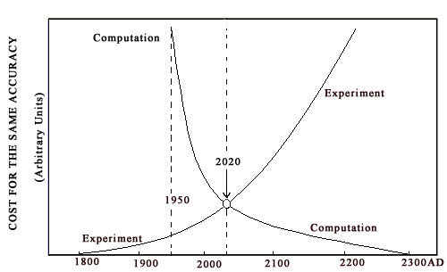
Motivation I.
University of Szeged, Department of Chemical Informatics
Molecular Informatics
More Money for Applied Science

Slide 4

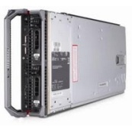


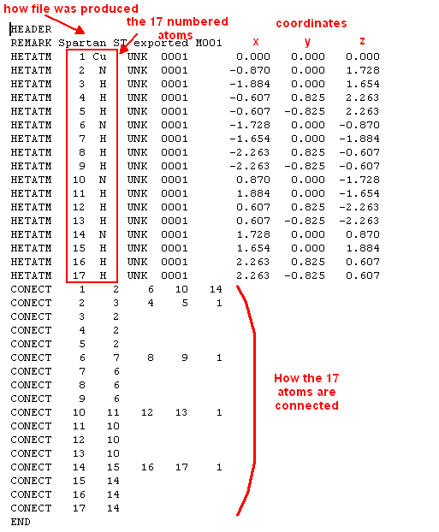


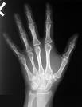
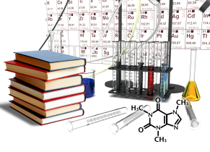
University of Szeged, Department of Chemical Informatics
Workflow of the Com2Chem
Initial input
(.pdb,…)
Runable input
(.com)
Terminated output
(.log)
Input preparation
Regeneration of input
x2
Normal
termination?
Output with
no error termination
Normal term.
Conv. Crit.
Freq
Modified input
Output with Error output
Manipulation of the input
(By hand)
Calculation and collection of molecular properties
Computational
Know How
Database
Com2Chem: Computational Combinatorial Chemistry
Methodology Know How
Chemical
Know How

Slide 5
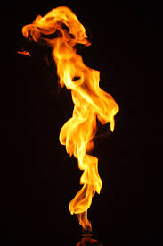
University of Szeged, Department of Chemical Informatics
Calculation Matrix I.
C_{x}H_{y}
Σ | x\y | 0 | 1 | 2 | 3 | 4 | 5 | 6 | 7 | 8 | 9 | 10 | 11 | 12 | 13 | 14 | 15 | 16
2 | 1 | 0 | 0 | 0 | 1 | 1
6 | 2 | 0 | 1 | 1 | 1 | 1 | 1 | 1
22 | 3 | 1 | 2 | 2 | 5 | 3 | 4 | 2 | 2 | 1
0 | 4 | 3 | 7 | 7 | 19 | 11 | 21 | 9 | 12 | 5 | 4 | 2
146 | 5 | 6 | 27 | 21 | 87 | 40 | 116 | 40 | 85 | 26 | 35 | 10 | 8 | 3
3020 | 6 | 17 | 109 | 83 | 435 | 185 | 685 | 217 | 593 | 159 | 313 | 77 | 100 | 25 | 17 | 5
4398 | 7 | 50 | 532 | 315 | 2425 | 913 | 4379 | 1227 | 4376 | 1031 | 2732 | 575 | 1111 | 222 | 284 | 56 | 39 | 9
152963 | 8 | 196 | 2815 | 1765 | 14894 | 5257 | 30329 | 7946 | 34088 | 7426 | 24306 | 4678 | 11673 | 2082 | 3809 | 654 | 801 | 137
http://stuff-stock.deviantart.com/art/Flame-STOCK-153459617

Slide 6

University of Szeged, Department of Chemical Informatics
M_{r} (g/mol) | Σ(Y=5) | Σ(Y=6)
1-75 | 26 398 | 378
76-100 | 153 058 | 928 593
101-125 | 235 070 | 7 731 832
126-150 | 160 848 | 10 924 887
151-175 | 29 932 | 4 917 433
176-200 | 18 266 | 1 697 180
201-225 | 28 781 | 1 025 626
226-250 | 8 462 | 825 300
251-275 | 1 383 | 589 487
275-300 | 968 | 106 103
Calculation Matrix II.
C_{1-Y}H_{0-2Y+2}X_{0-Y}O_{0-Y}S_{0-Y}N_{0-Y}
X=F,Cl,Br,I
C+N+O+S+F+Cl+Br+I=Y
S valence (connectivity) 2, 4, 6
N valence (connectivity) 3, 5
Σ=
663 166
28 746 819
http://kbond4.wordpress.com/

Slide 7
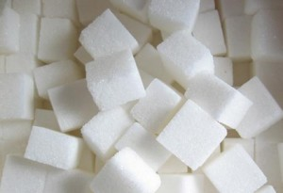
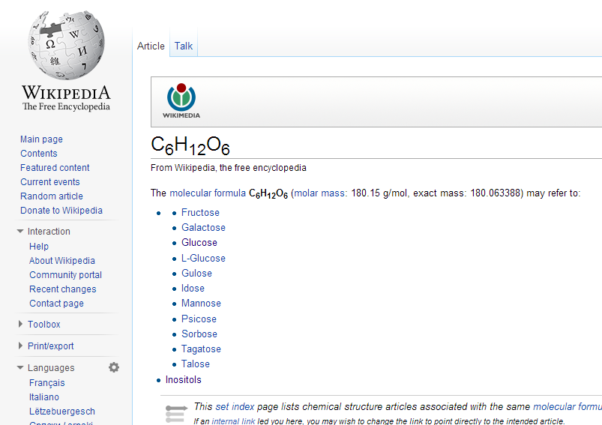
University of Szeged, Department of Chemical Informatics
Calculation Matrix III.
Stochiometry | Σ
 | 267 258
 | 17 121 162
C₆H₁₂O₆
C₁₋₆H₀₋₁₄O₀₋₆
11 constitutional isomers!
http://www.lapszemle.ro/2011/08/07/a-cukor-nem-olvad-hanem-szetbomlik/

Slide 8
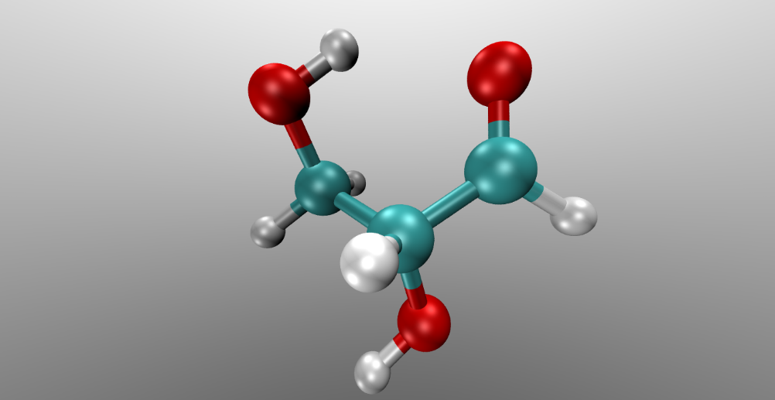
Example I.
University of Szeged, Department of Chemical Informatics
Glyceraldehyde
- Formula C3H6O3
- Organic molecule present in several biological process.
- Important during the prebiotic stage of the Earth.

Slide 9
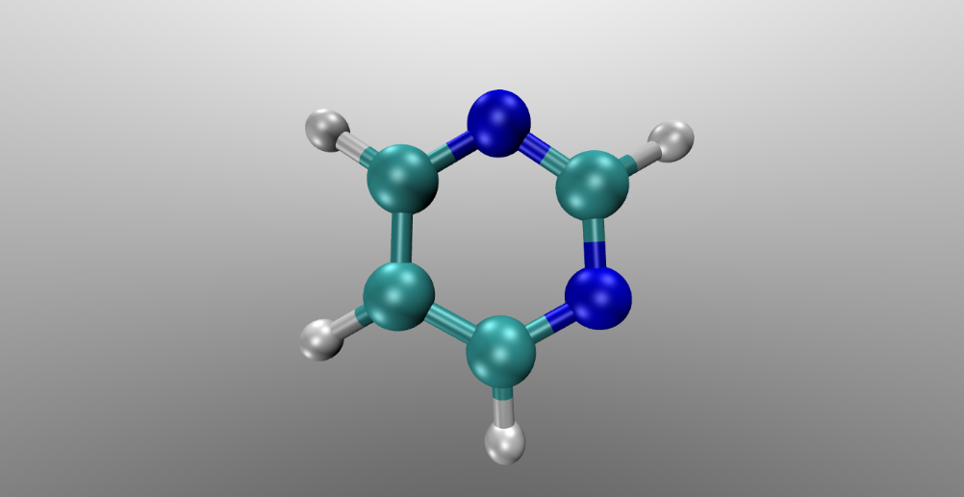
Example II.
University of Szeged, Department of Chemical Informatics
Pyrimidine
- Formula C4H4N2
- Wide occurrence in nature as substituted and ring fused compounds.
- Derivatives of pyrimidine are present in nucleotides, this are ADN structure.

Slide 10
Details of computations
University of Szeged, Department of Chemical Informatics
Isomers and spatial conformations
-Glyceraldehyde:
277 com files on gas phase and 277 in aqueous phase.
-Pyrimidine:
7983 com files on gas phase and 7983 in aqueous phase.
- Spatial conformations makes reference to the generation of some species that are exactly the same but the orientation in the space (relative Cartesian coordinates of the entire specie) is different, This leads to different electronic/atomic interactions.

Slide 11
Details of computations
University of Szeged, Department of Chemical Informatics
Gaussian 09
Calculation on G09 were made under G3MP2B3 method:
Optimization, frequency, QCISD(T) and MP2 calculation.
Each calculation used 8 processor from the cluster.
For the Gas Phase Glyceraldehyde isomers calculation it took:
49 days, 9 hours, 59 minutes and 50 seconds CPU time
6 days, 4 hours, 14 minutes and 59 seconds clock time
For the Gas Phase Pyrimidine isomers calculation it took:
1131 days, 16 hours, 23 minutes and 47.1 seconds CPU time
141 days, 11 hours, 3 minutes and 23.4 seconds, clock time

Slide 12
Database
University of Szeged, Department of Chemical Informatics
STRUCTURAL HIERARCHY

Slide 13
Database
University of Szeged, Department of Chemical Informatics
MODULS
15 x 10⁶
„known small
molecule”
55000
„know protein
structure”

Slide 14
Selections of models
University of Szeged, Department of Chemical Informatics
Molecule
Definition of standard process
Database, as a useful product
trans
cis
tautormer2
tautormer2
The definitions should be flexible
tautormer1
tautormer1
H⁺
0
H⁺
0
H⁺
0
H⁺
0

Slide 15
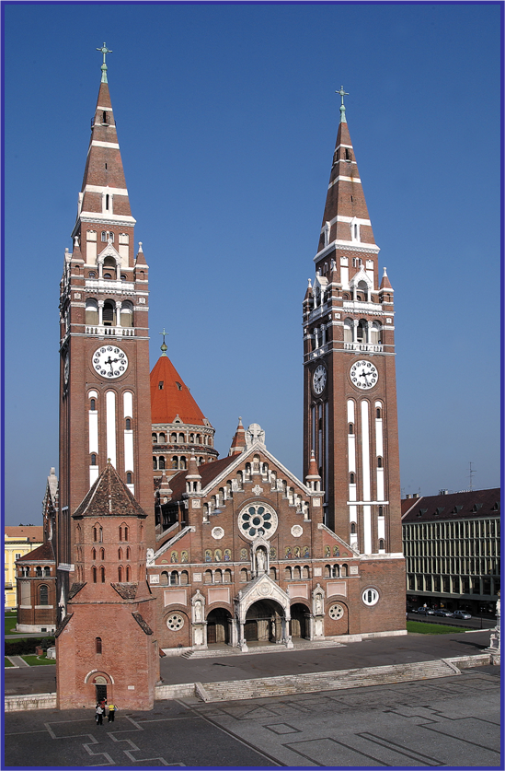
Köszönöm megtisztelő figyelmüket!
THANK YOU FOR YOUR ATTENTION
Financial support
HURO/0901/037/2.2.2 Complex molecular database for environmental protection
TÁMOP 4.2.2-A: Új funkcionális anyagok…
TÁMOP 4.2.2-C: Szuperszámítógép a nemzeti virtuális laboratórium

Slide 16
THANK YOU FOR YOUR ATTENTION

